Slide 1

FSP KNOWLEDGE SHARING
june 7 2023
KHANH PHAN & khanh le
SDD/SWD/FSP1
IIBU
Renesas Electronics Corporation

Slide 2
Agenda
Introduction to FSP Page 03
FSP Architecture Page 07
E2 studio software Page 14
Change FSP version Page 20
Create new project Page 23

Slide 3
INTRODUCTION TO FSP

Slide 4
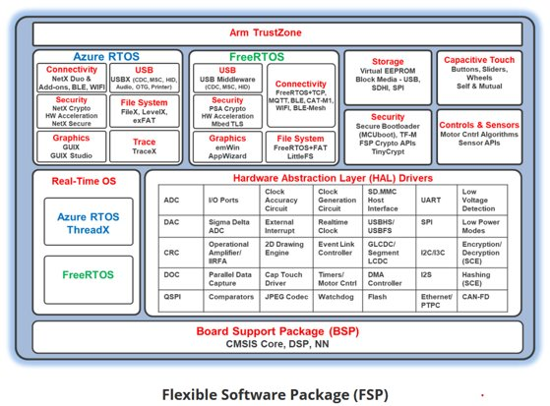
Introduction to fsp (FLEXIBLE SOFTWARE PACKAGE)
What is FSP?
The Renesas Flexible Software Package (FSP) is an enhanced software package of e2 Studio IDE, designed to provides a quick and versatile way to build and connect your devices in embedded system design (using HAL drivers, FreeRTOS, Azure-RTOS, middleware drivers, BSP,…).
Purpose of FSP
Provide lightweight and efficient drivers that meet common use cases in embedded systems
Reference document: RA Flexible Software Package Documentation: Introduction (renesas.github.io)

Slide 5
Introduction to fsp (advantage of fsp)
Quality
Peer review in whole process ( create driver spec ➔ review test result)
Process: Create new branch ➔ do your task ➔ create pull request (PR) ➔ peer review ➔ modify based on review ➔ check modify version ➔ merge PR into your branch
Ease to use
FSP provides uniform and intuitive APIs that are well documentation
Each module is supported with detailed user documentation including example code (which is published on Renesas GitHub website).
Reference document: RA Flexible Software Package Documentation: Introduction (renesas.github.io)

Slide 6
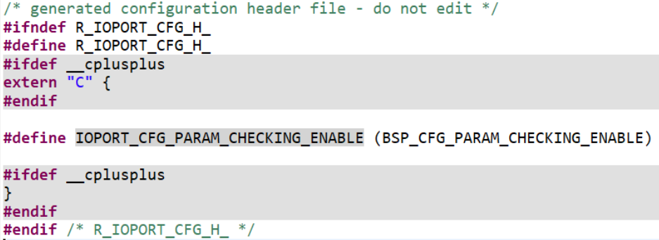
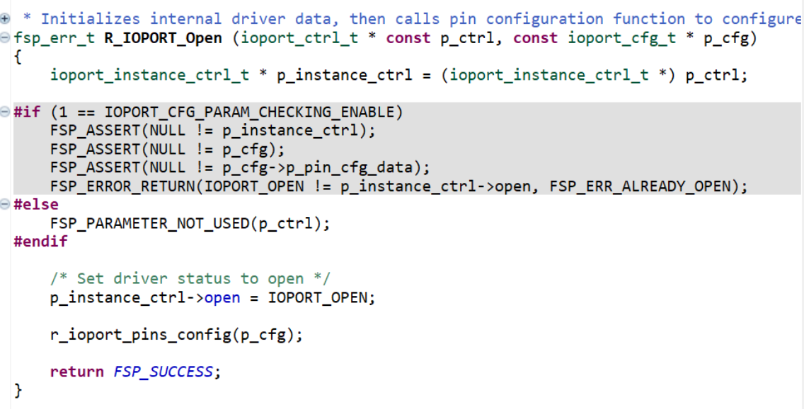
Introduction to fsp (advantage of fsp)
Scalablility
FSP modules can be used on any MCU in the RA family, provided the MCU has any peripherals required by the module.
Build time configuration
FSP modules also have build time configurations that can be used to optimize the size of the module for the feature set required by the application.
Reference document: RA Flexible Software Package Documentation: Introduction (renesas.github.io)

Slide 7
FSP ARCHITECTURE

Slide 8
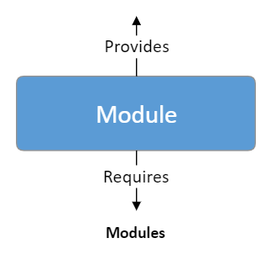
FSP Architecture
FSP Modules
Module can be peripheral drivers, purely software, or anything between.
Each module consist of a folder with source code, documentation, and any thing else that the customer needs to use the code effectively
Modules are independent units, but they may depend on other modules
Common functionality required by multiple modules is often placed into a self-contained submodule so it can be reused

Slide 9
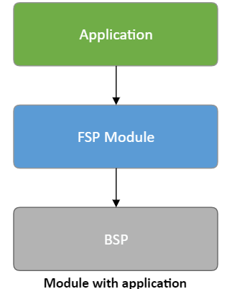
FSP Architecture
FSP Modules
The Board Support Package (BSP) provide functionality to determine the MCU used as well as configuring clocks, interrupts and pins
Provides functions to user
Requires functions from BSP

Slide 10
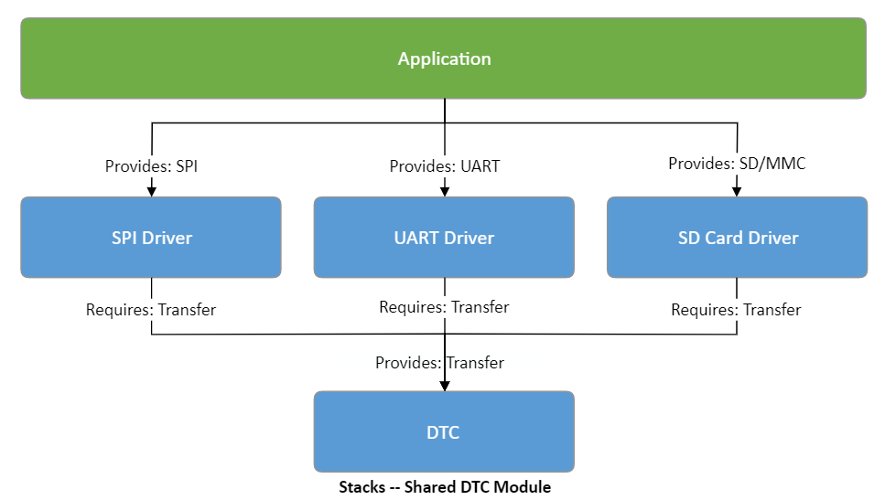
FSP Architecture
FSP Stacks
When modules are layered atop one another, an FSP stack is formed. A stack consists of a top level module and all its dependencies. The stacking process is performed by matching what one module provides with what another module requires.
FSP Stack

Slide 11
FSP Architecture
FSP Interfaces
A header file contains API (Application Programing Interface) definitions that can be shared by modules with similar features (or seperate module). Interfaces are definitions only and do not add to code size. In FSP design, interfaces are defined in header files. Interface could be one of this types:​
Enumerations: This type uses for define function parameters and structure members.​
Callback functions: This define the module callback function which will be handled by the ISR (Interrupt Service Routine).​
Data structures: define structure for interface data, interface api and interface instance.
Application
Interfaces
Modules

Slide 12
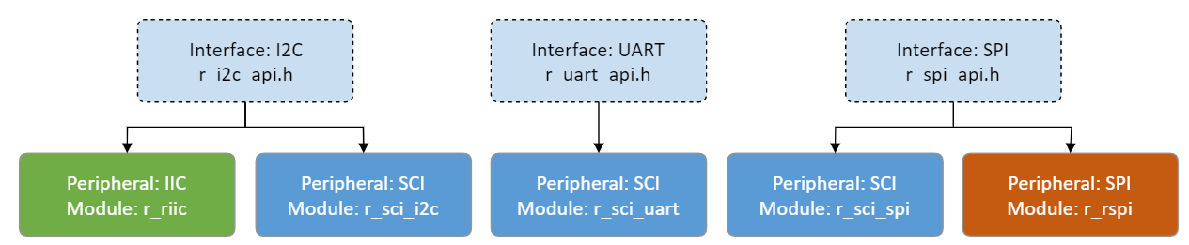
FSP Architecture
FSP Instances
Instances will implement data value to run with different features. Instances use the enumerations, data structures, and API prototypes from the interface.
FSP Instances

Slide 13
Application diagram
Application
interface
Stack
Stack
Module
Module
Module
Module
Driver
Driver
Driver
Driver
Hardware

Slide 14
E2 studio software

Slide 15
overview
Import, build and debug examples project on e2studio.
Change FSP version on e2studio.
Create new project.

Slide 16
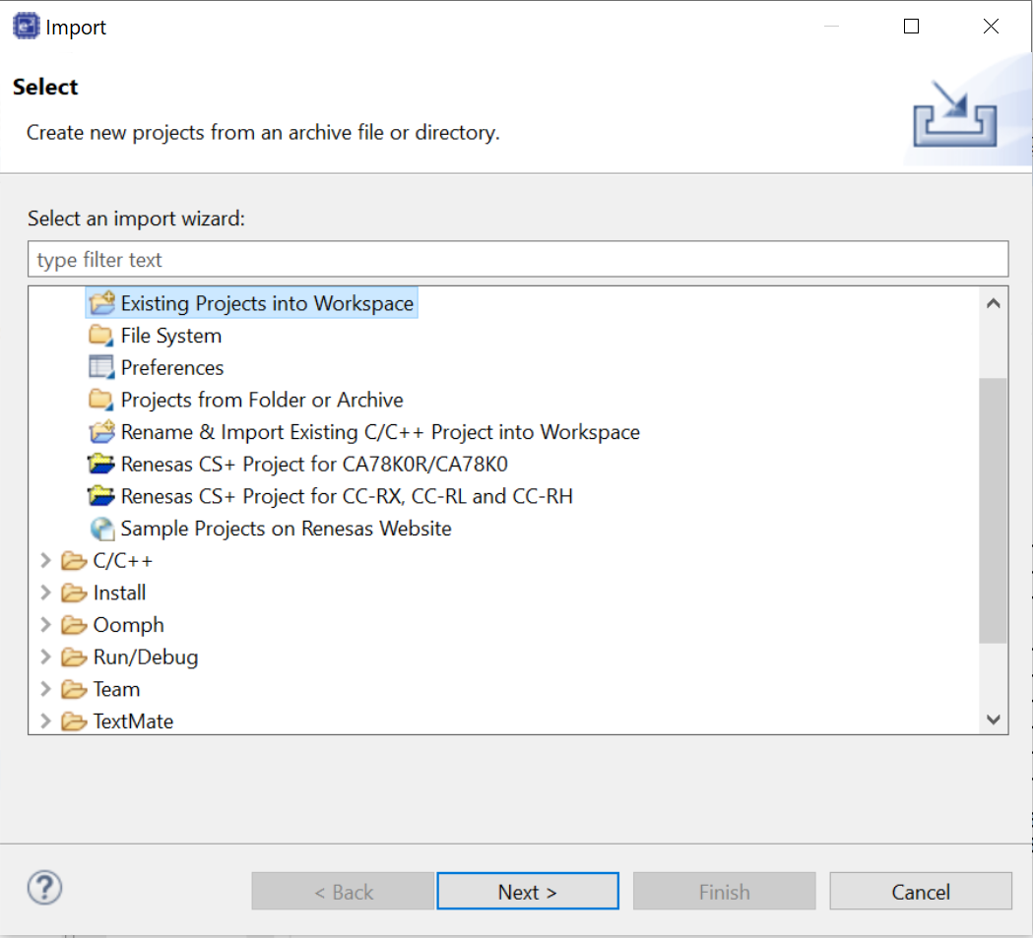
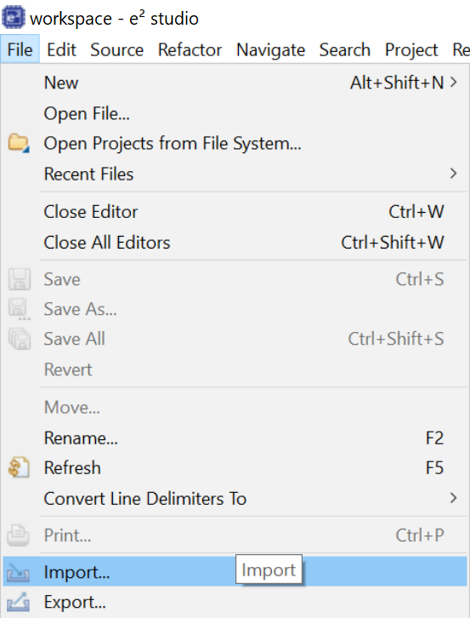
Import, build and debug examples project on e2 studio Import
1
3
4
2

Slide 17
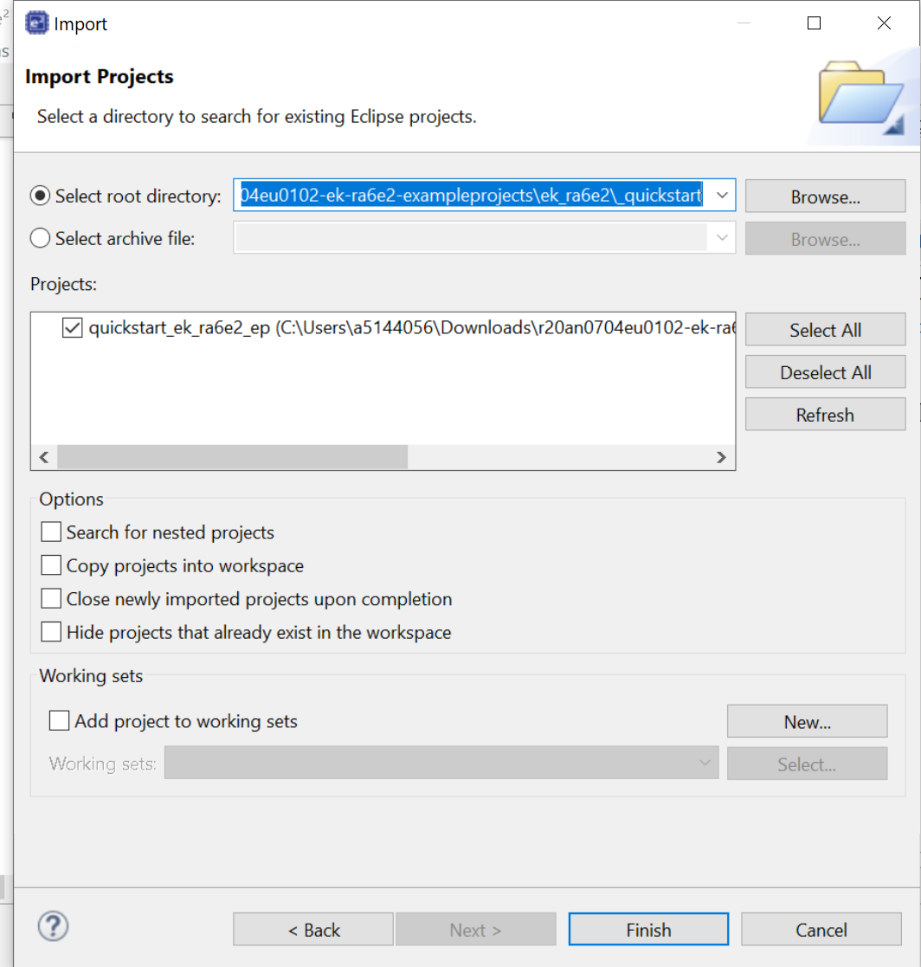
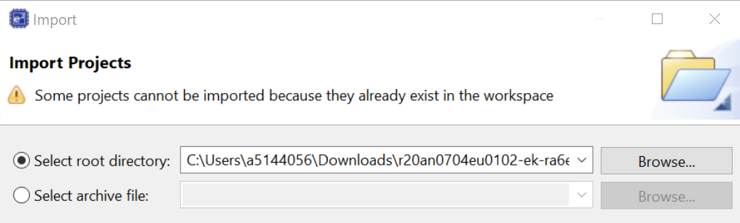
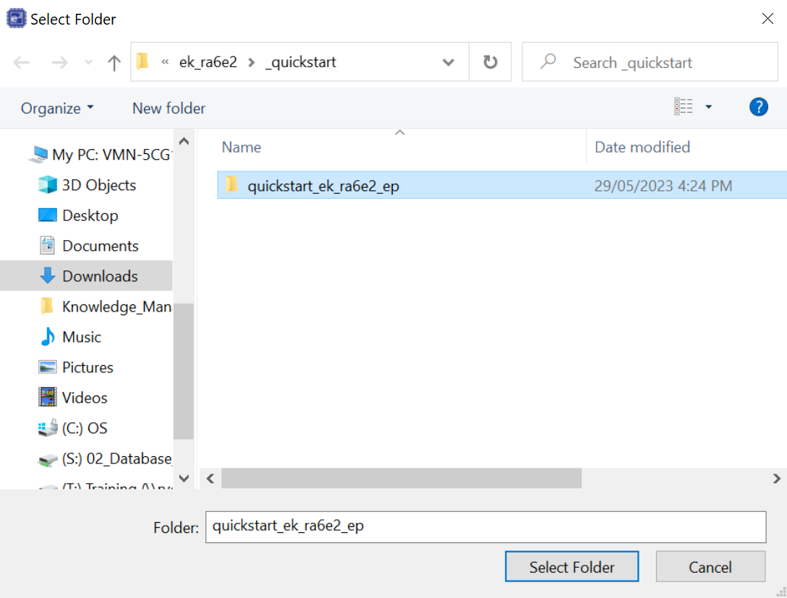
Import, build and debug examples project on e2 studio Import
5
8
6
7
9

Slide 18
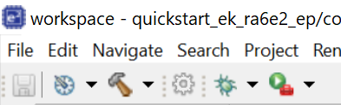
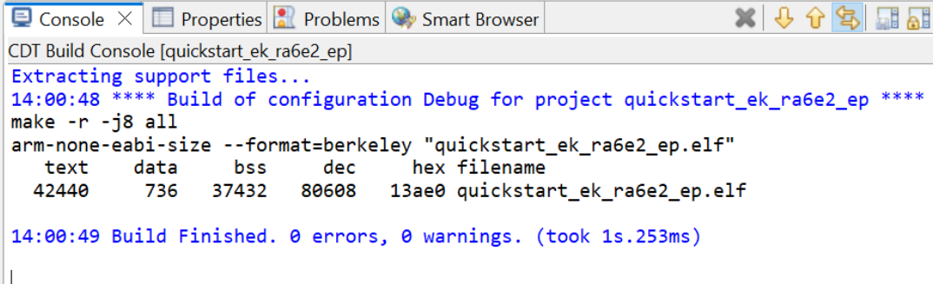
Import, build and debug examples project on e2 studio BUILD
build

Slide 19
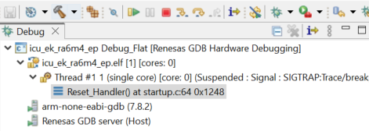
Import, build and debug examples project on e2 studio debug
debug

Slide 20
Change fsp version

Slide 21
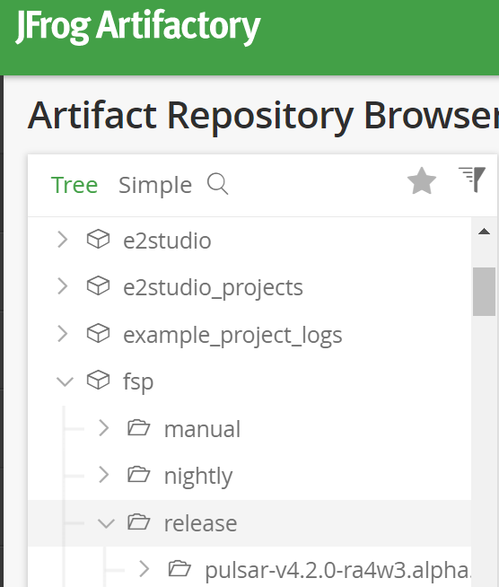
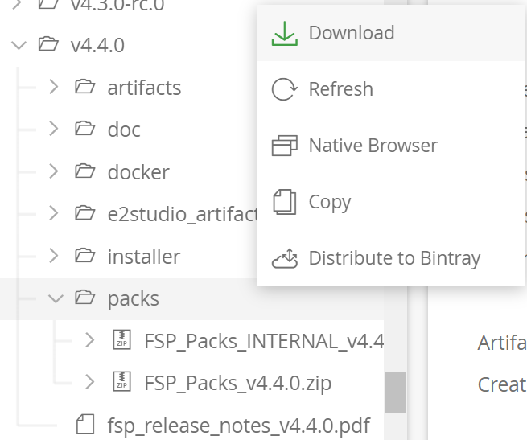
Change fsp version
Visit URL: Artifactory (renesas.com)
Download pack in version directory (v4.4.0)r ➔ right click on pack directory and choose download button
1
2

Slide 22

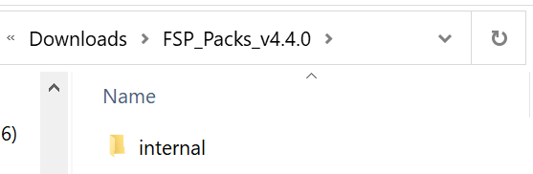
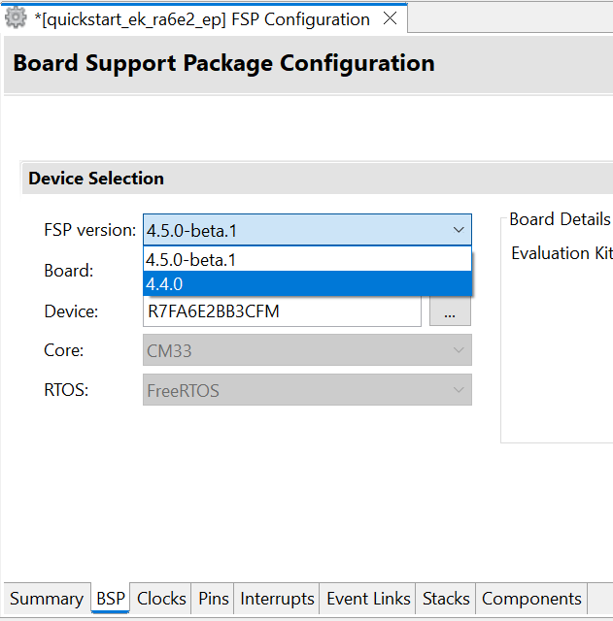
Change fsp version
Go to location “C:\Renesas\RA\e2studio_v2023-04_fsp_vx.x.0”and paste overwrite exists internal file
Extract recent download file: FSP_Packs_v4.4.0.zip
Change new version
Open directory and copy internal file

Slide 23
Create new project

Slide 24
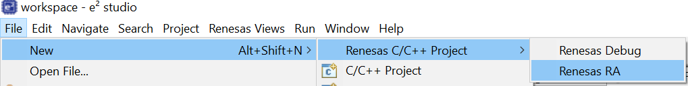
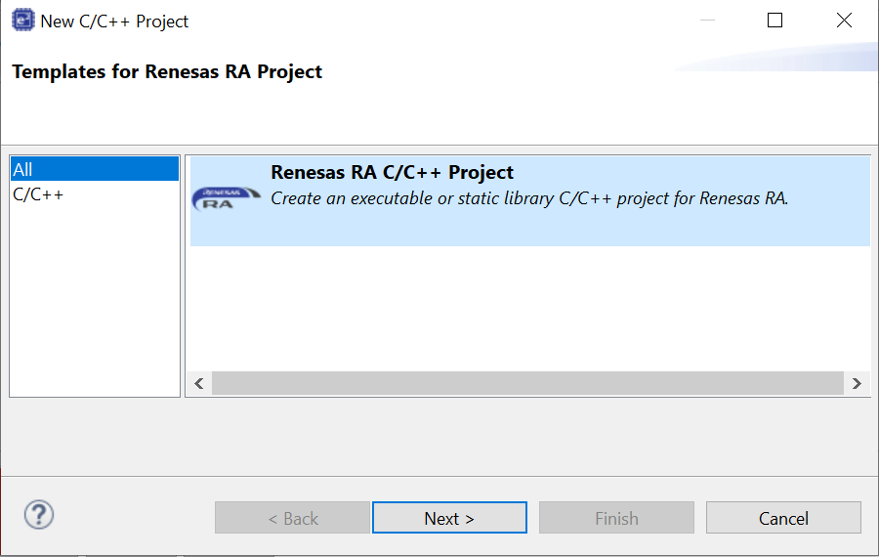
Create new project
Select File ➔ New ➔ Renesas C/C++ Project ➔ Renesas RA
1
Select Renesas RA C/C++ Project ➔ Next
2

Slide 25
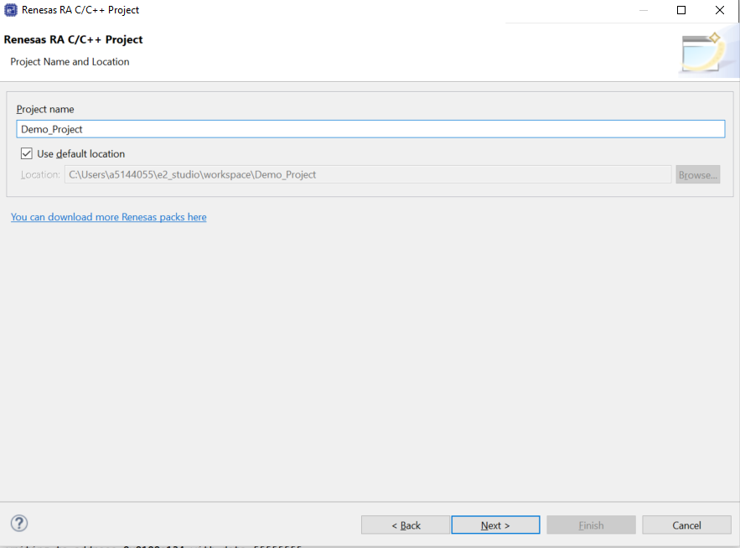
Create new project
1
Name the project at Project name ➔ Next
2

Slide 26
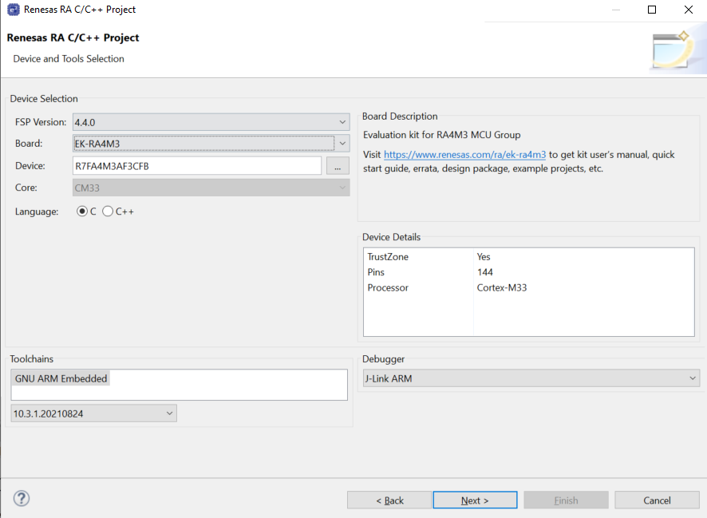
Create new project
Select FSP version
Select the FSP version, Board and Debugger then ➔ Next
Select Board
Select Debugger

Slide 27
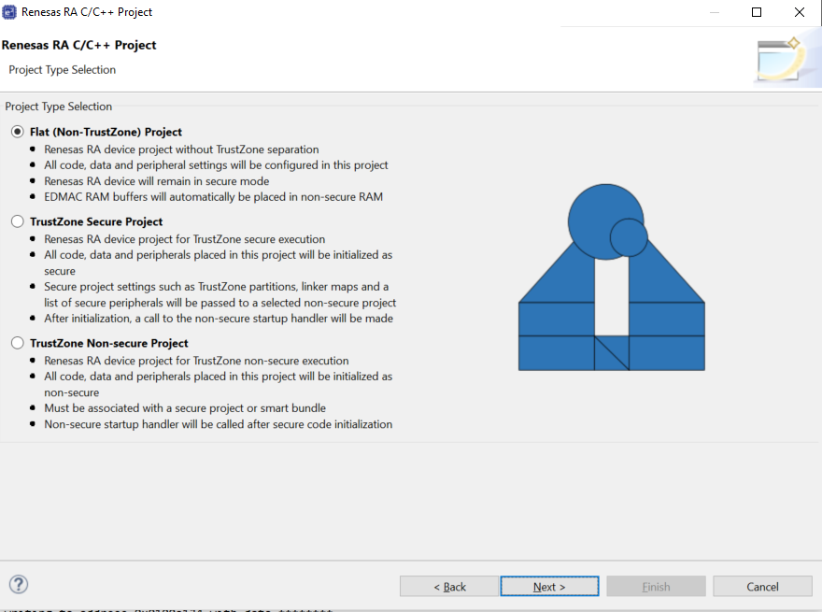
Create new project Flat project
Select Flat (Non-TrustZone) Project ➔ Next

Slide 28
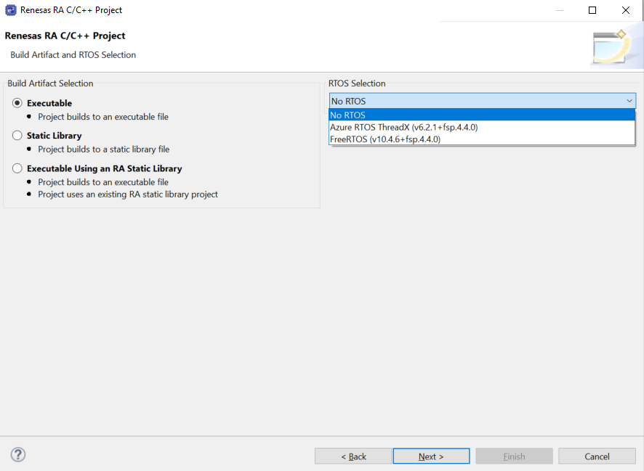
Create new project
Select No RTOS at RTOS selection then ➔ Next
* Azure RTOS & FreeRTOS will be selected corresponding to the project requirement

Slide 29
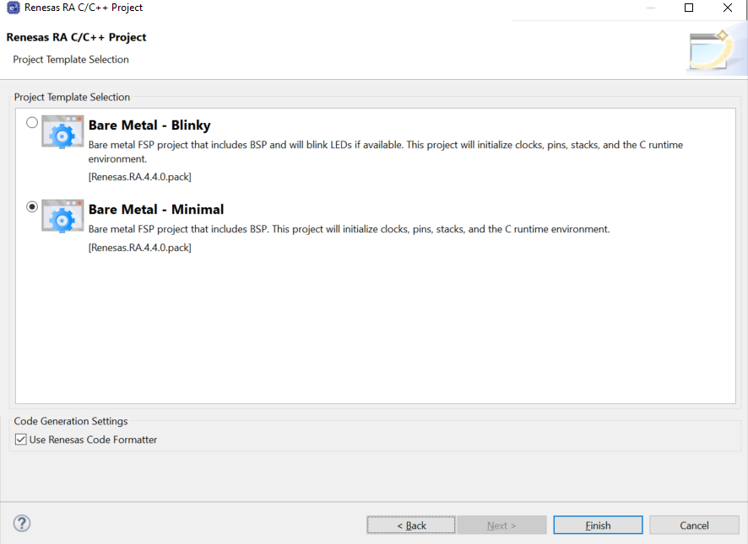
Create new project
Select project Template at this page then ➔ Finish to create project
1
2

Slide 30
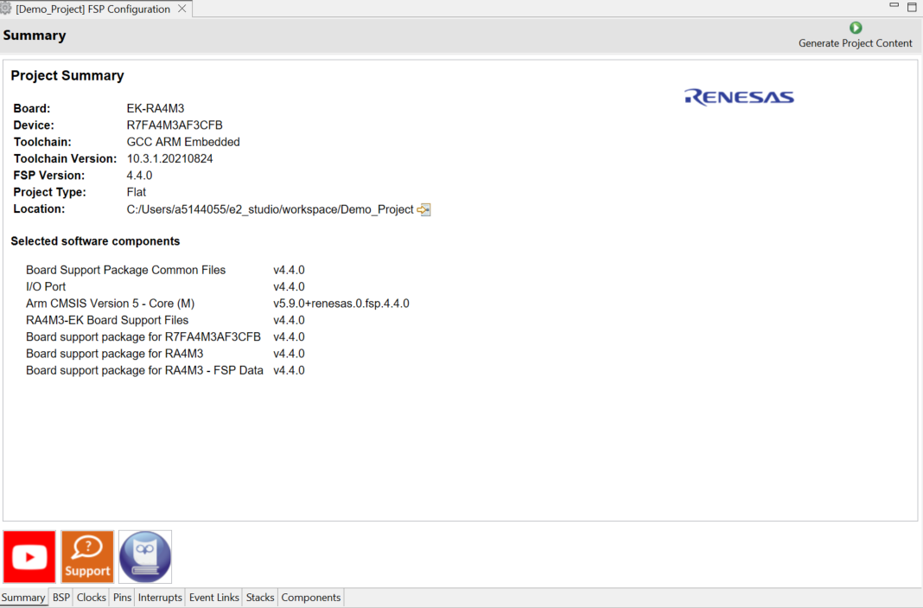
Create new project
Configuration
After creating new project, the project will have Project Configuration. There are 8 tabs to edit setting of project

Slide 31
Create new project
Configuration
Tab | Purpose
Summary | Provide all they key characteristics of the project: board, device, toolchain, and more.
BSP | View and change board specific parameters from the initial project selection.
Clocks | Configure the MCU clock settings for the project.
Pins | Configure the electrical characteristics and functions of each port pin.
Interrupts | Add new user events/interrupts.
Event Links | Configure events used by the Event Link Controller.
Stacks | Add and configure FSP modules.
Components | Provides an overview of the selected modules.

Slide 32
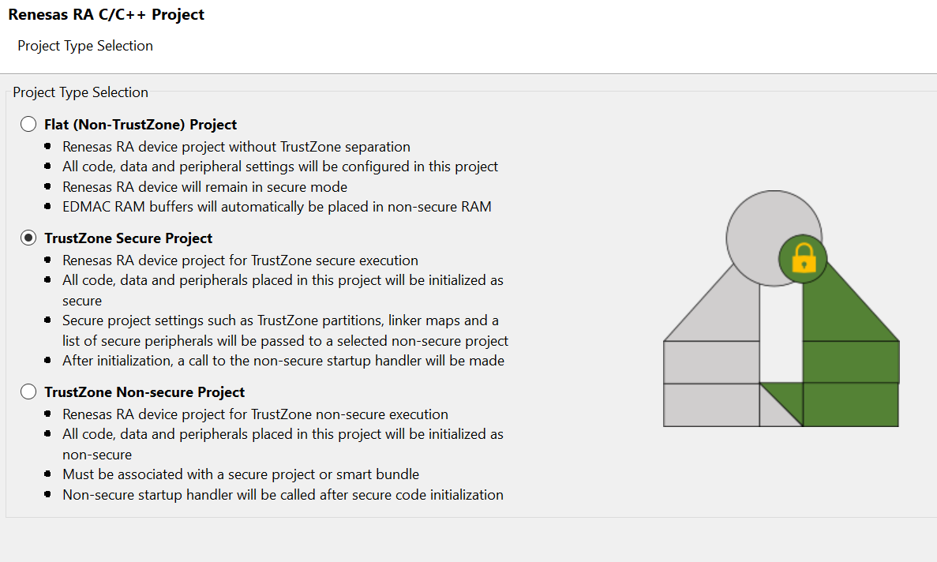
Create new project Trustzone secure project

Slide 33
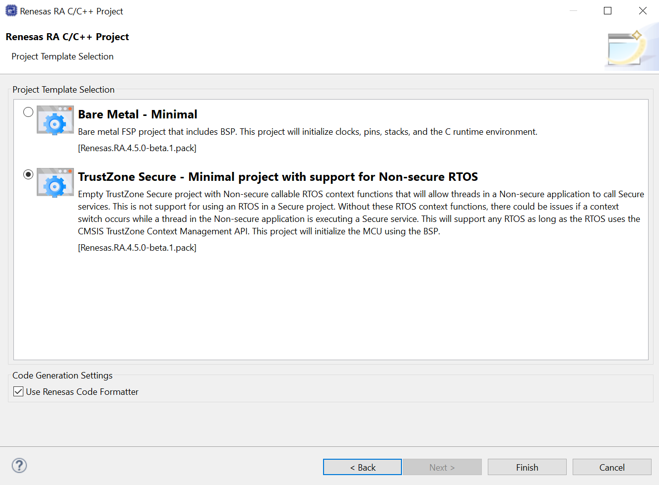
Create new project Trustzone secure project

Slide 34
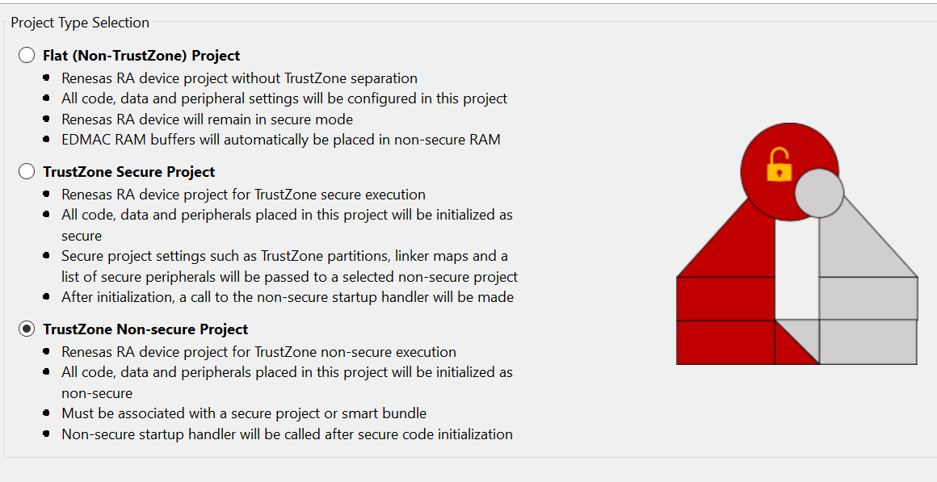
Create new project Trustzone non-secure project
Do step by step:
Create secure project
Generate project content
Build project
Choose option create non-secure project

Slide 35
test ep USING JLINK

Slide 36
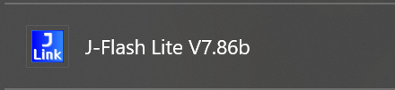
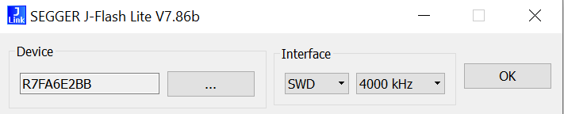
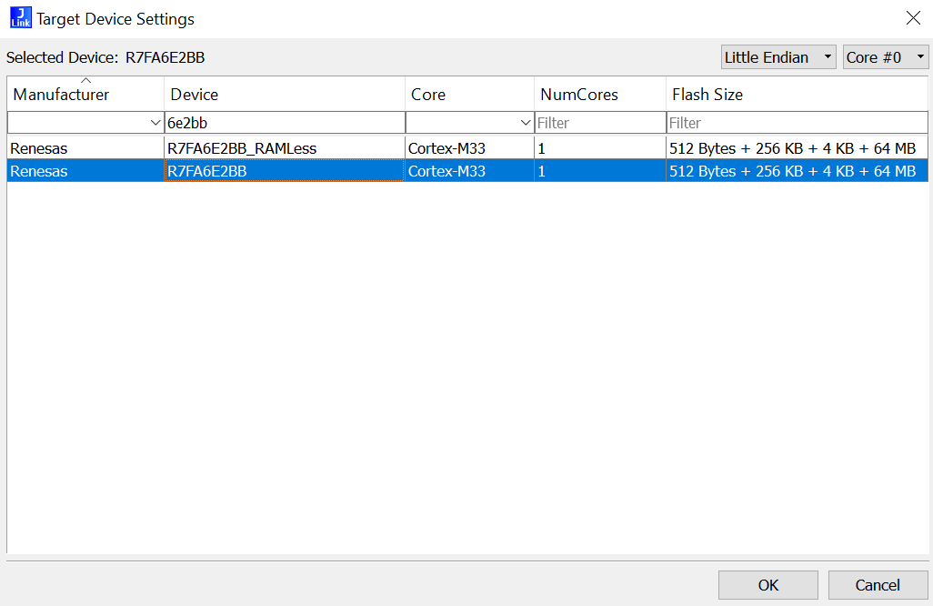
TEST EP USING JLINK Connect j-link
1. Open J-Flash Lite
1
2. Select device
5
2
3. Fill device’s name in search box and select correct device
3
4. Click OK button
5. Click OK button
4

Slide 37
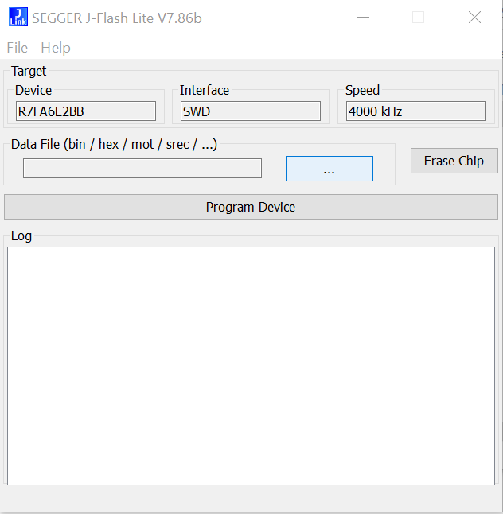
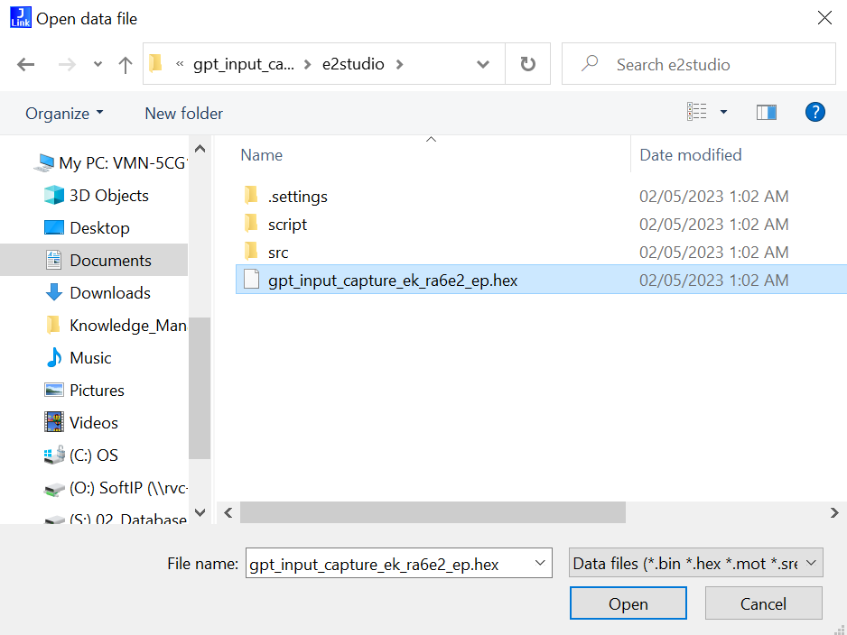
TEST EP USING JLINK Connect j-link
5
5. Click OK button
6. Select Data File
6
7. Select hex file of EP and click Open button
7

Slide 38
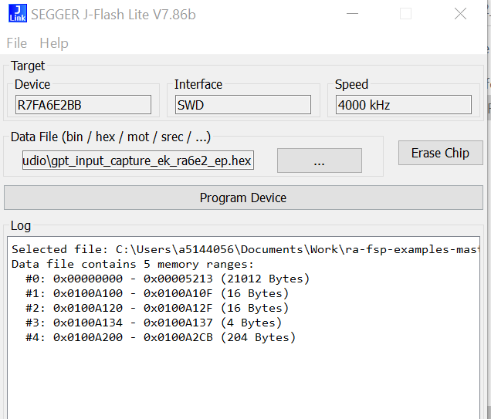
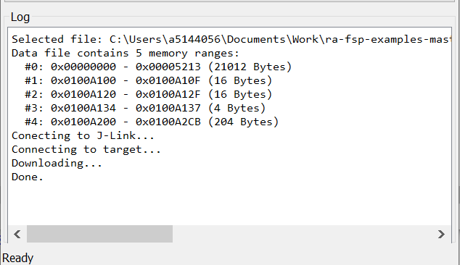
TEST EP USING JLINK Connect j-link
8. Click Program Device button
8
9. Finish connecting J-Link with Target Board
9

Slide 39
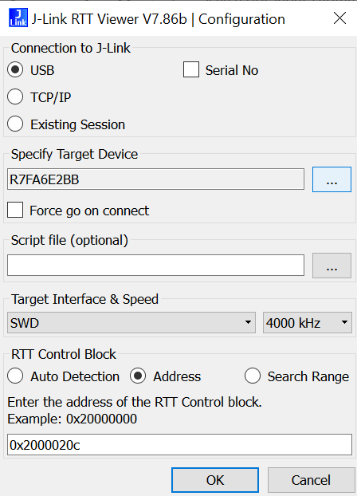
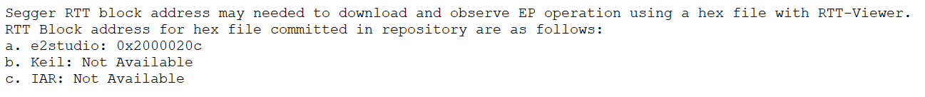
TEST EP USING JLINK View result by J-Link viewer
1. Choose USB at Connection to J-Link. Note: If using J-Link with e2studio Select Existing Session and Skip the connect step.
1
2. Select Specify Target Device
2
3. Select RTT Control Block → check readme.txt at EP folder to know board RTT block address
3

Slide 40

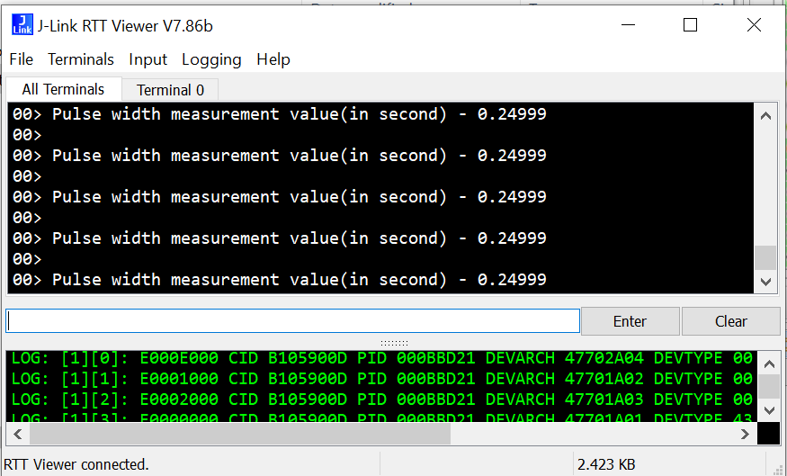
TEST EP USING JLINK View result by J-Link viewer
4. Connect pin based on readme file requirements (if have)
5. Review result

Slide 41
Thanks for listening

Slide 42
Renesas.com

