Slide 1

OBSERVER DESIGN PATTERN

Slide 2
OUR GROUP
Khoi Nguyen Hoang – 10421030
An Vuong Quoc - 10421002

Slide 3
CONTENTS
1. Overview
2. Definition of Observer Pattern
3. Benefit
4. Demonstration

Slide 4
OVERVIEW
Design patterns are categorized into 3 main groups: creational pattern; structural pattern; behavioral pattern
Observer design pattern is a behavior pattern
Notes:
Creational pattern
- Deal with object creation mechanism
Structural pattern
- Ease the design by identifying a simple way to realize relationships
Behavior patter
- Deal with common communication between objects

Slide 5
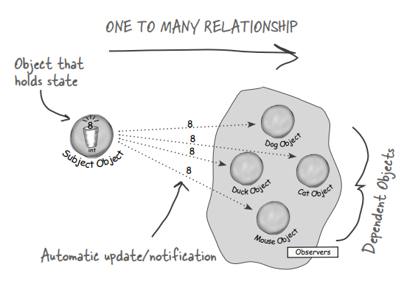
DEFINITION

Slide 6
DEFINITION
The Observer Pattern defines a one-to-many relationship between a set of objects
When the state of one object changes, all of its dependents are notified

Slide 7
DEFINITION
This pattern is used to make relation between objects at run time not compile time
Objects that changes called “Subject”
Objects that receives updates called “Object”

Slide 8
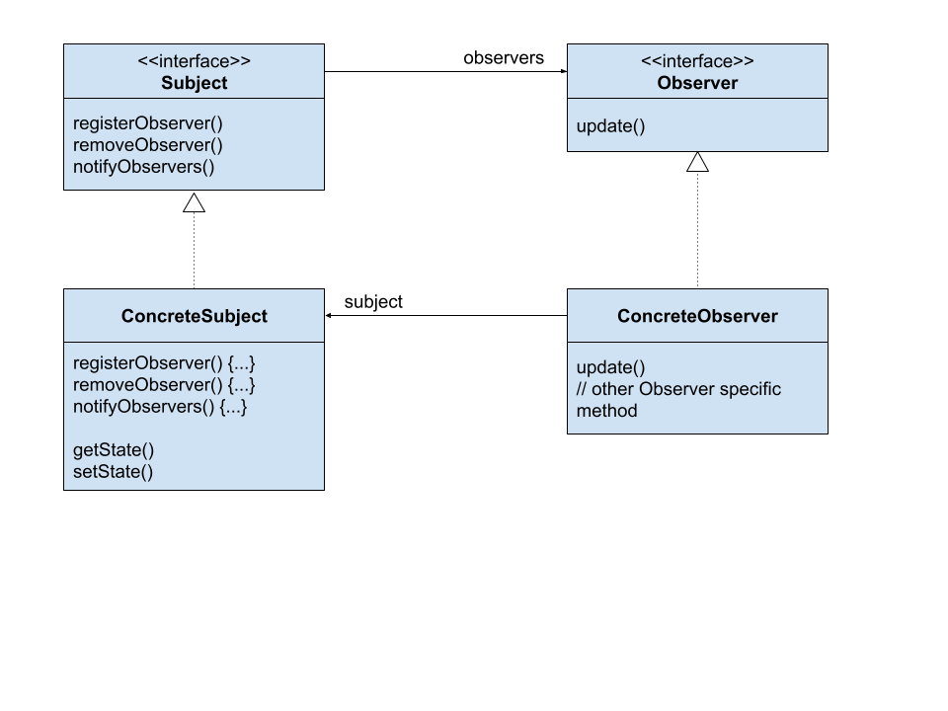
DEFINITION
Class diagram:

Slide 9
BENEFIT
Subject does not need to know the concrete class of an observer
Can add new observers at any time
Observers can be added without modifying the subject
Notes:
SGK trang 53

Slide 10
BENEFIT
Can reuse subjects or observers independently
Changes to either the subject or an observer will not affect the other
Notes:
SGK trang 53

Slide 11
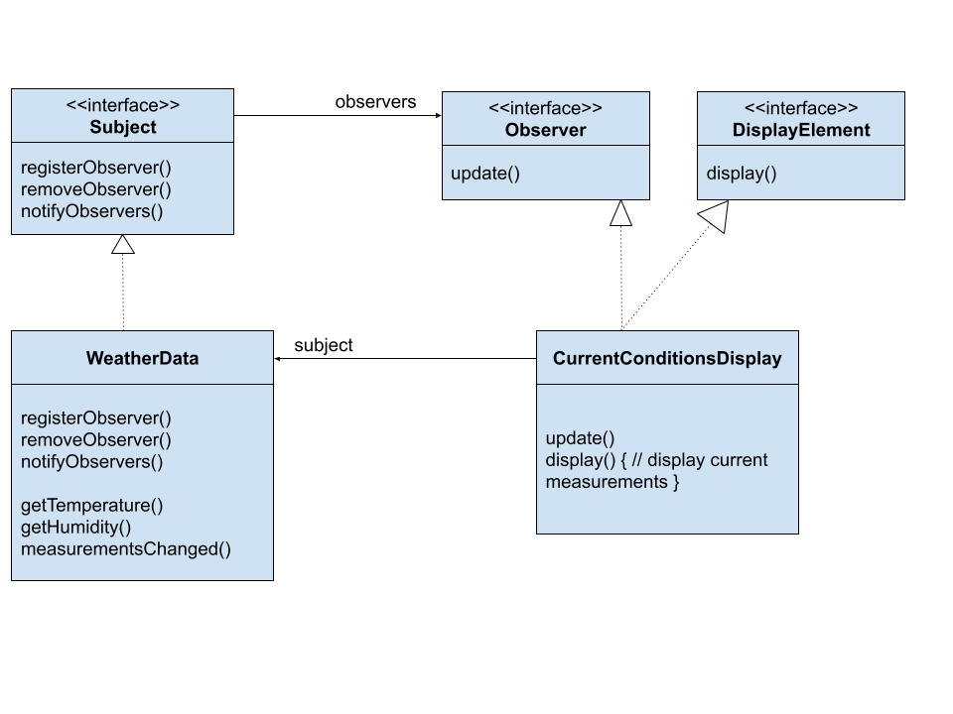
DEMO
Designing the Weather Station
Diagram

Slide 12
DEMO
Create interfaces:
#include <iostream>
// Observer.h
#ifndef OBSERVER_H
#define OBSERVER_H using namespace std;
class Subject;
class Observer{
public:
virtual void update(Subject* s) = 0;
virtual ~Observer(){}
};
#endif // OBSERVER_H
Notes:
Create interface Observer.h
The Observer interface is implemented by all observers, so they all have to implement the update() method.

Slide 13
DEMO
Create interfaces:
#include <iostream> // Subject.h
#ifndef SUBJECT_H
#define SUBJECT_H #include "Observer.h" using namespace std;
class Subject{
public:
virtual void registerObserver(Observer* observer) = 0; virtual void removeObserver(Observer* observer) = 0; virtual void notifyObservers() = 0; virtual ~Subject(){}
virtual float getTemp()=0; virtual float getHumid()=0; virtual void setTemp(float temperature)=0; virtual void setHumid(float humidity)=0;
};
#endif // SUBJECT_H
Notes:
Create interface Subject.h
Method notifyObservers() is called to notify all observers when the Subject’s state has changed.

Slide 14
DEMO
Create interfaces:
#include <iostream>
using namespace std;
class DisplayElement{
public:
virtual void display() = 0;
virtual ~DisplayElement(){}
};
Notes:
Create interface DisplayElement.h
The DisplayElement interface just includes one method, display(), that we will call when the display element needs to be displayed.

Slide 15
DEMO
Implementing the Subject interface in WeatherData
#include <iostream>
#include <vector> #include "Subject.h" using namespace std;
class WeatherData : public Subject{
private:
vector<Observer*> observers;
float temperature;
float humidity; public:
WeatherData() {. . .} void registerObserver(Observer* o) override {. . .} void removeObserver(Observer* o) override {. . .} void notifyObservers() override {. . .} void measurementsChanged() {. . .} void setMeasurements(float temperature, float humidity){. . .} float getTemp() override {return this->temperature;}
float getHumid() override {return this->humidity;}
void setTemp(float temperature)override {this->temperature=temperature;}
void setHumid(float humidity)override {this->humidity=humidity;}
};
Notes:
Subject interface in WeatherData
Code chi tiet o slide sau

Slide 16
DEMO
Implementing the Subject interface in WeatherData
WeatherData(){
this->observers = vector<Observer*>();
}
void registerObserver(Observer* o) override{
observers.push_back(o);
}
void removeObserver(Observer* o) override{
for(auto it = observers.begin(); it != observers.end(); ++it){
if(*it == o){
observers.erase(it);
break;
}
}
}
Notes:
Subject interface in WeatherData
registerObserver() : When an observer registers, we just add it to the end of the list.
removeObserver() : When an observer wants to un-register, we just take it off the list.

Slide 17
DEMO
Implementing the Subject interface in WeatherData
void notifyObservers() override {
for(auto anObserver : observers){
anObserver->update(temperature, humidity);
}
}
void measurementsChanged() {
this->notifyObservers();
}
void setMeasurements(float temperature, float humidity) {
this->temperature = temperature;
this->humidity = humidity;
notifyObservers();
}
Notes:
Subject interface in WeatherData
notifyObservers() : This is where we tell all the observers about the state.
measurementsChanged() : We notify the Observers when we get updated measurements

Slide 18
DEMO
Build display element(s):
#include <iostream>
#include "Observer.h"
#include "Subject.h"
#include "DisplayElement.h"
using namespace std;
class CurrentConditionsDisplay : public Observer, public DisplayElement{
private:
float temperature;
float humidity;
Subject* weatherData;
public:
CurrentConditionsDisplay(Subject* weatherData) {. . .}
void update(Subject* s) override {. . .}
void display() {. . .}
};
Notes:
In this demo, we only build 1 display element => CurrentConditionsDisplay

Slide 19
DEMO
Build display element(s):
CurrentConditionsDisplay(Subject* weatherData){
this->weatherData = weatherData;
weatherData->registerObserver(this);
}
void update(Subject* s) override{
this->temperature = s->getTemp();
this->humidity = s->getHumid();
this->display();
}
void display(){
cout << "Current Temperature: " << this->temperature << " F_degree" << endl;
cout << "Current Humidity: " << this->humidity << "%" << endl;
}
Notes:
In this demo, we only build 1 display element => CurrentConditionsDisplay
update() : When update() is called, we save the temp and humidity and call display()
display() : prints out the most recent temp and humidity

Slide 20
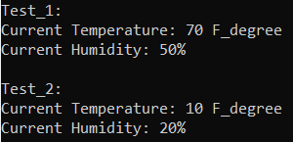
DEMO
Test results in the main file:
#include <iostream> #include "WeatherData.h"
#include "CurrentConditionsDisplay.h" using namespace std;
int main()
{
WeatherData weatherData;
CurrentConditionsDisplay currentConditionsDisplay(&weatherData);
cout << "Test_1: " << endl;
weatherData.setMeasurements(70, 50);
cout << "\nTest_2: " << endl;
weatherData.setMeasurements(10, 20);
}
Notes:
The main.cpp file => WeatherStation

Slide 21
THANK YOU FOR LISTENING

