Slide 2
done_money = 0
&& sum< max_money
&& cancel = 0
out_stock = 1
&& cancel = 0
(done_money= 1
||sum>max_money)
&&cancel = 0
IDLE
SELECT
out_stock = 0
&& cancel = 0
RECEIVE_MONEY
COMPARE
start = 1
start = 0
cancel = 1
enough_money = 0
cancel = 0
enough_money = 1
PROCESS
continue _buy = 1
cancel = 1
RETURN_CHANGE
continue_buy = 0
cancel = 1

Slide 3

Vending Machine Controller
clk
FSM
clk
reset_n
reset_n
start
start
done_money
done_money
cancel
cancel
done
done
continue_buy
continue_buy
Output Handler
money[2:0]
money[0]
item_out[0]
deno_5
end_trans
end_trans
item_1
money[1]
sum_money[7:0]
item_2
item_out[1]
deno_10
sum_money [7:0]
money[2]
item_3
item_out[2]
deno_20
price [7:0]
price[7:0]
item_out[3]
item_in[1:0]
item_4
item_out[3:0]
item_in[1:0]
item_select[1:0]
item_select[1:0]
change[7:0]
change[7:0]

Slide 4
reset_n
start
done
done_money
current_state
cancel
Next_State logic
end_trans
Ouput logic
sum_money [7:0]
continue_buy
deno_5
price[7:0]
deno_10
item_select[1:0]
deno_20
item_in[1:0]
clk
reset_n

Slide 5
clk
reset_n
start
done_money
cancel
Vending Machine Controller
continue_buy
done
money[2:0]
item_out[3:0]
item_in[1:0]
change[7:0]

Slide 6
2-4 Decoder
end_trans
y0
item_1
en
item[1:0]
y1
item_2
a
y2
item_3
b
y3
item_4
en
Sub
sum_money
a
change
result
price
b

Slide 7
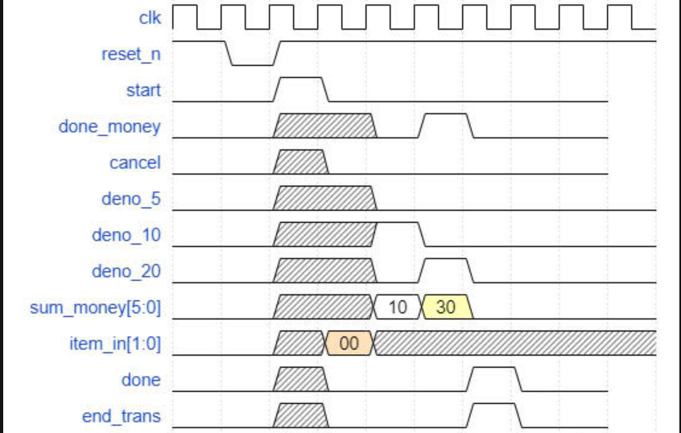
1
2
3
4
5
6

Slide 8
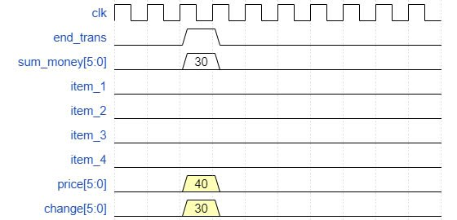
1

Slide 9
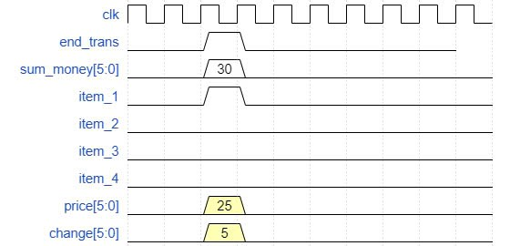
1

