Slide 1




Designing an AI-Integrated Automation System for Post Offices
Supervisor
Author
MEng Nguyen Thi Hoang Yen
Le Huy Anh
Hoang Quoc Dung
Do Thanh Hung
Bui Nhat Minh

Slide 2





Table of Contents
02
This presentation is organized into 5 main sections.
1
Business context, Problem statement
Introduction
2
Literature Review
Background, Related work, Research gap, and Proposed solution
3
Methodology
Business process analysis, Overall framework
4
Experiments and Results
Summary of quantitative results, Dataset
5
Conclusion and Future Works
Discussion, Limitation and Future research directions

Slide 3


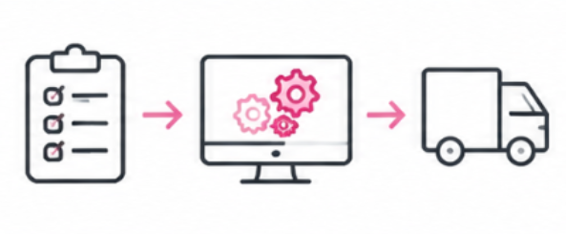


01
Introduction
03
1.1 Introduction – Business Context
Characteristics 1
Vietnam Post operates in an environment that requires the continuous receipt and dispatch of orders across the country.
Business Context
(Vietnam Post)
Characteristics 2
The acceptance stage is the initial point where data for the entire postal journey is generated. The quality of data created at this stage directly impacts subsequent processes.
Characteristics 3
Over-the-counter transactions still require multiple manual processing steps and data entry tasks performed directly by tellers, resulting in significant time consumption.
Vietnam Post is a leading state-owned enterprise in the fields of postal services, delivery, postal financial services, and logistics.
Characteristics 4
Volume spikes by 25–30% during peak periods (e.g., Lunar New Year 2026), leading to severe counter congestion.

Slide 4

01
Introduction
04
1.2 Introduction – Problem Statement
Prolonged Acceptance Time: Manual process takes 6–8 minutes per item
Repetitive Data Entry: Information already exists on package labels, but tellers must still manually read and re-type it into the system.
High Risk of Errors: Manual reading and entry of physical measurements (weight, dimensions) easily cause data errors, impacting downstream logistics.
Teller resources are currently consumed by mechanical tasks that can be automated: Tellers' time should shift from reading, typing, recording measurements, and performing repetitive calculations to inspecting goods, providing advice, serving customers, cross-selling services, and handling exceptions.
Goal
Develop a solution capable of supporting the automation of the parcel intake process, specifically regarding information recognition, package dimension measurement, and the calculation of necessary parameters.

Slide 5
02
Literature Review
05
2.1 Background
Computer Vision Application Trends
In recent years, Computer Vision and Deep Learning have become core technologies in logistics automation and parcel handling. Modern systems go beyond basic sorting, aiming for end-to-end automation—ranging from information recognition and 3D dimension measurement to parcel condition inspection. Research directly related to this topic focuses on three main problem categories:
  Text and handwriting recognition (OCR) on parcel labels.
  Parcel dimension measurement and volume estimation.
  Multi-task integration on a single computer vision system.

Slide 6
02
Literature Review
06
2.2 Related Works
Li et al. – Text Recognition with TrOCR
Peng et al. – Dimension Measurement via Laser Triangulation & Deep Learning
Architectural Innovation: Replaces traditional CNN + RNN combinations with a Transformer-based Image Encoder and Text Decoder.
Combines laser triangulation with deep learning on a structured light system to extract 3D depth features.
Fernandes et al. – Dimension Measurement via Geometry and Laser
Le Van Thai – Dimension Measurement via Stereo Vision
Uses a dual-camera system (Stereo Vision) observing from two different angles, calculating the disparity of corresponding points to reconstruct 3D space.
Determines box dimensions from camera images based on perspective geometry, object contours, and supporting laser lines.
Tran et al. – Integrated Processing System with YOLOv12
Develops an integrated system based on YOLOv12-BiFPN-ResCBAM for three tasks: barcode reading, dimension measurement, and damaged parcel detection.

Slide 7
02
Literature Review
07
2.2 Related Works
Author | Method | Task | Disadvantages | Advantages
Li et al. | TrOCR (Transformer) | Printed/handwritten text OCR | Requires language-specific fine-tuning | High accuracy, end-to-end
Fernandes et al. | Perspective geometry + Laser | 2D/3D dimension measurement | Dependent on laser hardware | Clear mathematical foundation, automated
Peng et al. | Laser Triangulation + DL | Depth & volume measurement | Expensive equipment costs | High 3D accuracy
Le Van Thai | Stereo Vision (2 Cameras) | Classification & 3D measurement | Sensitive to lighting and occlusion | Non-contact measurement
Tran et al. | YOLOv12-BiFPN-ResCBAM | Barcode, Dimension, Defect detection | Leaves handwritten OCR unaddressed | Multi-task, optimized for edge devices

Slide 8
02
Literature Review
08
2.3 Research Gap & Proposed Solution
Research Gap
Proposed Solution
  Cost vs. Accuracy: High-precision measurement methods using geometry + lazer or lazer + deep learning are constrained by the high cost of expensive laser and depth camera equipment.
  Lack of Comprehensive Multi-Tasking: No existing system simultaneously integrates physical dimension measurement and Vietnamese handwritten text OCR to extract package information.
  Data Structuring Problem: Raw OCR lacks a label region classification workflow (Layout Analysis) to convert extracted text into structured data (Full Name, Address, Phone Number).
  Integrated Multi-Tasking: Develop an end-to-end pipeline: Parcel Detection ➔ Dimension/Volume Measurement ➔ Vietnamese Handwritten Text OCR.
  Hardware Optimization: Utilize YOLO + Canny Edge + 2 standard cameras for dimension measurement, completely eliminating costly laser and depth camera hardware.
  Fine-Tuning Vietnamese TrOCR: Specialize the TrOCR model on realistic handwritten text data from Vietnamese postal shipping forms.

Slide 9
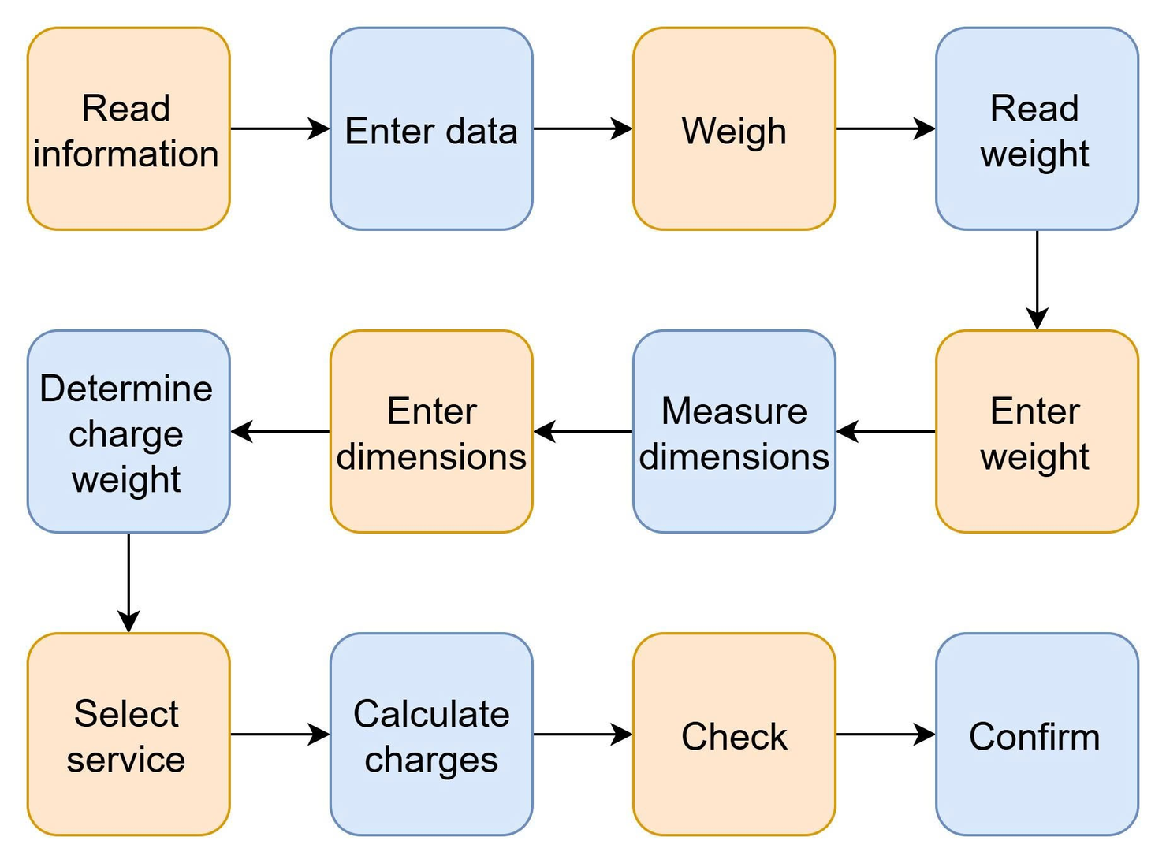
03
Methodology
09
3.1 Business Process Analysis
Current process
The current system involves multiple small steps that must be performed manually, resulting in significant time consumption (6–8 minutes per order) and a high risk of errors.

Slide 10
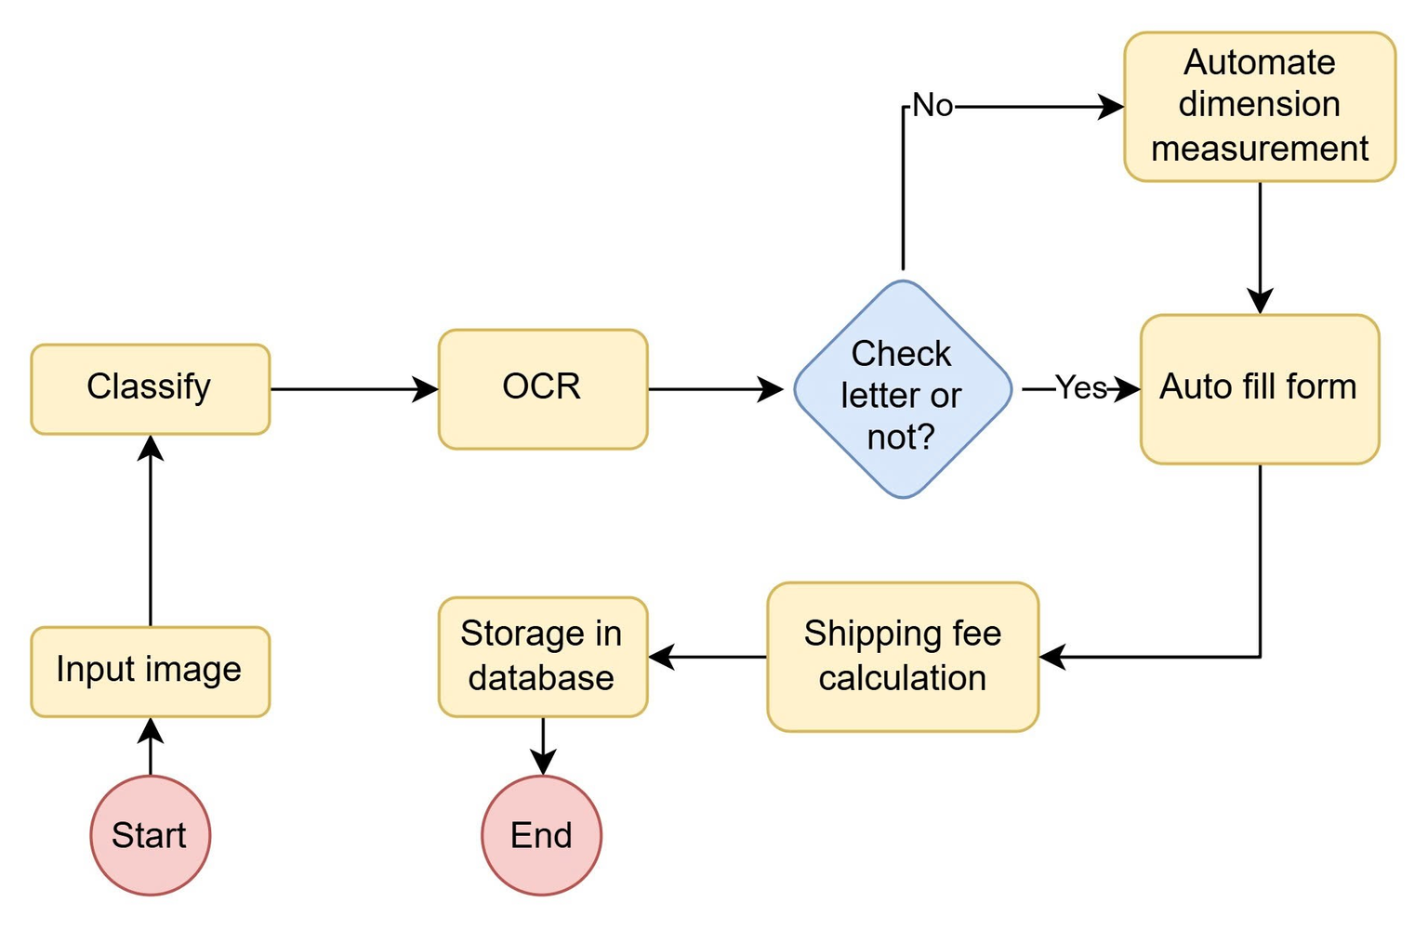
03
Methodology
10
3.2 Overall Framework
System supporting sorting, handwritten text recognition, volume calculation, fee calculation, and data storage.

Slide 11





03
Methodology
11
3.3 Handwriting Extraction and Recognition Module
1. Classify
2. Localize
3. Detect
4. Recognize
5. Normalize
Envelope vs. Parcel
Information-label region
Text-region bounding boxes
Handwritten characters
Raw text into structured JSON
YOLOv11n
YOLOv11n
EasyOCR (detection only)
Fine-tuned TrOCR
Claude API

Slide 12
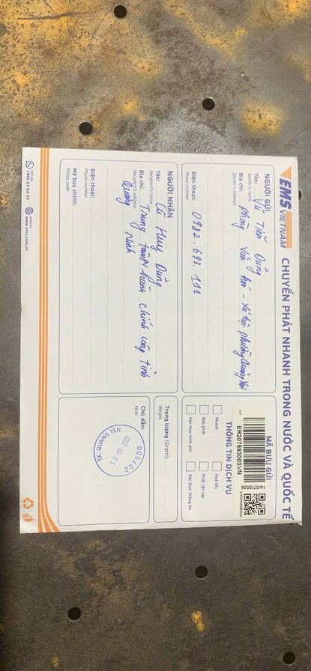
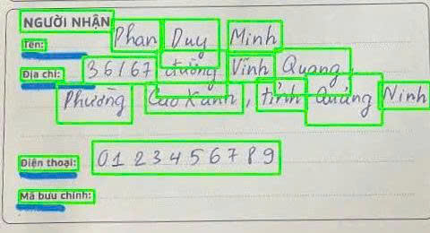
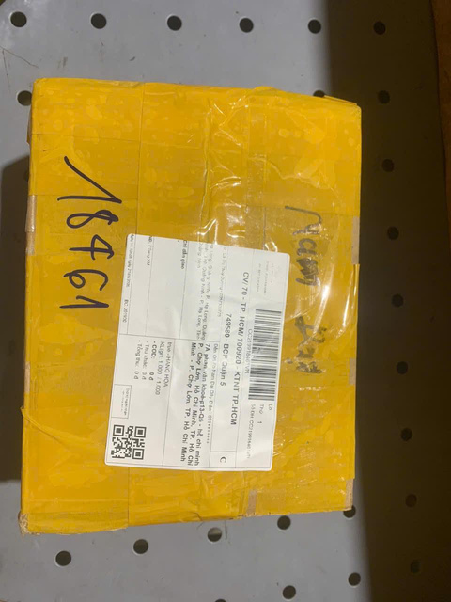
03
Methodology
12
3.3.1 Classification & Information-Region Localization
Model 1: Envelope/parcel classification
Purpose: Processes original input images and classifies postal items into two main categories: Box or Envelope.
Dataset preparation:
  Target Classes: Filtered to keep 2 core categories (Label-Box, Label-Envelope).
  Data Augmentation: Expanded training set to 1,050 samples using vertical flip, ±15° rotation, and ±15° brightness adjustments.
  Image Resizing: All images resized to 640 × 640.
  Dataset Partitioning:
  Training Set: 1,050 samples
  Validation Set: 44 samples
  Testing Set: 44 samples

Slide 13
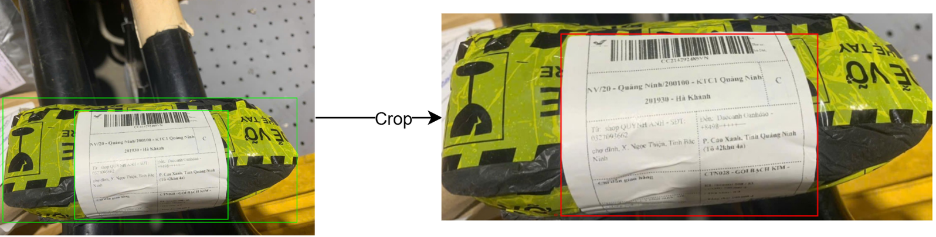
03
Methodology
13
3.3.1 Classification & Information-Region Localization
Model 2: Information-region localization
Purpose: Detects the exact shipping label / information region (Info Region) on cropped box surfaces for downstream OCR processing.
Dataset preparation:
  Source Selection: Selected box-only images from the dataset; envelope images were excluded as Model 2 focuses exclusively on box labels.
  Auto-Cropping: Cropped box regions from raw images using bounding box coordinates to isolate target surfaces.
  Single Class Objective: Fine-tuned to detect a single target class (Info Region).
  Dataset Partitioning:
  Training Set: 1,050 samples
  Validation Set: 44 samples
  Testing Set: 44 samples

Slide 14
03
Methodology
14
3.3.1 Classification & Information-Region Localization
Model & Training Environment
Hyperparameter | Value
Model Architecture | YOLO11n
Pretrained Weights | yolo11n.pt
Epochs | 50
Batch Size | 16
Hardware / Workers | GPU / 4 Workers
Shared Configuration: This training preset and hyperparameter setup is applied identically to both Model.
  Base Model: YOLO11n (Nano architecture, optimized for lightweight real-time execution).
  Pretrained Weights: Fine-tuned from COCO pretrained weights (yolo11n.pt) for transfer learning.
  Hardware Setup: GPU with 4 dedicated dataloader workers.
  Checkpointing: Best validation performance saved to weights/best.pt.

Slide 15
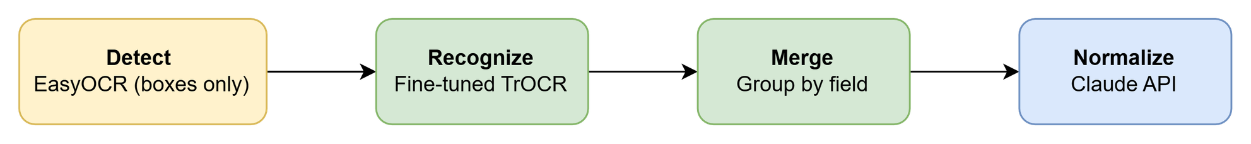
03
Methodology
15
3.3.2 Text Detection, Recognition & Normalization

Slide 16


03
Methodology
16
3.4 Parcel Dimension Measurement — Two Candidate Approaches
Option 1 — Webcam + Computer Vision
Option 2 — Ultrasonic Sensor Array + ESP32
  Camera captures a frame; YOLO26n removes person regions and YOLO Hand Keypoints removes hand regions to prevent noise from interfering with edge detection.
  YOLO Package Detection localizes the parcel as the ROI.
  Canny edge detection scans a horizontal line at y = 0.57×h within the ROI to find left/right boundaries.
  D_cm = D_pixel × cm_per_pixel ; repeated 3× for L, W, H → V = L × W × H.
  3× HC-SR04 ultrasonic sensors + 1× GY-SHT30-D temperature sensor, controlled by an ESP32 microcontroller.
  Two sensors measure horizontally, one vertically (top-down), covering length, width, and height.
  Time-of-Flight principle: d_raw = v(T) × t / 2, with v(T) = 331.3 + 0.606×T.
  Each sensor is individually calibrated using linear regression to correct systematic error.

Slide 17
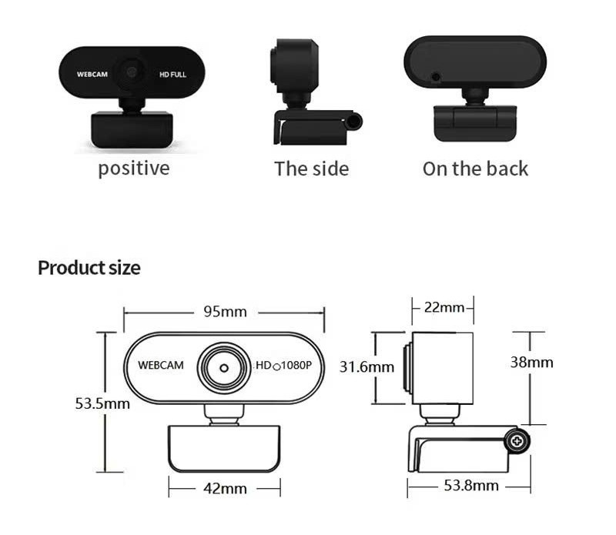
03
Methodology
17
3.4.1 Webcam-Based Dimension-Measurement Pipeline
Two cameras are used to measure the volume of a package.
The first camera captures the front of the package. The second camera captures the top of the package

Slide 18
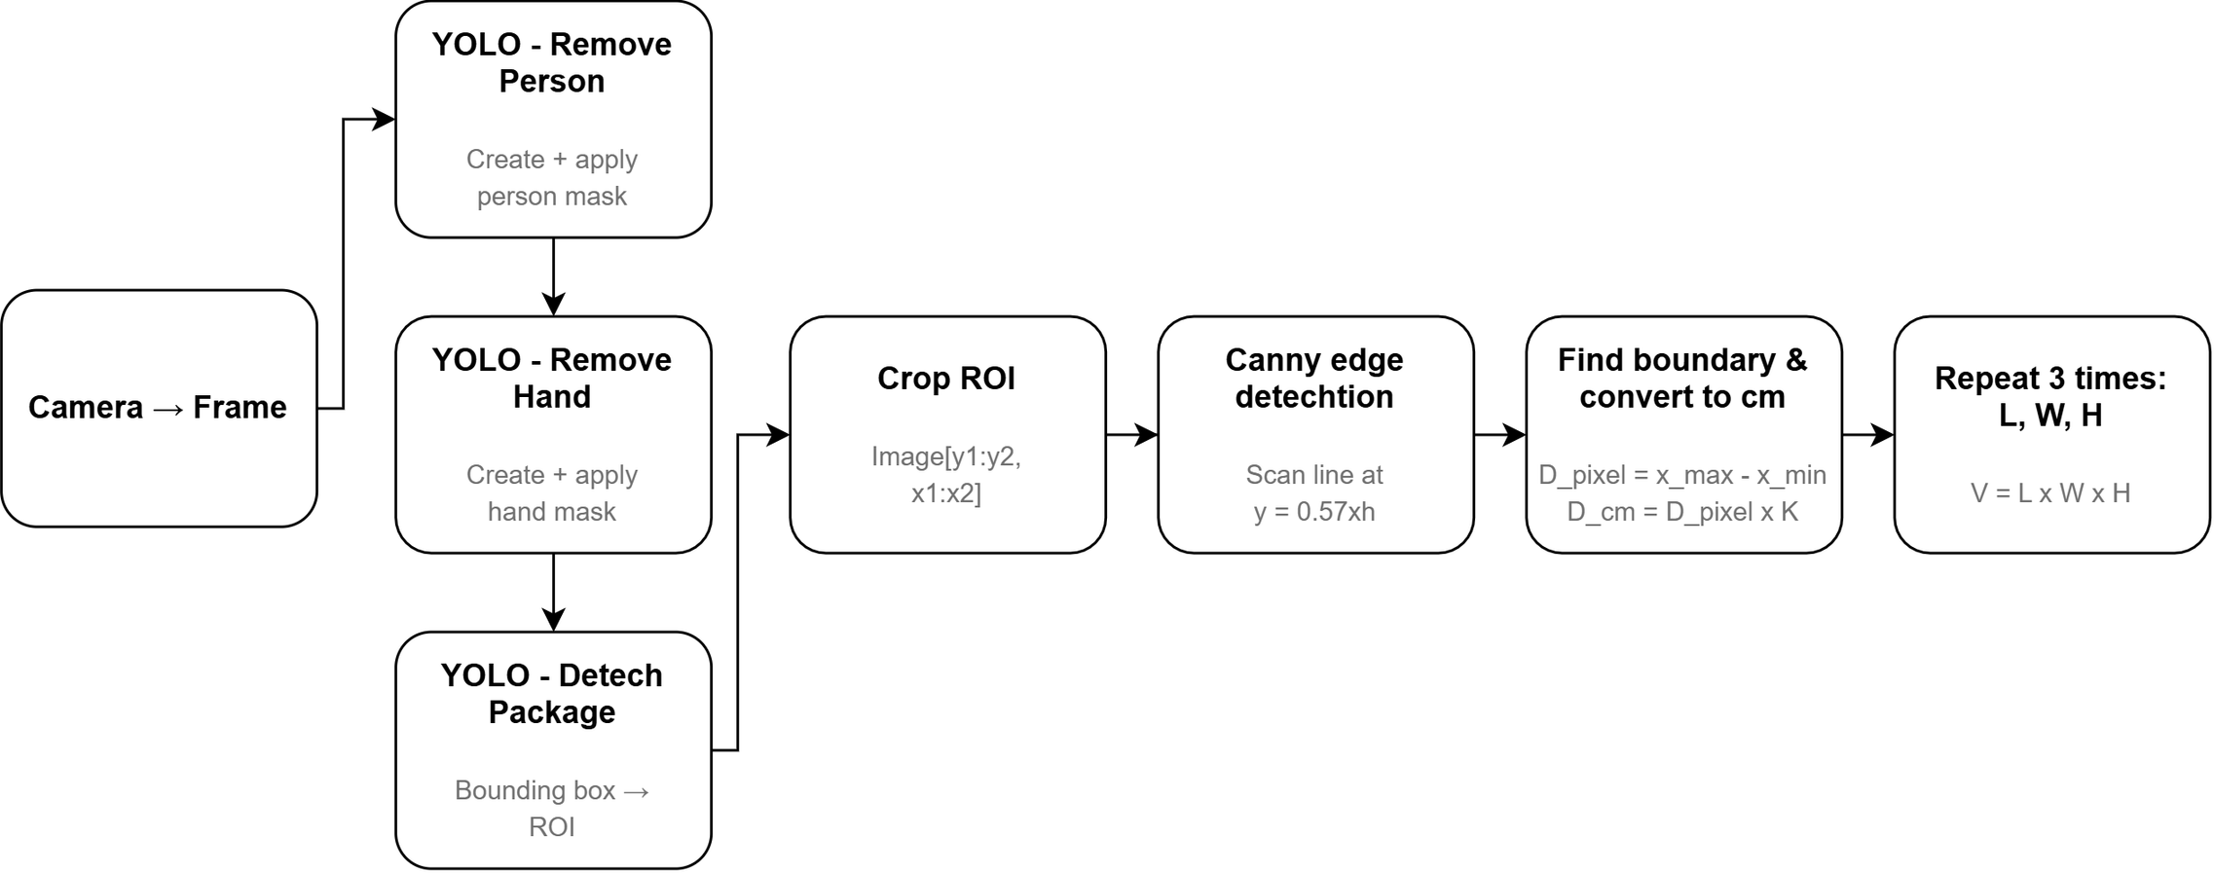
03
Methodology
18
3.4.1 Webcam-Based Dimension-Measurement Pipeline

Slide 19
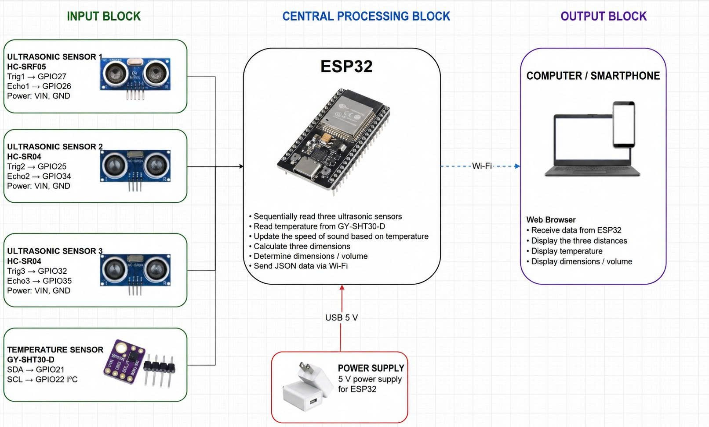
03
Methodology
19
3.4.2 Ultrasonic Measurement System
The system integrates distance and temperature measurements to calculate parcel dimensions and volume in real time.

Slide 20
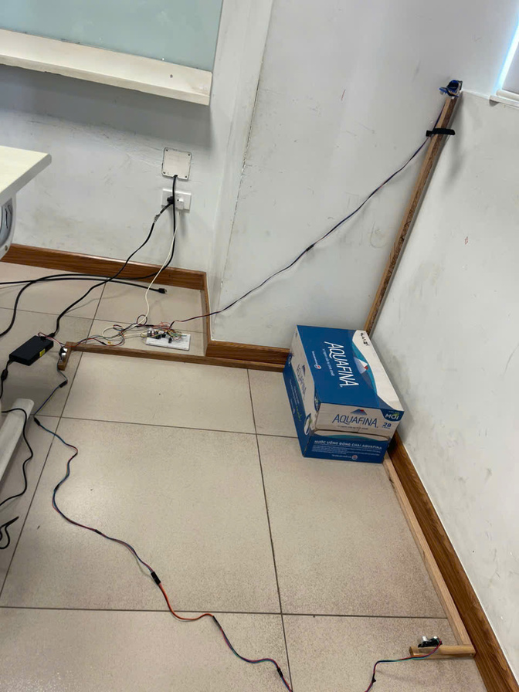
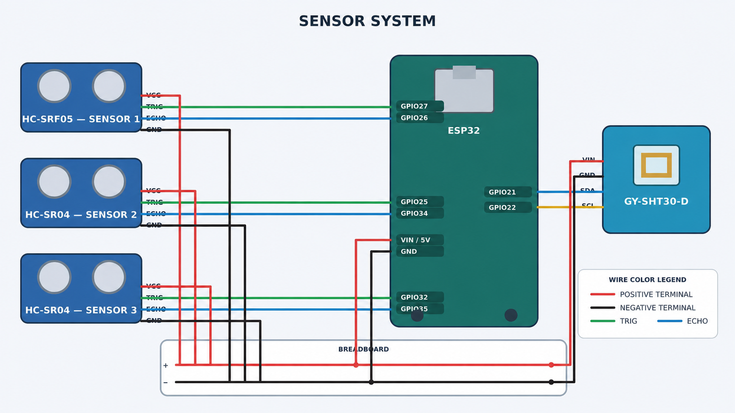
03
Methodology
20
3.4.2 Ultrasonic Measurement System

Slide 21
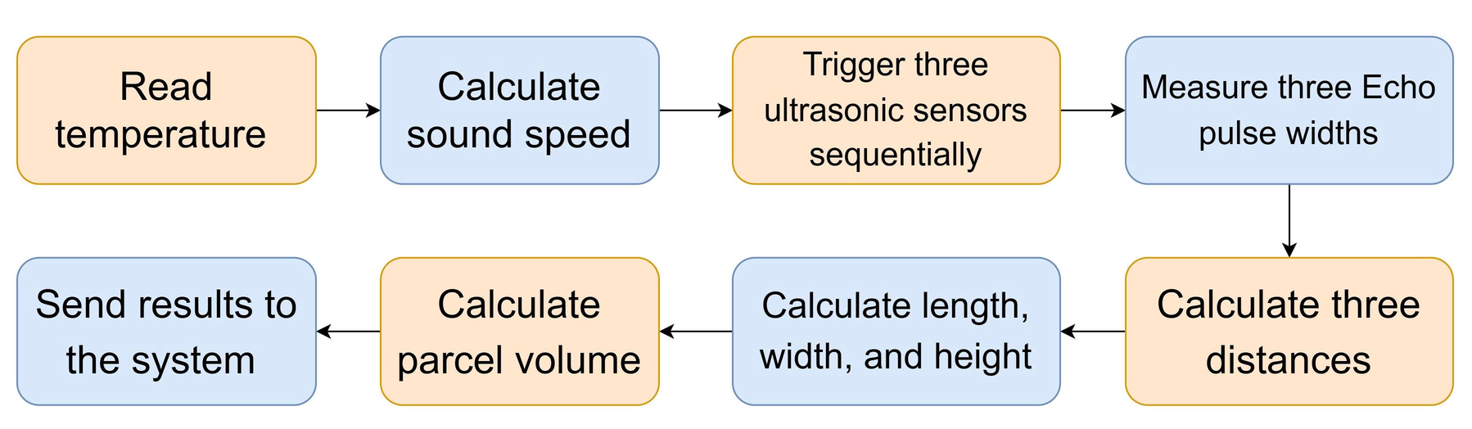
03
Methodology
21
3.4.2 Ultrasonic Measurement System
Step 1:
The ESP32 reads the ambient temperature from the SHT30-D sensor and calculates the corresponding speed of sound with formula: v(T) = 331.3 + 0.606×T.
Step 2:
The ESP32 triggers the three ultrasonic sensors sequentially to reduce crosstalk. Each sensor emits a 40 kHz ultrasonic wave, while the ESP32 measures the Echo pulse width and calculates the corresponding distance.
Step 3:
The three measured distances are subtracted from the fixed reference distances to determine the parcel dimensions:
L = 105 − d₁ W = 105 − d₂ H = 105 − d₃
Step 4:
The parcel volume is calculated and the results are sent to the system in JSON format via Wi-Fi:
V = L × W × H

Slide 22
04
22
Experiments and Results
4.1 Summary of Quantitative Results — All Models
Model | Key Metrics | Result
Envelope/parcel classification (YOLOv11n) | Precision / Recall / mAP50 / mAP50-95 | 0.9965 / 0.9972 / 0.9950 / 0.9666
Information-region localization (YOLOv11n) | Precision / Recall / mAP50 / mAP50-95 | 0.9715 / 0.9524 / 0.9790 / 0.8955
Handwriting recognition (fine-tuned TrOCR) | CER / WER (test set) | 5.39% / 14.99%
Person detection (YOLO26n, pre-trained) | mAP50-95 | 40.9
Hand detection (YOLO26n-hand, fine-tuned) | mAP50 / mAP50-95 | 99.5 / 89.8
Parcel detection — ROI (YOLO, fine-tuned) | mAP@50 / Precision / Recall | 94.8% / 95.3% / 90.2%

Slide 23
04
23
Experiments and Results
4.2 Datasets
Model | Dataset information | Reference
Envelope/parcel classification (YOLOv11n) | 1,137 samples (1,049 train, 44 val, 44 test) | Self-collected | Roboflow augmentation
Information-region localization (YOLOv11n) | 1,137 samples (1,049 train, 44 val, 44 test) | Self-collected | Roboflow augmentation
Handwriting recognition (fine-tuned TrOCR) | Train: 59,247 samples / Test: 1,000 samples | Hugging Face
Hand detection (YOLO26n-hand, fine-tuned) | 26.768 images (18.776 train/ 3.996 validation/ 3.996 test) | Ultralytics
Parcel detection — ROI (YOLO, fine-tuned) | 9.216 images (7.373 train/ 922 validation/ 921 test) | RoboFlow

Slide 24
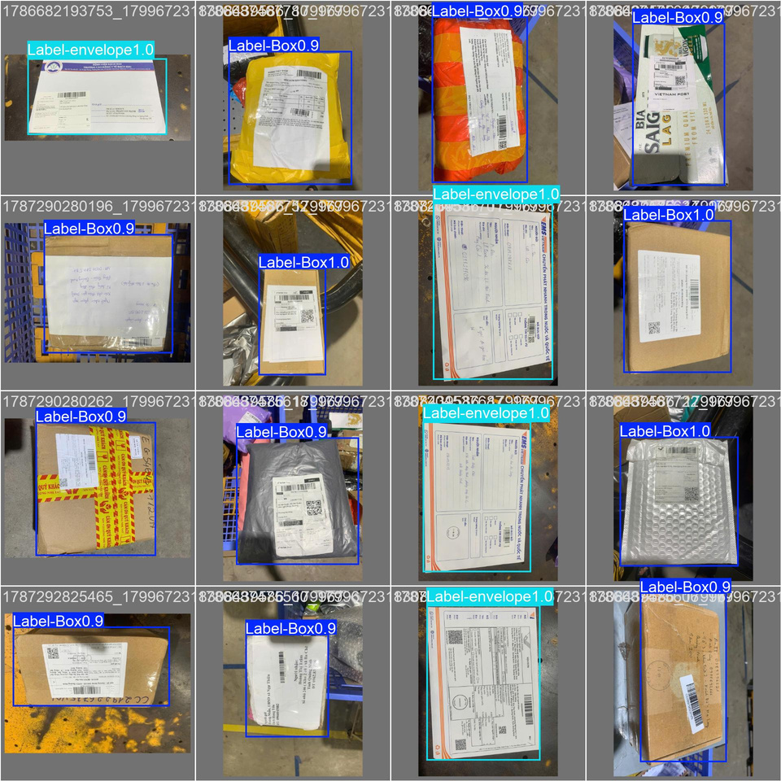
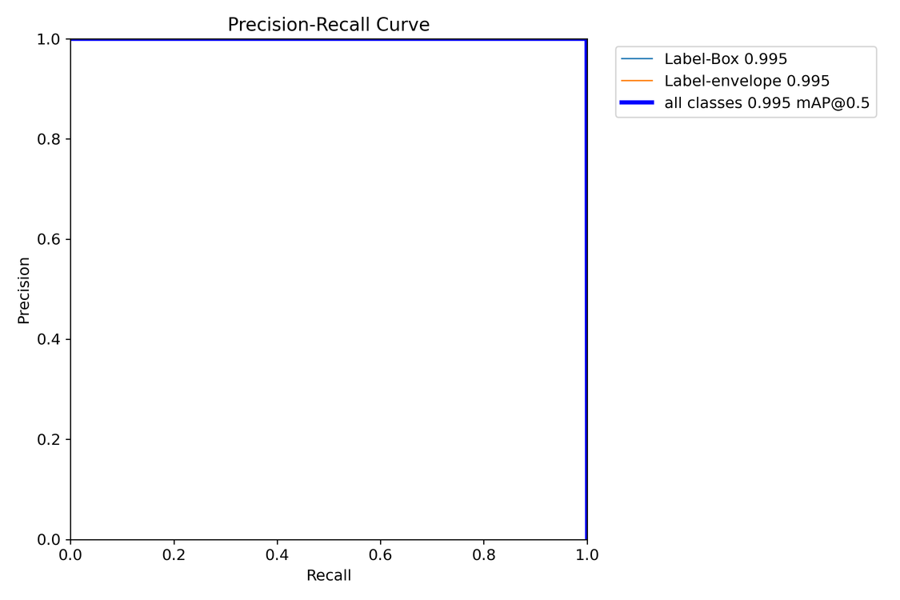
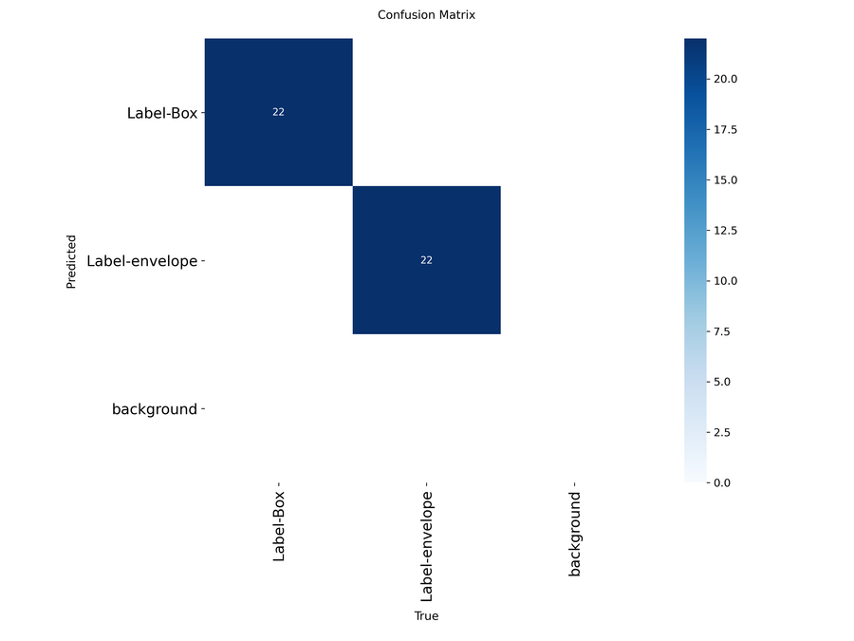
04
24
Experiments and Results
4.3 Envelope/Parcel Classification Results
0.9950
0.9666
0.9965
0.9972
mAP@0.5
mAP@0.5:0.95
Precision
Recall

Slide 25
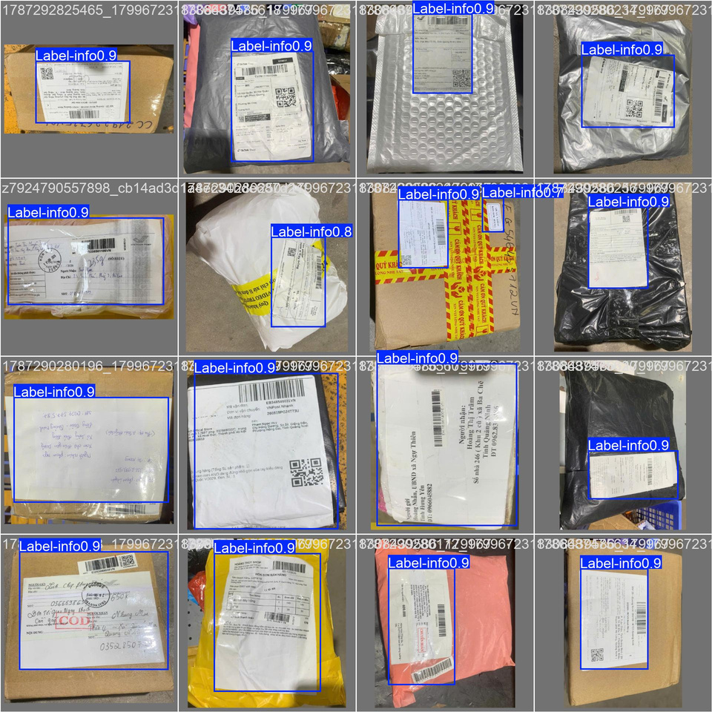
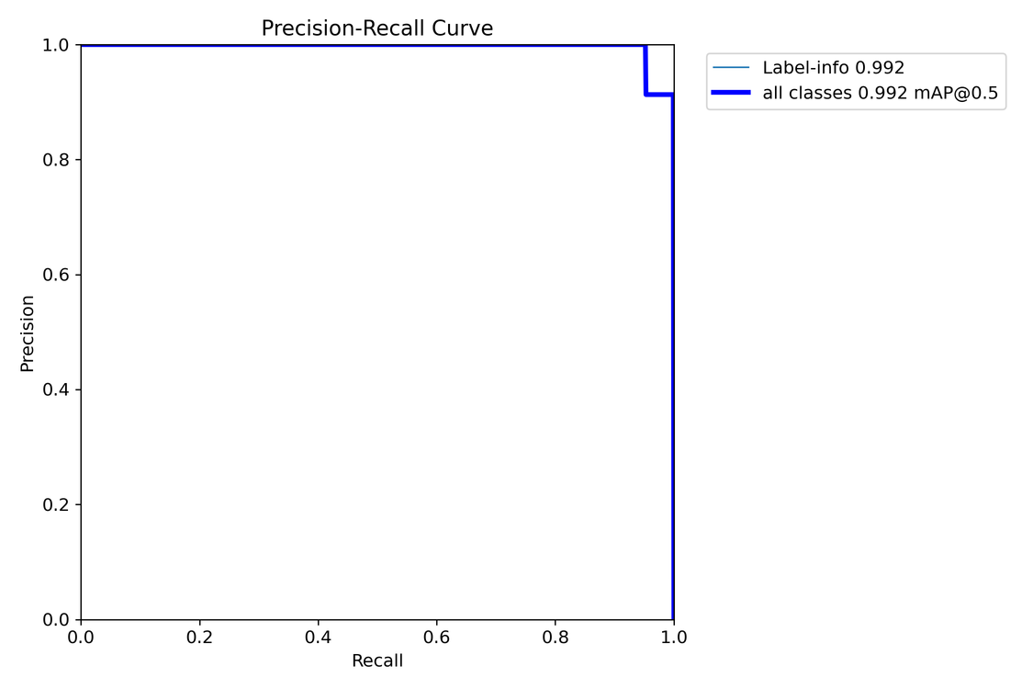
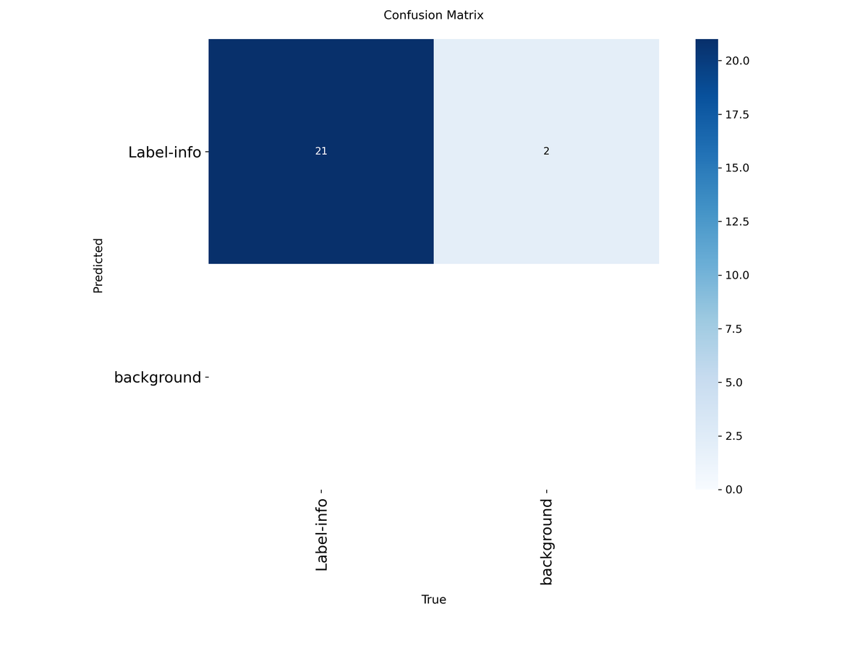
04
25
Experiments and Results
4.4 Information-region localization Results
0.9790
0.8915
0.9715
0.9524
mAP@0.5
mAP@0.5:0.95
Precision
Recall

Slide 26
04
26
Experiments and Results
4.5 Webcam Dimension-Measurement Results
The selection of the K-factor plays a crucial role; in many cases, while the error on individual edges may be significant, the overall volumetric error is lower than that associated with other K-factors.
Trial | Height factor | Block ratio | L (cm) | W (cm) | H (cm) | Volume error
Reference | — | — | 30.00 | 22.00 | 10.00 | 0.00%
1 | 0.55·h | 32/603 | 30.25 | 22.55 | 10.24 | 5.83%
4 | 0.55·h | 32/605 | 30.15 | 22.48 | 10.21 | 4.85%
6 | 0.55·h | 32/608 | 30.00 | 22.37 | 10.16 | 3.31%
8 (optimal) | 0.55·h | 32/614 | 29.71 | 22.15 | 10.06 | 0.31%

Slide 27
04
27
Experiments and Results
4.6 Ultrasonic Sensor Mesurement Results
Sensor | MAE before (cm) | MAE (cm) | MAPE (%) | Measurements
US1 | HC-SRF05 | 0.9016 | 2.1361 | 9,700
US2 | HC-SR04 | 1.7193 | 4.1628 | 9,700
US3 | HC-SR04 | 1.7445 | 4.0969 | 9,700
  Each sensor was evaluated using 9,700 measurements collected at 97 ground-truth distances.
  US1 achieved the lowest MAE of 0.90 cm and MAPE of 2.14%.
  US2 and US3 produced MAEs of 1.72 cm and 1.74 cm, respectively.
  US1 was the most accurate sensor in the evaluated setup.
  The differences may also have been affected by sensor placement, measurement direction, and individual device variation.
  US1 achieved the lowest measurement error, which aligns with the higher specified accuracy of the HC-SRF05 sensor than the others.

Slide 28





05
28
Conclusion and Future Works
5.1 Key Finding
5.2 Limitation
  The proposed multi-stage pipeline (classify → localize → detect → recognize → normalize) enables automated processing of handwritten Vietnamese postal labels.
  All four detection models (classification, localization, digit reading, parcel/person/hand detection) achieved mAP50 above 88%, confirming YOLO fine-tuning is viable for postal-specific tasks.
  Fine-tuning TrOCR on Vietnamese handwriting data sharply reduced error rates (CER 72.5%→5.39%, WER 106.95%→14.99%).
  Ultrasonic sensor calibration via linear regression cut measurement error by ~75% (CB1: MAE 0.91cm → 0.23cm).
  End-to-end OCR accuracy (including block merging + Claude API normalization) not yet measured on large-scale real-world data.
  Digit-merging step for the digital scale module is still incomplete, blocking full end-to-end operation.
  Three-sensor ultrasonic cluster requires full hardware assembly and real-world validation.
  Webcam-based measurement depends on auxiliary models (person/hand removal) to reduce noise before edge detection.
5.3 Future works
Validate Ultrasonic Hardware
  Assemble the complete three-sensor cluster and run real-world tests to compare against the webcam-based method.
Complete Digit Merging
  Finish the digit-to-value merging logic for the digital scale module to enable full end-to-end weight reading.
Improve Data Coverage
  Expand training data for information-region localization (lowest mAP50-95) and test on more diverse real-world postal labels.

Slide 29
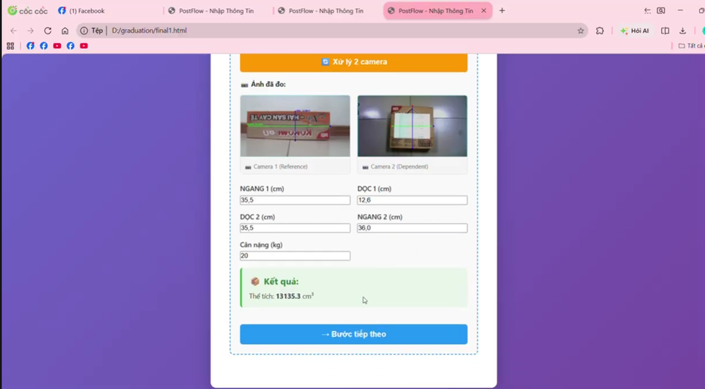
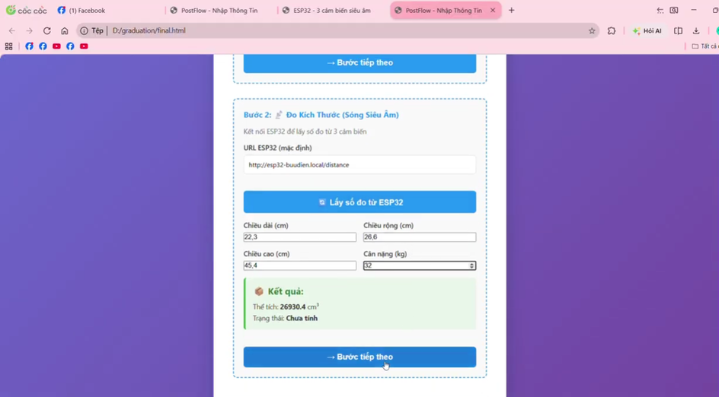
05
29
Conclusion and Future Works
5.4 Demo
Automated postal system using multiple cameras
Automated postal system using multiple ultrasonic sensors

Slide 30
Thank You!
Questions & Discussion

