Slide 1
Time Series Data Mining Review
Author: Sun Zhao
Email: zixiaojindao@gmail.com

Slide 2
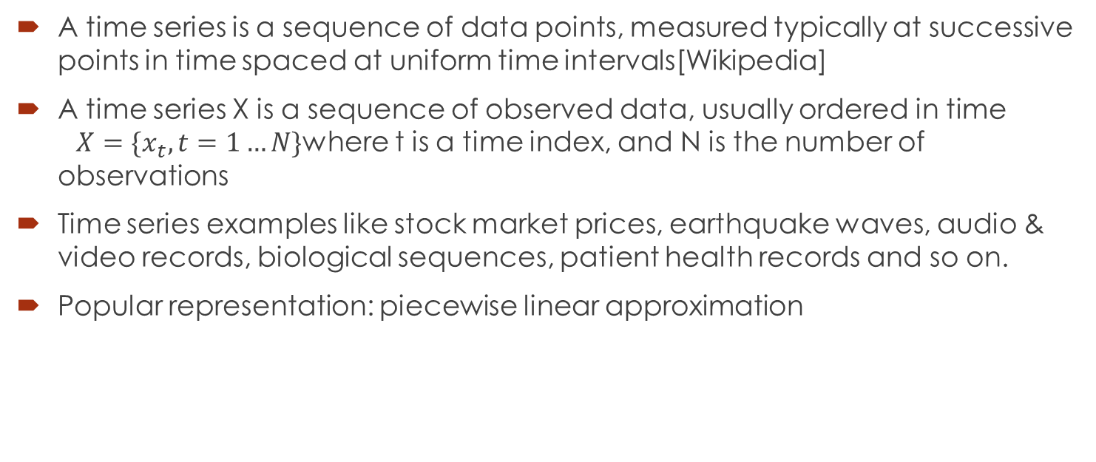
Time Series Definition
A time series is a sequence of data points, measured typically at successive points in time spaced at uniform time intervals[Wikipedia]
A time series X is a sequence of observed data, usually ordered in time $X=\{x_{t},t=1…N\}$where t is a time index, and N is the number of observations
Time series examples like stock market prices, earthquake waves, audio & video records, biological sequences, patient health records and so on.
Popular representation: piecewise linear approximation

Slide 3
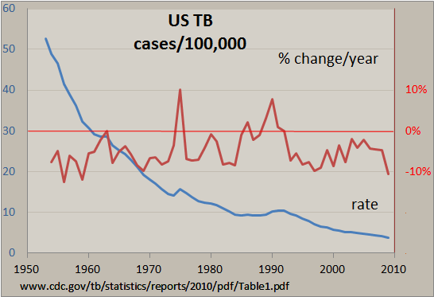
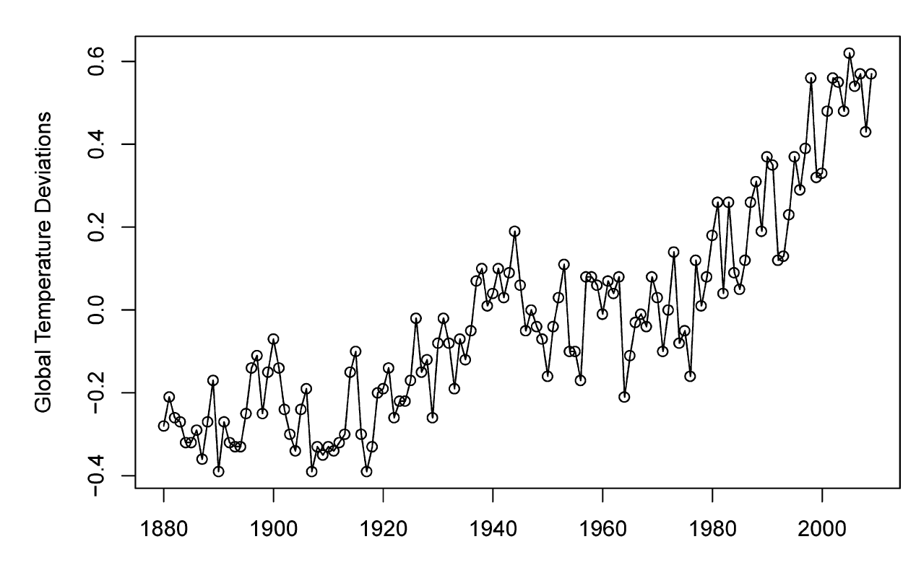
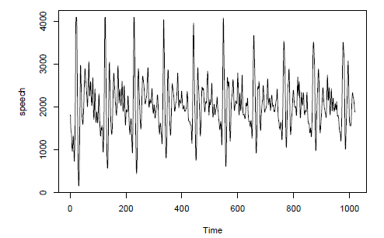
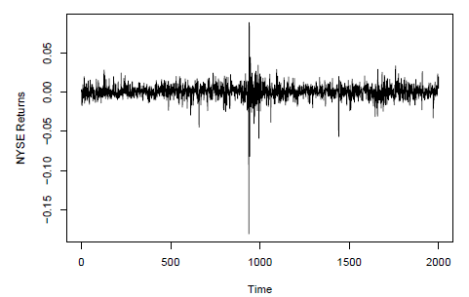
Time Series Visualization Examples

Slide 4
Time Series Data Mining(TSDM)
Segmentation
Forecasting
Prediction
Query by content
Frequent Subsequence Mining
Correlation Detection
Associate Rules
Motif Discovery
Clustering
Classification

Slide 5
Segmentation
Given a time series T, produce the best representation using only K segments.
Given a time series T, produce the best representation such that the maximum error for any segment does not exceed some user-specified threshold, max error.
Given a time series T, produce the best representation such that the combined error of all segments is less than some user-specified threshold, total max error.

Slide 6
Segmentation Basic Approaches[1]
Sliding Windows: A segment is grown until it exceeds some error bound. The process repeats with the next data point not included in the newly approximated segment.
Top-Down: The time series is recursively partitioned until some stopping criteria is met.
Bottom-Up: Starting from the finest possible approximation, segments are merged until some stopping criteria is met.

Slide 7
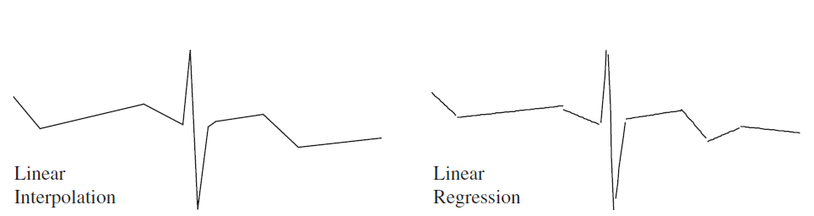
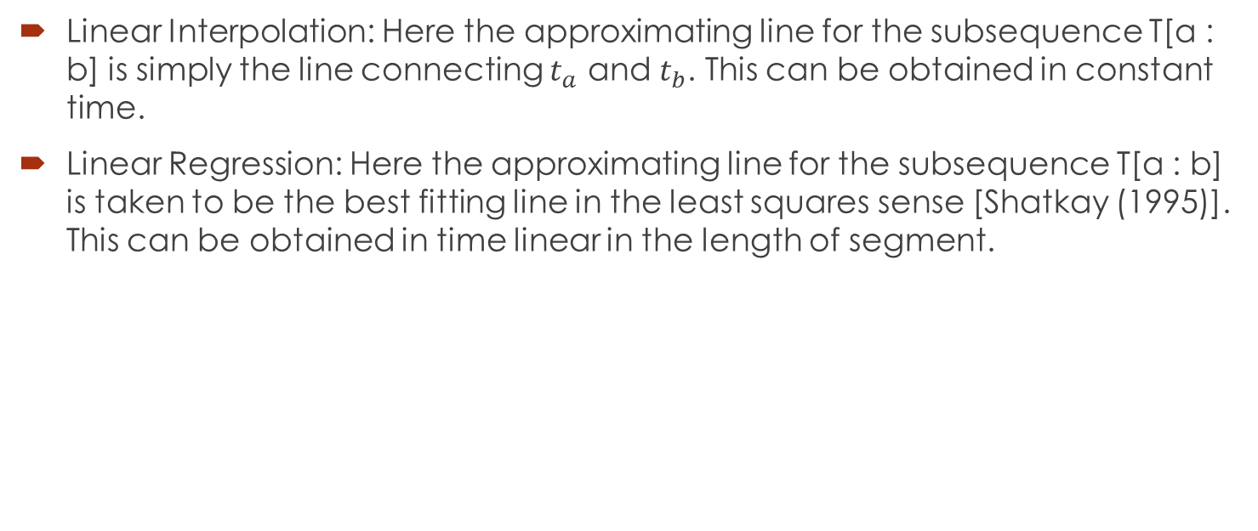
Create Segments
Linear Interpolation: Here the approximating line for the subsequence T[a : b] is simply the line connecting $t_{a}$ and $t_{b}$. This can be obtained in constant time.
Linear Regression: Here the approximating line for the subsequence T[a : b] is taken to be the best fitting line in the least squares sense [Shatkay (1995)]. This can be obtained in time linear in the length of segment.

Slide 8
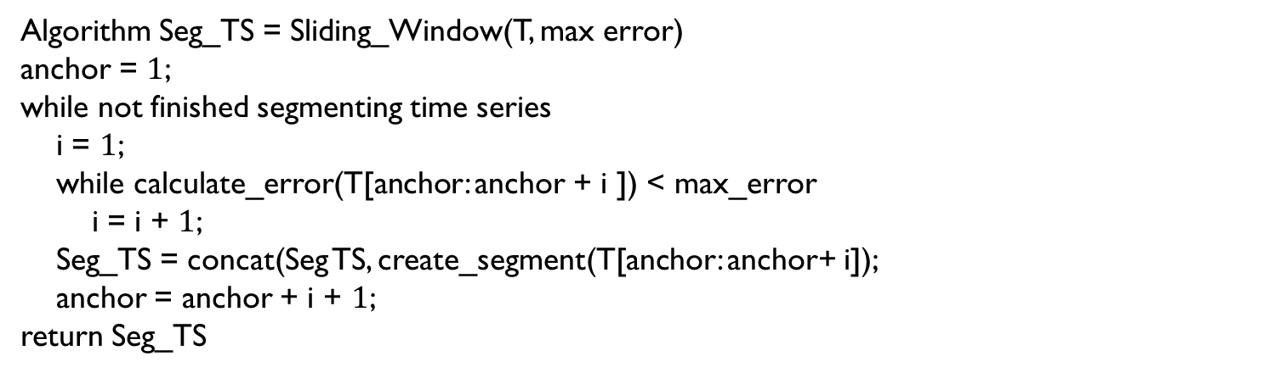
Sliding Window
Algorithm Seg_TS = Sliding_Window(T, max error)
anchor = $1$;
while not finished segmenting time series
i = $1$;
while calculate_error(T[anchor: anchor + i ]) < max_error
i = i + $1$;
Seg_TS = concat(Seg TS, create_segment(T[anchor: anchor+ i]);
anchor = anchor + i + $1$;
return Seg_TS

Slide 9
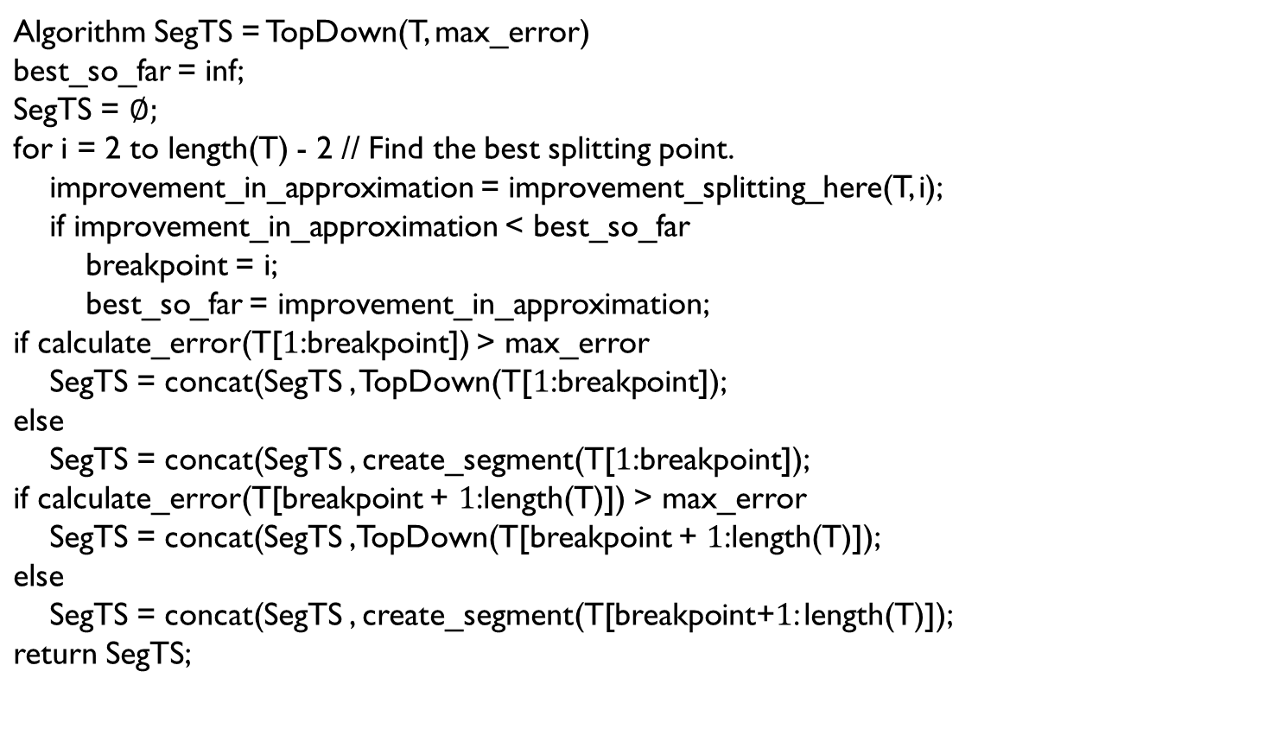
Top-Down Segmentation
Algorithm SegTS = TopDown(T, max_error) best_so_far = inf; SegTS = $∅;$ for i = 2 to length(T) - 2 // Find the best splitting point. improvement_in_approximation = improvement_splitting_here(T, i); if improvement_in_approximation < best_so_far breakpoint = i; best_so_far = improvement_in_approximation; if calculate_error(T[$1$:breakpoint]) > max_error SegTS = concat(SegTS , TopDown(T[$1$:breakpoint]); else SegTS = concat(SegTS , create_segment(T[$1$:breakpoint]); if calculate_error(T[breakpoint + $1$:length(T)]) > max_error SegTS = concat(SegTS ,TopDown(T[breakpoint + $1$:length(T)]); else SegTS = concat(SegTS , create_segment(T[breakpoint+$1$: length(T)]); return SegTS;

Slide 10
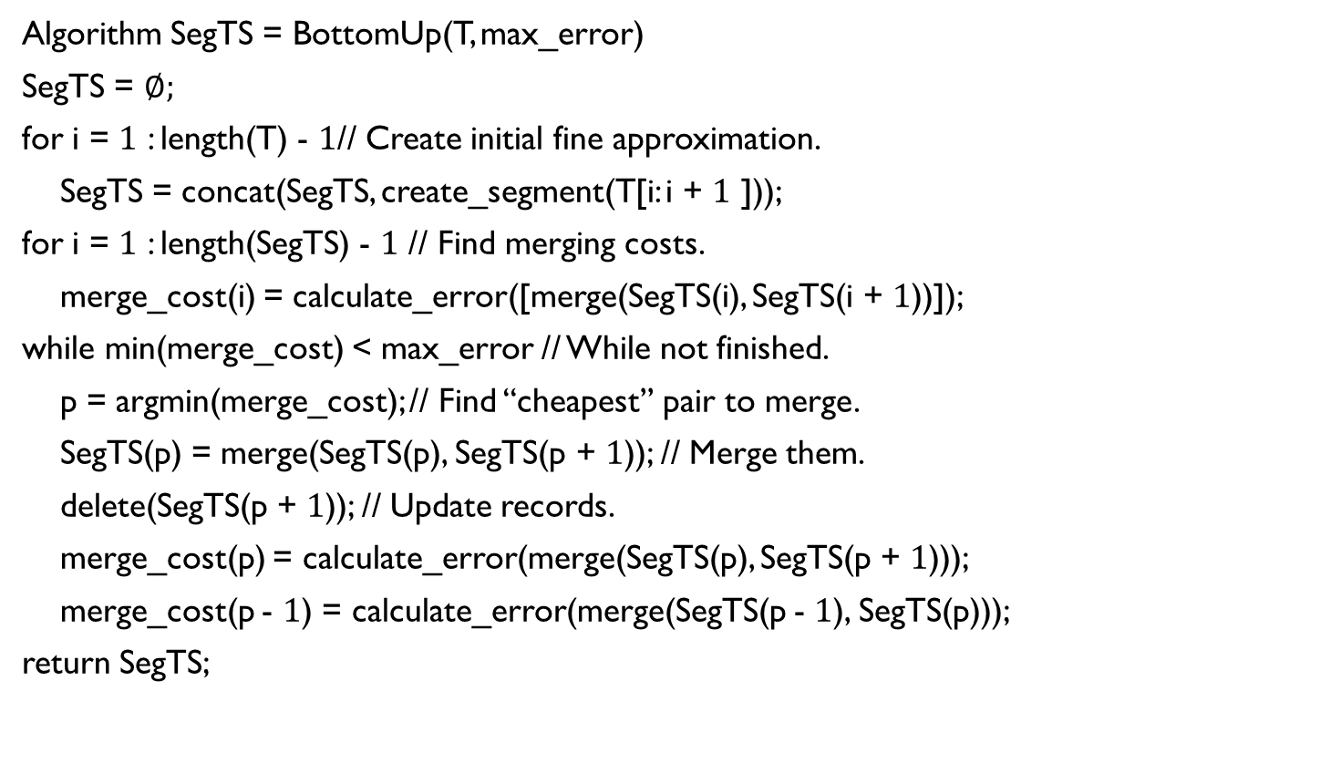
Bottom-up Segmentation
Algorithm SegTS = BottomUp(T, max_error)
SegTS = $∅;$
for i = $1$ : length(T) - $1$// Create initial fine approximation.
SegTS = concat(SegTS, create_segment(T[i: i + $1$ ]));
for i = $1$ : length(SegTS) - $1$ // Find merging costs.
merge_cost(i) = calculate_error([merge(SegTS(i), SegTS(i + $1$))]);
while min(merge_cost) < max_error // While not finished.
p = argmin(merge_cost); // Find ‘‘cheapest’’ pair to merge.
SegTS(p) = merge(SegTS(p), SegTS(p + $1$)); // Merge them.
delete(SegTS(p + $1$)); // Update records.
merge_cost(p) = calculate_error(merge(SegTS(p), SegTS(p + $1$)));
merge_cost(p - $1$) = calculate_error(merge(SegTS(p - $1$), SegTS(p)));
return SegTS;

Slide 11
Forecasting[2]
Given a query time series t, forecast the next certain number of data points of t.
Subjective
subjective basis using judgment, intuition, commercial knowledge and any other relevant information
Univariate
based on a model fitted only to present and past observations of a given time series
Multivariate
depend at least partly on values of one or more additional series

Slide 12

Univariate Forecasting
No trend and non-seasonal time series
simple exponential smoothing (SES)
$${\hat{x}}_{N}\left(1\right)=c_{0}x_{N}+c_{1}x_{N−1}+c_{2}x_{N−2}+…$$
$$c_{i}=α{(1−α)}^{i}$$
Where forecasting value of $x_{N+h}$ is denoted by ${\hat{x}}_{N}\left(h\right)$
Recursive form
$${\hat{x}}_{N}\left(1\right)=αx_{N}+(1−α){\hat{x}}_{N−1}\left(1\right)$$
$${\hat{x}}_{0}\left(1\right)=x_{1}$$
When feasible?
$$X_{t}=μ+α\sum_{j<t}{Z_{j}}+Z_{t}$$
Where $Z_{t}$ is a pure stochastic process
Optimization of $α$:
0.1—0.3
Near to one
Square error sum & Gradient decent

Slide 13
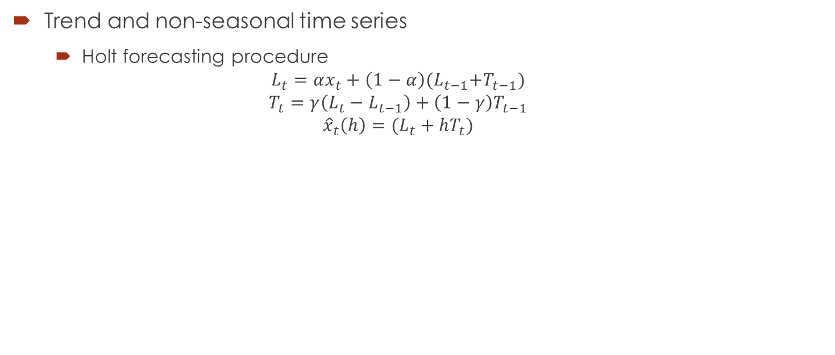
Univariate Forecasting
Trend and non-seasonal time series
Holt forecasting procedure
$$L_{t}=αx_{t}+\left(1−α\right){(L}_{t−1}+T_{t−1})$$
$$T_{t}=γ\left(L_{t}−L_{t−1}\right)+\left(1−γ\right)T_{t−1}$$
$${\hat{x}}_{t}\left(h\right)=(L_{t}+hT_{t})$$

Slide 14
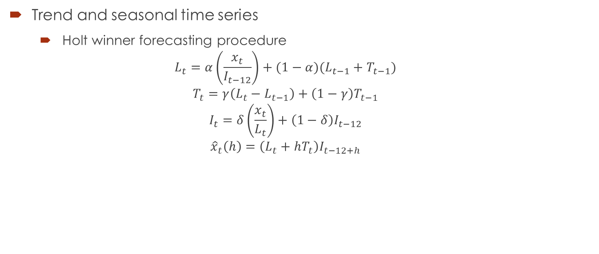
Univariate Forecasting
Trend and seasonal time series
Holt winner forecasting procedure
$$L_{t}=α\left(\frac{x_{t}}{I_{t−12}}\right)+(1−α)(L_{t−1}+T_{t−1})$$
$$T_{t}=γ\left(L_{t}−L_{t−1}\right)+\left(1−γ\right)T_{t−1}$$
$$I_{t}=δ\left(\frac{x_{t}}{L_{t}}\right)+\left(1−δ\right)I_{t−12}$$
$${\hat{x}}_{t}\left(h\right)=\left(L_{t}+hT_{t}\right)I_{t−12+h}$$

Slide 15
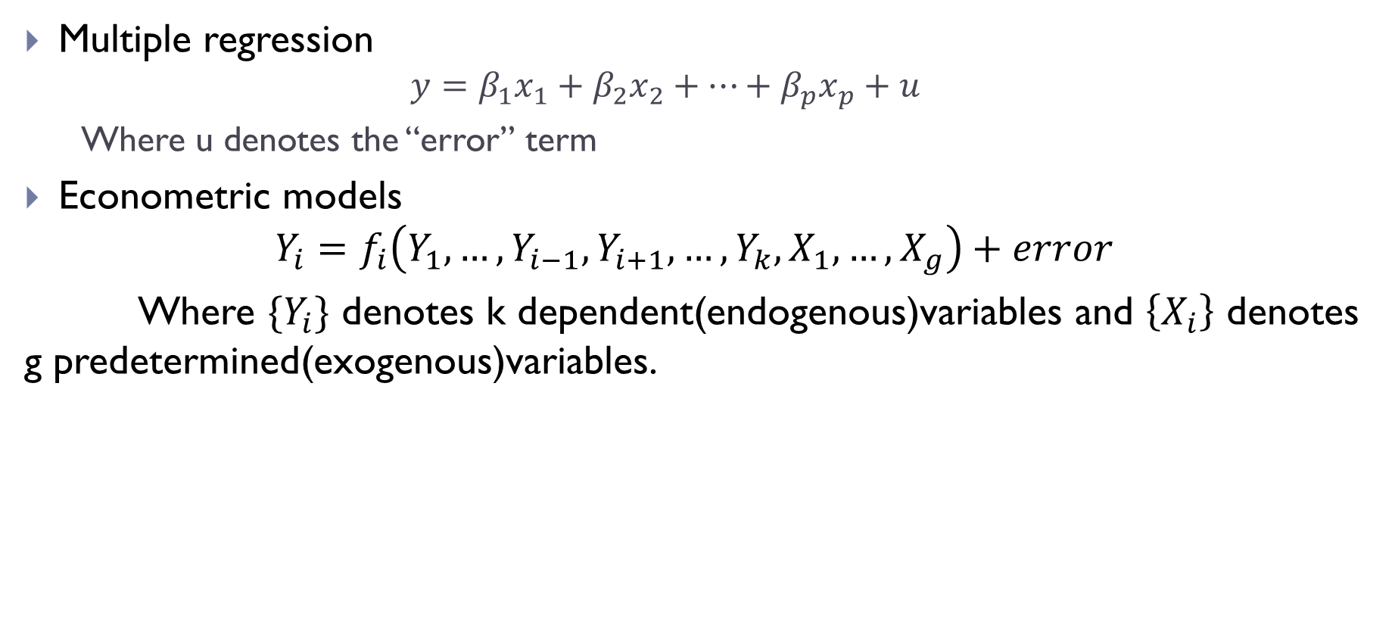
Multivariate Forecasting
Multiple regression
$$y=β_{1}x_{1}+β_{2}x_{2}+…+β_{p}x_{p}+u$$
Where u denotes the “error” term
Econometric models
$$Y_{i}=f_{i}\left(Y_{1},…,Y_{i−1},Y_{i+1},…,Y_{k},X_{1},…,X_{g}\right)+error$$
Where $\{Y_{i}\}$ denotes k dependent(endogenous)variables and $\left\{X_{i}\right\}$ denotes g predetermined(exogenous)variables.

Slide 16
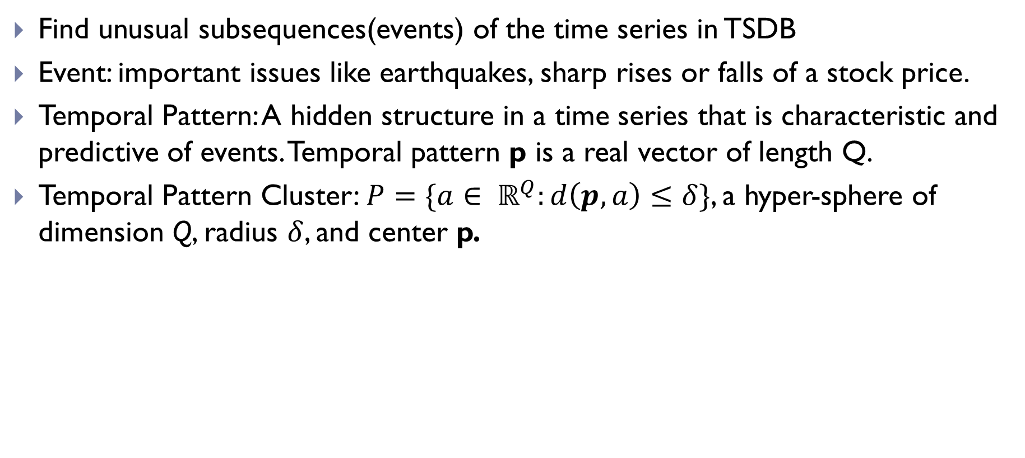
Prediction
Find unusual subsequences(events) of the time series in TSDB
Event: important issues like earthquakes, sharp rises or falls of a stock price.
Temporal Pattern: A hidden structure in a time series that is characteristic and predictive of events. Temporal pattern p is a real vector of length Q.
Temporal Pattern Cluster: $P=\{a∈ ℝ^{Q}:d\left(p,a\right)≤δ\}$, a hyper-sphere of dimension Q, radius $δ$, and center p.

Slide 17
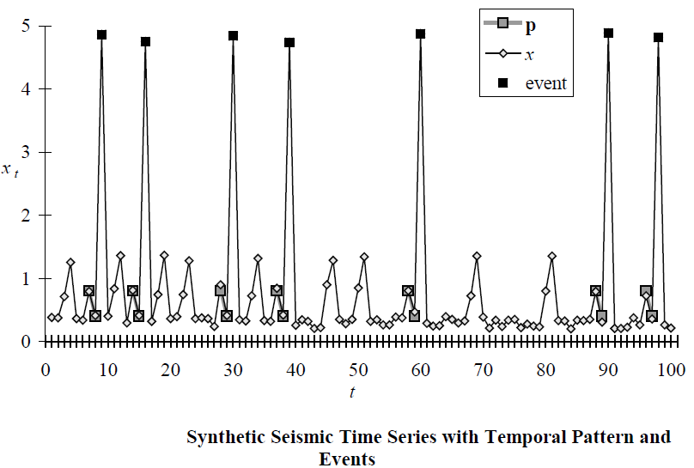
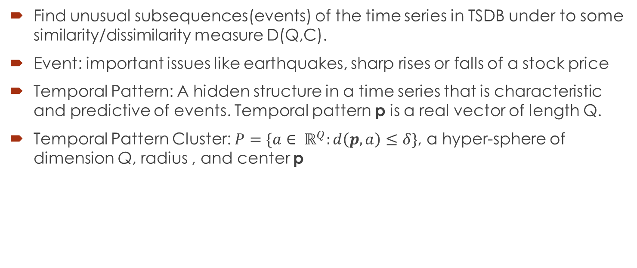
Prediction
Find unusual subsequences(events) of the time series in TSDB under to some similarity/dissimilarity measure D(Q,C).
Event: important issues like earthquakes, sharp rises or falls of a stock price
Temporal Pattern: A hidden structure in a time series that is characteristic and predictive of events. Temporal pattern p is a real vector of length Q.
Temporal Pattern Cluster: $P=\{a∈ ℝ^{Q}:d\left(p,a\right)≤δ\}$, a hyper-sphere of dimension Q, radius , and center p

Slide 18
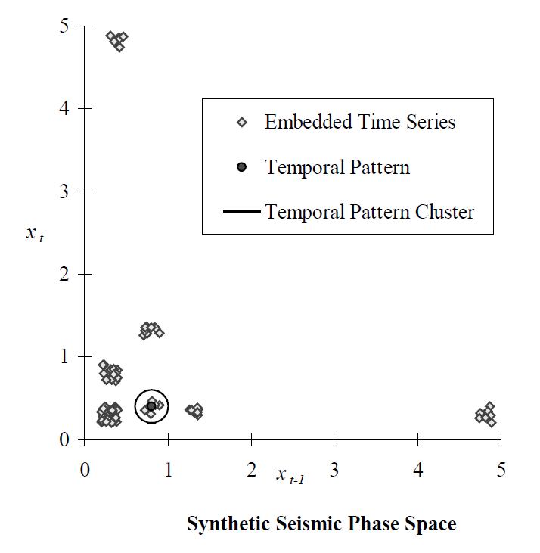

Time Delay Embedding[3]
Time-Delay Embedding: $x_{t}=(x_{t−\left(Q−1\right)τ},…,x_{t−2τ},x_{t−τ}, x_{t})$

Slide 19
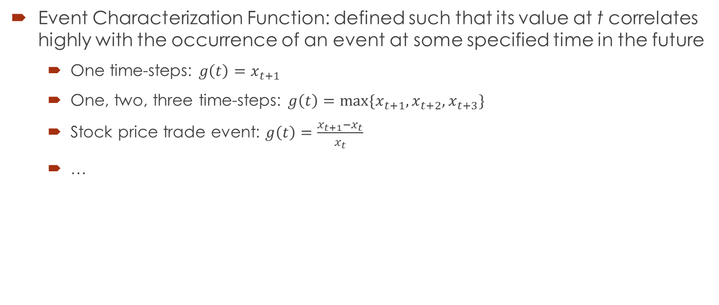
Event Characterization
Event Characterization Function: defined such that its value at t correlates highly with the occurrence of an event at some specified time in the future
One time-steps: $g\left(t\right)=x_{t+1}$
One, two, three time-steps: $g\left(t\right)=max⁡\{x_{t+1}, x_{t+2}, x_{t+3}\}$
Stock price trade event: $g\left(t\right)=\frac{x_{t+1}−x_{t}}{x_{t}}$
…

Slide 20
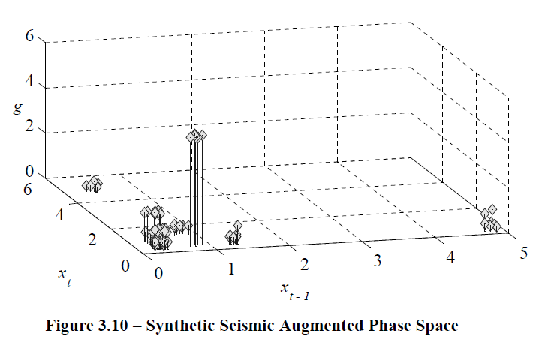
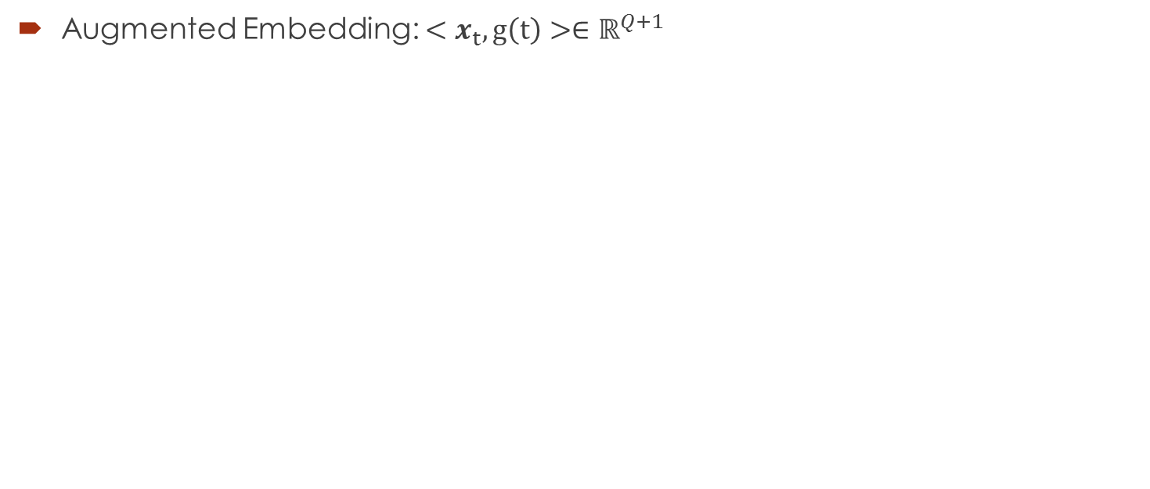
Augmented Embedding
Augmented Embedding: $<x_{t}, g\left(t\right)>∈ℝ^{Q+1}$

Slide 21
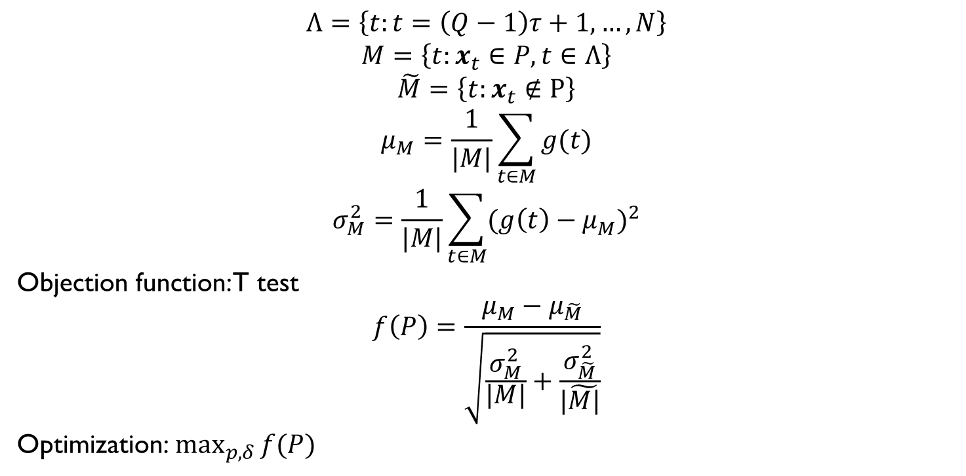
Object Function & Optimization
$$Λ=\left\{t:t=\left(Q−1\right)τ+1,…,N\right\}$$
$$M=\left\{t:x_{t}∈P, t∈Λ\right\}$$
$$\tilde{M}=\left\{t:x_{t}∉P\right\}$$
$$μ_{M}=\frac{1}{|M|}\sum_{t∈M}{g(t)}$$
$$σ_{M}^{2}=\frac{1}{|M|}\sum_{t∈M}{{(g\left(t\right)−μ_{M}^{})}^{2}}$$
Objection function: T test
$$f\left(P\right)=\frac{μ_{M}−μ_{\tilde{M}}}{\sqrt{\frac{σ_{M}^{2}}{|M|}+\frac{σ_{\tilde{M}}^{2}}{|\tilde{M|}}}}$$
Optimization:$\max_{p,δ}{f(P)}$

Slide 22
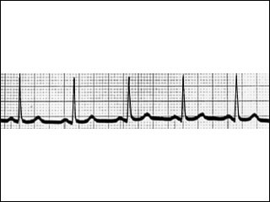
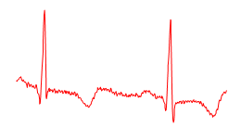
Query by Content
Given a query time series Q, and some similarity measure D(Q,C), find the nearest matching time series in database DB.
Motivating applications: keyword-based search in handwritten documents, DNA and protein matching, query-by-humming.
Full Sequence Matching
Subsequence Matching

Slide 23
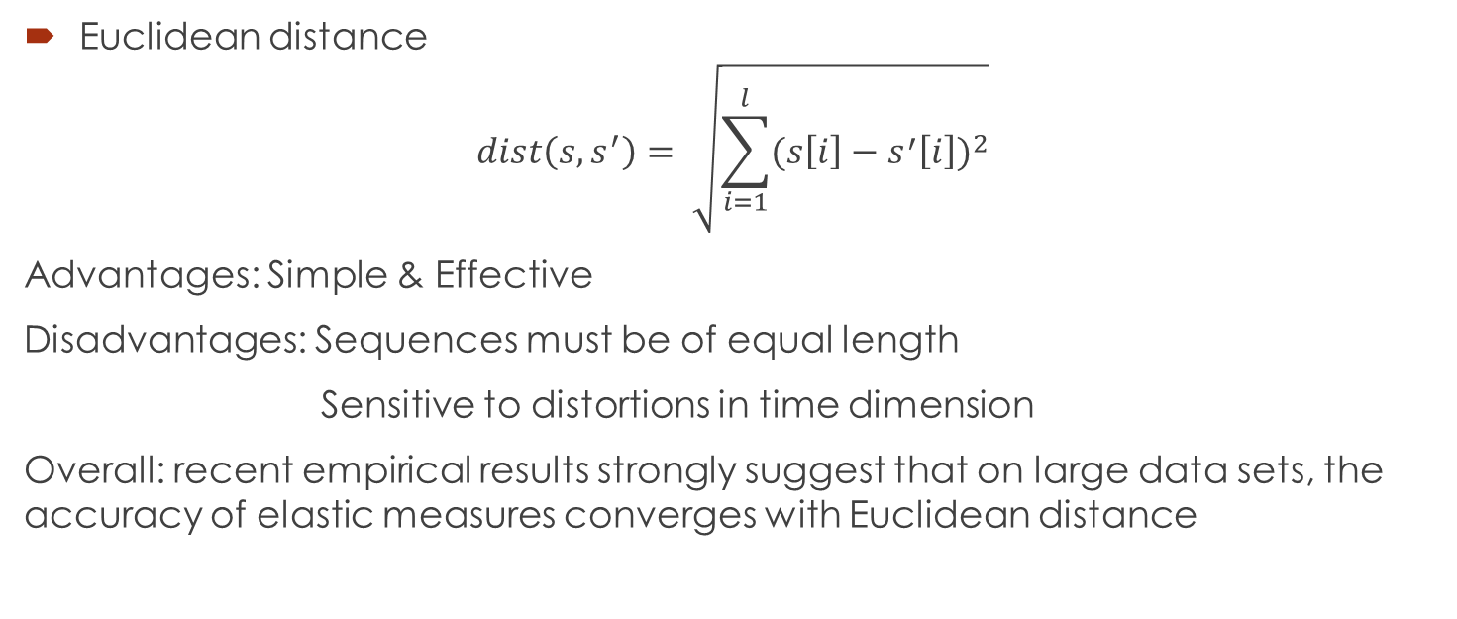
Full Sequence Matching
Euclidean distance
$$dist\left(s,s^{′}\right)= \sqrt{\sum_{i=1}^{l}{{(s\left[i\right]−s^{′}\left[i\right])}^{2}}}$$
Advantages: Simple & Effective
Disadvantages: Sequences must be of equal length
Sensitive to distortions in time dimension
Overall: recent empirical results strongly suggest that on large data sets, the accuracy of elastic measures converges with Euclidean distance

Slide 24
Full Sequence Matching
Dynamic Time Warping(DTW) algorithm[Kruskal and Liberman 1983]
int DTWDistance(s: array [1..n], t: array [1..m])
{
DTW := array [0..n, 0..m]
for i := 1 to m
DTW[0, i] := infinity
for i := 1 to n
DTW[i, 0] := infinity
DTW[0, 0] := 0
for i := 1 to n
for j := 1 to m
cost:= d(s[i], t[j])
DTW[i, j] := cost + minimum(DTW[i-1, j ], // insertion
DTW[i , j-1], // deletion
DTW[i-1, j-1]) // match
return DTW[n, m]
}

Slide 25
Subsequence Matching[4]
concatenating all data base sequence into one long one X？
Q:
TCTAGGGCA
…ACTTAGCTGTAGTCGTTCTATGGCATATGCATGCCATG…

Slide 26
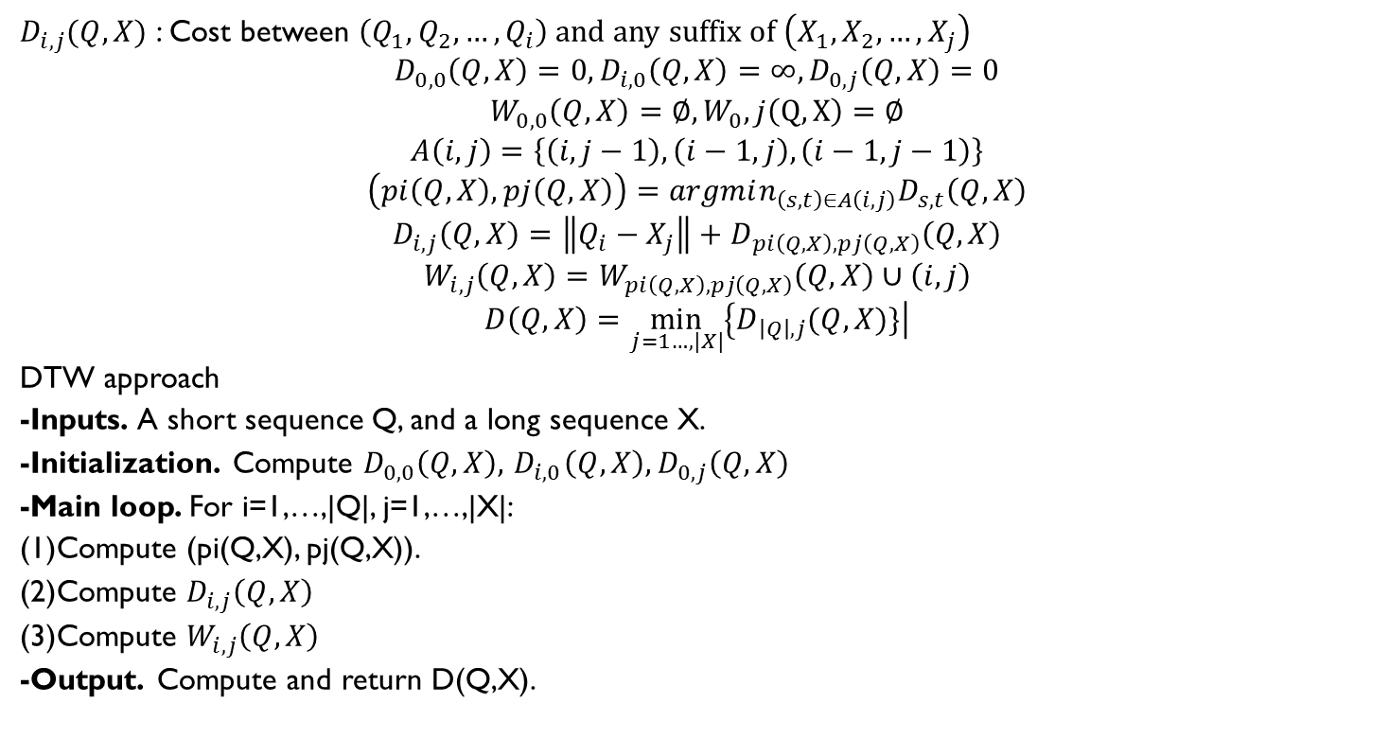
Subsequence Matching
$D_{i,j}(Q,X)$ : Cost between $\left(Q_{1},Q_{2},…,Q_{i}\right)$ and any suffix of $\left(X_{1}, X_{2},…,X_{j}\right)$
$$D_{0,0}\left(Q,X\right)=0, D_{i,0}\left(Q,X\right)=∞, D_{0,j}\left(Q, X\right)=0$$
$$W_{0,0}\left(Q,X\right)=∅, W_{0},j\left(Q,X\right)=∅$$
$$A\left(i,j\right)=\left\{\left(i,j−1\right),\left(i−1,j\right),\left(i−1,j−1\right)\right\}$$
$$\left(pi\left(Q,X\right),pj\left(Q,X\right)\right)=argmin_{\left(s,t\right)∈A\left(i,j\right)}D_{s,t}\left(Q,X\right)$$
$$D_{i,j}\left(Q,X\right)=\left\|Q_{i}−X_{j}\right\|+D_{pi\left(Q,X\right),pj\left(Q,X\right)}\left(Q,X\right)$$
$$W_{i,j}\left(Q,X\right)=W_{pi\left(Q,X\right),pj\left(Q,X\right)}\left(Q,X\right)∪\left(i,j\right)$$
$$D\left(Q,X\right)=\min_{j=1…,|X|}\left\{D_{\left|Q\right|,j}(Q,X)\}\right|$$
DTW approach
-Inputs. A short sequence Q, and a long sequence X.
-Initialization. Compute $D_{0,0}\left(Q,X\right),{ D}_{i,0}\left(Q,X\right), D_{0,j}\left(Q, X\right)$
-Main loop. For i=1,…,|Q|, j=1,…,|X|:
(1)Compute (pi(Q,X), pj(Q,X)).
(2)Compute $D_{i,j}\left(Q,X\right)$
(3)Compute $W_{i,j}\left(Q,X\right)$
-Output. Compute and return D(Q,X).
O(|Q||X|)

Slide 27
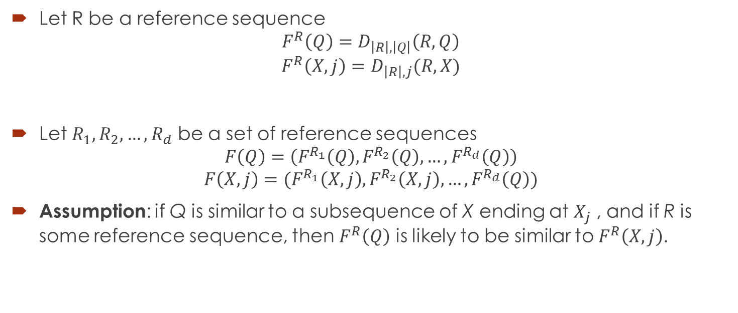
Subsequence Matching
Let R be a reference sequence
$$F^{R}\left(Q\right)=D_{\left|R\right|,\left|Q\right|}\left(R,Q\right)$$
$$F^{R}\left(X,j\right)=D_{\left|R\right|,j}(R,X)$$
Let $R_{1},R_{2},…,R_{d}$ be a set of reference sequences
$$F\left(Q\right)=\left(F^{R_{1}}\left(Q\right), F^{R_{2}}\left(Q\right),…,F^{R_{d}}\left(Q\right)\right)$$
$$F\left(X,j\right)=(F^{R_{1}}\left(X,j\right),F^{R_{2}}\left(X,j\right),…,F^{R_{d}}\left(Q\right))$$
Assumption: if Q is similar to a subsequence of X ending at $X_{j}$ , and if R is some reference sequence, then $F^{R}\left(Q\right)$ is likely to be similar to $F^{R}\left(X,j\right)$.

Slide 28
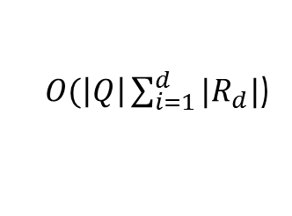
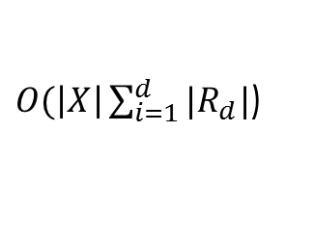
Subsequence Matching
Offline step:
Compute F(X, j) for all j.
Online steps, given a query Q:
Embedding step:
Compute F(Q).
Filter step:
Compare F(Q) to all F(X, j).
Select p best matches → p candidate endpoints.
Refine step:
Use DTW to evaluate each candidate endpoint.
$O(\left|X\right|\sum_{i=1}^{d}{|R_{d}|}$)
$O(\left|Q\right|\sum_{i=1}^{d}{|R_{d}|}$)

Slide 29
Subsequence Matching
Optimization
Filter step: sampling values of Distance(F(Q), F(X,j)) for all j
Refine step: Max length limited to 2|Q|
Reference sequences selection
Details omitted
Faloutsos C, Ranganathan M, Manolopoulos Y. Fast subsequence matching in time-series databases[M]. ACM, 1994.
Find Subsequence with equal length of query sequence

Slide 30
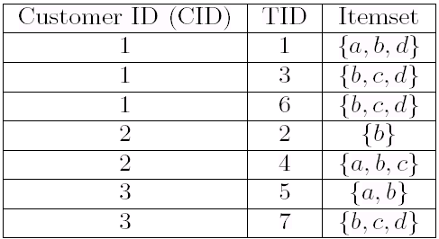
Frequent subsequence mining[6]
Sequence
representation
S= ({a}, {b, c}) is a sequence
The support of S is Sup_{D}(S)
Frequent sequential pattern:
Sup_{D}(S) >= Min Support
Sup_{D}(S) = Sup_{D} ({a}, {b, c} ) = 2

Slide 31
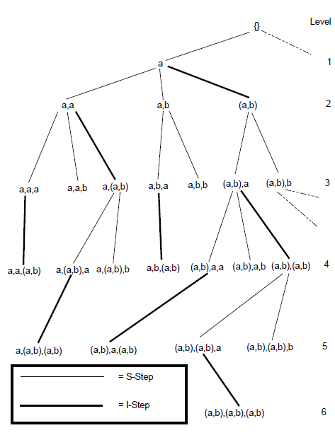
Sequence Tree
S = ({a, b, c}, {a, b})
Sequence-extended sequence
S’=({a,b,c},{a,b},{d})
Item-extended sequence
S’=({a,b,c},{a,b,d}

Slide 32
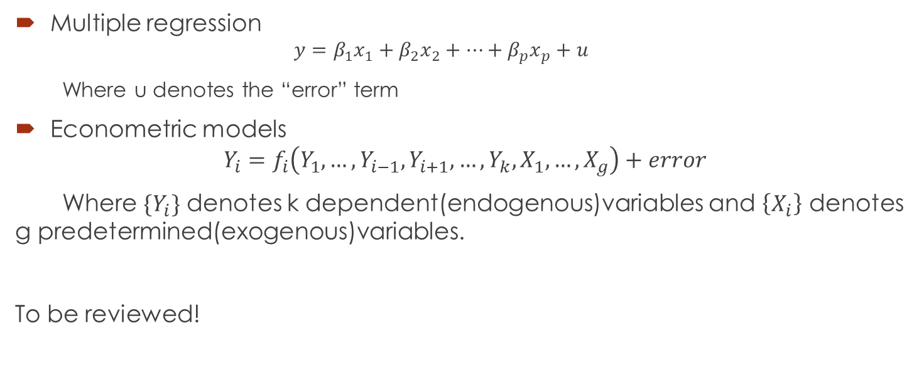
S-step pruning
Sequence s and its S-Extended sequence $s_{a}=(s,\left\{i_{j}\right\})$ and $s_{b}=\left(s,\left\{i_{k}\right\}\right)$
$s_{a}$ is frequent and $s_{b}$ is not frequent➔$\left(s,\left\{i_{j}\right\},\left\{i_{k}\right\}\right)and \left(s,\left\{i_{j}, i_{k}\right\}\right)$ is not frequent
Remove $i_{k}$ from $S_{s_{a}} and I_{s_{a}}$

Slide 33
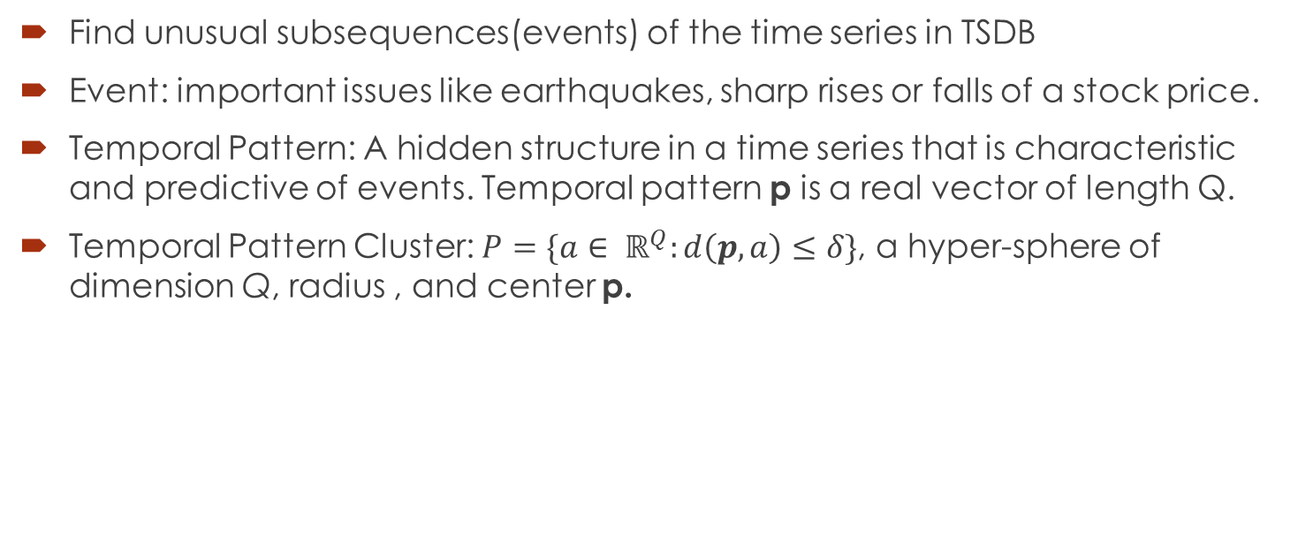
S-step Pruning Example
Node ({a}), $S_{(\left\{a\right\})}=\left\{a,b,c,d\right\},I_{(\left\{a\right\})}=\{b,c,d\}$
S-Extended:$\left(\left\{a\right\},\left\{a\right\}\right),\left(\left\{a\right\},\left\{b\right\}\right),\left(\left\{a\right\},\left\{c\right\}\right),\left(\left\{a\right\},\left\{d\right\}\right)$
$\left(\left\{a\right\},\left\{c\right\}\right)and \left(\left\{a\right\},\left\{d\right\}\right)are infrequent$→
$$\left(\left\{a\right\},\left\{a\right\},\left\{c\right\}\right),\left(\left\{a\right\},\left\{b\right\},\left\{c\right\}\right),\left(\left\{a\right\},\left\{a,c\right\}\right),(\left\{a\right\},\left\{b,c\right\}),\left(\left\{a\right\},\left\{a\right\},\left\{d\right\}\right),\left(\left\{a\right\},\left\{b\right\},\left\{d\right\}\right),$$
$$\left(\left\{a\right\},\left\{a,d\right\}\right),\left(\left\{a\right\},\left\{b,d\right\}\right)are infrequent$$
$$S\left(\left\{a\right\},\left\{a\right\}\right)=S\left(\left\{a\right\},\left\{b\right\}\right)=\left\{a,b,c,d\right\}−\left\{c,d\right\}=\left\{a,b\right\}$$
$$I\left(\left\{a\right\},\left\{a\right\}\right)=\left\{b,c,d\right\}−\left\{c,d\right\}=\left\{b\right\}$$
$$I\left(\left\{a\right\},\left\{b\right\}\right)=\left\{b,c,d\right\}−\left\{b\right\}−\left\{c,d\right\}=∅$$

Slide 34
I-step pruning
Sequence $s=\left(s^{′},\left\{i_{1},…,i_{n}\right\}\right)$
I-Extended sequence $s_{a}=\left(s′,\left\{i_{1},…,i_{n},i_{j}\right\}\right) and s_{b}=(s^{′},\left\{i_{1},…,i_{n},i_{k}\right\})$, $i_{j}<i_{k}$
$s_{a}$ is frequent and $s_{b}$ is not frequent➔$\left(s′,\left\{i_{1},…,i_{n},i_{j},i_{k}\right\}\right)$ is not frequent
Remove $i_{k}$ from $I_{s_{a}}$
$(s,\left\{i_{l}\right\})$ is infrequent →$\left(s_{a},\left\{i_{l}\right\}\right)$ is infrequent
Remove the same itemset from $S_{s_{a}}$ in S-step pruning

Slide 35
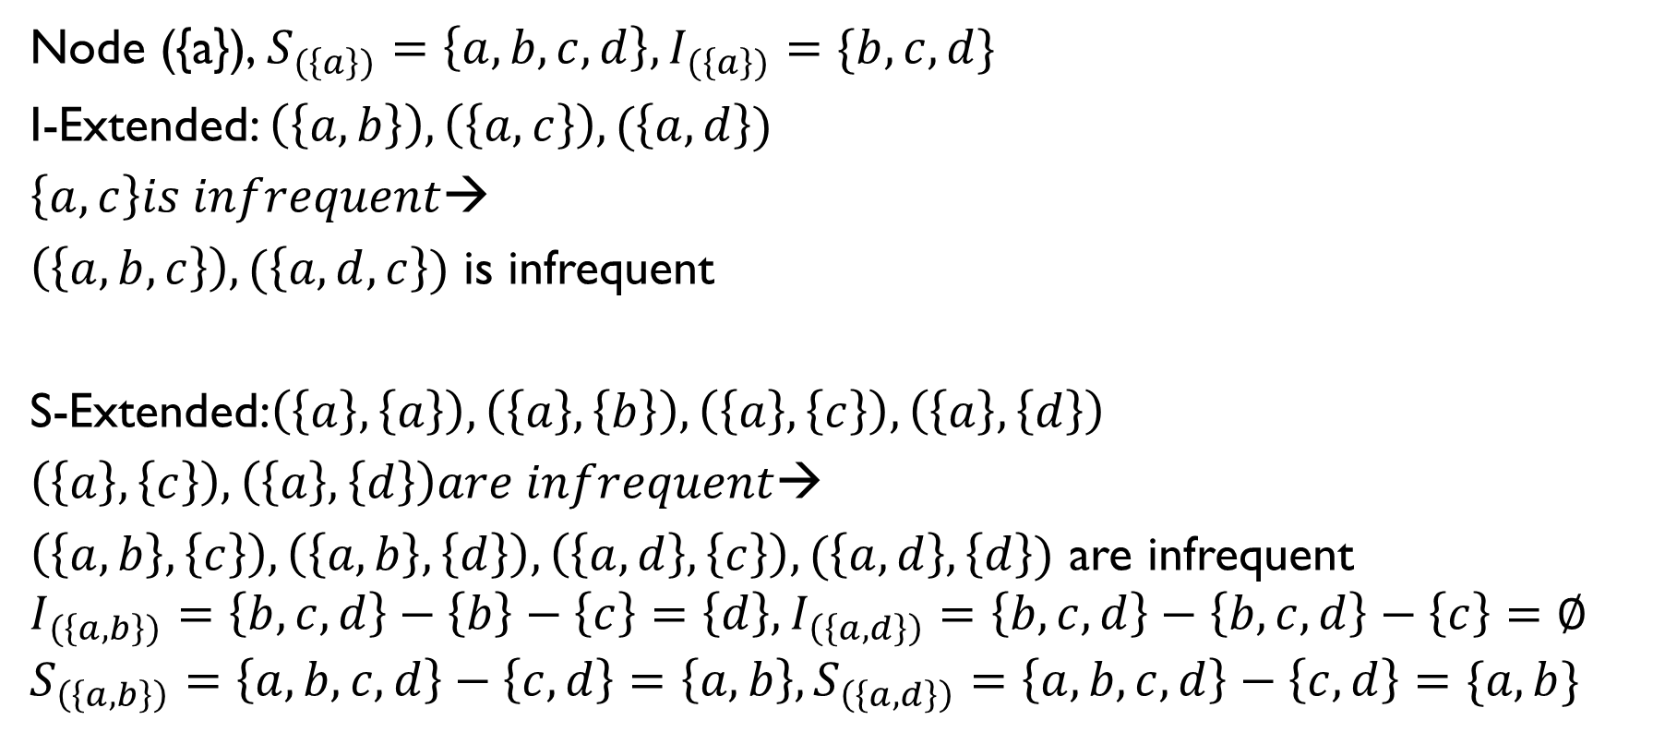
I-step Pruning Example
Node ({a}), $S_{(\left\{a\right\})}=\left\{a,b,c,d\right\},I_{(\left\{a\right\})}=\{b,c,d\}$
I-Extended: $\left(\left\{a,b\right\}\right),\left(\left\{a,c\right\}\right),(\left\{a,d\right\})$
$\left\{a,c\right\}is infrequent$→
$\left(\left\{a,b,c\right\}\right),(\left\{a,d,c\right\})$ is infrequent
S-Extended:$\left(\left\{a\right\},\left\{a\right\}\right),\left(\left\{a\right\},\left\{b\right\}\right),\left(\left\{a\right\},\left\{c\right\}\right),\left(\left\{a\right\},\left\{d\right\}\right)$
$\left(\left\{a\right\},\left\{c\right\}\right),\left(\left\{a\right\},\left\{d\right\}\right)are infrequent$→
$\left(\left\{a,b\right\},\left\{c\right\}\right),\left(\left\{a,b\right\},\left\{d\right\}\right),\left(\left\{a,d\right\},\left\{c\right\}\right),(\left\{a,d\right\},\left\{d\right\})$ are infrequent
$$I_{(\left\{a,b\right\})}=\left\{b,c,d\right\}−\left\{b\right\}−\left\{c\right\}=\left\{d\right\},I_{\left(\left\{a,d\right\}\right)}=\left\{b,c,d\right\}−\left\{b,c,d\right\}−\left\{c\right\}=∅$$
$$S_{\left(\left\{a,b\right\}\right)}=\left\{a,b,c,d\right\}−\left\{c,d\right\}=\left\{a,b\right\},S_{\left(\left\{a,d\right\}\right)}=\left\{a,b,c,d\right\}−\left\{c,d\right\}=\{a,b\}$$

Slide 36
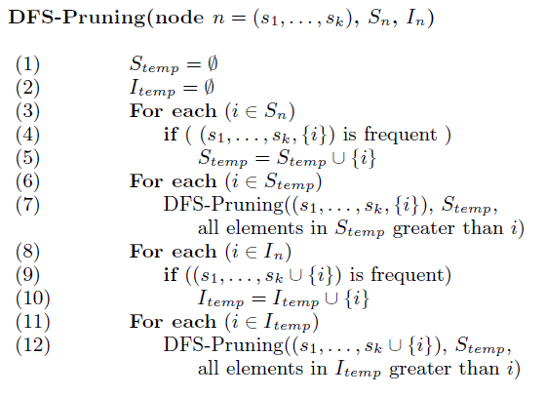
DFS-Pruning Algorithm
DFS-Pruning Algorithm

Slide 37
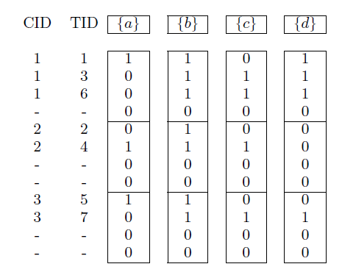

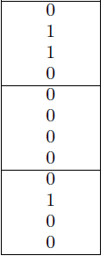
How to count frequency？
Sequence bitmap, last item set indicator

Slide 38
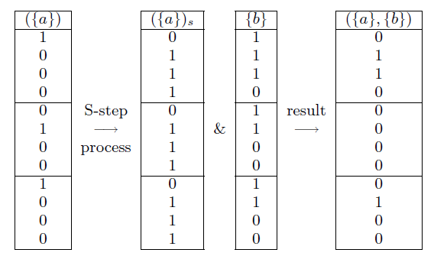
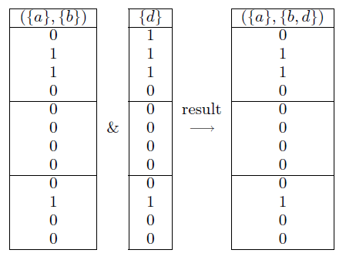
Bitmap Counting
S-Process I-Process

Slide 39
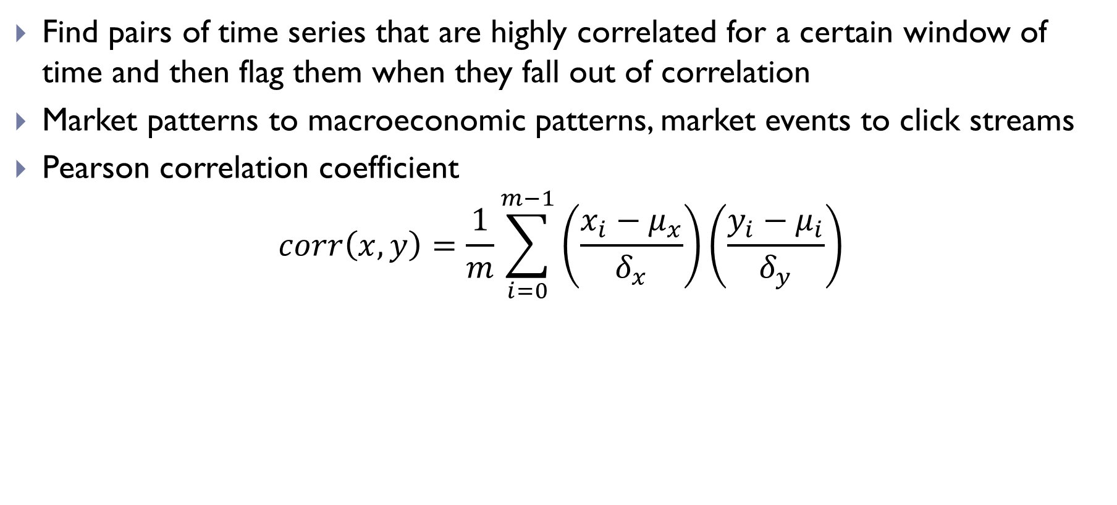
Correlation Detection
Find pairs of time series that are highly correlated for a certain window of time and then flag them when they fall out of correlation
Market patterns to macroeconomic patterns, market events to click streams
Pearson correlation coefficient
$$corr\left(x,y\right)=\frac{1}{m}\sum_{i=0}^{m−1}{\left(\frac{x_{i}−μ_{x}}{δ_{x}}\right)\left(\frac{y_{i}−μ_{i}}{δ_{y}}\right)}$$

Slide 40
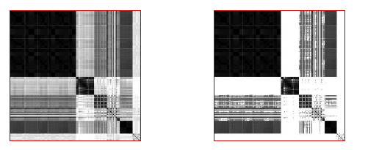
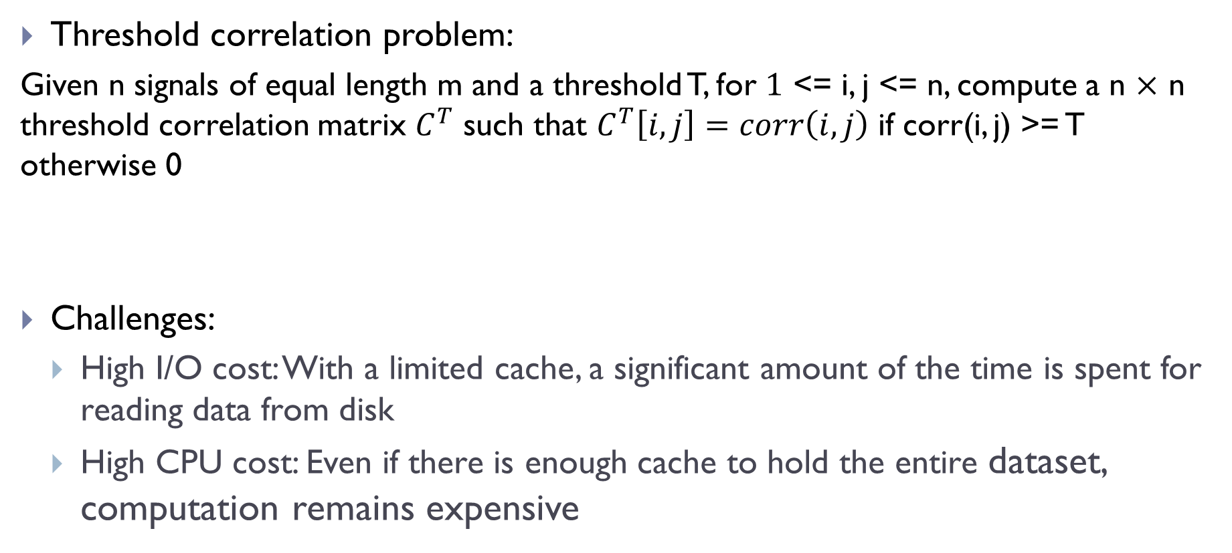
All Pair Correlation Detection[8]
Threshold correlation problem:
Given n signals of equal length m and a threshold T, for $1$ <= i, j <= n, compute a n $×$ n threshold correlation matrix $C^{T}$ such that $C^{T}\left[i,j\right]=corr\left(i,j\right)$ if corr(i, j) >= T otherwise 0
Challenges:
High I/O cost: With a limited cache, a significant amount of the time is spent for reading data from disk
High CPU cost: Even if there is enough cache to hold the entire dataset, computation remains expensive

Slide 41
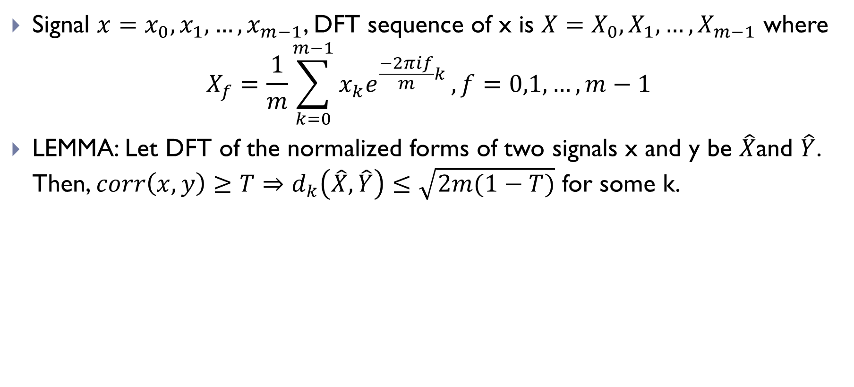
IO Optimizations-Definition
Signal $x=x_{0},x_{1},…,x_{m−1}$, DFT sequence of x is $X=X_{0},X_{1},…,X_{m−1}$ where
$$X_{f}=\frac{1}{m}\sum_{k=0}^{m−1}{x_{k}e^{\frac{−2πif}{m}k}}, f=0,1,…,m−1$$
LEMMA: Let DFT of the normalized forms of two signals x and y be $\hat{X}$and $\hat{Y}$. Then, $corr\left(x,y\right)≥T⇒d_{k}\left(\hat{X},\hat{Y}\right)≤\sqrt{2m(1−T)}$ for some k.

Slide 42
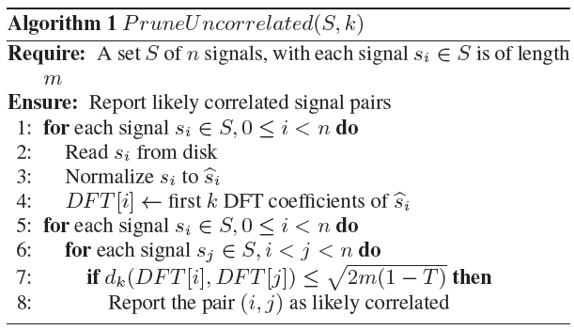
IO Optimizations-DFT Pruning
k = 5 is sufficient thus all DFT[i] could be held in memory.

Slide 43
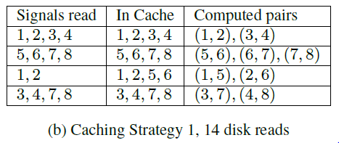
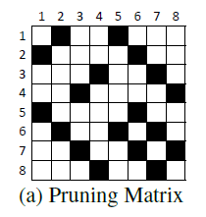
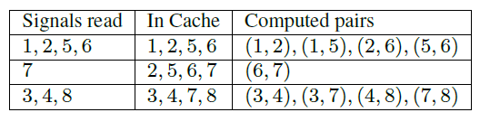
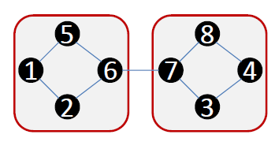

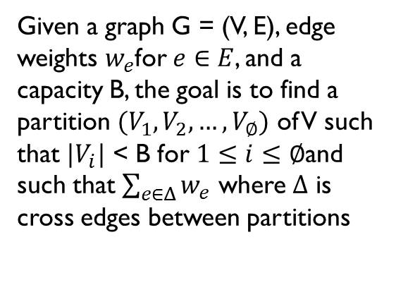
IO Optimizations-Cache Strategy
Given a graph G = (V, E), edge weights $w_{e}$for $e∈E$, and a capacity B, the goal is to find a partition $(V_{1},V_{2},…,V_{∅})$ of V such that $|V_{i}|$ < B for $1≤i≤∅$and such that $\sum_{e∈Δ}{w_{e}}$ where $Δ$ is cross edges between partitions

Slide 44


Computation Optimization
Approximate Algorithms
$corr\left(i,j\right)−ε≤corr^{ε}\left(i,j\right)≤corr\left(i,j\right)+ε$

Slide 45
Associate Rules
Rule: pattern → pattern (support level, confidence level)
R1 : 80% of customers who bought diaper also bought beer (diaper →beer (20%, 80%))
R2 : When the prices of IBM and SUN go up, 80% of time the price of Microsoft goes up (on the same day)
R3 : If the prices of IBM and SUN go up, Microsoft's will most likely (80% of time) go up the next day

Slide 46
Rule Categories
Intra-transaction association rules: associations among items within the same transaction record such as R1 and R2
Inter-transaction association rules: association among items from different transaction records such as R3

Slide 47
Algorithms
Intra-transaction association rules
Apriori algorithm[9]
FP-growth algorithm[10]
Inter-transaction association rules
E-Apriori and EH-Apriori[11]

Slide 48

Motif Discovery[5]
Detection of previously unknown, frequently occurring patterns.

Slide 49


Motif Definition
Match & Trivial Match
Match: Given a positive real number R (called range) and a time series T containing a subsequence C beginning at position p and a subsequence M beginning at q, if D(C, M) ≤ R, then M is called a matching subsequence of C

Slide 50

Motif Definition
Given length n and range R
$1$-motif
the subsequence $C_{1}$that has the highest count of non-trivial matches
K-motif
$K^{th}$ significant subsequence $C_{k}$ and satisfy $D\left(C_{k},C_{i}\right)>2R$ for all i < k

Slide 51

Motif Definition
Given length n and range R
$1$-motif
the subsequence $C_{1}$that has the highest count of non-trivial matches
K-motif
$K^{th}$ significant subsequence $C_{k}$ and satisfy $D\left(C_{k},C_{i}\right)>2R$ for all i < k

Slide 52


Brute Force 1-motif Detection
$O\left(m^{2}\right)$ search space! m=len(T)

Slide 53





Optimization
Dimensionality Reduction & Discretization

Slide 54
Optimization
Searching a set of smaller matrices, whose total size is much less than the naïve O(m²) matrix.
Within the smaller matrices, using ADM to prune away a large fraction of the search space
D(Q,Cª) ≤ D(Q,C^{b}) + D(Cª,C^{b})

Slide 55
Clustering[12]
Find natural groupings of the time series in database DB under some similarity/dissimilarity measure D(Q,C).
Three time series clustering approaches:
raw-data-based
feature-based
model-based
General clustering methods
K-means
Hierarchical clustering
Neural networks
Similarity/distance measures
L p distance
Pearson’s correlation
Short time series distance
Dynamic time warping distance
Kullback–Liebler distance
Probability-based distance

Slide 56
Classification[7]
Given an unlabeled time series Q, assign it to one of two or more predefined classes
Three time series clustering approaches:
feature-based
sequence distance based
model-based

Slide 57
Feature Based Classification
Discrete symbolic:
k-gram based
pattern-based (define pattern criterion)
feature mining
Real value:
Time series shapelets[13]
Classifier:
Naive Bayes
SVM
Neural networks

Slide 58
Sequence Distance Based Classification
Similarity measure
Euclidean distance
DTW/Fast DTW
Alignment based distances for symbolic sequences
Global alignment: Needleman-Wunsch Algorithm
Local alignment: Smith-Waterman Algorithm, BLAST, BLAT
Classifiers:
KNN
SVM with particular kernels

Slide 59
Model Based Classification
Assumption: sequences in a class are generated by an underlying model M. Given a class of sequences, M models the probability distribution of the sequences in the class.
General process
Training step: Learn parameters for model M
classification step: Assign a new sequence to the class with the highest likelihood.
Generative models:
Naive Bayes
k-order Markov
Profile HMM

Slide 60
References
[1]Data Mining in Time Series Data base, Mark Last
[2]The Analysis of Time Series An Introduction, Chris Chatfield
[3] Time Series Data Mining: Identifying Temporal Patterns for Characterization and Prediction of Time Series Events, Richard J. Povinelli
[4] Papapetrou P, Athitsos V, Potamias M, et al. Embedding-based subsequence matching in time-series databases[J]. ACM Transactions on Database Systems (TODS), 2011, 36(3): 17
[5] Lonardi J L E K S, Patel P. Finding motifs in time series[C]//Proc. of the 2nd Workshop on Temporal Data Mining. 2002: 53-68.
[6] J. Ayres, J. Flannick, J. Gehrke, and T. Yiu, “Sequential pattern mining using a bitmap representation,” in KDD, 2002
[7] Xing Z, Pei J, Keogh E. A brief survey on sequence classification[J]. ACM SIGKDD Explorations Newsletter, 2010, 12(1): 40-48.
[8] Mueen A, Nath S, Liu J. Fast approximate correlation for massive time-series data[C]//Proceedings of the 2010 international conference on Management of data. ACM, 2010: 171-182.

Slide 61
References
[9]:R. Agrawal, R. Srikant, “Fast algorithms for mining association rules”. In: J.Bocca, M.Jarke, C.Zaniolo eds. Proc. of the 20th Int’l Conf on Very Large DataBases (VLDB’94). Santiago: Morgan Kaufmann, 1994. pp. 487-499
[10]: J. Han, J. Pei, Y. Yin, “Mining frequent patterns without candidate generation”. In: M. Dunham, J. Naughton, W. Chen eds. Proc. of 2000 ACM-SIGMOD Int’l Conf on Management of Data (SIGMOD’00). Dallas, TX, New York: ACM Press, 2000. pp. 1-12
[11]:H. Lu, J. Han, and L. Feng, “Stock movement and n-dimensional inter-transaction association rules”. In Proc. of the SIGMOD Workshop on Research Issues on Data Mining and Knowledge Discovery, 1998.
[12] Warren Liao T. Clustering of time series data—a survey[J]. Pattern Recognition, 2005, 38(11): 1857-1874.
[13] Ye L, Keogh E. Time series shapelets: a new primitive for data mining[C]//Proceedings of the 15th ACM SIGKDD international conference on Knowledge discovery and data mining. ACM, 2009: 947-956.

Slide 62
Above materials and slides: https://github.com/zixiaojindao/time-series-survey.git
Thanks!

