Slide 1
Vietnam Korea University of Information and Communication Technology
Faculty of digital economy and e-commerce
Teacher : Nguyen Thi Kieu Trang

Slide 2










SPOIL TEAM:MEMBER

Slide 3
Business Model Canvas
Automatic refrigerator with voice control

Slide 4
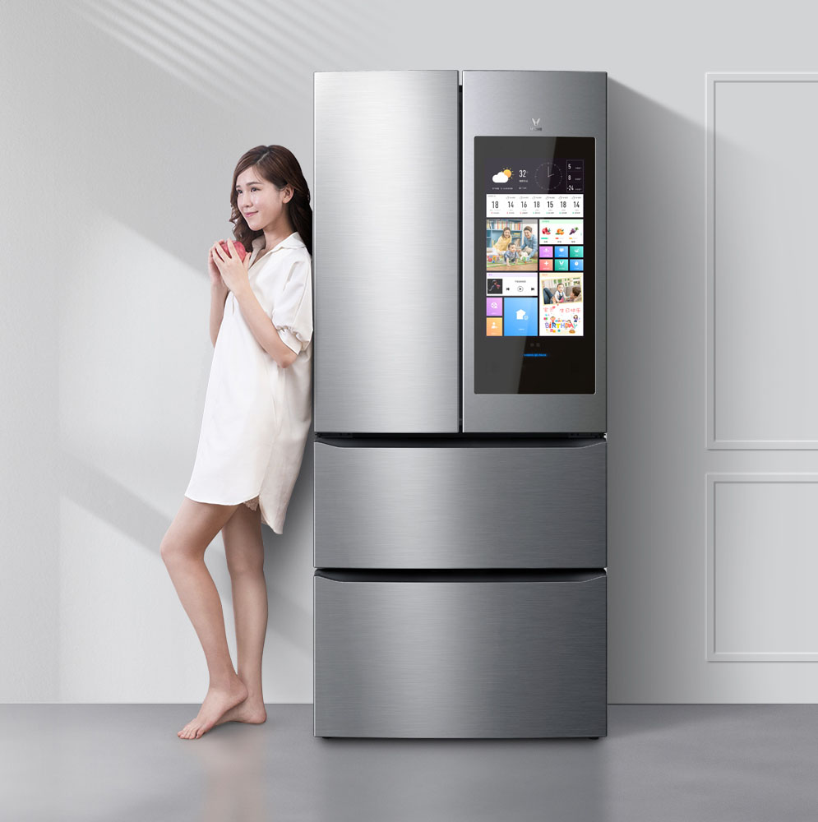

Introduce about the ideas
Voice control smart refrigerator:
-Refrigerator with an external touch screen like a smartphone, users can ask the refrigerator to answer questions, tell you the weather information and even play a music or an audiobook… without touching the refrigerator.

Slide 5
CONTENT
01
02
03
04
Customer Segments
05
Revenue Streams
02
Value proposition
Key Resources
06
Key activities
Channels
07
Customer Relationships
08
Key partnerships
08
09
Cost Structure

Slide 6
Customer Segments
01

Slide 7
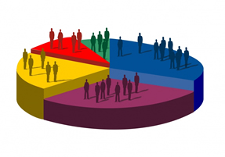
—Someone Famous
Basically, the product is aimed at low- to middle-class customers as well as upper-class people who have a good lifestyle and luxury in their personal lives.

Slide 8
02
Value proposition

Slide 9
Value Proportions
Value Proportions
We have diferences services for each customer segment
Package 1 for ordinary customers For VIP customers
We bring convenience and smart experience like never before to our customers.We solve the problem of losing time while waiting for customers to find their food.

Slide 10
Channels
03

Slide 11

Channels
Channels
Distribution channel:
+Direct channel: Manufacturers sell directly to consumers through manufacturers' stores,website, ecommerce (official store)
+Indirect channel:: reseller, supermarket, grocery, e-commerce
+Communication:run ads on TV, radio, speakers, internet, facebook, telesale

Slide 12
04
Customers Relationship

Slide 13
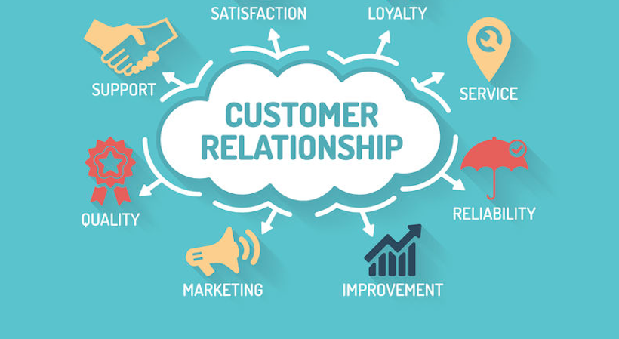
Customer Relationship
Customer Relationship
+Long-term +Personal Assistance +Dedicated Personal assistance +Automatic Services + 24/7 help via phone

Slide 14
05
Revenue Streams

Slide 15

Revenue Streams
Revenue Streams
+Registration
If you want to use smart products, you need to register through the app once a year, the registration price is not too expensive
+Sell product
+Advertisement
when customers visit to shop for food on the refrigerator allows other companies to list their products for sale

Slide 16
06.Key resources

Slide 17
Key Resources
Key Resources
_ Supporters and investors - the company's relationship with major investors _ Awards - nominations that help promote the company's products to a global audience
_ App / Website - the main channel to provide information about refrigerators
_ Platform - an analytics and holistic system for customer delivery and personalization
Staff - general staff plus technical staff who maintain and develop the platform.

Slide 18
Key activities
07

Slide 19

Key Activities
Key Activities
Sales and marketing
_ Technology R&D - As technology is constantly changing, the company needs to continuously invest and innovate its technology system.
_ Producing proprietary technology - Producing products and technologies that other companies' products do not have.
_ Delivery of goods - optimize the transportation of goods globally.
_ Customer care - survey the user's experience after the sale to improve the product and give the customer the best experience

Slide 20
08
Key partnerships

Slide 21
Key Partnerships
Key Partners _ Transport and logistics partner _ Agency: link together to create quality advertising clips, campaigns for the company. Create great buzz about the brand. _ Ground partner, construction design, engineering
_ The investors
_ Payment service partner and installment support: Payment via ATM card, Visa, Mastercard. Optimize forms for customers. Link with Home Credit, FE Credit. To have an installment program for customers.

Slide 22

09.Cost Structure

Slide 23

Cost Structure
Cost Structure
_ Cost of capital
_ Research and development
_ Sales administration expenses
_ Financial expenses
_ Management of Enterprise expenses
_ Tax expenses
_ Marketing
_ The infrastructure
_ Staff

Slide 24
THANKS FOR WATCHING

