Slide 1

Alzheimer’s -
A Neglected Epidemic
By No.61 Robin

Slide 2
Vocabulary
Sinewy
Amorous
Proxy

Slide 3
Vocabulary
Hedonism
Prophylactic
Regimen

Slide 4
Vocabulary
Antiretroviral
Prudish
Harangue

Slide 5
Vocabulary
Ideological
Abate
Ageism

Slide 6
Vocabulary
Defy
Invidiousness

Slide 7
Before the main content start,
Let me first introduce you a short background story !

Slide 8

Once upon a time…
AIDS (Acquired Immune
Deficiency Syndrome)
used to be one of the
most devil king that
tortured many people in
New York City

Slide 9
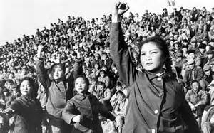

But one day…
Here comes the hero –
Mr.Kramer & some people launched
one of the most successful fight in the
history against AIDS !

Slide 10

Finally…
About 30 years ago , AIDS was the first time
Fell out of the 10 leading diseases causes of death in NY !!!

Slide 11

However…
Unfortunately, the war hasn’t gone to an end
What has replaced the AIDS until now is :

Slide 12
So , what really is
the Alzheimer’s?

Slide 13
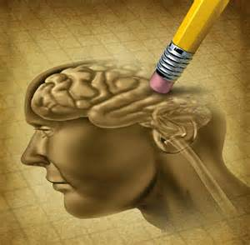
Alzheimer’s – Introduction
the most common form of dementia
It is often diagnosed in people over 65 years of age
Alzheimer’s had claimed
636000 lives in NY in a
single year
There is no cure for the
disease !

Slide 14
Alzheimer’s – the Challenge
About 30 years ago , Mr.Kramer successfully eliminate AIDS out of the top 10 list
In early 20th century , Mayor Michael R fight against infant mortality
Bloomberg’s campaign against smoking
However , there’s few social movement analogous profile of Alzheimer’s

Slide 15

Alzheimer’s – the Challenge
Campaigns against AIDS fight for the community consists of the gays
-> relatively minor (<5000)
Campaigns aginst
Alzheimer’s fight for all
the old people in the world
-> Too Large !!!

Slide 16
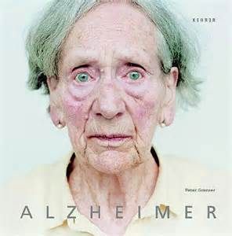
Alzheimer’s – the Challenge
Another barrier will be our distorted views on aging
-> Ageism
Also , cultural reckoning
should be responsible for
this problem
-> Ex : the Normal Heart

Slide 17
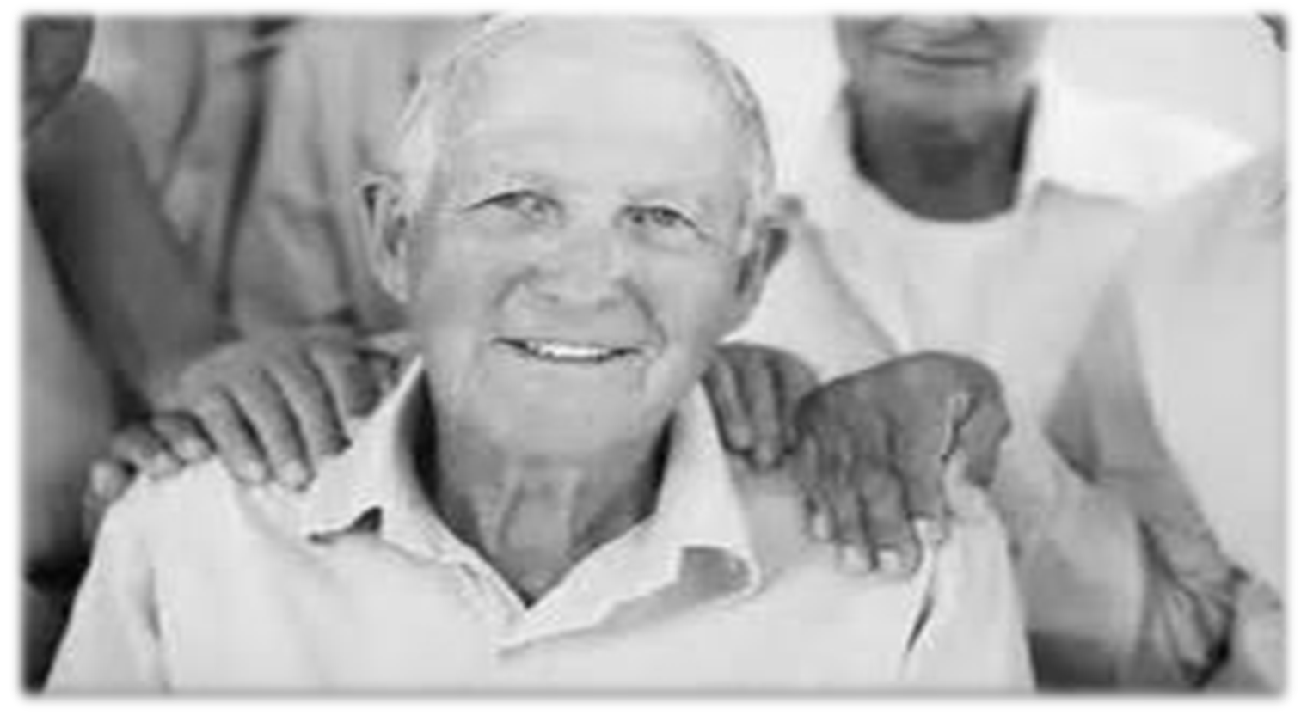
Alzheimer’s – Conclusion
No matter how many challenges that fighting against the Alzheimer’s will encounter , we can never deny that this issue will absolutely one day become one of the toughest problems of human civilization !!!

Slide 18
Discussion
Is there anyone whose friends or families has problem with the Alzheimer’s?
How should our society take action to face the upcoming challenge brings by Alzheimer’s ?

