Slide 1
Chapter 14
Citric Acid Cycle and Glyoxylate Cycle
Copyright © 2013 Pearson Canada Inc.
14 - <number>

Slide 2
Chapter 14 Outline:
Overview of Pyruvate Oxidation and the Citric Acid Cycle
Pyruvate Oxidation: A Major Entry Route for Carbon into the Citric Acid Cycle
Coenzymes Involved in Pyruvate Oxidation and the Citric Acid Cycle
Action of the Pyruvate Dehydrogenase Complex
The Citric Acid Cycle
Stoichiometry and Energetics of the Citric Acid Cycle
Regulation of Pyruvate Dehydrogenase and the Citric Acid Cycle
Anaplerotic Sequences: The Need to Replace Cycle Intermediates
Glyoxylate Cycle: An Anabolic Variant of the Citric Acid Cycle
Copyright © 2013 Pearson Canada Inc.
14 - <number>

Slide 3
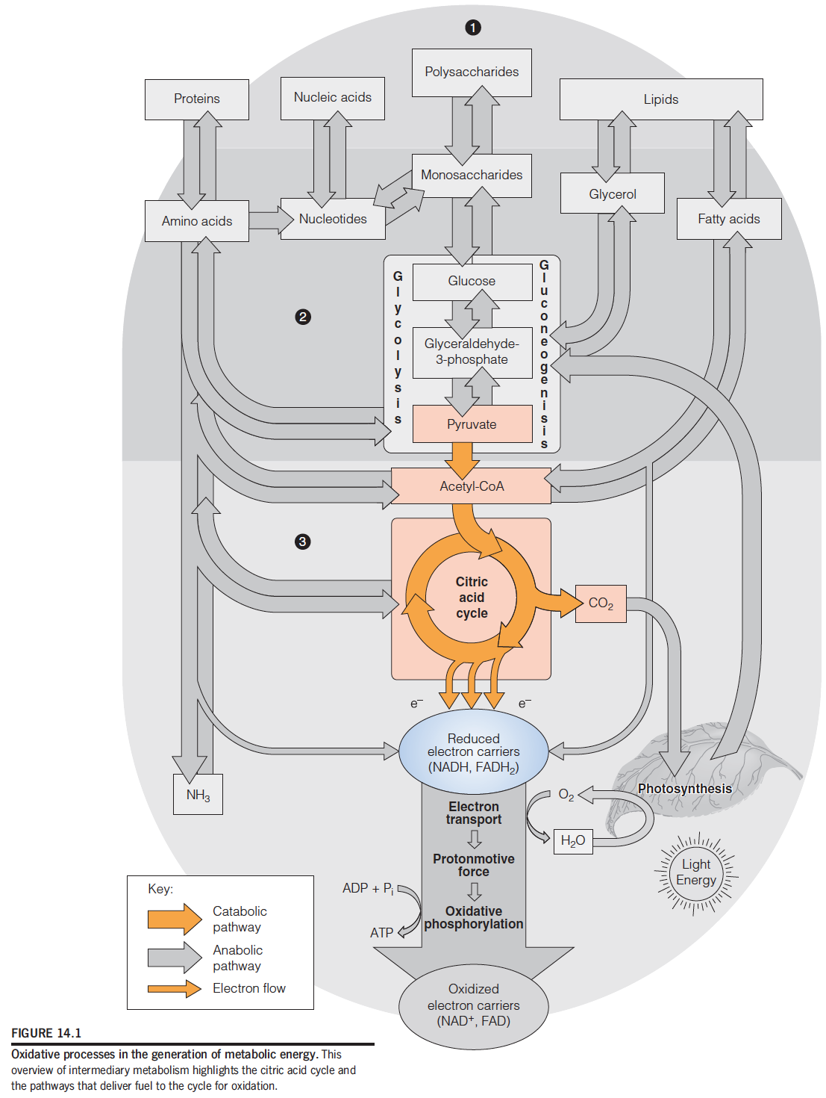
Overview of Pyruvate Oxidation and the Citric Acid Cycle
The citric acid cycle is the central oxidative pathway in respiration, the process by which all metabolic fuels—carbohydrate, lipid, and protein—are catabolized in aerobic organisms and tissues.
Most of the energy yield from substrate oxidation in the citric acid cycle comes from subsequent reoxidation of reduced electron carriers.
Copyright © 2013 Pearson Canada Inc.
14 - <number>

Slide 4
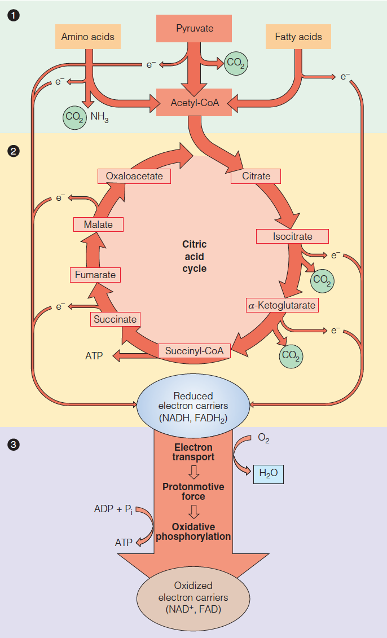
The three stages of respiration:
Stage 1 - carbon from metabolic fuels is incorporated into acetyl-CoA.
Stage 2 - the citric acid cycle oxidizes acetyl-CoA to produce CO₂, reduced electron carriers, and a small amount of ATP.
Stage 3 - the reduced electron carriers are reoxidized, providing energy for the synthesis of additional ATP.
Copyright © 2013 Pearson Canada Inc.
14 - <number>

Slide 5
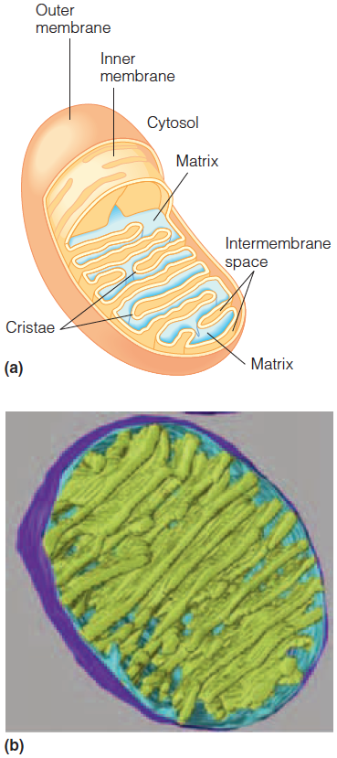
Overview of Pyruvate Oxidation and the Citric Acid Cycle
Schematic of a mitochondrion.
Computer model generated from electron tomograms of a mitochondrion.
Dehydrogenases catalyze substrate oxidations.
Oxidases catalyze the subset of oxidations in which O₂ is the direct electron acceptor.
Copyright © 2013 Pearson Canada Inc.
14 - <number>

Slide 6
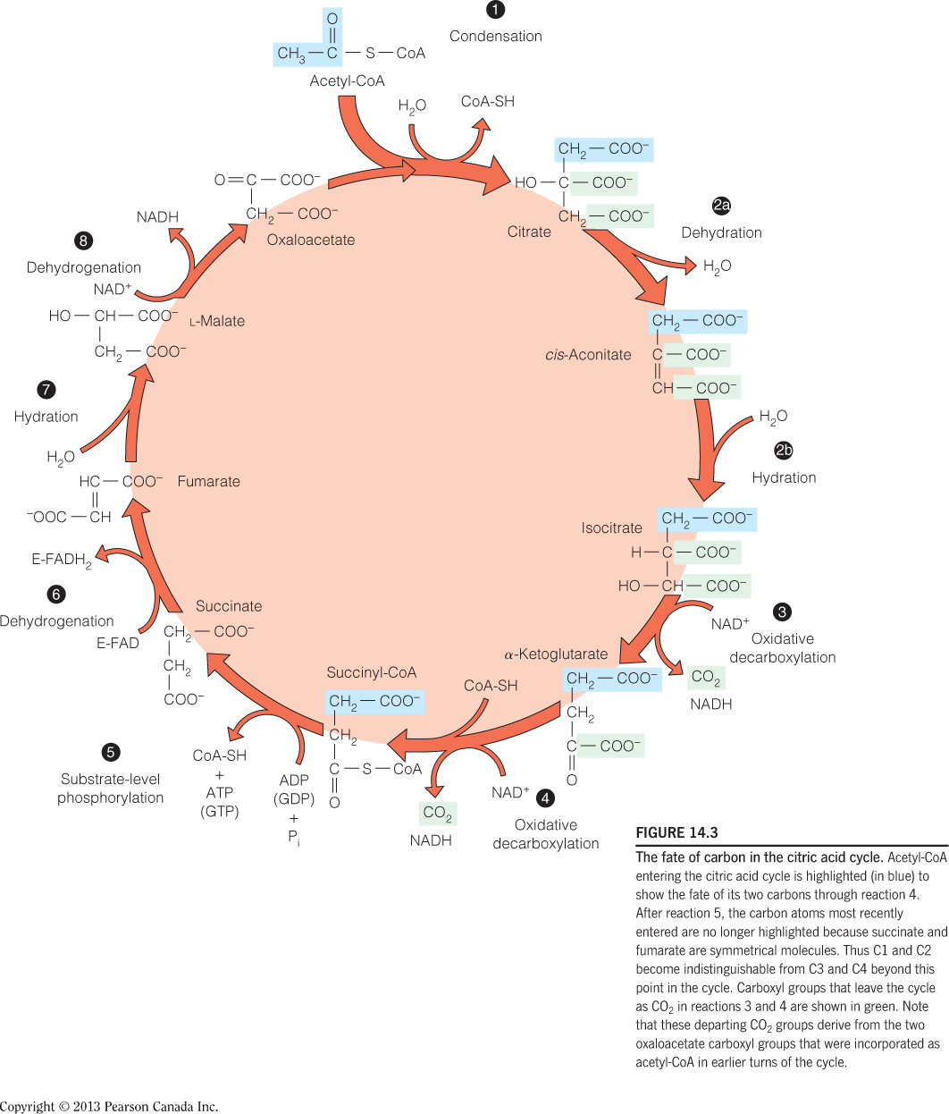
Overview of Pyruvate Oxidation and the Citric Acid Cycle
The fate of carbon in the citric acid cycle:
Note that these departing CO₂ groups derive from the two oxaloacetate carboxyl groups that were incorporated as acetyl-CoA in earlier turns of the cycle.
Copyright © 2013 Pearson Canada Inc.
14 - <number>

Slide 7
Copyright © 2013 Pearson Canada Inc.
1 - <number>

Slide 8
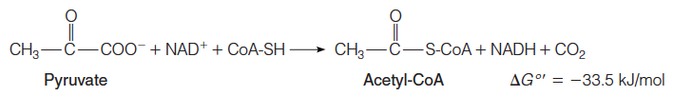
Pyruvate Oxidation: A Major Entry Route for Carbon into the Citric Acid Cycle
Pyruvate oxidation to acetyl-CoA is catalyzed by the pyruvate dehydrogenase complex (PDH complex).
It is an oxidative decarboxylation, which is virtually irreversible involving three enzymes and five coenzymes.
Copyright © 2013 Pearson Canada Inc.
14 - <number>

Slide 9
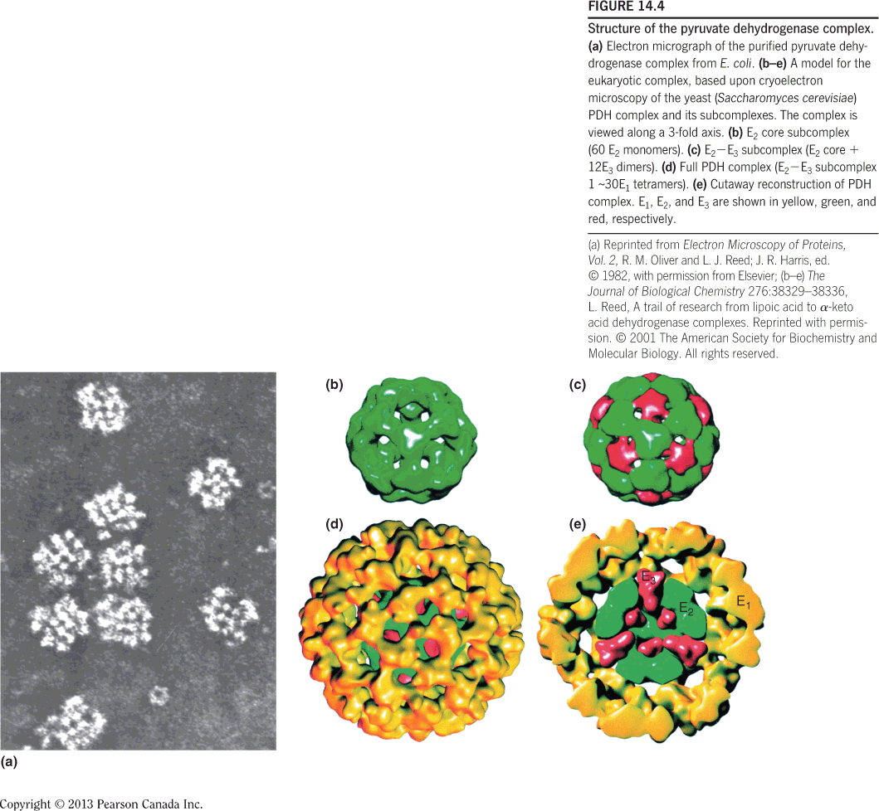
Pyruvate Oxidation: A Major Entry Route for Carbon into the Citric Acid Cycle
Structure of the pyruvate dehydrogenase complex:
Electron micrograph of the purified pyruvate dehydrogenasecomplex from E. coli.
E₂ core subcomplex (60 E₂ monomers).
E₂-E₃ subcomplex (E₂ core 12 E₃ dimers).
Full PDH complex (E₂-E₃ subcomplex 1 ~30 E₁ tetramers).
Cutaway reconstruction of PDH complex.
Copyright © 2013 Pearson Canada Inc.
14 - <number>

Slide 10
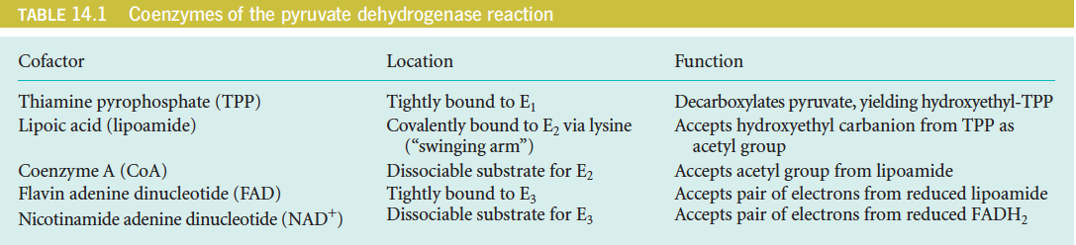
Pyruvate Oxidation: A Major Entry Route for Carbon into the Citric Acid Cycle
Copyright © 2013 Pearson Canada Inc.
14 - <number>

Slide 11
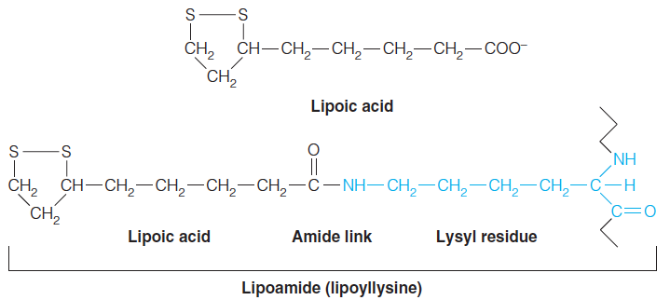
Coenzymes Involved in Pyruvate Oxidation and the Citric Acid Cycle
In pyruvate oxidation, the acceptor of the active aldehyde (hydroxyethyl group) generated by TPP is lipoic acid, which is the internal disulfide of 6,8-dithiooctanoic acid.
The coenzyme is joined to via an amide bond linking the carboxyl group of lipoic acid to a lysine ε-amino group. Thus, the reactive species is an amide, called lipoamide, or lipoyllysine.
Each lipoyllysine side chain is ~14Å long, and is located within a flexible lipoyl domain of E₂ (and E₃BP), allowing it to function as a “swinging arm” that can interact with the active sites of both the E₁ and E₃ components of the PDH complex.
Copyright © 2013 Pearson Canada Inc.
14 - <number>

Slide 12
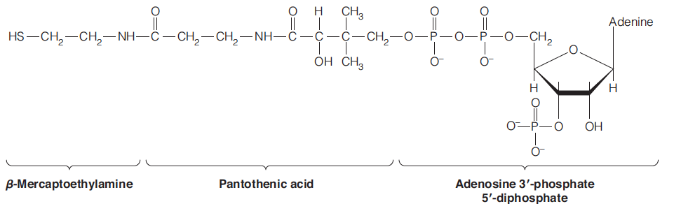
Coenzymes Involved in Pyruvate Oxidation and the Citric Acid Cycle
Coenzyme A (A for acyl) participates in activation of acyl groups in general, including the acetyl group derived from pyruvate.
The coenzyme is derived metabolically from ATP, the vitamin pantothenic acid, and β-mercaptoethylamine.
Copyright © 2013 Pearson Canada Inc.
14 - <number>

Slide 13
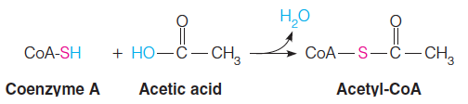
Coenzymes Involved in Pyruvate Oxidation and the Citric Acid Cycle
Thioesters such as acetyl-CoA are energy rich because thioesters are destabilized relative to ordinary oxygen esters.
Copyright © 2013 Pearson Canada Inc.
14 - <number>

Slide 14
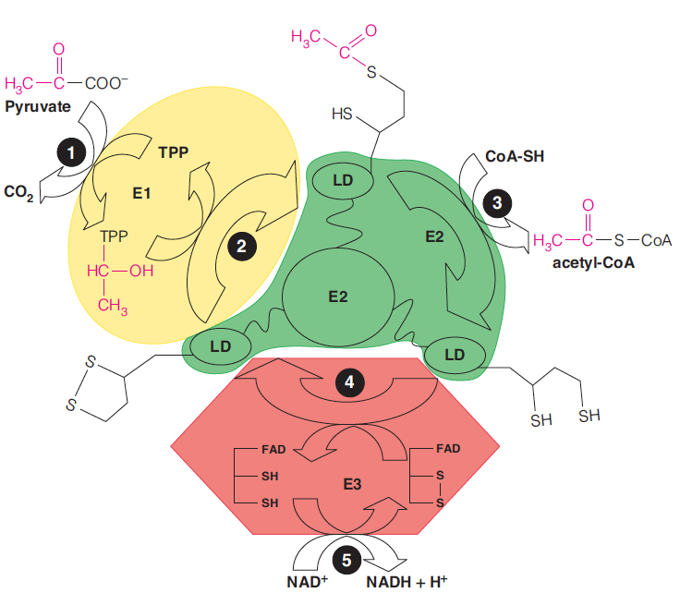
Action of the Pyruvate Dehydrogenase Complex
Mechanisms of the pyruvate dehydrogenase complex:
Substrate channeling
14 - <number>
Copyright © 2013 Pearson Canada Inc.

Slide 15
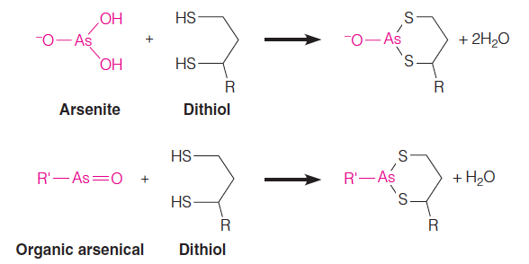
Action of the Pyruvate Dehydrogenase Complex
Arsenic poisoning, both intentional and unintentional, has had a long history, dating back to at least the eighth century.
Trivalent As(III) compounds such as arsenite and organic arsenicals react readily with thiols, and they are especially reactive with dithiols, such as dihydrolipoamide, forming bidentate adducts:
Copyright © 2013 Pearson Canada Inc.
14 - <number>

Slide 16
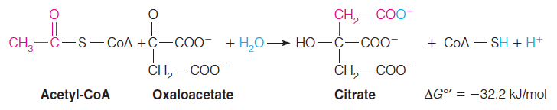
The Citric Acid Cycle
Step 1: Introduction of Two Carbon Atoms as Acetyl-CoA
The initial reaction, catalyzed by citrate synthase, is akin to an aldol condensation.
Copyright © 2013 Pearson Canada Inc.
14 - <number>

Slide 17
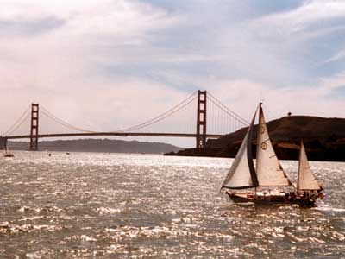
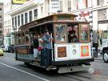

Citrate synthase, soda pop, and the world food supply
Soft drink
Aspergillus niger
Al³⁺ pollution

Slide 18
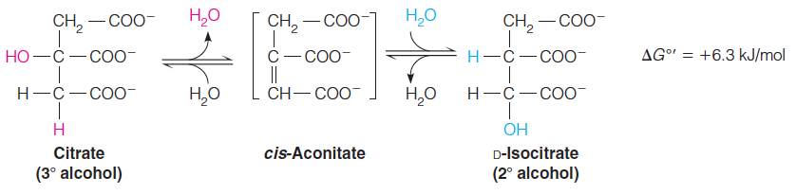
The Citric Acid Cycle
Step 2: Isomerization of Citrate
The tertiary alcohol of citrate presents yet another chemical problem: tertiary alcohols cannot be oxidized without breaking a carbon–carbon bond.
To set up the next oxidation in the pathway, citrate is converted to isocitrate, a chiral secondary alcohol, which can be more readily oxidized.
This isomerization reaction, catalyzed by aconitase, involves successive dehydration and hydration, through cis-aconitate as a dehydrated intermediate, which remains enzyme-bound.
Copyright © 2013 Pearson Canada Inc.
14 - <number>

Slide 19
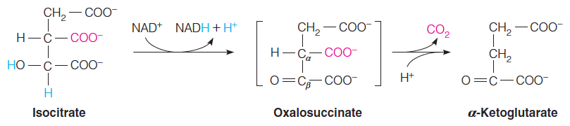
The Citric Acid Cycle
Step 3: Generation of CO₂ by an NAD⁺-Linked Dehydrogenase
The first of two oxidative decarboxylations in the cycle is catalyzed by isocitrate dehydrogenase.
Isocitrate is oxidized to a ketone, oxalosuccinate, an unstable
enzyme-bound intermediate that spontaneously β-decarboxylates to give the product, α-ketoglutarate.
The strategy here is to oxidize isocitrate’s secondary alcohol to a keto group β to the carboxyl group to be removed.
The β-keto group acts as an electron sink to stabilize the carbanionic transition state, facilitating decarboxylation.
Copyright © 2013 Pearson Canada Inc.
14 - <number>

Slide 20
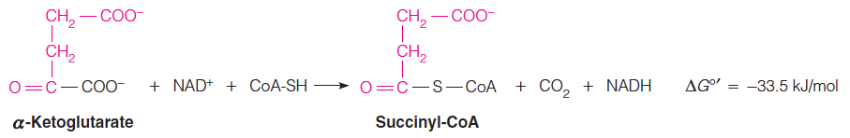
The Citric Acid Cycle
Two carbon atoms enter the citric acid cycle as acetyl-CoA, and two are lost as CO₂ in the oxidative decarboxylations of steps 3 and 4.
Step 4: Generation of a Second CO₂ by an Oxidative Decarboxylation
This is a multistep reaction entirely analogous to the pyruvate dehydrogenase reaction.
An α-keto acid substrate undergoes oxidative decarboxylation, with concomitant formation of an acyl-CoA thioester.
Copyright © 2013 Pearson Canada Inc.
14 - <number>

Slide 21
The Citric Acid Cycle
Step 5: A Substrate-Level Phosphorylation
Succinyl-CoA is an energy-rich thioester compound, and its potential energy is used to drive the formation of a nucleoside triphosphate
This reaction, catalyzed by succinyl-CoA synthetase, is comparable to the two substrate-level phosphorylation reactions that we encountered in glycolysis, except that in animal cells the energy-rich nucleotide product is not always ATP but, in some tissues, GTP.
Copyright © 2013 Pearson Canada Inc.
14 - <number>

Slide 22
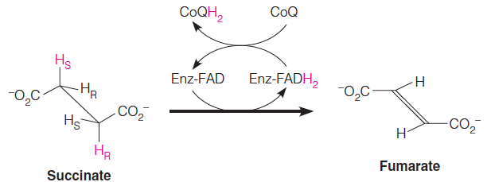
The Citric Acid Cycle
Step 6: A Flavin-Dependent Dehydrogenation
Completion of the cycle involves conversion of the four-carbon succinate to the four-carbon oxaloacetate.
The first of the three reactions, catalyzed by succinate dehydrogenase, is the FAD-dependent dehydrogenation of two saturated carbons to a double bond.
Copyright © 2013 Pearson Canada Inc.
14 - <number>

Slide 23
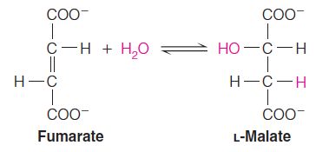
The Citric Acid Cycle
Step 7: Hydration of a Carbon–Carbon Double Bond
The stereospecific trans hydration of the carbon–carbon double bond is catalyzed by fumarate hydratase, more commonly called fumarase.
Copyright © 2013 Pearson Canada Inc.
14 - <number>

Slide 24
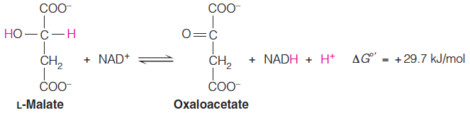
The Citric Acid Cycle
Step 8: A Dehydrogenation that Regenerates
Oxaloacetate
Finally, the cycle is completed with the NAD⁺–dependent dehydrogenation of malate to oxaloacetate, catalyzed by malate dehydrogenase.
Copyright © 2013 Pearson Canada Inc.
14 - <number>

Slide 25
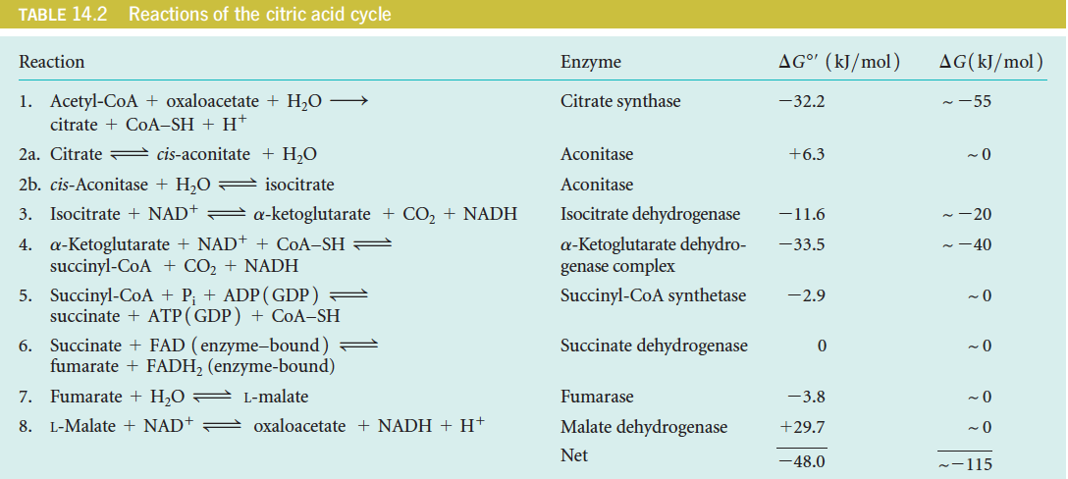
Stoichiometry and Energetics of the Citric Acid Cycle
One turn of the citric acid cycle generates one high-energy phosphate (ATP or GTP) through substrate-level phosphorylation, plus three NADH and one FADH₂ for subsequent reoxidation in the electron transport chain.
Copyright © 2013 Pearson Canada Inc.
14 - <number>

Slide 26
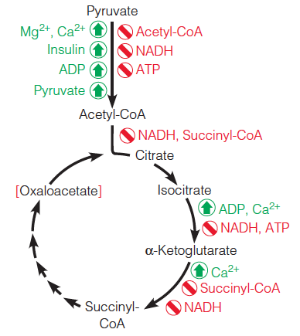
Regulation of Pyruvate Dehydrogenase and the Citric Acid Cycle
Major regulatory factors controlling pyruvate dehydrogenase
and the citric acid cycle:
Red brackets indicate concentration dependence.
NADH can inhibit through allosteric interactions, but apparent NADH inhibition can also be a reflection of reduced NAD⁺ availability.
Copyright © 2013 Pearson Canada Inc.
14 - <number>

Slide 27
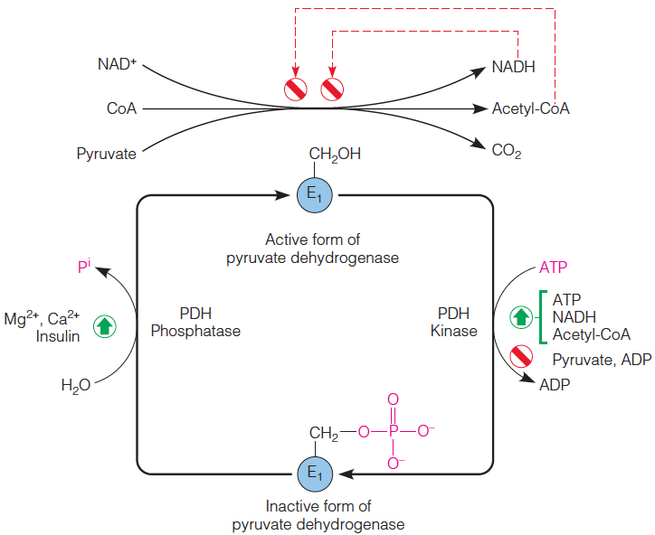
Regulation of Pyruvate Dehydrogenase and the Citric Acid Cycle
Regulation of the mammalian pyruvate dehydrogenase complex by feedback inhibition and by covalent modification of E₁.
A kinase and a phosphatase inactivate and activate the first component (E₁) of the pyruvate dehydrogenase complex by phosphorylating and dephosphorylating, respectively, three specific serine residues.
The active form of the pyruvate dehydrogenase complex is feedback inhibited by acetyl-CoA and NADH.
Ca2+ signals muscle constraction, Mg2+ binds ATP
14 - <number>
Copyright © 2013 Pearson Canada Inc.

Slide 28
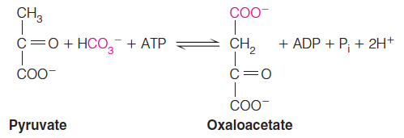
Anaplerotic Sequences:
The Need to Replace Cycle Intermediates
Citric acid cycle intermediates used in biosynthetic pathways must be replenished to maintain flux through the cycle.
Anaplerotic (filling up) pathways serve this purpose.
Copyright © 2013 Pearson Canada Inc.
14 - <number>

Slide 29
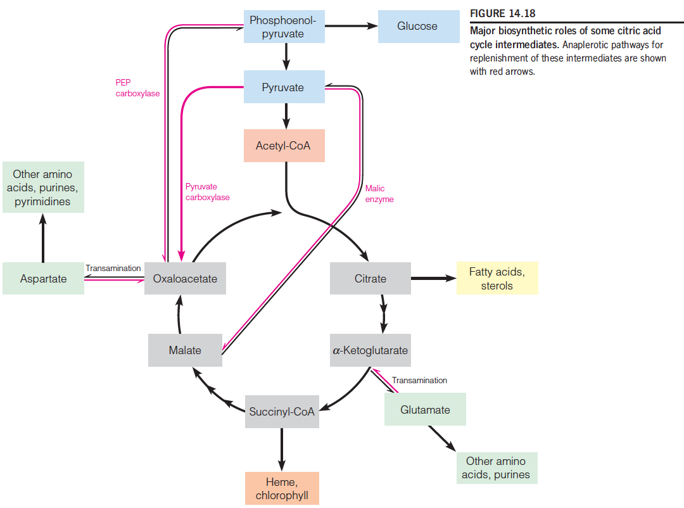
Anaplerotic Sequences:
The Need to Replace Cycle Intermediates
2
1
3
4
4
Copyright © 2013 Pearson Canada Inc.
14 - <number>

Slide 30

Anaplerotic Sequences:
The Need to Replace Cycle Intermediates
Because phosphoenolpyruvate is such an energy-rich compound, this reaction, catalyzed by phosphoenolpyruvate carboxylase, requires neither an energy cofactor nor biotin. This reaction is important in the C4 pathway of photosynthetic CO₂ fixation
Copyright © 2013 Pearson Canada Inc.
Occurs in plant and bacteria
14 - <number>

Slide 31
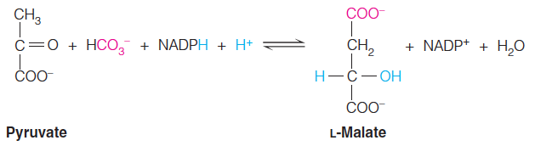
Anaplerotic Sequences:
The Need to Replace Cycle Intermediates
In addition to pyruvate carboxylase and phosphoenolpyruvate carboxylase, a third anaplerotic process is provided by an enzyme commonly known as malic enzyme but more officially as malate dehydrogenase (decarboxylating:NADP⁺).
The malic enzyme catalyzes the reductive carboxylation of pyruvate to give malate.
Copyright © 2013 Pearson Canada Inc.
14 - <number>

Slide 32
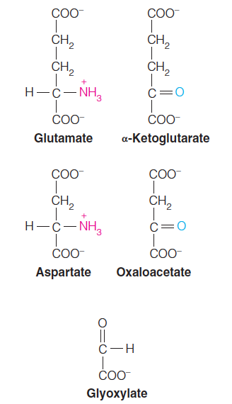
Glyoxylate Cycle: An Anabolic Variant of the Citric Acid Cycle
The glyoxylate cycle allows plants and bacteria to carry out net conversion of fat to carbohydrate, bypassing CO₂-generating reactions of the citric acid cycle.
Copyright © 2013 Pearson Canada Inc.
14 - <number>

Slide 33
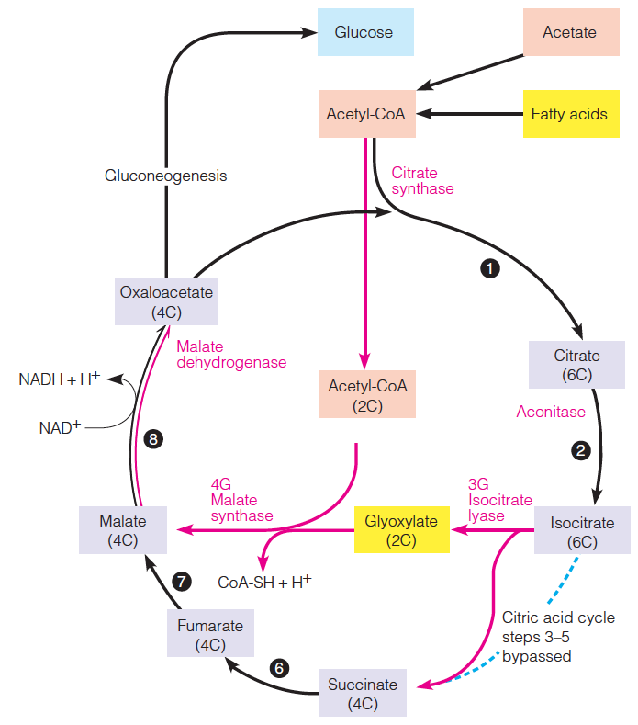
Glyoxylate Cycle: An Anabolic Variant of the Citric Acid Cycle
Reactions of the glyoxylate cycle:
Two acetyl-CoA molecules enter the cycle, one at the citrate synthase
step, and the second at the malate synthase step.
The reactions catalyzed by isocitrate lyase and malate synthase bypass the three citric acid cycle steps between isocitrate and succinate so that the two carbons lost in the citric acid cycle are saved, resulting in the net synthesis of oxaloacetate.
Copyright © 2013 Pearson Canada Inc.
14 - <number>

Slide 34
The End
Copyright © 2013 Pearson Canada Inc.
1 - <number>

