Slide 1
Chapter 22
Nucleotide Metabolism

Slide 2
Outline
Outlines of Pathways in Nucleotide Metabolism
De Novo Biosynthesis of Purine Nucleotides
Pyrimidine Nucleotide Metabolism
Glutamine-Dependent Amidotransferases
Deoxyribonucleotide Biosynthesis and Metabolism
Thymidylate Synthase: A Target Enzyme for Chemotherapy
Virus-Directed Alterations of Nucleotide Metabolism
Biological and Medical Importance of Other Nucleotide Analogs

Slide 3
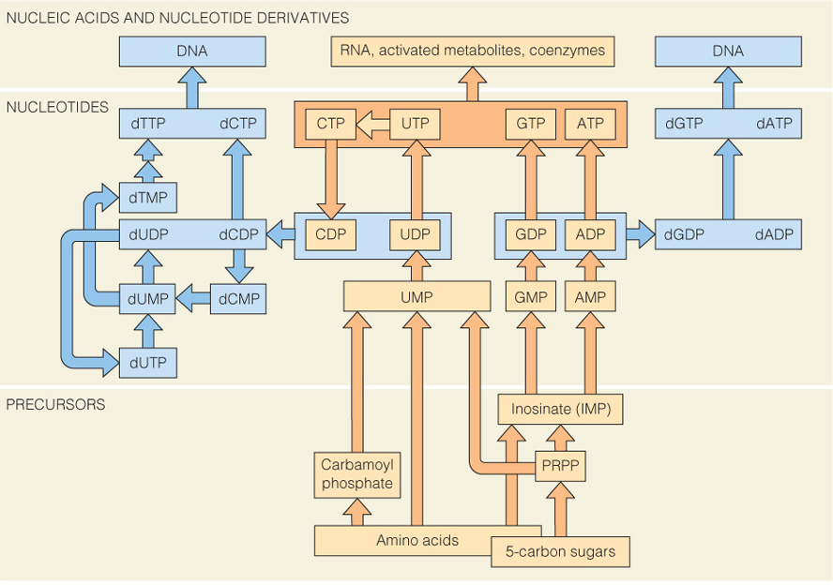
Outlines of Pathways in Nucleotide Metabolism
De novo pathways for synthesis and utilization of ribonucleotides (orange) and deoxyribonucleotides (blue).
Nucleotides arise through de novo synthesis from low-molecular-weight precursors or through salvage of nucleosides or bases.

Slide 4
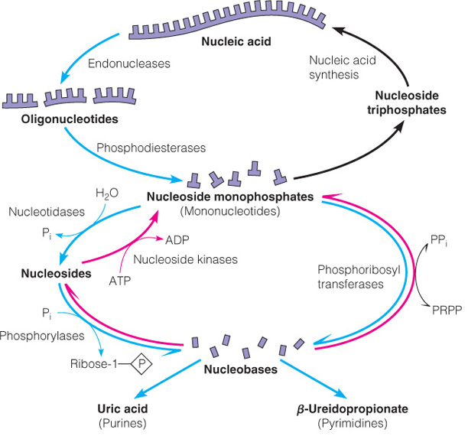
Outlines of Pathways in Nucleotide Metabolism
Reutilization of purine and pyrimidine bases:
The figure shows relationships between nucleic acid catabolism (blue) and resynthesis of nucleotides by salvage pathways (red).

Slide 5
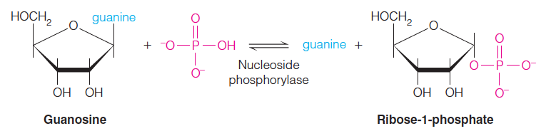
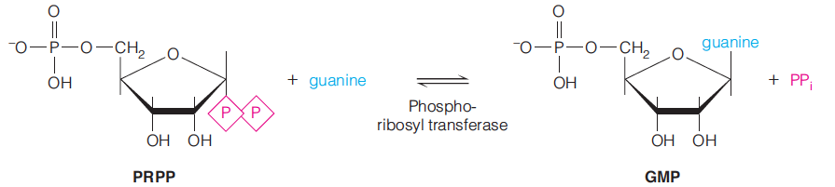
Outlines of Pathways in Nucleotide Metabolism
The most common route for cleavage to the free base (nucleobase) involves the action of a nucleoside phosphorylase.
A phosphoribosyltransferase reaction catalyzes the reversible transfer of a free base to the ribose of PRPP, displacing pyrophosphate and producing a nucleoside monophosphate.
Because the deoxyribose analog of PRPP is absent from most cells, these enzymes are not involved directly in deoxyribonucleotide metabolism.

Slide 6
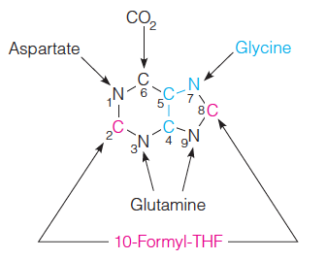
De Novo Biosynthesis of Purine Nucleotides
Low-molecular-weight precursors to the purine ring:
The source of each atom in the ring, as established with isotopic tracer studies of uric acid synthesis.

Slide 7
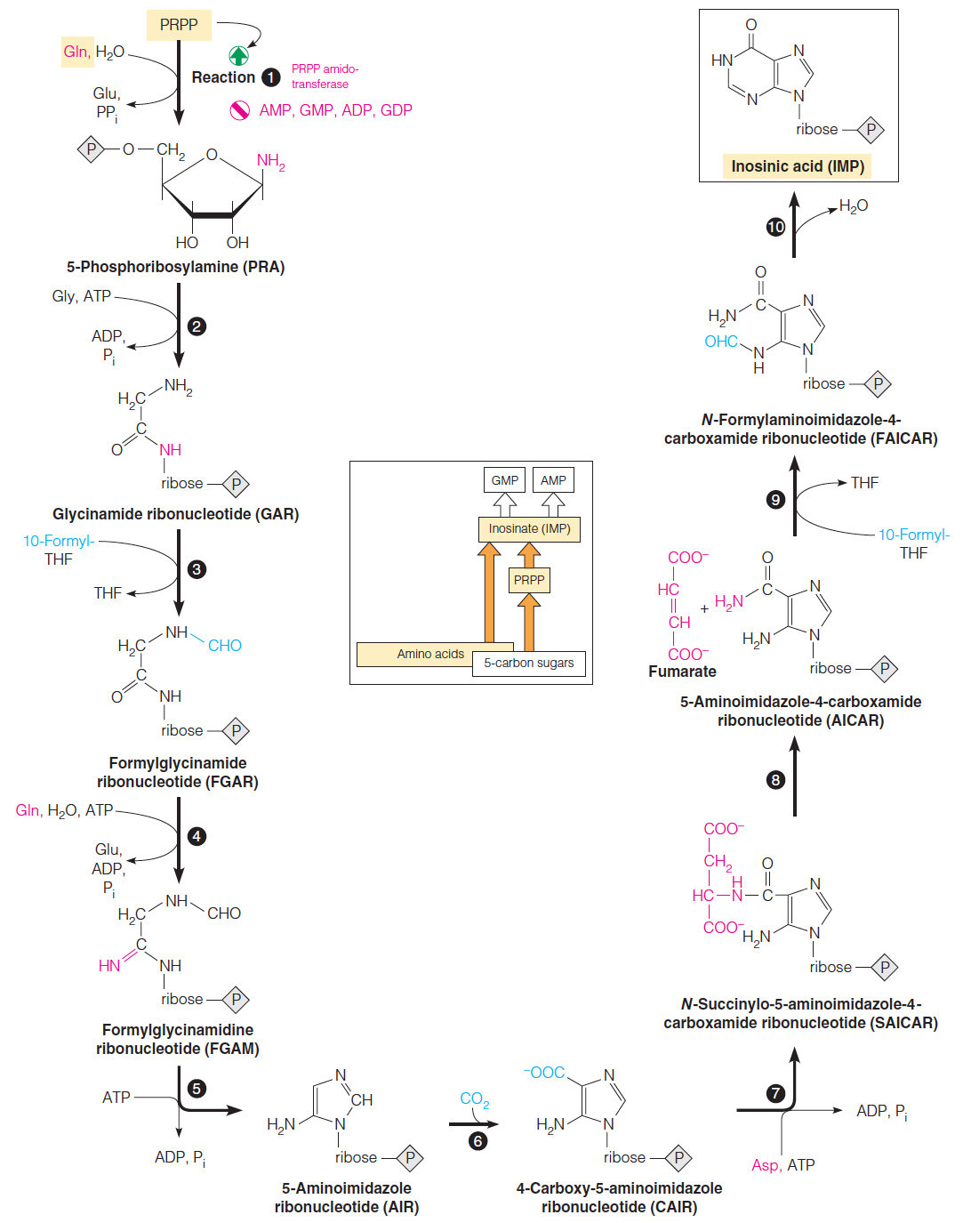
De Novo Biosynthesis of Purine Nucleotides
De novo biosynthesis of the purine ring:
The enzymes involved are:
  1. PRPP amidotransferase
  2. GAR synthetase
  3. GAR transformylase
  4. FGAR amidotransferase
  5. AIR synthetase
  6. AIR carboxylase
  7. SAICAR synthetase
  8. adenylosuccinate lyase
  9. AICAR transformylase
  10. IMP cyclohydrolase

Slide 8
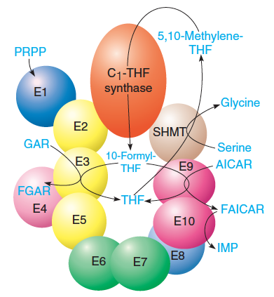
De Novo Biosynthesis of Purine Nucleotides
Model of the purinosome:
The figure shows a hypothetical model for a multi-enzyme complex in animal cells that transforms PRPP to IMP.
Serine hydroxymethyltransferase (SHMT) and the trifunctional enzyme C1-tetrahydrofolate (THF) synthase, also proposed to be part of the complex, channel one-carbon units from serine into 10-formyl-THF for the transformylase reactions.

Slide 9
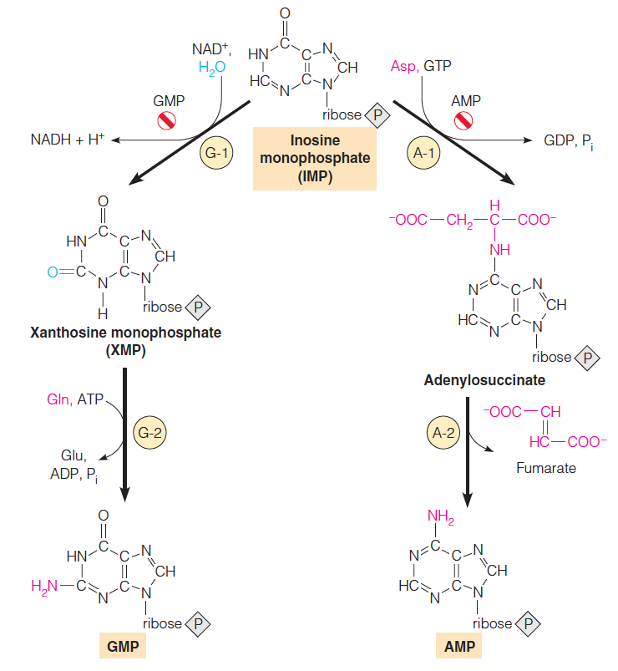
De Novo Biosynthesis of Purine Nucleotides
Pathways from IMP to GMP and AMP:
Enzymes are as follows:
  G-1 = IMP dehydrogenase
  G-2 = GMP synthetase
  A-1 = Adenylosuccinate synthetase
  A-2 = Adenylosuccinate lyase
Balancing the purine biosynthesis
Amino group donors

Slide 10


De Novo Biosynthesis of Purine Nucleotides
Nucleotides are active in metabolism primarily as the nucleoside triphosphates.
GMP and AMP are converted to their corresponding triphosphates through two successive phosphorylation reactions.
Conversion to the diphosphates involves specific ATP-dependent kinases.
Nucleoside diphosphate kinase, an equilibrium-driven enzyme, transfers a phosphoryl group from ATP in the synthesis of all other nucleoside triphosphates.

Slide 11
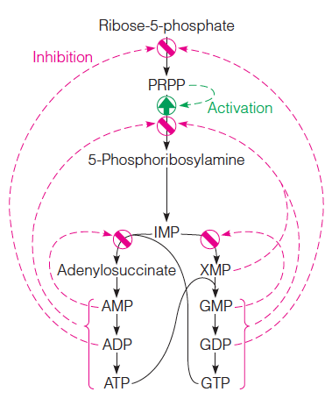
De Novo Biosynthesis of Purine Nucleotides

Slide 12
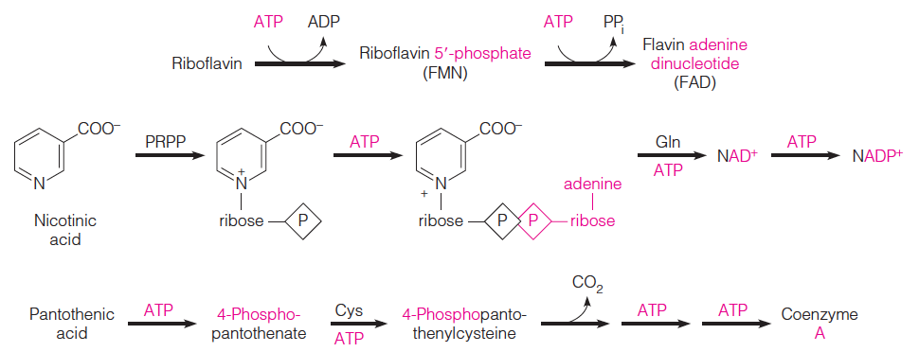
De Novo Biosynthesis of Purine Nucleotides
An important metabolic role of purine nucleotides is the synthesis of coenzymes, primarily those containing an adenylate moiety.
    Flavin nucleotides
    Nicotinamide nucleotides
    Coenzyme A

Slide 13
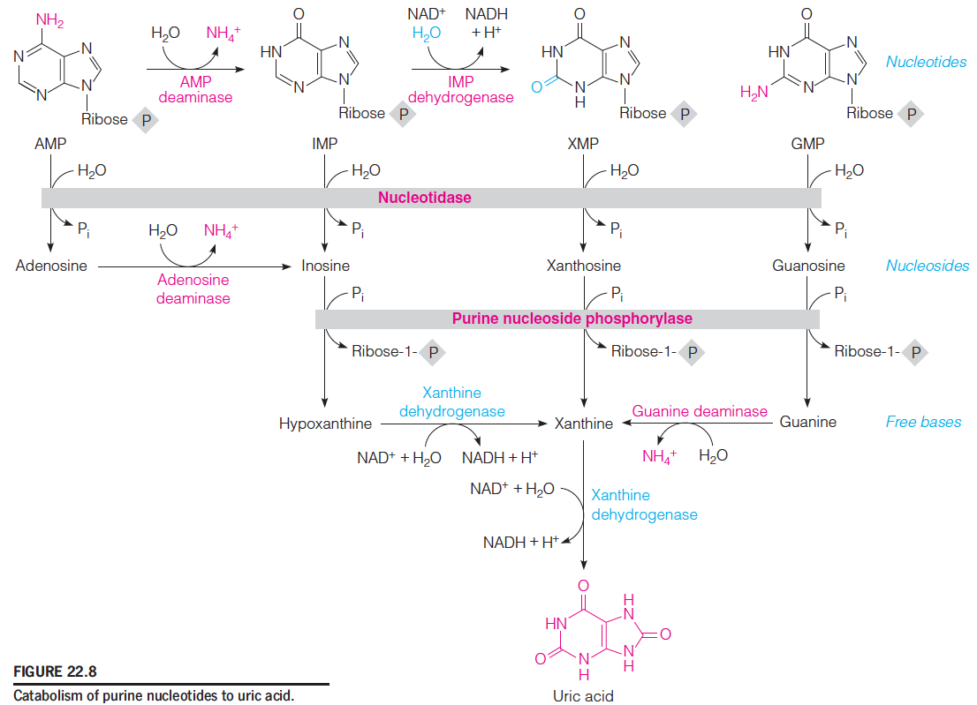
De Novo Biosynthesis of Purine Nucleotides
nucleosidase
Xanthine oxidase
All purine degradation leads to uric acid.

Slide 14
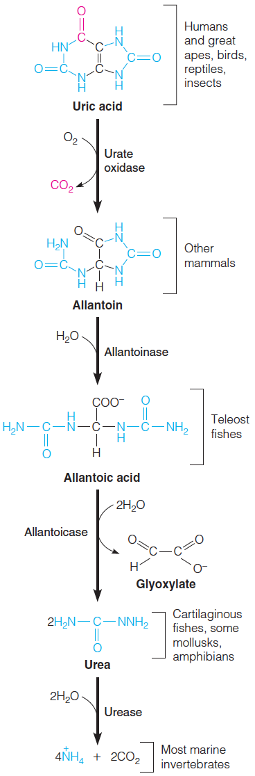
De Novo Biosynthesis of Purine Nucleotides
Catabolism of uric acid to ammonia and CO₂

Slide 15
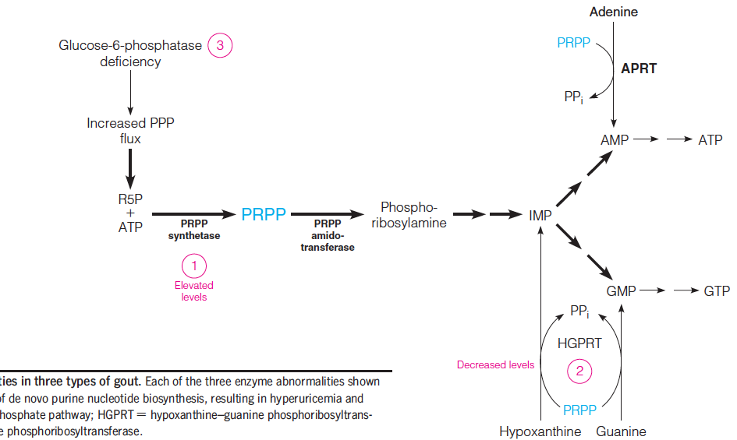
De Novo Biosynthesis of Purine Nucleotides
uric acid overproduction
Pentose phosphate pathway
Mutations → resistant to feedback inhibition
PRPP ↑
Several known genetic alterations in purine metabolism can lead to purine oversynthesis, uric acid overproduction, and gout. (3/1000)
Lesch-Nyham syndrome:
-- Gouty arthritis
-- malfunction of nerve system
-- self-mutilation

Slide 16
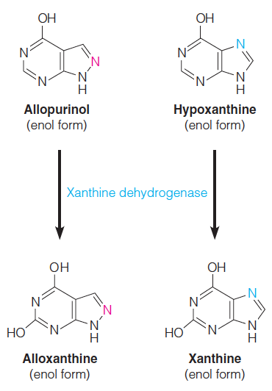
De Novo Biosynthesis of Purine Nucleotides
Many cases of gout are successfully treated by the antimetabolite allopurinol, a structural analog of hypoxanthine in which the N7 and C8 positions are interchanged.
Xanthine dehydrogenase hydroxylates allopurinol at C2 (as it does hypoxanthine), giving alloxanthine, which remains tightly bound to the reduced form of the enzyme.
Allopurinol is thus a suicide substrate that strongly inhibits xanthine dehydrogenase.
This inhibition causes accumulation of hypoxanthine and xanthine, both of which are more soluble and, hence, more readily excreted than is uric acid.

Slide 17
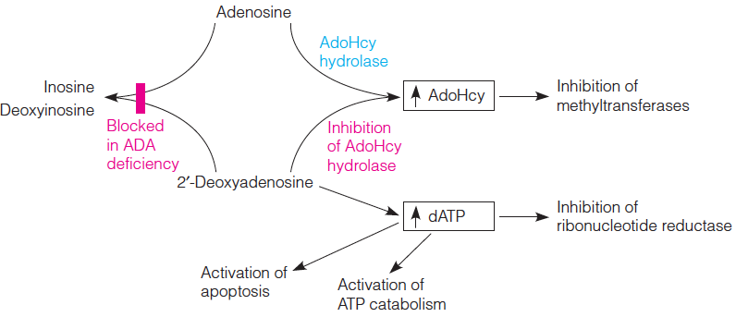
De Novo Biosynthesis of Purine Nucleotides
Metabolic consequences of adenosine deaminase (ADA) deficiency:
severe combined immunodeficiency disease (SCID), “bubble boy”
The first human disease treated by gene therapy
Histone methylation
DNA synthesis
Nucleoside kinases
Proliferation of B and T lymphocytes
x

Slide 18
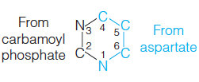
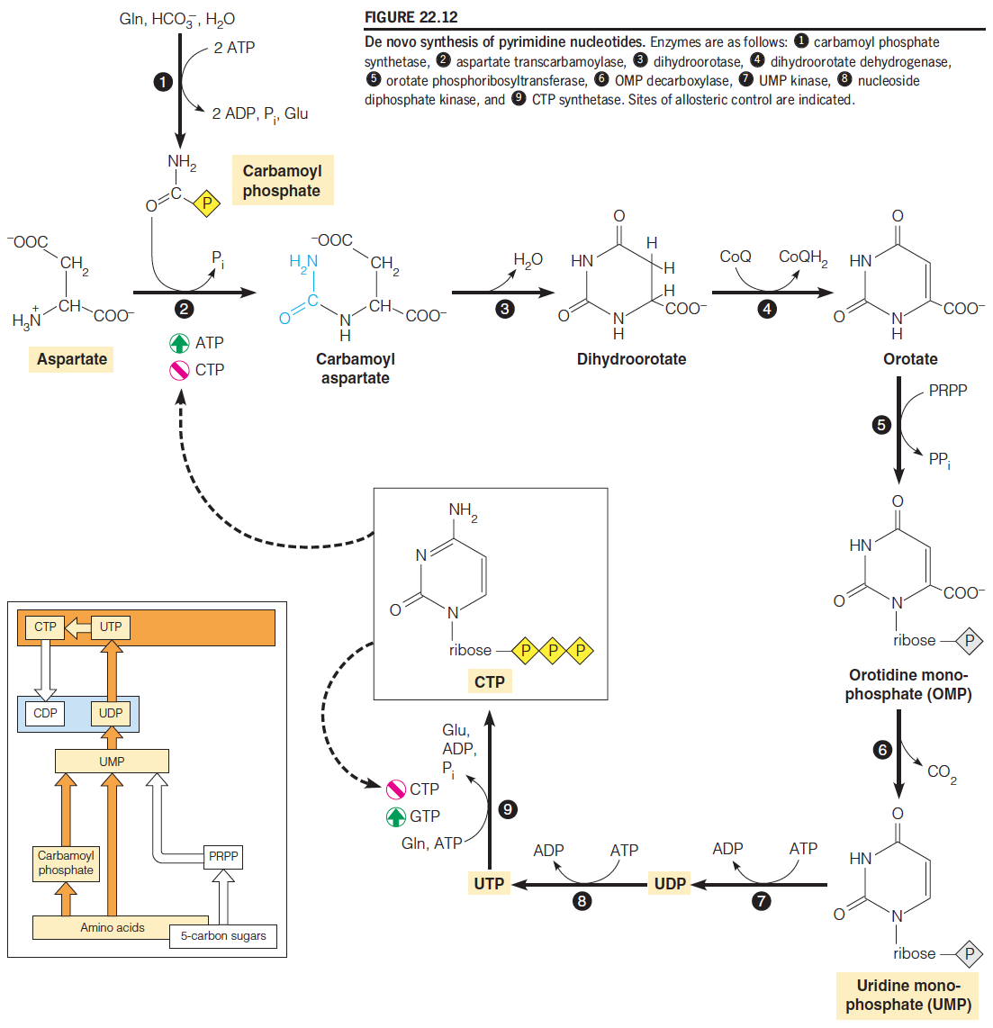
Pyrimidine Nucleotide Metabolism
Different from purine formation

Slide 19
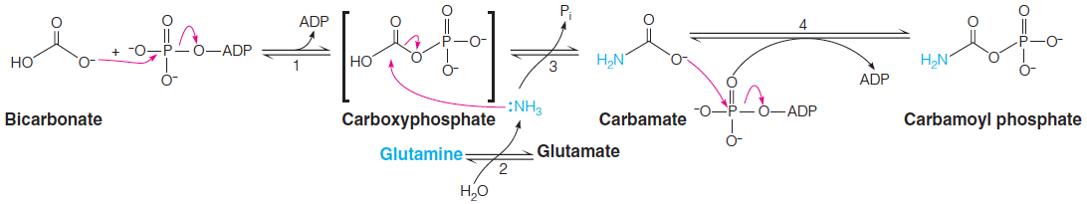
Pyrimidine Nucleotide Metabolism
Pyrimidine synthesis begins with formation of carbamoyl phosphate, a reaction catalyzed by carbamoyl phosphate synthetase.
Carbamoyl phosphate is formed from ATP, bicarbonate, and the amide nitrogen from glutamine.
This amidotransferase reaction involves four separate chemical steps:

Slide 20
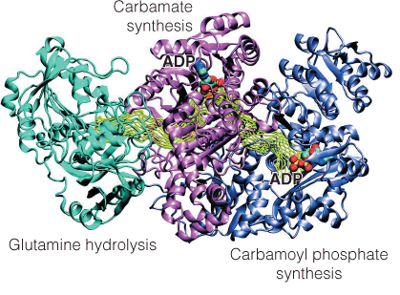
Pyrimidine Nucleotide Metabolism
Channeling in carbamoyl phosphate synthetase:
In eukaryotes the first three reactions of pyrimidine synthesis are catalyzed by a trifunctional enzyme, the CAD protein.
Similarly, the last two reactions are catalyzed by a bifunctional enzyme, UMP synthase.

Slide 21
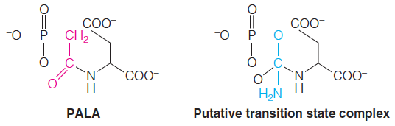
Pyrimidine Nucleotide Metabolism
Aspartate transcarbamoylase in eukaryotes is strikingly different from the E. coli enzyme.
This came to light through analysis of ATCase inhibition by N-phosphonoacetyl-L-aspartate (PALA).
This compound, synthesized as an analog of the putative transition-state complex formed between the two substrates, inhibits pyrimidine synthesis in mammalian cells.
However, cells eventually develop resistance to it, because levels of ATCase rise in these cells beyond the capacity of PALA to inhibit all of the activity.

Slide 22
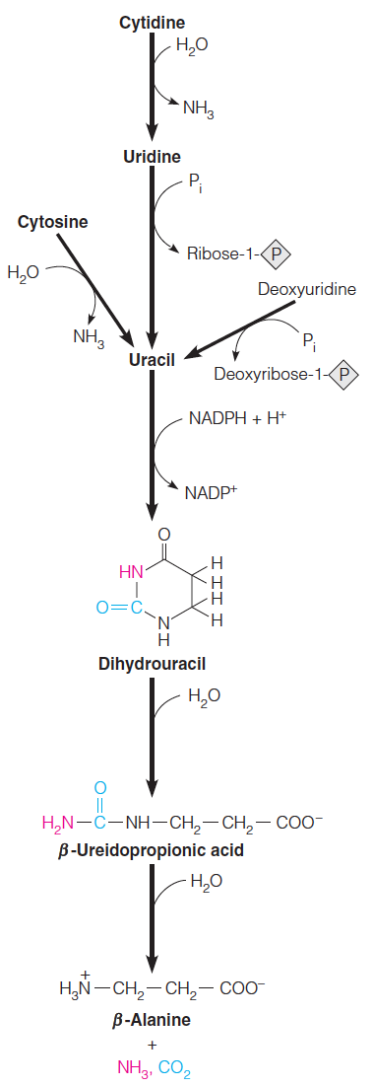
Pyrimidine Nucleotide Metabolism
Catabolic pathways in pyrimidine nucleotide metabolism:

Slide 23
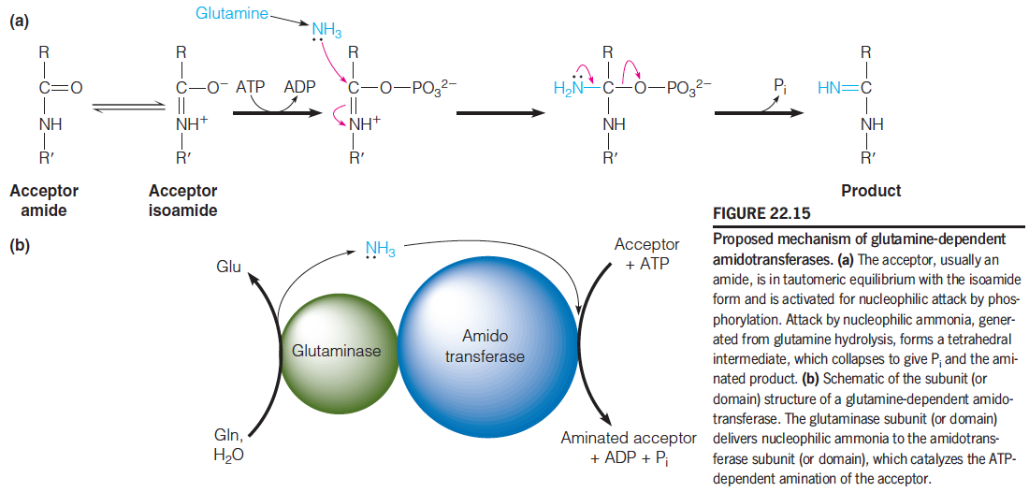
Glutamine-Dependent Amidotransferases
PRPP amidotransferase
FGAR amidotransferase
GMP synthetase
Carbamoyl phosphate synthetase
CTP synthetase

Slide 24
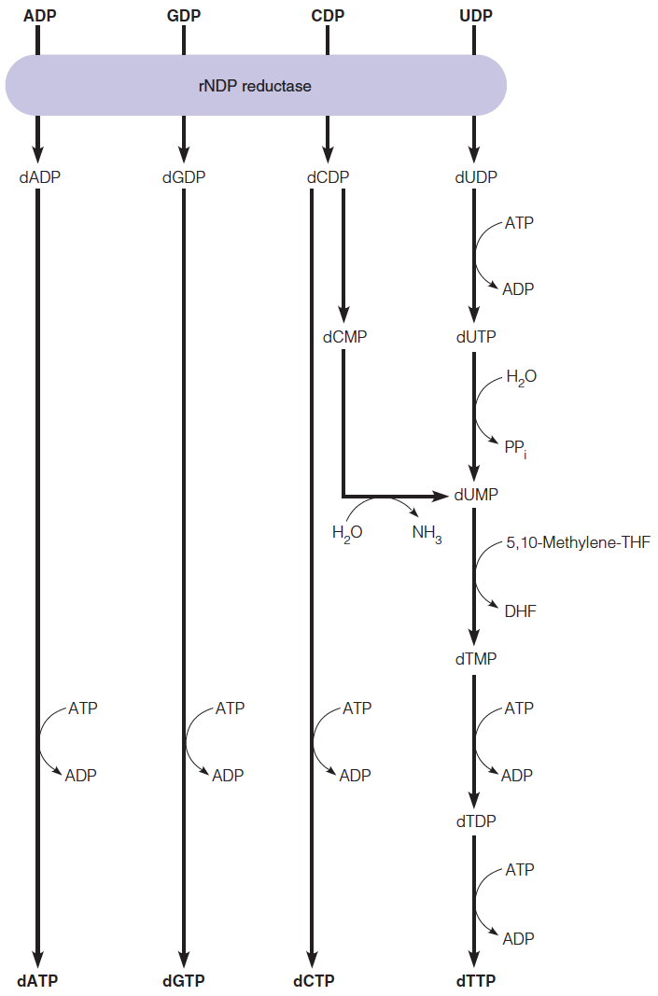
Deoxyribonucleotide Biosynthesis and Metabolism
Overview of deoxyribonucleoside triphosphate
(dNTP) biosynthesis

Slide 25
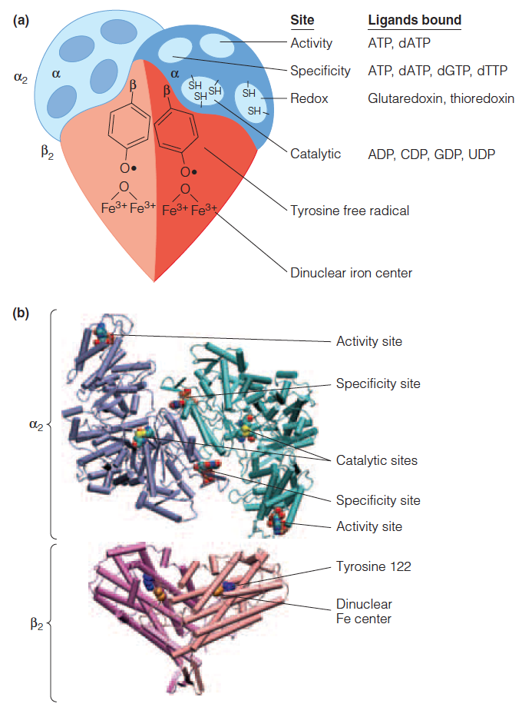
Deoxyribonucleotide Biosynthesis and Metabolism
Structure of E. coli ribonucleoside diphosphate reductase
Ribonucleotide reductase has two classes of allosteric sites.
Activity sites influence catalytic efficiency, and specificity sites determine specificity for one or more of the four substrates.

Slide 26
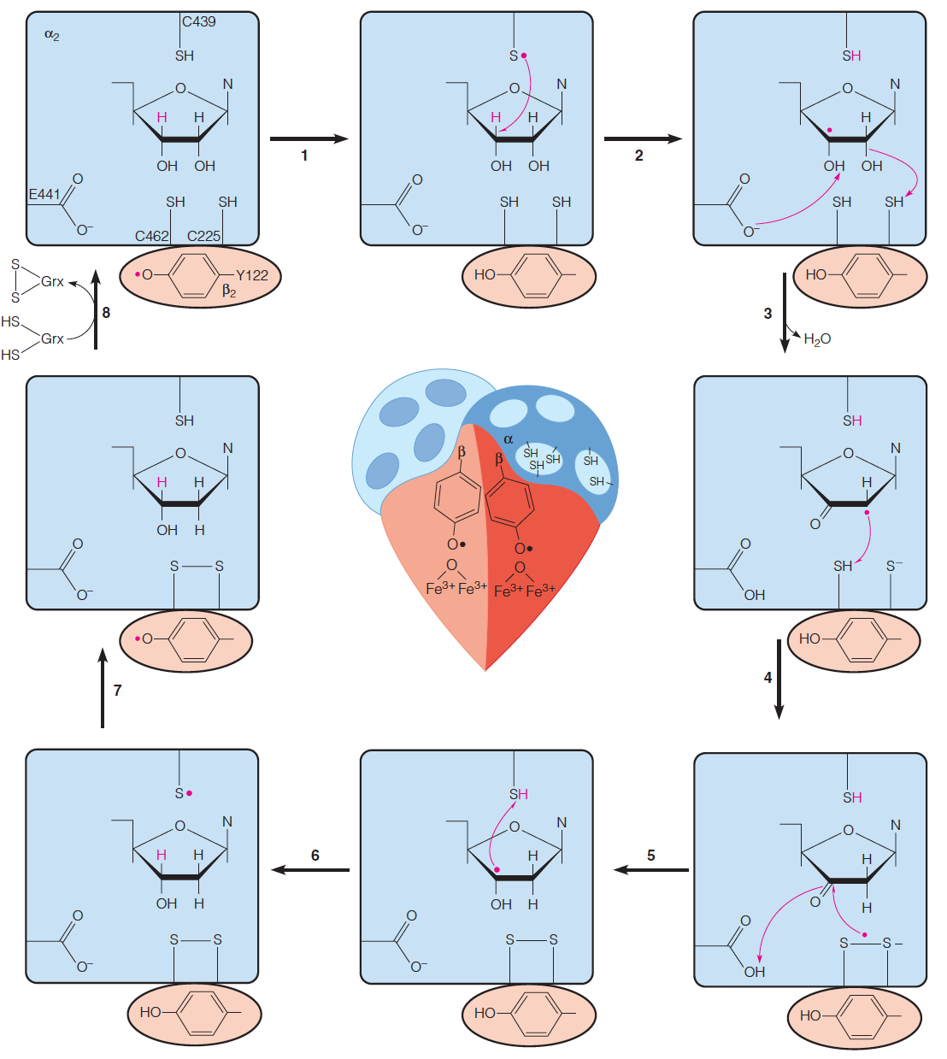
Deoxyribonucleotide Biosynthesis and Metabolism
Reduction of a ribonucleoside diphosphate by rNDP reductase
Ribonucleotide reductase contains catalytic residues on each of its subunits—
  1. redox-active thiols
  2. tyrosine free radical stabilized by an iron–oxygen complex

Slide 27
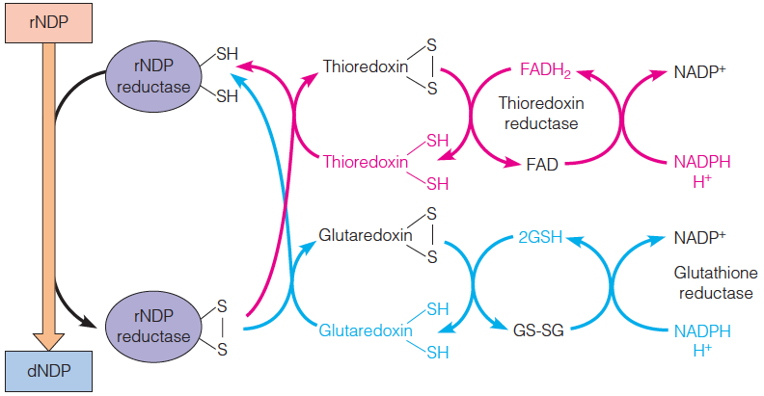
Deoxyribonucleotide Biosynthesis and Metabolism
Either thioredoxin or glutaredoxin can reduce the oxidized form of the reductase.
Oxidized thioredoxin and glutaredoxin are, in turn, reduced with electrons from NADPH in reactions catalyzed by thioredoxin reductase and glutathione reductase, respectively.
Glutaredoxin reduction requires two molecules of glutathione (GSH), resulting in oxidized glutathione (GS-SG)

Slide 28
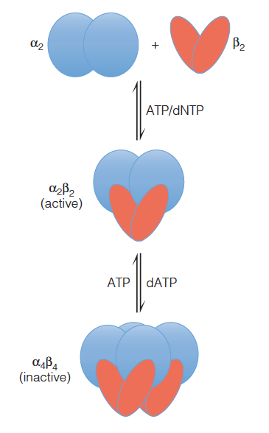
Deoxyribonucleotide Biosynthesis and Metabolism
Regulation of E. coli ribonucleotide reductase by reversible oligomerization:
All nucleotides stimulate formation of the active tetramer from α2 and β2 dimers.
dATP binding at the activity sites shifts the equilibrium to formation of inactive octamer.
ATP binding shifts the equilibrium back to active tetramer.

Slide 29
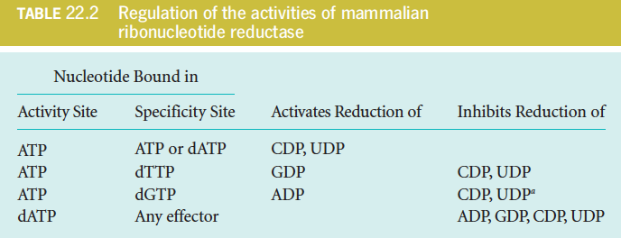
Deoxyribonucleotide Biosynthesis and Metabolism
The regulation scheme is designed to provide a balanced pool of precursors for DNA synthesis.

Slide 30
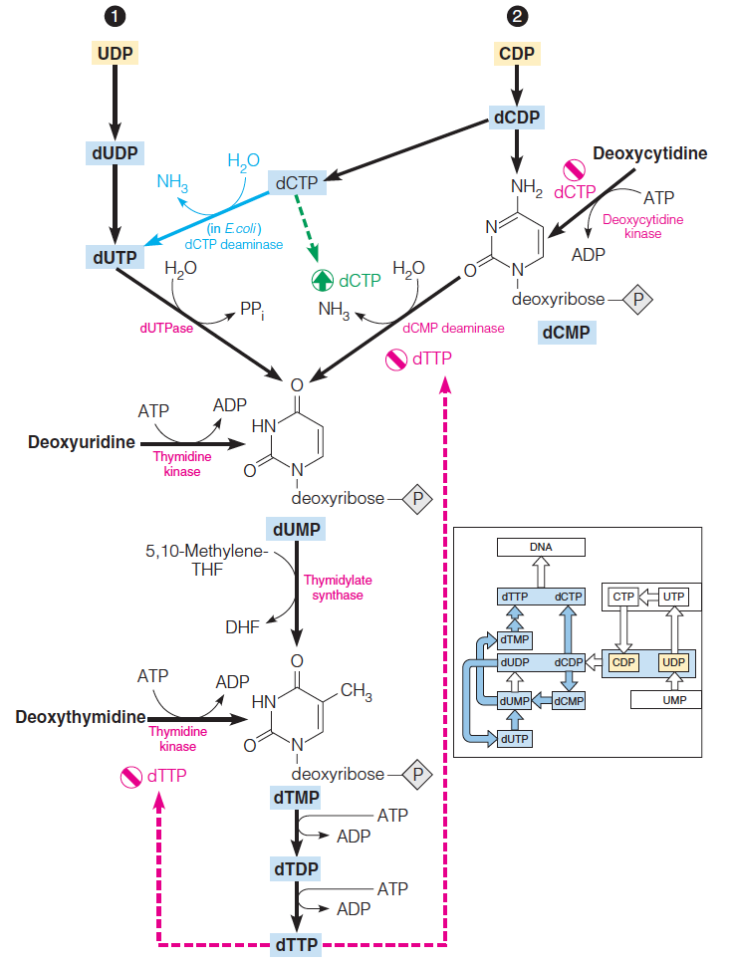
Deoxyribonucleotide Biosynthesis and Metabolism
Salvage and de novo synthetic pathways to thymine nucleotides
dUMP, the substrate for thymidylate synthesis, can arise either from UDP reduction and dephosphorylation or from deamination of a deoxycytidine nucleotide.

Slide 31
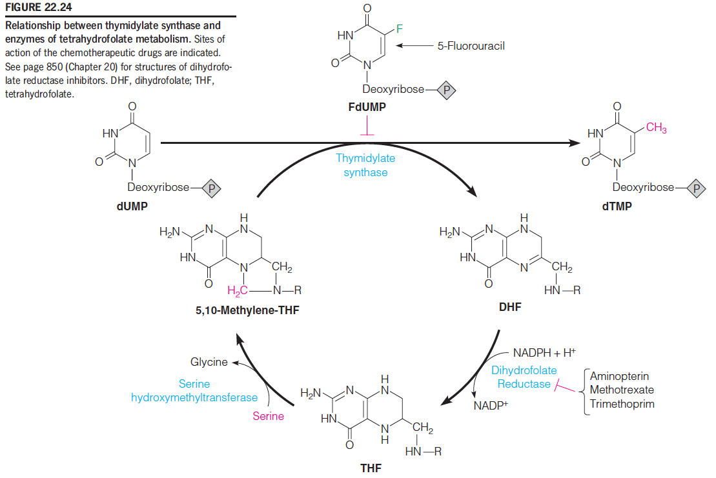
Deoxyribonucleotide Biosynthesis and Metabolism
In the reaction catalyzed by thymidylate synthase, 5,10-methylenetetrahydrofolate donates both a single-carbon methylene group and an electron pair to reduce that carbon to a methyl group.

Slide 32
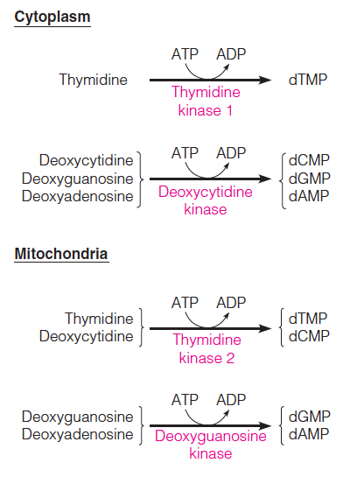
Deoxyribonucleotide Biosynthesis and Metabolism
Deoxyribonucleoside kinases, leading directly to deoxyribonucleoside monophosphates, are widely distributed, and they involve both purines and pyrimidines

Slide 33
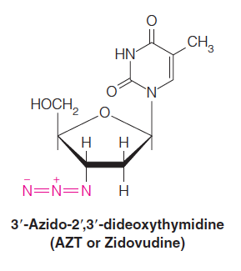
Deoxyribonucleotide Biosynthesis and Metabolism
Nucleoside analogs are being used or tested in the treatment of cancer and several viral diseases.
Invariably, these prodrugs must be converted to deoxyribonucleotides in order to be effective, and this has focused attention upon the deoxyribonucleoside kinases.
For example, a side effect of 3’-azido-2’,3’-dideoxythymidine (AZT or zidovudine), the first drug to receive approval for HIV infections, is cardiotoxicity—damage to the heart muscle.
The major route for AZT utilization involves the mitochondrial isoform of thymidine kinase, also called TK2.

Slide 34
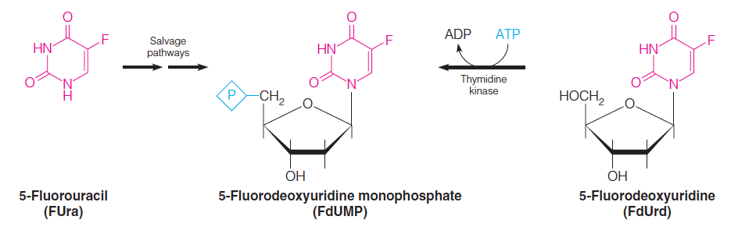
Deoxyribonucleotide Biosynthesis and Metabolism
Thymidylate Synthase:
A Target Enzyme for Chemotherapy
Inhibition of thymidylate synthase is an approach to cancer chemotherapy, by causing specific inhibition of DNA synthesis.

Slide 35
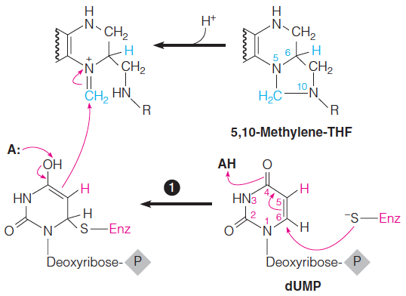
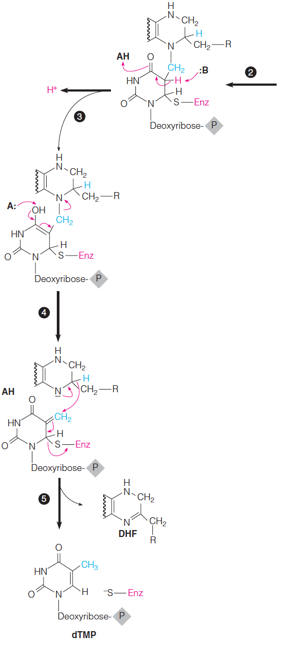
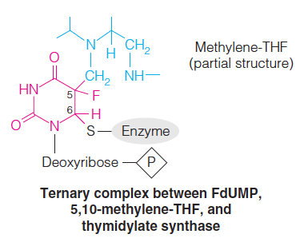
Deoxyribonucleotide Biosynthesis and Metabolism

Slide 36
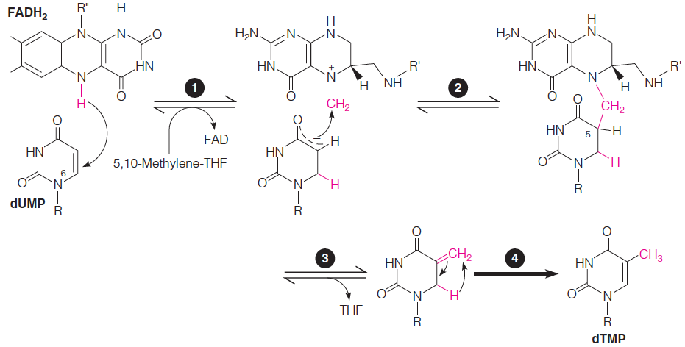
Deoxyribonucleotide Biosynthesis and Metabolism
Proposed mechanism for the reaction catalyzed by flavin-dependent thymidylate synthase (FDTS ):
FDTS is in a sense a bifunctional enzyme, taking the place of both classical thymidylate synthase and dihydrofolate reductase

Slide 37
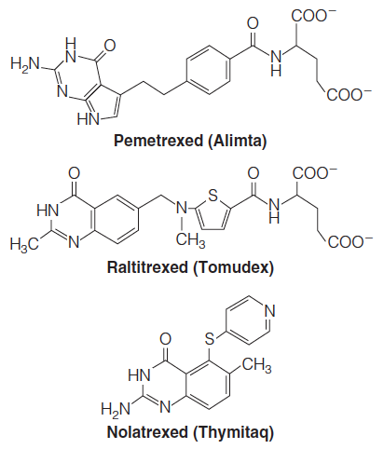
Deoxyribonucleotide Biosynthesis and Metabolism
Folate cofactor analogs (antifolates) that compete quite effectively with 5,10-methylene-THF for binding to thymidylate synthase (Ki values as low as 0.4 nM).
Antifolates are used clinically to treat certain types of cancer.

Slide 38
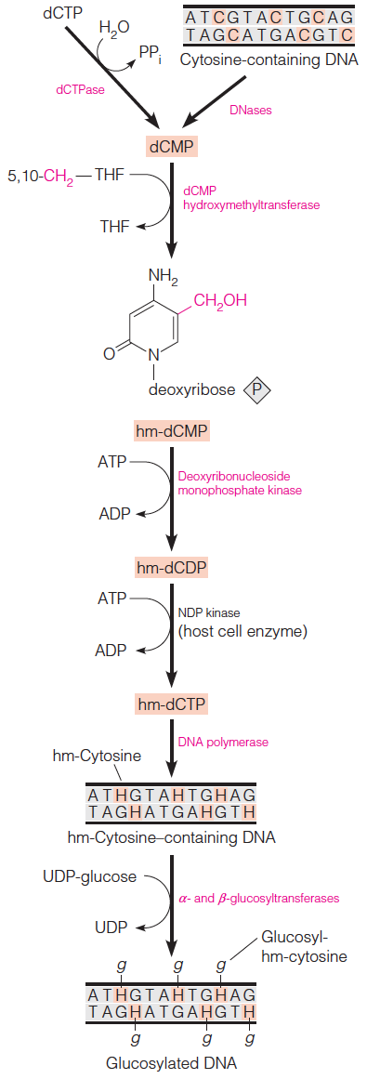
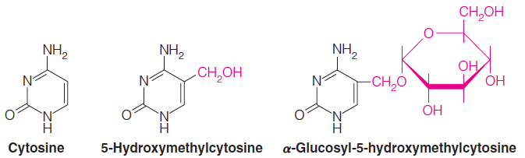
Virus-Directed Alterations of Nucleotide Metabolism
Metabolic pathways leading to nucleotide modifications in T-even phage–infected E. coli:
DNA of the T-even bacteriophages (T2, T4, and T6) contain no cytosine but instead contains 5-hydroxymethylcytosine, with most of the hydroxymethyl groups further modified by being in glycosidic linkage with glucose moieties.
Viral genome specifies several deoxuribonucleases, which specifically cleave cytosine-containing DNA.

Slide 39
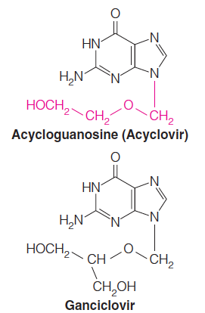
Virus-Directed Alterations of Nucleotide Metabolism
Virus-coded enzymes are often produced to help the infected cell augment its synthesis of nucleic acid precursors
If the virus-specified enzyme differs from its host cell counterpart sufficiently, scientists can design selective enzyme inhibitors
The herpes viruses are large DNA-containing viruses whose genomes encode several enzymes, including thymidine kinase.
This virus-encoded enzyme (HSV-TK) has extremely broad substrate specificity, capable of phosphorylating both pyrimidine and purine nucleosides.
Nucleoside analogs, such as acyclovir and ganciclovir are converted ultimately to the 5’-triphosphate, which interferes with DNA replication.
Uninfected cells do not efficiently phosphorylate acyclovir and ganciclovir, so DNA replication and, hence, virus growth are inhibited selectively in the infected cells.

Slide 40
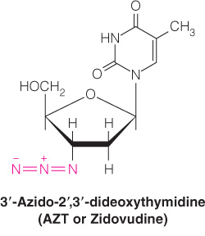
Biological and Medical Importance of Other Nucleotide Analogs
Arabinosyladenine (araA or Vidarabine) is now being used to treat several viral diseases, including viral encephalitis, a neurological disease caused by another member of the herpes virus family.
Unlike acycloguanosine, araA is phosphorylated to the triphosphate level by cellular kinases.
The triphosphate, araATP, is a selective inhibitor of DNA polymerases encoded by herpes viruses.
One such analog, 3’-azido-2’,3’-dideoxythymidine (AZT) is anabolized to the corresponding triphosphate, which is an inhibitor of viral reverse transcriptase (the enzyme that makes a DNA copy of the viral RNA).

Slide 41
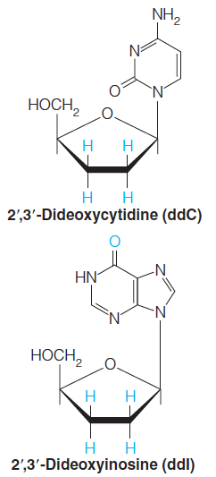
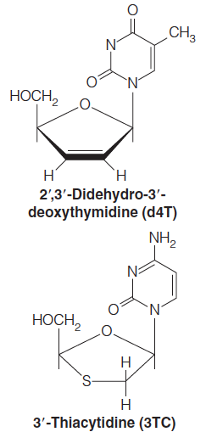
Biological and Medical Importance of Other Nucleotide Analogs
Other analogs receiving considerable attention are those being used to combat acquired immune deficiency syndrome (AIDS) caused by HIV.
Other nucleoside analogs— 2’,3’-dideoxycytidine (ddC), 2’,3’-dideoxyinosine (ddI), 3’-thiacytidine (3TC), and 2’,3’-didehydro-3’-deoxythymidine (d4T)—act by conversion to the corresponding triphosphate, which is incorporated into DNA but then blocks further replicative chain elongation because of the absence of a 3’-hydroxyl terminus (chain terminators).

Slide 42
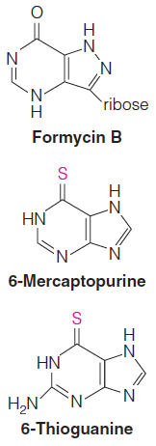
Biological and Medical Importance of Other Nucleotide Analogs
Purine salvage as a target
Parasitic protozoans (e.g., Plasmodium) lack the capacity for de novo purine synthesis, and they depend entirely on salvage of nucleosides and bases provided by the host.
Compounds such as allopurinol and formycin B inhibit the growth of these organisms in culture, partly through inhibition of salvage enzymes and partly through a specific ability of the salvage enzymes to anabolize the analog.
For example, allopurinol is converted to an analog of inosinic acid and then to an AMP analog and is finally incorporated into RNA.
Thiopurines as anti-cancer and immunosuppressive drugs:
Like 5-fluorouracil, 6-mercaptopurine and 6-thioguanine are prodrugs that require metabolic activation in order to exert their cytotoxic effects – cell cycle arrest and apoptosis.
Importance of pharmacogenetics
Thiopurine S-methyltransferase

Slide 43
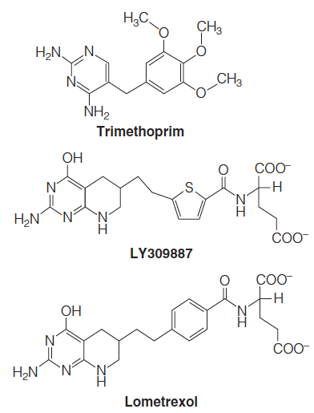
Biological and Medical Importance of Other Nucleotide Analogs
Folate antagonists
A class of dihydrofolate reductase inhibitors is exemplified by trimethoprim.
This compound is a specific inhibitor of dihydrofolate reductases of prokaryotic origin.
Trimethoprim and its relatives are widely used to treat both bacterial infections and certain forms of malaria.
The success of these drugs derives from their being extremely weak inhibitors of vertebrate dihydrofolate reductases.
Trimethoprim is often administered in conjunction with a sulfonamide drug to inhibit the synthesis of folate and hence to block sequential steps in the same pathway
Inhibit de novo purine synthesis

Slide 44
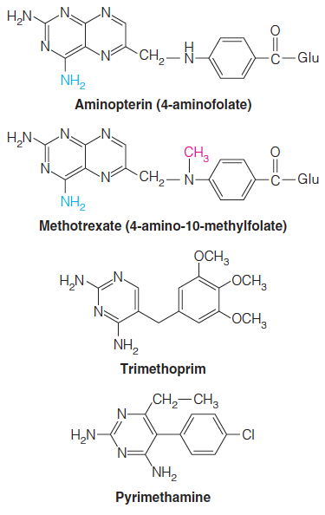
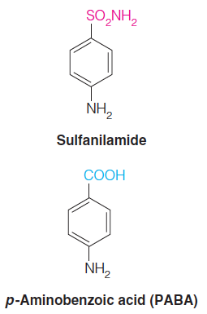
Coenzymes Involved in Nitrogen Metabolism
Dihydrofolate reductase is the target for a number of useful anticancer, antibacterial, and antiparasitic drugs.
Antibiotic, inhibits biosynthesis of folic acid
Cancer
Bacterial
Protozoal

Slide 45
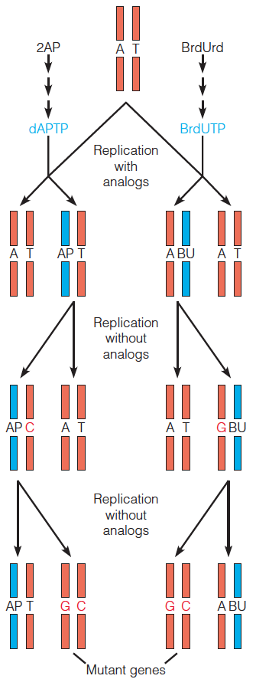
Biological and Medical Importance
of Other Nucleotide Analogs
Mechanisms of mutagenesis by nucleotide analogs:
2-Aminopurine (2AP) is converted by salvage pathways to deoxy aminopurine triphosphate (dAPTP), the dNTP analog of dATP.
BrdUrd is converted to BrdUTP, the dNTP analog of dTTP.
In the pathways shown, both analogs change an A-T base pair to a G-C base pair (red letters).
UV irradiation on BrdUrd → free radicals → DNA damage

Slide 46
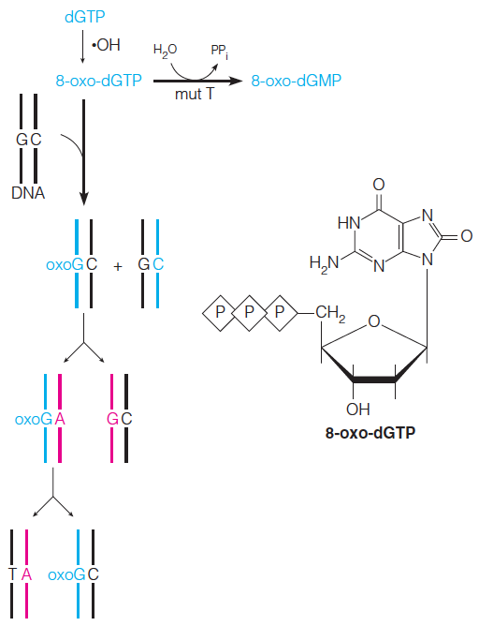
Biological and Medical Importance of Other Nucleotide Analogs
Nucleotide analogs with altered base-pairing properties are mutagenic because non-Watson–Crick base pairs form when the analog is either in the template or in an incoming nucleoside triphosphate
Mechanisms of mutagenesis by nucleotide analogs:
Oxidation of dGTP to 8-oxo-dGTP occurs in normal metabolism.
The mispairing event could cause mutation by changing a G-C base pair to a T-A.
An enzyme for removing this modified nucleotide has been discovered.

