Slide 1

Baseball IQ
AI-Powered Pre-Game Intelligence for MLB Fans
LangGraph
ChromaDB
Llama 3.1
Streamlit

Slide 2
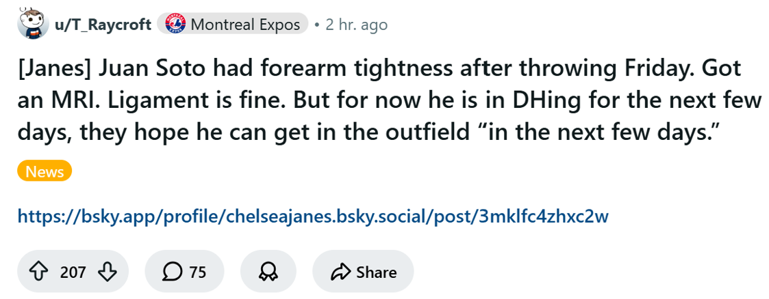
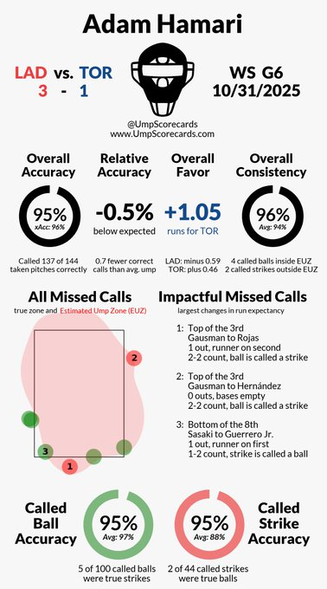
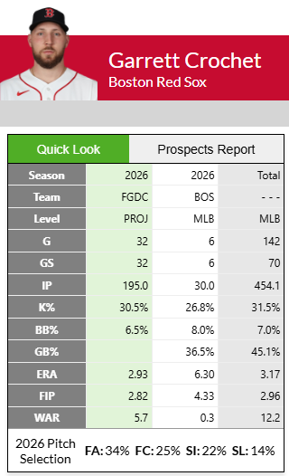
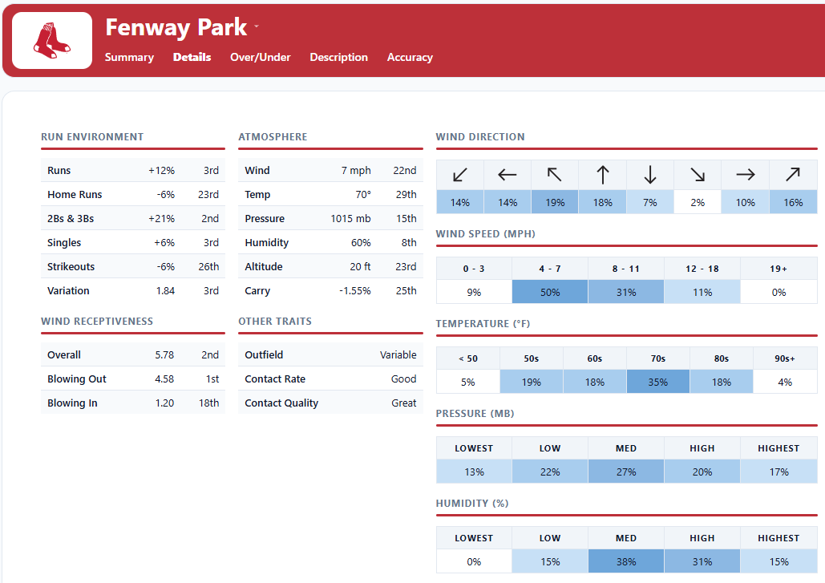
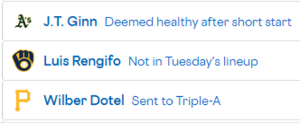
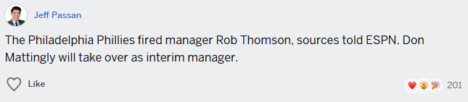
Problem & Motivation

Slide 3
The LLM's Role & Key Decisions
01
Llama 3.1
02
Prompt structure
03
LangGraph routing
Open source, zero costs and data on-device
Hallucination risks with any model
Constraint in the prompt
System prompt separates roles
Exact stats are injected verbatim
Qualitative context retrieved from source
ReAct agent reasons first, then calls the right tool
Tool calling: get_exact_matchup_stats for numeric (Pandas)
query_qualitative_data for semantic (ChromaDB)
Agentic Hybrid RAG — model drives retrieval, not hardcoded logic
CRITICAL RULES:
1. For stats → call get_exact_matchup_stats. DO NOT invent numbers.
2. For context → call query_qualitative_data.
Actual system prompt is longer and more concise!

Slide 4
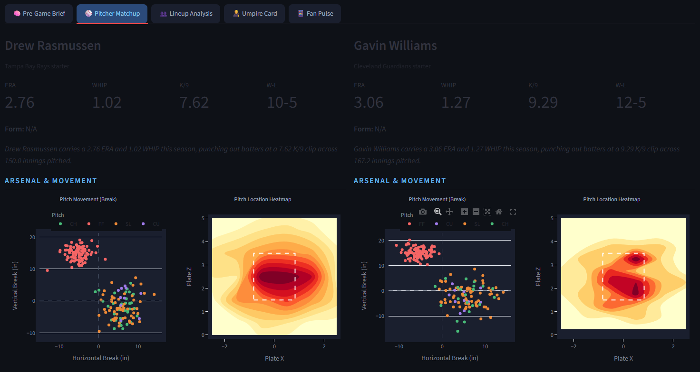
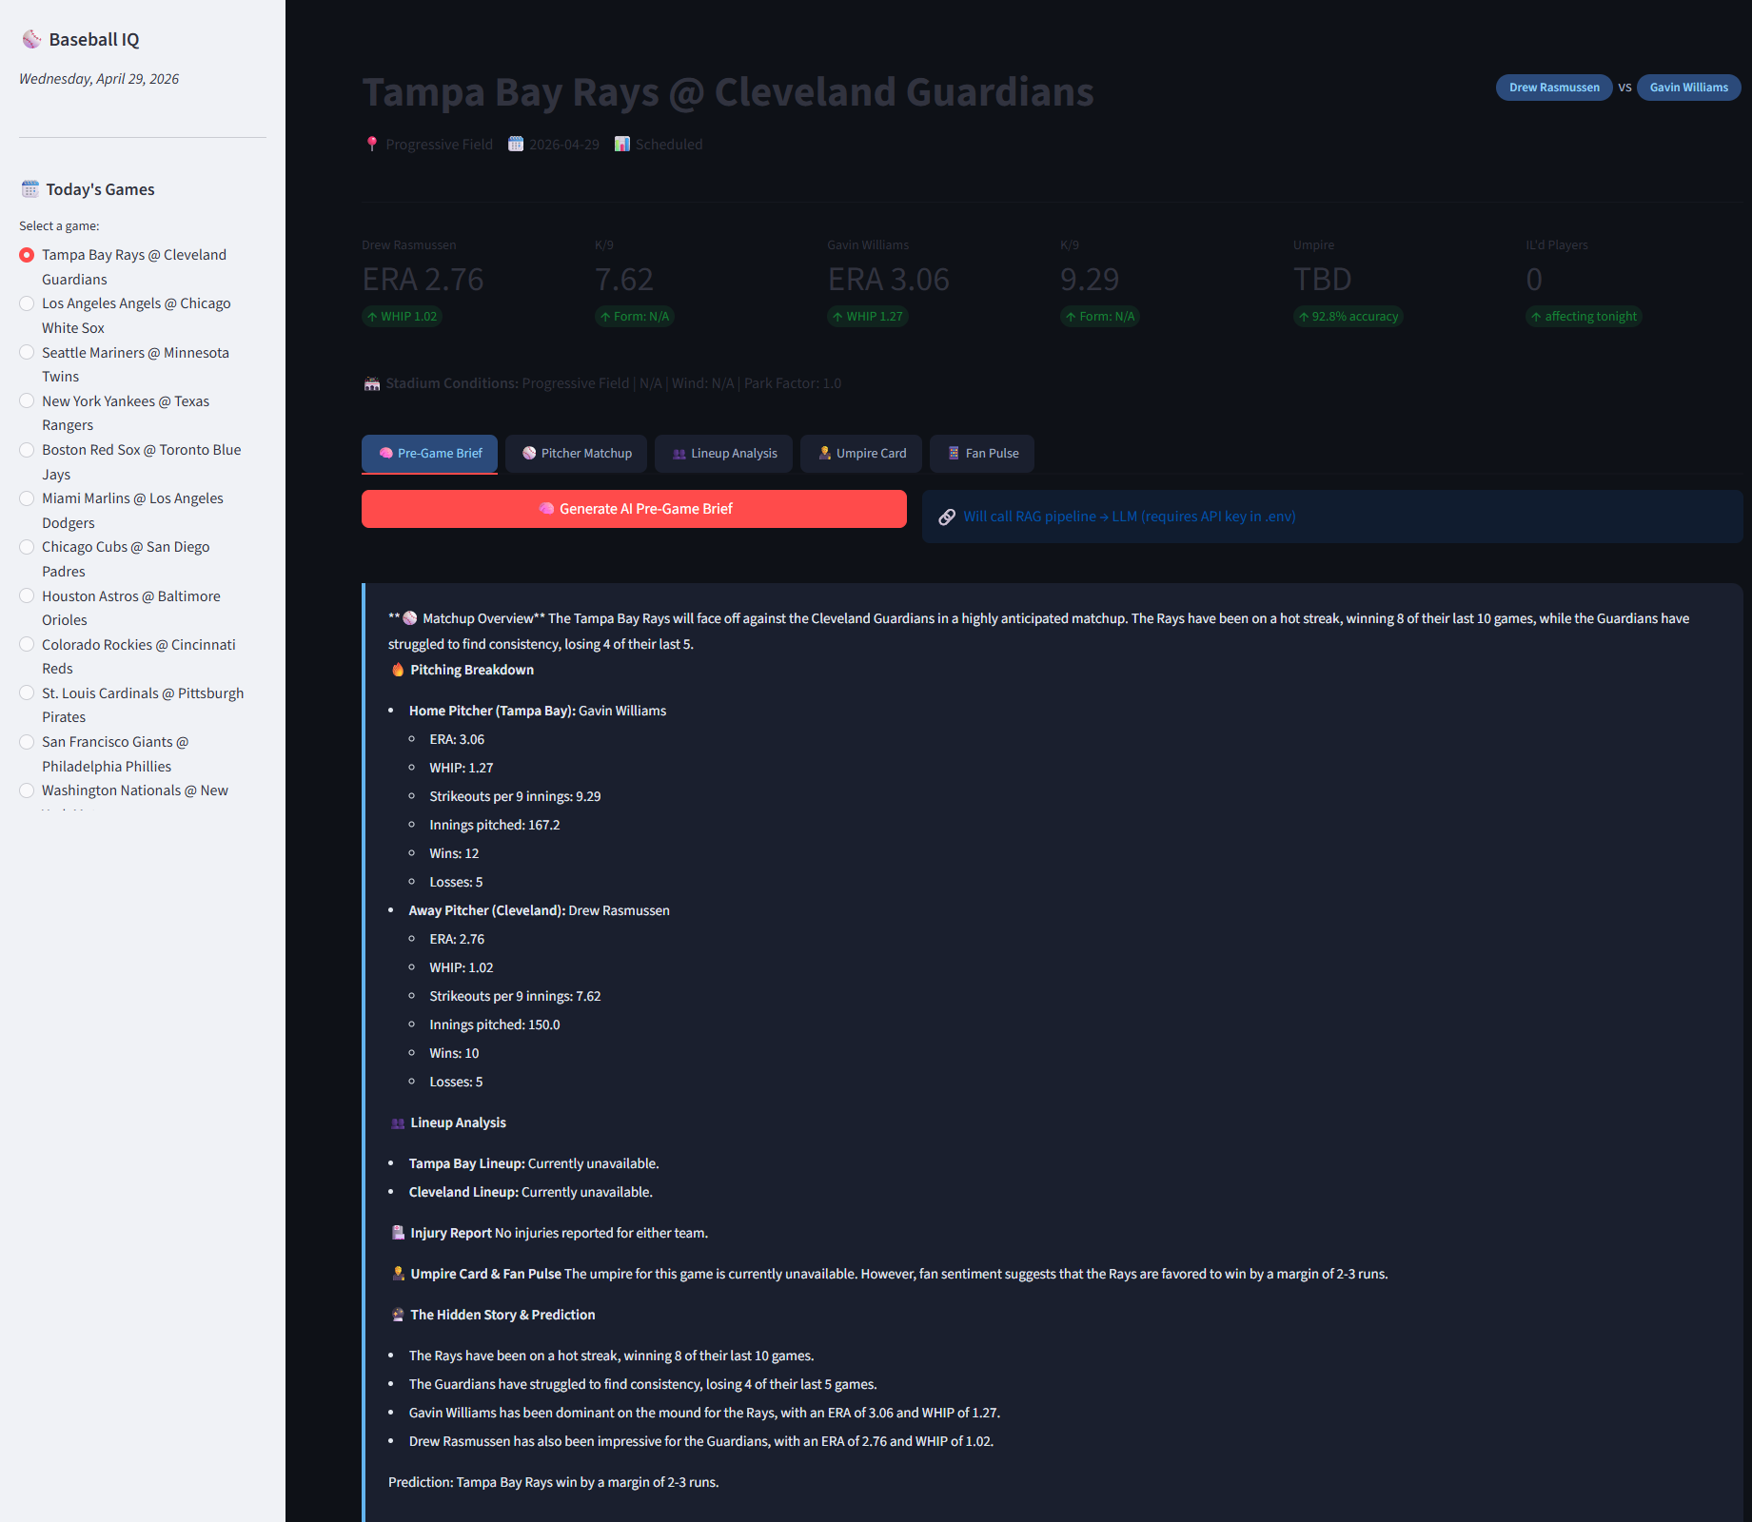
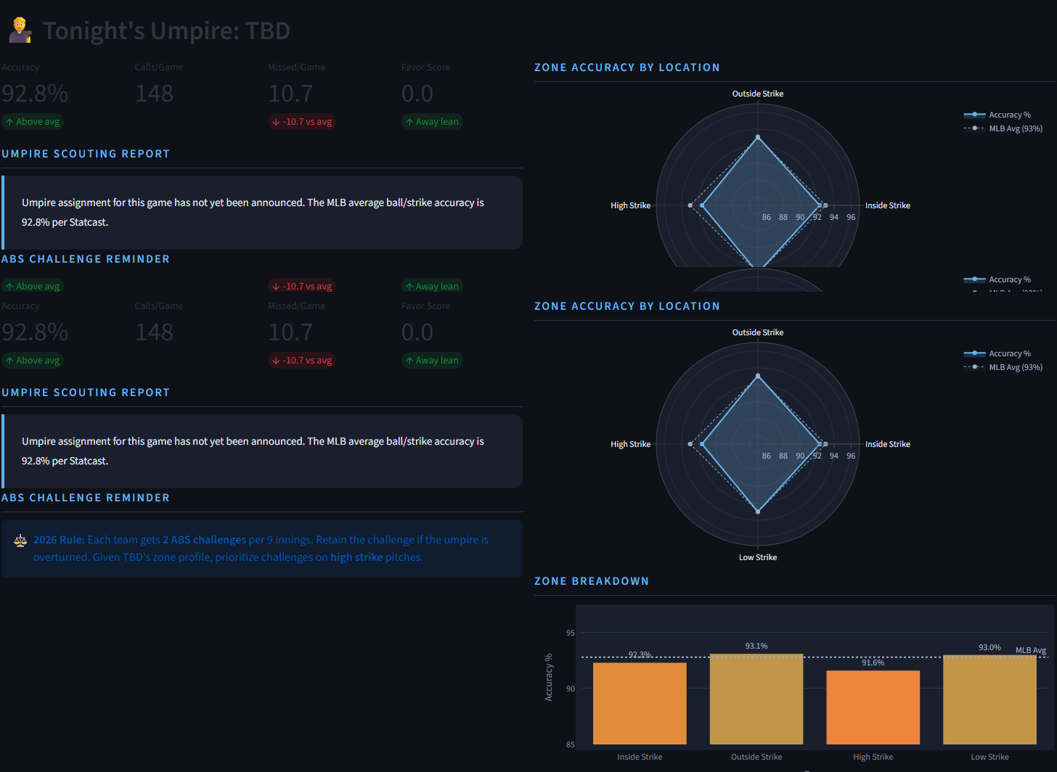
Baseball IQ in Action

Slide 5
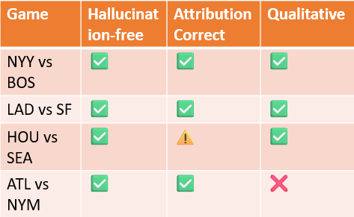


Evaluation, Results & Honest Reflection
What I evaluated
Manual review of generated briefs — checking for hallucinated stats, source attribution, and whether qualitative context actually changed the output
What worked
What I'd do differently
Hybrid routing prevented hallucinated numbers in briefs
Use cosine similarity to automate hallucination detection — embed the brief and source data, flag any stat with no close vector match
Prompt role-separation kept LLM in narrator role
Reddit scraping is brittle — need a more stable sentiment source
Radar charts made umpire data readable at a glance
Should have established a rubric for brief quality before generating the first one

Slide 6
Future Work
01
02
03
XGBoost Matchup Predictor
Fine-Tuned Narration Model
Stable Sentiment Pipeline
Train XGBoost on Statcast pitcher-batter matchup data to predict strikeout totals pre-game. Shadow tracker infrastructure is already in place to log predicted vs. actual box score results and compute MAE as data accumulates.
Fine-tune Llama 3.1 on FanGraphs articles and Baseball Prospectus so the model narrates like a real analyst. Keeps all RAG grounding benefits while replacing generic LLM prose with baseball-native vocabulary and tone.
Replace brittle Reddit scraping with a fine-tuned NLP classifier that labels posts as confirmed injury, unverified rumor, or fan speculation. More reliable qualitative signal, less noise entering ChromaDB retrieval.
The pipeline is built. These extensions add prediction, voice, and reliability.

Slide 7
THANK YOU!!
These extensions would add prediction and voice!

