Slide 1
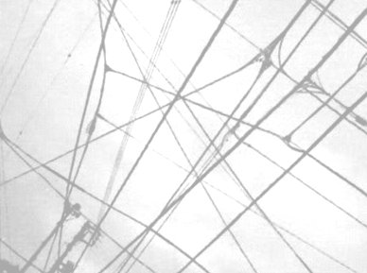
MarkLogic and the Linked Data Connection
Philip Fennell, Consultant
22nd May 2012

Slide 2
Big Data is big news

Slide 3
Volume, Velocity and Variety are growing…

Slide 4
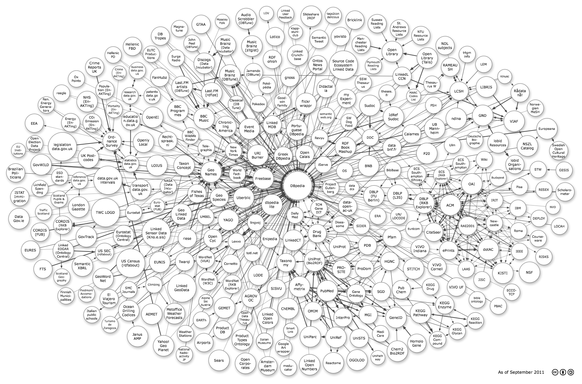
...but the Value is in the Connections

Slide 5
Big Data’s Value
is underpinned by Linked Data

Slide 6
The Linked Open Data Cloud

Slide 7
Linked Data is built upon
Semantic Web Technologies

Slide 8
RDF and SPARQL

Slide 9
a lack of standard protocols...

Slide 10
...leads to implementation specific APIs

Slide 11
and additional complexity

Slide 12
New Protocols from the W3C
SPARQL 1.1 Graph Store HTTP Protocol
SPARQL 1.1 Protocol

Slide 13
SPARQL 1.1 Graph Store HTTP Protocol
Graph Dataset Management over HTTP

Slide 14
SPARQL 1.1 Protocol
SPARQL Queries over HTTP

Slide 15
Graph Stores are Starting to
Support these Protocols

Slide 16
GRASP
GRaph store And SPARQL Protocol

Slide 17
A GitHub Project
https://github.com/philipfennell/grasp

Slide 18
XQuery Client Libraries
lib-gsp.xqy - Graph Store HTTP Protocol
lib-spq.xqy - SPARQL Protocol

Slide 19
GSP Convenience Functions
gsp:add-default-graph(...) gsp:add-named-graph(...) gsp:retrieve-default-graph-metainfo(...) gsp:retrieve-named-graph-metainfo(...) gsp:retrieve-default-graph(...) gsp:retrieve-named-graph(...) gsp:merge-default-graph(...) gsp:merge-named-graph(...) gsp:delete-default-graph(...) gsp:delete-named-graph(...) gsp:data(...)

Slide 20
Why so many functions?

Slide 21

I don’t like too many arguments!

Slide 22
I don’t like optional arguments!
xdmp:document-insert(
$uri as xs:string,$root as node(),
[$permissions as element(sec:permission)*],
[$collections as xs:string*],
[$quality as xs:int?],
[$forest-ids as xs:unsignedLong*]
) as empty-sequence()

Slide 23
SPQ Convenience Functions
spq:query(...)
spq:query-get(...)
spq:query-post(...)
spq:data(...)

Slide 24
Wrappers for Operations
Retrieve
Delete
Create
Update

Slide 25
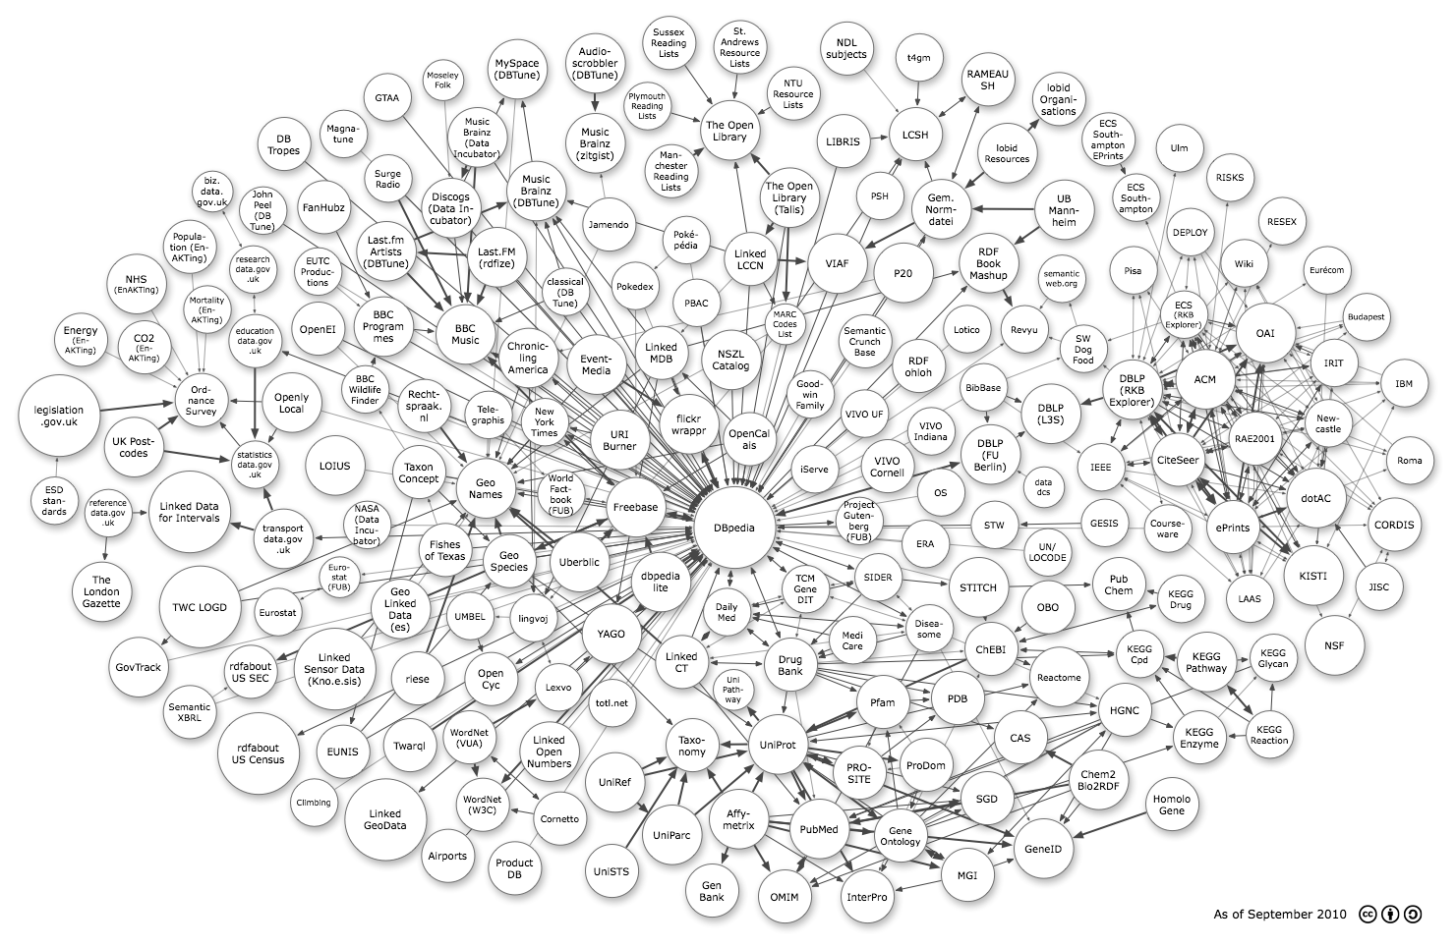
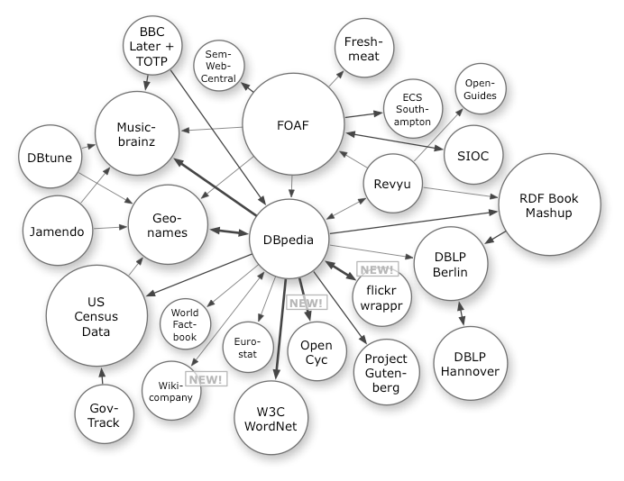
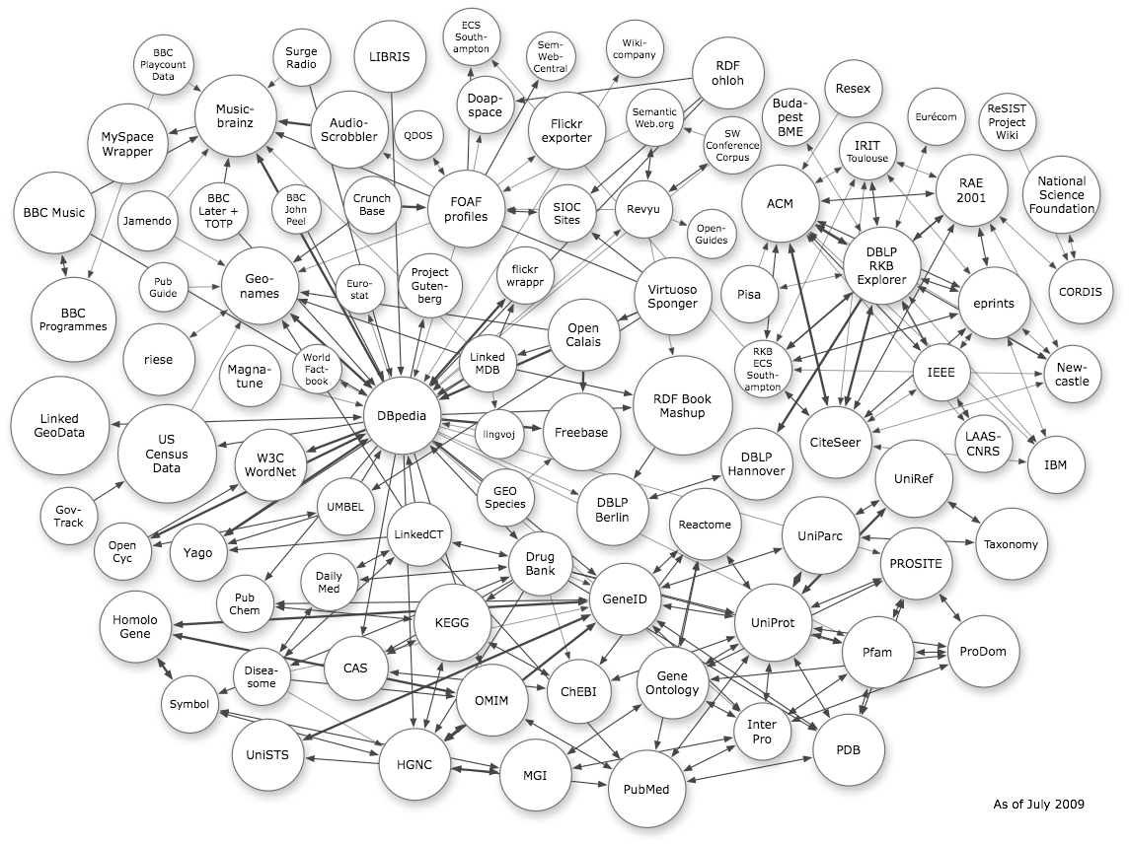
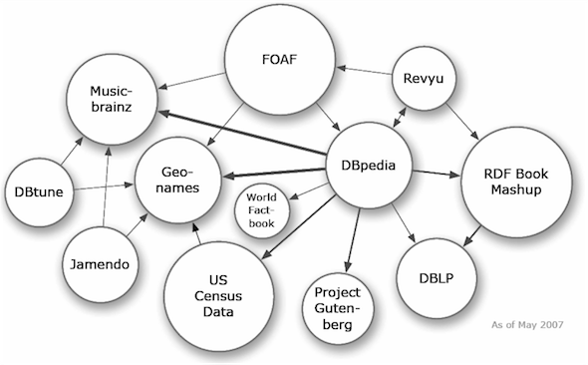
Linked Data has expanded
to this, in just five years

Slide 26
The Defining Factor in the Realization of Big Data's Potential

Slide 27

Time for a Demonstration

Slide 28
Thank You
philip.fennell@marklogic.com

