Slide 1
MarkLogic and the Linked Data Connection
Philip Fennell, Consultant 22nd May 2012

Slide 2
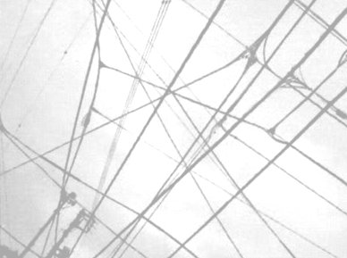
MarkLogic and the Linked Data Connection
Philip Fennell, Consultant
22nd May 2012

Slide 3
Big Data is big news
XML content processing pipelines are by no means new
Tend to be created using high-level tools like Apache Ant
Apache Cocoon was the first real XML 'pipeline' processor
These tools come with a lot of baggage
XProc adheres to the principles of pipeline processing
Notes:
3

Slide 4
Big Data is big news

Slide 5
Volume, Velocity and Variety are growing…

Slide 6
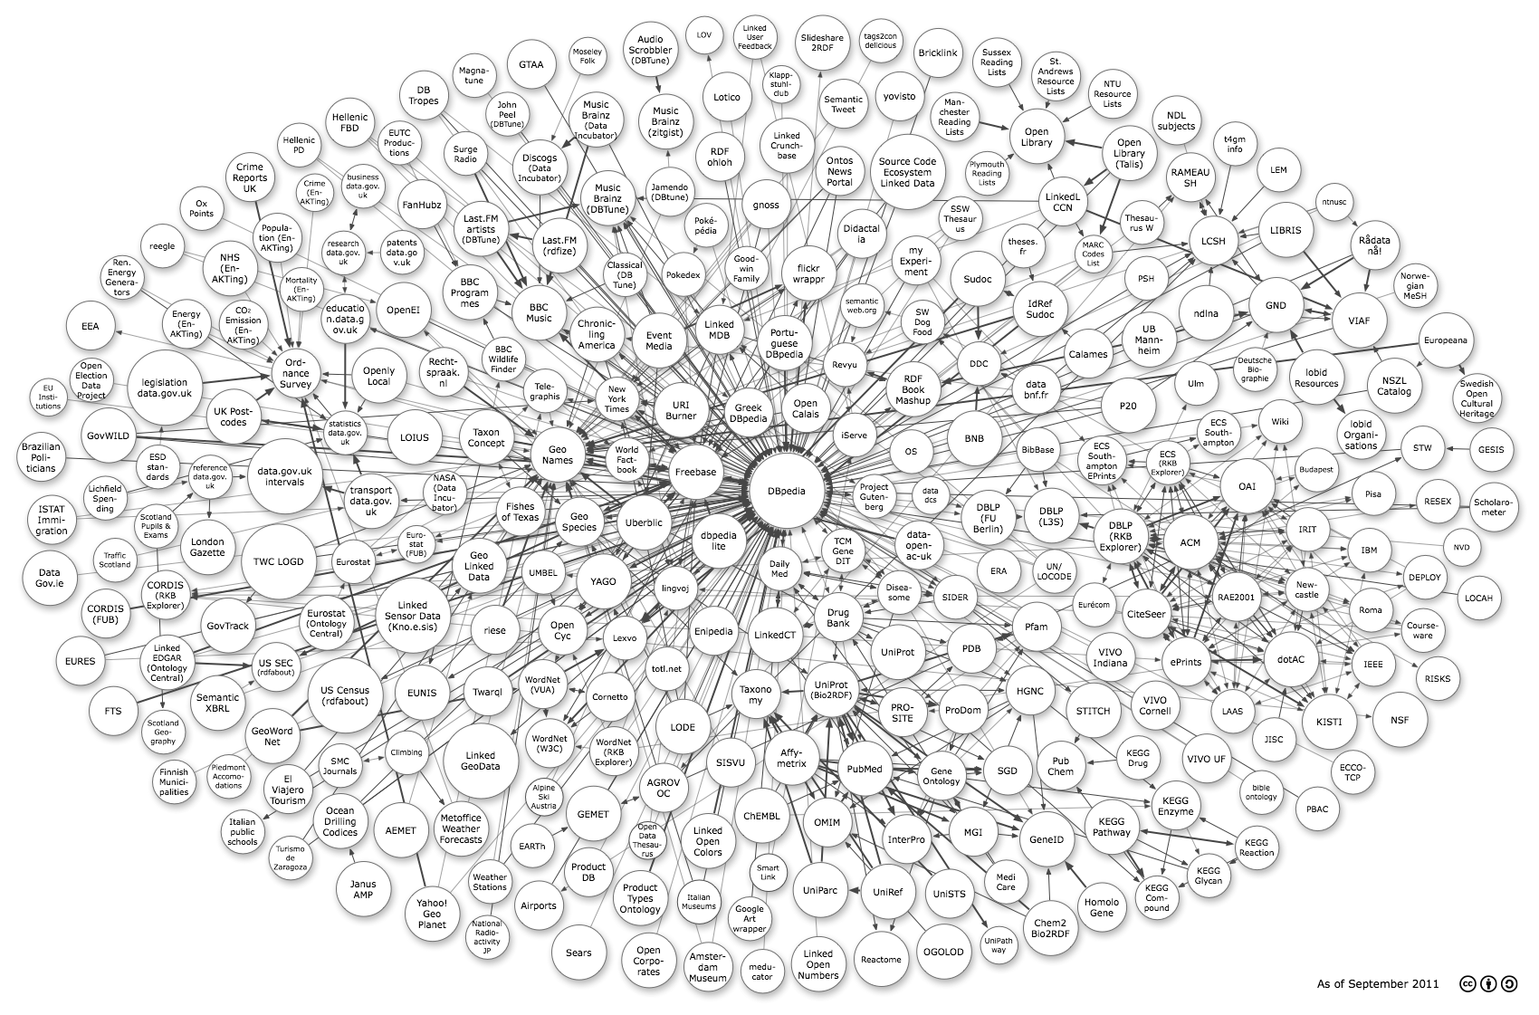
...but the Value is in the Connections

Slide 7
Big Data’s Value
is underpinned by Linked Data

Slide 8
The Linked Open Data Cloud

Slide 9
Linked Data is built upon
Semantic Web Technologies

Slide 10
RDF and SPARQL

Slide 11
a lack of standard protocols...

Slide 12
...leads to implementation specific APIs

Slide 13
and additional complexity

Slide 14
New Protocols from the W3C
SPARQL 1.1 Graph Store HTTP Protocol
SPARQL 1.1 Protocol

Slide 15
SPARQL 1.1 Graph Store HTTP Protocol
Graph Dataset Management over HTTP

Slide 16
SPARQL 1.1 Protocol
SPARQL Queries over HTTP

Slide 17
Graph Stores are Starting to
Support these Protocols

Slide 18
GRASP
GRaph store And SPARQL Protocol

Slide 19
A GitHub Project
https://github.com/philipfennell/grasp

Slide 20
XQuery Client Libraries
lib-gsp.xqy - Graph Store HTTP Protocol
lib-spq.xqy - SPARQL Protocol

Slide 21
Convenience Functions
gsp:add-default-graph(...) gsp:add-named-graph(...) gsp:retrieve-default-graph-metainfo(...) gsp:retrieve-named-graph-metainfo(...) gsp:retrieve-default-graph(...) gsp:retrieve-named-graph(...) gsp:merge-default-graph(...) gsp:merge-named-graph(...) gsp:delete-default-graph(...) gsp:delete-named-graph(...) gsp:data(...)

Slide 22
Why so many functions?

Slide 23
I don’t like too many arguments!

Slide 24
Wrappers for Operations
Retrieve
Delete
Create
Update

Slide 25
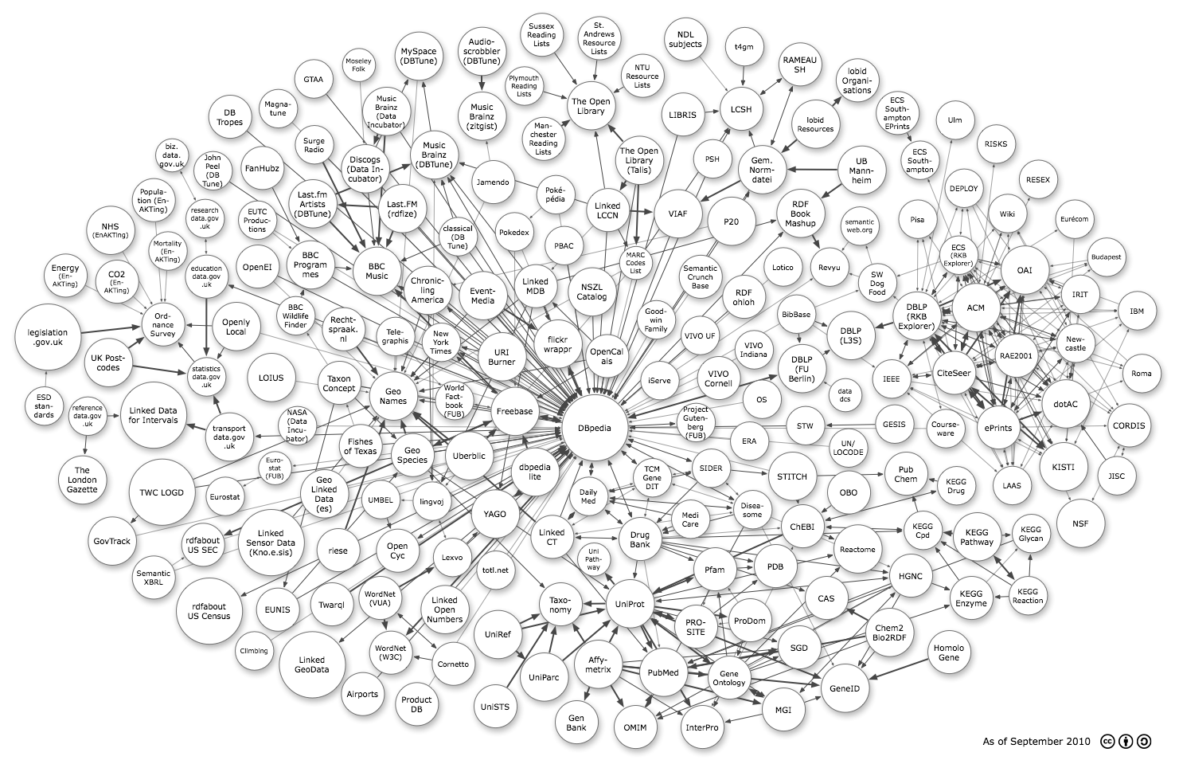
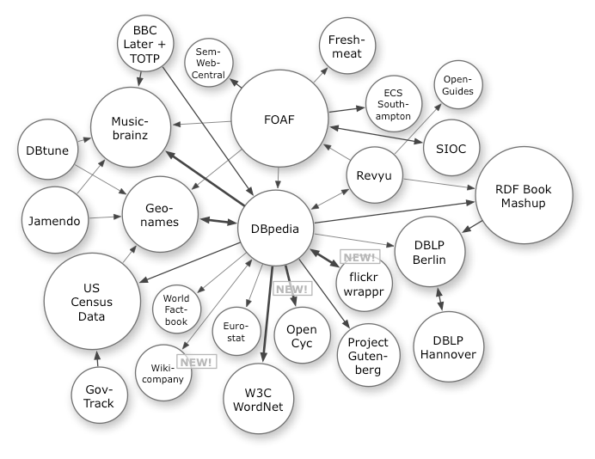
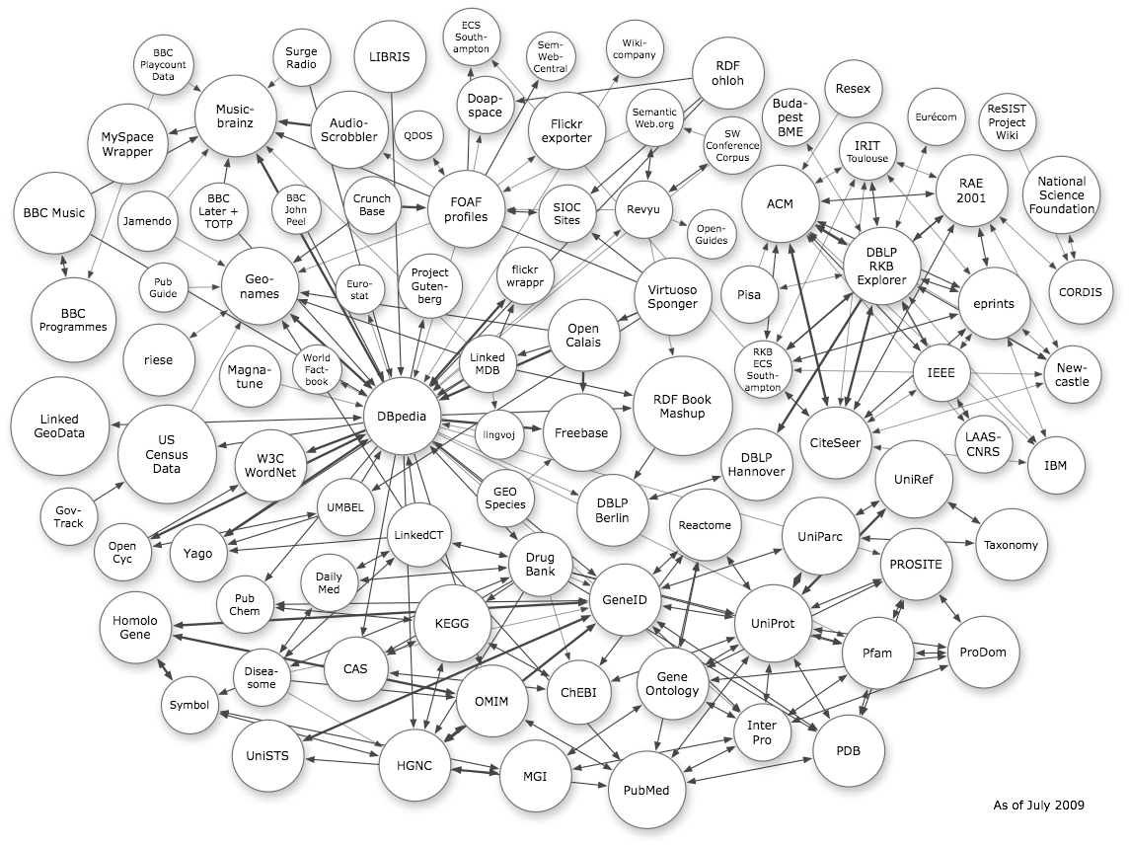
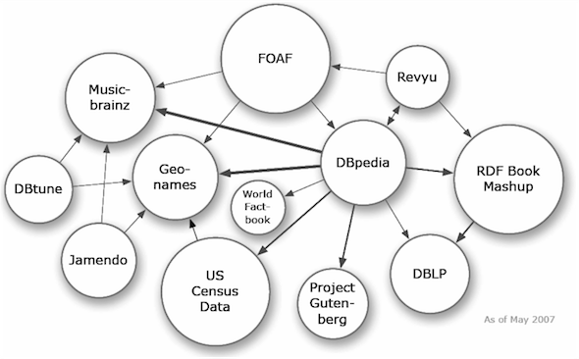
Linked Data is Growing

Slide 26
The Defining Factor in the Realization of Big Data's Potential

Slide 27
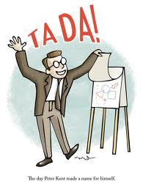
Time for a Demonstration

Slide 28
Thank You
philip.fennell@marklogic.com

