Slide 1
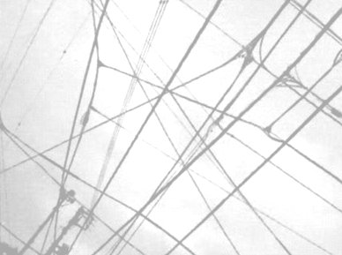
MarkLogic and the Linked Data Connection
Philip Fennell, Consultant
22nd May 2012

Slide 2
Big Data is big news
Notes:
Big Data is 'big news'

Slide 3
Volume, Velocity and Variety are growing…
Notes:
and whilst the Volume, Velocity and Variety of that data continues to grow its true Value is not any measure of the afore mentioned variables but

Slide 4
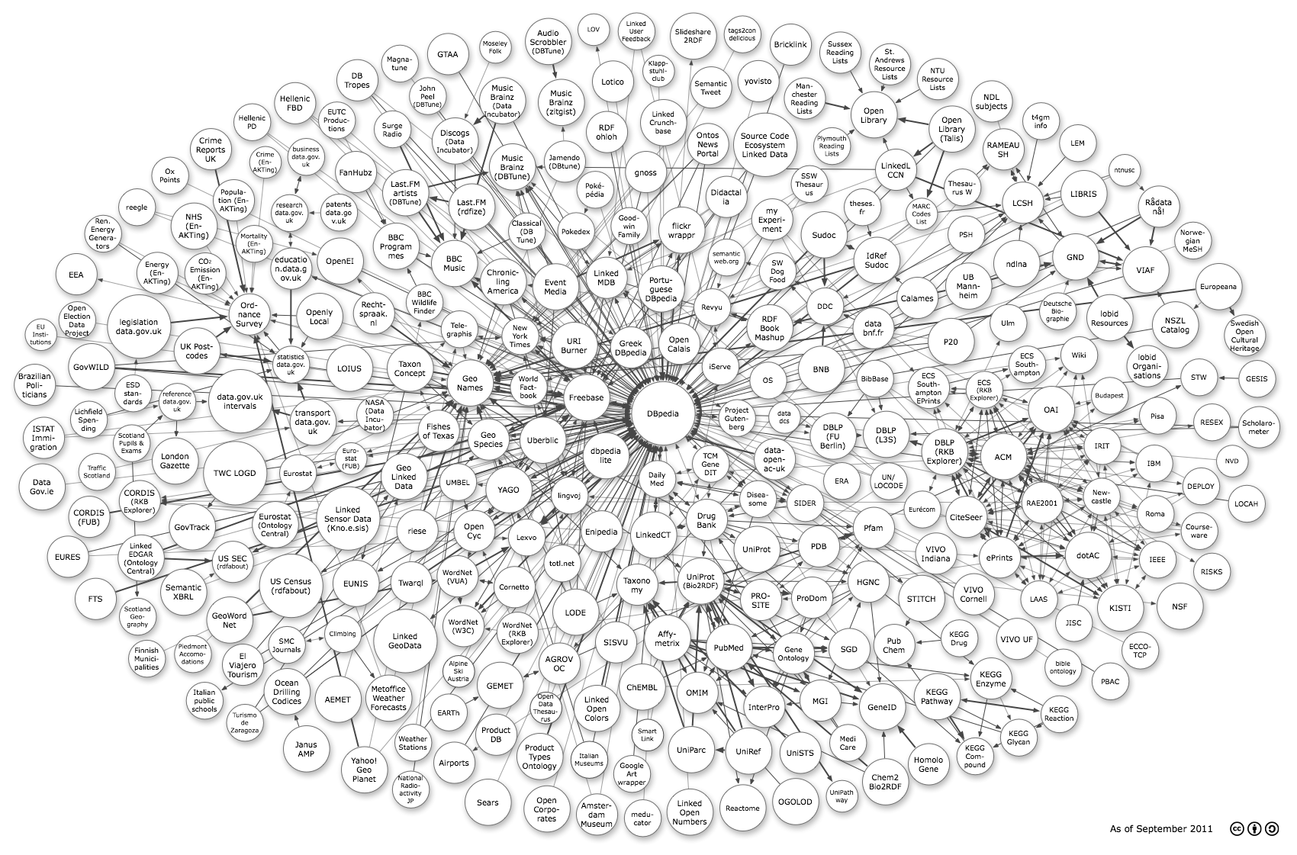
...but the Value is in the Connections
Notes:
the connections within and between data sets.

Slide 5
Big Data’s Value
is underpinned by Linked Data
Notes:
Those connections, or links, have the potential to grow at an even fast rate as more links emerge over time. Linked Data underpins the value of Big Data and is the key to realising the potential of Big Data.

Slide 6
Linked Open Data
Notes:
Linked [Open] Data

Slide 7
Linked Data is built upon
Semantic Web Technologies
Notes:
is built upon the foundations of the Semantic Web technologies and as such is exposed as

Slide 8
RDF and SPARQL
Notes:
RDF Graphs and queried via the SPARQL query language.

Slide 9
A lack of standard protocols...
Notes:
Due to the historical lack of standard protocols for acceessing these repositories

Slide 10
...leads to implementation specific APIs
Notes:
it has lead to a variety of implementation specific APIs to load and query the data sets held within

Slide 11
and additional complexity
Notes:
and the additional complexity of a middle-tier archtecture to bridge the gap between content stores and graph stores.

Slide 12
New protocols from the W3C
SPARQL 1.1 Graph Store HTTP Protocol
SPARQL 1.1 Protocol
Notes:
The W3C have been working on a number of specifications regarding managing and querying RDF data sets over HTTP

Slide 13
SPARQL 1.1 Graph Store HTTP Protocol
Graph Dataset Management over HTTP

Slide 14
SPARQL 1.1 Protocol
SPARQL Queries over HTTP

Slide 15
Support is Growing for these protocols
Notes:
Support is growing for these protocols

Slide 16
GRASP
GRaph store And SPARQL Protocol
Notes:
and to enable MarkLogic to interact directly with these data sources I've been developing GRASP (GRaph store And Sparql Protocol),

Slide 17
A GitHub project
https://github.com/philipfennell/grasp

Slide 18
XQuery client libraries
lib-gsp.xqy - Graph Store HTTP Protocol
lib-spq.xqy - SPARQL Protocol
Notes:
which is a set of XQuery libraries that implement the client end of these protocols.

Slide 19
A Wide Range of functions
gsp:add-default-graph, gsp:add-named-graph, gsp:retrieve-default-graph-metainfo, gsp:retrieve-named-graph-metainfo,
gsp:retrieve-default-graph,
gsp:retrieve-named-graph,
gsp:merge-default-graph,
gsp:merge-named-graph,
gsp:delete-default-graph,
gsp:delete-named-graph, gsp:data,
spq:query, spq:data
Notes:
and provide a wide range of convenience functions that simplify making the HTTP requests to Graph Stores that support these protocols.

Slide 20
But why so many functions?
Notes:
Why so many functions when one or two, with a pile of optional arguments, would do?

Slide 21
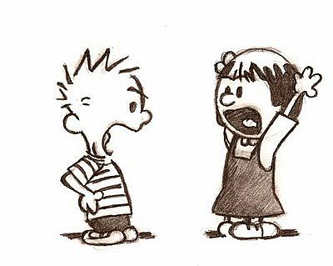
I don’t like too many arguments!
Notes:
The simple answer is, I don't like too 'arguments'.

Slide 22
I don’t like optional arguments!
xdmp:document-insert(
'/books/collection/A123.xml',
<book>
<title>Linked Data</title>
</book>,
(), (), (),
5780546120451828821
)
Notes:
Well, I don't like too many optional arguments where some have to be set as an empty sequence in order to pad the way to setting others.

Slide 23
A RESTful interface for Graph Stores
Notes:
Basically, these functions are wrappers for their respective RESTful actions and, in effect, provide a RESTful interafce to a Graph Store.

Slide 24
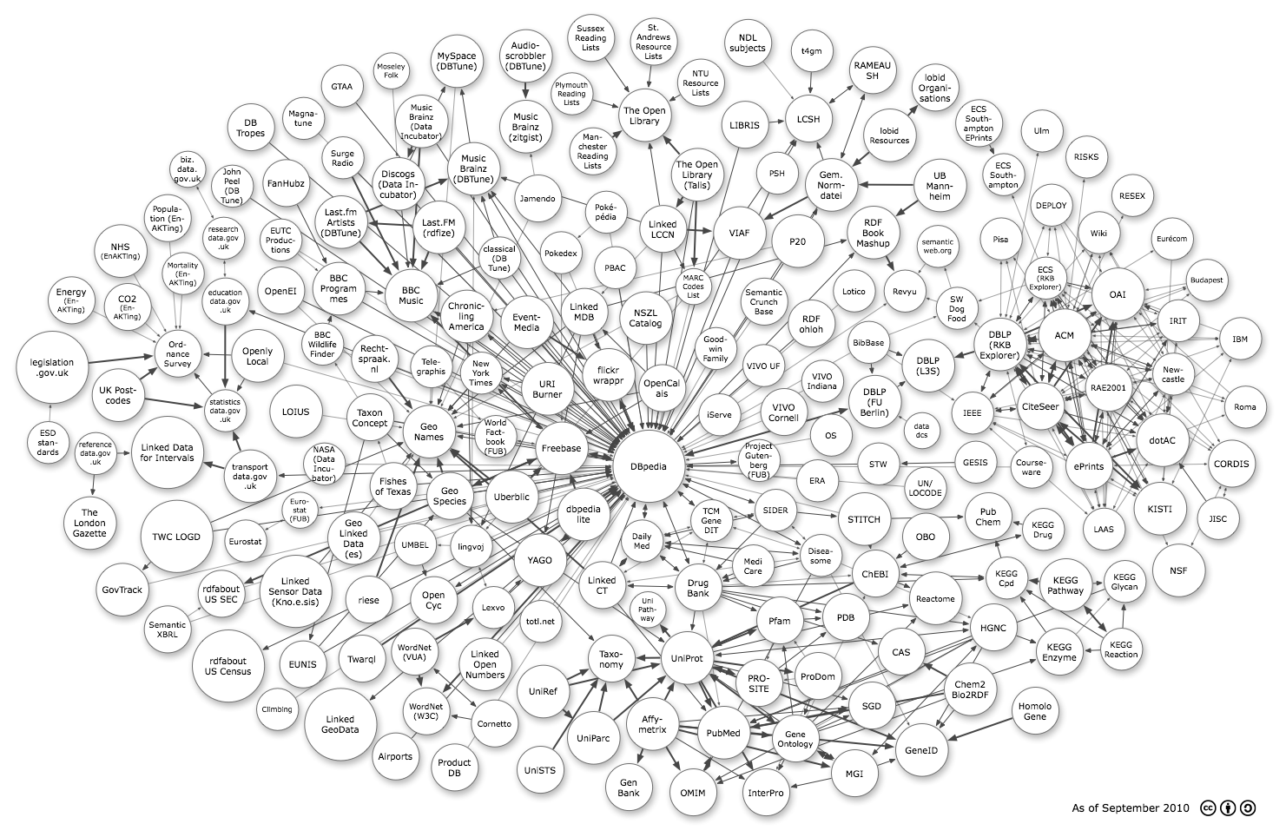
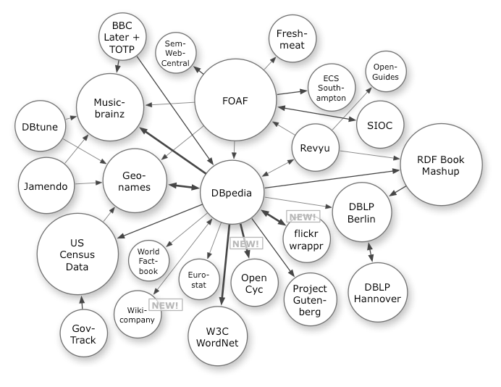
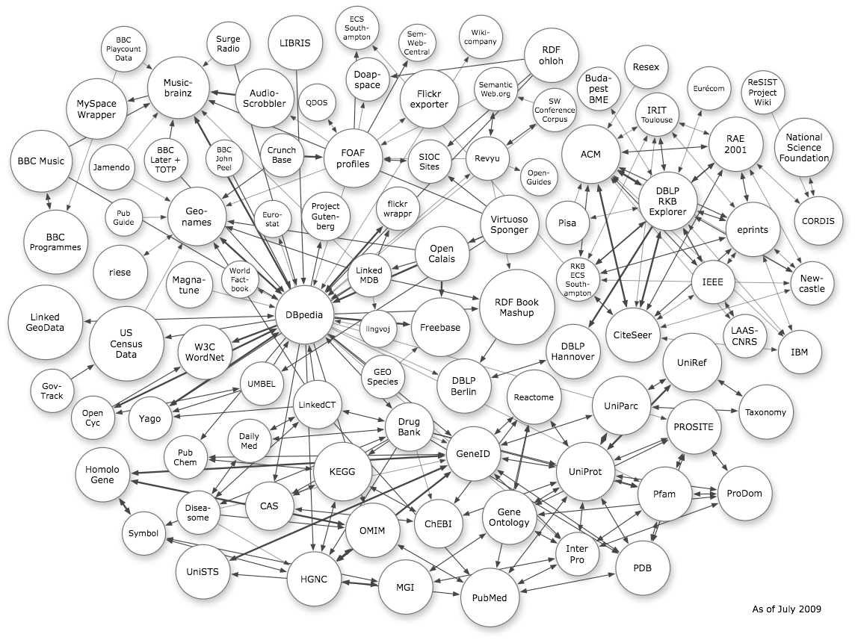
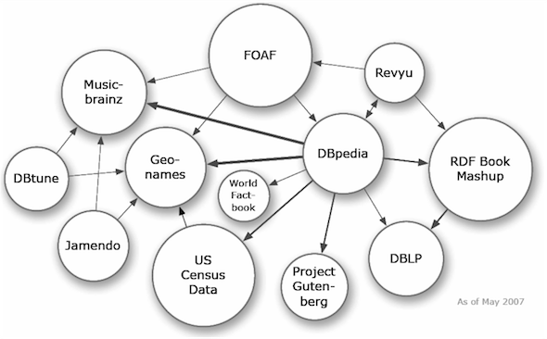
Linked Open Data has expanded
to this in just five years
Notes:
The Linked Open Data Cloud has grown considerable in just five years.

Slide 25
The defining factor in the Realization of Big Data's Potential
Notes:
If the rate at which the Linked Open Data Cloud has expanded over the last five years is anything to go by, the ability of businesses to interact with such a richly inter-linked source of information will be the defining factor in the realistion of Big Data's potential.

Slide 26

Time for a Demonstration

Slide 27
Thank You
philip.fennell@marklogic.com

