Slide 1
Exam 70-533 Implementing Microsoft Azure Infrastructure Solutions
Speaker Information:
https://www.microsoft.com/en-ie/learning/exam-70-535.aspx
Notes:
Presentation: 105 minutes
Lab: 50 minutes
After completing this module, students will be able to:
Identify suitable workloads for the cloud.
Identify services and capabilities that Microsoft Azure provides.
Use Azure portals to manage Azure services and subscriptions.
Use Windows PowerShell to manage Azure services and subscriptions.
Use Azure Command-Line Interface (CLI) to manage Azure services and subscriptions.
Describe the primary characteristics of Azure Resource Manager.
Use Azure services to enhance management and monitoring of Azure.
Required materials
To teach this module, you need the Microsoft PowerPoint file 20533D_01.pptx.
Preparation tasks
To prepare for this module, you should:
Read all this module’s materials.
Practice performing the demonstrations and labs.
Work through the Module Review and Takeaways section to determine how you will use the information to reinforce student learning and promote knowledge transfer to on-the-job performance.
As you prepare for this class, it is imperative that you complete the labs yourself. This gives you an understanding of how the labs work, as well as the concepts that each lab covers. This enables you to provide meaningful hints to students who might have issues while working in the labs. Furthermore, it will help guide your lecture to ensure that you discuss the concepts that the labs cover.
20533D
1: Introduction to Microsoft Azure

Slide 2
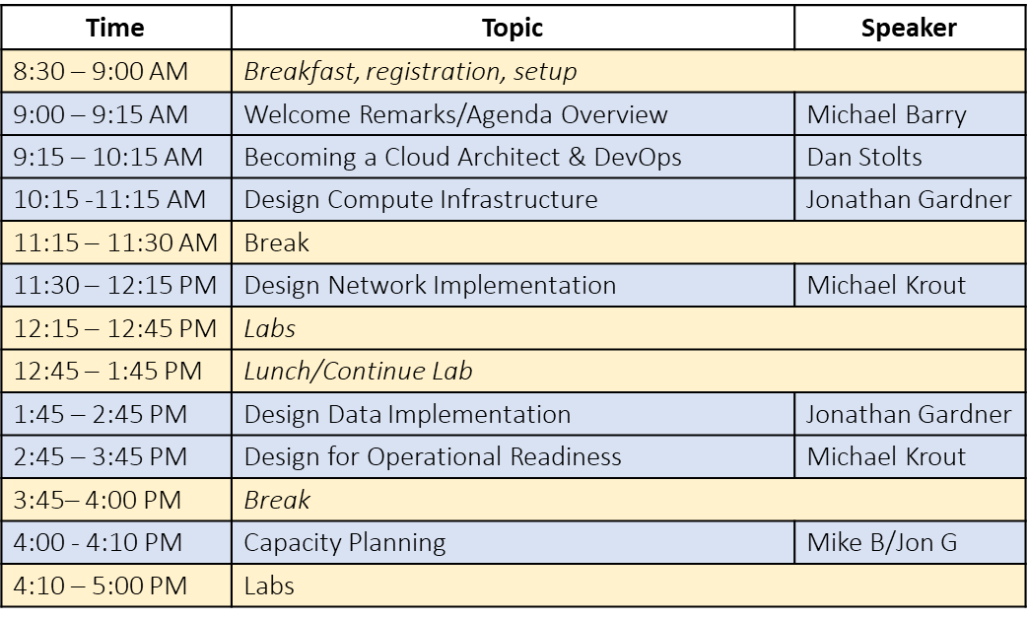
Agenda: 70-535 Architecting Azure Solutions
Day 1: Thursday, February 15, 2018
Day 2: Friday, February 16, 2018
WiFi Code: MSFTGUEST
WiFi Password: msevent25mp
Socialize: #70-535 @ITProGuru
Content…PPTX and Labs:https://github.com/guruskill Program Home: https://ptdrv.linkedin.com/8na8bsr Evaluation Link: https://tinyurl.com/FL0215

Slide 3
Compute & Networking
Multi-NIC Virtual Machine Creation using Two Subnets https://github.com/Azure/azure-quickstart-templates/blob/master/101-1vm-2nics-2subnets-1vnet/
Create a virtual network using PowerShell https://docs.microsoft.com/en-us/azure/virtual-network/virtual-networks-create-vnet-arm-ps
Create a virtual network using the Azure CLI https://docs.microsoft.com/en-us/azure/virtual-network/virtual-networks-create-vnet-arm-cli
http://github.com/guruskill/70-535

Slide 4
Containers
Create your first container https://blogs.technet.microsoft.com/canitpro/2017/08/02/step-by-step-first-steps-with-azure-container-services/
More ways to create containers https://docs.microsoft.com/en-us/azure/container-instances/

Slide 5
Storage and Operational Readiness
Getting Started with Storage - Manage Storage Account - in .Net https://azure.microsoft.com/en-us/resources/samples/storage-dotnet-manage-storage-accounts/
Desired State Configuration (DSC) https://docs.microsoft.com/en-us/azure/automation/automation-dsc-getting-started
How Azure Backup Works in 10 mins https://docs.microsoft.com/en-us/azure/backup/backup-try-azure-backup-in-10-mins
More Storage: https://azure.microsoft.com/en-us/resources/samples/?service=storage

Slide 6
Day 1 Labs
Multi-NIC Virtual Machine Creation using Two Subnets https://github.com/Azure/azure-quickstart-templates/blob/master/101-1vm-2nics-2subnets-1vnet
Create a virtual network using PowerShell https://docs.microsoft.com/en-us/azure/virtual-network/virtual-networks-create-vnet-arm-ps
Create a virtual network using the Azure CLI https://docs.microsoft.com/en-us/azure/virtual-network/virtual-networks-create-vnet-arm-cli
Create your first container https://blogs.technet.microsoft.com/canitpro/2017/08/02/step-by-step-first-steps-with-azure-container-services/
More ways to create containers https://docs.microsoft.com/en-us/azure/container-instances/
Getting Started with Storage - Manage Storage Account - in .Net https://azure.microsoft.com/en-us/resources/samples/storage-dotnet-manage-storage-accounts/
Authentication: Broken Link in lab Use: https://docs.microsoft.com/en-us/dotnet/azure/dotnet-sdk-azure-authenticate?view=azure-dotnet
Desired State Configuration (DSC) https://docs.microsoft.com/en-us/azure/automation/automation-dsc-getting-started
How Azure Backup Works in 10 mins https://docs.microsoft.com/en-us/azure/backup/backup-try-azure-backup-in-10-mins
More… http://github.com/guruskill/70-535
Azure Quick Start Templates https://github.com/Azure/azure-quickstart-templates

Slide 7
Security, Identity and Platform Services
Enable encryption on a running Windows VM https://github.com/Azure/azure-quickstart-templates/tree/master/201-encrypt-running-windows-vm
Azure AD Dev Integration (.NET, Java, or Node.js) https://github.com/guruskill/70-534/blob/master/Labs/AzureADLab.md
Design Advanced Applications https://github.com/guruskill/70-534/blob/master/Labs/AdvancedAppsLab.md
Creating an Azure AD B2C and Connect an Application https://github.com/guruskill/70-534/blob/master/Labs/AzureADB2CLab.md

Slide 8
Day 2 Labs
Enable encryption on a running Windows VM https://github.com/Azure/azure-quickstart-templates/tree/master/201-encrypt-running-windows-vm
Azure AD Dev Integration (.NET, Java, or Node.js) https://github.com/guruskill/70-534/blob/master/Labs/AzureADLab.md
Design Advanced Applications https://github.com/guruskill/70-534/blob/master/Labs/AdvancedAppsLab.md
Creating an Azure AD B2C and Connect an Application https://github.com/guruskill/70-534/blob/master/Labs/AzureADB2CLab.md
Create an alert rule on a metric with the Azure portal https://github.com/guruskill/70-534/blob/master/Labs/06-Monitoring-Create-Alerts.md
Azure Automation Account https://github.com/guruskill/70-534/blob/master/Labs/06-Monitoring-Azure-Automation.md

Slide 9
Thought Experiment / Case Study 1 Web App - SOLUTION DESIGN
Break Into Teams of 5-8
Prepare report to to be delivered to CA during your next meeting
Include any clarifying questions or additional observations in report
Background: Contoso Vacations is a full-service travel agency with operations across North America and Europe. As part of a campaign to gain market share in emerging tourism trends, Contoso recently acquired Fabrikam Adventures, a small agritourism company that helps vacationers find and book working vacations on farms and ranches. As part of the acquisition, Contoso has decided to sunset all but three of Fabrikam’s existing applications.
You are a team of Cloud Architects at Contoso Vacations. The Chief Architect (CA) has just sent an email that was forwarded to you for collaboration, asking for your help on a special project.
Subject: Need plan to migrate 3 Fabrikam apps to Azure
I wanted to give you a status update on the datacenter consolidation project. I got word from the Steering Committee that the target data for decommissioning the Fabrikam datacenter will be the end of Q3, when their cage lease expires. The plan is for all their legacy LOB apps to be sunset and folded into our corresponding Contoso LOB apps. That leaves them with three customer-facing apps to continue supporting after the DC closes.
These three applications will be migrated to Azure, so that Fabrikam’s existing datacenter can be decommissioned. The applications that will be migrated to Azure include:
GoFabrikam.com – Fabrikam’s customer-facing website lets vacationers browse, search, and book trips. The current website is an asp.net application that runs on IIS and SQL Server 2014 SP2. Traffic volume to this website is low, but performance needs to be reliable in order to capture every potential booking.
Agri-Hub – Fabrikam’s partner-facing website is used by farm operators to enter and update inventory, manage reservations and customer charges, and coordinate revenue payments from Fabrikam. The partner website is a section of the main website, but uses a SQL server 2008 (SP4) backend for reservations. It also has several custom APIs and scheduled batch process jobs that were written in Java, PHP, and C#, which allow the reservation system to integrate with several 3rd party service providers, including airlines, credit card processors, and banks.
Farm Viewer –Fabrikam provides real-time data about each farm on their website. Visitors can research information about crops, livestock, weather, and harvest activities as they book their trips. This information is collected by IoT sensors at each farm. The sensor data are sent to a web service, where they are collected and stored in a MongoDB database. The information is then accessed and displayed on the main website.
Desired Outcome:
For each of the three workflows identified as candidates to move to Azure, identify an architecture style for the target-state solution, and create a high-level solution design that indicates the Azure services that you plan on using. You do not need to specify service configurations or other details at this point; however, please be prepared to justify your decision in terms of features, cost, and quality.
Resources:
Email from the CTA: https://certprep.azurewebsites.net/wp-content/uploads/2017/09/Lab-1.pdf
Azure Architecture Styles
Azure Reference Architectures
Email at: https://certprep.azurewebsites.net/ Lab #1

Slide 10
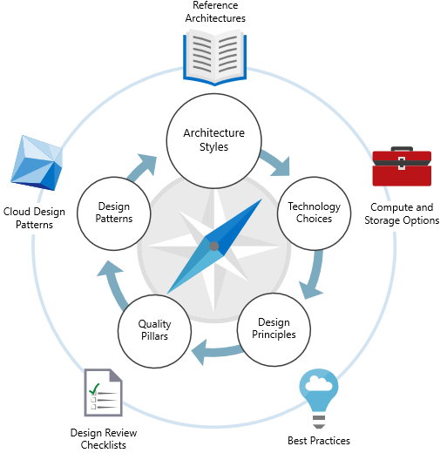
Solution Architecture: Overview
Session Goals
Understand Azure architectural approach, and recognize different Architecture Styles
Know when to choose a particular style, based on benefits, challenges, and best practices
Understand Technology Choices for implementing architecture styles.
Recognize Azure services that can be used for compute and data services
Reference: https://docs.microsoft.com/en-us/azure/architecture/

Slide 11
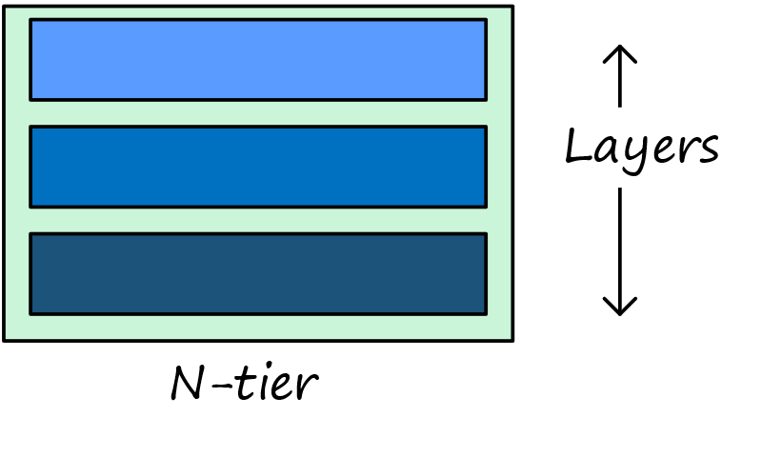
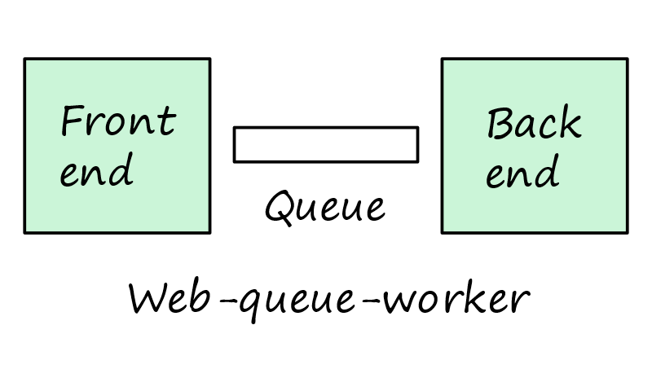
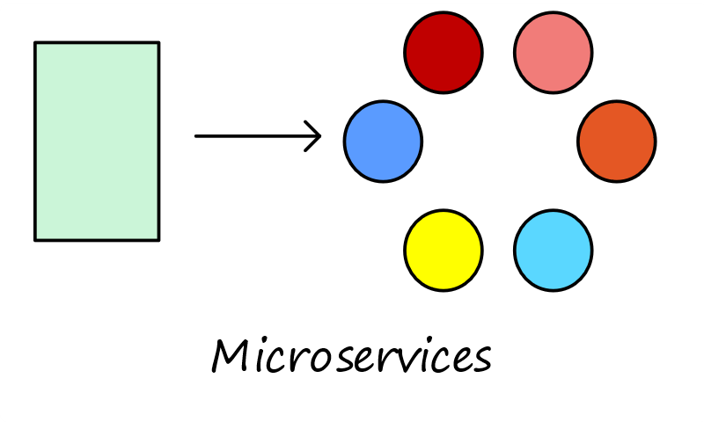
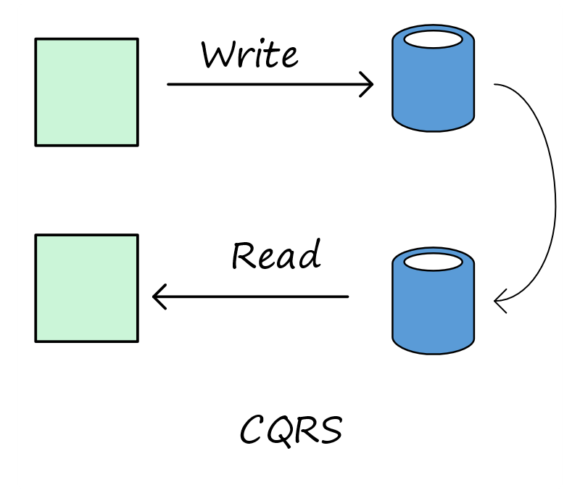
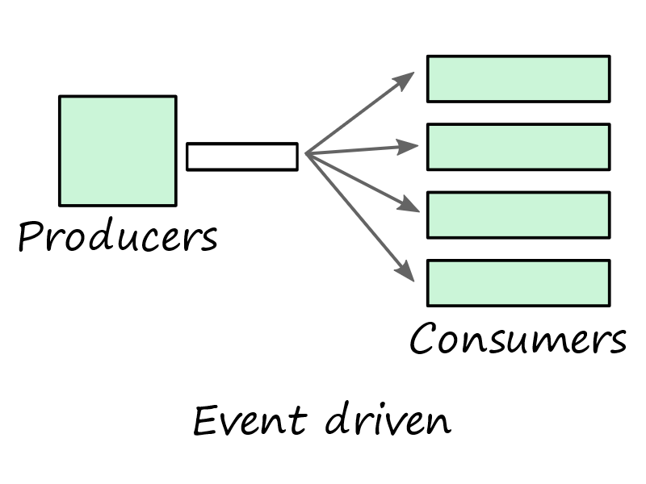
Lab Setup: Architecture Styles
N-tier
Traditional enterprise architecture
Ideal for lift-and-shift
Web-Queue-Worker
PaaS solutions
Relies on asynchronous messaging
Microservices
Many small, independent services
Requires mature DevOps processes
CQRS (Command and Query Responsibility Segregation)
Scale the read and write workloads independently; Large Scale
For collaborative domains where many users access the same data
Event-driven
Producers publish, consumers subscribe
Common with large data volumes (e.g. IoT)
Big Data & Big Compute
Parallel processing of chunks across large dataset
Parallel computations across large number of cores
Design Considerations
Scale
Complexity
Cost
Manageability
Service-Level Agreement
Architecture Styles
Know when to choose a particular style, based on benefits, challenges, and best practices
Technology Choices
Recognize Azure services that can be used for compute and data services
Reference: https://docs.microsoft.com/en-us/azure/architecture/guide/

Slide 12
Team Discussion: Architecture Styles

Slide 13
Case Study #1: Contoso Vacations
Contoso Vacations is a full-service travel agency with operations across North America and Europe. As part of a campaign to gain market share in emerging tourism trends, Contoso recently acquired Fabrikam Adventures, a small agritourism company that helps vacationers find and book working vacations on farms and ranches. As part of the acquisition, Contoso has decided to sunset all but three of Fabrikam’s existing applications.
The three applications that remain will be migrated to Azure, so that Fabrikam’s existing datacenter can be decommissioned. The three applications that will be migrated to Azure include:
GoFabrikam.com – Fabrikam’s customer-facing website lets vacationers browse, search, and book trips. The current website is an asp.net application that runs on IIS and SQL Server 2014 SP2. Traffic volume to this website is low, but performance needs to be reliable in order to capture every potential booking.
Agri-Hub – Fabrikam’s partner-facing website is used by farm operators to enter and update inventory, manage reservations and customer charges, and coordinate revenue payments from Fabrikam. The partner website is a section of the main website, but uses a SQL server 2008 (SP4) backend for reservations. It also has several custom APIs and scheduled batch process jobs that were written in Java, PHP, and C#, which allow the reservation system to integrate with several 3rd party service providers, including airlines, credit card processors, and banks.
Farm Viewer (“View”) –Fabrikam provides real-time data about each farm on their website. Visitors can research information about crops, livestock, weather, and harvest activities as they book their trips. This information is collected by IoT sensors at each farm. The sensor data are sent to a web service, where they are collected and stored in a MongoDB database. The information is then accessed and displayed on the main website.

Slide 14
Thought Experiment / Case Study 1 Web App - SOLUTION DESIGN
Break Into Teams of 5-8
Prepare report to to be delivered to CTO during your next meeting
Include any clarifying questions or additional observations in report
Application
Architecture: N-tier, Web-queue-worker, Microservices, CQRS, Event-driven
Design Considerations / Why?: Scale, Complexity, Cost, Manageability, Service-Level Agreement
GoFabrikam.com –
Agri-Hub –
Farm Viewer -

Slide 15
Thought Experiment / Case Study #2 Acquisition and Migration of Fabrikam Team Collaboration Exercise
Break Into Teams of 5-8
Prepare report to to be delivered to CTO during your next meeting
Include any clarifying questions or additional observations in report
You are the administrator for Contoso. You have more than 100 hosts in your on-premises datacenter. You are replicating and using Site Recovery as part of your BC/DR plan. Contoso just acquired another company, Fabrikam, Inc. The development teams at both Contoso and Fabrikam use Visual Studio and Visual Studio Team Services.
Letter from the CTO:
As you know, we have finalized the acquisition of Fabrikam. I would like for you to come up with a plan of execution for migrating the workloads running in the Fabrikam datacenter. The lease of the space will be expiring in 9 months at which time we must have everything out. I would prefer that we get everything moved quickly, in the next 4-6 months. Then we can do some cleanup later if needed. We MUST make sure we maintain a high degree of confidence in securing all data as we go through this transition. All applications will continue to be used for the foreseeable future. It is important to minimize system downtime of Fabrikam services. The physical machines at Fabrikam are beyond or nearing their expected usable life. We have a directive from leadership to minimize capital expenditures where possible, so we should look at viability of putting services in Azure. I would also like you to be conscious of the costs of ongoing maintenance of these services until such a time that they can be evaluated for longer term upkeep projections. Where possible, leverage our DevOps practices and switch applications to native cloud apps leveraging serverless compute. Some of the Fabrikam apps are already running in containers. Plan on adding these to our existing container infrastructure running on Azure Service Fabric.
Fabrikam has 5 VMware hosts, 10 Hyper-V hosts and more than 60 VMs. They are running a mix of operating systems, some running Linux but most running Windows Server. The following is a quick list of servers and apps.
46-web applications running on Windows Server and IIS; 4 are only providing API services to applications. Those that use data, use SQL server. All but three are running stateless.
3-websites running on Linux, Apache, PHP, WordPress
3-containerized applications running .NET core on Linux
8-containerized applications running Node.js
1-Oracle database server
3-SQL servers running more than 20 databases
2-Domain Controllers
2-External DNS servers
2-Monitoring and reporting servers
1-file server
1-3 node cluster for batch processing and analysis running R scripts; usually on a monthly cadence to do analysis of customer purchasing patterns
Email from CTO Continued on next slide

Slide 16
Thought Experiment / Case Study #2 Answer the following questions in a report back to the CTO…
Break Into Teams of 5-8
Prepare report to to be delivered to CTO during your next meeting
Include any clarifying questions or additional observations in report
Email from CTO Continued:
With this in mind, answer the following questions :
What site should be used to receive Fabrikam VM services and why?
What tool(s) could we use to securely migrate the VM workloads while minimizing downtime?
How can we minimize downtime of Fabrikam web services?
Can the Linux websites be migrated to serverless compute on Azure? If so, how?
What are the best destination services for migration of the IIS websites?
What is the best way to move the containers to Azure Container Instances?
What are the next steps after an application has been moved to Azure?
Is the batch cluster a good candidate for migration to serverless compute? Why or Why not?
Are there any tools to help us understand what is running at Fabrikam and what would be needed for the migration?
Is there a tool or service to switch the existing web workloads to the new production location (Azure or Contoso) with little or no downtime?
What challenges do you think you need to prepare for?

