Slide 1

Architect an Azure Compute Infrastructure
ARM Virtual Machines
ARM Templates
Design for Availability
Containers

Slide 2
VMs

Slide 3
VMs
When you pay for a VM, this is what you are paying for: Cores, RAM, Temp Disk
What is a VM?
Cores (CPUs)
RAM
Temp Disk
Disks
Network Interface Cards
Pricing is charged by the hour.
Partial hours are charged by the minute.
Storage is priced and charged separately.
Limits
Learn about default and Maximum Limits. Eg.20 cores per region. 10,000 Max.
Windows/Linux
Containers
Encryption
Memory, CPU, Disk, Network intensive?
How many cores
How much disk space
SSDs required
IOPS required
How many NICs
Networking Speed
Notes:
Limits: https://docs.microsoft.com/en-us/azure/azure-subscription-service-limits#virtual-machines-limits
Pricing - https://azure.microsoft.com/en-us/pricing/details/virtual-machines/linux/
Vertical scaling - https://docs.microsoft.com/en-us/azure/virtual-machines/linux/vertical-scaling-automation?toc=%2fazure%2fvirtual-machines%2flinux%2ftoc.json

Slide 4
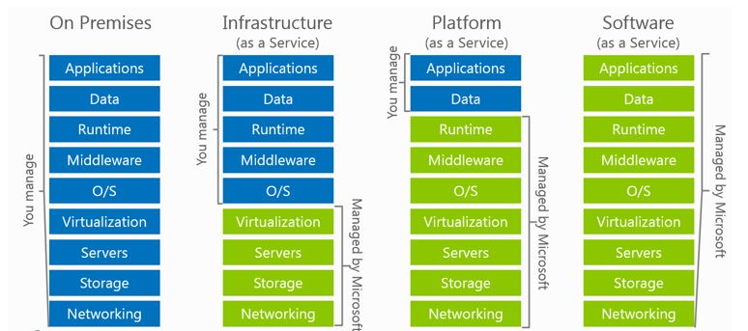
VMs or Paas? – What is the workload
Use VMs
Lift & Shift
Existing Deployment Model
OS customization required
Installed Dependencies required
Hardcoded lookups (Folders, drive letters, etc)
Portability
Notes:
If you want to lift and shift an app – for example, a legacy app
You need to customize the OS and install depend

Slide 5
VMs – Supported Operating Systems
Linux distributions and versions supported on Azure
Linux
CentOS
CoreOS
Debian
Oracle
Red Hat
SUSE
openSUSE
Ubuntu
Windows Server
Windows 2003* https://support.microsoft.com/en-us/help/3206074
Windows 2008R2+
Distribution | Version | Drivers | Agent
CentOS | CentOS 6.3+, 7.0+ | CentOS 6.3: LIS download CentOS 6.4+: In kernel | Package: In repo under "WALinuxAgent" Source code: GitHub
CoreOS | 494.4.0+ | In kernel | Source code: GitHub
Debian | Debian 7.9+, 8.2+ | In kernel | Package: In repo under "waagent" Source code: GitHub
Oracle Linux | 6.4+, 7.0+ | In kernel | Package: In repo under "WALinuxAgent" Source code: GitHub
Red Hat Enterprise Linux | RHEL 6.7+, 7.1+ | In kernel | Package: In repo under "WALinuxAgent" Source code: GitHub
SUSE Linux Enterprise | SLES/SLES for SAP 11 SP4 12 SP1+ | In kernel | Package: for 11 in Cloud:Tools repo for 12 included in "Public Cloud" Module under "python-azure-agent" Source code: GitHub
openSUSE | openSUSE Leap 42.1+ | In kernel | Package: In Cloud:Tools repo under "python-azure-agent" Source code: GitHub
Ubuntu | Ubuntu 12.04, 14.04, 16.04, 16.10 | In kernel | Package: In repo under "walinuxagent" Source code: GitHub
Notes:
https://docs.microsoft.com/en-us/azure/virtual-machines/linux/endorsed-distros
Bring your own image for windows server 2003

Slide 6
VM Sizes
Type | Sizes | Description
General purpose | B (Preview), Dsv3, Dv3, DSv2, Dv2, DS, D, Av2, A0-7 | Balanced CPU-to-memory ratio. Ideal for testing and development, small to medium databases, and low to medium traffic web servers.
Compute optimized | Fs, F | High CPU-to-memory ratio. Good for medium traffic web servers, network appliances, batch processes, and application servers.
Memory optimized | Esv3, Ev3, M, GS, G, DSv2, DS, Dv2, D | High memory-to-CPU ratio. Great for relational database servers, medium to large caches, and in-memory analytics.
Storage optimized | Ls | High disk throughput and IO. Ideal for Big Data, SQL, and NoSQL databases.
GPU | NV, NC | Specialized virtual machines targeted for heavy graphic rendering and video editing. Available with single or multiple GPUs.
High performance compute | H, A8-11 | Our fastest and most powerful CPU virtual machines with optional high-throughput network interfaces (RDMA).
Notes:
B series - https://buildazure.com/2017/09/11/more-affordable-azure-vms-with-burstable-b-series/
Determine Cores, RAM, ACUs, Disks, NICs, Network Speed, Temporary Storage, SSD support
High level categories:
Acu helps normalize cpu perf.. D&f have same acu

Slide 7
VM Azure Compute Unit (ACU)
SKU Family | ACU \ vCPU
A0 | 50
A1-A4 | 100
A5-A7 | 100
A1_v2-A8_v2 | 100
A2m_v2-A8m_v2 | 100
A8-A11 | 225*
D1-D14 | 160
D1_v2-D15_v2 | 210 - 250*
DS1-DS14 | 160
DS1_v2-DS15_v2 | 210-250*
D_v3 | 160-190* **
Ds_v3 | 160-190* **
E_v3 | 160-190* **
Es_v3 | 160-190* **
F1-F16 | 210-250*
F1s-F16s | 210-250*
G1-G5 | 180 - 240*
GS1-GS5 | 180 - 240*
H | 290 - 300*
L4s-L32s | 180 - 240*
M | 160-180**
Provide a way of comparing compute (CPU) performance across Azure SKUs
Not all Azure Cores are created equal
A1 Core != F1 Core
Compare compute (CPU) performance across SKUs.
Notes:
Not all Azure Cores are created equal
A1 Core != F1 Core
Compare compute (CPU) performance across SKUs.
https://docs.microsoft.com/en-us/azure/virtual-machines/windows/acu
Azure Compute Unit (ACU) to provide a way of comparing compute (CPU) performance across Azure SKUs. This will help you easily identify which SKU is most likely to satisfy your performance needs. ACU is currently standardized on a Small (Standard_A1) VM being 100 and all other SKUs then represent approximately how much faster that SKU can run a standard benchmark.
ACUs marked with a * use Intel® Turbo technology to increase CPU frequency and provide a performance boost. The amount of the boost can vary based on the VM size, workload, and other workloads running on the same host.+
**Hyper-threaded.

Slide 8
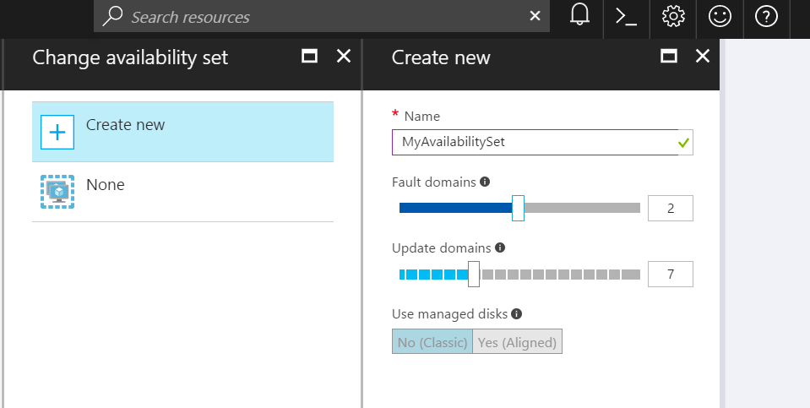
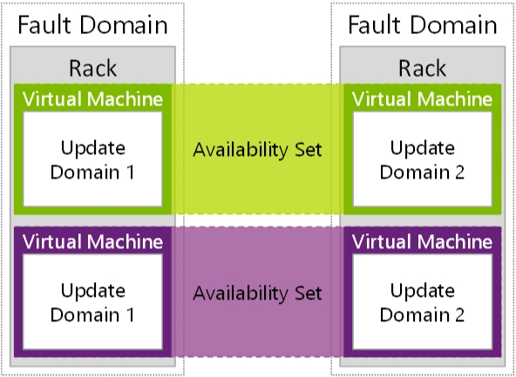
Availability Sets
Availability Sets are for Unplanned & Planned Maintenance
Fault Domains (2 default, some regions allow 3)
Upgrade Domains (5 default, 1-20 allowed)
Front with Load Balancer, App Gateway
Notes:
To provide redundancy to your application, we recommend that you group two or more virtual machines in an availability set.
Fault domain – collection of resources that may fail at the same time due to same root cause. Servers in same rack are part of same fault domain. A fault domain has a single point of failure. Place resources in separate fault domain so that they remain available in case of a failure
Update domain – logical collection of resources that can be updated at the same time. One update domain has updates applied at a time and may require rebooting. Pleace resources in separate update domains – it is automatic (indicate groups of virtual machines and underlying physical hardware that can be rebooted at the same time. )
One update domain has updates applied at a time
Availability set – can place vm’s in an availability set at creation or after deployment . Moving a vm in or out of availability set causes it to reboot
Fault domains
A fault domain is a logical group of underlying hardware that share a common power source and network switch, similar to a rack within an on-premises datacenter. As you create VMs within an availability set, the Azure platform automatically distributes your VMs across these fault domains. This approach limits the impact of potential physical hardware failures, network outages, or power interruptions.+
Update domains
An update domain is a logical group of underlying hardware that can undergo maintenance or be rebooted at the same time. As you create VMs within an availability set, the Azure platform automatically distributes your VMs across these update domains. This approach ensures that at least one instance of your application always remains running as the Azure platform undergoes periodic maintenance. The order of update domains being rebooted may not proceed sequentially during planned maintenance, but only one update domain is rebooted at a time.+
Managed Disk fault domains
For VMs using Azure Managed Disks, VMs are aligned with managed disk fault domains when using a managed availability set. This alignment ensures that all the managed disks attached to a VM are within the same managed disk fault domain. Only VMs with managed disks can be created in a managed availability set. The number of managed disk fault domains varies by region - either two or three managed disk fault domains per region. You can read more about these managed disk fault domains for Linux VMs or Windows VMs.
https://docs.microsoft.com/en-us/azure/virtual-machines/windows/manage-availability

Slide 9
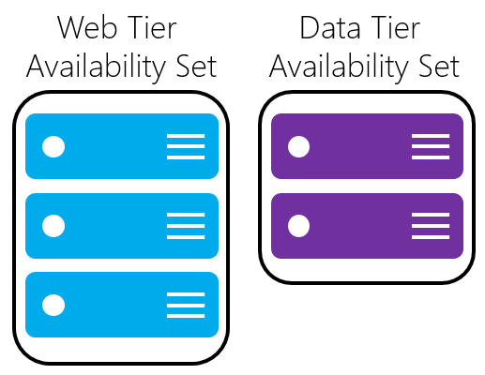
Availability Sets
Do NOT put a single VM in an Availability Set
Example - for an application,
Place front-end virtual machines in the same availability set
AND
Data-tier virtual machines in their own availability set
Notes:
Fault domain – collection of resources that may fail at the same time due to same root cause. Servers in same rack are part of same fault domain. A fault domain has a single point of failure. Place resources in separate fault domain so that they remain available in case of a failure
Update domain – logical collection of resources that can be updated at the same time. One update domain has updates applied at a time and may require rebooting. Place resources in separate update domains – it is automatic
One update domain has updates applied at a time
Availability set – can place vm’s in an availability set at creation or after deployment . Moving a vm in or out of availability set causes it to reboot

Slide 10
VM Scaling
Resize VMs (Scale up or down)
Offline operation
Just a reboot if in a cluster that supports new size
Requires a deallocation if new size is not supported in the cluster (a little longer)
Scale In or Out
You can create new instances of the VM based on platform images (max 1000) or your own custom images (max 100)
Using VM Scale Sets
Using Azure Automation
Scheduled
Azure Autoscale
System Metrics (CPU, RAM, etc)
Custom Metrics
Notes:
If the VM is part of an availability set and the new size is not supported in the cluster, all VMs in the availability set will need to be deallocated for the resize to happen
https://docs.microsoft.com/en-us/azure/virtual-machines/windows/resize-vm
- Azure Autoscale
System Metrics (CPU, RAM, etc)
Custom Metrics https://docs.microsoft.com/en-us/azure/monitoring-and-diagnostics/monitoring-overview-autoscale#resource-metrics
Scale
Up/Down
In/Out

Slide 11
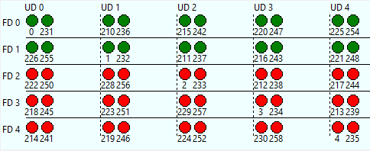
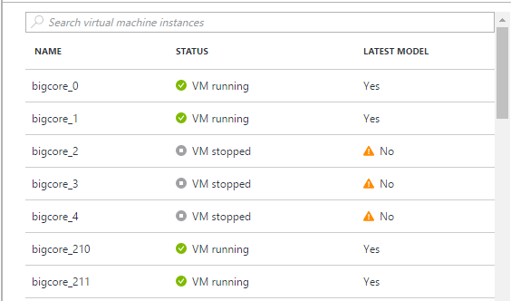
Virtual Machine Scale Sets
Deploy and manage VMs as a set
An Azure Compute resource Microsoft.Compute/virtualMachineScaleSets
Scale - Deploy identical resources
Easily
Rapidly
At scale.. 10s – 10,000s of cores
Low cost - Dynamically increase/decrease compute power to optimize costs
Elasticity - Automatically scale to changing demand
Notes:
https://azure.microsoft.com/en-us/documentation/services/virtual-machines-scale-sets

Slide 12
VM Disks
OS Disk (attached via SATA)
VHD based
Persists
Separate storage cost
Temporary Disk
Doesn’t persist - SSD
No Separate storage cost
Data Disk (SCSI)
VHD based
Persists
Separate storage cost
Current Max Data Disk Size: 4095GB
Notes:
https://docs.microsoft.com/en-us/azure/storage/storage-premium-storage#scalability-and-performance-targets
The temporary disk is labeled as the D: drive by default and it used for storing pagefile.sys

Slide 13
VM Disks – SSD
Premium Disks Type | P4 | P6 | P10 | P20 | P30 | P40 | P50
Disk size | 32 GB | 64 GB | 128 GB | 512 GB | 1024 GB (1 TB) | 2048 GB (2 TB) | 4095 GB (4 TB)
IOPS per disk | 120 | 240 | 500 | 2300 | 5000 | 7500 | 7500
Throughput per disk | 25 MB/S | 50 MB/S | 100 MB/S | 150 MB/S | 200 MB/S | 250 MB/S | 250 MB/S
Premium Storage Disk Types
P10, P20, P30
Support for SSD (Premium Storage)
DS-series, DSv2-series, GS-series, and Fs-series.
You can use Standard OR Premium storage with these series.
Notes:
https://docs.microsoft.com/en-us/azure/storage/storage-premium-storage#scalability-and-performance-targets

Slide 14
 | Azure Premium Disk | Azure Standard Disk
Disk Type | Solid State Drives (SSD) | Hard Disk Drives (HDD)
Overview | SSD-based high-performance, low-latency disk support for VMs running IO-intensive workloads | HDD-based cost effective disk support for Dev/Test VM scenarios
Scenario | Production and performance sensitive workloads | Dev/Test, non-critical, Infrequent access
Disk Size | P4: 32 GB (Managed Disks only) P6: 64 GB (Managed Disks only) P10: 128 GB P20: 512 GB P30: 1024 GB P40: 2048 GB P50: 4095 GB | Unmanaged Disks: 1 GB – 4 TB (4095 GB) Managed Disks: S4: 32 GB S6: 64 GB S10: 128 GB S20: 512 GB S30: 1024 GB S40: 2048 GB S50: 4095 GB
Max Throughput per Disk | 250 MB/s | 60 MB/s
Max IOPS per Disk | 7500 IOPS | 500 IOPS
Notes:
Managed disk - https://docs.microsoft.com/en-us/azure/virtual-machines/windows/managed-disks-overview
https://docs.microsoft.com/en-us/azure/storage/common/storage-premium-storage
Unmanaged disks
The original method is to use unmanaged disks. In an unmanaged disk, you manage the storage accounts that you use to store the virtual hard disk (VHD) files that correspond to your VM disks. VHD files are stored as page blobs in Azure storage accounts.
Managed disks
When you choose Azure Managed Disks, Azure manages the storage accounts that you use for your VM disks. You specify the disk type (Premium or Standard) and the size of the disk that you need. Azure creates and manages the disk for you. You don't have to worry about placing the disks in multiple storage accounts to ensure that you stay within scalability limits for your storage accounts. Azure handles that for you.
Throughput and IOPS are lower for smaller disks

Slide 15
VM Disks
Disks can be resized up to 4TB
Managed Vs Unmanaged.
Encryption
Disk Caching
None – for Write only and Write heavy (SQL Logs)
ReadOnly – for Read only or read-intensive disks (SQL Data files)
ReadWrite – for Operating System disks
Notes:
Disk and Azure Storage pricing: https://azure.microsoft.com/en-us/pricing/details/storage/blobs/
Encryption: https://docs.microsoft.com/en-us/azure/security/azure-security-disk-encryption#disk-encryption-deployment-scenarios-and-user-experiences
IaaS VMs are secured at rest, because you can use industry-standard encryption technology to address organizational security and compliance requirements.
IaaS VMs boot under customer-controlled keys and policies, and you can audit their usage in your key vault.
Managed disks: https://docs.microsoft.com/en-us/azure/virtual-machines/windows/managed-disks-overview
Managed disks are encrypted by default

Slide 16
VM Disks
Images are representations of your VM that you can use to create more instances of the VM
You can capture an Image of a VM and it will include all the disks
Snapshots only capture one disk at a time.
Disk Snapshots let you capture current state copies of your disks.
Managed Disks: Take Snapshots of the disk
Unmanaged Disks: Take Snapshots of the underlying VHD blob
Notes:
You can capture an Image of a VM and it will include all the disks. https://docs.microsoft.com/en-us/azure/virtual-machines/windows/capture-image-resource
Managed Disks: Take Snapshots of the disk https://docs.microsoft.com/en-us/azure/storage/storage-managed-disks-overview#images-versus-snapshots
Unmanaged Disks: Take Snapshots of the underlying VHD blob https://docs.microsoft.com/en-us/azure/storage/storage-incremental-snapshots

Slide 17
Exam Tip - Increase size of existing Disks
You can easily increase the size of existing disks. For example, you might want to increase the size of a 30-GB disk to 128 GB, or even to 4 TB. Or, you might want to convert your P20 disk to a P30 disk because you need more capacity or more IOPS and throughput.
Notes:
https://docs.microsoft.com/en-us/azure/storage/storage-premium-storage#scalability-and-performance-targets

Slide 18
VM Recommendations
Premium Storage for Production Workloads (Storage SLAs)
Choose a VM Size that works with premium storage for production
Use Managed Disks over Unmanaged Disks
Scaling Up/Down is just resizing the VM
Scaling In/Out – the VMs should be in an availability set
Use VM reboot logs to determine if VM was rebooted by planned maintenance
Use snapshots to prevent accidental data loss
Enable VM diagnostics for production (includes boot diagnostics)
Stopped VMs are still charged for use. VMs need to be deallocated to stop charges. Stopping through OS does not deallocate! Stop with portal or CLI.
Notes:
https://docs.microsoft.com/en-us/azure/architecture/reference-architectures/virtual-machines-linux/single-vm

Slide 19
ARM Templates
Notes:
Patterns for defining complex templates -https://docs.microsoft.com/en-us/azure/azure-resource-manager/best-practices-resource-manager-design-templates

Slide 20
Azure RM
* as code

Slide 21
Azure Resource Manager (ARM)
Enable application management within Azure
Resource groups are containers that can contain multiple IaaS + PaaS resources
Support lifecycle management with integrated Role Based Access Control (RBAC)
Templatize application deployment and configuration
Supports DevOps
RESOU
R
CE G
R
OUP
Notes:
All the resources in your resource group should share the same lifecycle. You deploy, update, and delete them together. If one resource, such as a database server, needs to exist on a different deployment cycle it should be in another resource group.
Each resource can only exist in one resource group.
You can add or remove a resource to a resource group at any time.
You can move a resource from one resource group to another group. For more information, see Move resources to new resource group or subscription.
A resource group can contain resources that reside in different regions.
A resource group can be used to scope access control for administrative actions.
A resource can interact with resources in other resource groups. This interaction is common when the two resources are related but do not share the same lifecycle (for example, web apps connecting to a database).

Slide 22
Azure Resource Manager
Describe
WHERE Resource Inventory
WHAT Component Relationships
HOW Tags + links + groups
Provision
WHERE Across Regions
WHAT Across Resources
HOW In service and in guest
Control
WHO Access control
WHAT Changes
HOW RBAC

Slide 23
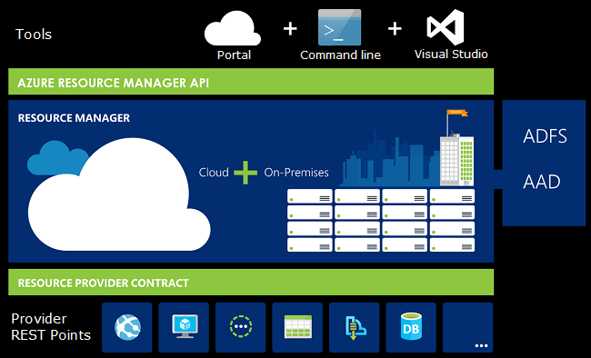
What is ARM?
Resource
Resource Group
Resource Provider
Resource Manager Template
Notes:
https://docs.microsoft.com/en-us/azure/azure-resource-manager/resource-group-overview
The following image shows how all the tools interact with the same Azure Resource Manager API. The API passes requests to the Resource Manager service, which authenticates and authorizes the requests. Resource Manager then routes the requests to the appropriate resource providers.
If you are new to Azure Resource Manager, there are some terms you might not be familiar with.
resource - A manageable item that is available through Azure. Some common resources are a virtual machine, storage account, web app, database, and virtual network, but there are many more.
resource group - A container that holds related resources for an Azure solution. The resource group can include all the resources for the solution, or only those resources that you want to manage as a group. You decide how you want to allocate resources to resource groups based on what makes the most sense for your organization. See Resource groups.
resource provider - A service that supplies the resources you can deploy and manage through Resource Manager. Each resource provider offers operations for working with the resources that are deployed. Some common resource providers are Microsoft.Compute, which supplies the virtual machine resource, Microsoft.Storage, which supplies the storage account resource, and Microsoft.Web, which supplies resources related to web apps. See Resource providers.
Resource Manager template - A JavaScript Object Notation (JSON) file that defines one or more resources to deploy to a resource group. It also defines the dependencies between the deployed resources. The template can be used to deploy the resources consistently and repeatedly. See Template deployment.
declarative syntax - Syntax that lets you state "Here is what I intend to create" without having to write the sequence of programming commands to create it. The Resource Manager template is an example of declarative syntax. In the file, you define the properties for the infrastructure to deploy to Azure.

Slide 24
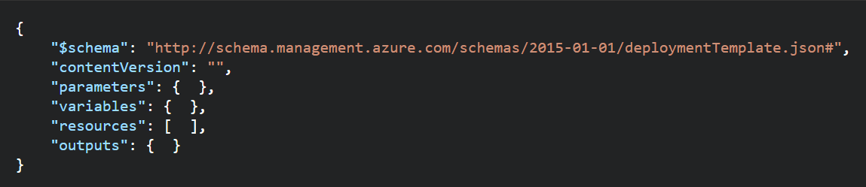
ARM Templates - Structure
Element name | Required | Description
$schema | Yes | Location of the JSON schema file that describes the version of the template language. Use the URL shown in the preceding example.
contentVersion | Yes | Version of the template (such as 1.0.0.0). You can provide any value for this element. When deploying resources using the template, this value can be used to make sure that the right template is being used.
parameters | No | Values that are provided when deployment is executed to customize resource deployment.
variables | No | Values that are used as JSON fragments in the template to simplify template language expressions.
resources | Yes | Resource types that are deployed or updated in a resource group.
outputs | No | Values that are returned after deployment.
Notes:
https://docs.microsoft.com/en-us/azure/azure-resource-manager/resource-group-authoring-templates

Slide 25
Template Deployment Mode
Complete: Resource Manager deletes resources that exist in the resource group but are not specified in the template.
Incremental: Resource Manager leaves unchanged resources that exist in the resource group but are not specified in the template.

Slide 26
Existing Resource Group
contains:
Resource A
Resource B
Resource C
Template defines:
Resource A
Resource B
Resource D
When deployed in incremental mode, Resource C is deleted. The resource group contains:
Resource A
Resource B
Resource C
Resource D
When deployed in complete mode, Resource C is deleted. The resource group contains:
Resource A
Resource B
Resource D
To use complete mode, use the Mode parameter
Notes:
New-AzureRmResourceGroupDeployment -Mode Complete -Name ExampleDeployment ` -ResourceGroupName ExampleResourceGroup -TemplateFile c:\MyTemplates\storage.json

Slide 27
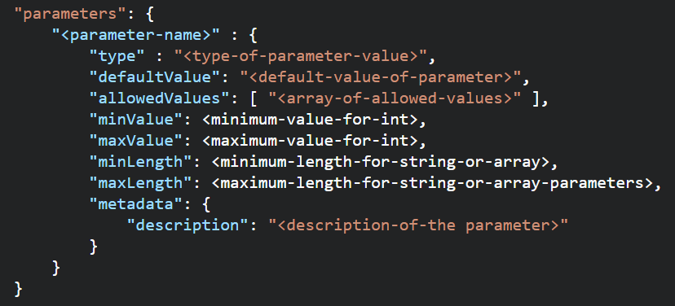
ARM Templates - Parameters
Element name | Required | Description
parameterName | Yes | Name of the parameter. Must be a valid JavaScript identifier.
type | Yes | Type of the parameter value. See the list of allowed types after this table.
defaultValue | No | Default value for the parameter, if no value is provided for the parameter.
allowedValues | No | Array of allowed values for the parameter to make sure that the right value is provided.
minValue | No | The minimum value for int type parameters, this value is inclusive.
maxValue | No | The maximum value for int type parameters, this value is inclusive.
minLength | No | The minimum length for string, secureString, and array type parameters, this value is inclusive.
maxLength | No | The maximum length for string, secureString, and array type parameters, this value is inclusive.
description | No | Description of the parameter that is displayed to users through the portal.
Allowed Types
string
secureString
int
bool
object
secureObject
array
Notes:
In the parameters section of the template, you specify which values you can input when deploying the resources. These parameter values enable you to customize the deployment by providing values that are tailored for a particular environment (such as dev, test, and production). You do not have to provide parameters in your template, but without parameters your template would always deploy the same resources with the same names, locations, and properties.

Slide 28
Re-use ARM Templates
By passing in parameters to your ARM Templates, you can re-use them in many different scenarios. You can deploy full solutions with t-shirt sizing (Small, Medium, Large) based on parameters you pass in: Size of VM, # of VMs, etc.
Be aware of what values in the ARM template need to be unique when re-using templates: https://docs.microsoft.com/en-us/azure/azure-resource-manager/resource-manager-template-best-practices#resource-names
https://docs.microsoft.com/en-us/azure/azure-resource-manager/best-practices-resource-manager-design-templates

Slide 29
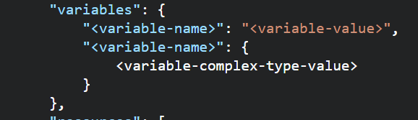
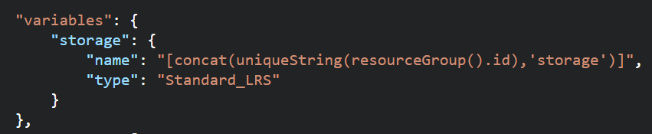
ARM Templates –Variables
Use Variables for
Use variables for values that you need to use more than once in a template.
Include variables for resource names that must be unique.
Use variables for extra manipulation of parameters
You can group variables into complex objects. Use the variable.subentry format to reference a value from a complex object.
Notes:
https://docs.microsoft.com/en-us/azure/azure-resource-manager/resource-manager-template-best-practices#variables

Slide 30
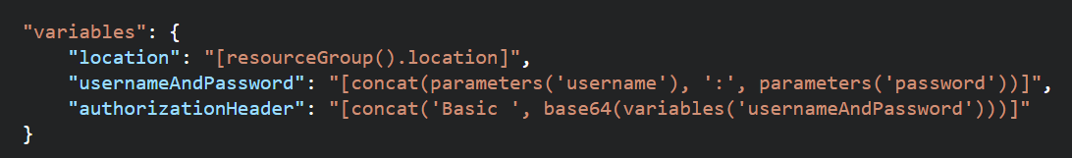
ARM Templates – Functions and Expressions
Templates are JSON
Functions and Expressions extend the JSON capabilities
They let you use some coding notions inside your templates to create or evaluate dynamic values
Functions you see often:
concat – concatenates multiple values
copyIndex – returns the index of an iteration loop
resourceGroup – access properties of this resource group, like the location.
resourceId – get the unique identifier for a resource.
All Functions: https://docs.microsoft.com/en-us/azure/azure-resource-manager/resource-group-template-functions

Slide 31
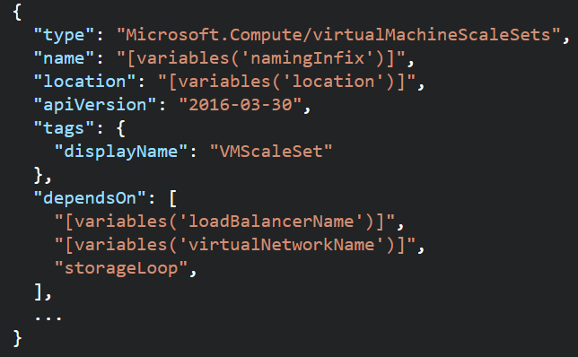
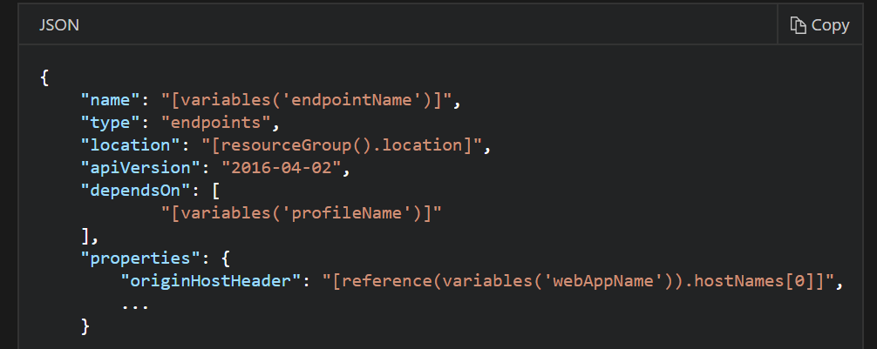
ARM Templates - Dependencies
Resources may require a dependency chain; e.g. You need a VNET before you can deploy a VM.
Use “dependsOn” property to explicitly build the dependencies between resources. Resources wont get created until their dependencies are created.
Use Child resources. Only certain resources can have child resources.
Use the “reference” function to create an implicit relationship. Resources that reference another resource are created after the referenced resource.
Notes:
https://docs.microsoft.com/en-us/azure/azure-resource-manager/resource-group-define-dependencies

Slide 32
ARM Templates Advanced Topics
Creating and Updating Resources in one ARM Template based deployment: https://docs.microsoft.com/en-us/azure/azure-resource-manager/resource-manager-update
Share state between linked templates: https://docs.microsoft.com/en-us/azure/azure-resource-manager/best-practices-resource-manager-state
Patterns for deploying resources: https://docs.microsoft.com/en-us/azure/azure-resource-manager/best-practices-resource-manager-design-templates

Slide 33
Deploy Templates

Slide 34
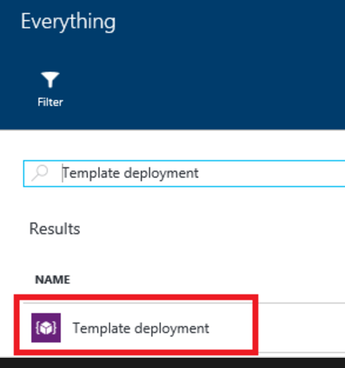
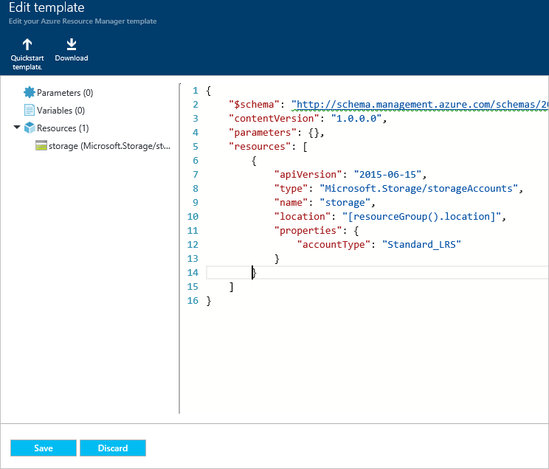
Deploy Templates – Portal, Custom Template

Slide 35
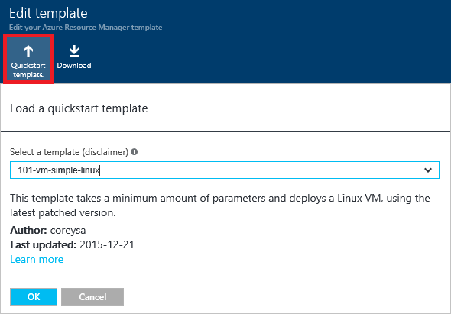
Deploy Templates – Portal, Quickstart

Slide 36
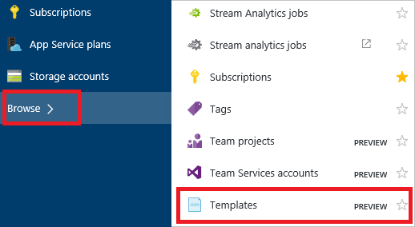
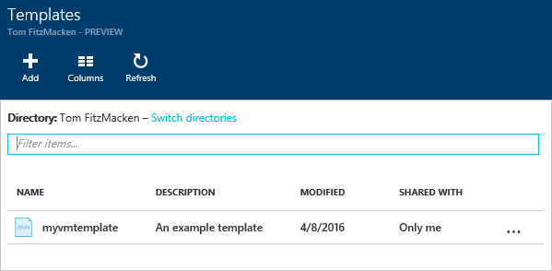
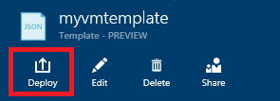
Deploy Templates – Portal, from Account

Slide 37
ARM Role Based Access Control

Slide 38
Deploy Templates – Portal
Create resource group
Deploy resources from Marketplace
Deploy resources from custom template
Deploy resources from a template saved to your account
Next Steps
https://docs.microsoft.com/en-us/azure/azure-resource-manager/resource-group-template-deploy-portal

Slide 39
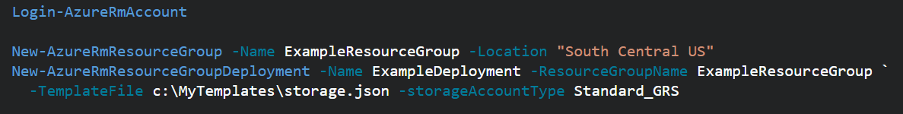
Deploy Templates - Powershell
Deploy a Template from a local json file
Deploy a Template from an external source:
Pass in a local parameter file:
Pass in an external parameter file

Slide 40
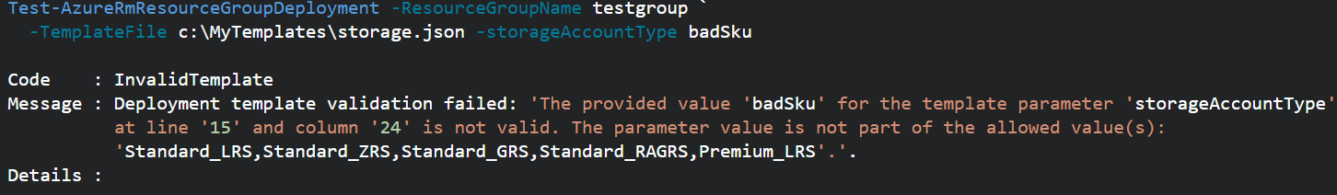
Deploy Templates - PowerShell
You can pass in parameters inline and with a local parameter file.
You CANNOT pass in parameters inline and with an external parameter file.
You can TEST a deployment before running it.
Template Deployments have 2 modes: INCREMENTAL or COMPLETE
Both modes deploy resources defined in Template.
Complete Deployment DELETES resources in group not defined in Template
Incremental does not DELETE resources not defined in Template
Use “-Mode” argument to set Mode.
Notes:
https://docs.microsoft.com/en-us/azure/azure-resource-manager/resource-group-template-deploy

Slide 41
Deploy resources with Resource Manager templates and Azure PowerShell
Deploy a template from your local machine
Deploy a template from an external source
Parameter files
Test a template deployment
Incremental and complete deployments
Sample template
Next steps
https://docs.microsoft.com/en-us/azure/azure-resource-manager/resource-group-template-deploy

Slide 42
Regional Availability

Slide 43
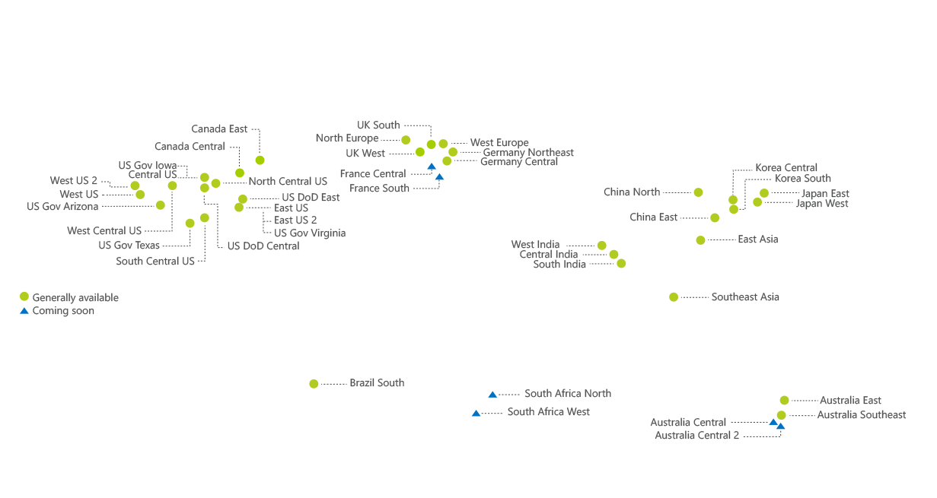

Regions
An Azure Region is a geographic region that contains a collection of data centers.
It’s more than one building.
Over 40 Azure regions
Special / Sovereign Regions
Notes:
An Azure Region is a geographic region that contains a collection of data centers. Datacenters will be in close geo proximity to each other – separate buildings
It’s more than one building.
There are over 36 Azure regions: https://azure.microsoft.com/en-us/regions/
Regions might have restrictions – eg. China - you might need a billing address in that country
All services might not be available in all regions
Special / Sovereign Regions:
US Gov Virginia/Iowa
China East, China North
Germany Central, Gemany Northeast

Slide 44
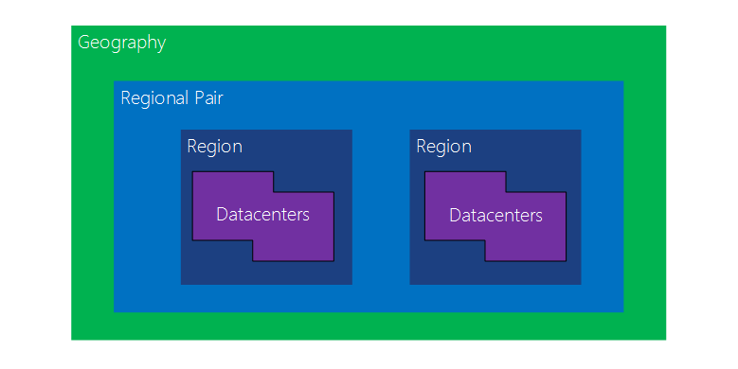
Regional Availability - Regions
Region Pairs
In same geography (such as US, Europe or Asia)
Replicated resources are replicated across pairs
In broad geographic outage, one region in the pair is prioritized
Data resides in the same geography as its pair (except Brazil South)
Azure Storage GRS and RA-GRS replicates data from one region to its pair.
Notes:
Datacenters are
An Azure Region is a geographic region that contains a collection of data centers.
It’s more than one building.
There are over 36 Azure regions: https://azure.microsoft.com/en-us/regions/
Special / Sovereign Regions:
US Gov Virginia/Iowa
China East, China North
Germany Central, Gemany Northeast
Region Pairs
In same geography (such as US, Europe or Asia)
Replicated resources are replicated across pairs
In broad geographic outage, one region in the pair is prioritized
Data resides in the same geography as its pair (except Brazil South)
Pairs: https://docs.microsoft.com/en-us/azure/best-practices-availability-paired-regions#what-are-paired-regions
Azure Storage GRS and RA-GRS replicates data from one region to its pair.

Slide 45
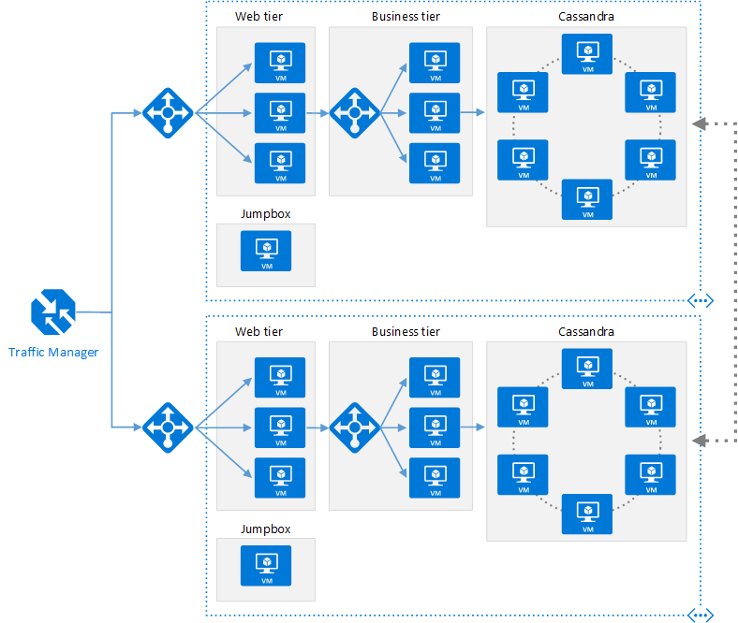
Regional Availability - Design
Primary/Secondary Region for Higher Availability
Traffic Manager routes requests
Put Primary, Secondary and Traffic Manager is separate regions
Make sure each region’s VNET IP range does not overlap
The same ARM template can be deployed, with minor parameter changes for VNET IP address space, and Resource locations.
Notes:
Microsoft Azure Traffic Manager allows you to control the distribution of user traffic for service endpoints in different datacenters. Service endpoints supported by Traffic Manager include Azure VMs, Web Apps, and cloud services. You can also use Traffic Manager with external, non-Azure endpoints.+
Traffic Manager uses the Domain Name System (DNS) to direct client requests to the most appropriate endpoint based on a traffic-routing method and the health of the endpoints. Traffic Manager provides a range of traffic-routing methods and endpoint monitoring options to suit different application needs and automatic failover models. Traffic Manager is resilient to failure, including the failure of an entire Azure region.

Slide 46
Regional Availability - Design
Configurations
Active/passive with hot standby (rec)
Active/passive with cold standby
Active/active
Use Regional Pairing
In broad outage, one region from pair is prioritized
Data residency issues mitigated
Traffic Manager
routing = priority,
health probe = write a custom service that reports accurately
Read Reference Architecture Here.
https://docs.microsoft.com/en-us/azure/architecture/reference-architectures/virtual-machines-linux/multi-region-application

Slide 47
High Availability
Availability within a region vs. Regional Availability
Azure Storage makes 3 copies of data within a region (including VM disks)
Use Availability Sets
Design loosely coupled service with asynchronous communication. Use Azure Storage queues or Azure Sevice Bus for queue-centric workflow.
Fault Detection and Retry Logic within your application
Circuit Breaker Pattern
Immutable Infrastructure, Infrastructure as Code
https://docs.microsoft.com/en-us/azure/architecture/resiliency/high-availability-azure-applications
https://docs.microsoft.com/en-us/azure/architecture/resiliency/index#designing-for-resiliency

