Slide 1
A Closer Look — the Frame: the soul, vice & virtue (ash-Shams 91:7–10)
THE QUR’AN’S OWN MAP OF THE SOUL
Every soul is shown both its VICE and its VIRTUE. To purify it is to SUCCEED; to corrupt it is to FAIL.
— ash-Shams 91:7–10 (the soul · its vice / its virtue · purify → success · corrupt → failure)
THE COURSE’S QUESTION FOR THIS SERIES
The Qur’an’s logic is conditional: if the soul is purified it succeeds, else if corrupted it fails. Is its measured text compatible with this — both fates open, virtue recommended?
Ten short tests — one per week, one tool each — measure it. No slogans; only Book6.

Slide 2
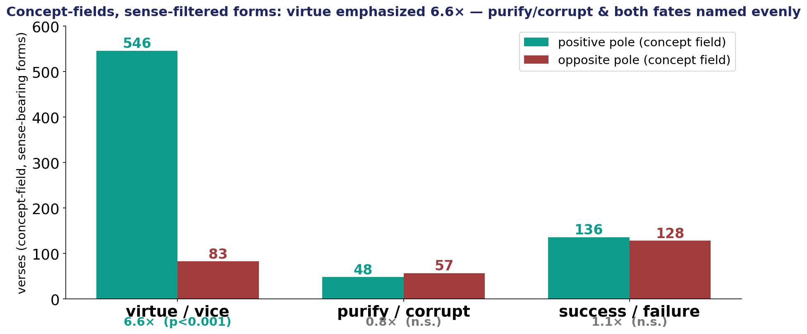
Concept-fields, not single words: virtue emphasized; both fates named evenly
Each Shams 91:7–10 axis as a pre-committed CONCEPT-FIELD (its roots united) — positive pole vs opposite.

Slide 3
How the series works — ten tools on one question
Each week, “A Closer Look” runs the same four beats with that week’s tool:
THE CLAIM — a popular reading of the soul / virtue / fate.
THE TEST — put it to Book6 with the week’s tool; statistically valid, no cherry-picking.
THE VERDICT — scoped to the evidence; we decline what the data cannot license.
THE LESSON — one transferable thinking-principle (the ten synthesize in Week 10).
The through-line: does careful measurement support the Qur’an’s soul → success direction?

