Slide 1
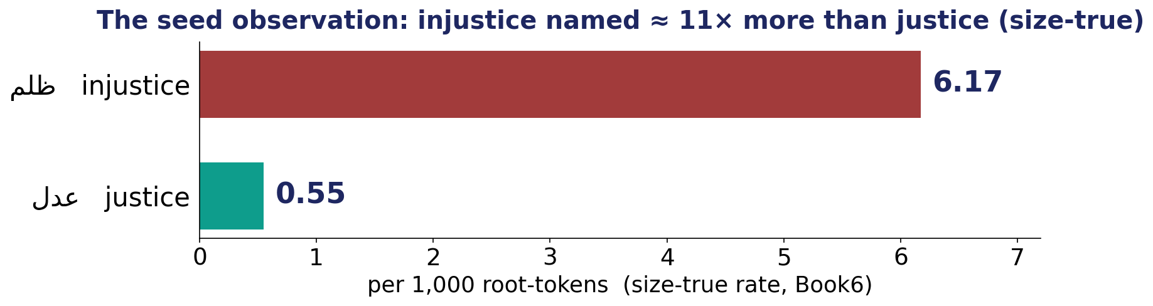
A Closer Look #1 — the soul’s vice or its virtue: which does the text name more?
THE CLAIM
“The Qur’an dwells on the disease - the wrong - more than the cure.”
Anchor: al-Isrāʾ 17:82 ( شِفاءٌ وَرَحمة )
وَنُنَزِّلُ مِنَ الْقُرْآنِ مَا هُوَ شِفَاءٌ وَرَحْمَةٌ لِلْمُؤْمِنِينَ وَلَا يَزِيدُ الظَّالِمِينَ إِلَّا خَسَارًا
One pair (injustice ≫ justice, 11×) suggests it — but two words are not data. Test the field.

Slide 2
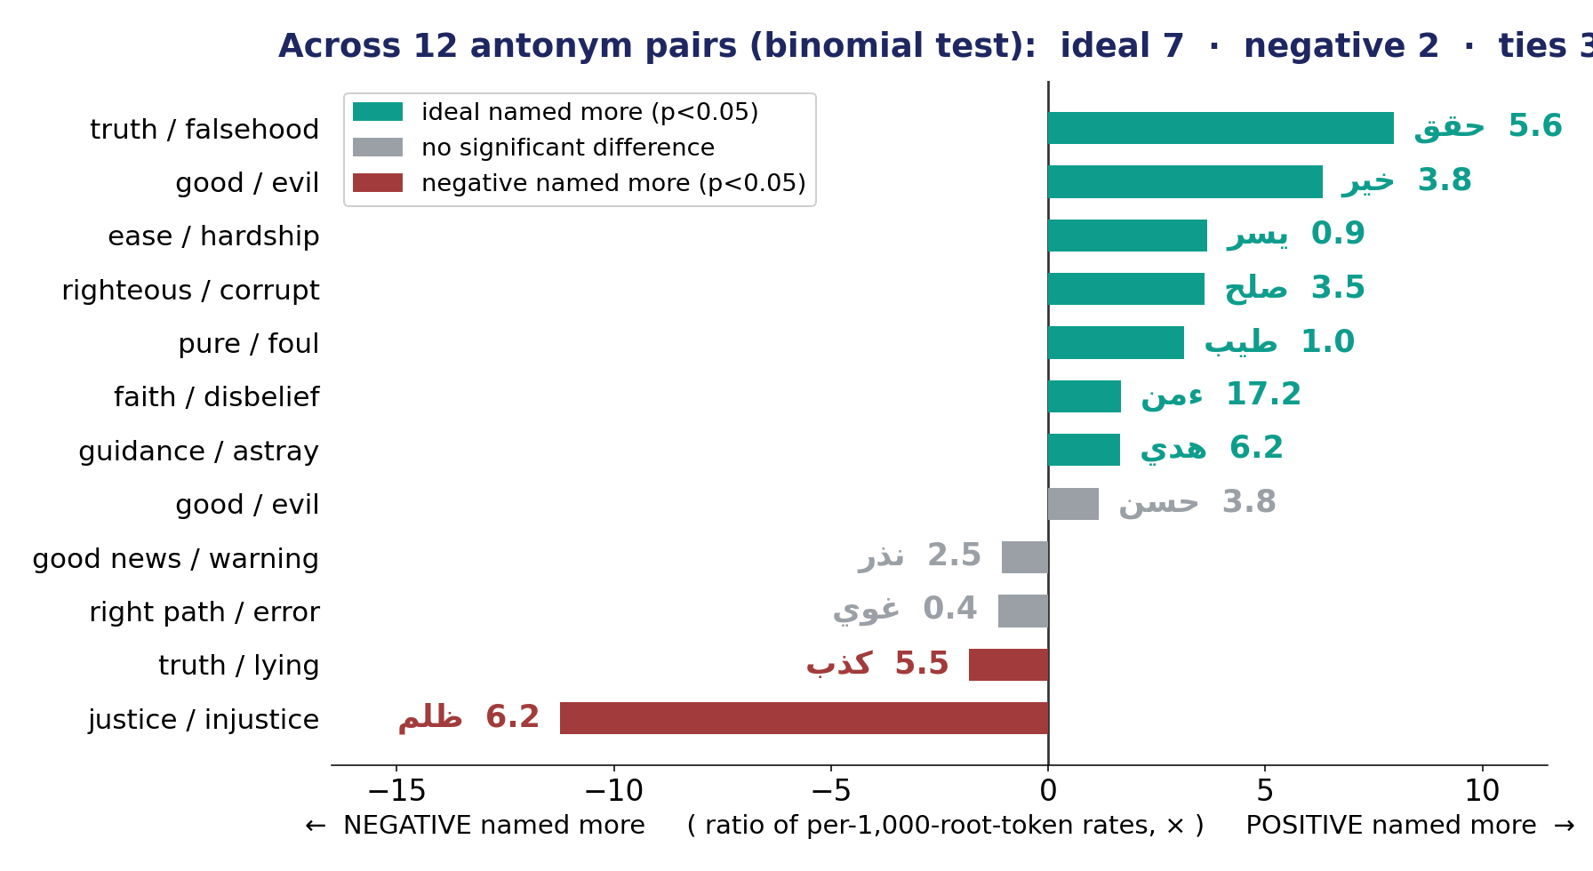
The Test — every antonym pair, significance-checked (size-true)
A binomial test on 12 ideal-vs-opposite pairs, per 1,000 root-tokens — no eyeballing, no cherry-pick.

Slide 3
The Verdict — and the Lesson
THE VERDICT
The “vice-heavy” reading fails — and we decline its opposite. Across 12 pairs the IDEAL is named significantly more in 7, the vice in 2, with 3 ties.
The text leans to the soul’s virtue (the field confirms it, 5.6×) — while naming a few diseases, like injustice and lying, without flinching.
LESSON #1
Scope the claim to the evidence: a difference is not a finding until it is tested — and a chosen dozen cannot speak for the whole.
Lesson #1 of 10 — collected toward the Week-10 synthesis (the soul → success).

