Slide 1
A Closer Look #3 — the God who judges the soul: wrath or mercy?
THE CLAIM
“The Qur’an’s God, who weighs the soul, is more a God of wrath than of mercy.”
WHY IT IS WORTH ASKING
The soul that purifies itself meets its Maker — so how does that Maker name Himself?
An intuition about the soul’s path — measure it, with this week’s tool.

Slide 2
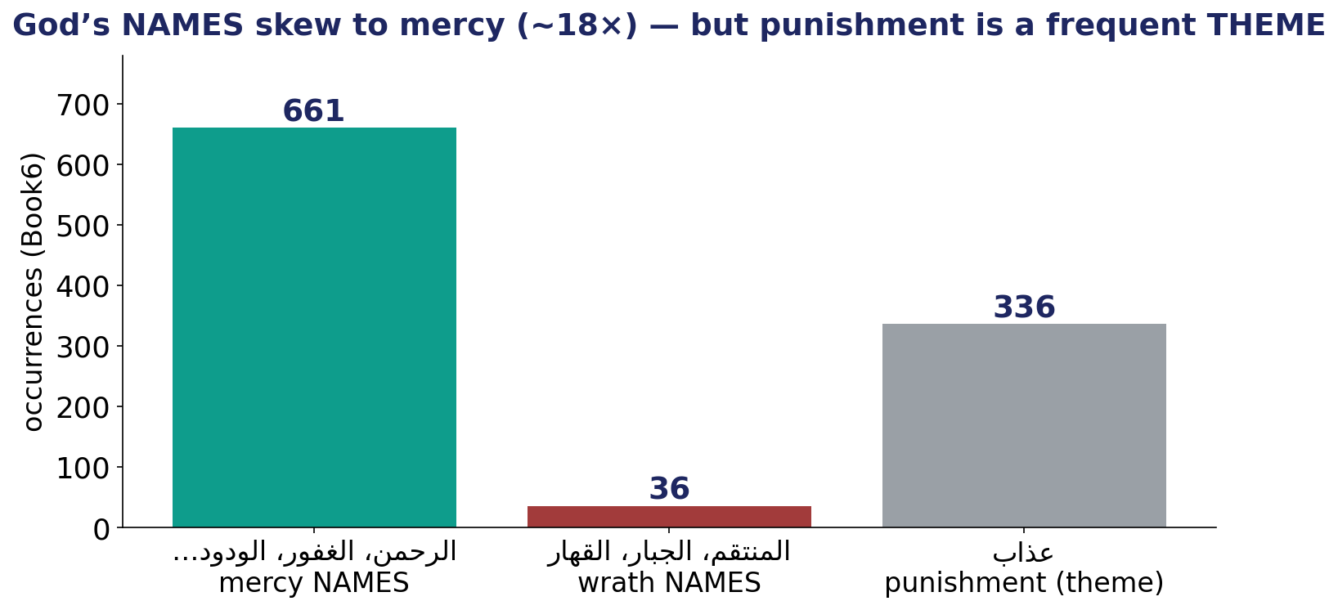
The Test — God’s NAMES vs the theme of punishment
Divine-attribute roots counted in Book6 — names of mercy vs names of might, and punishment as a theme.

Slide 3
The Verdict — and the Lesson
THE VERDICT
God’s NAMES skew ~18× to mercy: roots of the merciful names total 661 vs 36 for the names of might.
Punishment (عadhāb) is a frequent THEME (336) — but it is a theme, not the dominant NAME.
The Judge of the soul names Himself, overwhelmingly, by mercy.
LESSON #3
Distinguish a NAME from a THEME — and watch your classification choices; the forms lean to mercy.
Lesson #3 of 10 — collected toward the Week-10 synthesis (the soul → success).

