Slide 1
A Closer Look #4 — does the soul fail unless faith, deeds, patience & truth?
THE CLAIM
“Sūrat al-ʿAsr’s fourfold formula — faith, deeds, patience, truth — recurs across the Qur’an.”
WHY IT IS WORTH ASKING
al-ʿAsr says the human is in loss except through that fourfold. Is it a recurring pattern, or one famous verse?
An intuition about the soul’s path — measure it, with this week’s tool.

Slide 2
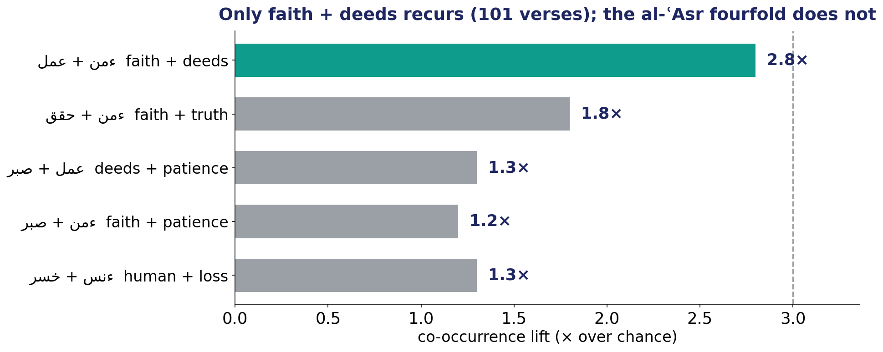
The Test — a famous verse vs a frequent pattern
Co-occurrence lift for each al-ʿAsr pair, and for human + loss — what actually recurs together?

Slide 3
The Verdict — and the Lesson
THE VERDICT
Only faith + deeds recurs — 101 verses, 2.8× chance (structural). The other pairs, and human ↔ loss, sit at chance.
al-ʿAsr is a unique, memorable construction — not a corpus-wide pattern. The recurring engine of success is faith + deeds.
The verse is quotable; the pattern is faith-and-works.
LESSON #4
A famous verse is not a frequent pattern — co-occurrence finds what RECURS, not what is quotable.
Lesson #4 of 10 — collected toward the Week-10 synthesis (the soul → success).

