Slide 1
A Closer Look #5 — are patience and prayer really paired?
THE CLAIM
“Seek help in patience and prayer (2:45) — these two supports of the soul are a real Qur’anic pair.”
WHY IT IS WORTH ASKING
Many ‘famous pairings’ are just one memorable verse. Is patience-and-prayer a real, recurring bond?
An intuition about the soul’s path — measure it, with this week’s tool.

Slide 2
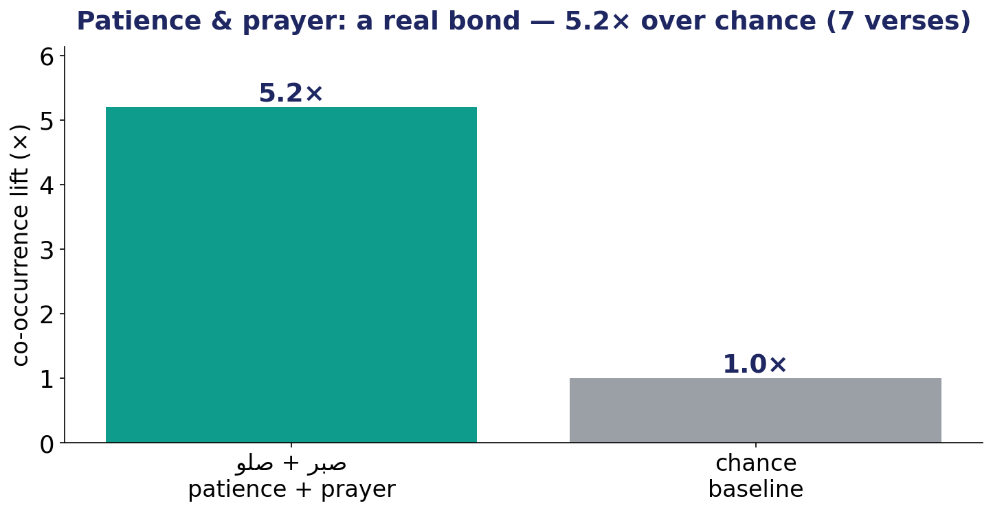
The Test — a real bond or a single phrase?
Length-aware co-occurrence lift for patience + prayer, against the chance baseline, with its verse-count.

Slide 3
The Verdict — and the Lesson
THE VERDICT
Supported — modestly. Patience and prayer co-occur 5.2× above chance, across 7 verses: it clears the structural bar.
A genuine link — but read its support: 7 verses is a slim foundation, not a flood.
The soul’s two supports are really linked — and honestly, only modestly.
LESSON #5
Lift tells a real bond from a one-off phrase — but always read the support behind it.
Lesson #5 of 10 — collected toward the Week-10 synthesis (the soul → success).

