Slide 1
A Closer Look #6 — guidance and the straight path: which contains which?
THE CLAIM
“Guidance and the straight path are simply the same idea, interchangeable.”
WHY IT IS WORTH ASKING
They share many verses — but a shared count hides a direction. Does the path imply guidance, or guidance the path?
An intuition about the soul’s path — measure it, with this week’s tool.

Slide 2
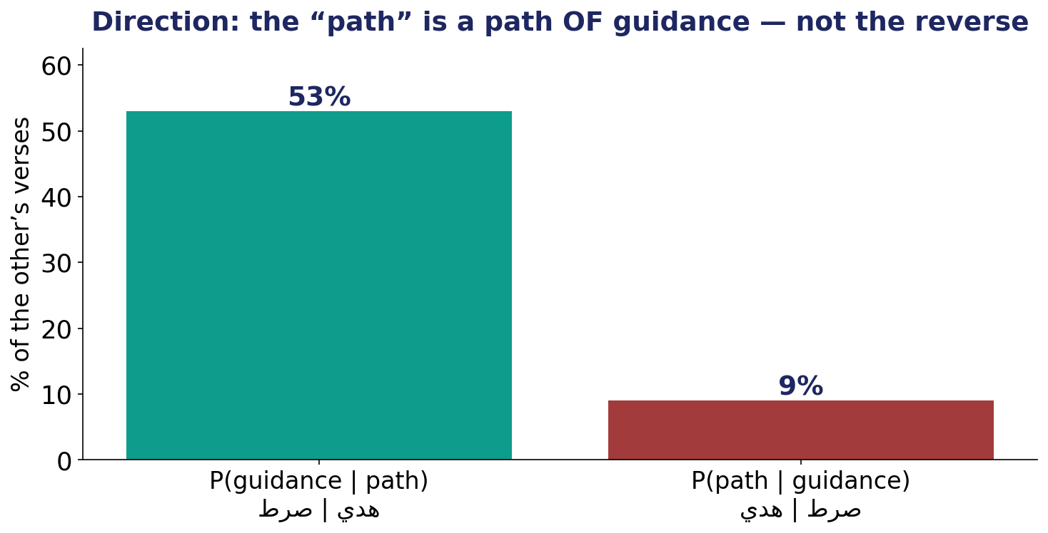
The Test — the direction inside a shared bond
Conditional probabilities: how often each of the pair names the other.

Slide 3
The Verdict — and the Lesson
THE VERDICT
The straight path is a path OF guidance: 53% of ‘path’ verses also name guidance — but only 9% the reverse.
Not interchangeable: the soul’s road (the path) is defined by guidance, not guidance by the road.
The specific (the path) is contained in the general (guidance).
LESSON #6
A shared count hides a direction — measure both ways before calling two ideas ‘the same’.
Lesson #6 of 10 — collected toward the Week-10 synthesis (the soul → success).

