Slide 1
A Closer Look #7 — is there a signature motif of the saved soul?
THE CLAIM
“Faith, righteous deeds, and reward recur together as the Qur’an’s core moral motif.”
WHY IT IS WORTH ASKING
If the soul’s success has a recurring ‘scene’, a three-root motif test will find it.
An intuition about the soul’s path — measure it, with this week’s tool.

Slide 2
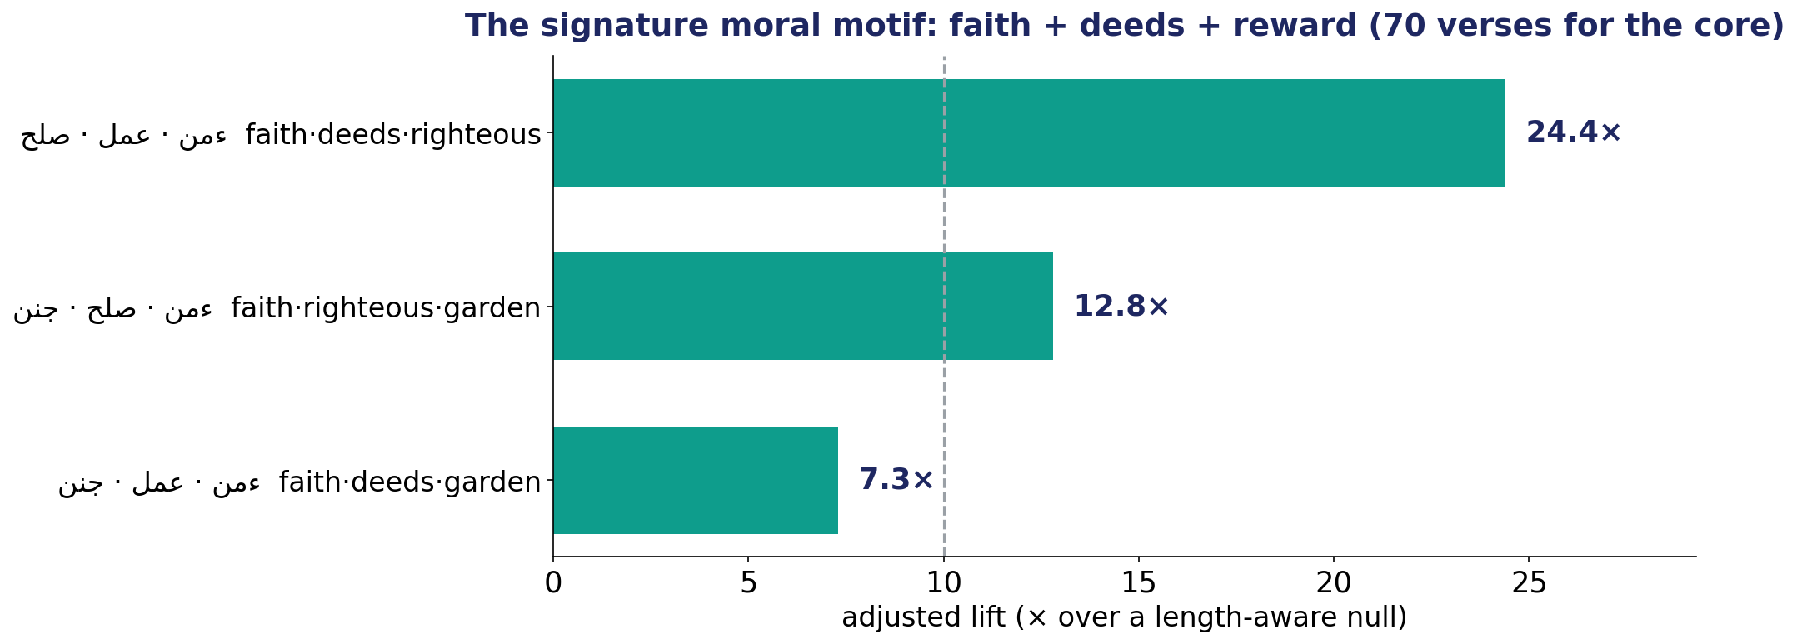
The Test — the recurring scene of the purified soul
Adjusted lift (against a length-aware null) for the faith·deeds·reward triads.

Slide 3
The Verdict — and the Lesson
THE VERDICT
Strongly supported. Faith + deeds + righteousness co-occur in 70 verses (24× chance); with the garden, 23 verses (13×).
This IS the Qur’an’s signature motif — the purified soul that believes, acts, and arrives at reward.
The success of the soul is not abstract; it has a recurring, measurable shape.
LESSON #7
Motifs surface a text’s recurring scenes — and this triad is the Qur’an’s moral engine.
Lesson #7 of 10 — collected toward the Week-10 synthesis (the soul → success).

