Slide 1
A Closer Look #8 — does an astonishing motif have to be real?
THE CLAIM
“A three-root motif 576× above chance must be a genuine finding.”
WHY IT IS WORTH ASKING
Lift can dazzle. The soul’s ‘return’ motif looks modest by comparison — which one should we trust?
An intuition about the soul’s path — measure it, with this week’s tool.

Slide 2
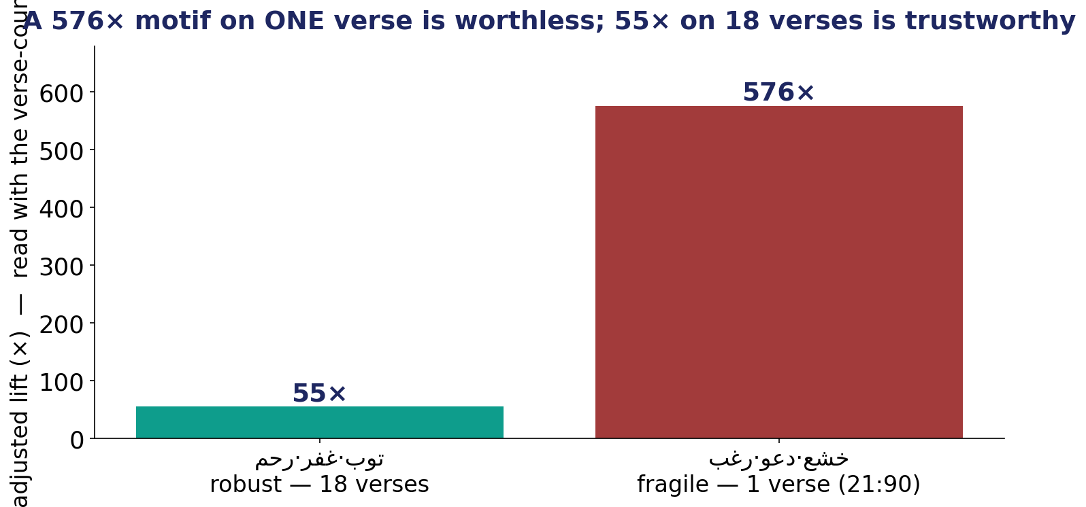
The Test — significance is not support
Adjusted lift for two trios — read together with how many verses each stands on.

Slide 3
The Verdict — and the Lesson
THE VERDICT
The 576× trio rests on a SINGLE verse (21:90). Remove it and it vanishes — worthless despite the lift.
The repentance → forgiveness → mercy trio is 55× on 18 verses: far lower lift, far more trustworthy.
The soul’s return to God is a robust pattern; the dazzling one-verse trio is not a finding.
LESSON #8
A sky-high lift on one verse is not a finding — support and stability decide, not the multiple.
Lesson #8 of 10 — collected toward the Week-10 synthesis (the soul → success).

