Slide 1
A Closer Look #9 — ‘man and woman, 24 times each’ — a designed balance?
THE CLAIM
“The words for man and woman each occur exactly 24 times — a deliberate numerical balance.”
WHY IT IS WORTH ASKING
A viral ‘miracle count’. Does it survive a fair, consistent counting rule on Book6?
An intuition about the soul’s path — measure it, with this week’s tool.

Slide 2
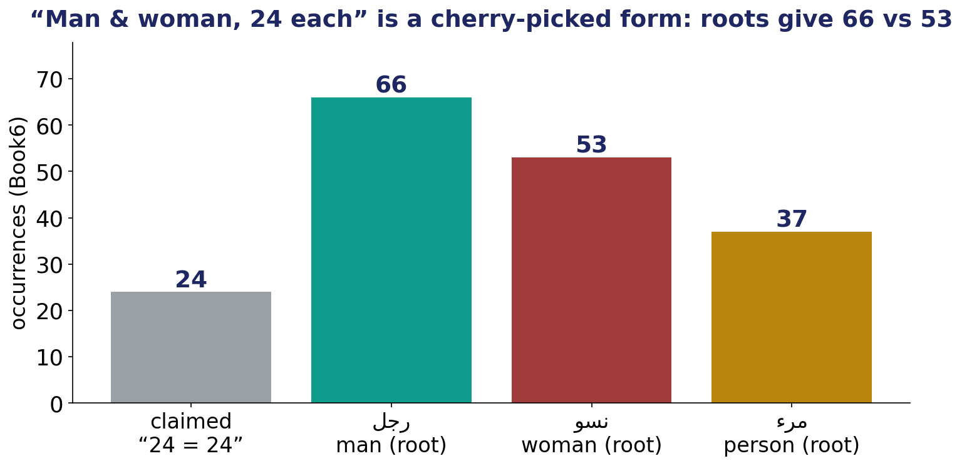
The Test — a balance claim under a fair rule
The claimed form-count vs the size-true root counts for man and woman.

Slide 3
The Verdict — and the Lesson
THE VERDICT
Contradicted at the fair root level: the roots give 66 vs 53 (and ‘person’ 37) — not 24 = 24.
The ‘24 each’ counts one hand-picked definite form and discards the rest of each root.
The soul’s dignity is not established — or refuted — by a word-count trick.
LESSON #9
A balance claim lives or dies by its counting rule — fix the rule first, and the coincidence dissolves.
Lesson #9 of 10 — collected toward the Week-10 synthesis (the soul → success).

