Slide 1
A Closer Look #10 — the synthesis: the Qur’an’s logic is conditional
NOT A STATIC FATE — AN IF / THEN / ELSE-IF / THEN, SUSTAINED TO THE END
The soul is given both vice and virtue, designed optimally. Success is not a single act but a SUSTAINED direction - continual good deeds and thoughts, held to life’s last leg:
IF the soul keeps purifying itself → it SUCCEEDS; ELSE IF it lets itself be corrupted → it FAILS. (Shams 91:9–10)
TILTED TOWARD MERCY — AND THE CONDITION IS DURATIVE
The scales favor the soul: virtue emphasized 6.6×, God named by mercy ~18×, a good deed repaid TENFOLD vs evil once (6:160).
The demand is ongoing: the deed-verb is present-tense (“keeps doing”), the deeds are plural, and perseverance fills 118 verses (“then remained steadfast” — Fussilat 41:30).
Conditional, so reward and punishment are JUST (a fixed fate would void them) — yet weighted to ENCOURAGE: good repaid tenfold, evil only once, “and they are not wronged.” (interpretation)

Slide 2
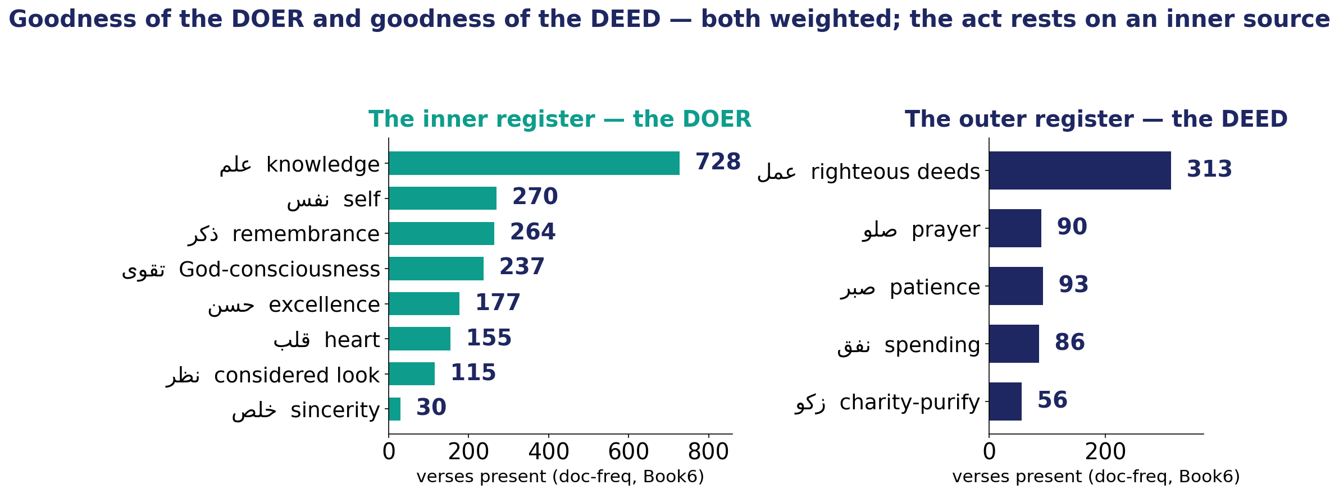
A Closer Look #10 — the human, diagnosed and then prescribed (doer + deed)
THE DIAGNOSIS (computed)
The human is named by its faults — hasty, forgetful, despairing, grasping, unjust, ungrateful. The cause is placed INSIDE the actor:
heart ↔ disease 21× · heart ↔ faith 2.7×
THE PRESCRIPTION — two columns
DOER (inner): faith · taqwā · sincerity · a purified heart · remembrance · knowledge · reflection.
DEED (outer): righteous works · prayer · patience · spending.
Coupled as one: faith → deeds 2.8× (101 verses); sincerity → worship 28.7×.
Both columns are weighted & the deed rests on the doer
The inner register rivals the deeds in size: knowledge 728, self 270, remembrance 264, taqwā 237 — vs deeds 313, patience 93, prayer 90.
حسن فاعلي و فعلي — goodness of the doer AND goodness of the deed.

Slide 3
A Closer Look #10 — thought is the root, action the fruit
THE VERDICT (interpretation)
The object of ash-Shams 91:9–10 is the self (nafs): purify IT, or corrupt IT.
Deeds are the EVIDENCE of which way the self was turned — not the cause itself.
The heart is named as the locus: disease 21×, tranquility 23.5×, faith 2.7×.
So thought is the root, and action the fruit.
THE SOURCE — the prophetic mission
Knowledge is not self-made. The messenger’s task is to:
recite the signs → PURIFY (تزكية — the Shams verb) → TEACH the Book and wisdom.
This formula is complete in 4 verses: 2:129, 2:151, 3:164, 62:2.
Honest limit: نية (explicit “intention”) is ~absent (1 ayah) — it rides on heart, taqwā, and sincerity as a FIELD; the prophetic triad is a 4-verse formula (robust as a phrase, not high-frequency).

Slide 4
Ten Lessons — what careful measurement taught
#1 A difference is not a finding until it is tested.
#2 Widespread ≠ evenly spread — control the confound.
#3 Distinguish a Name from a theme.
#4 A famous verse is not a frequent pattern.
#5 Lift finds a real bond — but read its support.
#6 A shared count hides a direction.
#7 Motifs surface a text’s recurring scenes.
#8 A sky-high lift on one verse is not a finding.
#9 A true number can still be a false claim — audit the reading.
#10 No single number is a portrait — only the pipeline is.
The Qur’an’s direction — the soul toward success — survives measurement; the slogans about it often do not.

Slide 5
Ten Lessons, elaborated (1–5)
#1 A difference is not a finding until it is tested.
Virtue outweighs vice 6.6× — but a raw gap can be an artifact of corpus size or word choice. It only stands after a size-true test (per-1,000 root-tokens) and surface-form filtering. (CL #1 · frequency)
#2 Widespread ≠ evenly spread — control the confound.
A root can touch many surahs yet pile up in a few. al-Baqara looked like the “home” of 30 of 50 top roots by raw count — and 0 of 50 once normalized by surah size. (CL #2 · distribution)
#3 Distinguish a Name from a theme.
God’s NAMES skew ~18× to mercy (al-Raḥmān, al-Ghafūr); yet punishment is still a frequent THEME (ʿadhāb, 336 verses). A title is not a tally — count the right unit. (CL #3 · forms)
#4 A famous verse is not a frequent pattern.
al-ʿAsr’s fourfold (faith, deeds, patience, truth) is iconic, but only faith + deeds actually recurs (101 verses, 2.8×); the other pairs don’t co-occur above chance. Fame ≠ frequency. (CL #4 · co-occurrence)
#5 Lift finds a real bond — but read its support.
Lift flags genuine pairs (patience + prayer 5.2×), but a multiplier resting on 2 verses is noise. Always read the × together with the verse-count behind it. (CL #5 · lift & tiers)

Slide 6
Ten Lessons, elaborated (6–10)
#6 A shared count hides a direction.
Guidance and “the straight path” share verses, but P(guidance | path) = 53% while P(path | guidance) = 9%: the path is a path OF guidance, not the reverse. Symmetry can conceal asymmetry. (CL #6 · direction)
#7 Motifs surface a text’s recurring scenes.
Three-root motifs (faith · deeds · reward) recover the Qur’an’s signature moral scene — but only after a length-aware triple-null separates a real motif from coincidence. (CL #7 · motifs)
#8 A sky-high lift on one verse is not a finding.
A 576× trio resting on a single verse (21:90) collapses on leave-one-out; a 55× trio spread over 18 verses survives. Support and stability beat raw magnitude. (CL #8 · significance)
#9 A true number can still be a false claim — audit the reading.
“Man and woman, 24 each” is arithmetically true for one cherry-picked form but false at the fair root level (66 vs 53). The number is real; the claim built on it is not. (CL #9 · audit)
#10 No single number is a portrait — only the pipeline is.
The human (انسان) comes into focus only when frequency, distribution, co-occurrence, direction, motif, significance and audit run together — with computed fact and interpretation kept separate. (CL #10 · capstone)

