Slide 1
SPECIAL TOPIC · the rarest words
Hapax Legomena — concepts the Qur'an says exactly ONCE
Two kinds of 'once', computed from Book6
A hapax legomenon appears a single time in a corpus. The Qur'an has two levels: a once-only ROOT (the whole consonantal family occurs once) and a once-only FORM (a specific surface word occurs once, though its root may be common). 408 roots and 3,027 forms are hapax.
Every example carries its address; we report the count and the address, and decline to over-read.

Slide 2
Two levels of 'once-only'
the corpus, by how rare its units are
ROOT hapax — 408
the whole 3-letter family occurs once e.g. صمد (112:2)
FORM hapax — 3,027
one surface word occurs once; root may be common e.g. كوثر (108:1, root كثر ×167)
Why distinguish them
A once-only ROOT is a concept the Qur'an names a single time. A once-only FORM is a unique wording of a possibly-common idea. The two answer different questions — unique concepts vs unique expressions — so we count and present them separately, both from Book6.

Slide 3
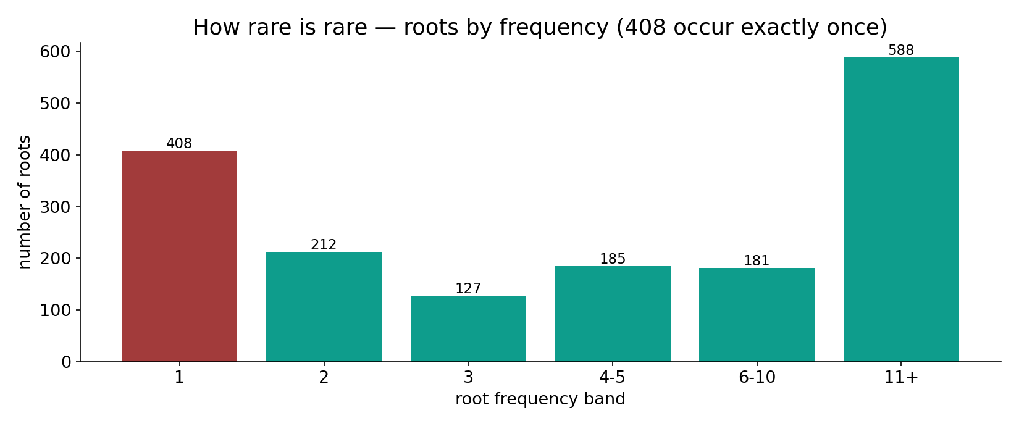
How rare is 'rare'? — roots by frequency
In the data — of 1,701 roots: 408 occur once, 212 twice, 127 thrice; only 588 occur 11+ times. Rarity is the NORM, not the exception — the hapax sit at the tip of a steep long tail.

Slide 4
Two flagship examples
صمد — a once-only ROOT (112:2)
ص-م-د occurs once, in al-Ikhlāṣ: 'Allāh, aṣ-Ṣamad' — the Eternal, Absolute, self-sufficient. A unique root for a unique description of God. (root freq = 1.)
كوثر — a once-only FORM (108:1)
كوثر occurs once, opening al-Kawthar — abundance. Its ROOT ك-ث-ر is common (167 āyahs); only this intensive FORM is unique. (form = 1, root = 167.)

Slide 5
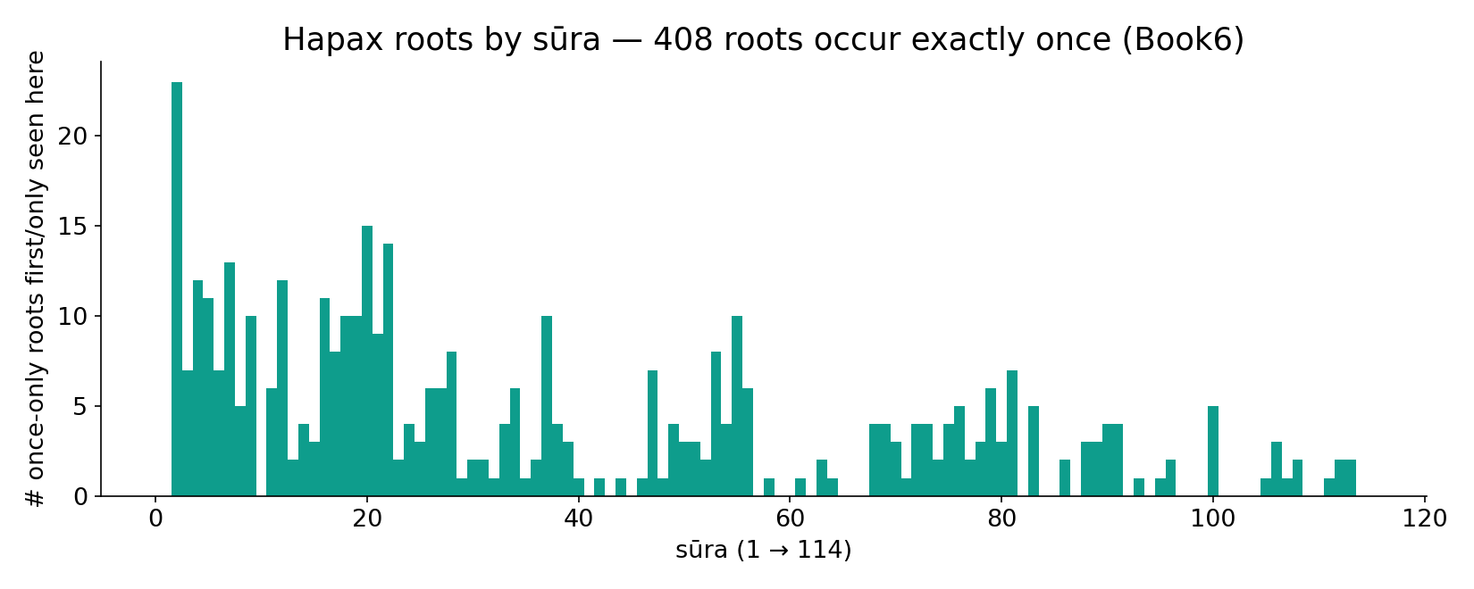
Once-only ROOTS by sūra — where they fall
In the data — raw counts are highest in the long sūras (al-Baqara 23, Ṭā-Hā 15, al-Ḥajj 14): length alone puts more unique roots there. Length, not mystery, drives the raw tally.

Slide 6
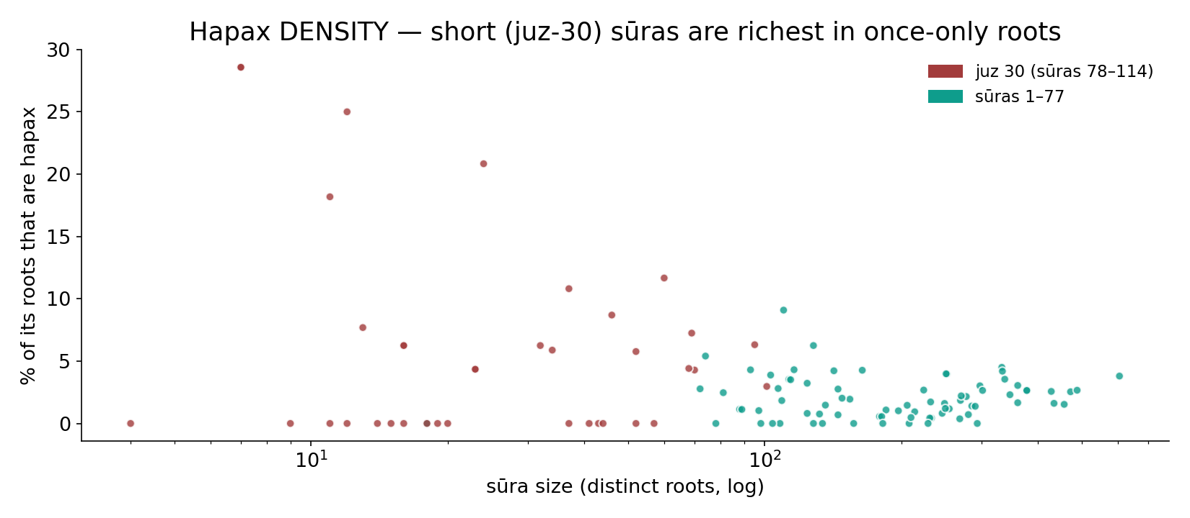
Density flips it — short sūras are RICHEST
In the data — normalize by sūra size and the juz-30 short sūras dominate. Sūra 108 (al-Kawthar) tops it at ~29% hapax. Brevity concentrates the rare word.

Slide 7
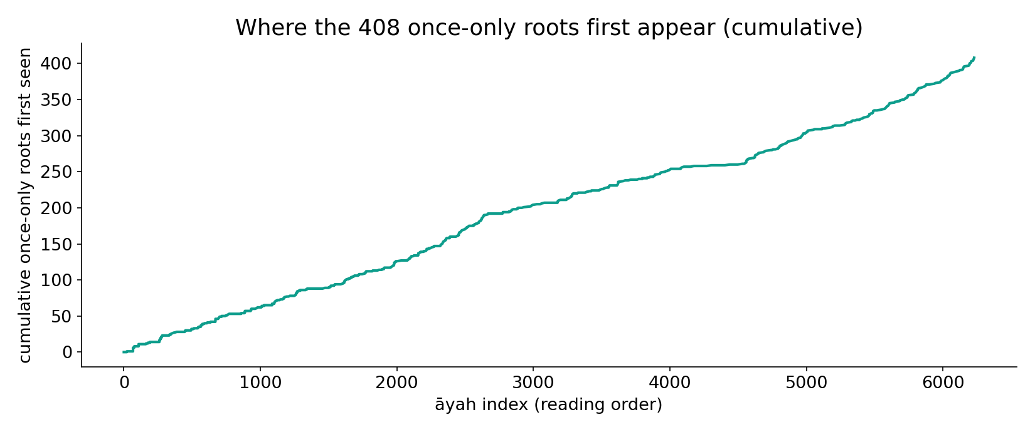
Where the 408 first appear (cumulative)
In the data — new once-only roots accrue steadily through the reading order, with surges in the long early sūras and again in the dense juz-30 tail — the corpus keeps introducing unique vocabulary throughout.

Slide 8
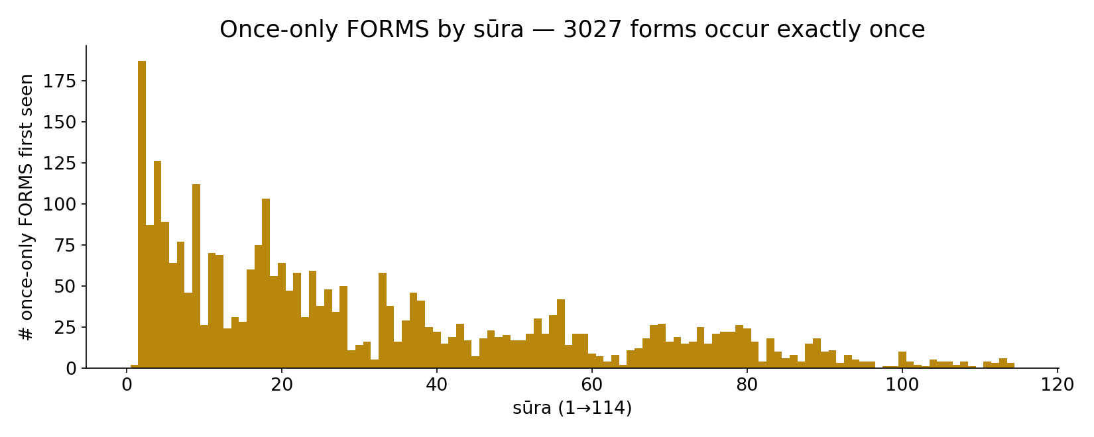
Once-only FORMS by sūra
In the data — 3,027 forms occur once; like roots, raw counts track length, but the short late sūras are dense with unique wordings (عاديات, كنود, هاويه …).

Slide 9
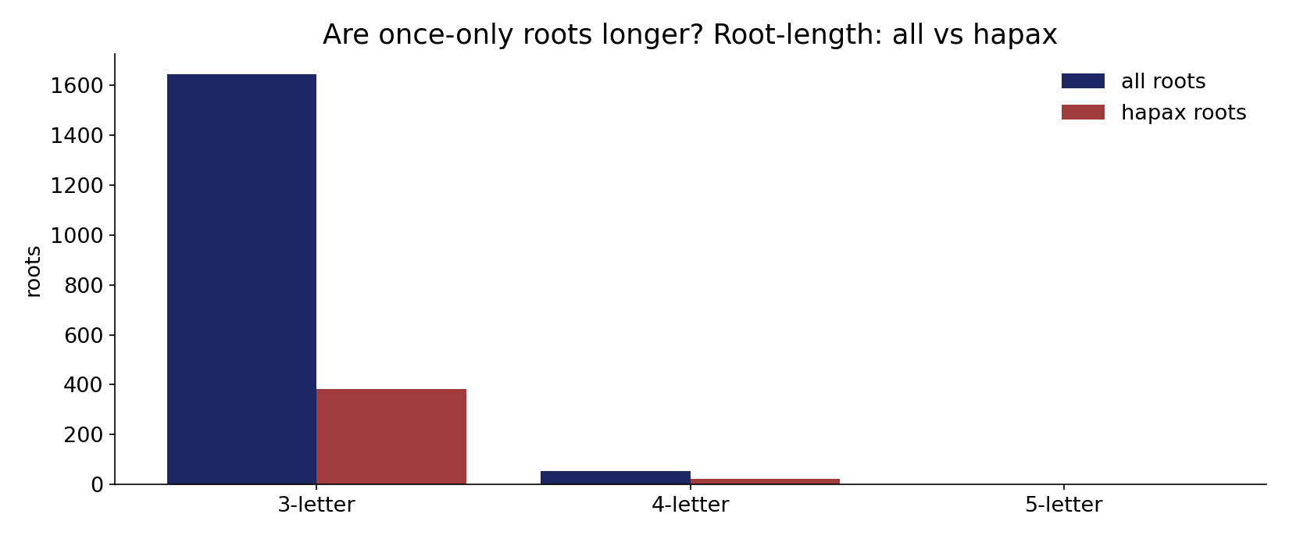
Are once-only roots different in shape?
In the data — hapax roots track the overall root-length profile (mostly 3-letter), with a mild lean toward 4–5-letter roots: rarer roots are slightly likelier to be longer/less-templatic.

Slide 10
Gallery — once-only ROOTS in the short sūras (juz 30)
once-only in the whole Qur'an:
صمد — the Eternal / Absolute (112:2)
وءد — the infant girl buried alive (81:8)
عسعس — the night as it recedes (81:17)
كنس — the stars that sweep / recede (81:16)
دهق — a cup brim-full (78:34)
ثجج — water pouring down (78:14)
وهج — a blazing lamp (78:13)
طفف — those who give short measure (83:1)
رين — the rust / stain over hearts (83:14)
ءرم — Iram of the pillars (89:7)

Slide 11
Gallery — once-only FORMS (common roots, unique words)
a unique surface form:
كوثر — abundance (root كثر ×167) (108:1)
عاديات — the charging war-steeds (100:1)
كنود — ungrateful to his Lord (100:6)
هاويه — the abyss / Hell (101:9)
مسد — a rope of palm-fibre (111:5)
ضبحا — panting (of the steeds) (100:1)
مبثوث — scattered (moths) (101:4)
منفوش — carded (wool) (101:5)

Slide 12
Once-only ≠ mystery — often it is SPECIFICITY
One verse, five once-only roots (al-Baqara 2:61)
بقل herbs · قثّاء cucumber · فوم garlic · عدس lentils · بصل onions — the foods of Egypt, asked of Moses. Five hapax ROOTS, each naming a SPECIFIC thing mentioned only here. Rarity = lexical specificity, not hidden code.
Specific items
foods, plants, places, materials named once because the topic arises once.
Loanwords / names
proper nouns (Iram) and borrowings naturally appear a single time.
Unique descriptors
a few are unique theological terms — صمد, كوثر — singular by design.

Slide 13
The corpus by rarity — the headline counts
Book6 inventory — distinct vs once-only
6821
3027
1701
408
roots (distinct)
ROOT hapax
forms (distinct)
FORM hapax
Roughly 1 in 4 roots, and nearly half of forms, are once-only
408 of 1,701 roots (24%) and 3,027 of 6,821 forms (44%) occur exactly once — the corpus is built on a long tail of rare, often single-use vocabulary atop a small core of high-frequency roots.

Slide 14
Which sūras introduce the most once-only roots
Top sūras by # once-only ROOTS first/only seen there
23
15
14
13
12
12
al-Baqara (2)
Ṭā-Hā (20)
al-Ḥajj (22)
al-Aʿrāf (7)
an-Nisāʾ (4)
Yūsuf (12)
Length leads — but read it against size
The leaders are all long sūras; their raw hapax counts reflect length. The density view (slide 6) is the size-true reading: short sūras are proportionally richer in once-only words.

Slide 15
Resolving the paradox — raw count vs density
RAW COUNT
long sūras hold more hapax — because they hold more of everything
DENSITY
short sūras are richer per word — al-Kawthar ~29%
Two true statements, one size-true
Both charts are real. The raw tally tracks length (a confound); the density (hapax ÷ sūra roots) is the size-true measure and reverses the ranking. The honest claim about 'where rare words live' is the density one — the same normalization discipline used across the whole course.

Slide 16
What the 408 once-only roots actually are
Concrete specifics
foods, animals, materials, body-parts, place-names — most hapax. Named once because mentioned once.
Narrative / proper
one-off names and story-specific terms (Iram, specific peoples, unique events).
Unique descriptors
a small set of singular theological/eschatological terms — aṣ-Ṣamad, al-Kawthar, fuṭūr — unique by design.

Slide 17
Reading hapax honestly — the audit
✓ Counts are exact
408 roots / 3,027 forms, reproducible from Book6.
✓ Each is addressable
every hapax carries a sūra:āyah — look it up.
✓ Density is size-true
short-sūra richness holds after normalization.
~ Meaning varies
most hapax are specifics, a few are unique terms.
✗ Not a cipher
a count of one is not a hidden code or miracle.
✗ No over-reading
we report count + address, nothing more.

Slide 18
How this was computed (reproducible)
Book6
6,236 āyahs · roots + surface forms
frequency
normalize forms; tally per root & per form
hapax
freq exactly 1
count
==1
Full tables provided
Every hapax root and form, with its address, is exported to Hapax_roots_full.csv (408) and Hapax_forms_full.csv (3,027). Roots are normalized (Persian/Arabic letter variants folded) so the count is stable; the whole pipeline re-runs from Book6.

Slide 19
Takeaway
The once-only word
The Qur'an names 408 roots and over 3,000 forms a single time. Some are unique words for unique things — aṣ-Ṣamad for God, al-Kawthar for the gift; far more are simply the precise word a specific moment required. Rarity is the corpus's norm, concentrated densest in the short sūras.
Read honestly: a count of one, with its address — comprehensive tables attached, nothing over-read.

Slide 20
Quick reference
The numbers
408 once-only ROOTS · 3,027 once-only FORMS · ~24% of roots, ~44% of forms · densest sūra 108 (~29%) · flagship صمد (112:2 root), كوثر (108:1 form).
Where to find it
Full lists: Hapax_roots_full.csv, Hapax_forms_full.csv. Galleries above prioritize the salient short-sūra and theological cases; every figure recomputes from Book6.

