Slide 1
SPECIAL TOPIC - the text that dares its reader
The Challenges of the Qur'an (al-Tahaddi)
A scripture that issues falsifiable dares
Uniquely, the Qur'an repeatedly CHALLENGES its audience - to imitate it, to find a contradiction in it, to find a rupture in the creation it describes. These are open, addressable invitations, not vague claims. This topic gathers them straight from the text, with addresses and live counts.
Every verse is quoted from Book6 by address; every chart recomputes from Book6. We PRESENT the challenges; whether they are 'met' is a theological reading we do not adjudicate.

Slide 2
What a 'challenge' is - three kinds, one structure
Literary
imitate the text - produce its like. Whole -> ten suras -> one sura -> a single statement (17:88; 11:13; 2:23/10:38; 52:34), with the standing prediction 'you never will' (2:24).
al-tahaddi: an open, addressable, falsifiable dare
Textual consistency
find a contradiction across a corpus revealed over ~23 years - read it through and look (4:82).
Cosmic observation
find a flaw or rupture in creation - inspect the universe, then inspect again (67:3-4).

Slide 3
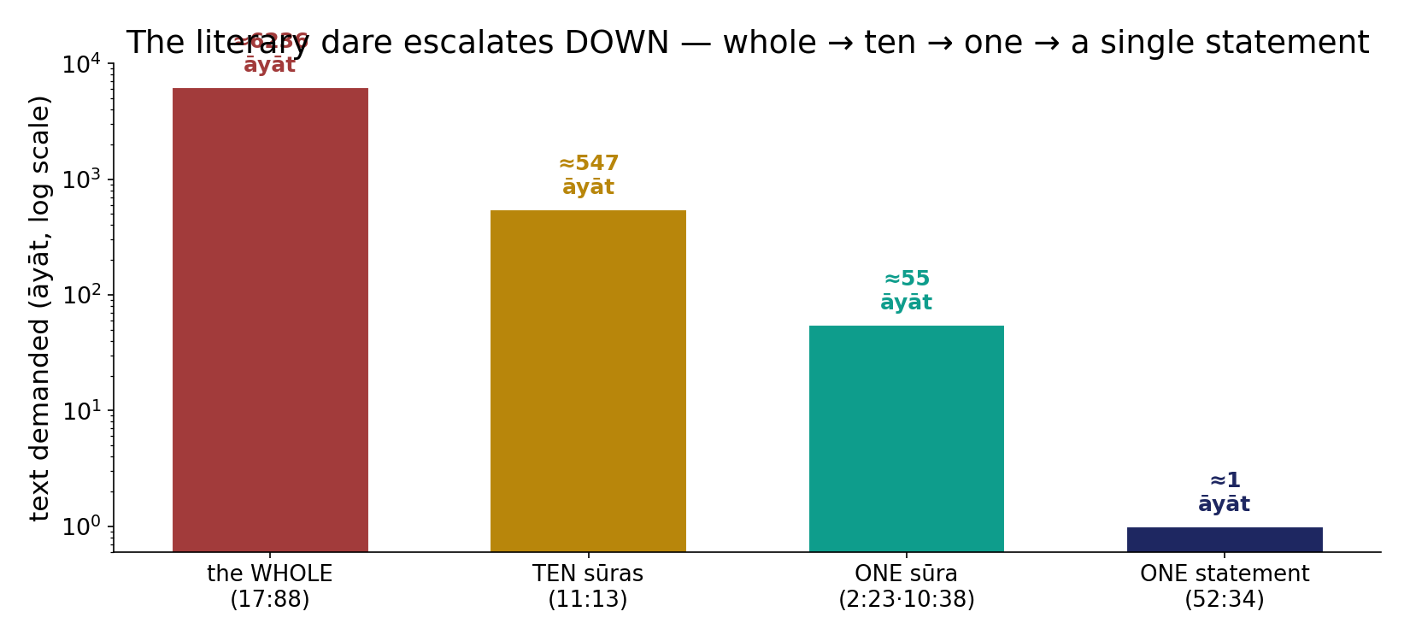
The literary dare escalates DOWN
In the data - the bar is lowered from the whole corpus (~6,236 ayat) to ten suras, to one sura (~55 ayat), to a single statement. Lowering the bar sharpens the dare rather than softening it.

Slide 4
The literary-challenge verses, verbatim
the text's own words (address - snippet - gloss):
17:88 لَا يَأْتُونَ بِمِثْلِهِ - jinn & humankind together could not bring its like
11:13 فَأْتُوا بِعَشْرِ سُوَرٍ مِّثْلِهِ مُفْتَرَيَاتٍ - then bring ten fabricated suras like it
2:23 فَأْتُوا بِسُورَةٍ مِّن مِّثْلِهِ - then bring a single sura from its like
10:38 فَأْتُوا بِسُورَةٍ مِّثْلِهِ - then bring one sura like it
52:34 فَلْيَأْتُوا بِحَدِيثٍ مِّثْلِهِ - then let them bring a statement like it - if truthful

Slide 5
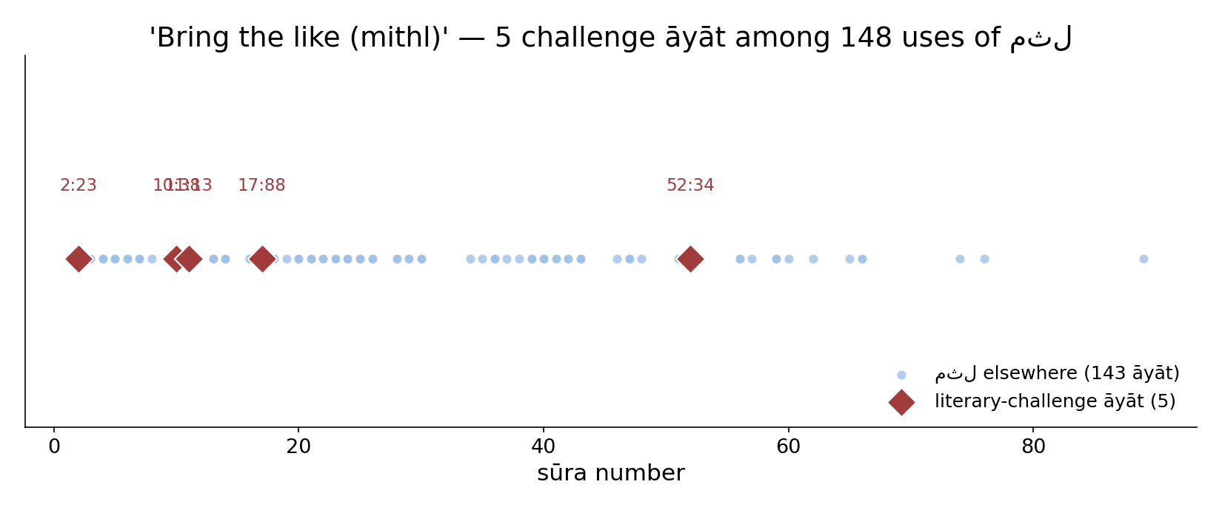
'Bring the like (mithl)' - a needle in the haystack
In the data - the root for 'like' occurs in 148 ayat across the corpus; exactly 5 of them carry the literary challenge. The dare is a precise, locatable subset of a common word - not a vague motif.

Slide 6
A standing, falsifiable prediction - 2:24
2:24 فَإن لَّمْ تَفْعَلُوا وَلَن تَفْعَلُوا
'And if you do not - and you will NEVER do it -': the text does not merely invite, it PREDICTS the challenge will go unmet for all time. A prediction is falsifiable: one counter-example would end it.
Why this is unusual
Most scriptures assert; this one stakes a claim that could in principle be DISPROVEN by anyone who produces the like. That structure - an open, repeatable, falsifiable dare - is itself the subject of this topic, presented here without our verdict.

Slide 7
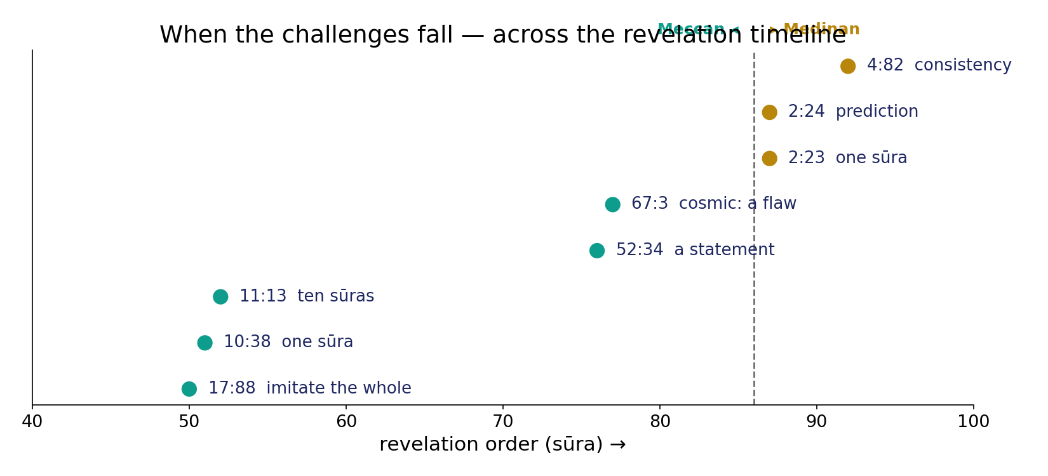
When the challenges fall - across the revelation timeline
In the data - the dares appear in both the Meccan period (the literary & cosmic challenges) and the Medinan period (2:23-24, 4:82). The challenge is sustained across the whole revelation, not a one-off.

Slide 8
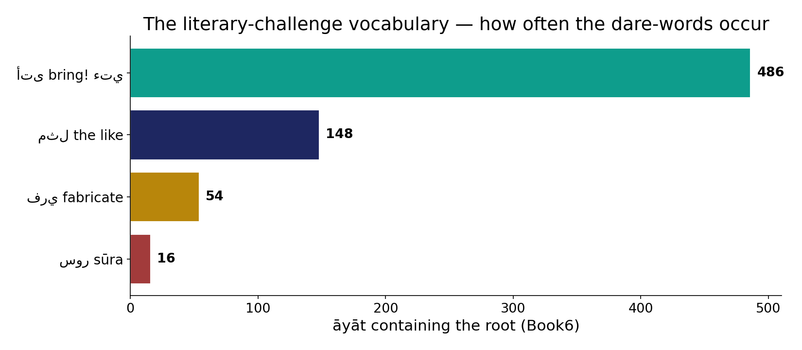
The literary-challenge vocabulary
In the data - the dare's words: 'bring!' (486 ayat - the imperative verb of the challenge), 'the like' (148), 'fabricate' (54), 'sura' (16). The challenge is built from the corpus's own core vocabulary.

Slide 9
The challenge inventory - verses by kind
Challenge ayat collected from Book6, by kind
5
2
1
1
Literary (imitate)
Prediction (2:24)
Consistency (4:82)
Cosmic (67:3-4)
Nine challenge ayat, four kinds
Five literary dares (17:88; 11:13; 2:23; 10:38; 52:34), one standing prediction (2:24), one consistency dare (4:82), and the two-verse cosmic dare (67:3-4). Few in number, sharp in wording, and each addressable.

Slide 10
The internal-consistency challenge - 4:82
The dare
Read it through (tadabbur) and look for the inconsistencies a long, human-authored, serially-produced text would accumulate.
4:82 أَفَلَا يَتَدَبَّرُونَ … لَوَجَدُوا فِيهِ اخْتِلَافًا كَثِيرًا
'Do they not reflect ...? Had it been from other than God, they would have found in it much discrepancy.' An invitation to search for internal contradiction across a ~23-year corpus.
Where our method touches it
The Two Books FDR work measured STRUCTURE - contiguity, composition, signal - and found coherent, non-random organization. That speaks to structure, NOT to this verse's theological claim, which we do not adjudicate.

Slide 11
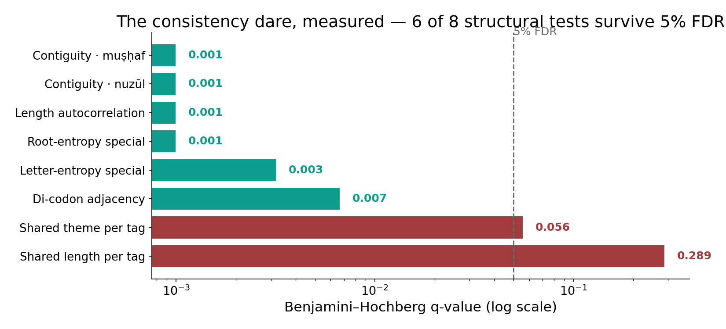
The consistency dare, measured - the Two Books FDR battery
In the data - 6 of 8 representative structural tests survive a single Benjamini-Hochberg 5% FDR (q <= 0.0067); the two borderline tests correctly drop out. Structural coherence is robust - which is NOT proof of 4:82's claim, only that the text is non-random.

Slide 12
The cosmic challenge - look for a flaw (67:3-4)
67:3 مَّا تَرَى فِي خَلْقِ الرَّحْمَنِ مِن تَفَاوُتٍ … هَلْ تَرَى مِن فُطُورٍ
'You see no disparity (tafawut) in the Most Merciful's creation. Return the gaze - do you see any rupture (futur)?' An empirical dare: inspect the universe for a flaw.
67:4 فَارْجِعِ الْبَصَرَ … يَنقَلِبْ إِلَيْكَ الْبَصَرُ خَاسِئًا وَهُوَ حَسِيرٌ
'Then look again and again - your gaze returns to you humbled and exhausted.' The challenge predicts the outcome of repeated, careful observation: no rupture found. An invitation to look, framed as a search for order - which we present, not prove.

Slide 13
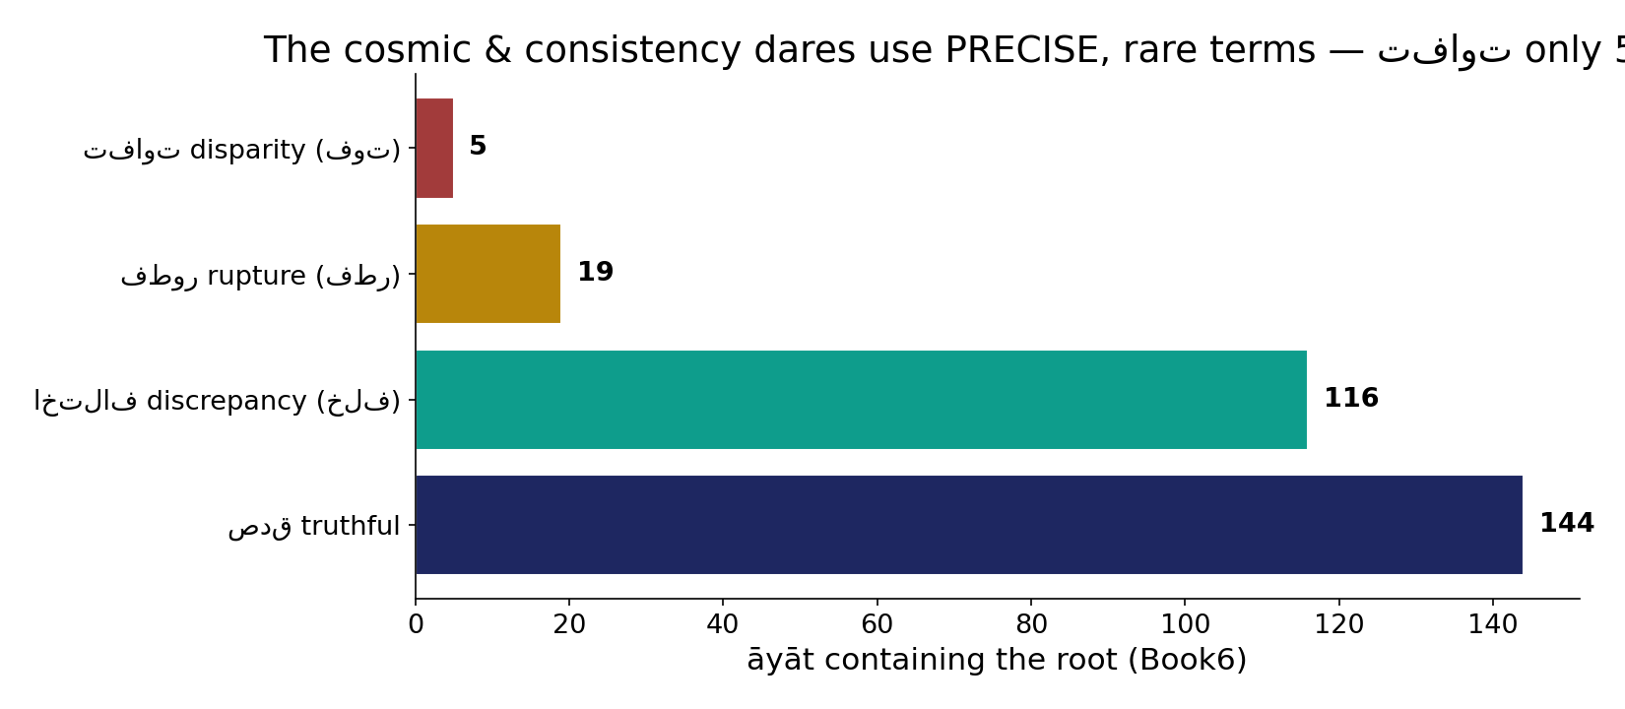
The cosmic & consistency dares use rare, precise terms
In the data - 'disparity' (tafawut) occurs in only 5 ayat, 'rupture' (futur) in 19, 'discrepancy' (ikhtilaf) in 116, 'truthful' (sidq) in 144. The cosmic dare's signature word tafawut is near-unique - a deliberate, exact term.

Slide 14
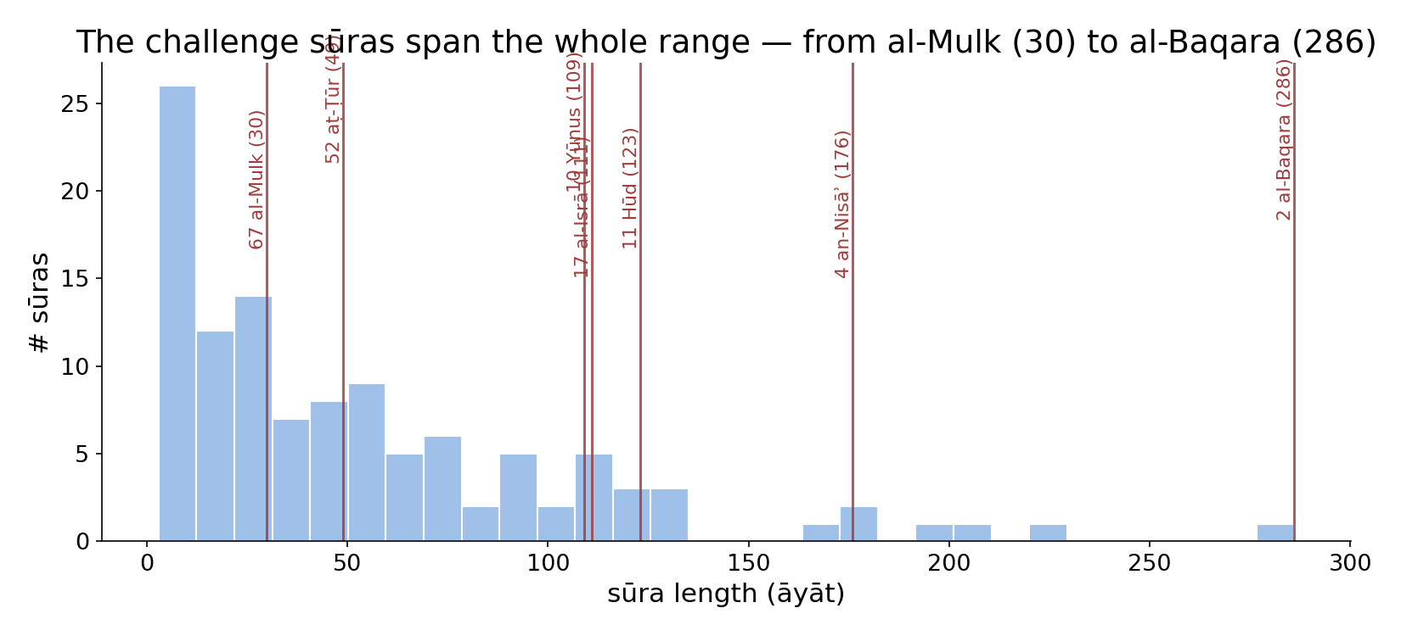
The challenge suras span the whole corpus
In the data - the seven challenge suras run from al-Mulk (30 ayat) to al-Baqara (286). The dare is not confined to one register or length - it recurs across short Meccan and long Medinan suras alike.

Slide 15
The family of challenges - one falsifiable structure
LITERARY
imitate the text - whole->ten->one->a statement (17:88...52:34)
CONSISTENCY
find a contradiction across the whole corpus (4:82)
COSMIC
find a rupture in creation (67:3-4)
Three targets, one shape
Whether aimed at the text, its coherence, or the cosmos, every challenge has the same form: an open invitation, addressable by anyone, that could in principle be defeated by a single counter-example - a sura, a contradiction, a rupture. That common structure is what makes the tahaddi distinctive.

Slide 16
How we present these - honestly
WHAT WE DO
- Quote each challenge from Book6 with its address. - Count the dare-vocabulary from the corpus. - Note that each is, by its wording, open and falsifiable.
WHAT WE DO NOT DO
- We do NOT declare the challenges met or unmet - that is a theological judgement. - We do NOT treat our structural findings as proof of the claims. - The data is: the text issues these dares, here.

Slide 17
Reading the challenges honestly - the audit
✓ Verses are addressable
every challenge carries a sura:ayah - look it up in Book6.
✓ Vocabulary is counted
dare-words tallied live from the corpus.
✓ Structure is robust
6/8 FDR tests survive - the corpus is demonstrably non-random.
~ 'Met?' is theology
whether a dare stands is a reading we present, not settle.
✗ Not a proof
non-random structure != proof of a divine-origin claim.
✗ No over-reading
we report verse + count + structure, nothing more.

Slide 18
How this was computed (reproducible)
Book6
6,236 ayat - roots + surface forms - revelation order
challenge ayat
9 verses by address; dare-roots normalized & counted
7 figures
escalation, timeline, vocab, FDR...
locate
chart
Fully reproducible
Verses are quoted by address; every figure recomputes from Book6.xlsx via gen_figs_chal.py (fixed seed). Roots are normalized (Persian/Arabic letter variants folded) so counts are stable; the FDR battery is the live result from the Two Books FDR-summary lecture. Nothing here is hand-tuned.

Slide 19
Takeaway
A text that invites inspection
The Qur'an is distinctive in repeatedly daring its reader: imitate me (17:88 -> 52:34), find a contradiction in me (4:82), find a flaw in the creation I describe (67:3-4) - and it predicts each dare will stand (2:24).
The data shows the dares are few, precise, and addressable; the structure they sit in is demonstrably non-random (6/8 FDR). Whatever one concludes, the form is remarkable: an open, falsifiable, repeatable invitation, laid out here from the text itself - the reader inspects, as the verses ask.
Presented, not adjudicated: a count of dares and their addresses, faithfully from Book6.

Slide 20
Quick reference
The challenges (by address)
Literary: 17:88 - 11:13 - 2:23 - 10:38 - 52:34. Prediction: 2:24. Consistency: 4:82. Cosmic: 67:3-4. Dare-verb 'bring' in 486 ayat; 'like' in 148.
The numbers
9 challenge ayat - 4 kinds - tafawut only 5 ayat - futur 19 - 6/8 structural tests survive 5% FDR - 7 figures recompute from Book6 (gen_figs_chal.py).

