Slide 1
SPECIAL TOPIC - frequency, Week 1
Warning or glad tidings? What the Qur'an leans on
A false either/or, tested on the corpus
Is the Qur'an 'essentially a book of glad tidings' or 'essentially warning'? Either slogan forces one axis onto a two-channel signal. We count both fields - warning (n-dh-r) and tidings (b-sh-r) - sense-aware, and read the messenger's role and the way the two are paired.
Every count recomputes from Book6; both roots are polysemous (b-sh-r also = mortal/human; n-dh-r also = vow), so figures use the prophetic senses.

Slide 2
The question, and the method
The claim to test
'More about warning' vs 'more about tidings' - an either/or that may itself be the error.
The method
- count the warning-field (n-dh-r) against the tidings-field (b-sh-r)
- read the messenger's ROLE-words: warner (nadhir) vs herald (bashir)
- check how often the two are bound in one ayah, and in what order

Slide 3
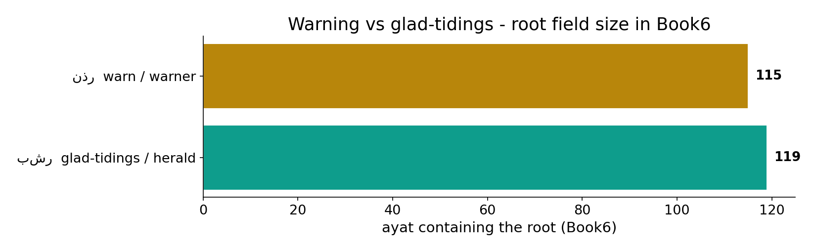
The two fields, by size
In the data - the warning-root appears in 115 ayat and the tidings-root in 119: close in size, with warning modestly ahead.

Slide 4
True glad tidings - the text's own words
the text's own words (address - snippet - gloss):
2:25 وَبَشِّرِ الَّذِين آمَنُواْ وَعَمِلُواْ - glad tidings
36:11 وَخَشِيَ الرَّحْمَن بِالْغَيْبِ فَبَشِّرْهُ بِمَغْفِرَةٍ وَأَجْرٍ كرِيمٍ - glad tidings
9:21 يُبَشِّرُهُمْ رَبُّهُم بِرَحْمَةٍ مِّنْهُ - glad tidings

Slide 5
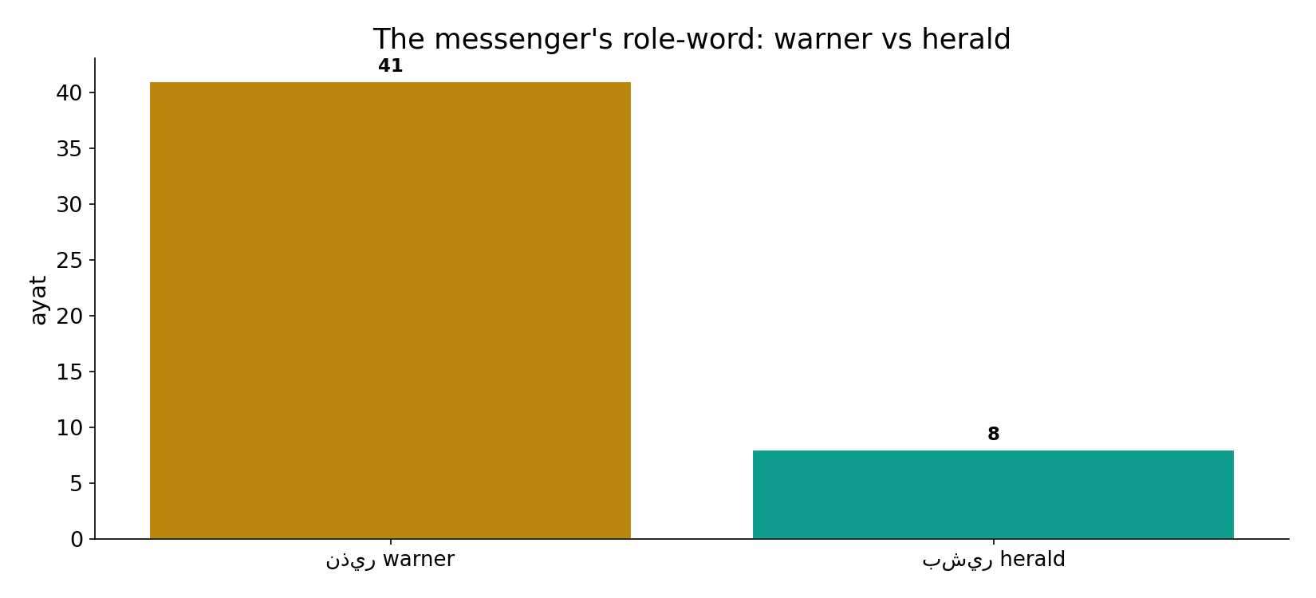
The role-word leans hard to 'warner'
In the data - as the messenger's title, warner (nadhir, 41) outnumbers herald (bashir, 8). The ROLE is warner even where the message carries mercy.

Slide 6
What the data shows
Warning is the volume
The warning-field (115) edges out tidings (119), and the messenger's title is overwhelmingly 'warner' (41 vs 8).
Mercy is the framing
When the two are paired the herald comes FIRST - 'a herald and a warner' (7:188; 35:24). Tidings opens; warning presses.
The question is half wrong
The corpus binds the two channels rather than choosing; 'more about X or Y' is the analyst's axis, not the text's shape.

Slide 7
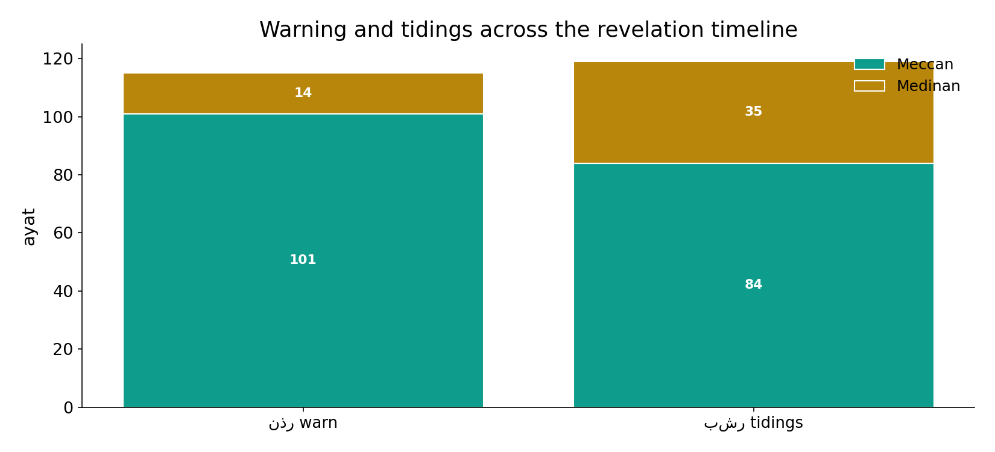
Both channels run the whole revelation
In the data - warning and tidings both span the Meccan and Medinan periods; neither is a late add-on. The two are co-present throughout.

Slide 8
The warner role, and 'tidings' of punishment
the text's own words (address - snippet - gloss):
35:24 إِنَّا أَرْسَلْنَاك بِالْحَقِّ بَشِيرًا وَنَذِيرًا وَإِن مِّنْ - warner (and herald)
38:70 إِلَّا أَنَّمَا أَنَا نَذِيرٌ مُّبِينٌ - warner
67:26 اللَّهِ وَإِنَّمَا أَنَا نَذِيرٌ مُّبِينٌ - warner
31:7 فِي أُذُنَيْهِ وَقْرًا فَبَشِّرْهُ بِعَذَابٍ أَلِيمٍ - ‘tidings’ of punishment
84:24 فَبَشِّرْهُم بِعَذَابٍ أَلِيمٍ - ‘tidings’ of punishment

Slide 9
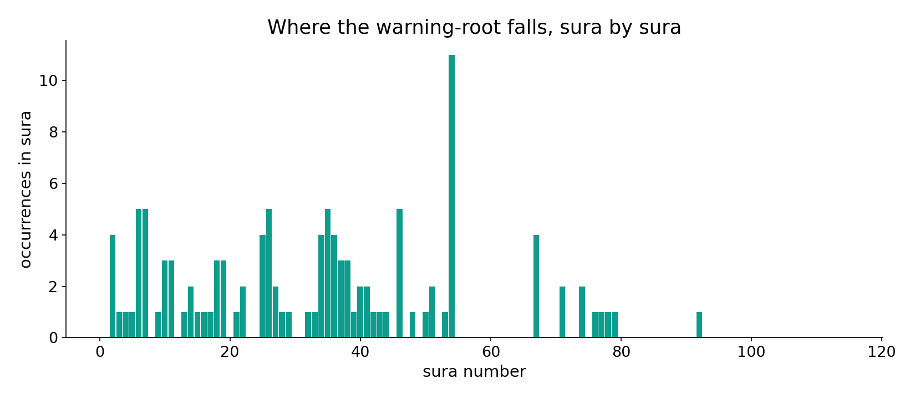
The warning-root, sura by sura
In the data - warning is spread across the corpus, concentrated where confrontation with denial is densest.

Slide 10
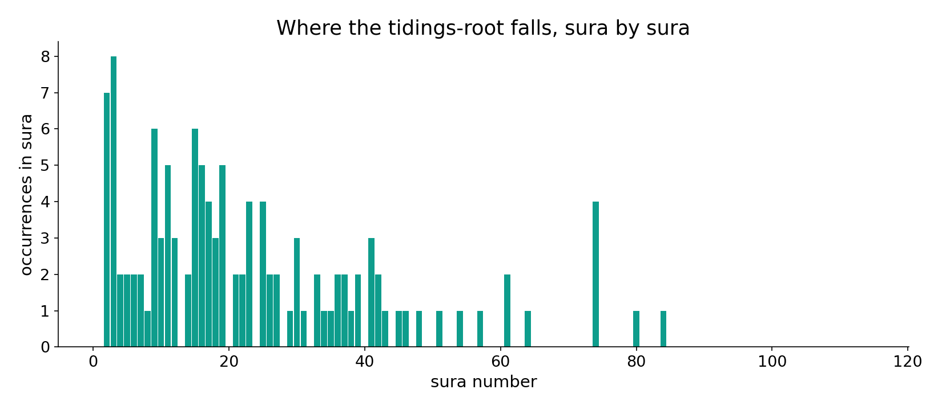
The tidings-root, sura by sura
In the data - tidings track the passages of reward and mercy; the two distributions interleave rather than separate.

Slide 11
Warning leads in volume, tidings leads in order
The honest finding is a SHAPE, not a winner. As distribution, warning is modestly larger; as a messenger-role, warner dominates; yet whenever the two are set together the glad tidings is named first and the bond is tight (above-chance co-occurrence). A measurement trap survives only because the senses were filtered: counting bashshir as 'good news' would inflate tidings with the very verses that announce punishment ('give them tidings of a painful torment').
Volume says warning; sequence says mercy - both are true at once.

Slide 12
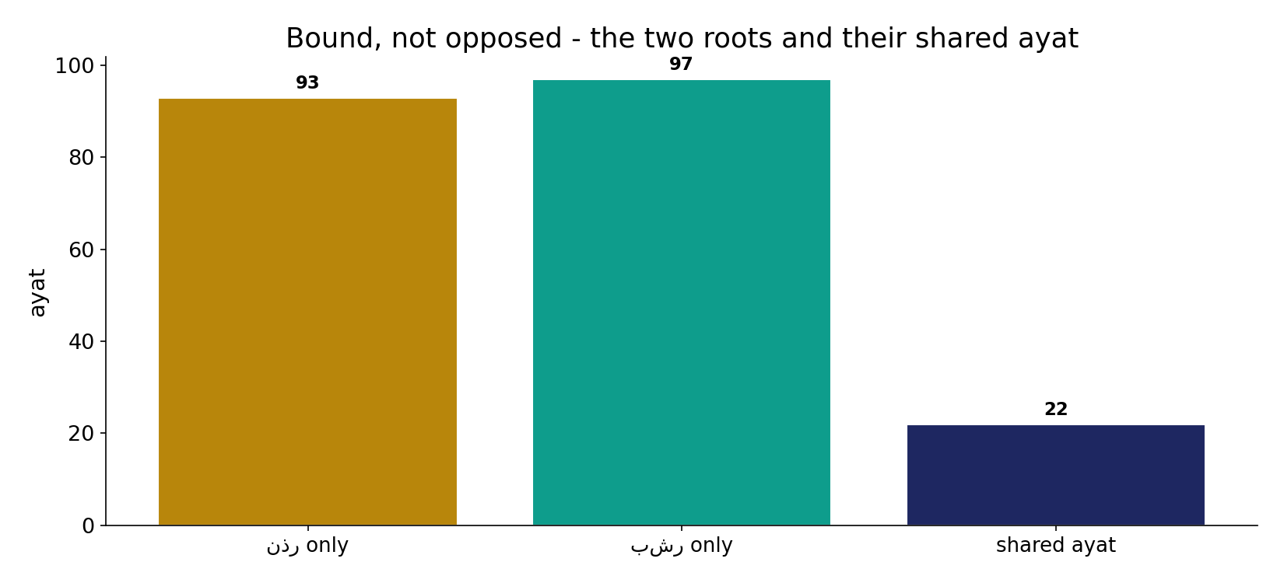
Bound, not opposed
In the data - the two roots share 22 ayat. 'A herald and a warner' (bashiran wa-nadhiran) is a set phrase - the corpus binds them rather than choosing one.

Slide 13
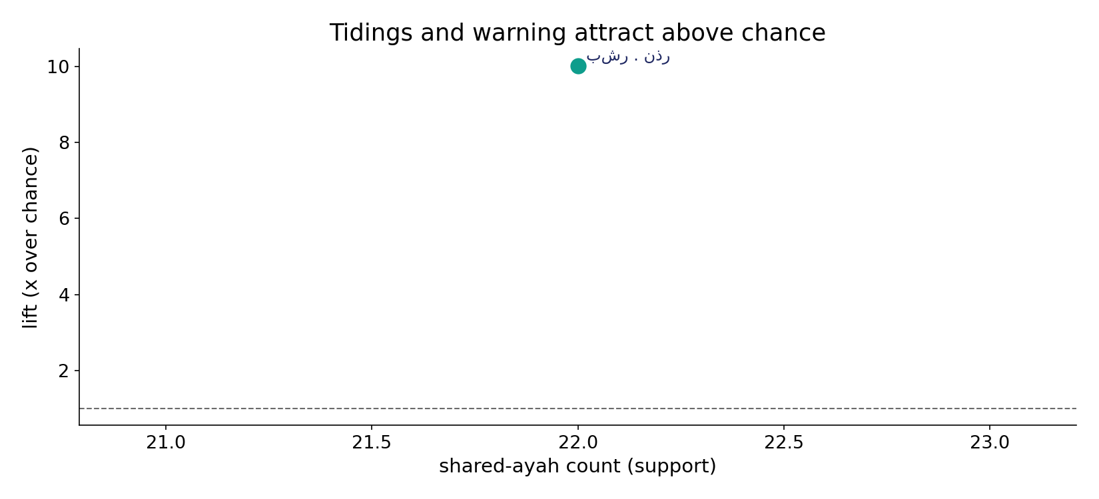
And they attract above chance
In the data - warning and tidings co-occur at 10.0x the rate chance predicts: a deliberate pairing, not coincidence.

Slide 14
One prophetic act, two channels
WARN (nadhir)
press the consequence of denial
BIND
a herald and a warner - one phrase
HERALD (bashir)
open with mercy and reward
Two channels, not two books
The corpus does not pick warning or tidings; it runs both and binds them - leading with mercy, pressing with warning.

Slide 15
Honest limits and critique
'More about X or Y' forces one axis
A two-channel signal has no single winner. Reported as a winner, the finding misleads; reported as a shape, it is faithful.
Sense-filtering is load-bearing
b-sh-r also means mortal/human and is sometimes ironic ('tidings of punishment'); n-dh-r also means vow. Raw root counts would distort the comparison - the prophetic senses were isolated first.

Slide 16
Reading this honestly - the audit
✓ Fields are counted
warning 115 vs tidings 119 ayat, recomputed from Book6.
✓ Roles are counted
warner 41 vs herald 8, surface forms.
✓ The pairing is real
22 shared ayat at 10.0x chance.
~ 'Lean' is a shape
warning leads volume, tidings leads order - not a single verdict.
✗ Not an either/or
the corpus binds the two channels; the slogan picks one.
✗ No raw-root counting
ironic tidings and 'mortal' senses are filtered out.

Slide 17
How this was computed (reproducible)
Book6
warning & tidings roots; role-forms
measure
field size, role-words, co-occurrence & lift
figures
field bars, role bar, timeline, sura maps
count
chart
Fully reproducible
Every figure recomputes from Book6.xlsx via the shared wk.py kernel (fixed seed). Roots are normalized (Persian/Arabic letter variants folded) so counts are stable; surface forms are used wherever a concept must be kept apart from its root family (per the course's sense-verification rule).

Slide 18
Appendix - input snippets (Book6, vocalized)
verbatim snippets with addresses:
2:25 وَبَشِّرِ الَّذِين آمَنُواْ وَعَمِلُواْ - glad tidings
36:11 وَخَشِيَ الرَّحْمَن بِالْغَيْبِ فَبَشِّرْهُ بِمَغْفِرَةٍ وَأَجْرٍ كرِيمٍ - glad tidings
9:21 يُبَشِّرُهُمْ رَبُّهُم بِرَحْمَةٍ مِّنْهُ - glad tidings

Slide 19
Takeaway
A herald who is also a warner
The Qur'an does not choose between warning and glad tidings - it runs both channels the whole way through.
By volume warning leads (115 vs 119) and the messenger is titled 'warner' (41); by sequence tidings leads, named first wherever the two are bound (22 shared ayat, 10.0x chance).
Warning is the volume; mercy is the framing - presented from the text, not adjudicated.

Slide 20
Quick reference
The numbers
warning-field 115 ayat - tidings-field 119 - warner 41 vs herald 8 - 22 shared ayat at 10.0x chance.
The shape
warning leads volume; tidings leads order; the two are bound ('herald and warner'), so 'either/or' is the wrong frame.

