Slide 1
SPECIAL TOPIC - frequency & address, Week 1
Who does the Qur'an address?
Everyone, one community, or its opponents? - read from the vocatives
Is the Qur'an speaking to all humanity, to a community, or to its critics? We separate MENTION (named anywhere) from ADDRESS (the vocative 'O ...!'), and a fixed identity (a noun) from an ongoing act (a verb), then read the speech frame ('Say!' vs 'they said').
Counts recompute from Book6; vocative openings are detected from the tokenized text and are reproducible.

Slide 2
The question, and the method
The question
Does the Qur'an address everyone, a community, or opponents - and as fixed identities or ongoing acts?
The method
- count the vocative 'O ...!' openings by addressee
- separate mention (named) from address (called)
- track the dialogue frame - 'Say!' (qul) commands

Slide 3
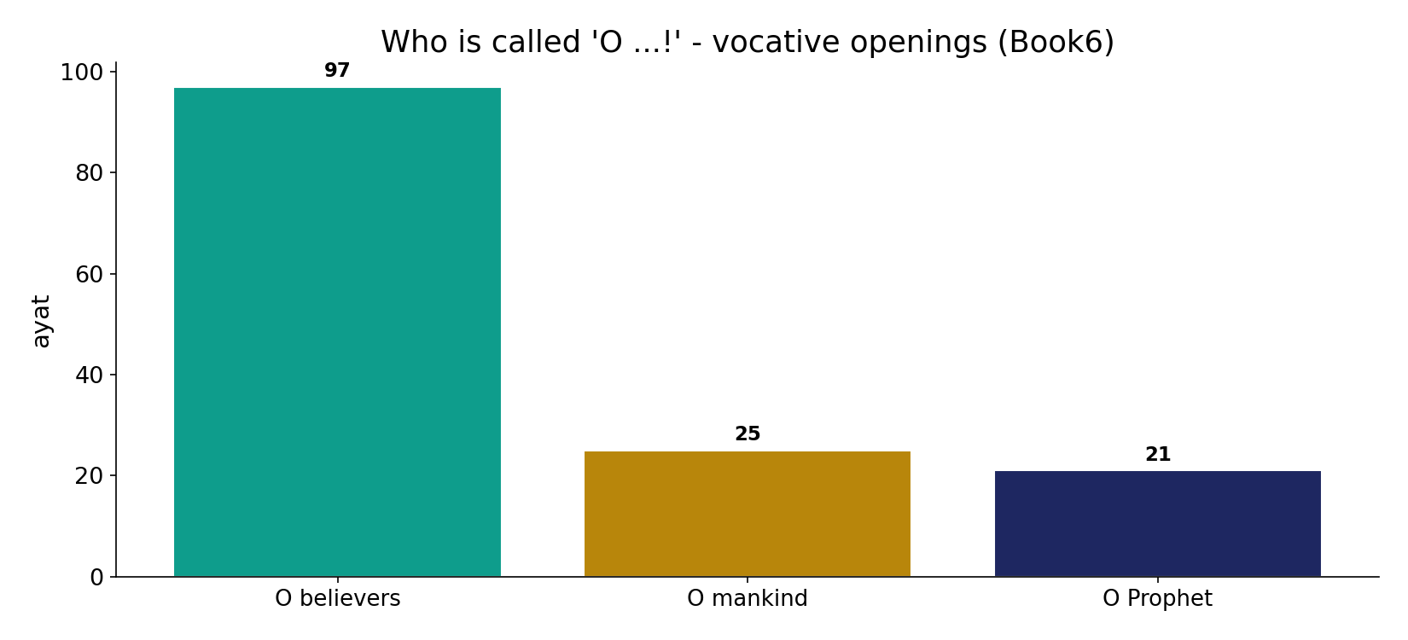
The vocative goes to the believing community
In the data - direct 'O ...!' openings: believers 97, mankind 25, the Prophet 21. The primary addressee is the community of faith.

Slide 4
Universal frame - 'O mankind'
the text's own words (address - snippet - gloss):
49:13 يَا أَيُّهَا النَّاسُ إِنَّا خَلَقْنَاكُم مِّن ذَكرٍ وَأُنثَى - O mankind (universal)
2:21 يَا أَيُّهَا النَّاسُ اعْبُدُواْ رَبَّكُمُ الَّذِي خَلَقَكُمْ وَالَّذِينَ - O mankind — worship your Lord
3:64 قُلْ يَا أَهْلَ الْكِتَابِ تَعَالَوْاْ إِلَى كلَمَةٍ سَوَاء - O People of the Book

Slide 5
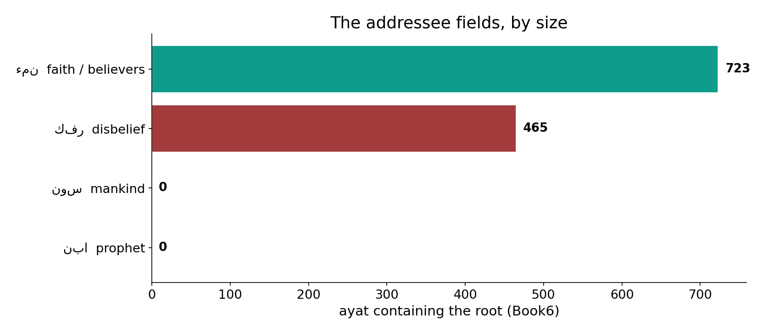
The addressee fields, by size
In the data - faith (723), disbelief (465), mankind (0) and prophet (0) fields: a universal frame around a community focus.

Slide 6
What the data shows
Identity AND act
believers and disbelievers are each named both as a settled NOUN and an ongoing VERB - faith (723) and denial (465) are processes, not only labels.
Addressed in-community
the vocative goes to believers 97 times, mankind only 25, the Prophet 21 - a community focus inside a universal frame.
Staged as dialogue
'Say!' (qul) opens 349 replies - a scripted back-and-forth, not a monologue.

Slide 7
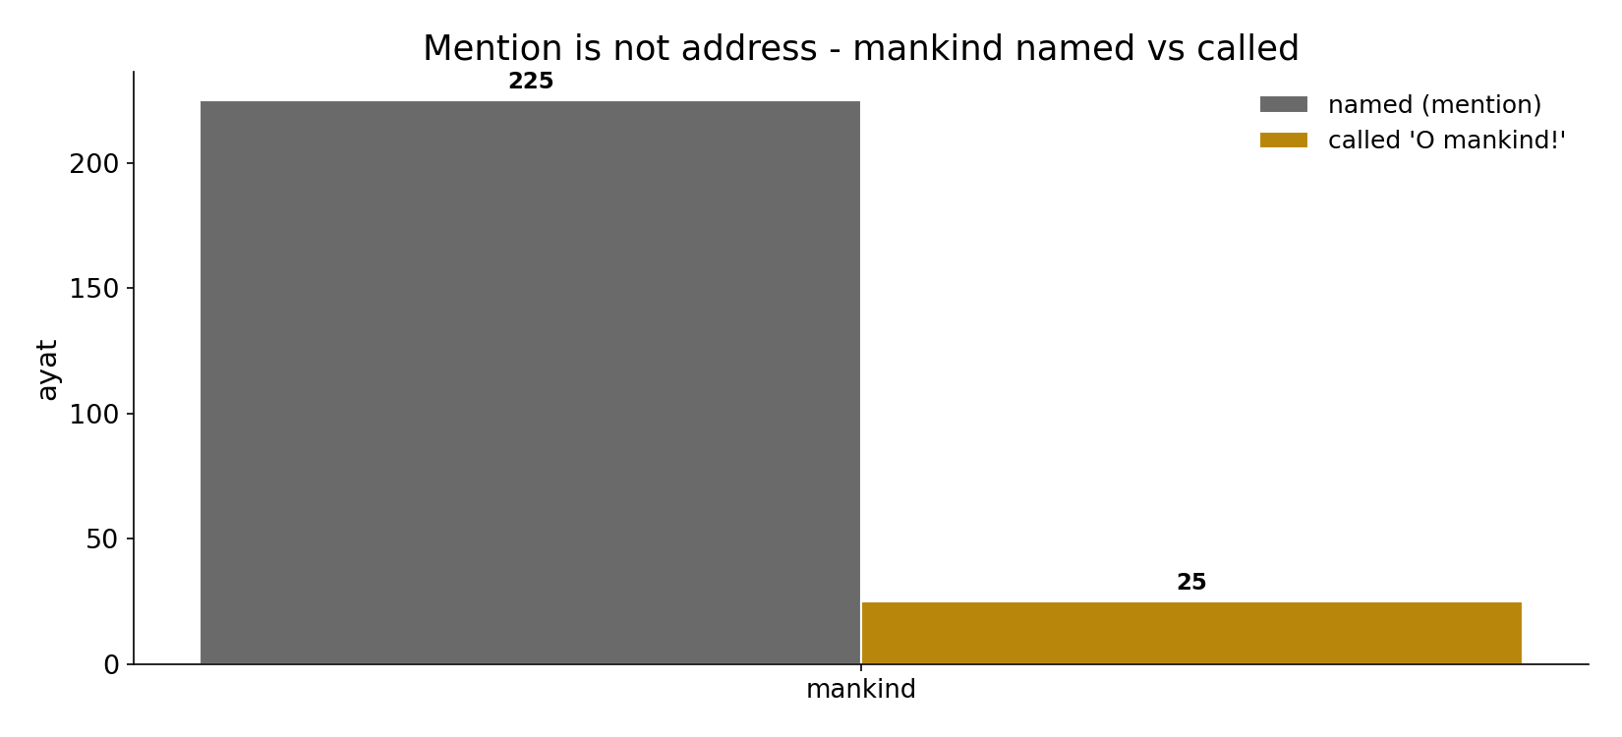
Mention is not address
In the data - 'mankind' is NAMED 225 times but directly CALLED only 25. Counting mentions would overstate the universal address.

Slide 8
Community focus, and the dialogue
the text's own words (address - snippet - gloss):
5:1 يَا أَيُّهَا الَّذِينَ آمَنُواْ أَوْفُواْ بِالْعُقُودِ أُحِلَّتْ - O you who believe (community)
2:104 يَا أَيُّهَا الَّذِينَ آمَنُواْ لاَ تَقُولُواْ رَاعِنَا - O you who believe — address
112:1 قُلْ هُوَ اللَّهُ أَحَدٌ - “Say!” — God scripts the Prophet
109:1 قُلْ يَا أَيُّهَا الْكافِرُونَ - “Say: O disbelievers”
2:11 وَإِذَا قِيلَ لَهُمْ لاَ تُفْسِدُواْ فِي الأَرْضِ قَالُواْ إِنَّمَا - “they said” — quoted objection

Slide 9
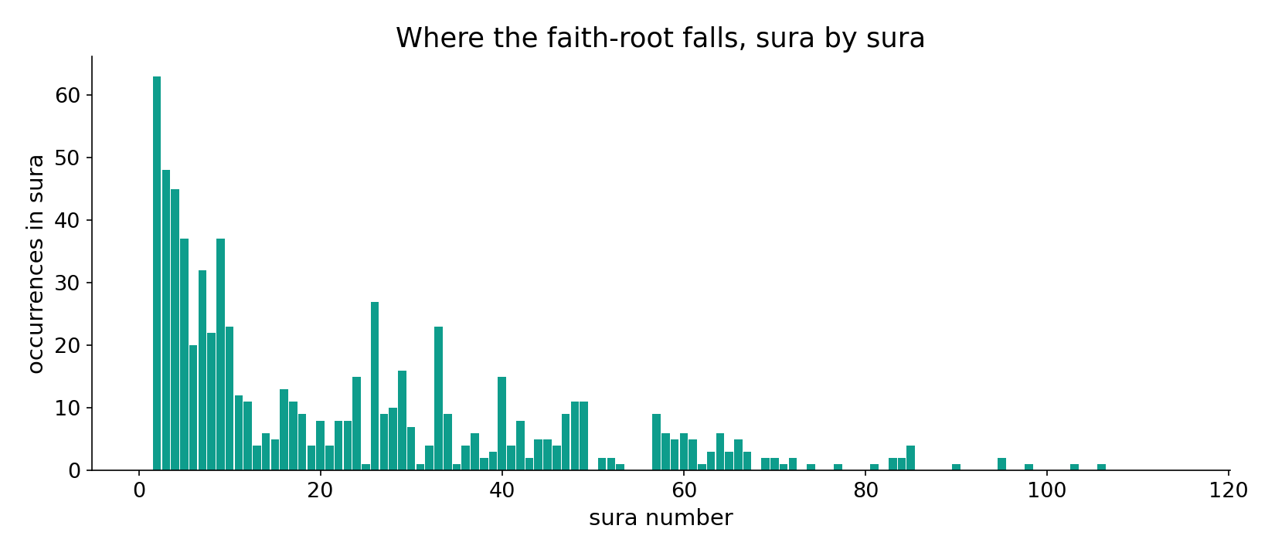
The faith-root across the corpus
In the data - the faith-root is densest in the Medinan community sūras, thinning in the short Meccan tail.

Slide 10
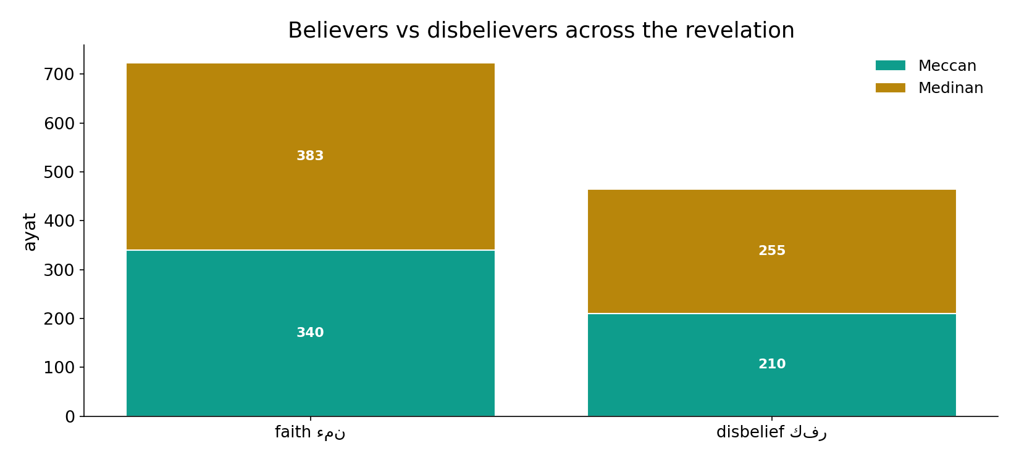
Believers and disbelievers across the revelation
In the data - both groups are addressed across periods; the believing-community focus sharpens in the Medinan suras.

Slide 11
A community address inside a universal frame, in dialogue
The primary addressee is the believing community (most vocatives), set inside a universal frame: 'mankind' is named hundreds of times but directly called far less. And it is a scripted dialogue - God tells the Prophet 'Say!' and quotes opponents 'they said.' Mention is not address: counting names alone would overstate the universal reach; the vocative reveals the real focus.
A universal frame, a community focus, a dialogue form - all three at once.

Slide 12
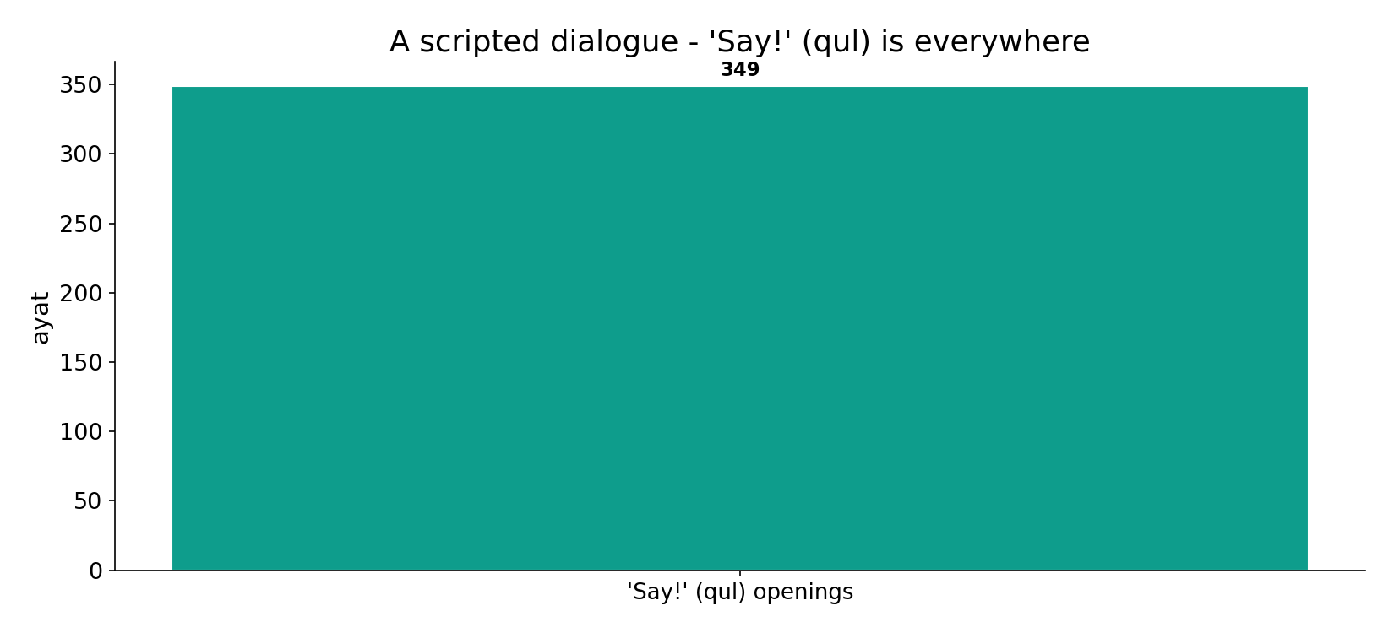
A scripted dialogue
In the data - 'Say!' (qul) opens speech 349 times: the text is staged as a back-and-forth, God instructing the Prophet to answer.

Slide 13
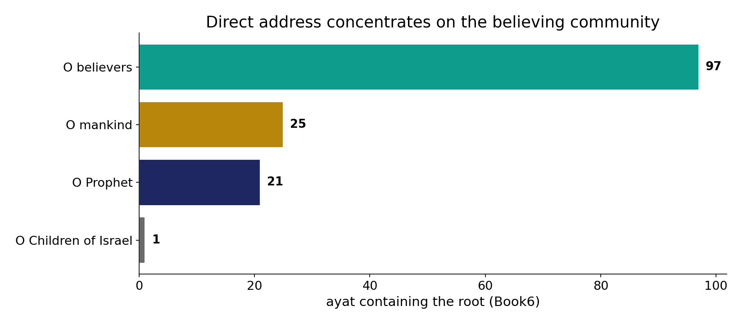
Direct address, by group
In the data - of all 'O ...!' openings, the believing community dominates (97), inside a universal frame ('O mankind' 25).

Slide 14
Frame, focus, form
Universal frame
'O mankind' - all are in view
Community focus
most vocatives -> believers
Dialogue form
'Say!' - a staged reply
Three things at once
a universal address, a community focus, and a dialogue - the vocatives reveal the real centre of gravity.

Slide 15
Honest limits and critique
Mention != address
'mankind' is named 225 times but called only 25; reading mentions as address inflates the universal claim.
Noun and verb must be split
collapsing 'those who came to believe' into 'the believers' erases the act-vs-identity distinction; root + surface + morphology keep them apart.

Slide 16
Reading this honestly - the audit
✓ Vocatives counted
believers 97, mankind 25, Prophet 21.
✓ Mention vs address
mankind named 225, called 25.
✓ Dialogue frame
'Say!' opens 349 times.
~ Tokenized detection
vocatives read from tokenized text; small boundary variation possible.
✗ Not a proof
counts and co-occurrence locate meaning; they do not settle theology.
✗ No raw mixing
forms/senses separated before counting (course rule).

Slide 17
How this was computed (reproducible)
Book6
addressee roots; vocative openings
measure
field size, mention vs address, dialogue frame
figures
vocative bars, field bars, timeline, sura map
count
chart
Fully reproducible
Every figure recomputes from Book6.xlsx via the shared wk.py kernel (fixed seed). Roots are normalized (Persian/Arabic letter variants folded) so counts are stable; surface forms are used wherever a concept must be kept apart from its root family (per the course's sense-verification rule).

Slide 18
Appendix - input snippets (Book6, vocalized)
verbatim snippets with addresses:
49:13 يَا أَيُّهَا النَّاسُ إِنَّا خَلَقْنَاكُم مِّن ذَكرٍ وَأُنثَى - O mankind (universal)
2:21 يَا أَيُّهَا النَّاسُ اعْبُدُواْ رَبَّكُمُ الَّذِي خَلَقَكُمْ وَالَّذِينَ - O mankind — worship your Lord
3:64 قُلْ يَا أَهْلَ الْكِتَابِ تَعَالَوْاْ إِلَى كلَمَةٍ سَوَاء - O People of the Book

Slide 19
Takeaway
A community address, inside a universal frame, in dialogue
The Qur'an's primary addressee is the believing community, addressed directly far more than mankind at large.
Yet the frame is universal ('O mankind') and the form is dialogue ('Say!' 349 times). Faith and denial are named as both acts and identities.
Mention is not address - the vocatives, not the name-counts, reveal the focus. Presented from the text.

Slide 20
Quick reference
The numbers
vocatives: believers 97, mankind 25, Prophet 21; mankind named 225; 'Say!' 349; faith-field 723, disbelief 465.
The shape
community focus inside a universal frame, staged as dialogue; identity and act both named.

