Slide 1
SPECIAL TOPIC - distribution, Week 2
Why the Qur'an's order is not its revelation order
A non-chronological arrangement - what rule governs it instead?
The Qur'an was revealed over ~23 years, but its written (mushaf) order is not chronological. Using the revelation-order index in Book6, we compare canonical position against timing and length to find the organizing rule.
Correlations and quarter-averages recompute from Book6; revelation rank is per-sura (narrated, not computed) - a stated limit.

Slide 2
The question, and the method
The question
If not chronology, what rule sets the order of the 114 suras?
The method
- correlate canonical position with revelation order and with length
- bin the mushaf into quarters; read average length
- track landmark suras (first/last revealed) against their position

Slide 3
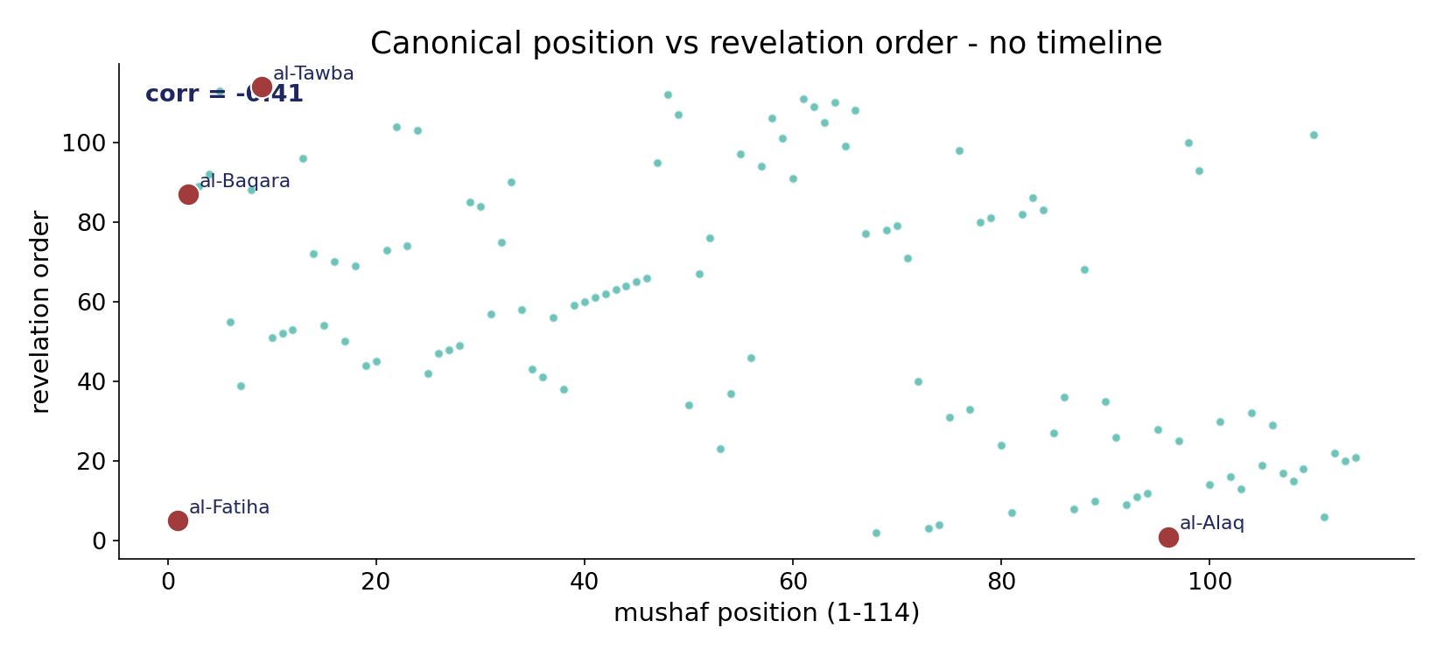
Position carries no chronology
In the data - canonical position vs revelation order correlates only -0.41: the arrangement is essentially non-chronological. al-Alaq (revealed 1st) sits at 96; al-Tawba (last) at 9.

Slide 4
First and last revealed
the text's own words (address - snippet - gloss):
96:1 اقْرَأْ بِاسْمِ رَبِّك الَّذِي خَلَقَ - FIRST revealed — at mushaf position 96
9:1 بَرَاءةٌ مِّنَ اللّهِ وَرَسُولِهِ إِلَى الَّذِينَ عَاهَدتُّم مِّنَ - al-Tawba #9 — revealed LAST (114th)

Slide 5
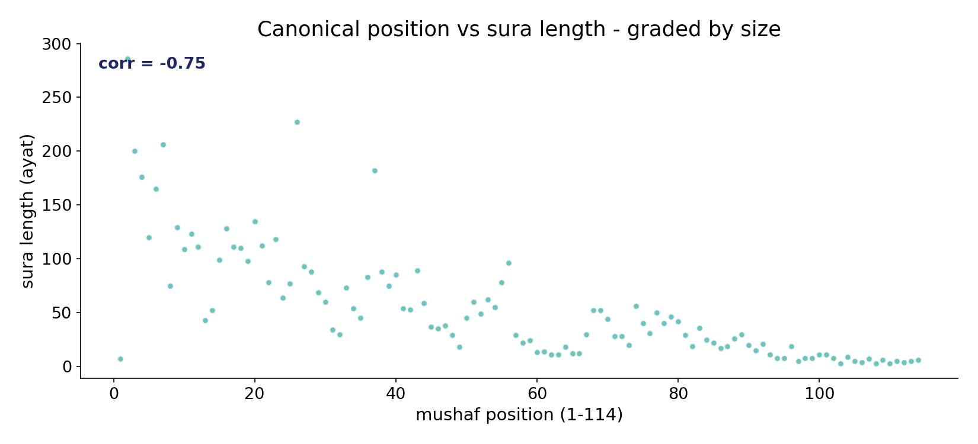
It is graded by length
In the data - position vs sura length correlates -0.75: a strong descending-length gradient. Length, not time, is the visible rule.

Slide 6
What the data shows
Non-chronological
position vs revelation correlates only -0.41 - the order is not a biography.
Graded by length
position vs length correlates -0.75; quarter averages fall 118 -> 10 ayat.
Thematic / liturgical
tradition holds the arrangement was prophet-directed and recitational - a structure, not a timeline (labelled, historical).

Slide 7
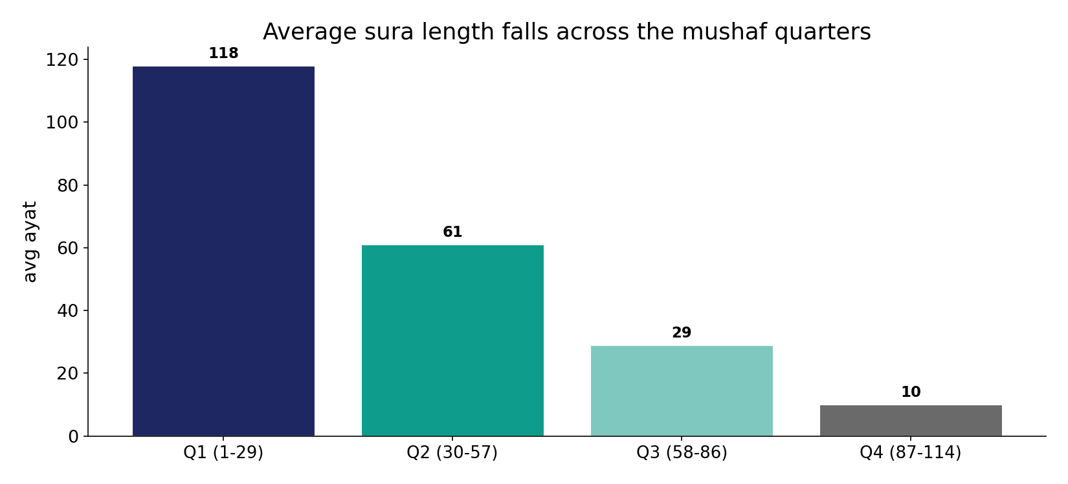
Quarter by quarter, length falls
In the data - average length drops 118 -> 61 -> 29 -> 10 ayat across the four mushaf quarters. The longest suras open; the shortest close.

Slide 8
The opening of the codex, and short suras placed late
the text's own words (address - snippet - gloss):
1:2 الْحَمْدُ للّهِ رَبِّ الْعَالَمِينَ - al-Fātiḥa #1 — revealed 5th
2:1 ذَلِك الْكِتَابُ لاَ رَيْبَ فِيهِ هُدًى لِّلْمُتَّقِينَ - al-Baqara #2 — revealed 87th, longest (286)
108:1 إِنَّا أَعْطَيْنَاك الْكوْثَرَ - al-Kawthar #108 — revealed 15th, shortest
110:1 إِذَا جَاء نَصْرُ اللَّهِ وَالْفَتْحُ - al-Naṣr #110 — revealed 102nd

Slide 9
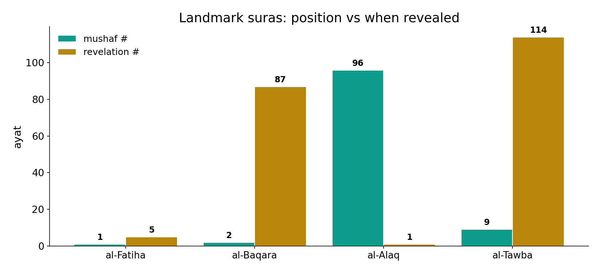
The first revealed becomes the 96th
In the data - al-Fatiha (#1) was revealed 5th; al-Baqara (#2) 87th; al-Alaq ('Read!', 1st revealed) sits at 96; al-Tawba (last) at 9. Position encodes no timeline.

Slide 10
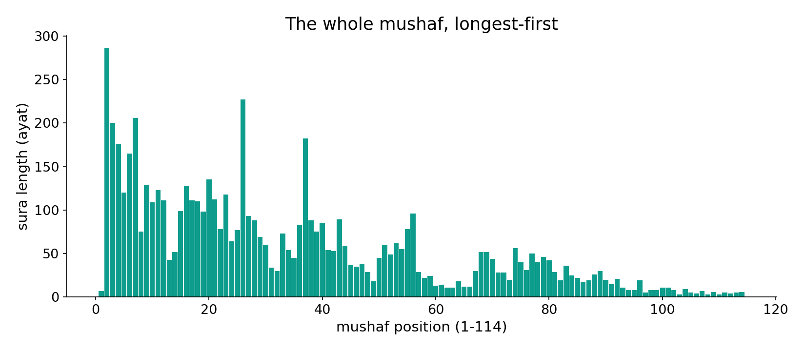
The whole mushaf, longest-first
In the data - the length profile descends across the codex, with al-Fatiha the short opening exception. Longest-first is a tendency, not an absolute law.

Slide 11
A thematic order, not a timeline
The canonical order is essentially non-chronological (corr -0.41) and graded by descending length (corr -0.75), clustering the short early-Meccan suras at the very end. The data shows the SHAPE - longest-first; the REASON (a prophet-directed, liturgical arrangement) lies outside the text and is a narrated, historical claim, not a computed one.
The codex maps WHAT the order is; it declines to compute WHY.

Slide 12
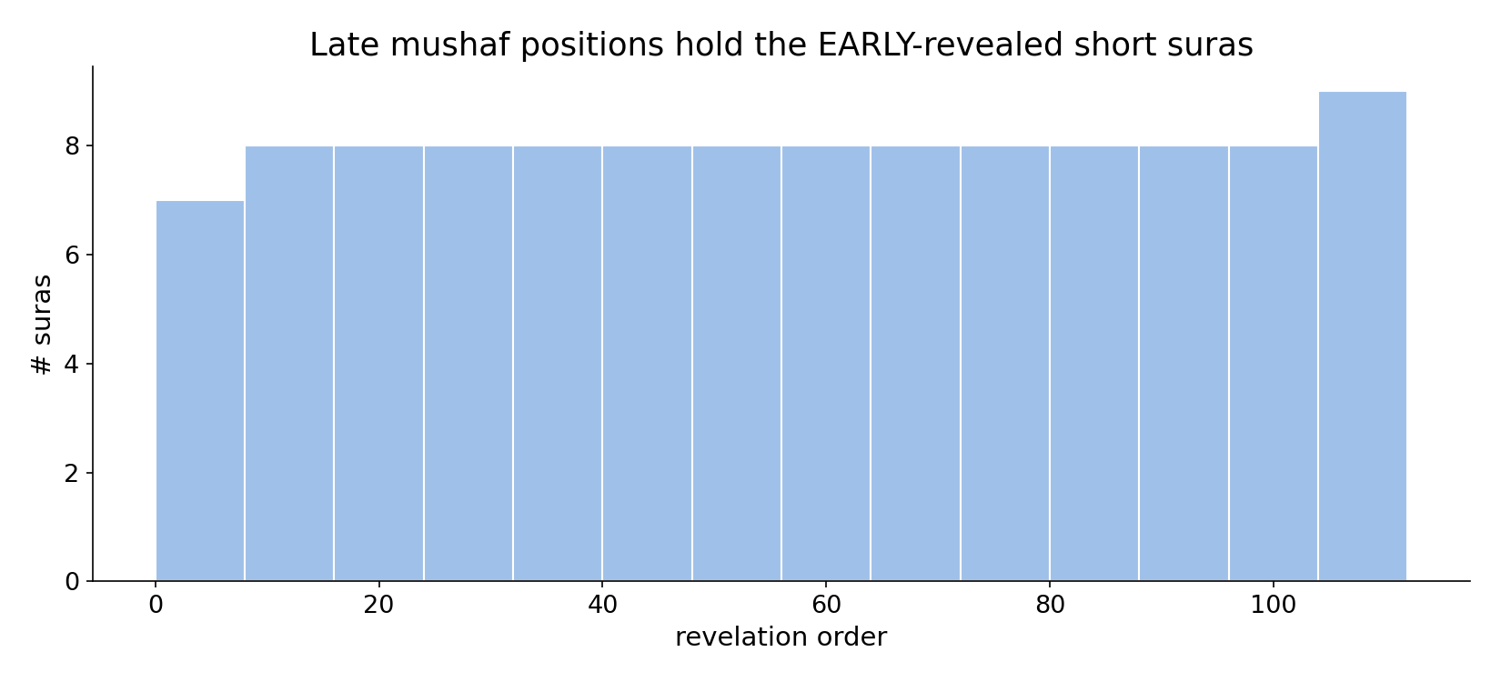
The early-revealed short suras cluster late
In the data - the short, early-Meccan suras are gathered at the END of the codex - the opposite of chronological order.

Slide 13
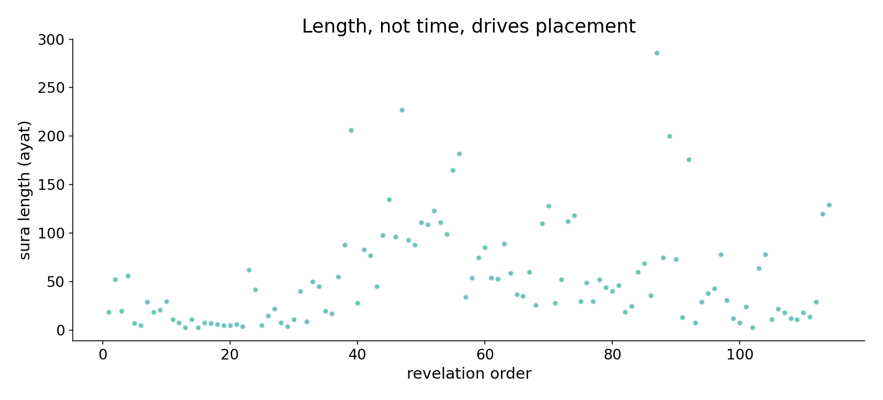
Length, not time, drives placement
In the data - length shows no clean trend with revelation order; the codex is sorted by size, and the timeline is scrambled within it.

Slide 14
What, not why
Revealed over ~23 yrs
a chronology exists
Codex sorts by length
longest-first gradient
Order is thematic
narrated, liturgical - outside the text
The data gives the shape
longest-first, non-chronological; the reason is a historical, narrated claim we do not compute.

Slide 15
Honest limits and critique
Length is a tendency, not a law
al-Fatiha is short yet first - an opening, not the longest. 'Longest-first' is strong but imperfect.
Revelation order is narrated
the timeline comes from sira and ahadith, only at the sura level (Meccan/Medinan verses mix within a sura) - so the chronology itself is an approximation.

Slide 16
Reading this honestly - the audit
✓ Correlations computed
position-revelation -0.41, position-length -0.75.
✓ Quarter trend
avg length 118->10 ayat.
✓ Landmarks placed
al-Alaq 1st->#96; al-Tawba last->#9.
~ Sura-level only
revelation rank is per-sura, narrated, not computed.
✗ Not a proof
counts locate structure; they do not settle theology or 'why'.
✗ No raw mixing
forms/senses separated before counting (course rule).

Slide 17
How this was computed (reproducible)
Book6
revelation-order index; sura lengths
measure
correlations, quarter-averages, landmarks
figures
scatter plots, quarter bars, length profile
count
chart
Fully reproducible
Every figure recomputes from Book6.xlsx via the shared wk.py kernel (fixed seed). Roots are normalized (Persian/Arabic letter variants folded) so counts are stable; surface forms are used wherever a concept must be kept apart from its root family (per the course's sense-verification rule).

Slide 18
Appendix - input snippets (Book6, vocalized)
verbatim snippets with addresses:
96:1 اقْرَأْ بِاسْمِ رَبِّك الَّذِي خَلَقَ - FIRST revealed — at mushaf position 96
9:1 بَرَاءةٌ مِّنَ اللّهِ وَرَسُولِهِ إِلَى الَّذِينَ عَاهَدتُّم مِّنَ - al-Tawba #9 — revealed LAST (114th)

Slide 19
Takeaway
A codex sorted by size, not by time
The Qur'an's order is non-chronological (corr -0.41) and graded by descending length (corr -0.75).
The first revealed sura sits at position 96; the last, at 9; the short early-Meccan suras are gathered at the end.
We map WHAT the order is - longest-first - and decline to compute WHY (a narrated, liturgical reason). Presented from the data.

Slide 20
Quick reference
The numbers
position-revelation corr -0.41; position-length corr -0.75; quarter avg length 118/61/29/10.
The shape
graded by descending length; non-chronological; short early-Meccan suras placed last; reason is narrated, not computed.

