Slide 1
SPECIAL TOPIC - distribution, Week 2
What defines a sura and an ayah?
Can the two units be defined by measurable criteria - or only marked?
The Qur'an has two units: the sura and the ayah. We measure both from Book6 - ayat per sura, root-tokens per ayah - to see whether length DEFINES them or merely corroborates boundaries that are otherwise marked by name, basmala and received verse-stops.
Every range and count recomputes from Book6; the anchor cases (al-Kawthar, al-Baqara, 2:282) are checked directly.

Slide 2
The question, and the method
The question
Do measurable criteria DEFINE a sura and an ayah, or only describe units that are received and marked?
The method
- count ayat per sura (1-114): floor, ceiling, distribution
- count root-tokens per ayah: shortest (disjoint letters) to longest (2:282)
- ask whether length defines, or only corroborates, the marked boundary

Slide 3
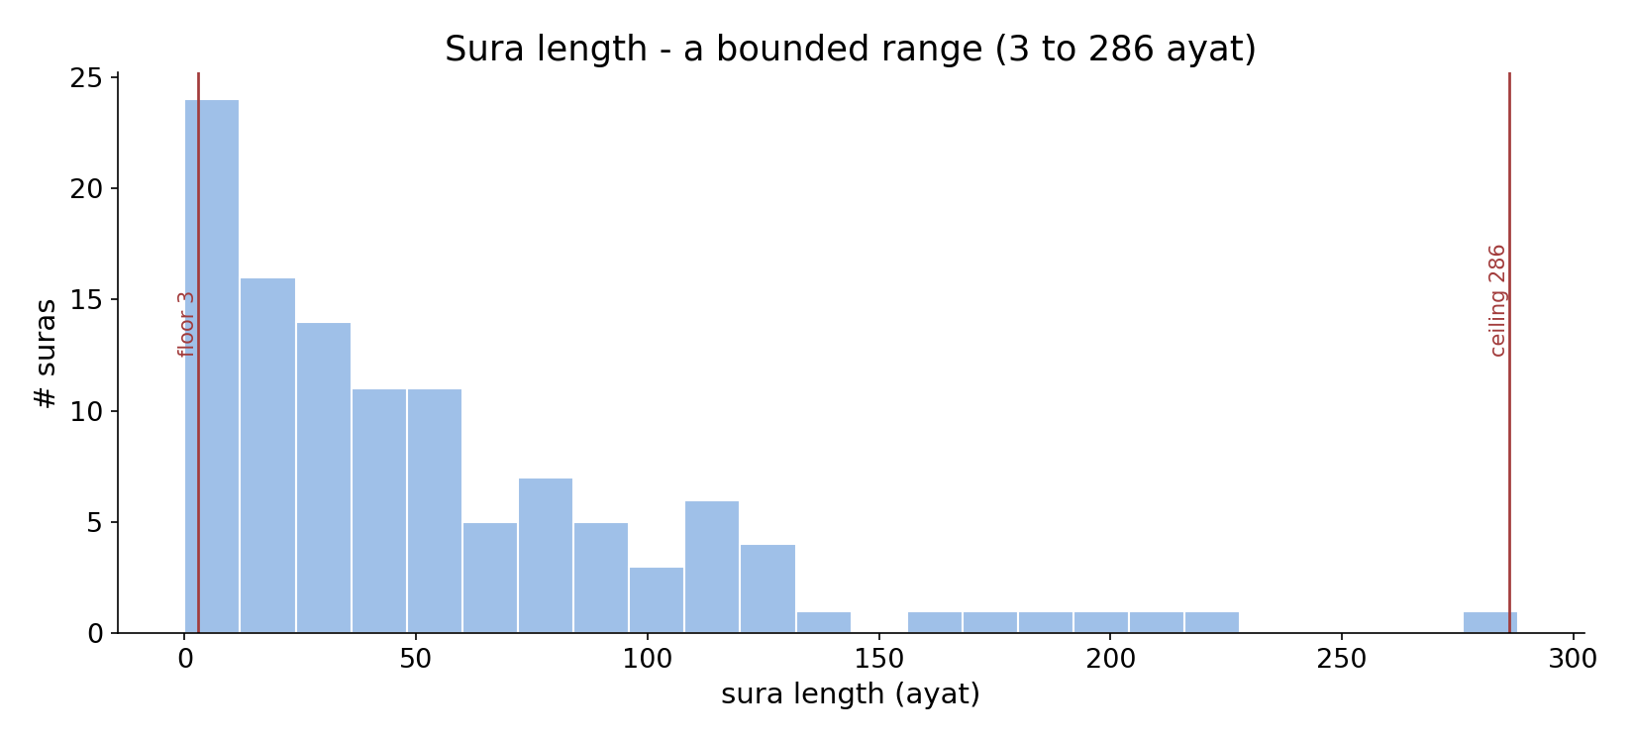
Sura length - a bounded range
In the data - suras run from 3 ayat (al-Kawthar, al-Asr, an-Nasr) to 286 (al-Baqara); median 39. A measurable range, but the boundary is marked by name and basmala.

Slide 4
The shortest suras (3 ayat)
the text's own words (address - snippet - gloss):
108:1 إِنَّا أَعْطَيْنَاك الْكوْثَرَ - shortest sūra (al-Kawthar, 3 ayahs)
110:1 إِذَا جَاء نَصْرُ اللَّهِ وَالْفَتْحُ - another 3-ayah sūra (an-Nasr)

Slide 5
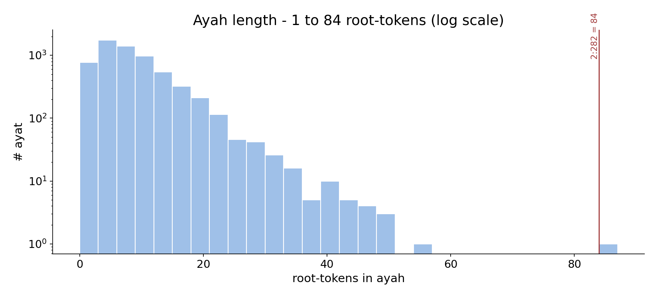
Ayah length - one token to 84
In the data - an ayah ranges from a single token (the disjoint letters; 55:64) to the 84-token debt verse (2:282); median 7. An ayah need not be a sentence.

Slide 6
What the data shows
A sura: 3 to 286 ayat
a named, basmala-bounded unit (except at-Tawba); floor 3, ceiling 286, median 39. Length is one visible handle.
An ayah: 1 to 84 tokens
a marked verse - from a single token (disjoint letters) to the 84-token debt verse; median 7. Not necessarily a sentence.
Marked, not defined
both units have measurable ranges, but neither is DEFINED by length - the boundaries are received (name, basmala, verse-stops).

Slide 7
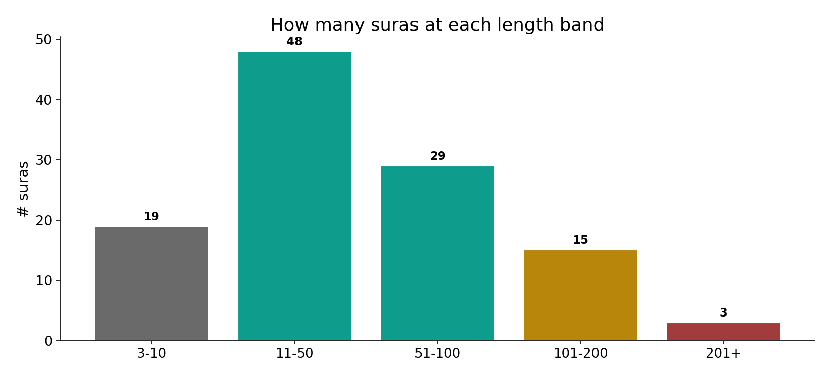
Suras by length band
In the data - most suras are short-to-mid (48 at 11-50 ayat, 29 at 51-100); only 3 exceed 200. The long suras are the rare giants.

Slide 8
Shortest ayat (1 token) and the longest
the text's own words (address - snippet - gloss):
2:1 الم - a 1-token ayah — the disjointed letters
55:64 مُدْهَامَّتَانِ - a single-word ayah (“dark green”)
2:282 يَا أَيُّهَا الَّذِينَ آمَنُواْ إِذَا تَدَايَنتُم بِدَيْنٍ إِلَى - longest ayah — 84 root-tokens (debt)
2:286 لاَ يُكلِّفُ اللّهُ نَفْسًا إِلاَّ وُسْعَهَا - al-Baqara closes — longest sūra (286)

Slide 9
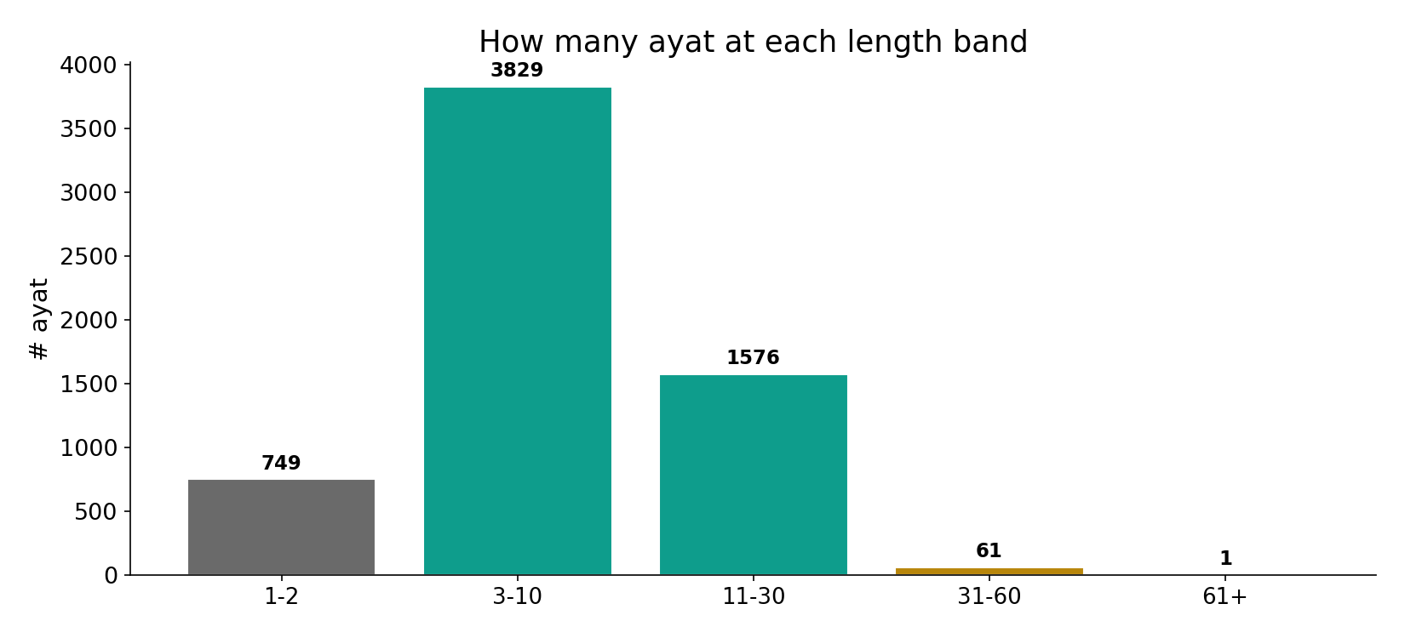
Ayat by length band
In the data - the overwhelming majority of ayat are 3-30 tokens (3829+1576); only 1 exceed 60. The debt verse is a lone outlier.

Slide 10
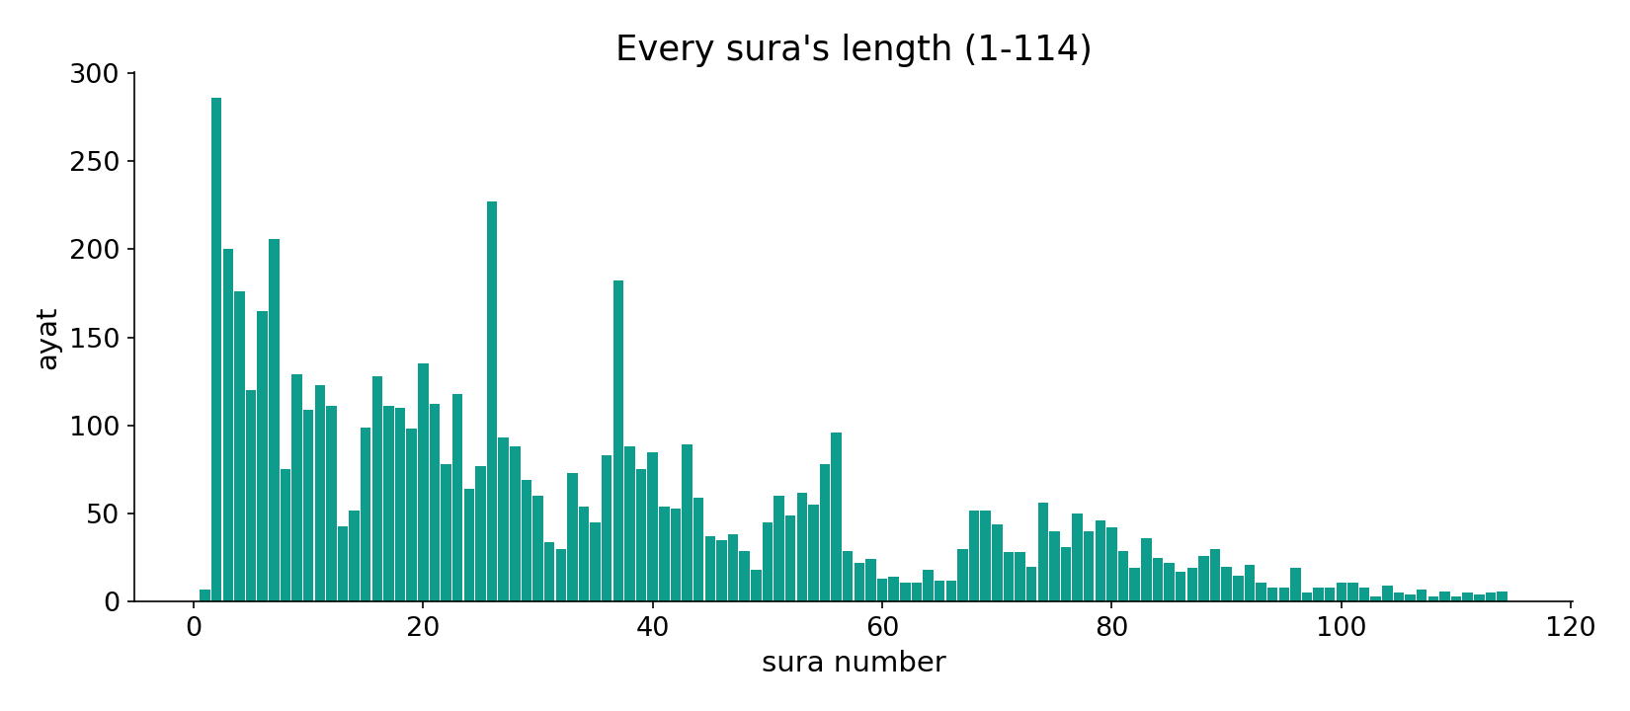
Every sura's length
In the data - the codex's descending-length profile is visible across all 114 suras (the same length-grading as the order topic).

Slide 11
Length corroborates; marking defines
Both units have measurable ranges that corroborate the anchor cases - suras 3-286 ayat, ayat 1-84 tokens. But length defines neither. The units are MARKED: suras by name and basmala, ayat by received verse-stops. The disjoint letters (a single token standing as a whole ayah) prove the marking is prior to length, grammar, or even meaning.
This mirrors the order topic's limit: segmentation, like arrangement, is given, not inferred.

Slide 12
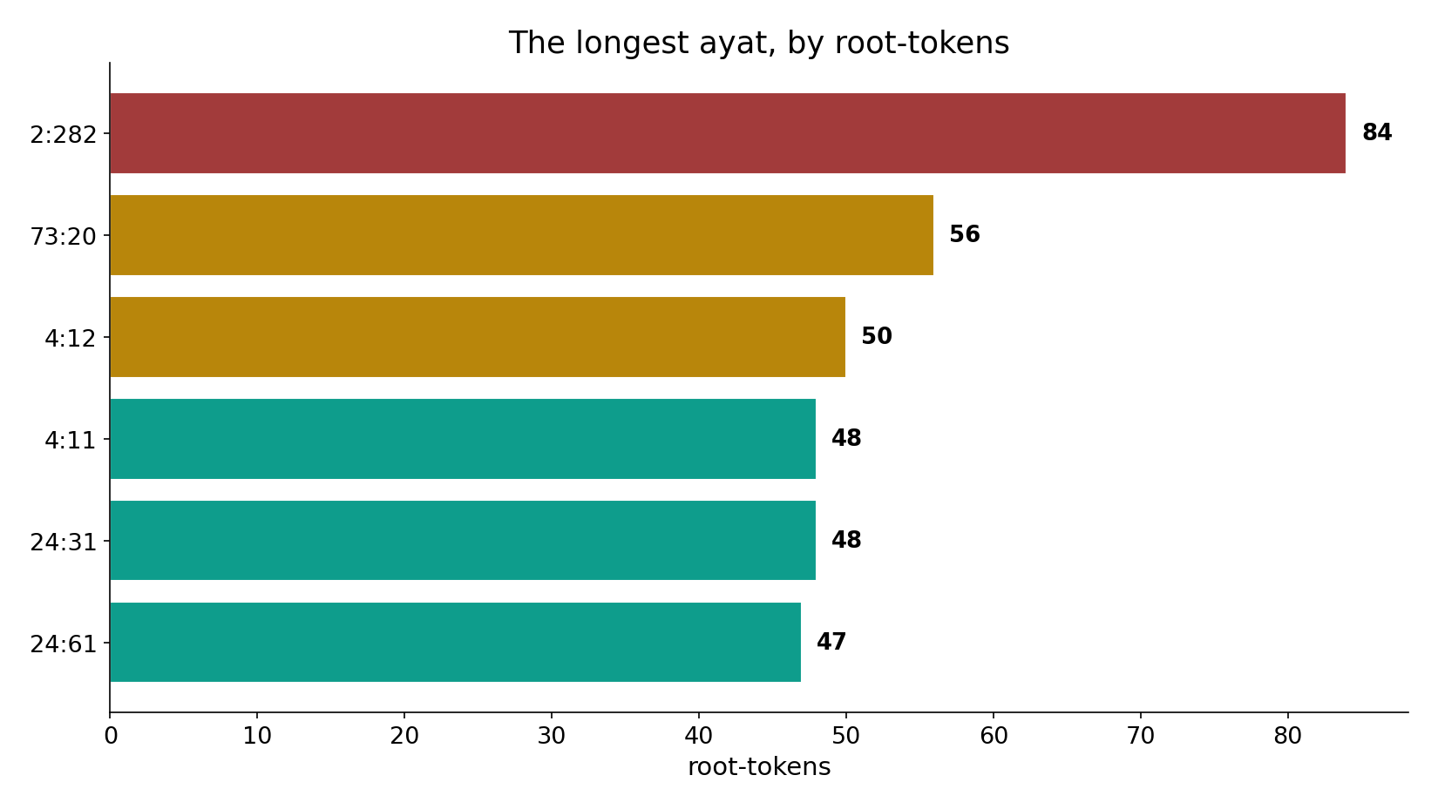
The longest ayat
In the data - 2:282 (the debt verse, 84 tokens) towers over the field; the next longest trail well behind. Length is a property, not the definition.

Slide 13
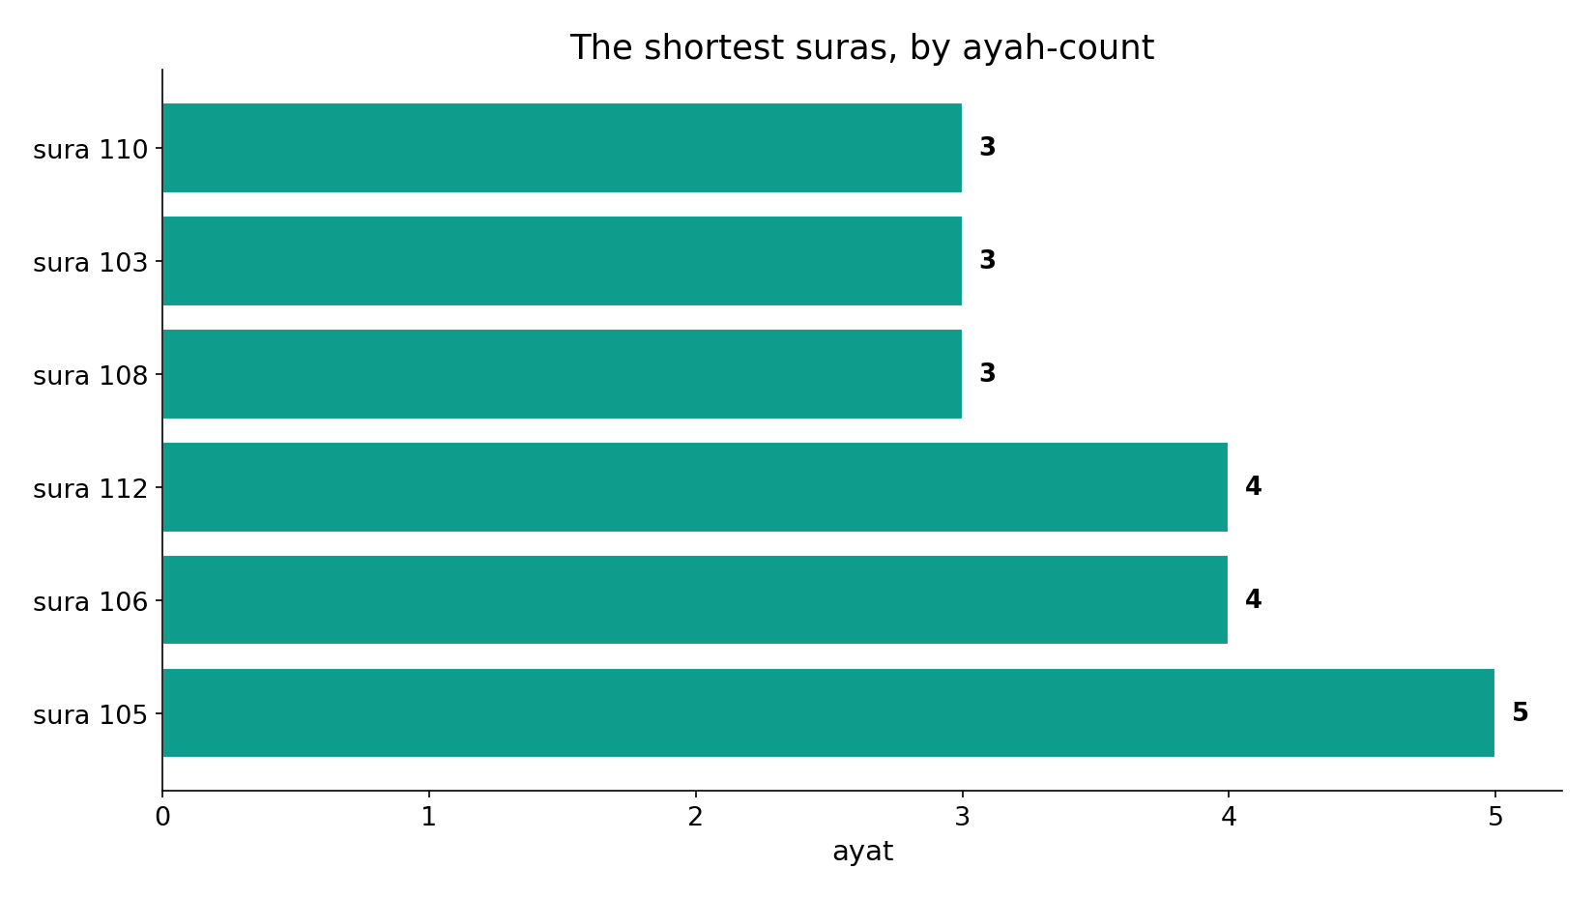
The shortest suras
In the data - the floor is 3 ayat (al-Kawthar and two others). Brevity does not stop a sura from being a complete, named, basmala-bounded unit.

Slide 14
Measured, then marked
Count the units
suras 3-286, ayat 1-84
Ranges corroborate
they fit the anchors
Marking defines
name, basmala, verse-stops
Length describes, marking defines
the disjoint-letter ayah proves marking is prior to length, grammar or meaning.

Slide 15
Honest limits and critique
Length is corroborating, not defining
you can describe the units by counting, but you cannot DERIVE the boundaries from a count - they are received.
Boundaries are narrated / recitational
the verse-stops and sura divisions come from transmission, not computation; counting can only characterise them.

Slide 16
Reading this honestly - the audit
✓ Sura range exact
3 to 286 ayat, median 39.
✓ Ayah range exact
1 to 84 tokens (2:282), median 7.
✓ Anchors verified
al-Kawthar=3, al-Baqara=286, 2:282 longest.
~ Length corroborates
it describes the units, it does not define them.
✗ Not a proof
counts/forms locate structure; they do not settle theology.
✗ No raw mixing
forms separated before counting (course rule).

Slide 17
How this was computed (reproducible)
Book6
ayat per sura; tokens per ayah
measure
floor/ceiling/median, length bands
figures
length histograms, band bars, longest/shortest
count
chart
Fully reproducible
Every figure recomputes from Book6.xlsx via the shared wk.py kernel (fixed seed). Roots are normalized (Persian/Arabic letter variants folded) so counts are stable; surface forms are used wherever a concept must be kept apart from its root family (per the course's sense-verification rule).

Slide 18
Appendix - input snippets (Book6, vocalized)
verbatim snippets with addresses:
108:1 إِنَّا أَعْطَيْنَاك الْكوْثَرَ - shortest sūra (al-Kawthar, 3 ayahs)
110:1 إِذَا جَاء نَصْرُ اللَّهِ وَالْفَتْحُ - another 3-ayah sūra (an-Nasr)

Slide 19
Takeaway
Measurable, but marked
A sura spans 3-286 ayat; an ayah spans 1-84 tokens. Both ranges are real and corroborate the anchors.
But length DEFINES neither - the disjoint letters stand as a whole ayah on a single token. The units are marked by name, basmala and received verse-stops.
Counting describes the units; it does not derive them. Presented from the data.

Slide 20
Quick reference
The numbers
suras 3-286 ayat (median 39); ayat 1-84 tokens (median 7); 3 suras over 200 ayat; only 1 ayat over 60 tokens.
The shape
both units have measurable ranges, but are defined by MARKING (name/basmala/verse-stops), not by length.

