Slide 1
SPECIAL TOPIC - forms & morphology, Week 3
A journey or an instilled state? Faith as act vs identity
Arabic marks DOING apart from BEING - and the corpus uses both
Arabic separates an act from a settled trait: 'those who came to believe' (a relative clause + perfect verb) names a journey; 'a believer' (a participle/noun) names an instilled state. The same split runs through disbelief and through the righteousness-root. We count the forms apart - never merging the concepts.
Counts recompute from Book6; the four forms of the righteousness-root are tallied by surface form, not by raw root.

Slide 2
The question, and the method
The nuance
Is faith named as an ongoing act, a settled identity - or deliberately both?
The method
- count the verbal phrase ('came to believe') apart from the noun ('a believer')
- split the righteousness-root into FOUR forms: deeds, a righteous person, reconciliation, an active reformer
- read the salvation formula - belief AND sustained deeds

Slide 3
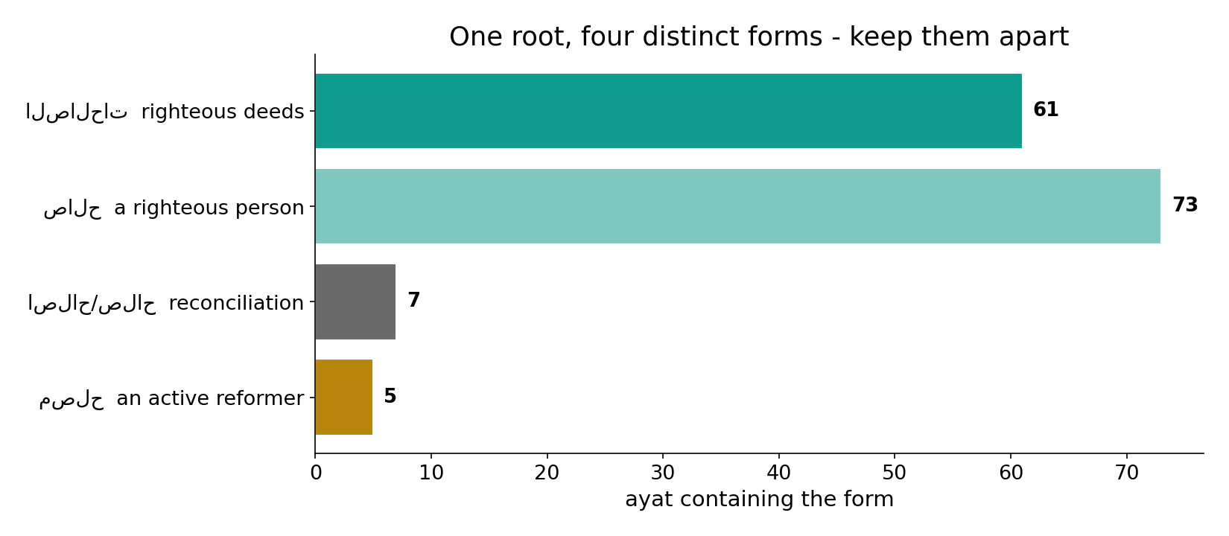
One root, four distinct concepts
In the data - the righteousness-root splits into righteous-DEEDS (61), a righteous PERSON (73), reconciliation (7) and the active REFORMER (5). Counting the root as one idea would merge four concepts.

Slide 4
Claimed (verb) is not yet instilled (state)
the text's own words (address - snippet - gloss):
49:14 وَلَكِن قُولُوا أَسْلَمْنَا وَلَمَّا يَدْخُلِ الْإِيمَانُ فِي قُلُوبِكُمْ وَإِن - claimed faith (verb) ≠ instilled

Slide 5
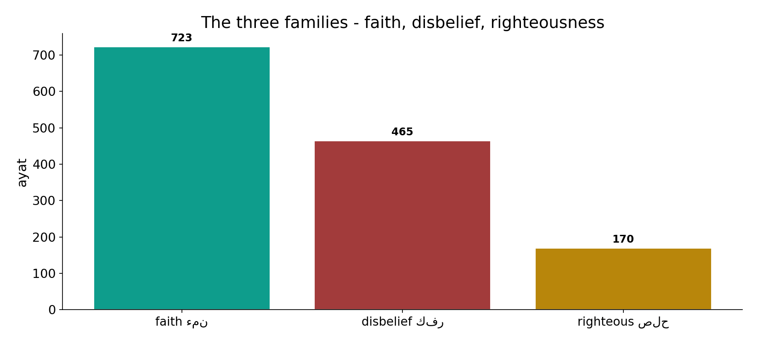
Faith, disbelief, righteousness - the three fields
In the data - faith (723), disbelief (465) and the righteousness-root (170) are all large fields; each is named as both act and state.

Slide 6
What the data shows
Doing AND being
each family is named both as a VERB (an act in progress) and a NOUN (a settled trait) - morphology marks journey vs arrival.
The reformer is rare
a righteous person (73) vastly outnumbers the active reformer (5, only 5); reform - making-good - is named where a society's fate hangs.
Salvation is durative
the signature formula is built on verbs - belief AND deeds together (70 ayat) - a sustained process, not a one-time claim.

Slide 7
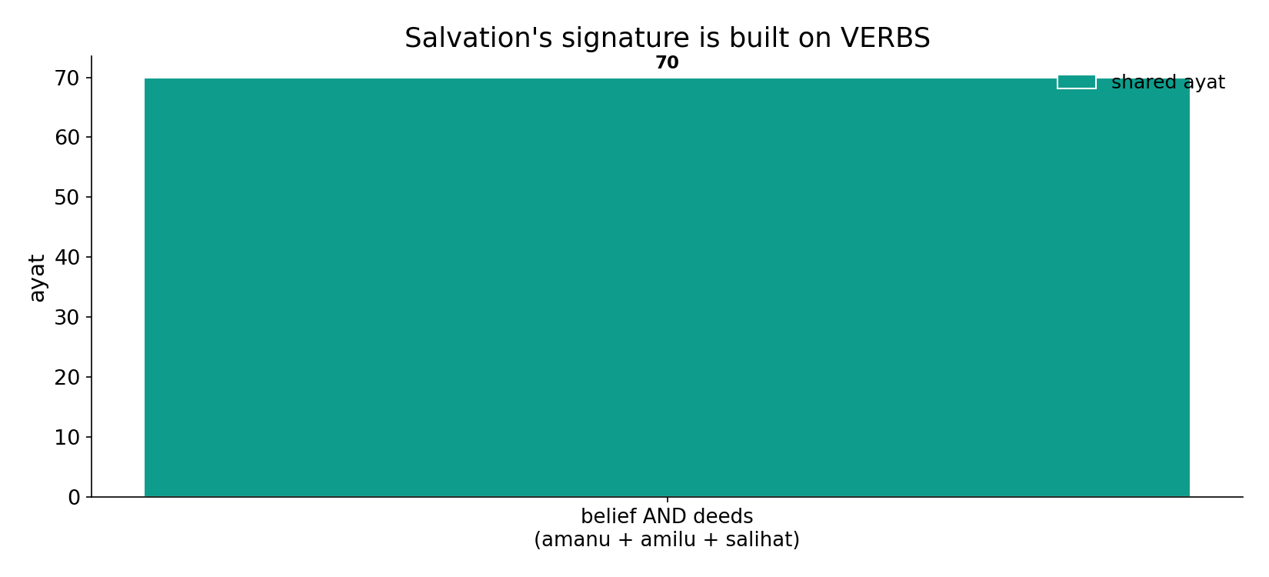
Salvation's formula is built on VERBS
In the data - 'those who BELIEVED and DID righteous deeds' co-occurs in 70 ayat: a sustained process (kept believing AND kept doing), not a one-time label.

Slide 8
Saved by sustained doing; reform over mere goodness
the text's own words (address - snippet - gloss):
2:25 الَّذِين آمَنُواْ وَعَمِلُواْ الصَّالِحَاتِ أَنَّ لَهُمْ - believed AND did good (verbs)
11:117 لِيُهْلِك الْقُرَى بِظُلْمٍ وَأَهْلُهَا مُصْلِحُونَ - spared as REFORMERS (مصلحون)
7:170 لاَ نُضِيعُ أَجْرَ الْمُصْلِحِينَ - the reward of the reformers

Slide 9
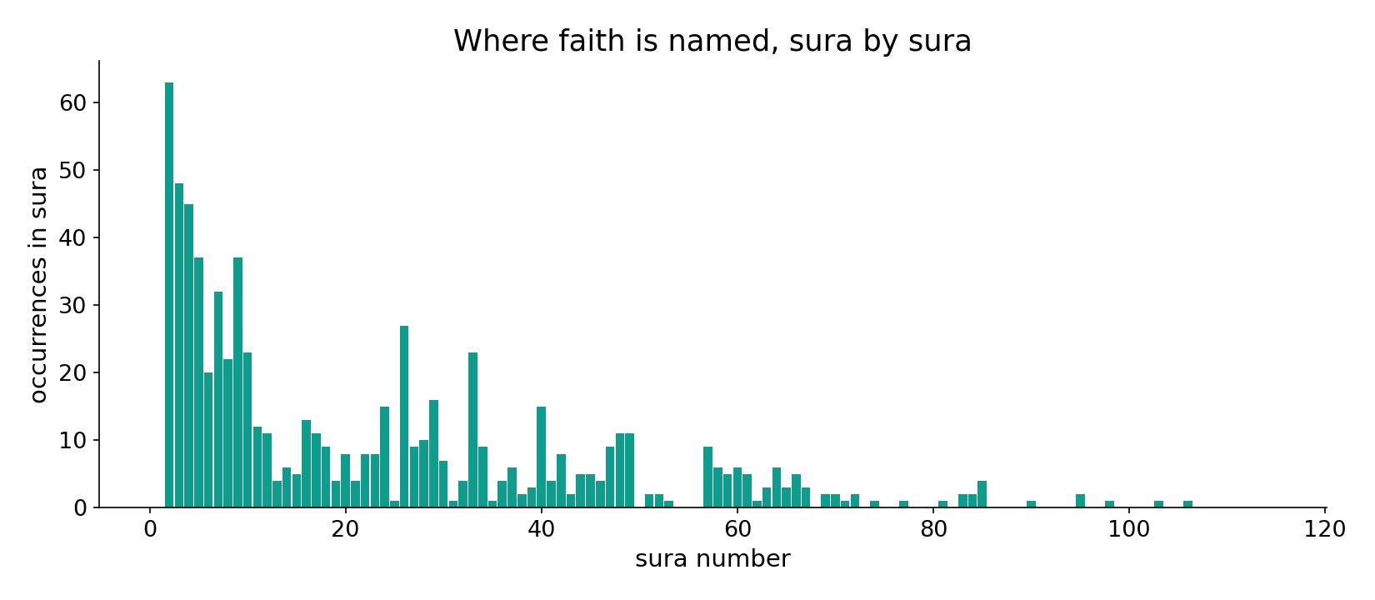
Faith across the corpus
In the data - faith is named densest in the Medinan community suras, as both an ongoing act and a settled identity.

Slide 10
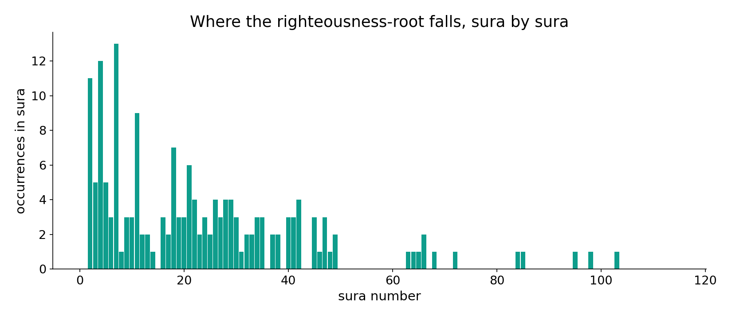
Righteousness across the corpus
In the data - the righteousness-root tracks the salvation passages, almost always paired with belief.

Slide 11
The grammar is the theology
49:14 says it outright: the Bedouins' claim 'we believe' (a verb) is rejected - 'faith has not yet entered your hearts.' The act is a journey, not the instilled state. And the corpus separates four forms of the righteousness-root - 61 deeds, 73 righteous persons, 7 reconciliations, 5 reformers - that a single root-count would collapse into one. Morphology carries the meaning.
Counting the root as one idea would merge four concepts - only form separation keeps them apart.

Slide 12
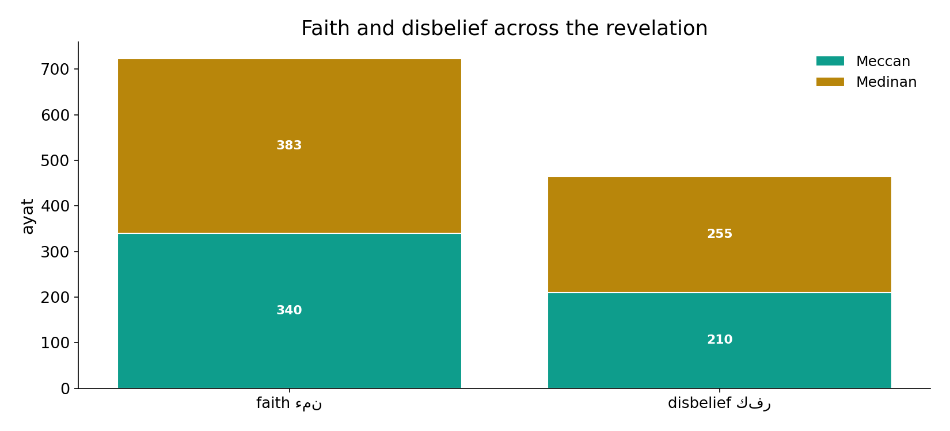
Faith and disbelief across the revelation
In the data - both run the whole revelation; the act/state distinction is grammatical, not chronological.

Slide 13
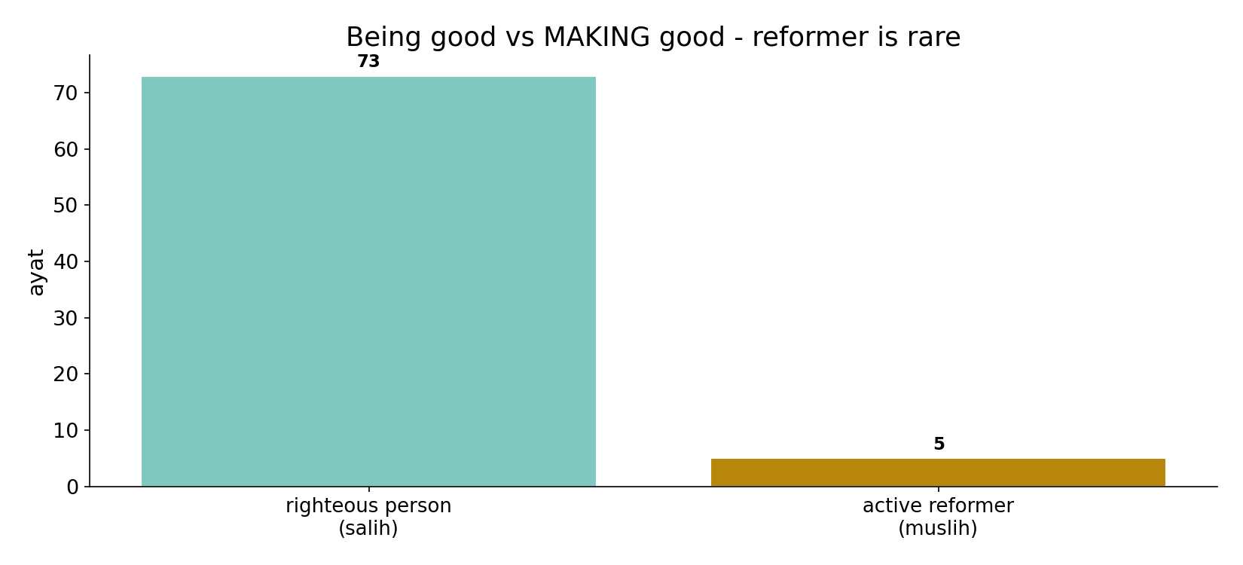
Being good vs MAKING good
In the data - a righteous PERSON (73) far outnumbers the active REFORMER (5); where a society's fate is at stake the corpus names reformers (11:117: towns spared as muslihun, not merely salihun).

Slide 14
Journey and arrival
Verb: 'came to believe'
an act, a journey
Noun: 'a believer'
a settled state
Both deployed
morphology marks the difference
The grammar is the theology
49:14 rejects the bare claim 'we believe'; salvation is built on sustained verbs, not a one-time label.

Slide 15
Honest limits and critique
Form-level counting is load-bearing
merging the righteousness-root into one tally would fuse deeds, persons, reconciliation and reform - four different ideas.
Near-equal does not mean 'no point'
for faith the verb and noun counts run close; the finding is not which dominates but that the corpus deploys BOTH deliberately - act and state.

Slide 16
Reading this honestly - the audit
✓ Four forms counted
deeds 61, person 73, reconcile 7, reformer 5.
✓ Salvation formula
belief+deeds co-occur in 70 ayat.
✓ Fields sized
faith 723, disbelief 465.
~ Forms, not voice
surface-form counts; fine voice differences are a separate study.
✗ Not a proof
morphology locates the distinction; theology is not settled by counts.
✗ No raw mixing
forms separated before counting (course rule).

Slide 17
How this was computed (reproducible)
Book6
faith/disbelief roots; 4 forms of the righteousness-root
measure
field size, form split, salvation co-occurrence
figures
form bars, field bars, salvation bar, sura maps
count
chart
Fully reproducible
Every figure recomputes from Book6.xlsx via the shared wk.py kernel (fixed seed). Roots are normalized (Persian/Arabic letter variants folded) so counts are stable; surface forms are used wherever a concept must be kept apart from its root family (per the course's sense-verification rule).

Slide 18
Appendix - input snippets (Book6, vocalized)
verbatim snippets with addresses:
49:14 وَلَكِن قُولُوا أَسْلَمْنَا وَلَمَّا يَدْخُلِ الْإِيمَانُ فِي قُلُوبِكُمْ وَإِن - claimed faith (verb) ≠ instilled

Slide 19
Takeaway
Faith is a verb the corpus also lets settle into a noun
The Qur'an names faith and righteousness as both an ongoing ACT and a settled STATE - the grammar marks journey vs arrival.
Salvation's formula is durative ('believed AND did deeds', 70 ayat); the active reformer (5) is named rarely but decisively where a society's fate is at stake.
Only form-level counting keeps the four righteousness-concepts apart. Presented from the text.

Slide 20
Quick reference
The numbers
faith 723 - disbelief 465; righteousness forms: deeds 61, person 73, reconcile 7, reformer 5; salvation formula 70 ayat.
The shape
act AND state both named; salvation is durative (verbs); reform (making-good) outranks mere goodness where society's fate is at stake.

