Slide 1
SPECIAL TOPIC - forms & senses, Week 3
Religion, Islam, Qur'an - one thing, or three?
Three words people use interchangeably - tested for equivalence
People treat 'din' (religion), 'islam' (submission) and 'Qur'an' as near-synonyms for 'the religion.' Equivalence leaves a fingerprint: true synonyms co-occur and gloss each other. We test for it rather than assume it - all three roots are polysemous, so figures use co-occurrence, not bare totals.
Every count recomputes from Book6; the co-occurrence numbers are exact and reproducible.

Slide 2
The question, and the method
The claim to test
Are din, islam and Qur'an one concept in the corpus - or a genus, a species, and a Book?
The method
- count each root's field, then the shared-ayah counts for all three pairs
- read what 'religion' pairs with (God? submission? 'to you yours'?)
- treat zero co-occurrence as a blunt-but-real signal of non-equivalence

Slide 3
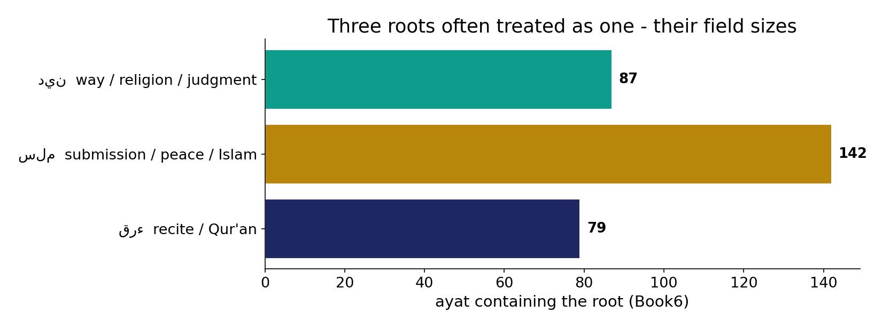
Three fields, three sizes
In the data - the three roots appear in 87, 142, 79 ayat respectively. Comparable sizes - so any non-overlap is not a frequency artefact.

Slide 4
The identity verses - religion and submission
the text's own words (address - snippet - gloss):
3:19 إِنَّ الدِّينَ عِندَ اللّهِ الإِسْلاَمُ وَمَا اخْتَلَفَ الَّذِينَ أُوْتُواْ الْكِتَابَ إِلاَّ - دین = اسلام (identity)
5:3 وَرَضِيتُ لَكُمُ الإِسْلاَمَ دِينًا فَمَنِ - اسلام approved AS the دین
3:85 وَمَن يَبْتَغِ غَيْرَ الإِسْلاَمِ دِينًا فَلَن يُقْبَلَ مِنْهُ وَهُوَ فِي الآخِرَةِ - no دین but اسلام is accepted

Slide 5
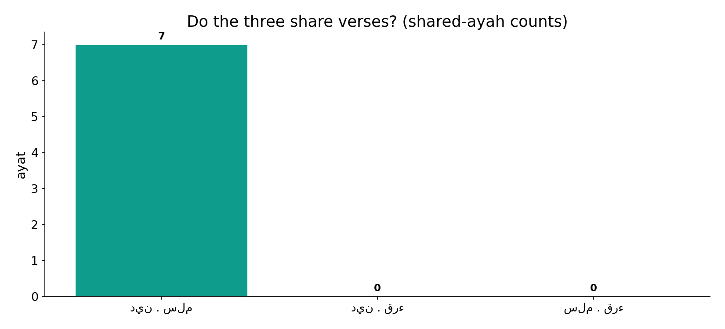
Only one pair ever shares a verse
In the data - 'religion' and 'submission' share 7 ayat; 'religion'+'Qur'an' and 'submission'+'Qur'an' share 0 and 0. Qur'an is never lexically equated with the religion.

Slide 6
What the data shows
din = the GENUS
a way / religion (and 'the Reckoning', and even 'debt'); it can be anyone's - 'to you yours, to me mine' (109:6). Field of 87 ayat.
islam = the SPECIES
the one din named as accepted (3:19; 3:85); din contains islam - equivalent only in the chosen case.
Qur'an = the BOOK
the recited text that CARRIES the din; zero shared ayat with either - the vehicle, not the destination.

Slide 7
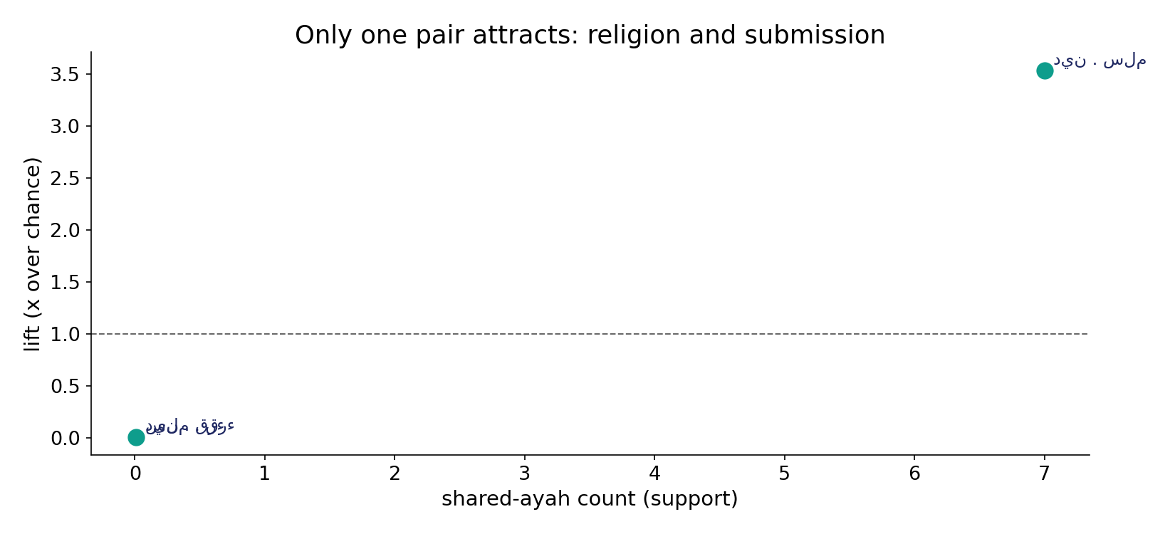
And that one pair attracts above chance
In the data - din+islam co-occur at 3.5x chance (7 ayat): a real bond. The Qur'an-root sits at zero with both.

Slide 8
'Religion' in its other senses, and the Qur'an as the Book
the text's own words (address - snippet - gloss):
1:4 مَالِكِ يَوْمِ الدِّينِ - دین = Day of Judgment
2:282 يَا أَيُّهَا الَّذِينَ آمَنُواْ إِذَا تَدَايَنتُم بِدَيْنٍ إِلَى أَجَلٍ مُّسَمًّى فَاكْتُبُوهُ - دین = debt (dayn)
109:6 لَكُمْ دِينُكُمْ وَلِيَ دِينِ - دین = each one’s way
15:1 الَرَ تِلْك آيَاتُ الْكِتَابِ وَقُرْآنٍ مُّبِينٍ - قرآن = the Book (kitāb)
12:2 إِنَّا أَنزَلْنَاهُ قُرْآنًا عَرَبِيًّا لَّعَلَّكُمْ تَعْقِلُونَ - قرآن sent down (anzalnā)

Slide 9
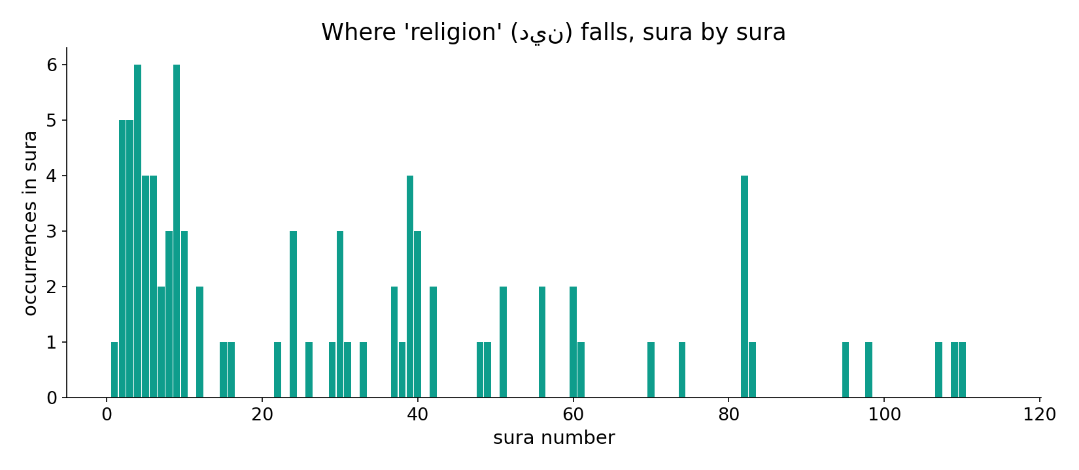
'Religion' across the corpus
In the data - 'religion' is spread across the corpus, clustering in the creed and law passages.

Slide 10
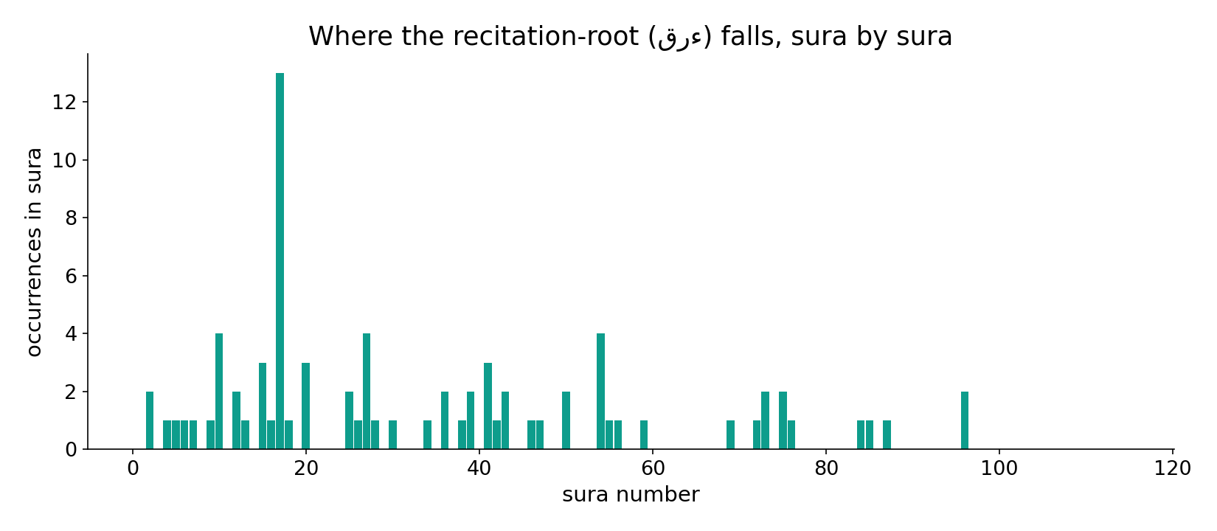
The recitation-root across the corpus
In the data - the Qur'an-root tracks passages about the Book, sending-down and reciting - the vehicle, not the religion.

Slide 11
A genus, a species, and a Book - not three names for one thing
The folk shortcut 'din = islam = Qur'an' is only half-supported. The corpus reserves identity strictly for din<->islam (the 'identity verses' 3:19, 5:3), treats islam as the specific din God accepts, and never lexically equates the Qur'an with the religion - it pairs the Book-root with sending-down, reminder and recital. Most 'din = Islam' claims quietly ignore the Judgment-Day and debt senses of din.
din contains islam; the Qur'an carries both - three layers, not one synonym.

Slide 12
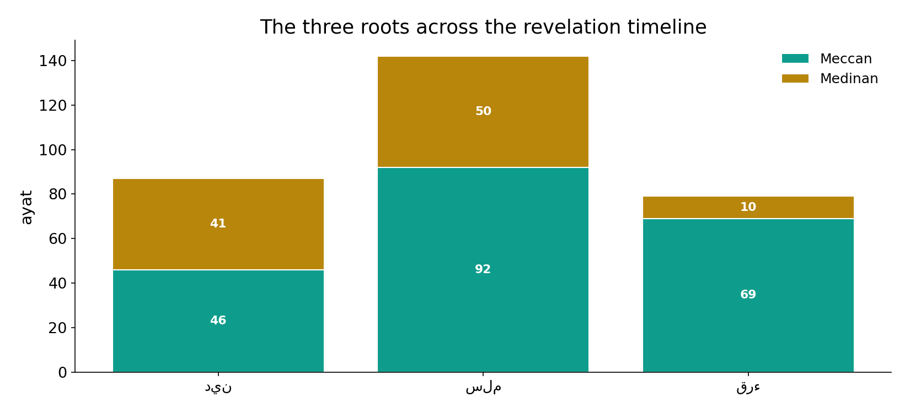
All three span the revelation
In the data - none of the three is period-bound; the distinction is conceptual, not chronological.

Slide 13
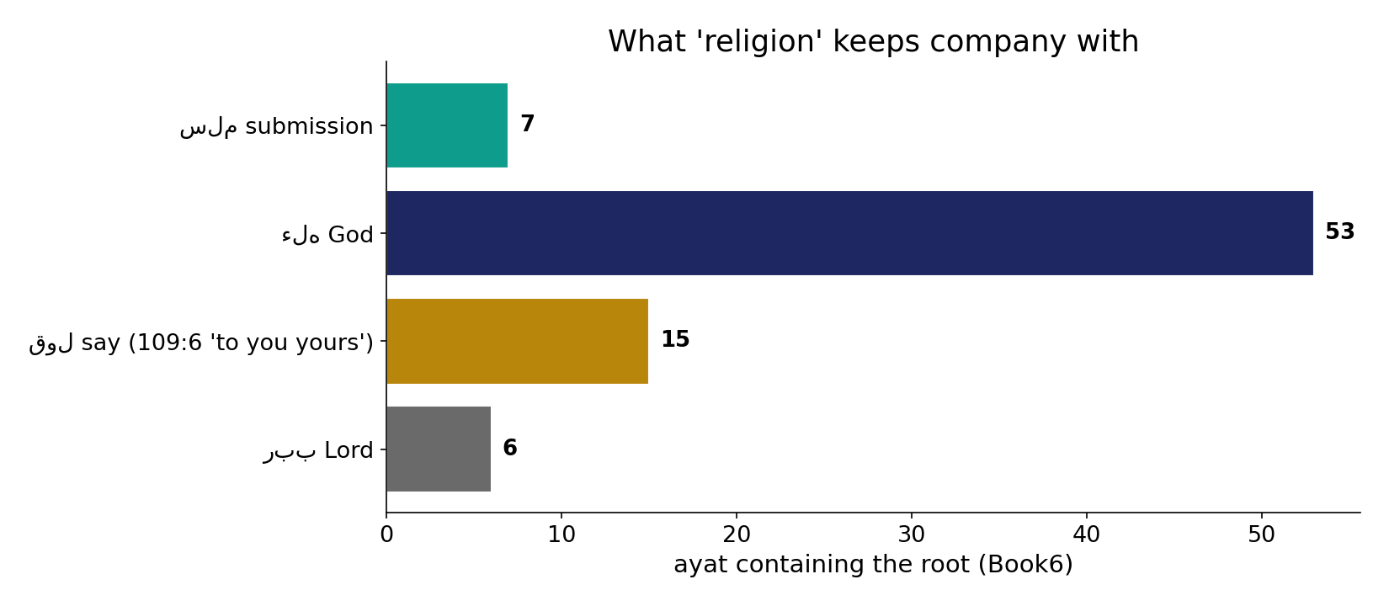
What 'religion' keeps company with
In the data - 'religion' pairs most with God and submission, and famously with 'say' (109:6: 'to you your religion, to me mine') - it can be anyone's way, the genus.

Slide 14
Genus, species, Book
din
the way - anyone's (genus)
islam
the accepted din (species)
Qur'an
the Book that carries it
Three layers, not one word
din contains islam; the Qur'an carries both - the corpus keeps them lexically distinct.

Slide 15
Honest limits and critique
Zero co-occurrence is blunt
Absence of shared verses does not by itself prove non-synonymy - but here it lines up with the grammar: the Qur'an-root is never used to mean 'the religion.'
Senses must be separated
din also = Judgment-Day and debt; islam's root also = peace/Solomon. Counting raw roots as one idea would merge distinct concepts - so figures lean on co-occurrence, which is sense-robust.

Slide 16
Reading this honestly - the audit
✓ Fields are counted
87/142/79 ayat for the three roots.
✓ Overlaps are exact
din+islam 7, din+Qur'an 0, islam+Qur'an 0.
✓ din<->islam attracts
3.5x chance - a real bond.
✗ Not a proof
co-occurrence and counts locate meaning; they do not settle theology.
~ 'Roles' are a gloss
genus/species/Book is the analyst's label on the usage.
✗ No raw-root mixing
senses/forms are separated before counting (course rule).

Slide 17
How this was computed (reproducible)
Book6
din, islam, Qur'an roots
measure
field size, all-pairs co-occurrence & lift
figures
field bars, co-occurrence bars, lift, sura maps
count
chart
Fully reproducible
Every figure recomputes from Book6.xlsx via the shared wk.py kernel (fixed seed). Roots are normalized (Persian/Arabic letter variants folded) so counts are stable; surface forms are used wherever a concept must be kept apart from its root family (per the course's sense-verification rule).

Slide 18
Appendix - input snippets (Book6, vocalized)
verbatim snippets with addresses:
3:19 إِنَّ الدِّينَ عِندَ اللّهِ الإِسْلاَمُ وَمَا اخْتَلَفَ الَّذِينَ أُوْتُواْ الْكِتَابَ إِلاَّ - دین = اسلام (identity)
5:3 وَرَضِيتُ لَكُمُ الإِسْلاَمَ دِينًا فَمَنِ - اسلام approved AS the دین
3:85 وَمَن يَبْتَغِ غَيْرَ الإِسْلاَمِ دِينًا فَلَن يُقْبَلَ مِنْهُ وَهُوَ فِي الآخِرَةِ - no دین but اسلام is accepted

Slide 19
Takeaway
One religion, named three ways - but not three synonyms
'Religion', 'submission' and 'Qur'an' are not interchangeable in the corpus.
Religion (din) is the broad way (any can hold one); islam is the specific din accepted (they share 7 ayat, 3.5x chance); the Qur'an is the Book that carries it (zero shared ayat).
A genus, a species, and a Book - presented from the text, not adjudicated.

Slide 20
Quick reference
The numbers
din 87 - islam-root 142 - Qur'an-root 79 ayat; din.islam 7 shared (3.5x), din.Qur'an 0, islam.Qur'an 0.
The shape
din (genus) contains islam (species); the Qur'an (Book) carries both; equivalence holds only for din<->islam in the chosen case.

