Slide 1
SPECIAL TOPIC - forms & voice, Week 3
Mukhlis or mukhlas? One vowel, two theologies
The same spelling forks into a human act and a divine election
Unvocalized, the participle is one spelling. The vowel forks it: mukhlis (active) = the one who MAKES his religion sincere - a human act; mukhlas (passive) = the one God HAS MADE sincere / chosen - a divine act. We classify all participle occurrences and read the company each keeps.
Counts recompute from Book6 by surface form and co-occurring root; the company (religion vs servants) is exact and reproducible.

Slide 2
The question, and the method
The puzzle
Does one consonantal spelling carry two opposite voices - a human striving and a divine choosing?
The method
- count every occurrence of the participle by surface form
- read the company it keeps - with 'religion' vs with 'servants'
- let the collocation separate the human act from the divine election

Slide 3
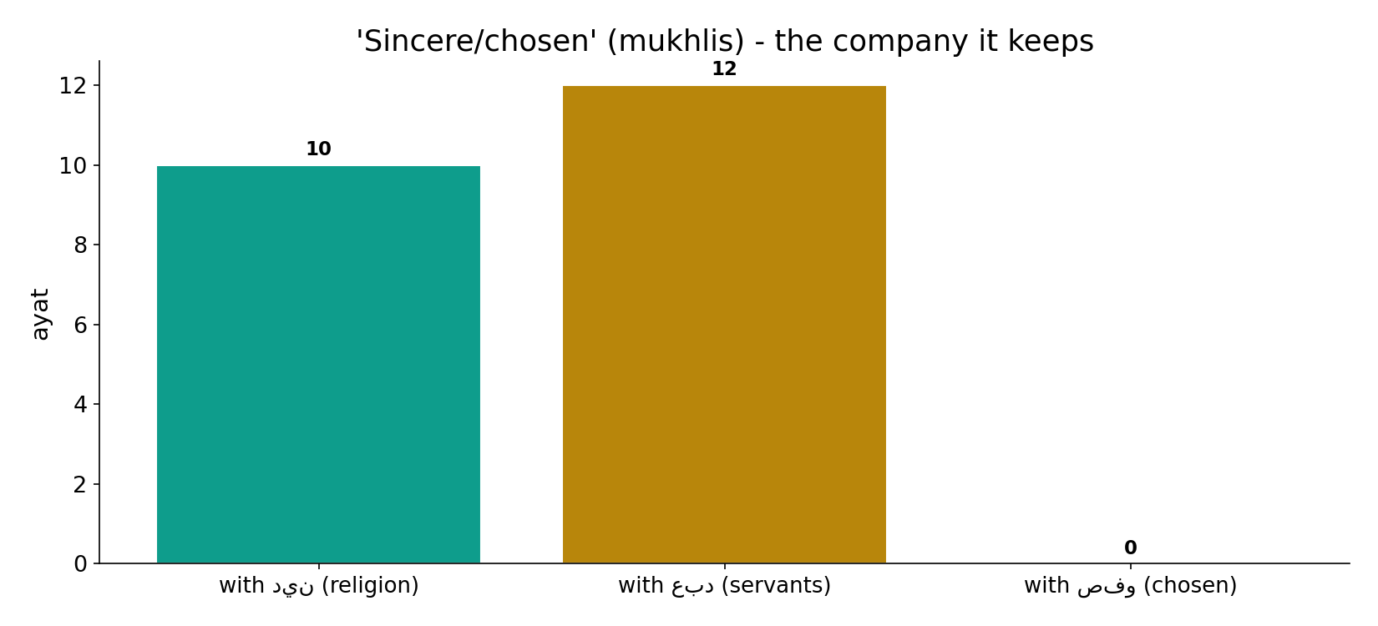
The company it keeps
In the data - the participle sits with 'religion' in 10 ayat, with 'servants' in 12, and with 'chosen' in 0. Two different worlds: striving vs election.

Slide 4
The participle in the text
the text's own words (address - snippet - gloss):
7:29 كُلِّ مَسْجِدٍ وَادْعُوهُ مُخْلِصِينَ لَهُ الدِّينَ كمَا - active
39:2 بِالْحَقِّ فَاعْبُدِ اللَّهَ مُخْلِصًا لَّهُ الدِّينَ - active
10:22 بِهِمْ دَعَوُاْ اللّهَ مُخْلِصِينَ لَهُ الدِّينَ لَئِنْ - active
98:5 إِلَّا لِيَعْبُدُوا اللَّهَ مُخْلِصِينَ لَهُ الدِّينَ حُنَفَاء - active
12:24 إِنَّهُ مِنْ عِبَادِنَا الْمُخْلَصِينَ - passive

Slide 5
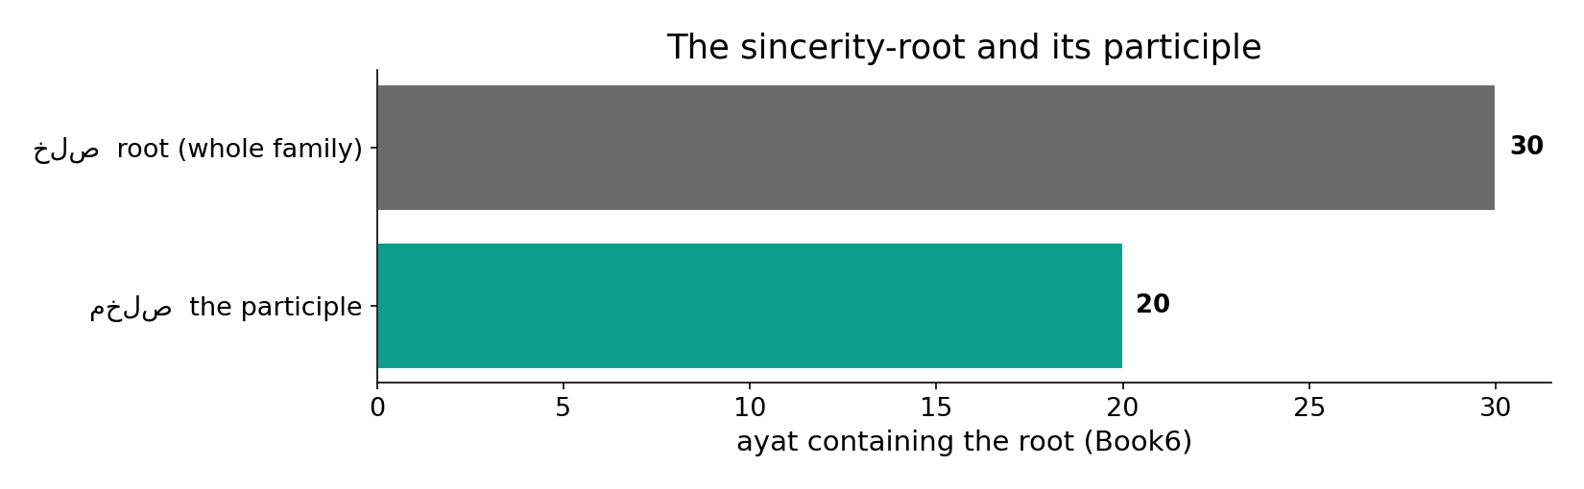
A rare, precise term
In the data - the sincerity-root appears in 30 ayat; the participle itself in only 20. A small, deliberate vocabulary for a sharp idea.

Slide 6
What the data shows
Active: the human act
making one's religion sincere - the participle sits with 'religion' in 10 ayat; the command 'worship, sincere to Him' (39:11).
Passive: the divine election
the one God HAS MADE sincere / chosen - sits with 'servants' in 12; Joseph (12:24), the Satan-proof exception (15:40, 38:83).
One root, both halves
you STRIVE as mukhlis; being made mukhlas is God's to give - effort meets grace, in a single spelling.

Slide 7
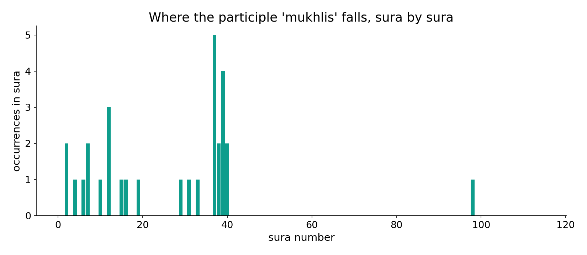
Where the participle falls
In the data - the participle clusters in the worship and prophet-narrative passages (Joseph 12:24, the chosen servants), not scattered at random.

Slide 8
Effort meets grace
the text's own words (address - snippet - gloss):
39:11 اعبد الله مخلصا له الدين - worship God, making religion sincerely His - the human act
37:40 عباد الله المخلصين - the chosen servants of God - the divine election
38:83 عبادك منهم المخلصين - except Your chosen servants among them

Slide 9
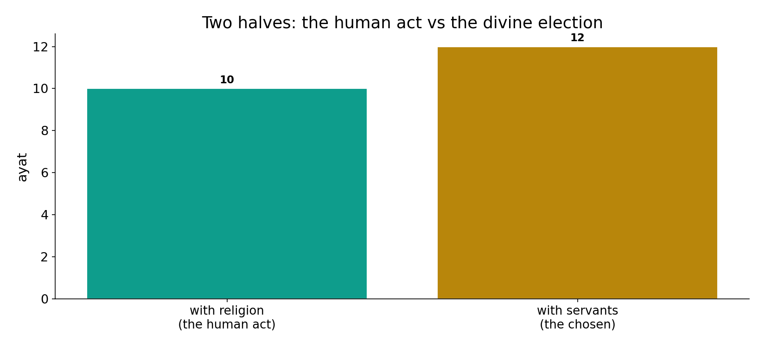
Two halves, two worlds
In the data - the religion-collocation (10) marks the human act of making one's faith sincere; the servant-collocation (12) marks the divinely-chosen. The vowel forks the voice.

Slide 10
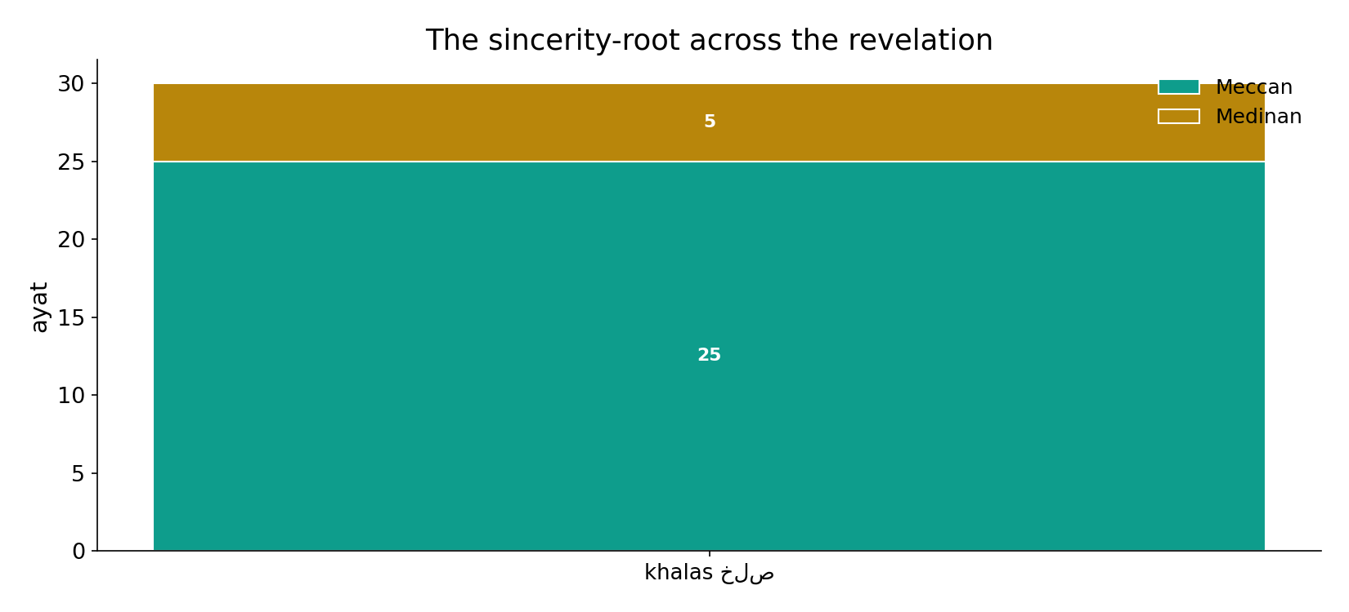
Across the revelation
In the data - the sincerity-root spans the revelation; the act/election split is grammatical, not chronological.

Slide 11
Effort meets grace, in one word
The participle is rare (20 occurrences) but splits cleanly by company: with 'religion' (10) it is the human act of making one's faith sincere - a command; with 'servants' (12) it is the divinely-CHOSEN, the ones Satan cannot mislead (15:40). You strive to be mukhlis; being made mukhlas - named among the chosen - is God's to give. It mirrors 'He purifies them' (yuzakkihim): one root holds both human striving and the grace that completes it.
The vowel on the lam is the hinge between a human act and a divine election.

Slide 12
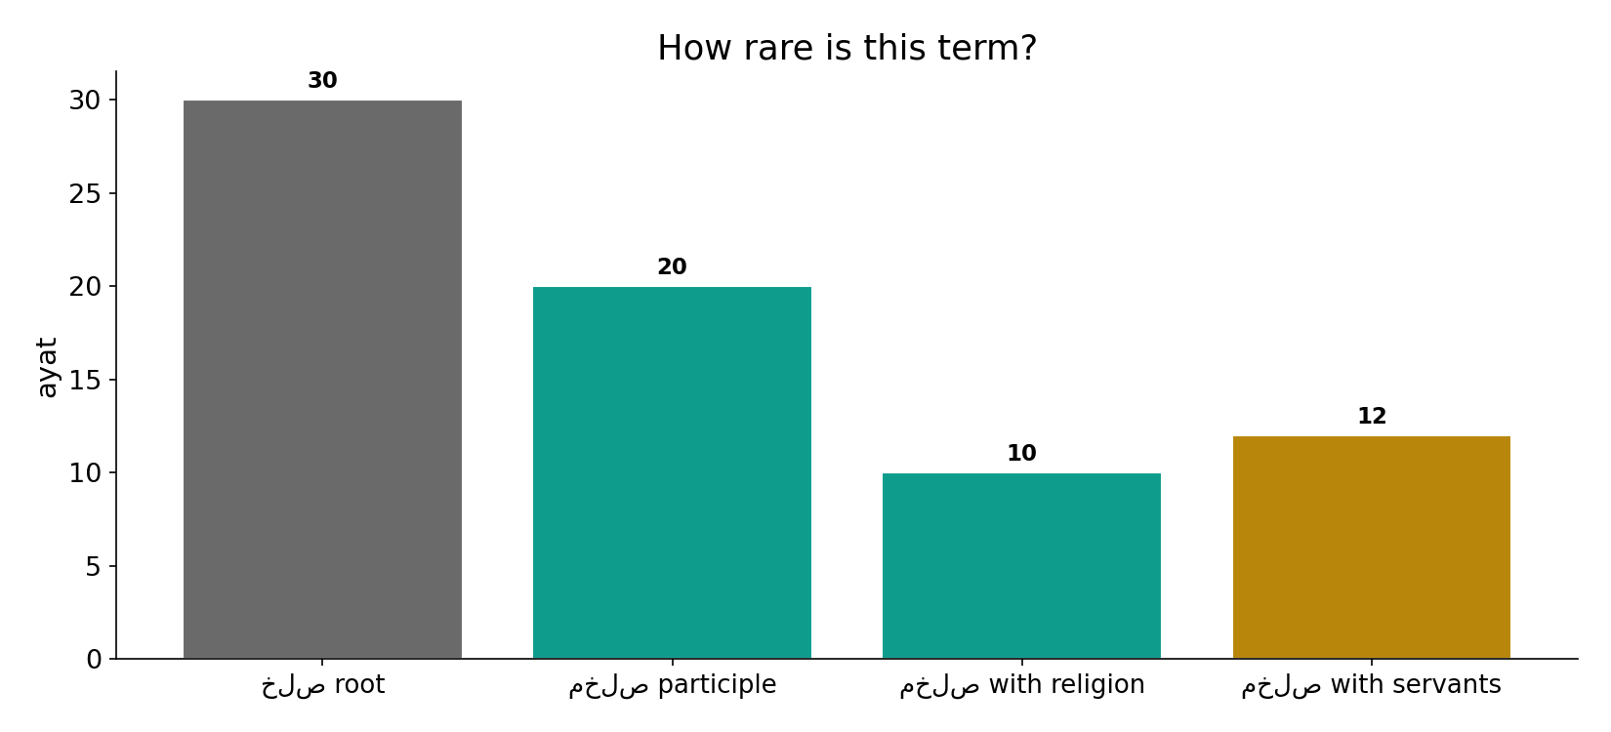
How rare the term is
In the data - root 30, participle 20, with-religion 10, with-servants 12: the whole phenomenon turns on a few dozen carefully-placed words.

Slide 13
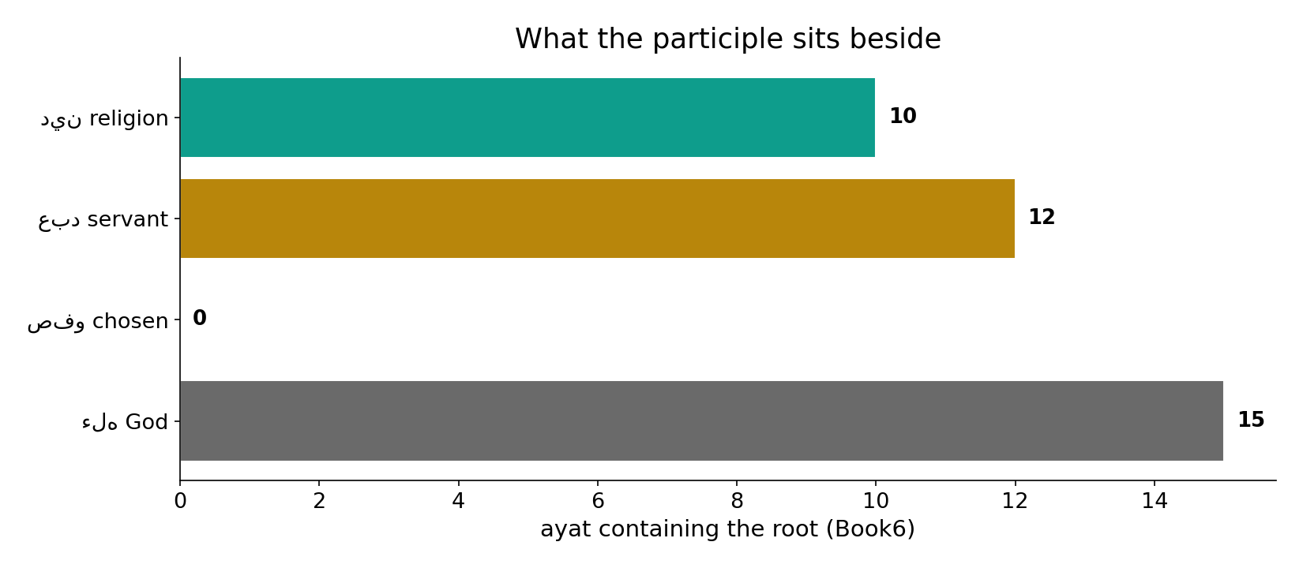
What it sits beside
In the data - the participle's neighbours are religion (10), servant (12), chosen (0) and God - the vocabulary of sincere worship and election.

Slide 14
Striving and being chosen
mukhlis (active)
you make your faith sincere
one spelling
the vowel forks it
mukhlas (passive)
God makes you sincere / chosen
Effort meets grace
with religion it is the human act; with servants it is the divine election - one root holds both.

Slide 15
Honest limits and critique
This rests on a single reading
the kasra/fatha split is the Hafs vocalization the corpus encodes; 12:24, 15:40, 38:83 and the Saffat series are known qira'at variant points - other readers vocalize some the opposite way.
A true diacritic can still carry a claim
the collocation (religion vs servants) is computed and robust; the precise voice assignment depends on the reading - we present both halves and flag the limit.

Slide 16
Reading this honestly - the audit
✓ Company computed
with religion 10, with servants 12, with chosen 0.
✓ Rarity counted
root 30, participle 20.
~ Voice = a reading
kasra/fatha follows the Hafs vocalization; some are qira'at variant points.
✗ Not a proof
morphology locates the distinction; theology is not settled by counts.
✗ No raw mixing
forms separated before counting (course rule).

Slide 17
How this was computed (reproducible)
Book6
the sincerity-participle; co-occurring roots
measure
surface-form count, company (religion vs servants)
figures
company bars, rarity bars, sura map, neighbours
count
chart
Fully reproducible
Every figure recomputes from Book6.xlsx via the shared wk.py kernel (fixed seed). Roots are normalized (Persian/Arabic letter variants folded) so counts are stable; surface forms are used wherever a concept must be kept apart from its root family (per the course's sense-verification rule).

Slide 18
Appendix - input snippets (Book6, vocalized)
verbatim snippets with addresses:
7:29 كُلِّ مَسْجِدٍ وَادْعُوهُ مُخْلِصِينَ لَهُ الدِّينَ كمَا - active
39:2 بِالْحَقِّ فَاعْبُدِ اللَّهَ مُخْلِصًا لَّهُ الدِّينَ - active
10:22 بِهِمْ دَعَوُاْ اللّهَ مُخْلِصِينَ لَهُ الدِّينَ لَئِنْ - active
98:5 إِلَّا لِيَعْبُدُوا اللَّهَ مُخْلِصِينَ لَهُ الدِّينَ حُنَفَاء - active
12:24 إِنَّهُ مِنْ عِبَادِنَا الْمُخْلَصِينَ - passive

Slide 19
Takeaway
One spelling, two theologies
The participle is rare (20 occurrences) but splits by company: with 'religion' (10) it is the human act of sincerity; with 'servants' (12) it is the divinely-chosen.
You strive to be mukhlis; being made mukhlas - Satan-proof, among the chosen - is God's to give. Effort meets grace in one root.
Honest limit: the voice depends on the Hafs reading; the company-counts are robust. Presented from the text.

Slide 20
Quick reference
The numbers
sincerity-root 30 ayat - participle 20; with religion 10, with servants 12, with 'chosen' 0.
The shape
active (human act, with religion) vs passive (divine election, with servants) - one spelling, forked by a vowel; the split rests on the reading.

