Slide 1
SPECIAL TOPIC - number & morphology, Week 4
One light, many darknesses
A creed encoded in grammatical number - with zero exceptions
Light and darkness are a stock pair, but their NUMBER tells a story: is 'light' (nur) ever plural? is 'darkness' (zulumat) ever singular? We count every surface form, tagging singular vs plural, and weigh light against darkness overall.
Counts recompute from Book6 by surface form; fire (nar) shares the lexical family but is a different sense and is excluded.

Slide 2
The question, and the method
The observation
Does the grammatical NUMBER of light vs darkness encode a consistent pattern?
The method
- count every surface form of light and of darkness
- tag each as singular or plural
- weigh light against darkness overall - let number, not translation, carry the finding

Slide 3
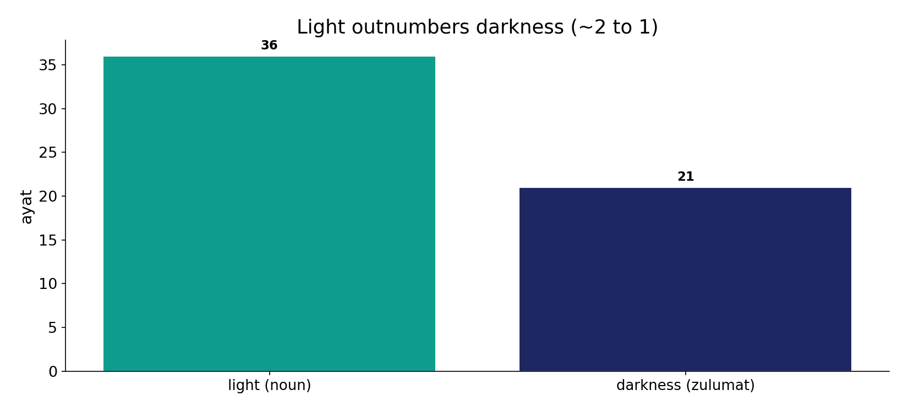
Light outnumbers darkness
In the data - light (noun) is named in 36 ayat, darkness in 21: the corpus weights illumination over its absence by roughly 1.7 to 1.

Slide 4
God is light; darknesses and the light
the text's own words (address - snippet - gloss):
24:35 اللَّهُ نُورُ السَّمَاوَاتِ وَالْأَرْضِ مَثَلُ نُورِهِ كمِشْكاةٍ - “God is the light of heavens & earth”
6:1 الْحَمْدُ لِلّهِ الَّذِي خَلَقَ السَّمَاوَاتِ وَالأَرْضَ وَجَعَلَ الظُّلُمَاتِ وَالنُّورَ ثُمَّ الَّذِينَ - “…and made the darknesses and the light”

Slide 5
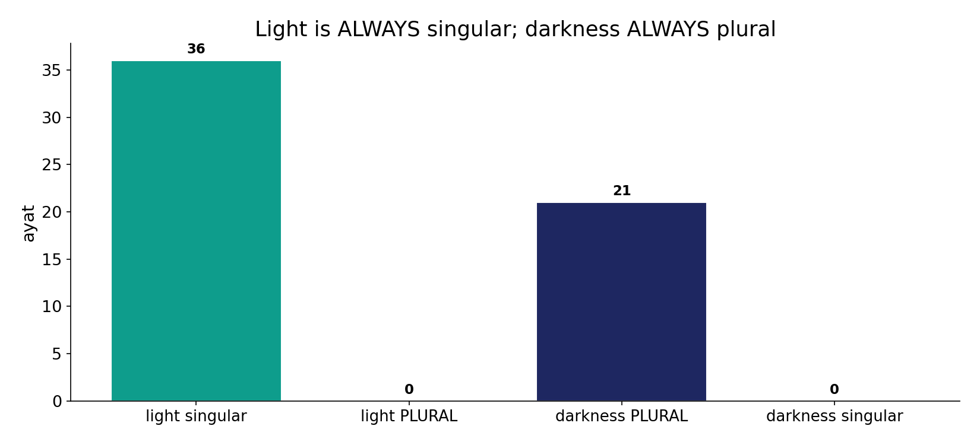
One light, many darknesses - zero exceptions
In the data - light is ALWAYS singular (plural 'anwar' = 0); darkness is ALWAYS plural (singular 'zulma' = 0). A hard morphological datum with no counter-examples.

Slide 6
What the data shows
One light
'nur' appears in 36 ayat and is ALWAYS singular - never pluralised ('anwar' = 0).
Many darknesses
'zulumat' appears in 21 ayat and is ALWAYS plural - the singular 'zulma' = 0.
And light leads
light is named ~1.7x as often as darkness - the corpus weights illumination over its absence.

Slide 7
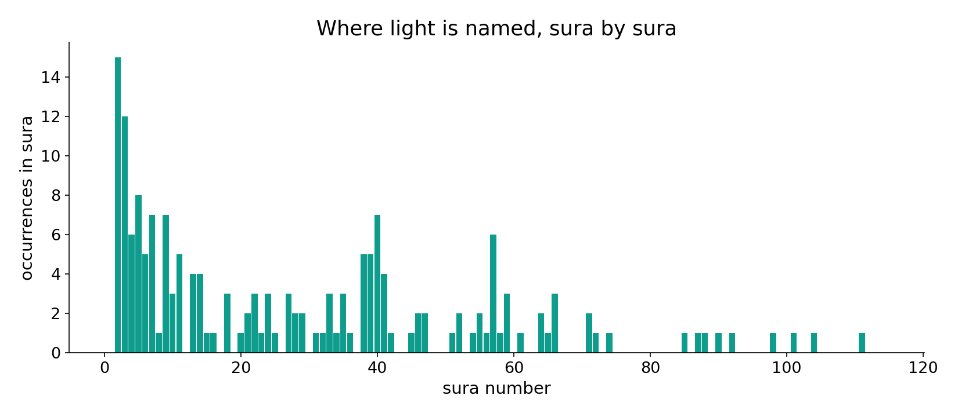
Light across the corpus
In the data - light clusters in the guidance and divine-attribute passages (24:35, 'God is the light...').

Slide 8
Out of the darknesses into the light
the text's own words (address - snippet - gloss):
2:257 أَوْلِيَآؤُهُمُ الطَّاغُوتُ يُخْرِجُونَهُم مِّنَ النُّورِ إِلَى الظُّلُمَاتِ أُوْلَئِك أَصْحَابُ النَّارِ هُمْ - the false gods: out of light into darkness
5:16 يَهْدِي بِهِ اللّهُ مَنِ اتَّبَعَ رِضْوَانَهُ سُبُلَ السَّلاَمِ وَيُخْرِجُهُم مِّنِ الظُّلُمَاتِ إِلَى - out of the darknesses into the light

Slide 9
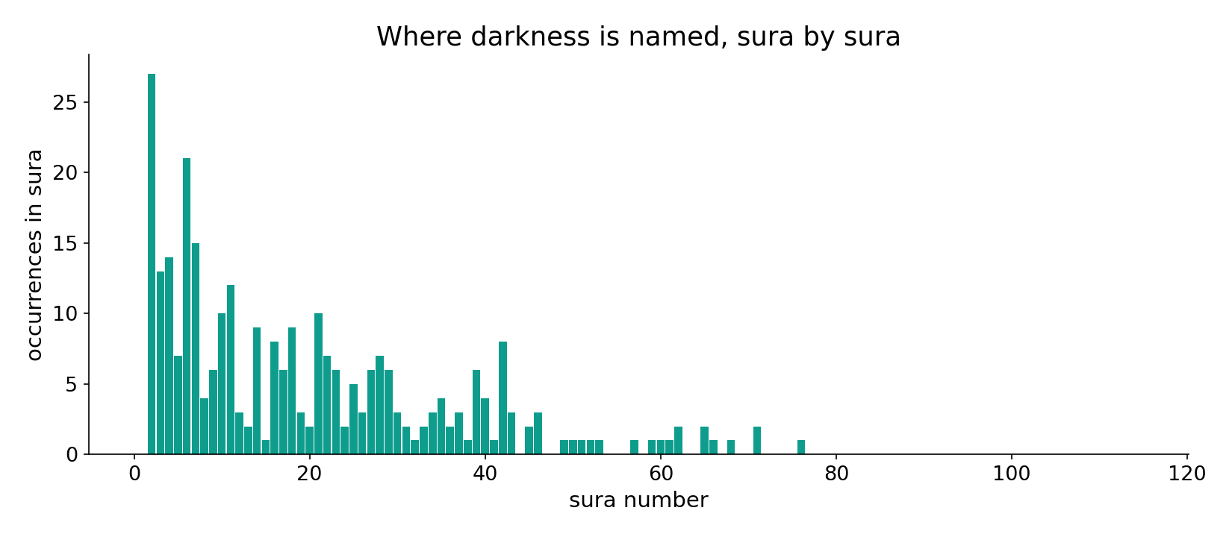
Darkness across the corpus
In the data - darkness appears alongside light in the journey passages ('out of the darknesses into the light').

Slide 10
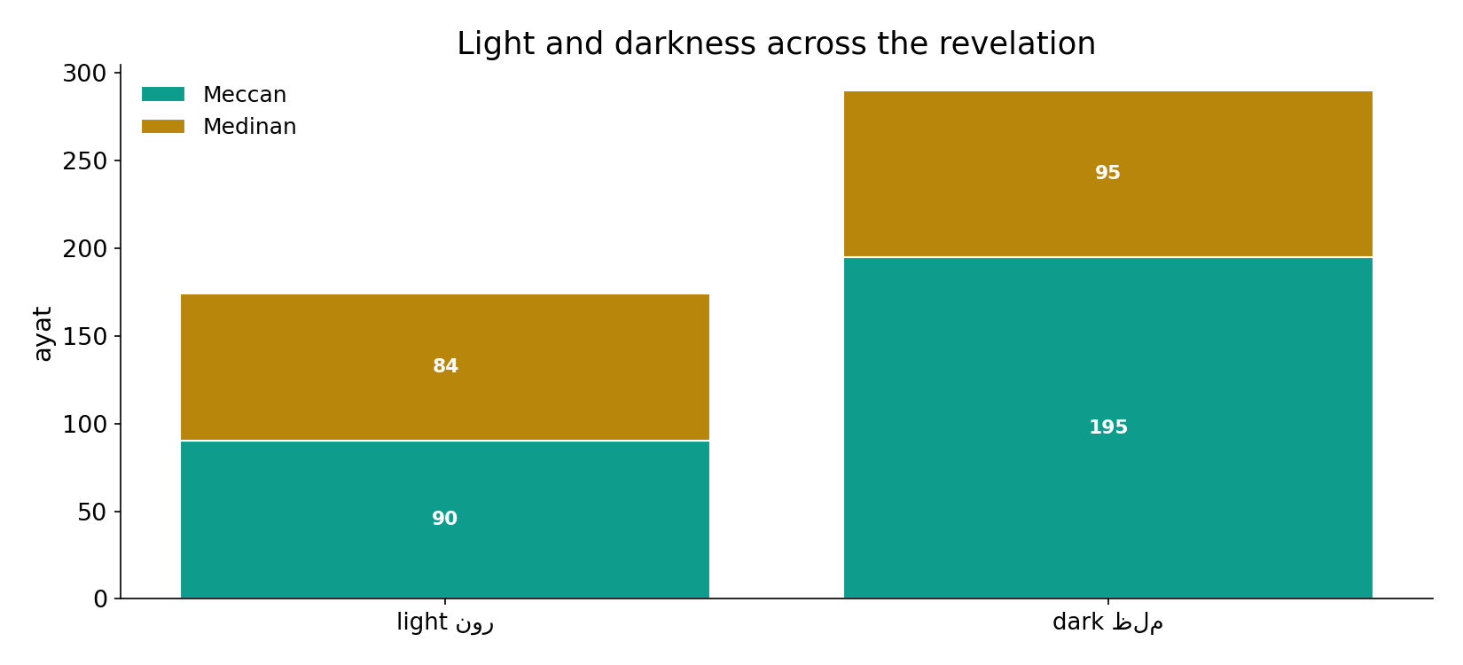
Both across the revelation
In the data - the pair runs the whole revelation; the singular/plural asymmetry holds throughout.

Slide 11
Unity of light, multiplicity of dark
With zero exceptions, a single 'nur' (never pluralised) is set against plural 'zulumat' (never singularised), and light outnumbers darkness (36 vs 21). The grammar encodes a creed: truth and guidance are ONE; error and confusion are MANY. The number is the message.
The morphology is a hard datum (0 counter-examples); the reading laid over it is labelled.

Slide 12
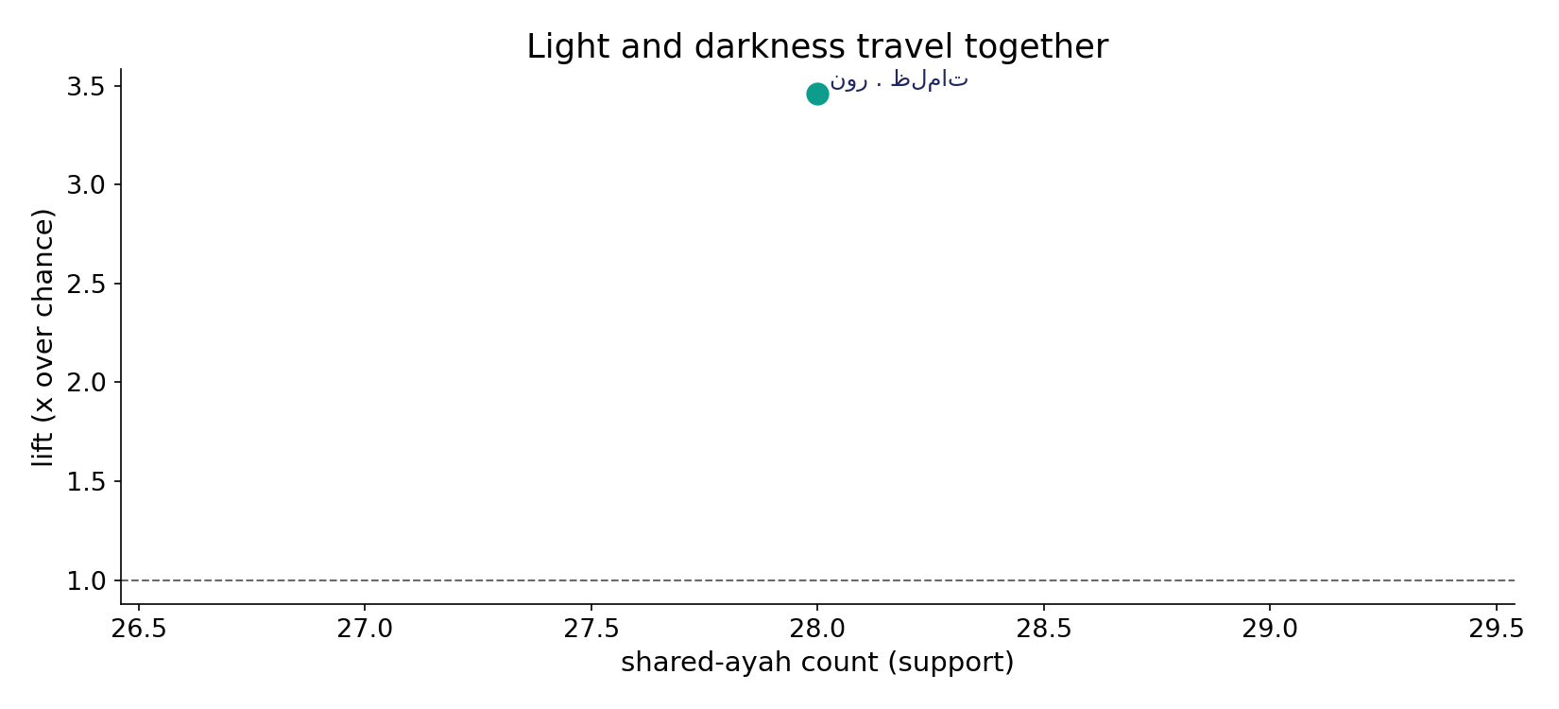
They travel together
In the data - light and darkness co-occur in 28 ayat at 3.5x chance: a deliberate contrast pair, not separate vocabularies.

Slide 13
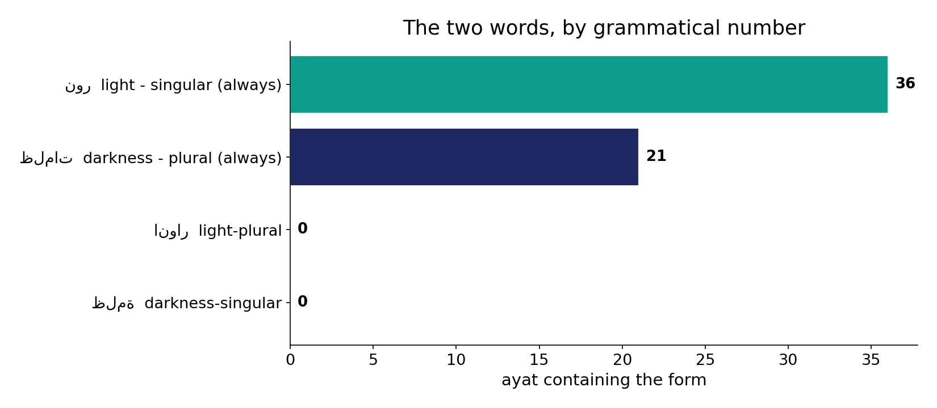
By grammatical number
In the data - singular light (36) vs plural darkness (21); the 'wrong-number' forms (plural light, singular darkness) are both 0/0 - they do not occur.

Slide 14
Grammar as creed
Light = singular
one - never pluralised
Darkness = plural
many - never singular
Light leads
~2x more frequent
The number is the message
one truth, many errors - a labelled reading over a 0-exception morphological datum.

Slide 15
Honest limits and critique
The reading is laid over the datum
'one truth, many errors' is the interpretation; the 0-exception singular/plural split is the computed fact.
Fire shares the family but not the sense
'nar' (fire) belongs to a related lexical family but is a different concept and is excluded - a sense-verification step.

Slide 16
Reading this honestly - the audit
✓ Counts exact
light 36, darkness 21.
✓ Zero exceptions
plural-light and singular-darkness both = 0; no counter-examples.
✓ Light leads
~1.7x more than darkness.
~ Fire excluded
'nar' is a different sense, kept out.
✗ Not a proof
counts/co-occurrence locate structure; they do not settle theology.
✗ No raw mixing
forms/senses separated before counting (course rule).

Slide 17
How this was computed (reproducible)
Book6
light & darkness surface forms
measure
number (singular/plural), totals, co-occurrence
figures
count bars, number bars, sura maps
count
chart
Fully reproducible
Every figure recomputes from Book6.xlsx via the shared wk.py kernel (fixed seed). Roots are normalized (Persian/Arabic letter variants folded) so counts are stable; surface forms are used wherever a concept must be kept apart from its root family (per the course's sense-verification rule).

Slide 18
Appendix - input snippets (Book6, vocalized)
verbatim snippets with addresses:
24:35 اللَّهُ نُورُ السَّمَاوَاتِ وَالْأَرْضِ مَثَلُ نُورِهِ كمِشْكاةٍ - “God is the light of heavens & earth”
6:1 الْحَمْدُ لِلّهِ الَّذِي خَلَقَ السَّمَاوَاتِ وَالأَرْضَ وَجَعَلَ الظُّلُمَاتِ وَالنُّورَ ثُمَّ الَّذِينَ - “…and made the darknesses and the light”

Slide 19
Takeaway
The number is the message
Light is always singular (36 ayat, never plural); darkness is always plural (21, never singular).
Light leads darkness ~1.7 to 1, and the two are a tight contrast pair (28 shared ayat).
The grammar encodes a creed - one truth, many errors - a labelled reading laid over a 0-exception datum. Presented from the text.

Slide 20
Quick reference
The numbers
light 36 (always singular) - darkness 21 (always plural) - plural-light 0, singular-darkness 0 - shared 28 ayat.
The shape
one light vs many darknesses, with zero exceptions; light outnumbers darkness ~2:1; fire excluded as a different sense.

