Slide 1
SPECIAL TOPIC - pairing & frame, Week 4
Wealth and children - blessing or trial?
A fixed lexical pair, and the frame the corpus puts it in
'Wealth' (mal) and 'children' (awlad) are each named ~80 times and recur as a fixed pair. We find the ayat that name both and read what is predicated of the pair - adornment, trial, or security?
Counts recompute from Book6; the pairing and its framing co-occurrences are exact.

Slide 2
The question, and the method
The pairing
When wealth and children appear together, are they framed as favour, or as a test?
The method
- count each word and the ayat that name both
- read what the pair co-occurs with - trial (fitna), adornment (zina), 'will not avail'
- separate the recurring pairing (computed) from the moral lesson (interpreted)

Slide 3
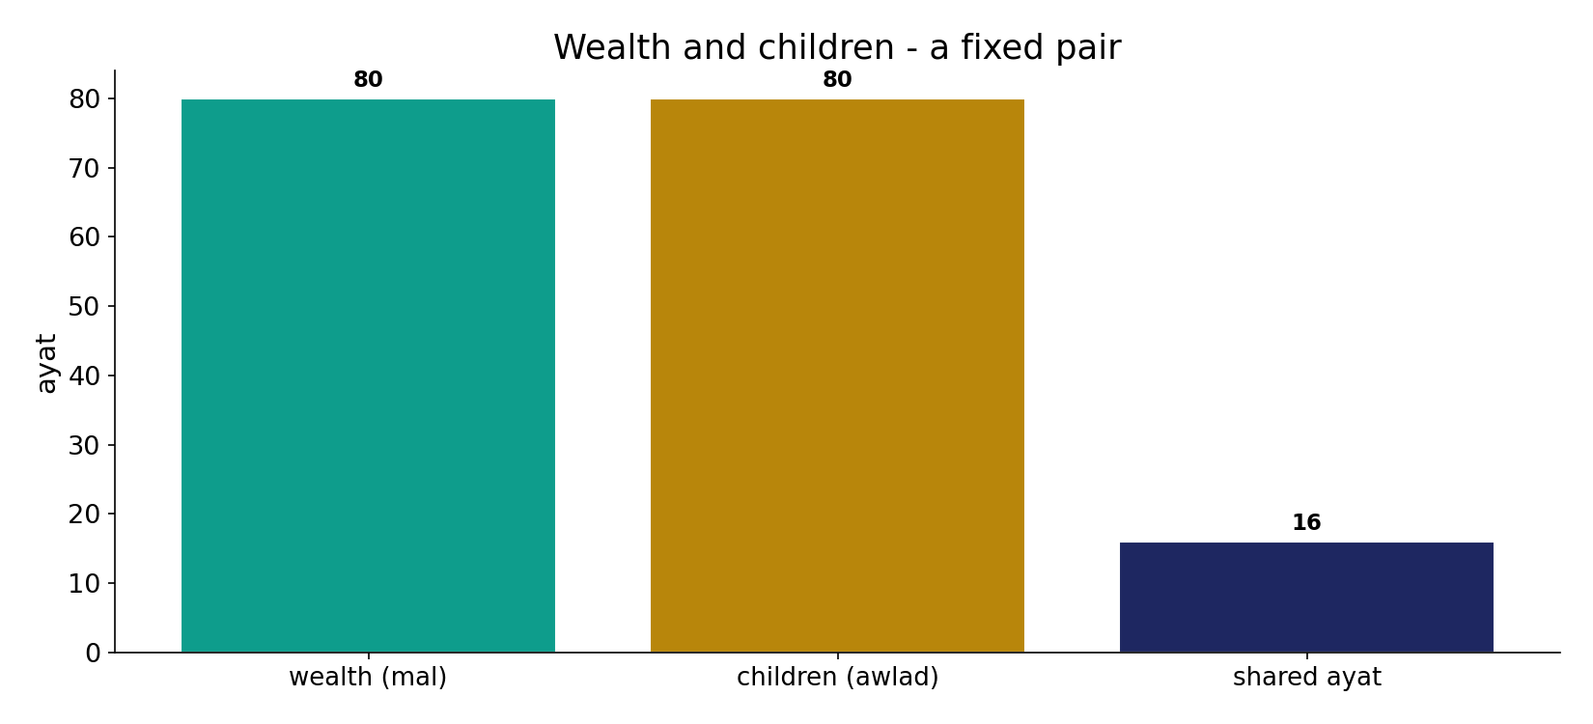
A fixed pair
In the data - wealth (80) and children (80) recur together in 16 ayat: 'your wealth and your children' is a set phrase for worldly capital.

Slide 4
A trial (fitna)
the text's own words (address - snippet - gloss):
8:28 وَاعْلَمُواْ أَنَّمَا أَمْوَالُكُمْ وَأَوْلاَدُكُمْ فِتْنَةٌ وَأَنَّ اللّهَ - wealth & children are a trial
64:15 إِنَّمَا أَمْوَالُكُمْ وَأَوْلَادُكُمْ فِتْنَةٌ وَاللَّهُ عِندَهُ أَجْرٌ - “your wealth and children are a trial”

Slide 5
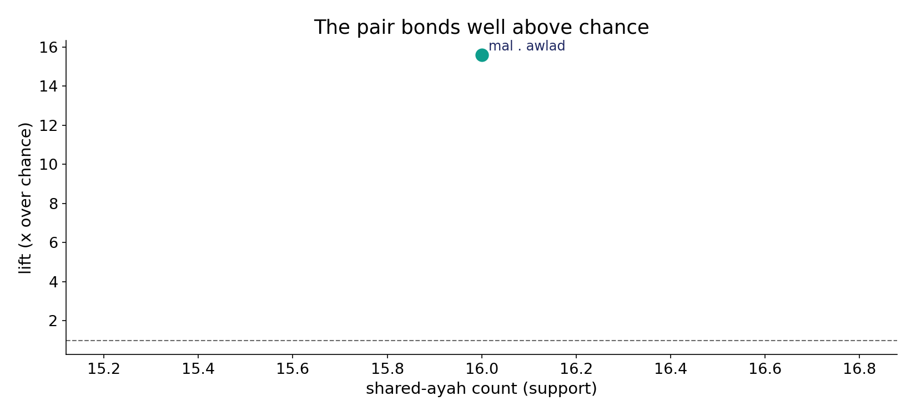
The bond is above chance
In the data - the pair co-occurs at 15.6x the rate chance predicts (16 ayat): a deliberate collocation, not coincidence.

Slide 6
What the data shows
A stable pair
wealth (80) and children (80) recur together in 16 ayat at 15.6x chance - a set phrase for worldly capital.
Framed as a test
where the pair appears it is cast as trial (2), adornment (3), or 'will not avail' (8) - not a sign of divine approval.
Capital reframed
the corpus demotes worldly capital from a reward to a test - what you DO with it decides (the durative-conditional logic).

Slide 7
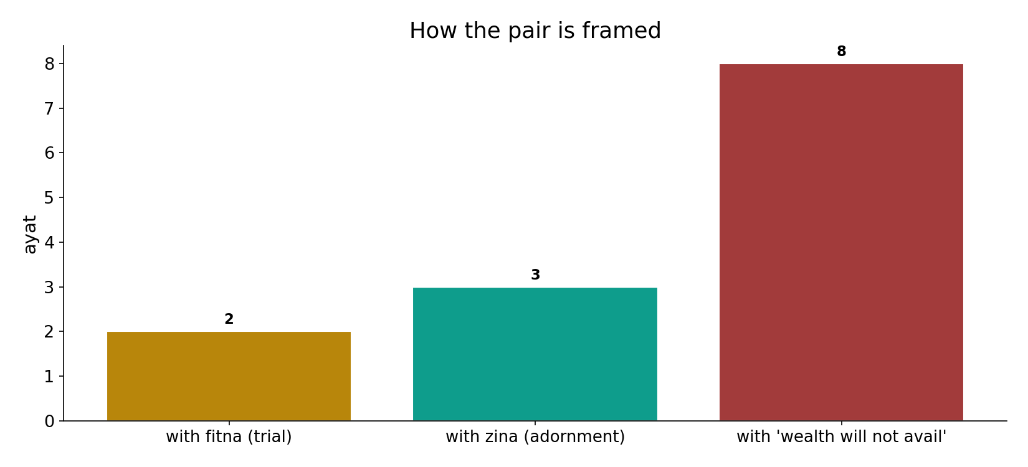
Framed as a trial
In the data - where the pair appears it sits with 'trial' (fitna, 2), 'adornment' (zina, 3) and 'will not avail against God' (8) - a test, not a verdict of favour.

Slide 8
Adornment, and will not avail
the text's own words (address - snippet - gloss):
18:46 الْمَالُ وَالْبَنُونَ زِينَةُ الْحَيَاةِ الدُّنْيَا وَالْبَاقِيَاتُ الصَّالِحَاتُ - adornment of the worldly life
3:10 إِنَّ الَّذِينَ كفَرُواْ لَن تُغْنِيَ عَنْهُمْ أَمْوَالُهُمْ وَلاَ أَوْلاَدُهُم - they will not avail against God

Slide 9
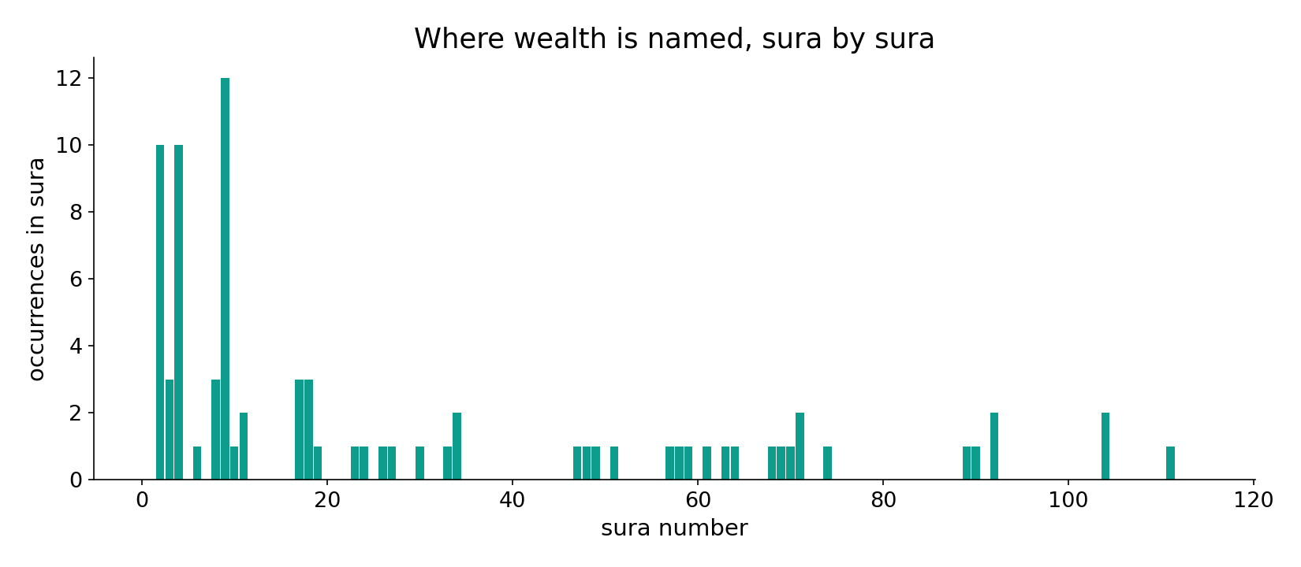
Wealth across the corpus
In the data - wealth is named across the corpus, densest where worldly attachment is the theme.

Slide 10
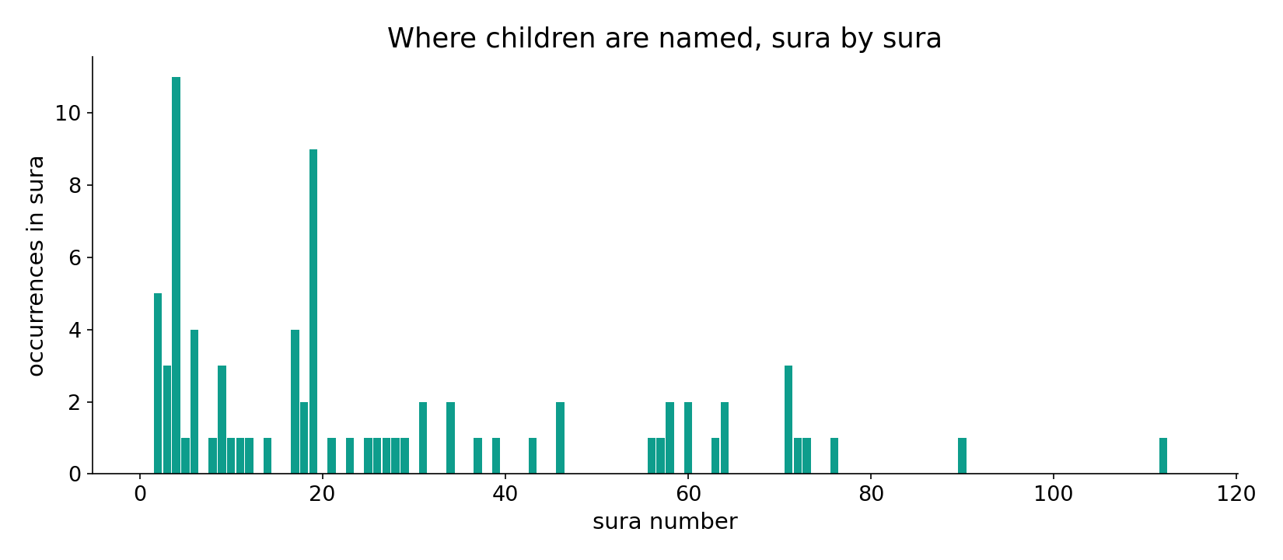
Children across the corpus
In the data - children track the same passages, reinforcing the paired 'worldly capital' motif.

Slide 11
Capital reframed as a test
Wealth and children form a stable lexical pair (16 ayat, 15.6x chance), and where the pair appears it is cast as adornment, trial, or something that 'will not avail' against God - not as a sign of favour. The corpus consistently demotes worldly capital from a reward to a test: the same durative-conditional logic as elsewhere, where what you do with the capital decides its worth.
The pairing is robust; the 'trial' framing is a strong tendency in the paired usage, not a blanket valuation.

Slide 12
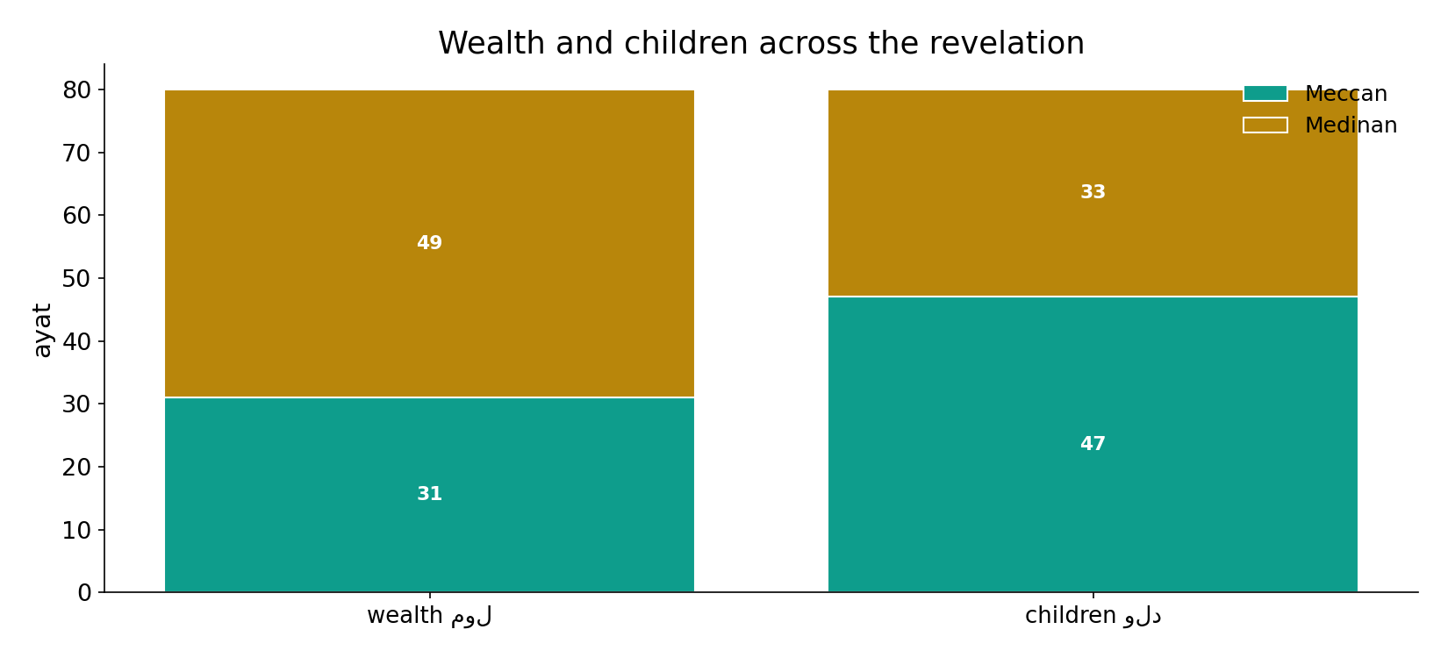
Both across the revelation
In the data - the pair runs the whole revelation; the 'trial' framing is a steady tendency, not a phase.

Slide 13
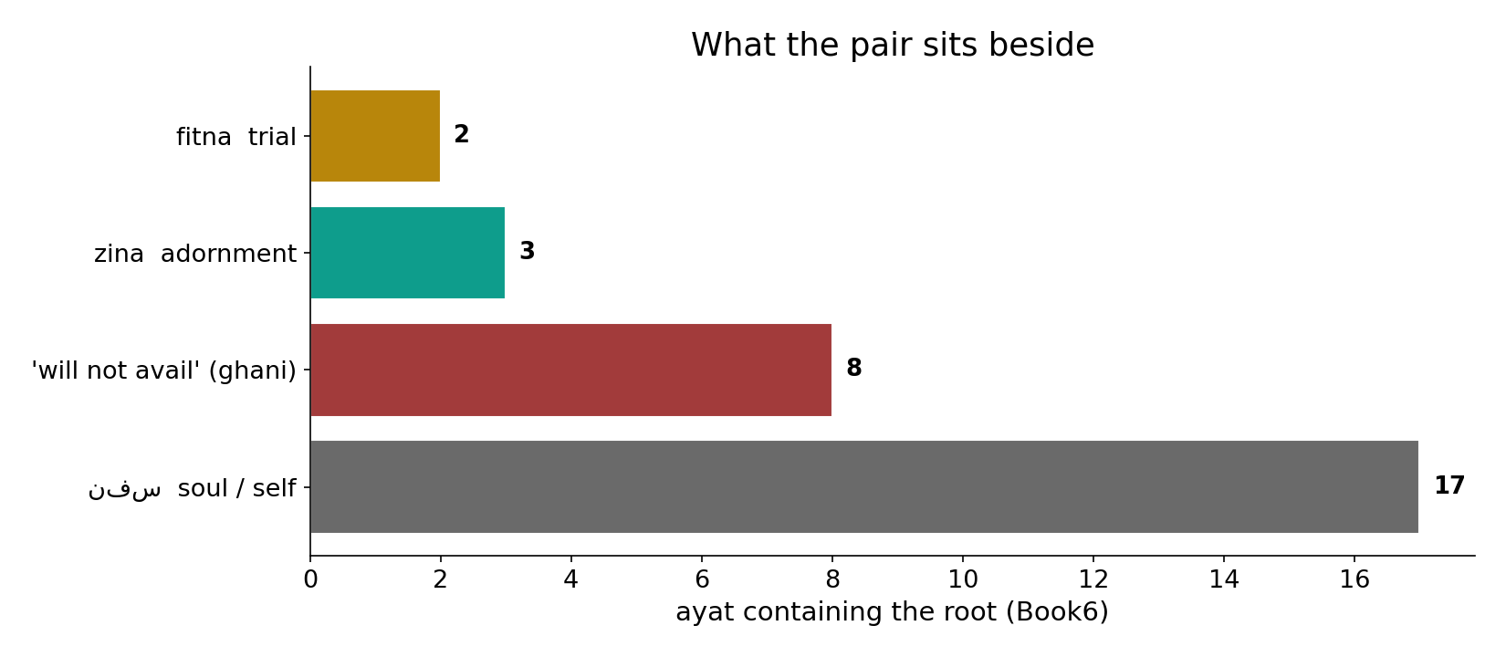
What the pair sits beside
In the data - the pair's neighbours are trial (2), adornment (3) and 'will not avail' (8) - the vocabulary of a test, not a reward.

Slide 14
Capital, reframed
Wealth + children
a fixed pair (16 ayat)
Framed as
trial, adornment
Verdict
a test, not a reward
Demoted from reward to test
what you DO with the capital decides - the durative-conditional logic.

Slide 15
Honest limits and critique
A tendency, not a blanket rule
other ayat do call children a gift (na'im); the finding is a tendency in the PAIRED usage, not a universal verdict on wealth or children.
Pairing vs lesson
the 16-ayah pairing is computed; the 'trial' framing is read from the verses that predicate fitna/zina - a labelled interpretation.

Slide 16
Reading this honestly - the audit
✓ Pair counted
wealth 80, children 80, shared 16.
✓ Bond above chance
15.6x expected.
✓ Framing co-occurrences
fitna 2, zina 3, 'avail' 8.
~ Tendency, not law
children are also called a gift elsewhere.
✗ Not a proof
counts/co-occurrence locate structure; theology is not settled by counts.
✗ No raw mixing
forms/senses separated before counting (course rule).

Slide 17
How this was computed (reproducible)
Book6
wealth & children roots; frame-words
measure
pairing count, lift, framing co-occurrence
figures
pair bars, lift, frame bars, sura maps
count
chart
Fully reproducible
Every figure recomputes from Book6.xlsx via the shared wk.py kernel (fixed seed). Roots are normalized (Persian/Arabic letter variants folded) so counts are stable; surface forms are used wherever a concept must be kept apart from its root family (per the course's sense-verification rule).

Slide 18
Appendix - input snippets (Book6, vocalized)
verbatim snippets with addresses:
8:28 وَاعْلَمُواْ أَنَّمَا أَمْوَالُكُمْ وَأَوْلاَدُكُمْ فِتْنَةٌ وَأَنَّ اللّهَ - wealth & children are a trial
64:15 إِنَّمَا أَمْوَالُكُمْ وَأَوْلَادُكُمْ فِتْنَةٌ وَاللَّهُ عِندَهُ أَجْرٌ - “your wealth and children are a trial”

Slide 19
Takeaway
Worldly capital, reframed as a test
Wealth and children are a fixed pair (16 shared ayat, 15.6x chance) - the corpus's shorthand for worldly capital.
Where the pair appears it is framed as trial (2), adornment (3) or 'will not avail' (8) - a test, not a verdict of favour.
The pairing is computed; the 'trial' framing is a strong tendency, labelled. Presented from the text.

Slide 20
Quick reference
The numbers
wealth 80 - children 80 - shared 16 (15.6x chance); with fitna 2, zina 3, 'avail' 8.
The shape
a fixed pair framed as a trial/adornment, not divine favour; a tendency in the paired usage, not a blanket rule.

