Slide 1
SPECIAL TOPIC - association, Week 5
Which Divine-Name pairs truly bond? Count vs lift
A big shared count can be mere frequency - lift exposes the real attraction
Verses end on paired Names - 'Forgiving, Merciful', 'Mighty, Wise'. Which pairs are a real bond, and which only look tight because both Names are everywhere? For each pair we compute the shared-verse COUNT and the LIFT (joint over expected-by-chance).
Counts and lifts recompute from Book6 and reproduce exactly; lift = observed shared ayat divided by frequency-expected.

Slide 2
The question, and the method
The question
Is a frequent Name-pairing a genuine bond, or an artefact of two common Names co-occurring by chance?
The method
- for each pair compute the shared-ayah COUNT and the LIFT (x over chance)
- rank by both; watch where the rankings disagree
- read count and lift together - neither alone is enough

Slide 3
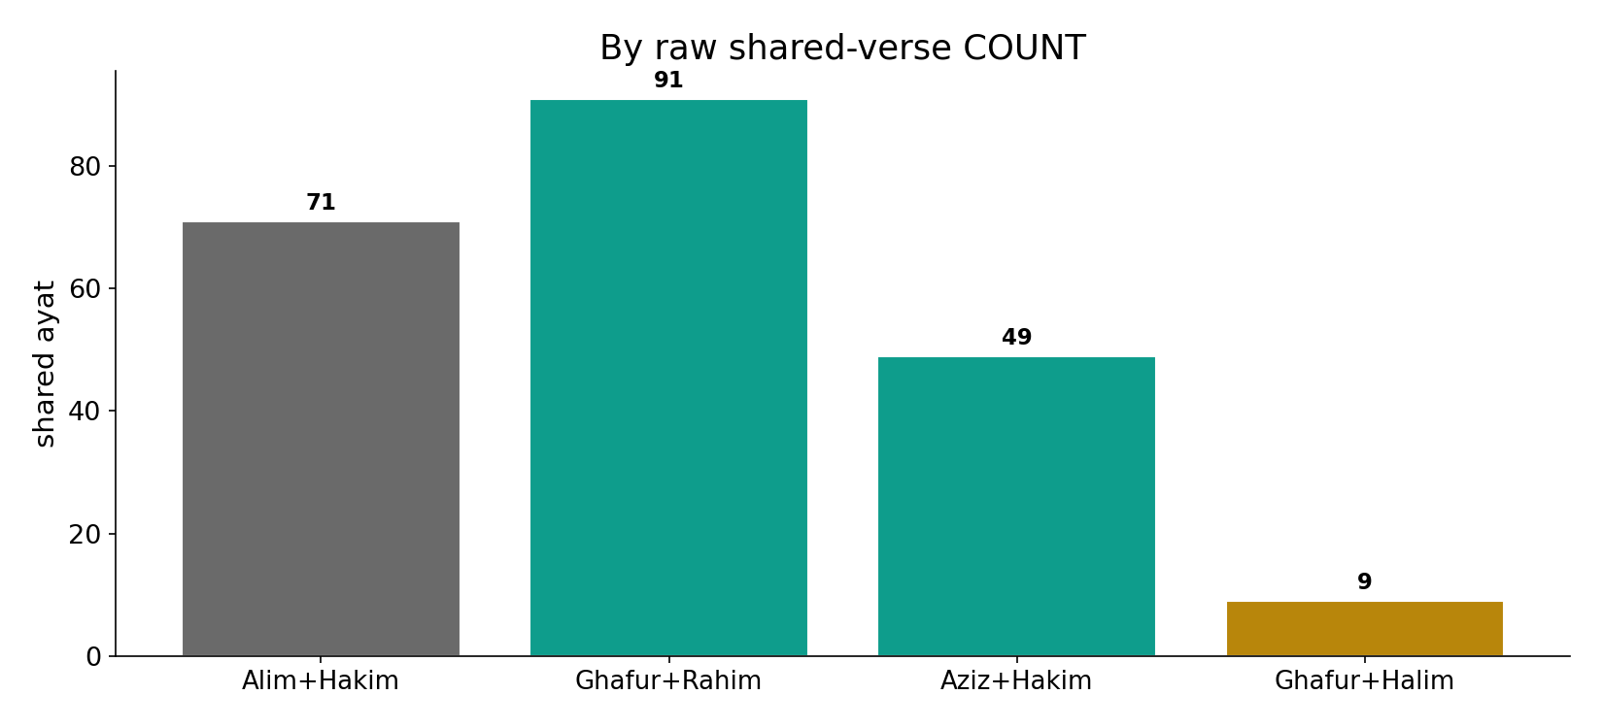
By raw count
In the data - by shared verses, Alim+Hakim (71) and Ghafur+Rahim (91) look like the tightest pairs.

Slide 4
The gold-standard and the tight-but-thin pairs
the text's own words (address - snippet - gloss):
48:7 وَلِلَّهِ جُنُودُ السَّمَاوَاتِ وَالْأَرْضِ وَكانَ اللَّهُ - “…ever Mighty, Wise” (ʿAzīz Ḥakīm)
2:235 وَلاَ جُنَاحَ عَلَيْكُمْ فِيمَا عَرَّضْتُم بِهِ مِنْ - “…Forgiving, Forbearing” (Ghafūr Ḥalīm)

Slide 5
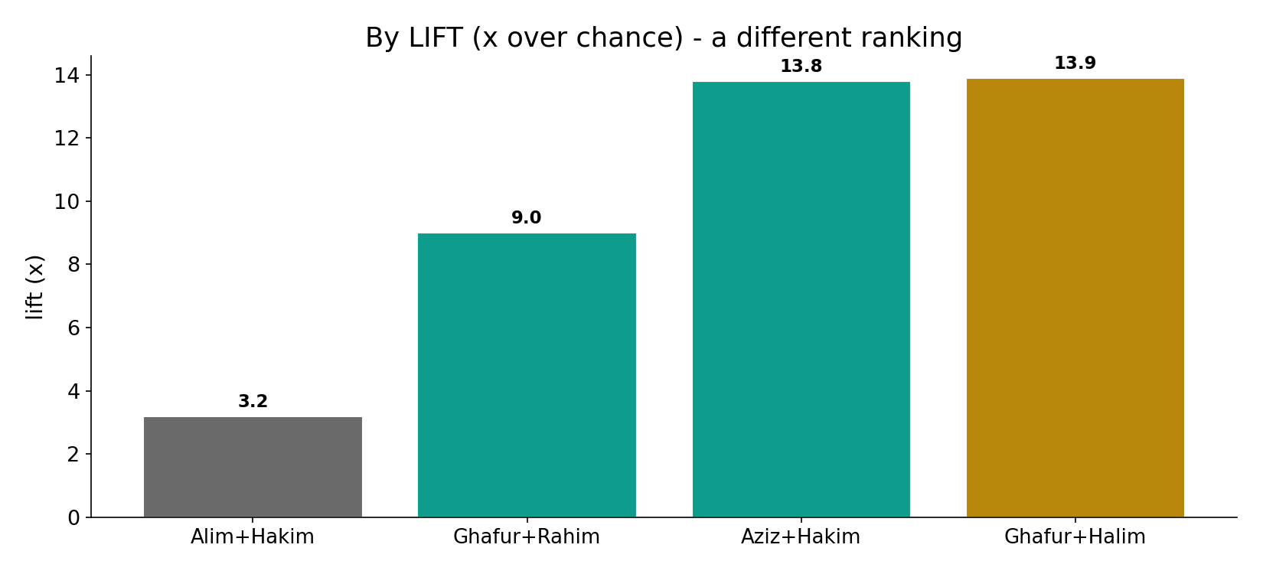
By lift - a different ranking
In the data - by lift, Ghafur+Halim (13.9x on 9 verses) and Aziz+Hakim (13.8x) win; Alim+Hakim's big count collapses to 3.2x.

Slide 6
What the data shows
Count says one thing
by raw shared verses, Alim+Hakim (71) and Ghafur+Rahim (91) look tightest.
Lift says another
by lift, Ghafur+Halim (13.9x) and Aziz+Hakim (13.8x) win; Alim+Hakim collapses to 3.2x.
The gold standard
Aziz+Hakim - strong lift (13.8x) AND solid support (49 verses): the bond you can trust.

Slide 7
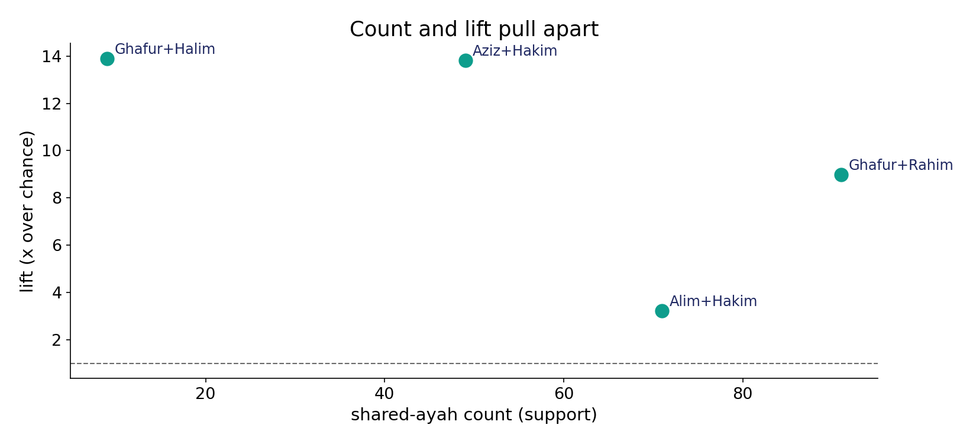
Count and lift pull apart
In the data - high count does not imply high lift. The frequent pair sits low on lift; the tight bond sits low on count. Read both axes.

Slide 8
The frequent-but-weak, and the common pair
the text's own words (address - snippet - gloss):
2:32 قَالُواْ سُبْحَانَك لاَ عِلْمَ لَنَا إِلاَّ مَا - “…the Knowing, the Wise” (ʿAlīm Ḥakīm)
2:173 إِنَّمَا حَرَّمَ عَلَيْكُمُ الْمَيْتَةَ وَالدَّمَ - “…Forgiving, Merciful” (Ghafūr Raḥīm)

Slide 9
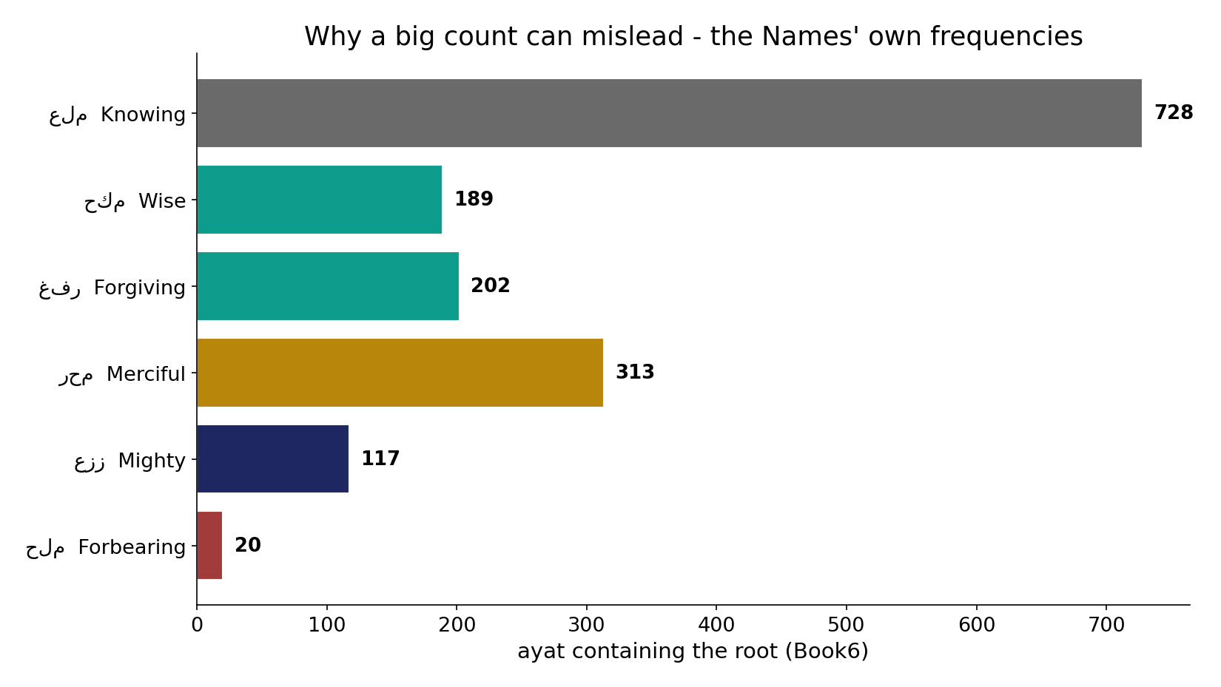
Why a big count misleads
In the data - 'Knowing' alone appears in 728 ayat. Two ubiquitous Names will share many verses by chance - inflating their count without a real bond.

Slide 10
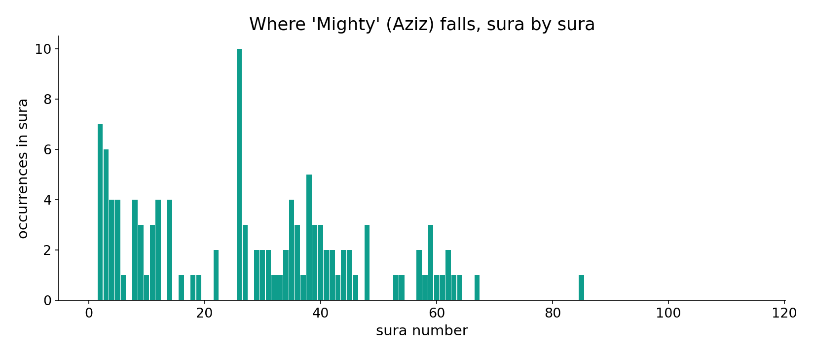
'Mighty' across the corpus
In the data - 'Mighty' (Aziz) clusters in the sovereignty passages; its pairing with 'Wise' is both frequent enough and tight.

Slide 11
Frequency is not a bond
The most FREQUENT pairing (Alim+Hakim, 71 verses) is among the WEAKEST by lift (3.2x) - inflated because 'Knowing' appears in 728 ayat. The tightest real bond is Ghafur+Halim (13.9x), rare but almost always together. The safest is Aziz+Hakim: strong lift AND solid support. Read three numbers, not one: count, lift, and stability.
High lift on a low count (Ghafur+Halim, ~9 verses) is itself thin support - a leave-one-out would wobble it.

Slide 12
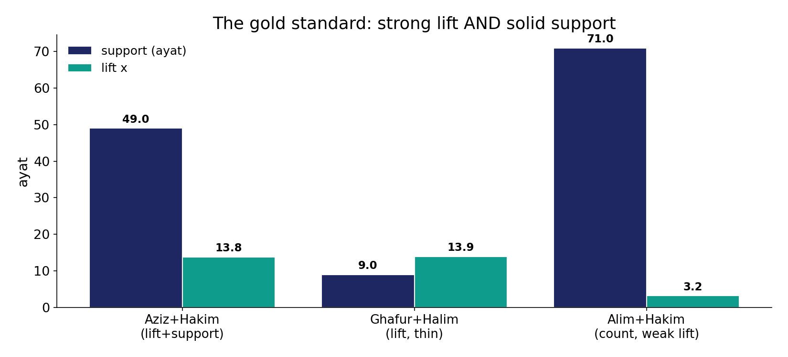
The gold standard
In the data - Aziz+Hakim has strong lift (13.8x) AND solid support (49 verses) - the safest bond. Ghafur+Halim is tighter (13.9x) but thin (9).

Slide 13
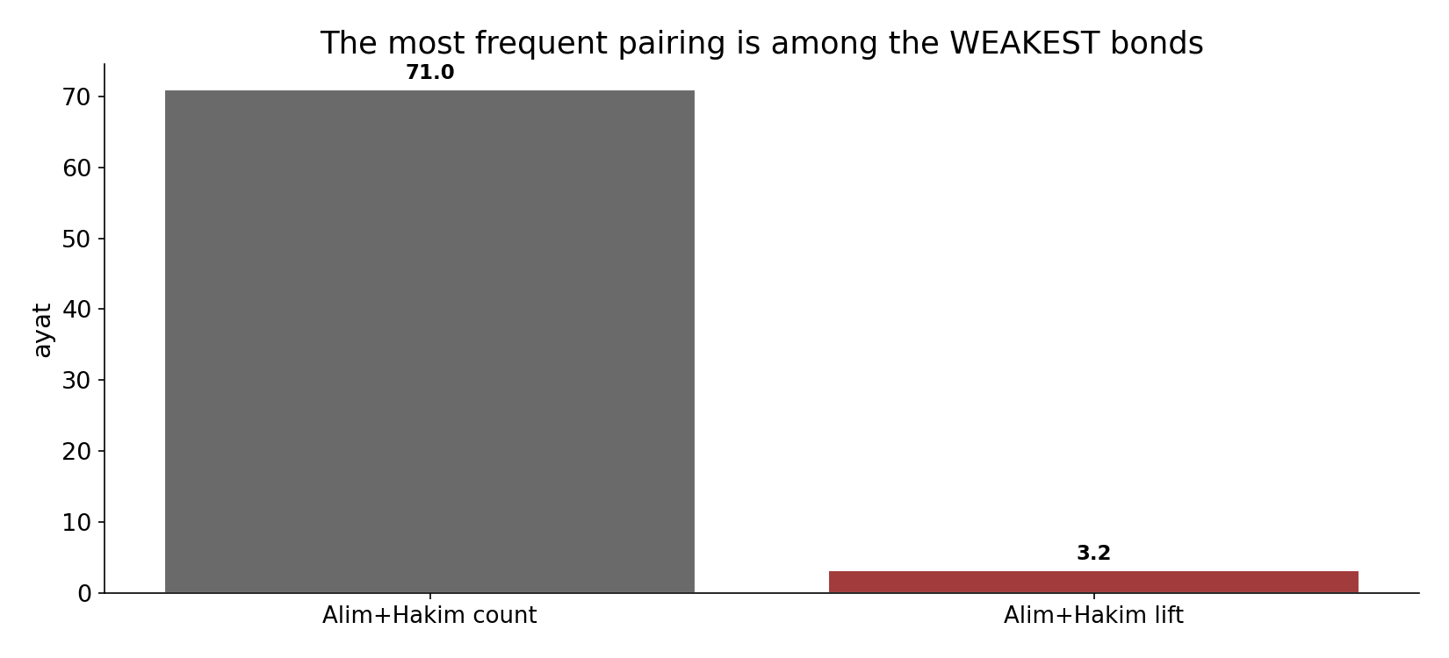
Frequency is not a bond
In the data - Alim+Hakim is the most FREQUENT pairing (71) yet among the WEAKEST by lift (3.2x) - inflated because 'Knowing' is everywhere.

Slide 14
Three numbers, not one
Count
support - can be mere frequency
Lift
attraction over chance
Stability
does it survive leave-one-out?
Frequency is not a bond
the frequent pair is weak; the tight pair is thin; the gold standard balances lift and support.

Slide 15
Honest limits and critique
Lift alone can mislead
a 13.9x lift on 9 verses is fragile; a leave-one-out would shake it. High lift on low count is not yet a secure bond.
Read three numbers
count, lift, and stability together; the frequent pair is weak, the tight pair is thin, the gold standard balances both.

Slide 16
Reading this honestly - the audit
✓ Counts exact
Alim+Hakim 71, Ghafur+Rahim 91, Aziz+Hakim 49, Ghafur+Halim 9.
✓ Lifts exact
3.2 / 9.0 / 13.8 / 13.9x.
✓ Frequency confound
'Knowing' in 728 ayat inflates its pairings.
~ Thin lifts wobble
13.9x on ~9 verses is fragile support.
✗ Not a proof
counts/lift locate structure; theology is not settled by counts.
✗ No raw mixing
forms/senses separated before counting (course rule).

Slide 17
How this was computed (reproducible)
Book6
Divine-Name roots; pairwise
measure
shared-verse count and lift (joint/expected)
figures
count bars, lift bars, count-vs-lift scatter
count
chart
Fully reproducible
Every figure recomputes from Book6.xlsx via the shared wk.py kernel (fixed seed). Roots are normalized (Persian/Arabic letter variants folded) so counts are stable; surface forms are used wherever a concept must be kept apart from its root family (per the course's sense-verification rule).

Slide 18
Appendix - input snippets (Book6, vocalized)
verbatim snippets with addresses:
48:7 وَلِلَّهِ جُنُودُ السَّمَاوَاتِ وَالْأَرْضِ وَكانَ اللَّهُ - “…ever Mighty, Wise” (ʿAzīz Ḥakīm)
2:235 وَلاَ جُنَاحَ عَلَيْكُمْ فِيمَا عَرَّضْتُم بِهِ مِنْ - “…Forgiving, Forbearing” (Ghafūr Ḥalīm)

Slide 19
Takeaway
Read count and lift together
The most frequent Name-pairing (Alim+Hakim, 71) is among the weakest bonds (3.2x) - frequency, not attraction.
The tightest bond is Ghafur+Halim (13.9x, but thin); the gold standard is Aziz+Hakim - strong lift (13.8x) and solid support (49).
Frequency is not a bond; lift alone can mislead; read count, lift and stability. Presented from the text.

Slide 20
Quick reference
The numbers
Alim+Hakim 71v/3.2x - Ghafur+Rahim 91v/9.0x - Aziz+Hakim 49v/13.8x - Ghafur+Halim 9v/13.9x.
The shape
big count can be mere frequency; lift exposes attraction; the gold standard (Aziz+Hakim) has both; thin lifts wobble.

