Slide 1
SPECIAL TOPIC - direction & agency, Week 6
'Out of darkness into light' - a one-way arrow
Direction encodes agency - and the lone reversal names the culprit
The Qur'an speaks of moving between darkness and light. Is the movement symmetric, or fixed in direction - and who is its agent? We count the directional phrase both ways and record the subject of each (who brings whom).
Direction is read from token order in ayat naming both; counts recompute from Book6.

Slide 2
The question, and the method
The question
Is the darkness/light movement symmetric, or one-way - and who drives it?
The method
- count the directional phrase both ways (darkness->light vs light->darkness)
- record the SUBJECT of each movement (God vs the false patron)
- let direction plus agency carry the finding

Slide 3
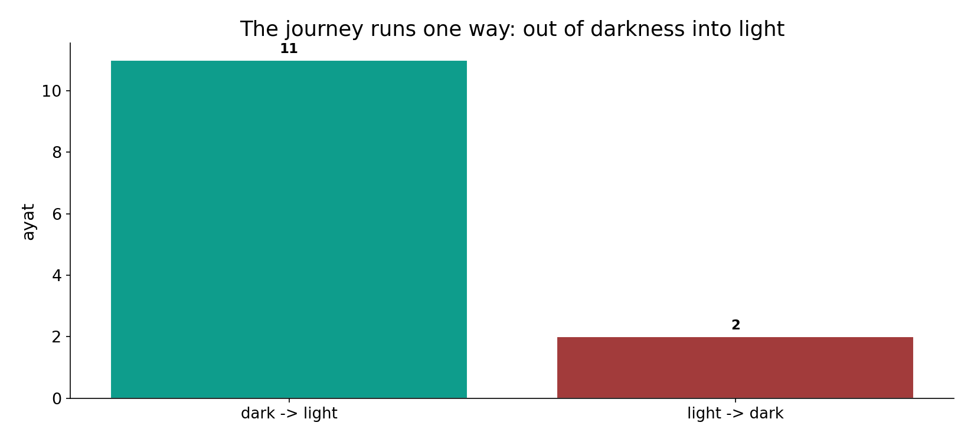
A one-way arrow
In the data - the journey runs darkness -> light 11 times and the reverse only 2: a ~6-to-1 directional asymmetry.

Slide 4
God brings out of darkness into light
the text's own words (address - snippet - gloss):
2:257 أَوْلِيَآؤُهُمُ الطَّاغُوتُ يُخْرِجُونَهُم مِّنَ النُّورِ إِلَى الظُّلُمَاتِ أُوْلَئِك أَصْحَابُ النَّارِ هُمْ - the false gods: out of light into darkness
5:16 يَهْدِي بِهِ اللّهُ مَنِ اتَّبَعَ رِضْوَانَهُ سُبُلَ السَّلاَمِ وَيُخْرِجُهُم مِّنِ الظُّلُمَاتِ إِلَى - out of the darknesses into the light
14:1 الَر كِتَابٌ أَنزَلْنَاهُ إِلَيْك لِتُخْرِجَ النَّاسَ مِنَ الظُّلُمَاتِ إِلَى النُّورِ بِإِذْنِ رَبِّهِمْ - “…to bring people out of darkness to light”

Slide 5
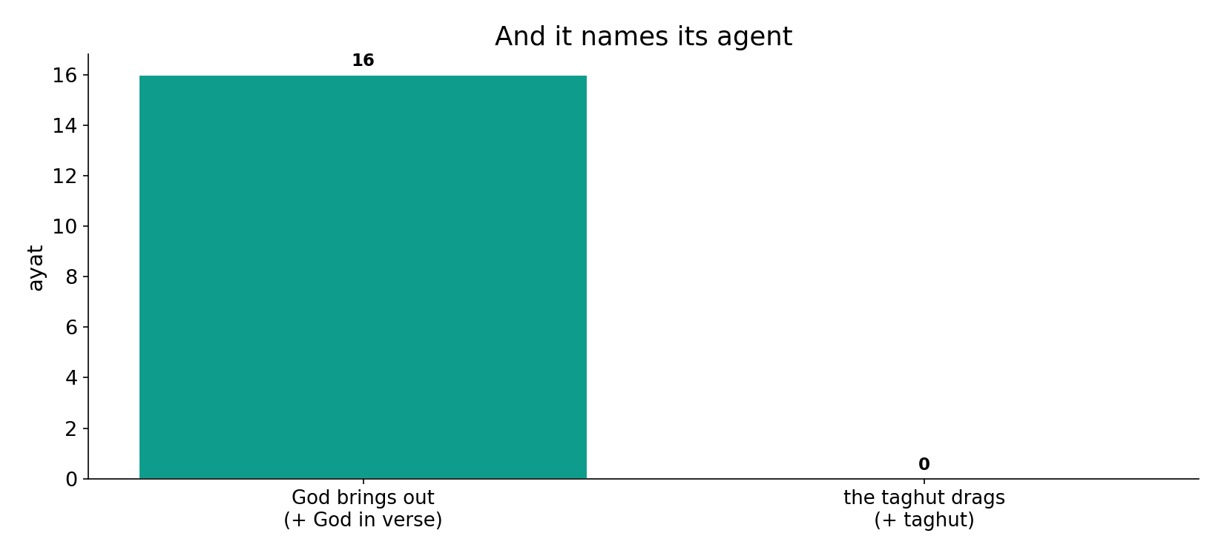
It names its agent
In the data - where the journey to light appears, God is the named subject (16 ayat with God in the verse); the reversal is tied to the false patron (taghut, 0).

Slide 6
What the data shows
A one-way arrow
out of (plural) darkness into (single) light 11 times; the reverse only 2 - a fixed direction.
God is its subject
the forward journey names God as the one who 'brings them out' (16 ayat with God in the verse).
The reversal names the agent
the lone light->darkness case (2:257) is the taghut dragging the wrong way - the exception that proves the rule.

Slide 7
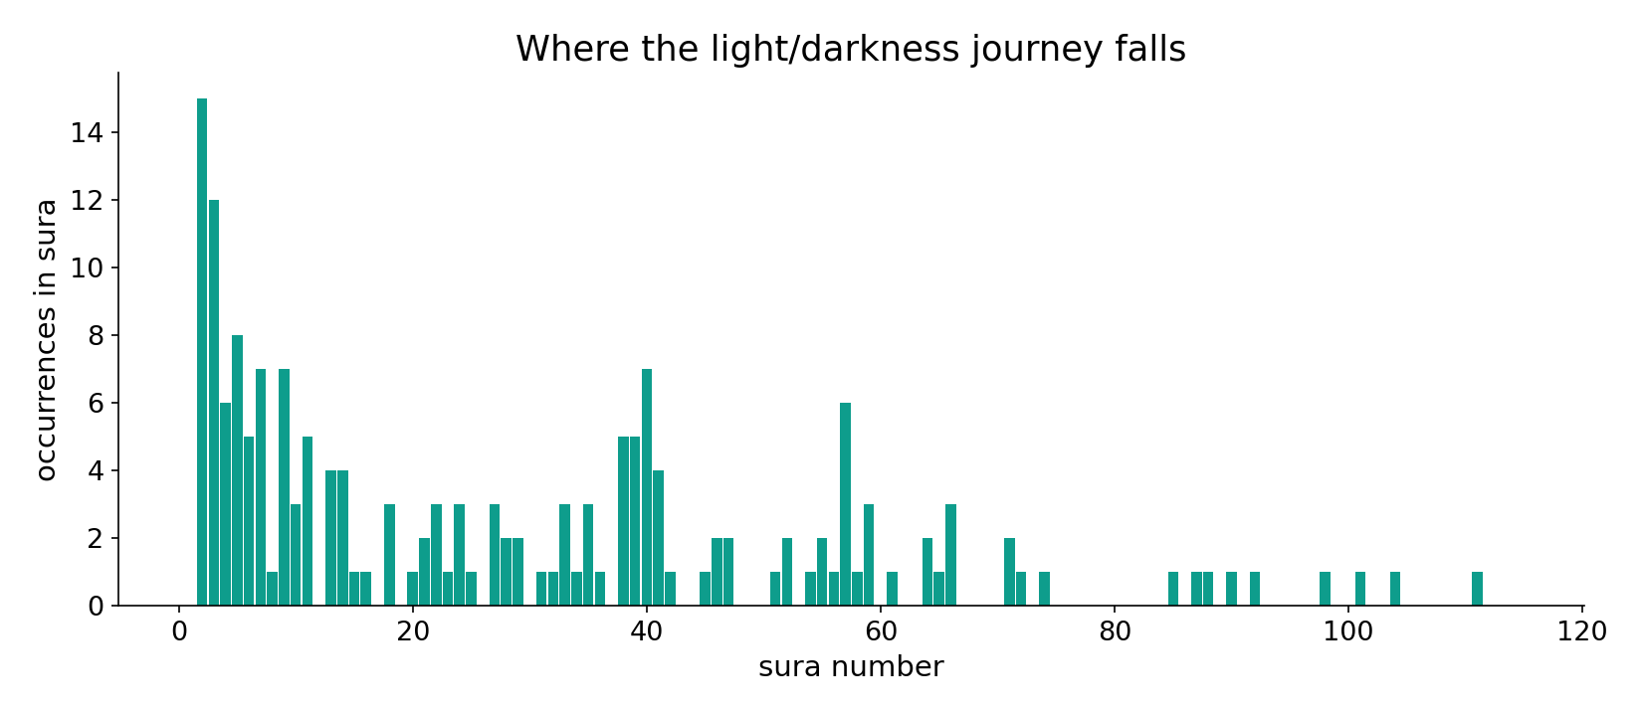
Where the journey falls
In the data - the light/darkness journey clusters in the guidance passages (2:257; 5:16; 14:1).

Slide 8
The lone reversal - the taghut
the text's own words (address - snippet - gloss):
2:257 أَوْلِيَآؤُهُمُ الطَّاغُوتُ يُخْرِجُونَهُم مِّنَ النُّورِ إِلَى الظُّلُمَاتِ أُوْلَئِك أَصْحَابُ النَّارِ هُمْ - the false gods: out of light into darkness

Slide 9
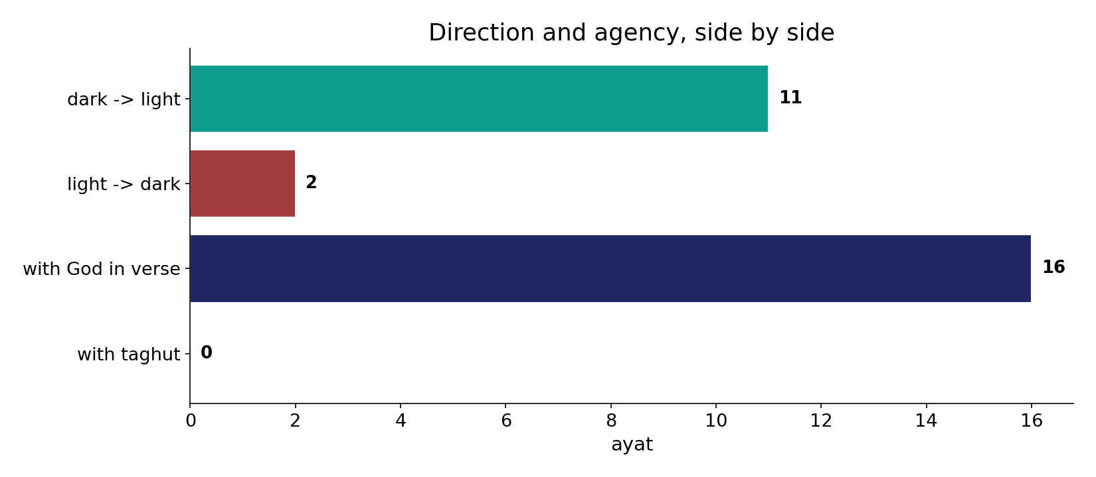
Direction and agency side by side
In the data - 11 forward vs 2 reverse; God-agency 16 vs taghut 0. The arrow and its driver point the same way.

Slide 10
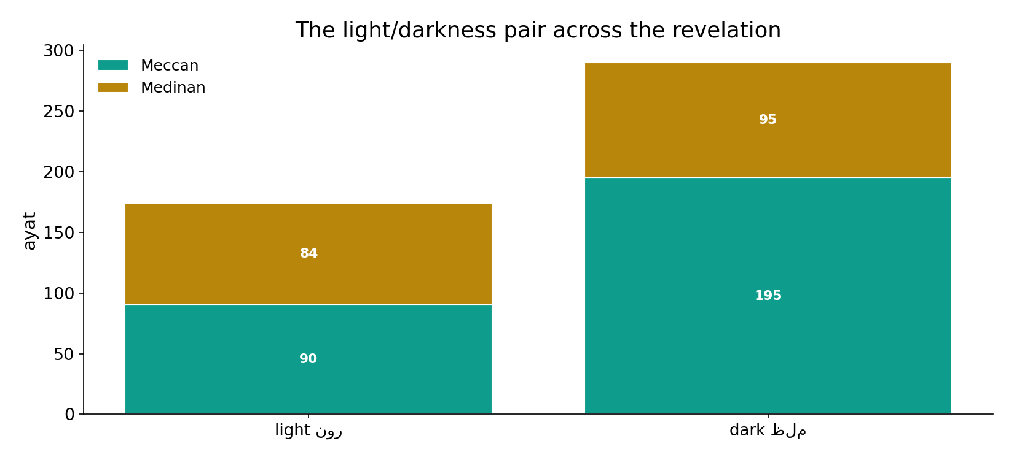
The pair across the revelation
In the data - the light/darkness contrast runs the whole revelation; the directional asymmetry is consistent.

Slide 11
Direction encodes agency
Salvation has a direction: out of the plural darknesses into the single light (11 times), and God is its subject. The one reversal (2) is explicitly attributed to the taghut (false gods). So the arrow encodes agency - toward light is God's work; toward darkness is the false patron's. This builds on the Week-4 number: one light, many darknesses.
Small support - a handful of directional phrases - but the asymmetry is clear and the agents are named.

Slide 12
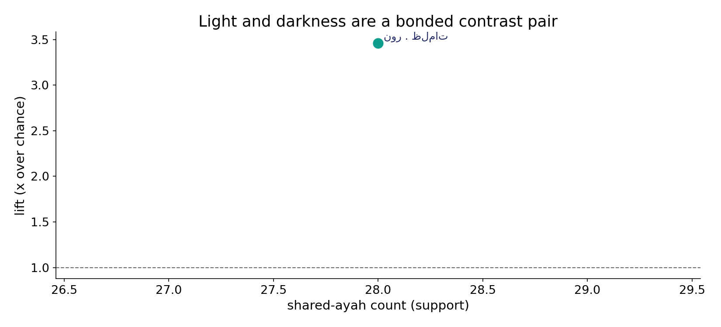
A bonded contrast pair
In the data - light and darkness co-occur in 28 ayat at 3.5x chance: they are deployed together precisely to mark the journey.

Slide 13
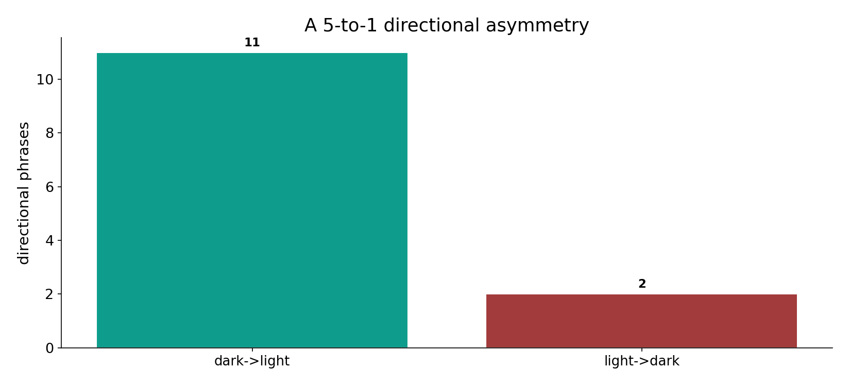
The asymmetry, plainly
In the data - 11 forward to 2 reverse: the lone reversal (2:257, the taghut) is the exception that names the agent of darkness.

Slide 14
Arrow and agent
Darkness (plural)
the starting state
-> Light (single)
God brings them out
Reversal
the taghut - the lone exception
Direction encodes agency
toward light is God's work; toward darkness is the false patron's - the lone reversal names it.

Slide 15
Honest limits and critique
Small support
only 13 directional phrases in all; the asymmetry is clear but rests on few verses.
'Direction = agency' is the reading
the counts and the named subjects are computed; the claim that direction encodes agency is the labelled interpretation.

Slide 16
Reading this honestly - the audit
✓ Direction counted
dark->light 11, reverse 2.
✓ Agents named
God 16, taghut 0.
✓ Pair bonded
28 shared ayat, 3.5x chance.
~ Few verses
the asymmetry rests on a small base.
✗ Not a proof
counts/co-occurrence locate structure; theology is not settled by counts.
✗ No raw mixing
forms/senses separated before counting (course rule).

Slide 17
How this was computed (reproducible)
Book6
light & darkness; directional token order
measure
direction count, named subject, co-occurrence
figures
direction bars, agent bars, sura map
count
chart
Fully reproducible
Every figure recomputes from Book6.xlsx via the shared wk.py kernel (fixed seed). Roots are normalized (Persian/Arabic letter variants folded) so counts are stable; surface forms are used wherever a concept must be kept apart from its root family (per the course's sense-verification rule).

Slide 18
Appendix - input snippets (Book6, vocalized)
verbatim snippets with addresses:
2:257 أَوْلِيَآؤُهُمُ الطَّاغُوتُ يُخْرِجُونَهُم مِّنَ النُّورِ إِلَى الظُّلُمَاتِ أُوْلَئِك أَصْحَابُ النَّارِ هُمْ - the false gods: out of light into darkness
5:16 يَهْدِي بِهِ اللّهُ مَنِ اتَّبَعَ رِضْوَانَهُ سُبُلَ السَّلاَمِ وَيُخْرِجُهُم مِّنِ الظُّلُمَاتِ إِلَى - out of the darknesses into the light
14:1 الَر كِتَابٌ أَنزَلْنَاهُ إِلَيْك لِتُخْرِجَ النَّاسَ مِنَ الظُّلُمَاتِ إِلَى النُّورِ بِإِذْنِ رَبِّهِمْ - “…to bring people out of darkness to light”

Slide 19
Takeaway
A one-way arrow that names its driver
The journey runs out of darkness into light 11 times; the reverse only 2 - a fixed direction.
God is the subject of the forward journey; the lone reversal (2:257) is the taghut dragging the other way.
Direction encodes agency - a labelled reading over a clear, if small, computed asymmetry. Presented from the text.

Slide 20
Quick reference
The numbers
dark->light 11 - light->dark 2 - with God 16 - with taghut 0 - pair 28 ayat (3.5x).
The shape
a one-way arrow (darkness->light), God its agent; the single reversal names the taghut; small support, clear asymmetry.

