Slide 1
SPECIAL TOPIC - reach & name-fields, Week 7
Local, regional, or global? The reach of the content
A global frame, told through a regional past, on a barely-named local stage
Is the Qur'an a local Arabian text, a regional Near-Eastern one, or a universal address? Its own name-vocabulary points somewhere. We count ayat naming three tiers - GLOBAL (mankind, the worlds), REGIONAL (the Abrahamic prophets), LOCAL (Kaaba, Aad/Thamud, the Arabic tongue, Mecca, Quraysh).
Counts recompute from Book6 by root/surface; proper-name normalization is imperfect (a stated limit), but the asymmetries are large.

Slide 2
The question, and the method
The question
Where does the Qur'an's content point - local, regional, or global?
The method
- count ayat naming each tier's key terms
- compare the three scales against each other
- treat name-mention as REACH, not emphasis - a labelled proxy

Slide 3
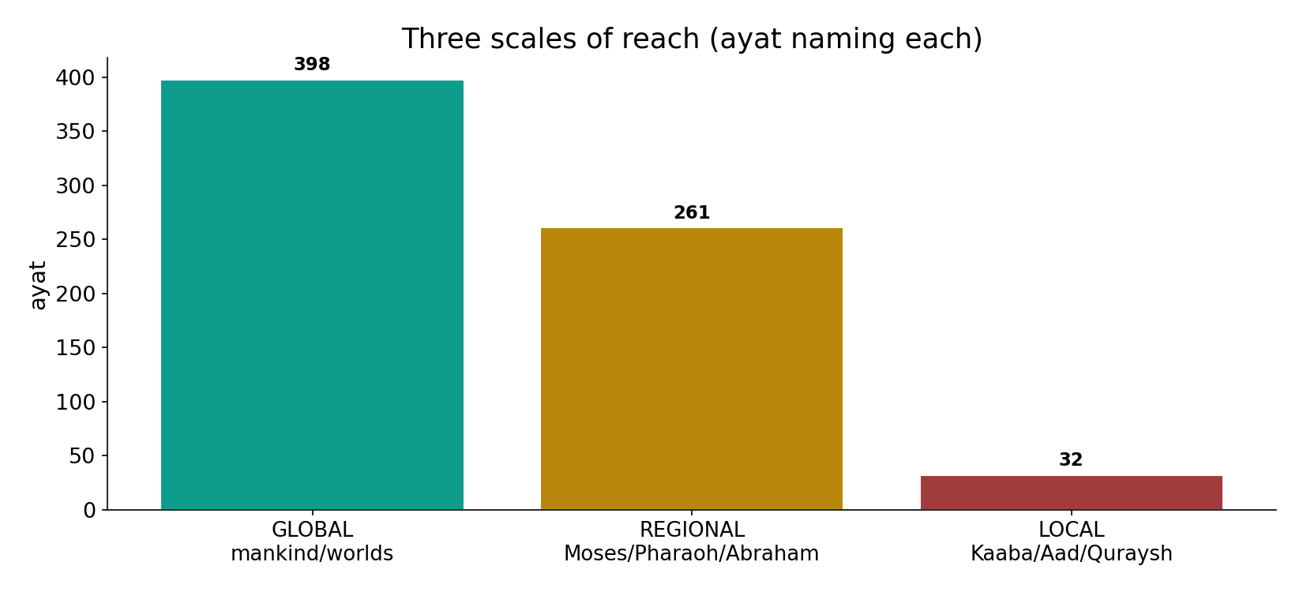
Three scales at once
In the data - global terms (mankind+worlds 398), regional (Moses+Pharaoh+Abraham 261) and local (Kaaba+Aad+Quraysh 32) all operate - the regional story is by far the densest.

Slide 4
GLOBAL - all mankind / the worlds
the text's own words (address - snippet - gloss):
1:2 الْحَمْدُ للّهِ رَبِّ الْعَالَمِينَ - GLOBAL — Lord of all the worlds
49:13 يَا أَيُّهَا النَّاسُ إِنَّا خَلَقْنَاكُم مِّن ذَكرٍ وَأُنثَى - GLOBAL — O mankind

Slide 5
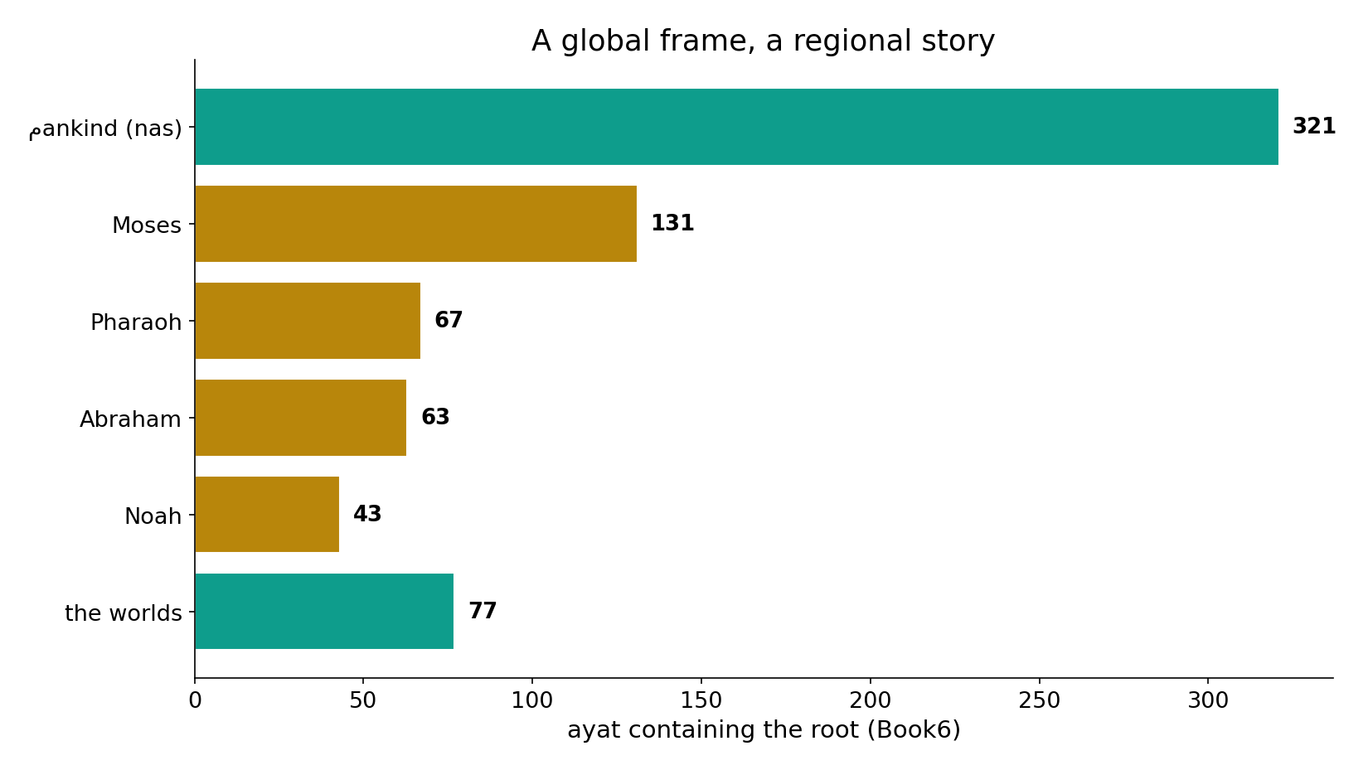
A global frame, a regional story
In the data - framed globally (mankind 321, the worlds 77) yet narrated through the Near-East: Moses fills 131 ayat - rivalling 'mankind' itself - with Pharaoh 67 and Abraham 63.

Slide 6
What the data shows
Global frame
the Qur'an addresses all mankind (321) and is 'Lord of the worlds' (77) - the widest scale.
Regional story
its narrative runs through the Abrahamic Near-East - Moses (131), Pharaoh (67), Abraham (63): by far the densest tier.
Local stage
its own Hijaz is named sparingly - Kaaba (4), Quraysh (1), the Arabic tongue (11): the stage, not the subject.

Slide 7
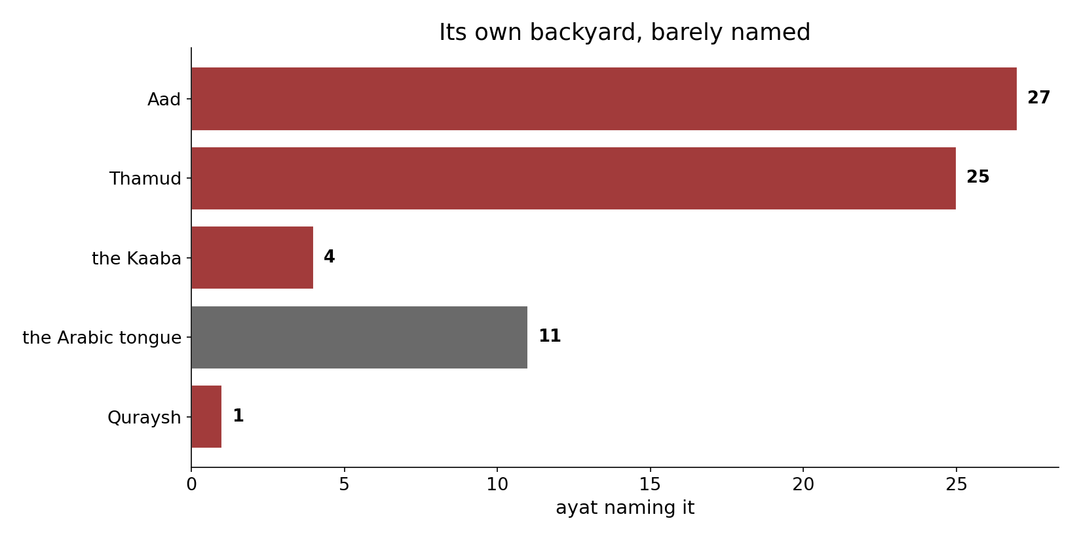
Its own backyard, barely named
In the data - the Arabian setting is sparse by name: Aad 27, Thamud 25, the Kaaba 4, the Arabic tongue 11, Quraysh 1. The local is the stage, not the subject.

Slide 8
REGIONAL past, LOCAL setting
the text's own words (address - snippet - gloss):
79:17 اذْهَبْ إِلَى فِرْعَوْنَ إِنَّهُ طَغَى - REGIONAL — “Go to Pharaoh”
2:136 وَمَا أُنزِلَ إِلَى إِبْرَاهِيمَ وَإِسْمَاعِيلَ وَإِسْحَقَ وَيَعْقُوبَ وَالأسْبَاطِ وَمَا - REGIONAL — Abraham, Moses, Jesus
3:96 إِنَّ أَوَّلَ بَيْتٍ وُضِعَ - LOCAL — first House, at Bakka
106:1 لِإِيلَافِ قُرَيْشٍ - LOCAL — for the security of Quraysh

Slide 9
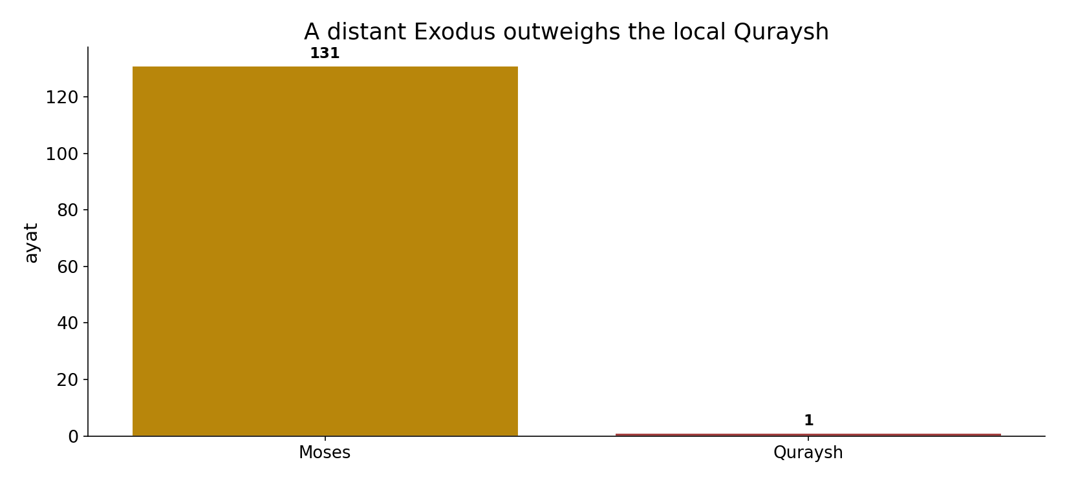
Exodus outweighs Quraysh
In the data - Moses (131) vs Quraysh (1): a distant Exodus dwarfs the local tribe by ~131x. No rounding artefact.

Slide 10
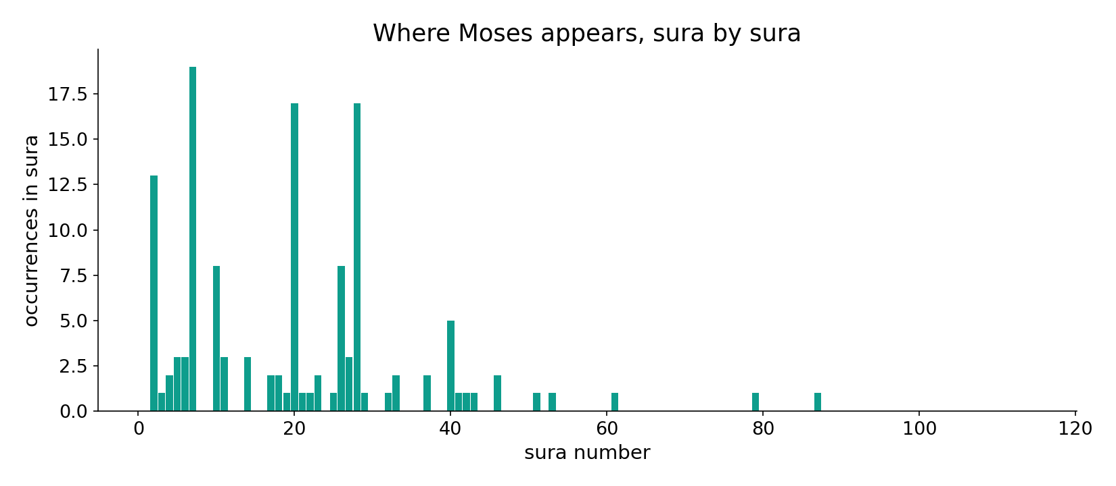
Moses across the corpus
In the data - the Moses narrative is spread across many suras - the densest single thread of the regional story.

Slide 11
The particular as a doorway to the universal
All three scales operate at once. The Qur'an addresses ALL mankind (global), tells its story through the shared Abrahamic past (regional, by far the densest - Moses alone fills 131 ayat), and treats its own Hijaz as the stage rather than the subject (Mecca/Quraysh barely named). A distant Exodus outweighs the local Quraysh by ~131x: the particular becomes the doorway to the universal, not its rival.
The asymmetry is robust - Moses vs Quraysh is no rounding artefact.

Slide 12
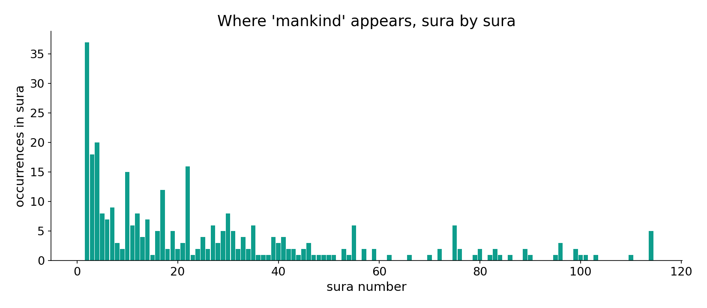
'Mankind' across the corpus
In the data - 'mankind' is named throughout - the global frame within which the regional story is told.

Slide 13
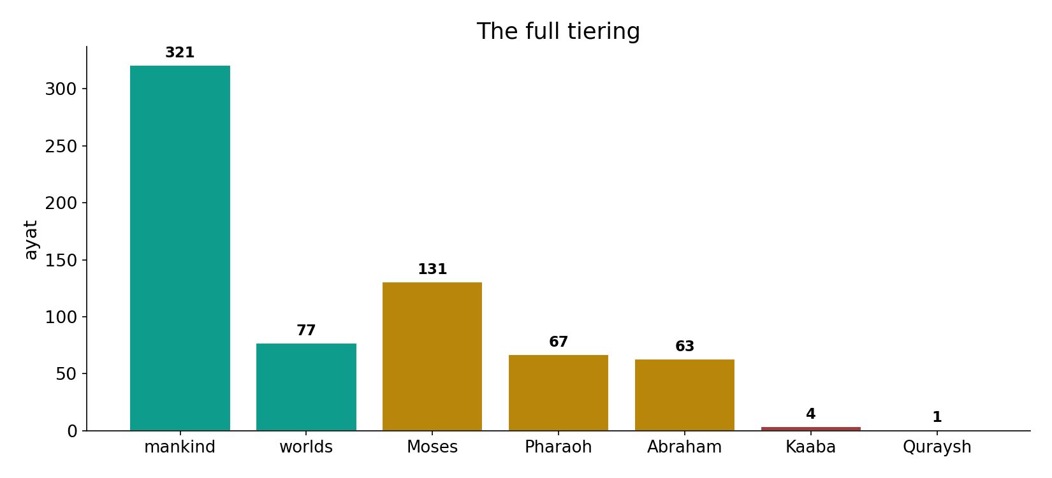
The full tiering
In the data - global (mankind 321, worlds 77), regional (Moses 131, Pharaoh 67, Abraham 63), local (Kaaba 4, Quraysh 1) - the particular is a doorway to the universal.

Slide 14
Three scales, one text
GLOBAL
all mankind, the worlds
REGIONAL
the Abrahamic past (densest)
LOCAL
Hijaz - the stage, barely named
The particular, a doorway to the universal
a distant Exodus outweighs the local tribe - the local is the stage, not the subject.

Slide 15
Honest limits and critique
Mention proxies reach, not weight
name-mention measures REACH, not emphasis or theological weight; proper-name normalization is imperfect; the tiers are the analyst's, not a Qur'anic category.
But the asymmetry is robust
Moses (131) vs Mecca/Quraysh (~1) is far too large to be an artefact - the global-frame/regional-story/local-stage shape holds.

Slide 16
Reading this honestly - the audit
✓ Tiers counted
global 398, regional 261, local 32.
✓ Asymmetry robust
Moses 131 vs Quraysh 1.
~ Name normalization
proper-name folding is imperfect (a stated limit).
~ Tiers are the analyst's
'local/regional/global' is a labelled category.
✗ Not a proof
counts/co-occurrence locate structure; theology is not settled by counts.
✗ No raw mixing
forms/senses separated before counting (course rule).

Slide 17
How this was computed (reproducible)
Book6
name-fields by tier (root/surface)
measure
ayat naming each; compare three scales
figures
tier bars, regional/local bars, sura maps
count
chart
Fully reproducible
Every figure recomputes from Book6.xlsx via the shared wk.py kernel (fixed seed). Roots are normalized (Persian/Arabic letter variants folded) so counts are stable; surface forms are used wherever a concept must be kept apart from its root family (per the course's sense-verification rule).

Slide 18
Appendix - input snippets (Book6, vocalized)
verbatim snippets with addresses:
1:2 الْحَمْدُ للّهِ رَبِّ الْعَالَمِينَ - GLOBAL — Lord of all the worlds
49:13 يَا أَيُّهَا النَّاسُ إِنَّا خَلَقْنَاكُم مِّن ذَكرٍ وَأُنثَى - GLOBAL — O mankind

Slide 19
Takeaway
A global frame, a regional story, a local stage
The Qur'an addresses all mankind (global, 321), narrates through the Abrahamic past (regional - Moses 131, the densest thread), and barely names its own Hijaz (local - Quraysh 1).
A distant Exodus outweighs the local tribe by ~131x - the particular is a doorway to the universal.
Name-mention proxies reach, not weight (a labelled limit); the asymmetry is robust. Presented from the text.

Slide 20
Quick reference
The numbers
mankind 321 - worlds 77 - Moses 131 - Pharaoh 67 - Abraham 63 - Kaaba 4 - Quraysh 1.
The shape
all three scales at once; regional story densest; local stage barely named; mention = reach (a labelled proxy).

