Slide 1
SPECIAL TOPIC - one word, two books, Week 7
One word for sunrise and scripture (aya)
The same word names a recited verse and a natural wonder
The Qur'an calls a verse an 'aya' - and calls a sunrise, the rain, the human body an 'aya' too. Does one word really span cosmos and scripture? The sign-root appears 353 times; we tag where it co-occurs with NATURE roots vs SCRIPTURE roots.
Counts recompute from Book6; the sign-root total (353) reproduces exactly; co-occurrence uses explicit nature/scripture root sets.

Slide 2
The question, and the method
The observation
Does the single word 'aya' genuinely span the natural world and the revealed text?
The method
- count the sign-root (353) and where it co-occurs with nature vs scripture roots
- compare the two registers; note the general remainder
- read the fusion verse (41:53) where cosmos and self are 'shown' as signs

Slide 3
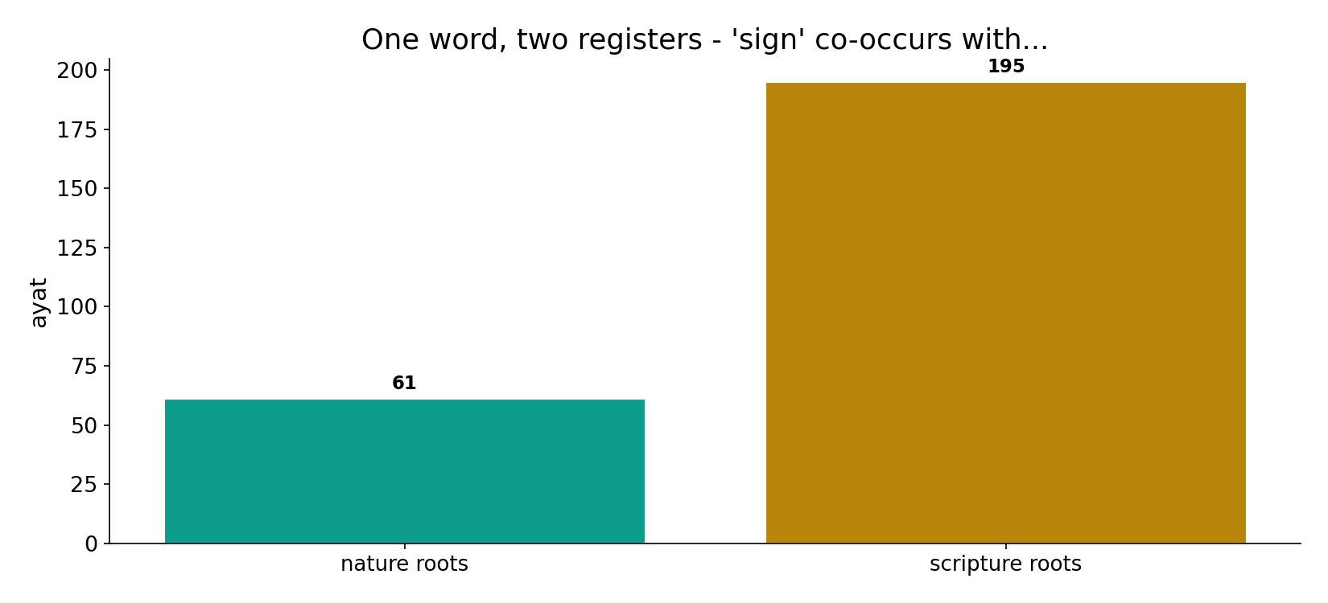
One word, two registers
In the data - the sign-root co-occurs with scripture roots in 195 ayat and with nature roots in 61: verbally it leans to the recited signs, yet it is the SAME word for a sunrise.

Slide 4
The fusion - signs in self and cosmos
the text's own words (address - snippet - gloss):
41:53 سَنُرِيهِمْ آيَاتِنَا فِي الْآفَاقِ وَفِي أَنفُسِهِمْ حَتَّى يَتَبَيَّنَ - signs in horizons & in themselves
51:21 وَفِي أَنفُسِكُمْ أَفَلَا تُبْصِرُونَ - NATURE — “and in yourselves; do you not see?”

Slide 5
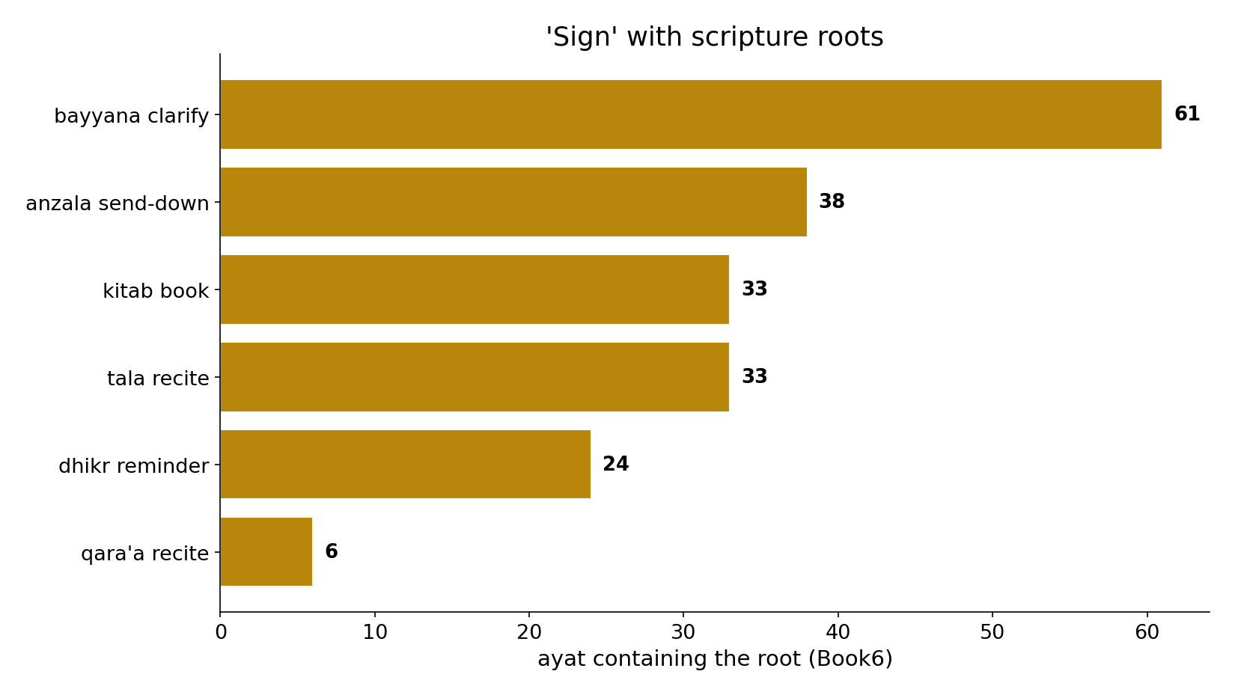
'Sign' with scripture
In the data - 'sign' pairs with clarify, send-down, book, recite, reminder - the vocabulary of revelation (195 co-occurrences).

Slide 6
What the data shows
One word, two books
the sign-root (353) names both a recited verse and a natural wonder - the same term for scripture and cosmos.
Verbally toward scripture
explicitly it sits with scripture (195) far more than nature (61)...
Conceptually both
...yet the very same word names the sun, the rain, the self - the fusion is deliberate (41:53).

Slide 7
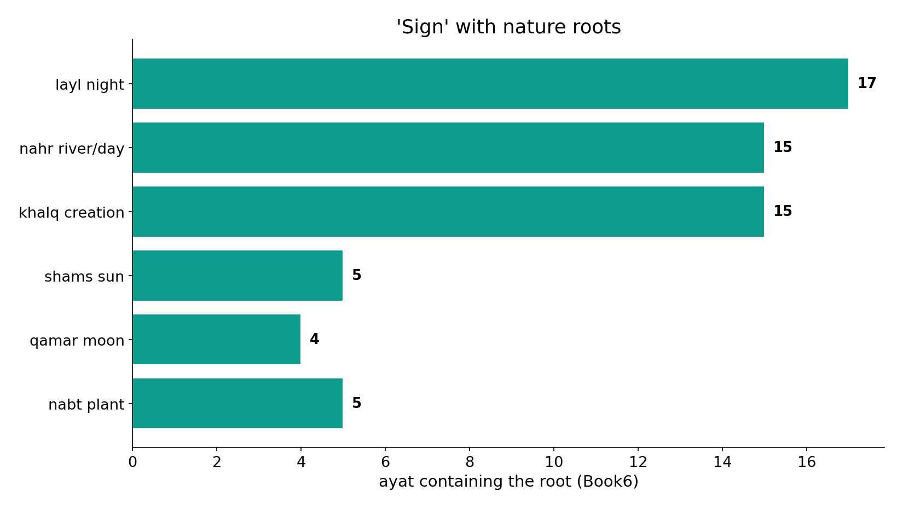
'Sign' with nature
In the data - 'sign' also pairs with night, creation, sun, moon, plant - the vocabulary of the cosmos (61 co-occurrences).

Slide 8
Nature signs and scripture signs
the text's own words (address - snippet - gloss):
2:164 إِنَّ فِي خَلْقِ السَّمَاوَاتِ وَالأَرْضِ وَاخْتِلاَفِ اللَّيْلِ وَالنَّهَارِ وَالْفُلْكِ - NATURE — heavens, earth, ships, rain
16:12 وَسَخَّرَ لَكُمُ اللَّيْلَ وَالْنَّهَارَ وَالشَّمْسَ وَالْقَمَرَ وَالْنُّجُومُ مُسَخَّرَاتٌ - NATURE — night, day, sun, moon, stars
45:6 تِلْك آيَاتُ اللَّهِ نَتْلُوهَا عَلَيْك بِالْحَقِّ فَبِأَيِّ حَدِيثٍ - SCRIPTURE — “these are God’s signs”
2:252 تِلْك آيَاتُ اللّهِ نَتْلُوهَا عَلَيْك بِالْحَقِّ وَإِنَّك - SCRIPTURE — “these are God’s signs, We recite”

Slide 9
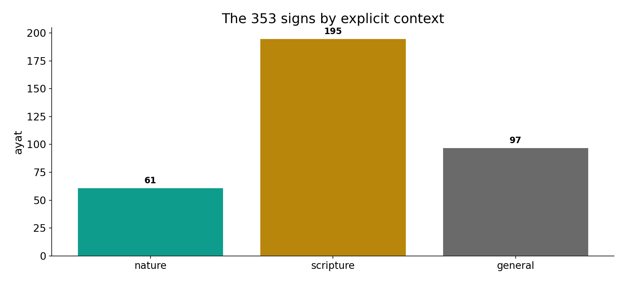
The 353 signs by context
In the data - of 353 sign-ayat, 195 sit explicitly with scripture, 61 with nature, and 97 are general 'Our signs' - the term is deployed across both books.

Slide 10
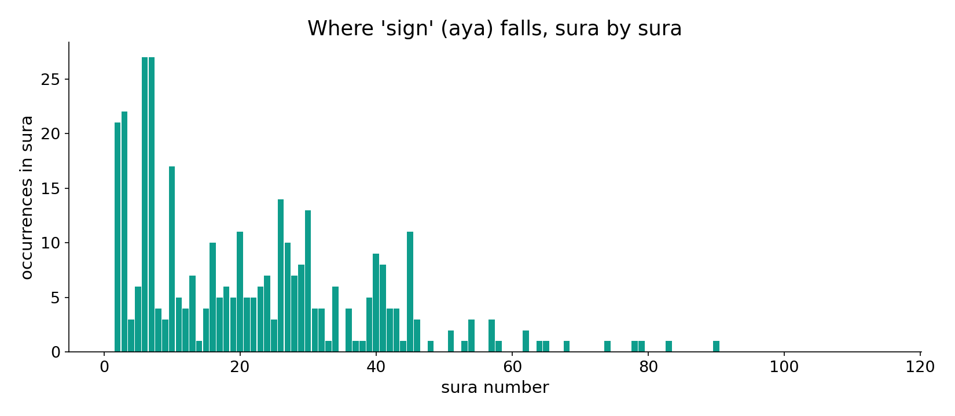
'Sign' across the corpus
In the data - the sign-root is spread throughout, naming verses and natural wonders alike.

Slide 11
Creation and revelation share one vocabulary
The sign-root spans both registers - leaning verbally to the recited signs (195 vs 61 in explicit co-occurrence) while naming nature with the very same term. The conflation is deliberate: the book and the world are presented as two volumes of one signage, each meant to be 'read.' 41:53 fuses them: 'We will show them Our signs in the horizons and in themselves.'
Of 353 sign-ayat, 97 are general 'Our signs' - the term floats freely between the two books.

Slide 12
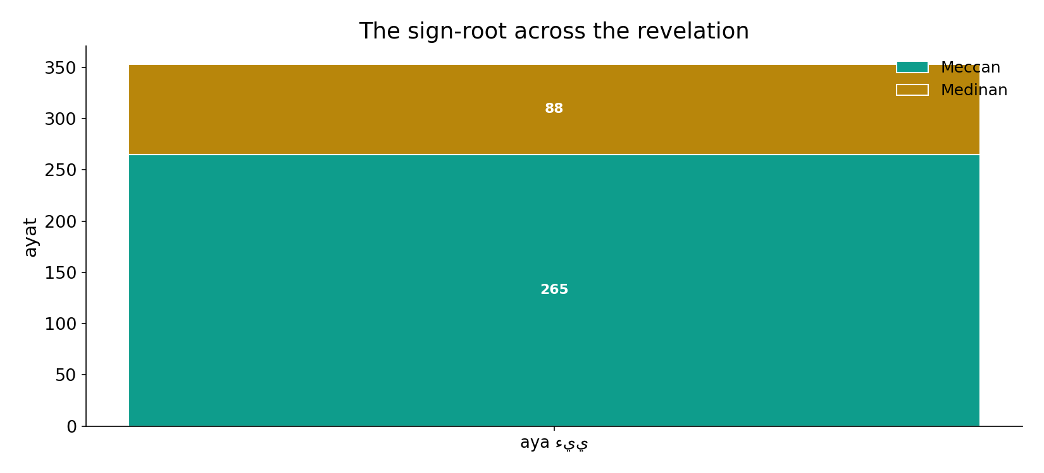
Across the revelation
In the data - the dual use of 'aya' runs the whole revelation; it is a structural feature, not a phase.

Slide 13
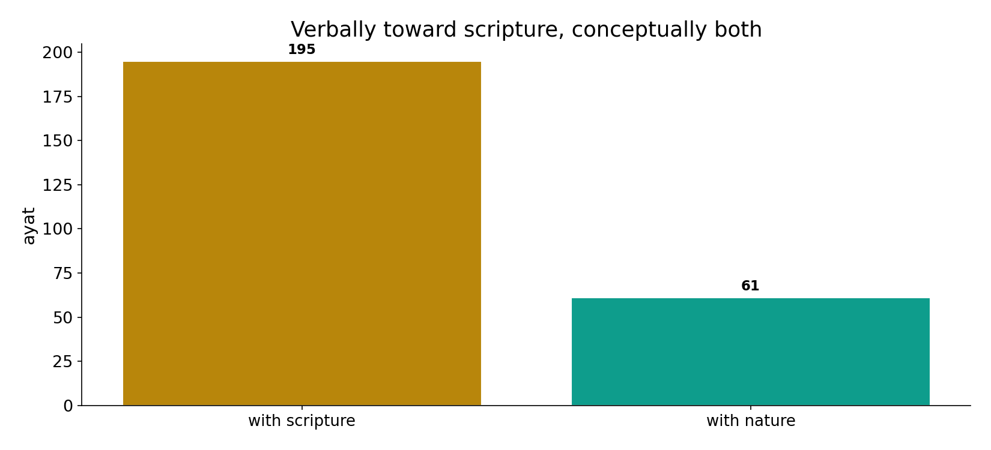
Verbally scripture, conceptually both
In the data - the explicit lean is to scripture (195 vs 61), but the same word names nature - the conflation is the point (41:53: signs 'in the horizons and in themselves').

Slide 14
Two books, one word
Nature signs
sun, rain, the self
One word: aya
names both
Scripture signs
verse, book, recite
Read creation as you read revelation
the book and the world are two volumes of one signage.

Slide 15
Honest limits and critique
Co-occurrence captures explicit pairing only
the 97 general 'Our signs' are untagged; the nature/scripture tiers are the analyst's, and the root sets are a choice.
But the dual use is robust
the single word naming both a verse and a sunrise is the hard datum, independent of the tiering.

Slide 16
Reading this honestly - the audit
✓ Sign-root counted
353 ayat (reproduces exactly).
✓ Two registers
scripture 195, nature 61.
~ Tiers are the analyst's
nature/scripture root sets are a labelled choice.
✗ Not a proof
counts/co-occurrence locate structure; theology is not settled by counts.
✗ No raw mixing
forms/senses separated before counting (course rule).

Slide 17
How this was computed (reproducible)
Book6
the sign-root; nature & scripture root sets
measure
co-occurrence by register; general remainder
figures
register bars, scripture/nature bars, sura map
count
chart
Fully reproducible
Every figure recomputes from Book6.xlsx via the shared wk.py kernel (fixed seed). Roots are normalized (Persian/Arabic letter variants folded) so counts are stable; surface forms are used wherever a concept must be kept apart from its root family (per the course's sense-verification rule).

Slide 18
Appendix - input snippets (Book6, vocalized)
verbatim snippets with addresses:
41:53 سَنُرِيهِمْ آيَاتِنَا فِي الْآفَاقِ وَفِي أَنفُسِهِمْ حَتَّى يَتَبَيَّنَ - signs in horizons & in themselves
51:21 وَفِي أَنفُسِكُمْ أَفَلَا تُبْصِرُونَ - NATURE — “and in yourselves; do you not see?”

Slide 19
Takeaway
Two volumes of one signage
The same word 'aya' (353) names a recited verse AND a sunrise - creation and revelation share one vocabulary.
Verbally it leans to scripture (195 vs 61), but the dual use is the point: 41:53 shows signs 'in the horizons and in themselves.'
Co-occurrence captures explicit pairing; the dual use is the robust datum. Presented from the text.

Slide 20
Quick reference
The numbers
sign-root 353 ayat; with scripture 195, with nature 61, general 97.
The shape
one word for verse and cosmos; verbally leans scripture, conceptually both; the fusion is deliberate (41:53).

