Slide 1
SPECIAL TOPIC - motif support, Week 8
The hypocrite syndrome - a motif, and its support
A vivid three-part portrait that rests on only three verses
The Qur'an paints the hypocrite (munafiq) with a recurring cluster - a diseased heart and deception. Is the full three-part motif as solid as it feels? We sense-filter the root to the hypocrite forms (not 'spending'), count the pairwise links and the full trio, and read each one's verse-SUPPORT.
Counts recompute from Book6 and reproduce exactly; only the munafiq forms of the root are counted.

Slide 2
The question, and the method
The claim to test
Is the hypocrite's 'diseased-heart + deception' motif a tight three-part formula, or a thin trio dressed as one?
The method
- sense-filter the root to the hypocrite forms (not 'spending')
- count each pairwise link and the full trio
- read the verse-SUPPORT - a vivid motif on few verses is fragile

Slide 3
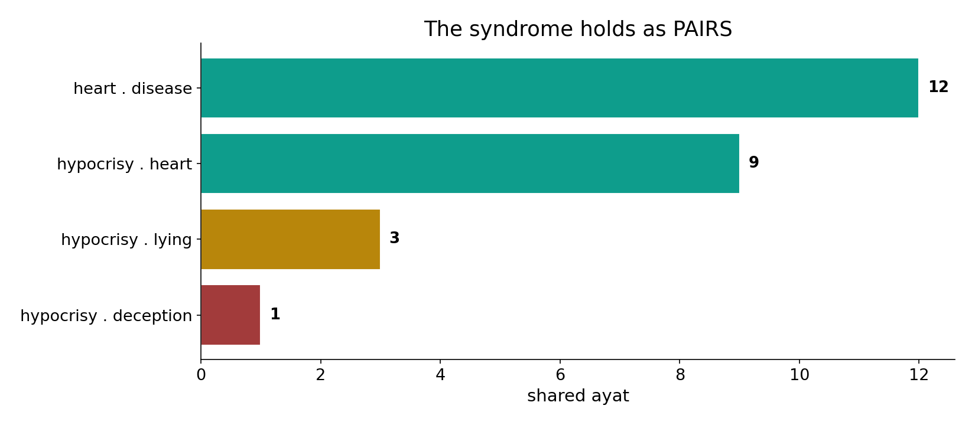
Strong as pairs
In the data - hypocrisy clusters with a diseased heart and deceit: heart+disease 12 ('in their hearts a disease'), hypocrisy+heart 9, hypocrisy+lying 3, hypocrisy+deception 1.

Slide 4
A diseased heart
the text's own words (address - snippet - gloss):
2:10 فِي قُلُوبِهِم مَّرَضٌ فَزَادَهُمُ اللّهُ مَرَضاً - “in their hearts is a disease”
8:49 إِذْ يَقُولُ الْمُنَافِقُونَ وَالَّذِينَ فِي قُلُوبِهِم مَّرَضٌ غَرَّ هَؤُلاء - “in whose hearts is a disease” (munāfiqūn)

Slide 5
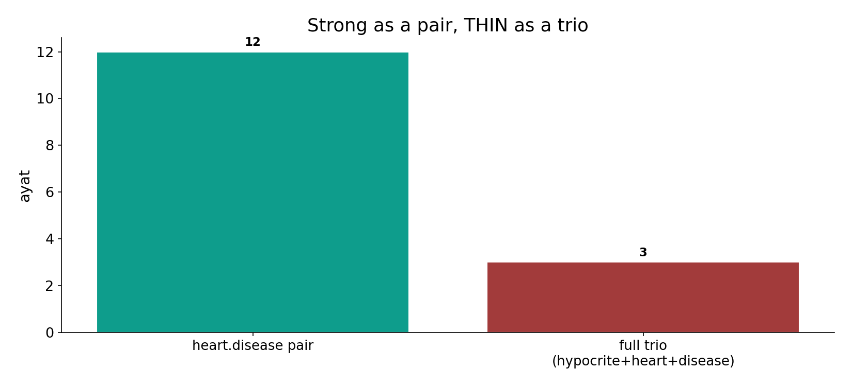
Thin as a trio
In the data - the strongest pair (heart+disease, 12) is robust, but the COMPLETE munafiq+heart+disease motif holds in only 3 verses - strong as a theme, slim as a trio.

Slide 6
What the data shows
A real pairwise syndrome
hypocrisy clusters with a diseased heart (9) and the heart with disease (12) - a genuine, well-supported motif.
But a thin trio
the complete three-part motif (hypocrite + heart + disease) holds in only 3 verses - slim as a tight formula.
Support, not vividness
a vivid motif on 3 verses is fragile; a leave-one-out would shake it - read the base, not the picture.

Slide 7
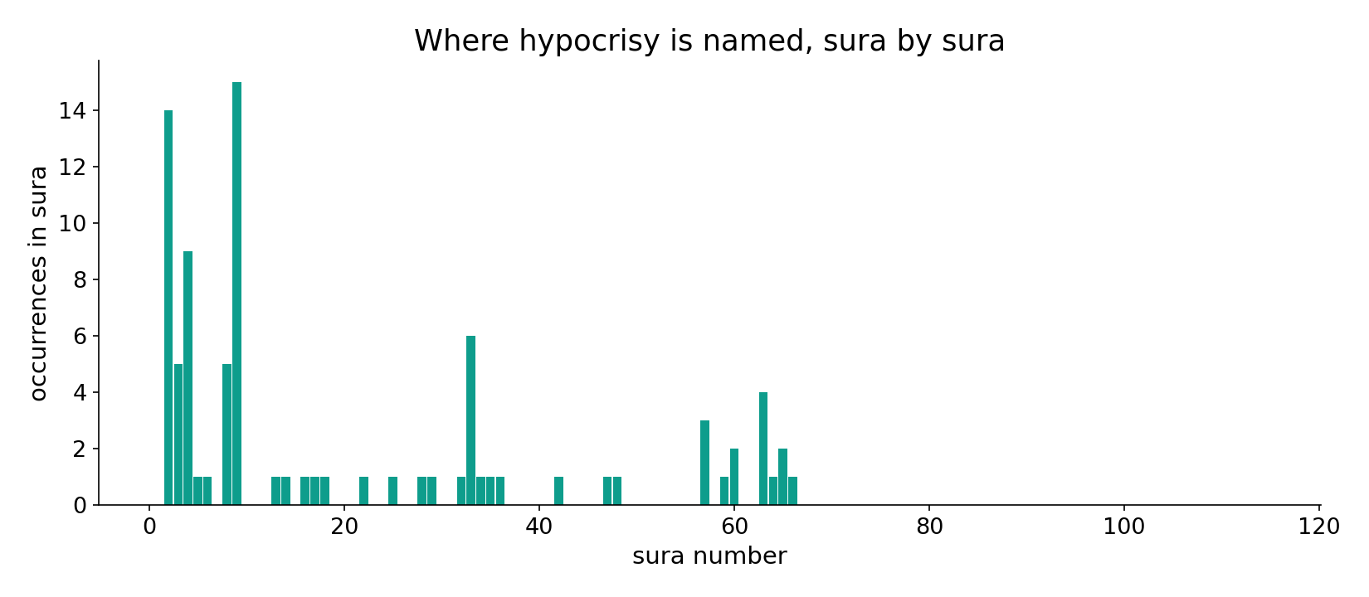
Hypocrisy across the corpus
In the data - the hypocrite forms cluster in the Medinan community suras (al-Baqara, an-Nisa, al-Munafiqun).

Slide 8
Deception, and they lie
the text's own words (address - snippet - gloss):
4:142 إِنَّ الْمُنَافِقِينَ يُخَادِعُونَ اللّهَ وَهُوَ خَادِعُهُمْ وَإِذَا - the hypocrites seek to deceive God
63:1 إِذَا جَاءك الْمُنَافِقُونَ قَالُوا نَشْهَدُ إِنَّك لَرَسُولُ اللَّهِ - “the hypocrites… God knows they lie”

Slide 9
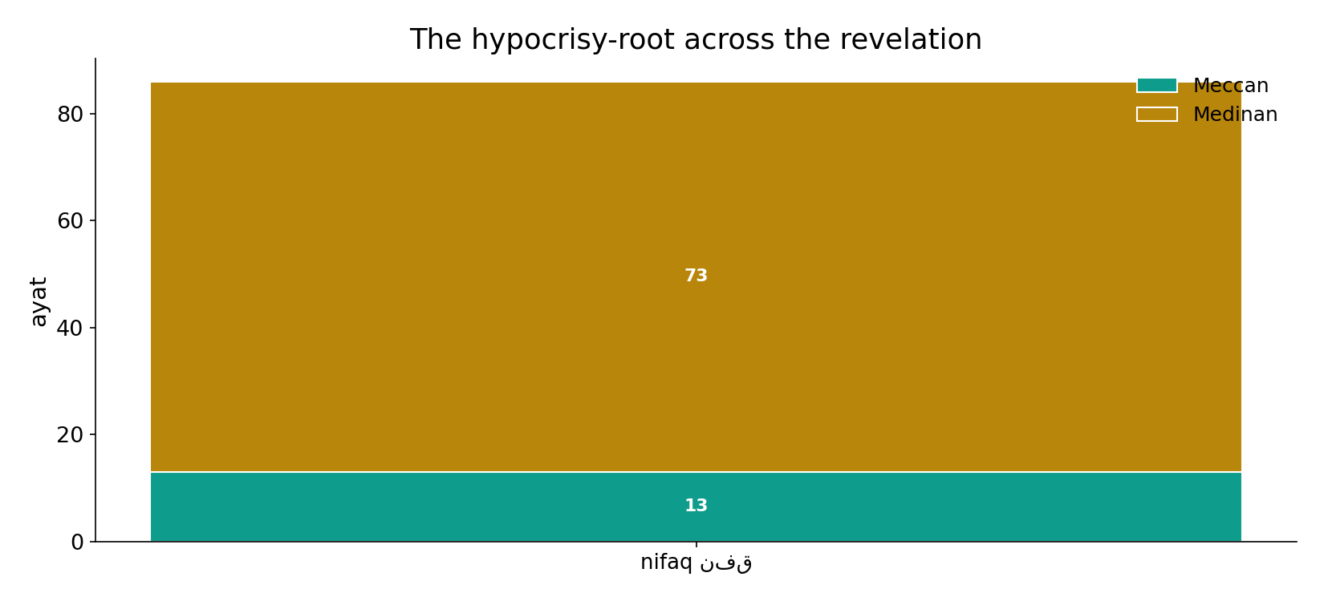
Across the revelation
In the data - the hypocrisy-root is concentrated in the Medinan period, when the community faced internal dissent.

Slide 10
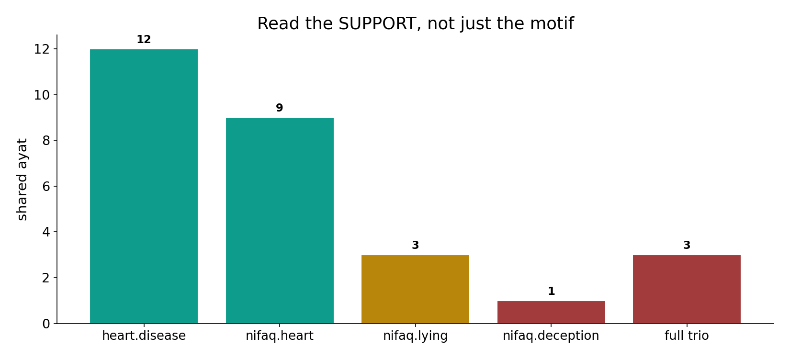
Read the support
In the data - the links weaken as they specialize: 12 -> 9 -> 3 -> 1 -> 3. The motif is real but its tightest form rests on little.

Slide 11
The portrait is real; its tightest form rests on little
The hypocrite is drawn as heart-diseased and deceptive - a robust PAIRWISE syndrome (heart+disease 12, hypocrisy+heart 9) but a thin TRIO (3 verses). So the portrait is genuine; quoting it as a tight three-part formula overstates a 3-verse base. Support, not vividness, decides - the exact Week-8 caution.
The root is polysemous (spend vs hypocrite) - only the munafiq forms were counted.

Slide 12
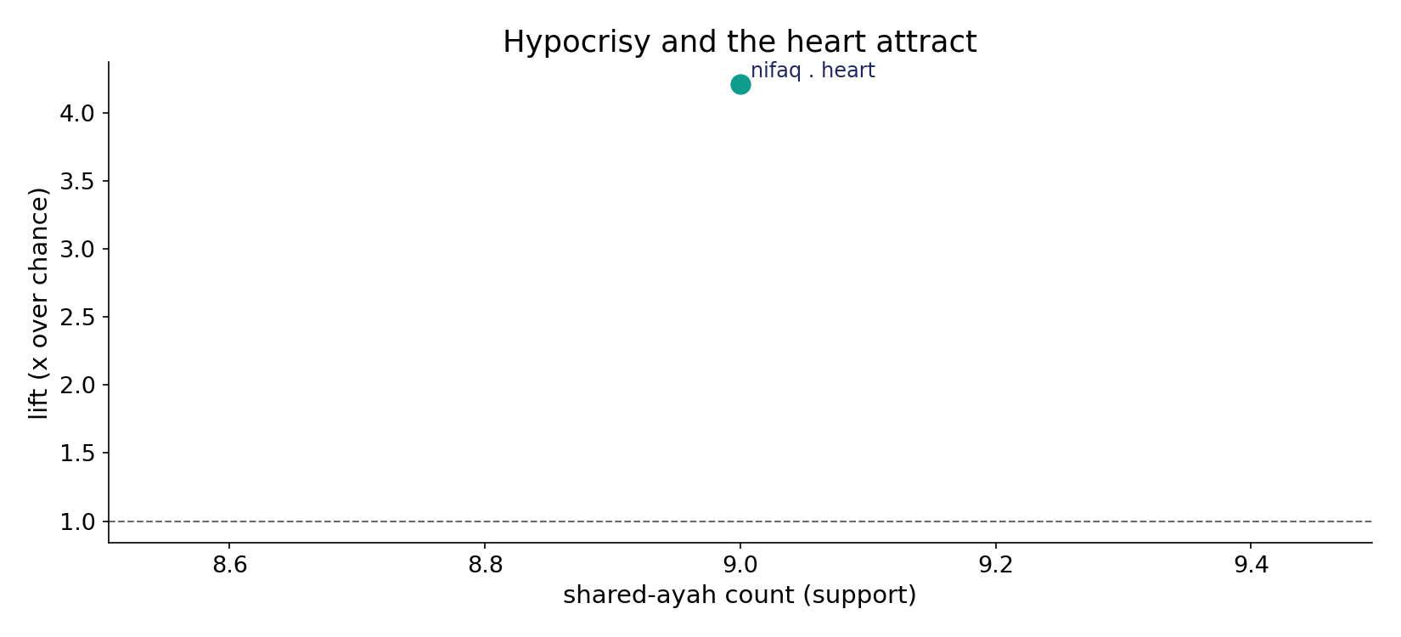
Hypocrisy and the heart attract
In the data - hypocrisy and 'heart' co-occur at 4.2x chance (9 ayat): the pairwise syndrome is genuine.

Slide 13
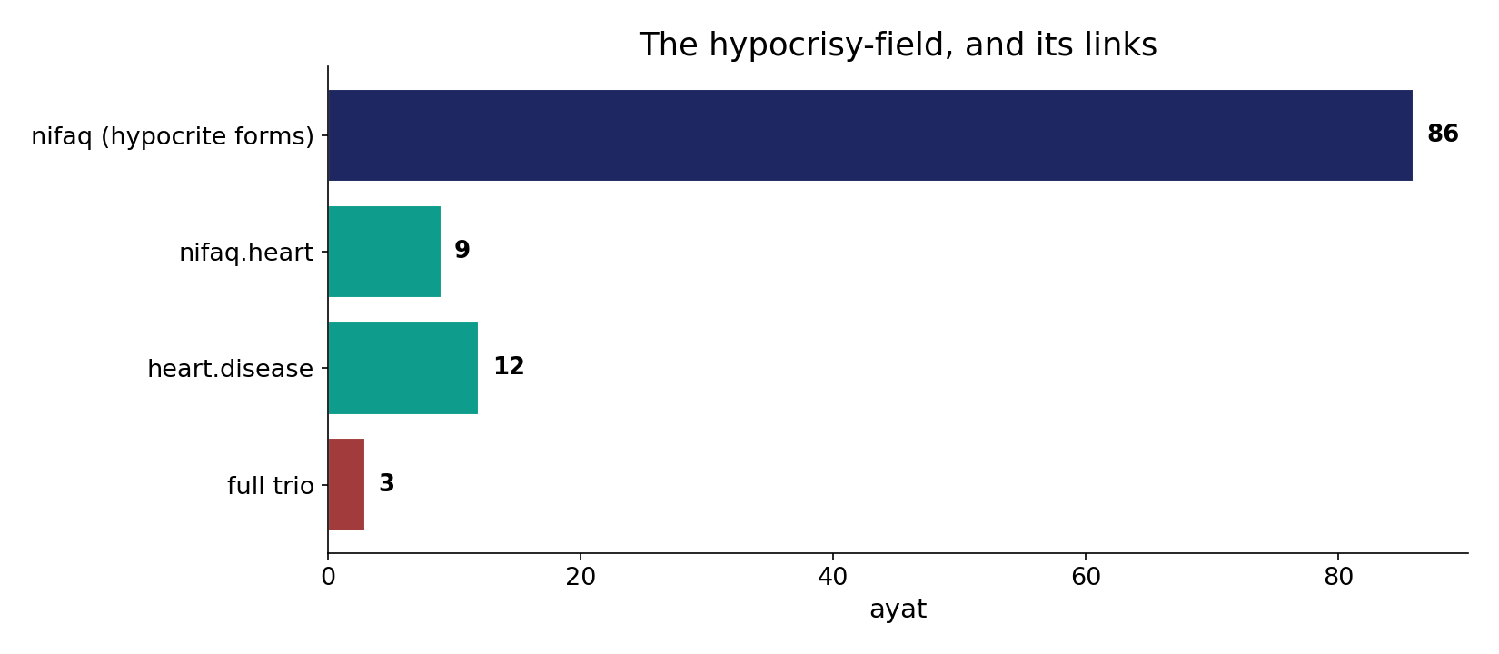
The field and its links
In the data - the hypocrite-field (86) supports strong pairs but a 3-verse trio - vividness is not support.

Slide 14
Vivid, but read the base
Pairs strong
heart+disease, nifaq+heart
Trio thin
only 3 verses
Verdict
support, not vividness
The portrait is real; the formula is fragile
a 3-verse trio wobbles under leave-one-out - the Week-8 caution.

Slide 15
Honest limits and critique
A 3-verse trio is fragile
with only 3 supporting verses, a leave-one-out would shake the trio - vividness must not be mistaken for support.
Sense-filtering is load-bearing
the root also means 'to spend' (infaq); only the hypocrite forms were counted, or the field would balloon with charity verses.

Slide 16
Reading this honestly - the audit
✓ Pairs counted
heart-disease 12, nifaq-heart 9, nifaq-lying 3, nifaq-deception 1.
✓ Trio counted
full motif = 3 verses.
✓ Lift computed
nifaq-heart 4.2x chance.
~ Thin trio wobbles
a 3-verse base is fragile under leave-one-out.
✗ Not a proof
counts/co-occurrence locate structure; theology is not settled by counts.
✗ No raw mixing
forms/senses separated before counting (course rule).

Slide 17
How this was computed (reproducible)
Book6
hypocrite forms (sense-filtered); cluster roots
measure
pairwise & trio co-occurrence; support
figures
pairwise bars, trio bar, support ladder, sura map
count
chart
Fully reproducible
Every figure recomputes from Book6.xlsx via the shared wk.py kernel (fixed seed). Roots are normalized (Persian/Arabic letter variants folded) so counts are stable; surface forms are used wherever a concept must be kept apart from its root family (per the course's sense-verification rule).

Slide 18
Appendix - input snippets (Book6, vocalized)
verbatim snippets with addresses:
2:10 فِي قُلُوبِهِم مَّرَضٌ فَزَادَهُمُ اللّهُ مَرَضاً - “in their hearts is a disease”
8:49 إِذْ يَقُولُ الْمُنَافِقُونَ وَالَّذِينَ فِي قُلُوبِهِم مَّرَضٌ غَرَّ هَؤُلاء - “in whose hearts is a disease” (munāfiqūn)

Slide 19
Takeaway
A genuine portrait, a fragile formula
The hypocrite-syndrome is real as PAIRS (heart+disease 12, hypocrisy+heart 9) but thin as a TRIO (3 verses).
Quoting it as a tight three-part formula overstates a 3-verse base - a leave-one-out would shake it.
Support, not vividness, decides; only the munafiq forms were counted. Presented from the text.

Slide 20
Quick reference
The numbers
hypocrite-field 86; heart.disease 12, nifaq.heart 9 (4.2x), nifaq.lying 3, nifaq.deception 1; full trio 3.
The shape
strong pairwise syndrome, thin 3-verse trio; read support not vividness; sense-filter spend vs hypocrite.

