Slide 1
SPECIAL TOPIC - women & men: economic, Week 9
Women & men - economic standing
What the text FIXES (financial personhood) vs what is interpreted (equality)
A common claim: the Qur'an denies women economic independence. What does the text actually fix - and what is left to interpretation? We gather the verses that assign women financial entitlements and report exactly what each establishes, keeping the computed datum apart from the equity verdict.
Verse content is quoted from Book6; the entitlements (inheritance, dowry, earnings) are what the cited verses establish.

Slide 2
The question, and the method
The claim to test
Does the Qur'an deny women economic independence - or fix a financial personhood?
The method
- gather the verses assigning women financial entitlements; report what each fixes
- keep the computed datum (what is fixed) apart from the equity verdict
- read the surrounding vocabulary (inheritance, earning, dowry)

Slide 3
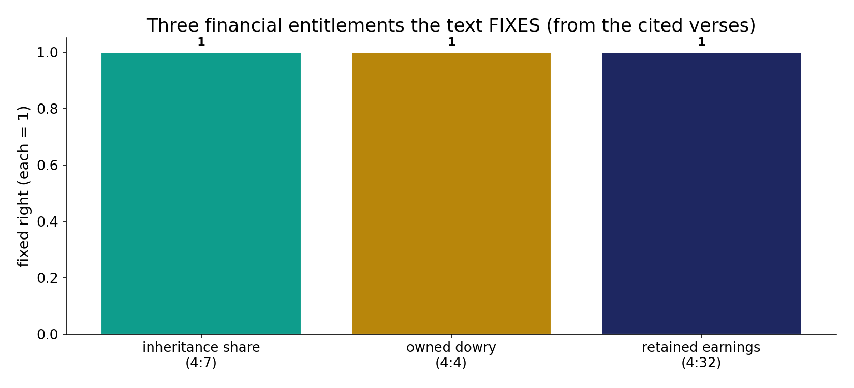
Three financial entitlements the text fixes
In the data (from the cited verses) - the corpus fixes three rights: an inheritance share (4:7), an owned dowry (4:4), and retained earnings (4:32). Each is stated, not left to custom.

Slide 4
A share of inheritance; the dowry is hers
the text's own words (address - snippet - gloss):
4:7 لِّلرِّجَالِ نَصيِبٌ مِّمَّا تَرَك الْوَالِدَانِ وَالأَقْرَبُونَ وَلِلنِّسَاء نَصِيبٌ مِّمَّا - men have a share — and women a share
4:4 وَآتُواْ النَّسَاء صَدُقَاتِهِنَّ نِحْلَةً فَإِن طِبْنَ - the dowry is the woman’s own

Slide 5
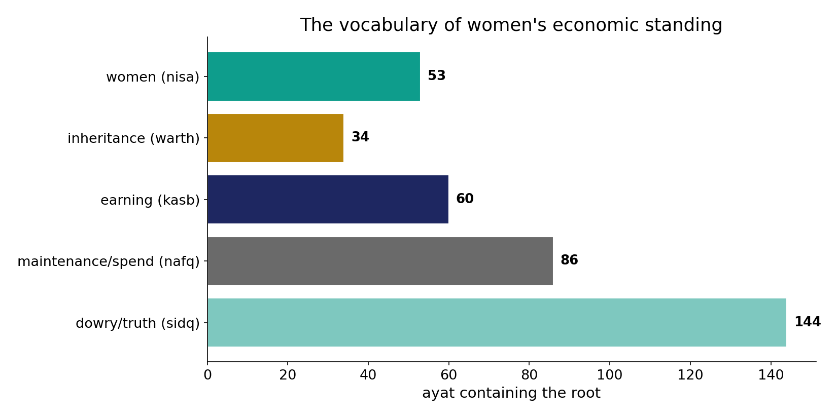
The vocabulary of women's economic standing
In the data - women (53), inheritance (34), earning (60), maintenance (86) and dowry/truth (144) form the field within which the entitlements sit.

Slide 6
What the data shows
A share of inheritance - 4:7
'men have a share of what parents and kin leave, and women have a share' - women's inheritance is a fixed right, not left to custom.
The dowry is hers - 4:4
'give women their dowries as a free gift' - the mahr is the woman's own property, hers to keep, spend or return.
She keeps her earnings - 4:32
'for men a share of what they earn, and for women a share of what they earn' - earnings belong to the earner, each gender severally.

Slide 7
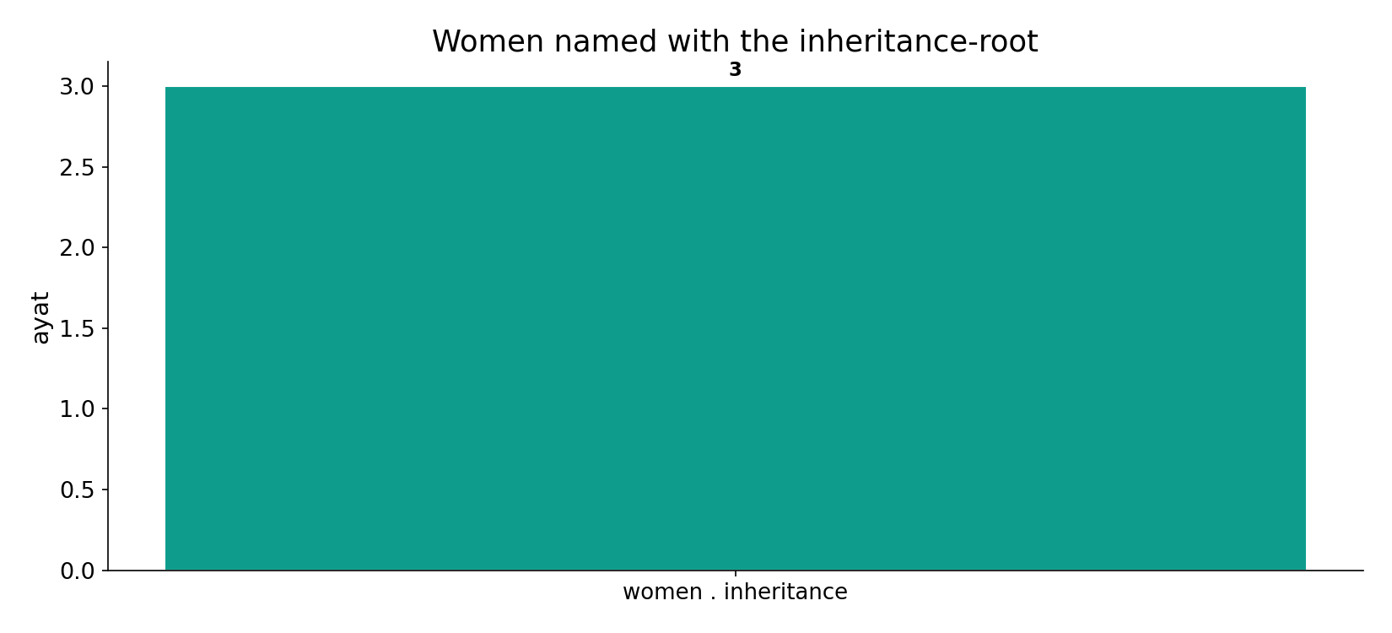
Women named with inheritance
In the data - 'women' and the inheritance-root co-occur (3); 4:7 fixes women's share where custom once bypassed them.

Slide 8
She keeps her earnings
the text's own words (address - snippet - gloss):
4:32 وَلاَ تَتَمَنَّوْاْ مَا فَضَّلَ اللّهُ بِهِ بَعْضَكُمْ عَلَى بَعْضٍ لِّلرِّجَالِ - each keeps what they earn
4:24 وَالْمُحْصَنَاتُ مِنَ النِّسَاء إِلاَّ مَا مَلَكتْ أَيْمَانُكُمْ كِتَابَ اللّهِ - “give them their due dowries”

Slide 9
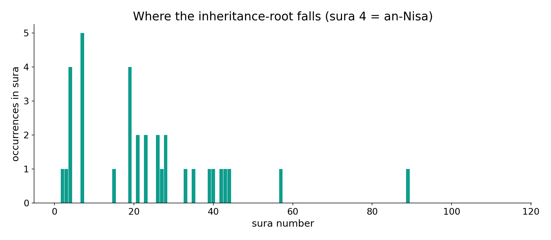
The inheritance-root across the corpus
In the data - the inheritance-root clusters in sura 4 (an-Nisa, 'The Women') - the legislative core of women's financial rights.

Slide 10
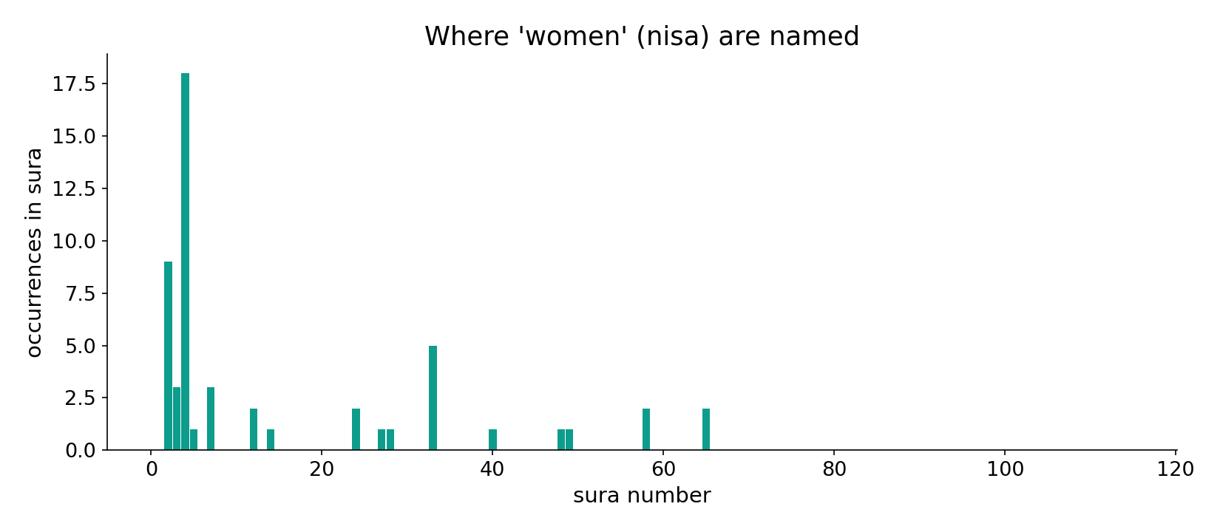
'Women' across the corpus
In the data - 'women' (nisa) are named across the corpus, densest in the legal passages of sura 4.

Slide 11
Financial personhood, fixed
Computed datum: the corpus establishes women's independent financial personhood - a guaranteed inheritance share (4:7), an owned dowry (4:4), and retained earnings (4:32). Whether the overall SYSTEM is 'equal' (cf. the inheritance ratio) is a separate, interpretive question; financial AGENCY is not - it is stated plainly.
These are entitlements the text names; their 'equality' is debated, but the agency is explicit.

Slide 12
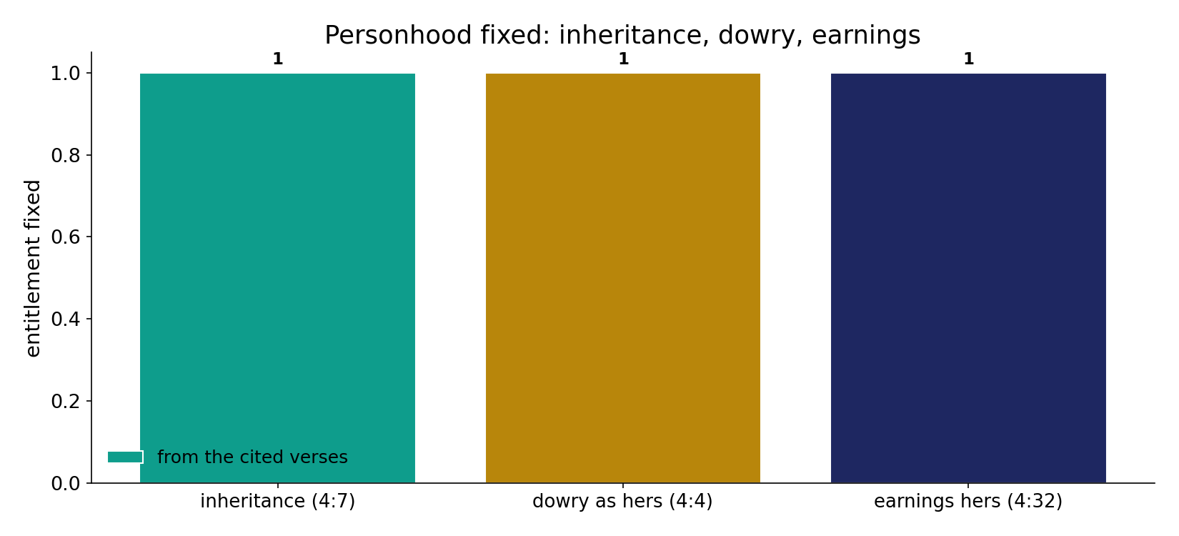
Personhood fixed
In the data (from the cited verses) - inheritance (4:7), the dowry as the woman's own (4:4), and earnings belonging to the earner (4:32): independent financial personhood, stated plainly.

Slide 13
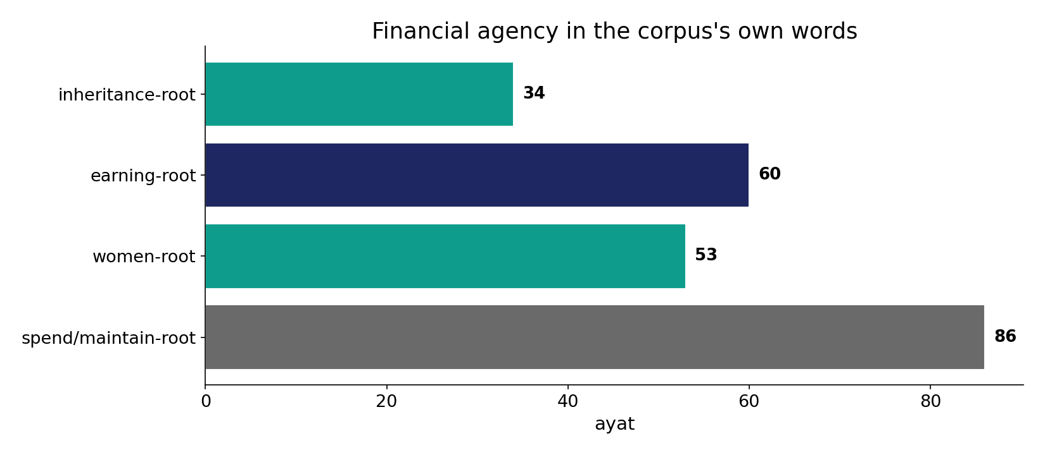
Financial agency in the corpus's words
In the data - the inheritance (34), earning (60) and maintenance (86) vocabulary frames a fixed financial agency for women.

Slide 14
What is fixed, what is interpreted
Inheritance 4:7
a guaranteed share
Dowry 4:4
the woman's own
Earnings 4:32
hers to keep
Agency fixed, equality debated
the text states financial personhood plainly; the system-equality verdict is interpretive.

Slide 15
Honest limits and critique
Adequacy is interpretive
these are entitlements the text names; whether they amount to 'equality' is debated and not settled by citation alone.
Context is interpretation
historical background (pre-Islamic deprivation) is interpretation, not data; we report what is fixed and scope the rest.

Slide 16
Reading this honestly - the audit
✓ Entitlements cited
inheritance 4:7, dowry 4:4, earnings 4:32.
✓ Vocabulary sized
women 53, inheritance 34, earning 60.
~ 'Equality' is interpretive
the system verdict is separate from the agency datum.
✗ Not a proof
counts/co-occurrence locate the text's data; the equity verdict is interpretive.
✗ No raw mixing
forms/senses separated before counting (course rule).

Slide 17
How this was computed (reproducible)
Book6
entitlement verses; economic vocabulary
measure
what each verse fixes; root fields
figures
entitlement bars, vocabulary bars, sura maps
count
chart
Fully reproducible
Every figure recomputes from Book6.xlsx via the shared wk.py kernel (fixed seed). Roots are normalized (Persian/Arabic letter variants folded) so counts are stable; surface forms are used wherever a concept must be kept apart from its root family (per the course's sense-verification rule).

Slide 18
Appendix - input snippets (Book6, vocalized)
verbatim snippets with addresses:
4:7 لِّلرِّجَالِ نَصيِبٌ مِّمَّا تَرَك الْوَالِدَانِ وَالأَقْرَبُونَ وَلِلنِّسَاء نَصِيبٌ مِّمَّا - men have a share — and women a share
4:4 وَآتُواْ النَّسَاء صَدُقَاتِهِنَّ نِحْلَةً فَإِن طِبْنَ - the dowry is the woman’s own

Slide 19
Takeaway
Financial personhood, fixed
The corpus fixes women's inheritance (4:7), owned dowry (4:4) and retained earnings (4:32) - an independent financial personhood.
Whether the overall system is 'equal' is a separate, interpretive question; the financial AGENCY is stated plainly.
We report what is fixed and scope the rest. Presented from the text.

Slide 20
Quick reference
The numbers
women 53 - inheritance 34 - earning 60 - maintenance 86; entitlements 4:7, 4:4, 4:32.
The shape
independent financial personhood is fixed (inheritance, dowry, earnings); 'equality of the system' is a separate, interpretive question.

