Slide 1
SPECIAL TOPIC - women & men: inheritance, Week 9
Women & men - inheritance
A fixed right, with case-specific shares - not a blanket 'half'
'The Qur'an gives women half.' Is the famous 2:1 the whole picture, or one case among several? We read the inheritance verses (4:7, 4:11, 4:12, 4:176) and report the actual shares by heir-CONFIGURATION, separating the fixed datum from the equity verdict.
Verse content is quoted from Book6; the shares are what the cited verses specify - the 2:1 holds in the child case but not universally.

Slide 2
The question, and the method
The claim to test
Is '2:1, women get half' the whole inheritance picture - or one configuration among several?
The method
- read the inheritance verses; report shares by heir-CONFIGURATION
- show where 2:1 holds (4:11) and where shares are equal (4:12)
- separate the fixed schedule from the equity verdict

Slide 3
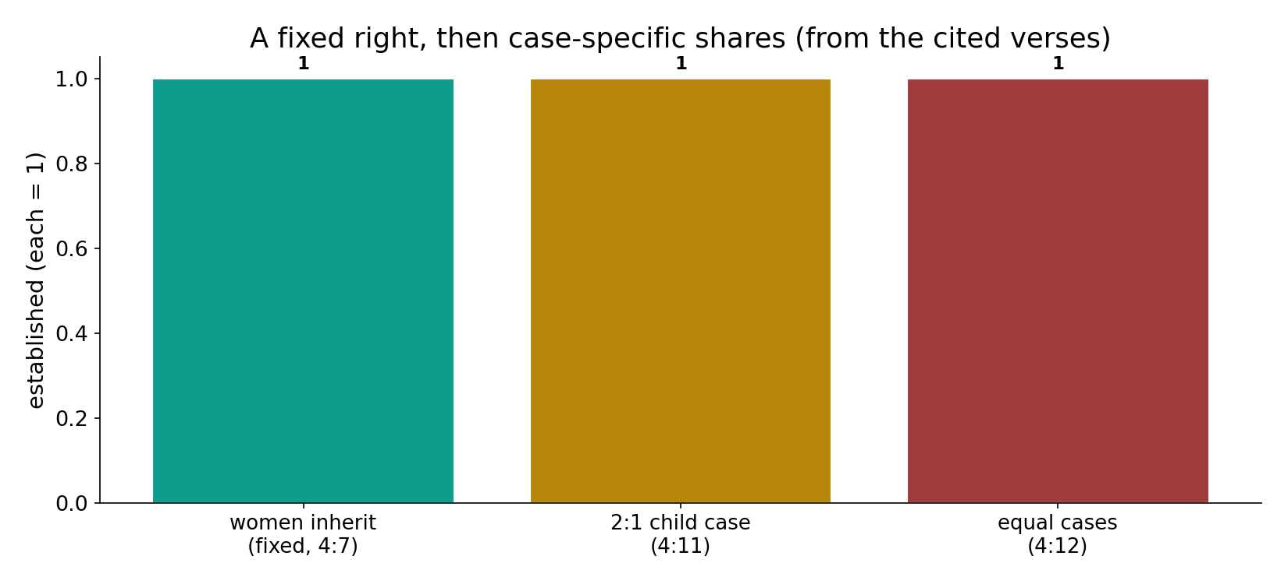
A fixed right, then case-specific shares
In the data (from the cited verses) - 4:7 fixes women's right to inherit; 4:11 gives the 2:1 child case; 4:12 has equal cases. A schedule, not a single ratio.

Slide 4
Women inherit - fixed (4:7); the 2:1 child case (4:11)
the text's own words (address - snippet - gloss):
4:7 لِّلرِّجَالِ نَصيِبٌ مِّمَّا تَرَك الْوَالِدَانِ وَالأَقْرَبُونَ وَلِلنِّسَاء نَصِيبٌ مِّمَّا - women guaranteed a fixed share
4:11 يُوصِيكُمُ اللّهُ فِي أَوْلاَدِكُمْ لِلذَّكرِ مِثْلُ حَظِّ الأُنثَيَيْنِ - child case: male = two females’ share

Slide 5
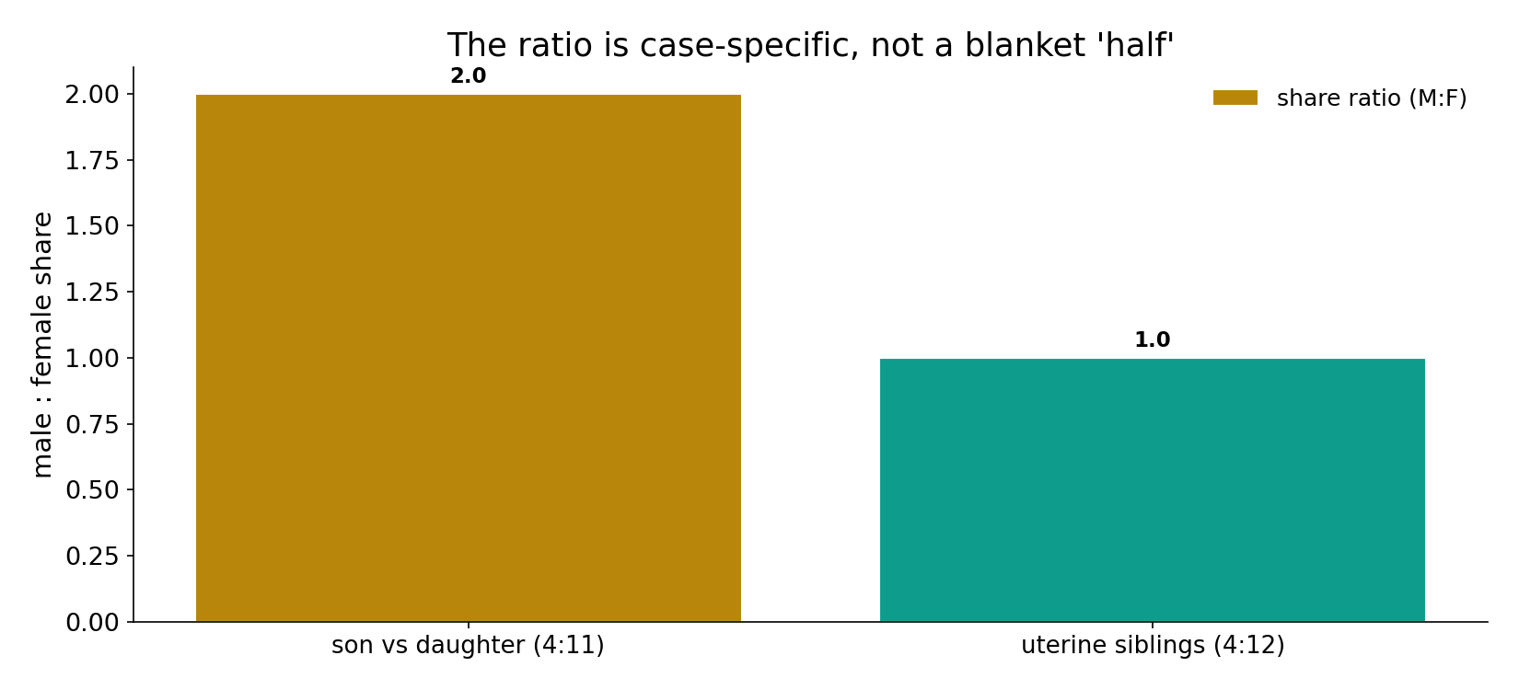
The ratio is case-specific
In the data - in the parents->children case (4:11) a son gets the share of two daughters (2:1); uterine siblings (4:12) inherit EQUALLY (1:1). The ratio varies by configuration.

Slide 6
What the data shows
Women inherit - a fixed right (4:7)
where custom once bypassed them, 4:7 guarantees women a defined share of parents' and kin's estate - enforceable.
The 2:1 case (4:11)
in the parents->children case, a son receives the share of two daughters; this specific configuration is the one most quoted.
Not always 2:1 (4:12)
shares vary by configuration: uterine siblings inherit equally; some parent and spouse shares match - case-specific, not a blanket 'half.'

Slide 7
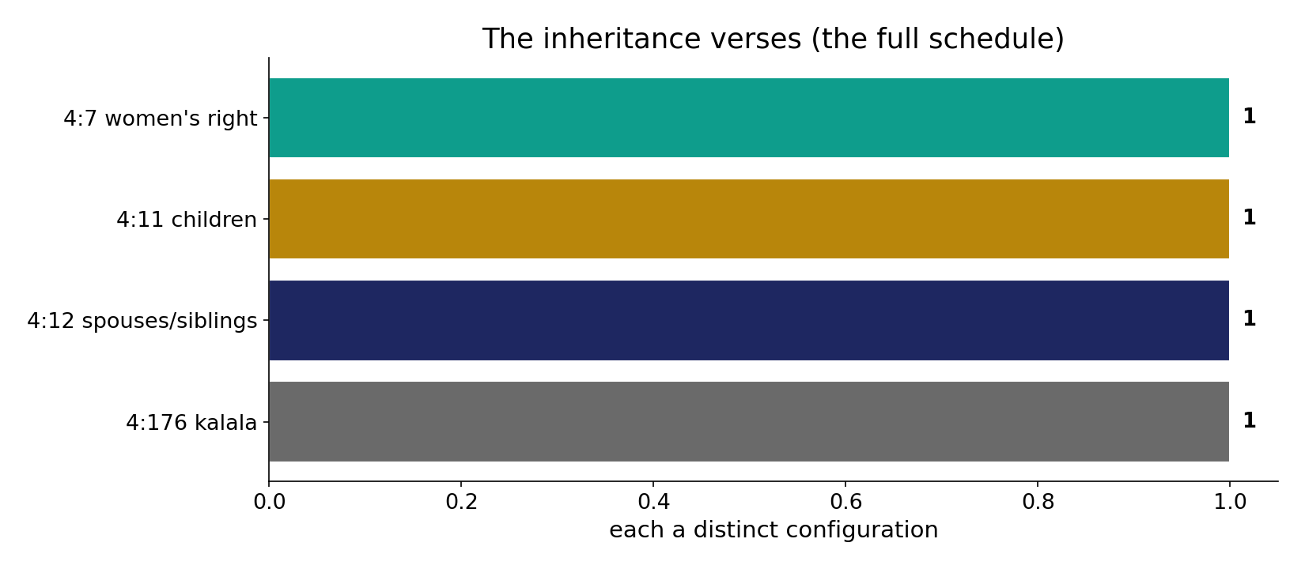
The full schedule
In the data - four verses (4:7, 4:11, 4:12, 4:176) specify shares for distinct configurations - the honest datum is the FULL schedule, not one verse.

Slide 8
Not always 2:1 - equal cases (4:12, 4:176)
the text's own words (address - snippet - gloss):
4:12 وَلَكُمْ نِصْفُ مَا تَرَك أَزْوَاجُكُمْ إِن لَّمْ - uterine siblings share equally
4:176 يَسْتَفْتُونَك قُلِ اللّهُ يُفْتِيكُمْ فِي الْكلاَلَةِ إِنِ امْرُؤٌ - kalāla — siblings’ shares fixed

Slide 9
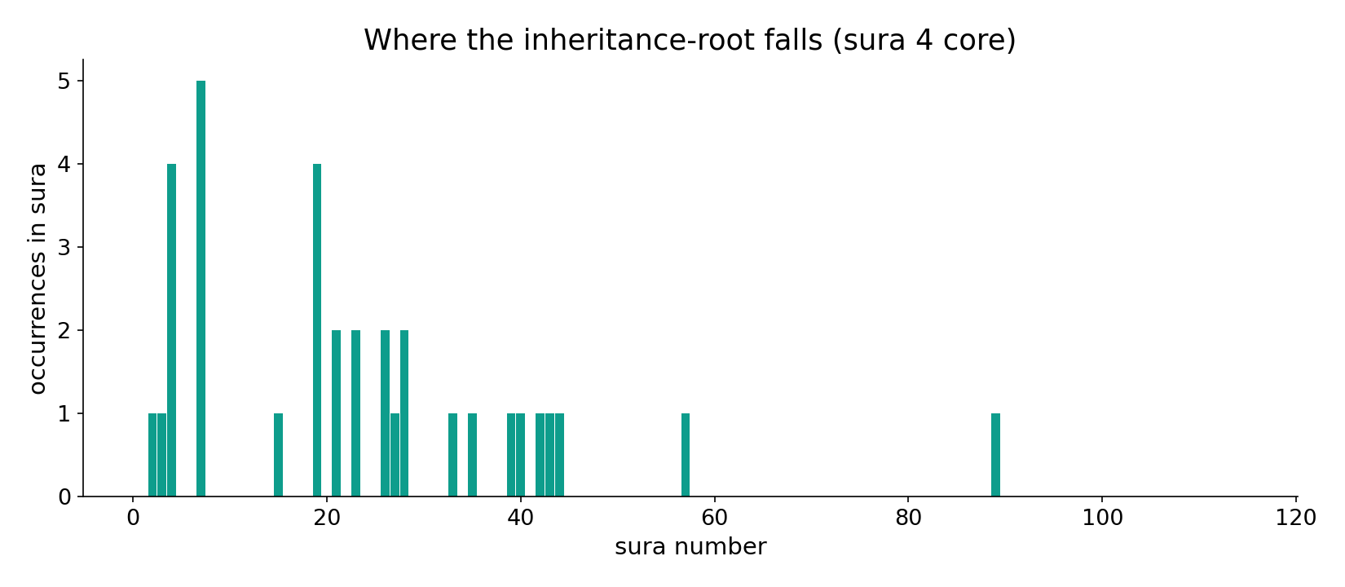
The inheritance-root across the corpus
In the data - the inheritance-root concentrates in sura 4 (an-Nisa) - the legislative core.

Slide 10
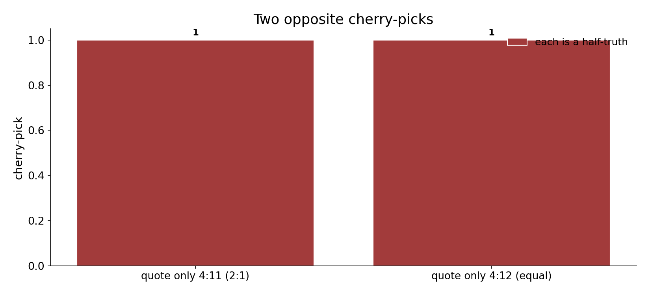
Two opposite cherry-picks
In the data - quoting only 4:11's 2:1 is a cherry-pick; quoting only the equal cases (4:12) is the opposite cherry-pick. Both distort the schedule.

Slide 11
A fixed schedule, an interpreted equity
Computed datum: the corpus FIXES women's inheritance as an enforceable right (4:7) and specifies shares that vary by heir - the well-known 2:1 holds in the child case (4:11) but not universally (uterine siblings equal, 4:12). Whether the scheme is 'equitable' is the interpretive crux: readings that pair the male's larger share with his exclusive maintenance duty argue net-parity; others read it as unequal. The numbers alone do not decide.
Quoting only 4:11's 2:1 is a cherry-pick; quoting only the equal cases is the opposite cherry-pick.

Slide 12
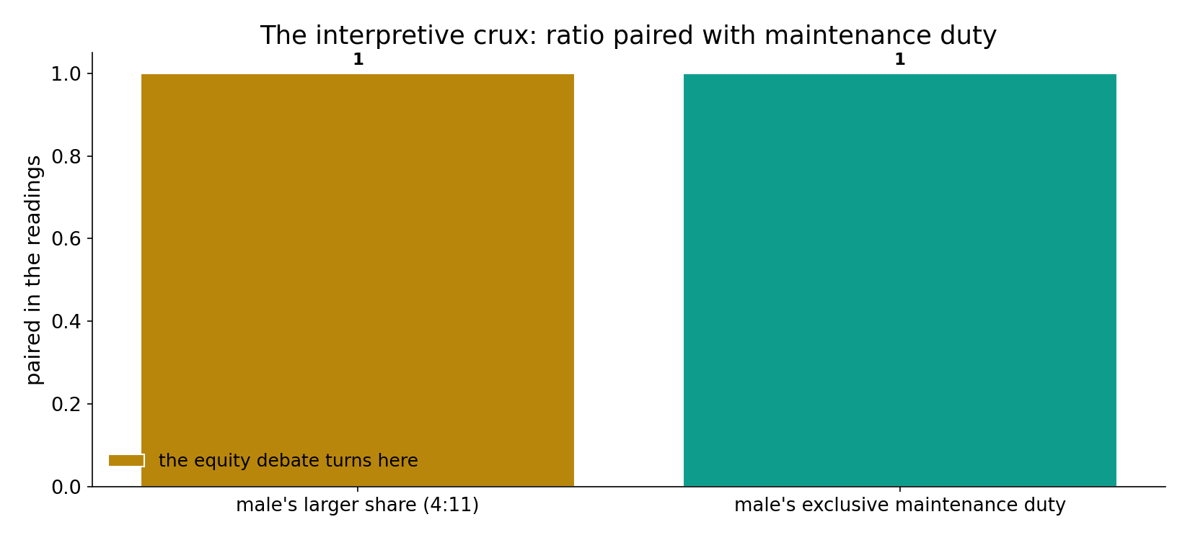
The interpretive crux
In the data - the equity debate turns on pairing the male's larger share (4:11) with his exclusive maintenance duty: net-parity readings vs unequal readings. The numbers alone do not decide.

Slide 13
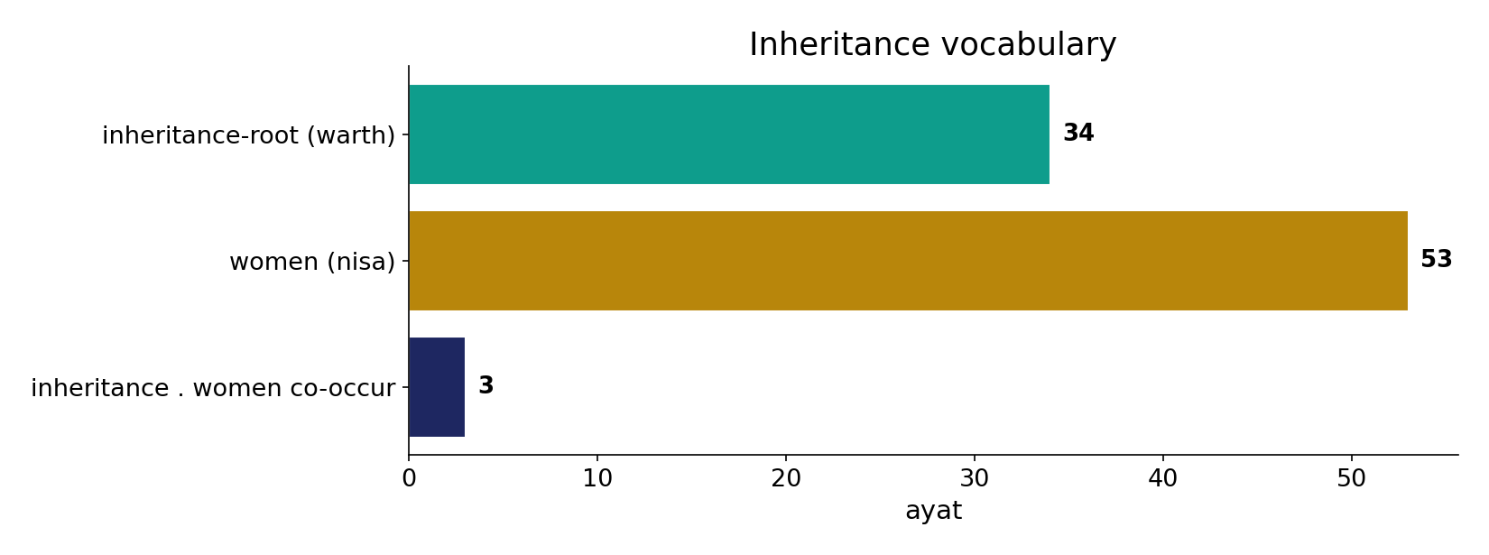
Inheritance vocabulary
In the data - the inheritance-root (34) and 'women' (53) co-occur (3); 4:7 fixes the right where custom once bypassed women.

Slide 14
Right fixed, ratio varies
4:7
women's inheritance fixed
4:11
2:1 in the child case
4:12
equal in other cases
A schedule, not a slogan
'women get half' is one configuration; the equity verdict turns on the frame, not the count.

Slide 15
Honest limits and critique
Both cherry-picks distort
quoting only 2:1 (4:11) or only the equal cases (4:12) misrepresents a schedule that varies by configuration.
The verdict turns on the frame
the honest datum is the FULL schedule plus the maintenance asymmetry; the equity verdict turns on the interpretive frame, not the count.

Slide 16
Reading this honestly - the audit
✓ Right fixed
4:7 guarantees women's inheritance.
✓ Schedule varies
2:1 in the child case (4:11), equal in others (4:12).
~ 'Equitable?' is interpretive
turns on the maintenance pairing, not the count.
✗ Not a proof
the text's data is computed; the equity verdict is interpretive.
✗ No raw mixing
forms/senses separated; registers kept apart (course rule).

Slide 17
How this was computed (reproducible)
Book6
inheritance verses; share configurations
measure
shares by heir-configuration; the full schedule
figures
schedule bars, ratio bars, sura map
count
chart
Fully reproducible
Every figure recomputes from Book6.xlsx via the shared wk.py kernel (fixed seed). Roots are normalized (Persian/Arabic letter variants folded) so counts are stable; surface forms are used wherever a concept must be kept apart from its root family (per the course's sense-verification rule).

Slide 18
Appendix - input snippets (Book6, vocalized)
verbatim snippets with addresses:
4:7 لِّلرِّجَالِ نَصيِبٌ مِّمَّا تَرَك الْوَالِدَانِ وَالأَقْرَبُونَ وَلِلنِّسَاء نَصِيبٌ مِّمَّا - women guaranteed a fixed share
4:11 يُوصِيكُمُ اللّهُ فِي أَوْلاَدِكُمْ لِلذَّكرِ مِثْلُ حَظِّ الأُنثَيَيْنِ - child case: male = two females’ share

Slide 19
Takeaway
A fixed schedule, an interpreted equity
The corpus fixes women's inheritance as an enforceable right (4:7) and specifies shares that VARY by configuration.
The famous 2:1 holds in the child case (4:11) but not universally (uterine siblings equal, 4:12).
Whether the scheme is 'equitable' turns on the interpretive frame (maintenance asymmetry), not the count. Presented from the text.

Slide 20
Quick reference
The verses
4:7 fixed right - 4:11 2:1 child case - 4:12 equal cases - 4:176 kalala; inheritance-root 34 ayat.
The shape
a fixed right with case-specific shares (2:1 not universal); the equity verdict turns on the interpretive frame, not the count.

