Slide 1
SPECIAL TOPIC - women & men: testimony, Week 9
Women & men - testimony
'Half a man's' is not a general rule - testimony weight varies by context
'A woman's testimony is worth half a man's.' Always - or only in a particular context? We compare the testimony verses across contexts: documenting a debt (2:282) vs the li'an accusation (24:6-9), reading the weight each assigns, and letting the VARIATION carry the finding.
Verse content is quoted from Book6; the weights (2-for-1 in debt, 1-for-1 in li'an) are what the cited verses establish.

Slide 2
The question, and the method
The claim to test
Is a woman's testimony 'half a man's' always, or only in a specific context?
The method
- compare testimony verses across contexts (debt 2:282 vs li'an 24:6-9)
- read the weight each assigns
- let the variation, not a single verse, carry the finding

Slide 3
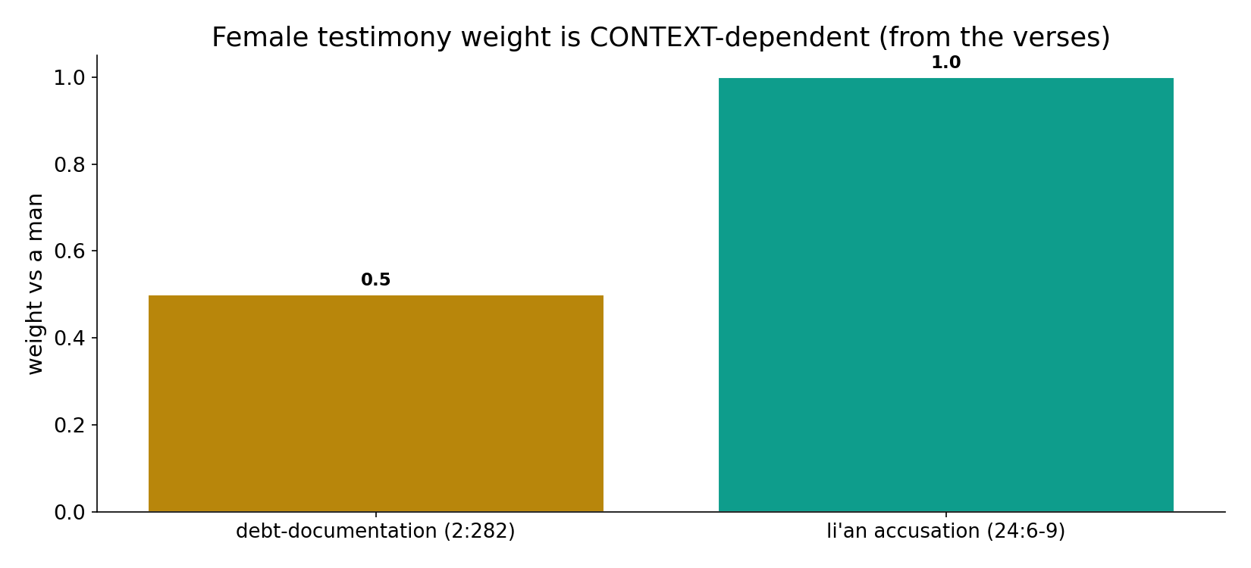
Testimony weight is context-dependent
In the data (from the cited verses) - in debt-documentation (2:282) two women stand for one man (0.5); in the li'an accusation (24:6-9) a woman's oath equals a man's (1.0). Context, not a universal scale.

Slide 4
Debt - two women for one man (2:282)
the text's own words (address - snippet - gloss):
2:282 يَا أَيُّهَا الَّذِينَ آمَنُواْ إِذَا تَدَايَنتُم بِدَيْنٍ إِلَى أَجَلٍ - debt contract: two women, one man

Slide 5
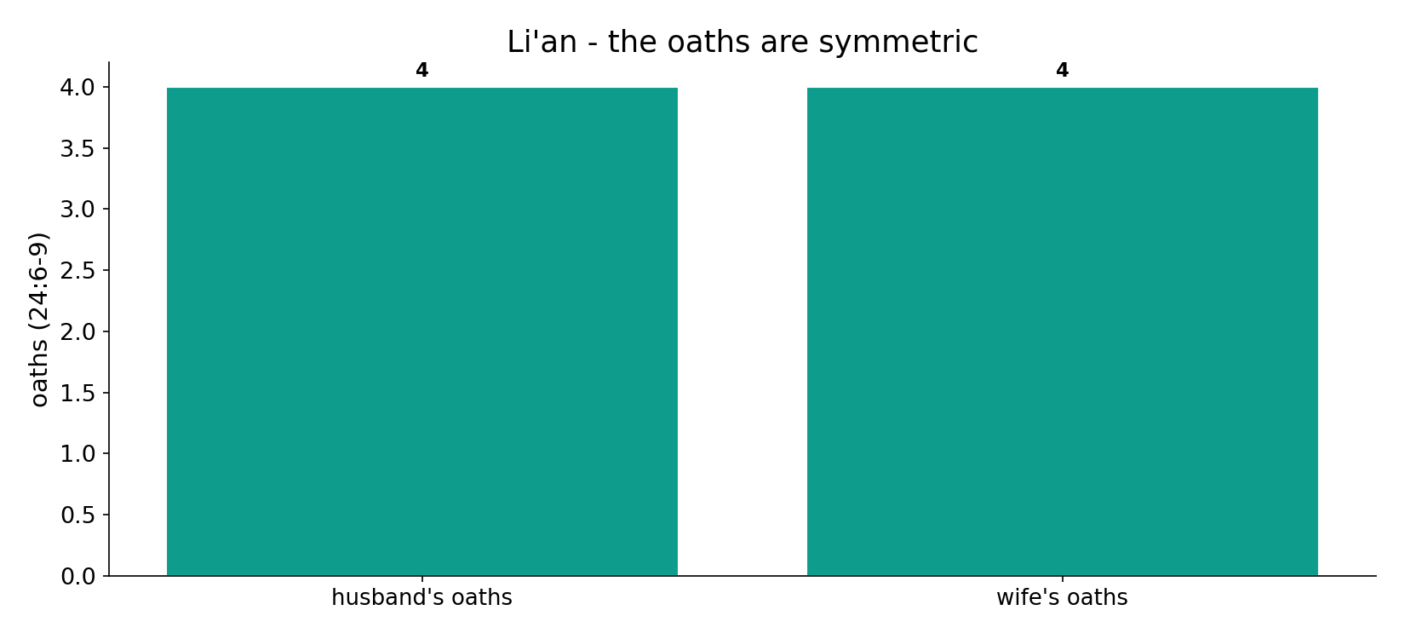
Li'an - the oaths are symmetric
In the data (24:6-9) - when a husband accuses his wife, each swears FOUR oaths; her four avert the penalty against his. One-to-one - equal.

Slide 6
What the data shows
Debt: two for one (2:282)
in documenting a deferred debt, two women stand for one man - 'so if one errs, the other reminds her.' Tied to that transaction.
Li'an: her oath equals his (24:6-9)
when a husband accuses his wife, each swears four oaths; HER four avert the penalty against his. One-to-one - equal.
So 'half' is not general
testimony weight is CONTEXT-dependent; 'half' is a generalization the corpus does not support across the board.

Slide 7
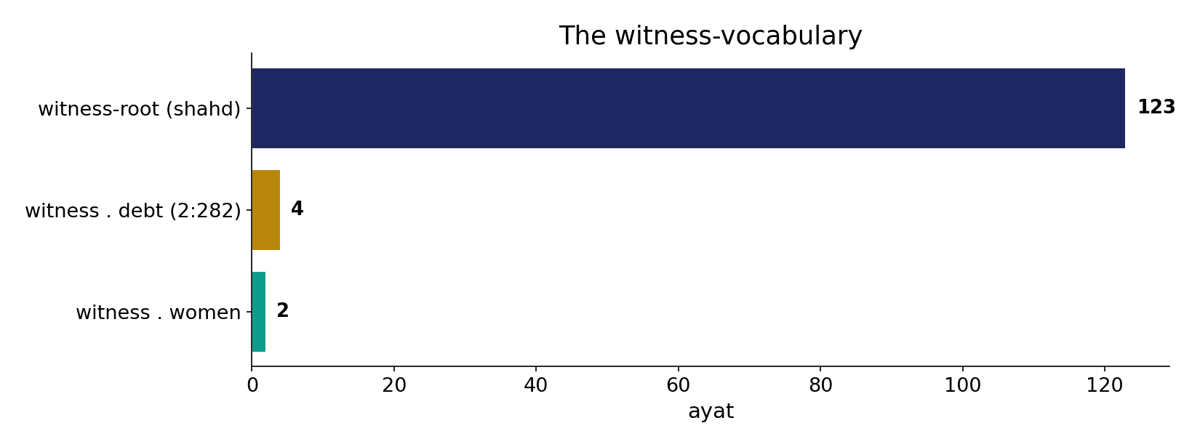
The witness-vocabulary
In the data - the witness-root (123) is a large field; 2:282 (witness+debt, 4) concerns RECORD-KEEPING of a commercial transaction, not a courtroom scale of worth.

Slide 8
Li'an - her oath equals his (24:6-9)
the text's own words (address - snippet - gloss):
24:6 وَالَّذِينَ يَرْمُونَ أَزْوَاجَهُمْ وَلَمْ يَكُن لَّهُمْ شُهَدَاء إِلَّا أَنفُسُهُمْ - liʿān: her oath set equal to his
24:8 وَيَدْرَأُ عَنْهَا الْعَذَابَ أَنْ تَشْهَدَ أَرْبَعَ شَهَادَاتٍ بِاللَّهِ إِنَّهُ - her four oaths avert the penalty
24:9 وَالْخَامِسَةَ أَنَّ غَضَبَ اللَّهِ عَلَيْهَا إِن كانَ مِنَ الصَّادِقِينَ - her fifth oath: God’s wrath if he is truthful

Slide 9
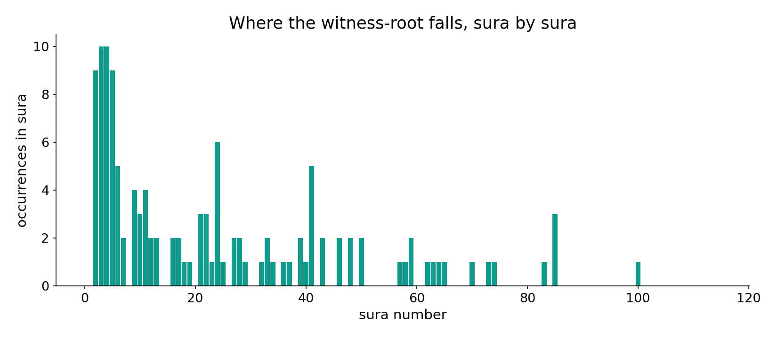
The witness-root across the corpus
In the data - the witness-root is spread across the corpus, in legal, theological and testimonial senses alike.

Slide 10
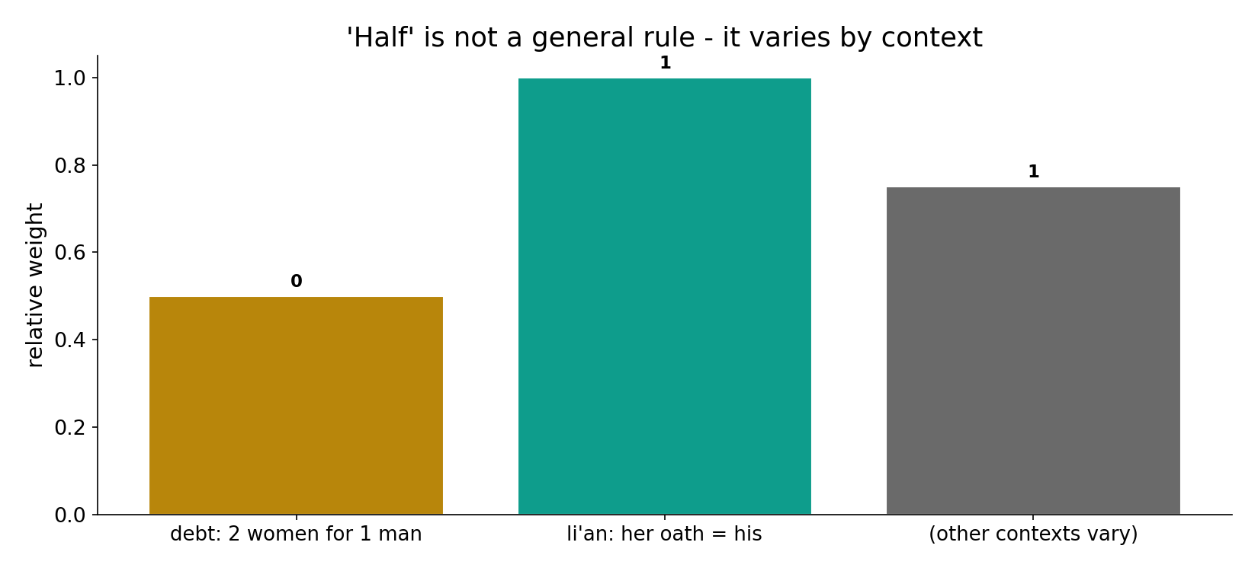
'Half' is not a general rule
In the data - the weight varies: 2-for-1 in debt (2:282), 1-for-1 in li'an (24:6-9). 'Half' is a generalization the corpus does not support across the board.

Slide 11
'Half' is not a general rule
Computed datum: testimony weight is CONTEXT-DEPENDENT, not uniform - 2-for-1 in debt-documentation (2:282) and 1-for-1 in li'an (24:6-9), where a woman's sworn word overturns a man's. So 'half' is a generalization the corpus does not support across the board. Reading 2:282 as a universal law of female worth ignores 24:6-9 - and that 2:282 concerns RECORD-KEEPING of an unfamiliar commercial transaction, not a courtroom scale of worth.
The datum is the VARIATION; the reason for it is interpretation, not count.

Slide 12
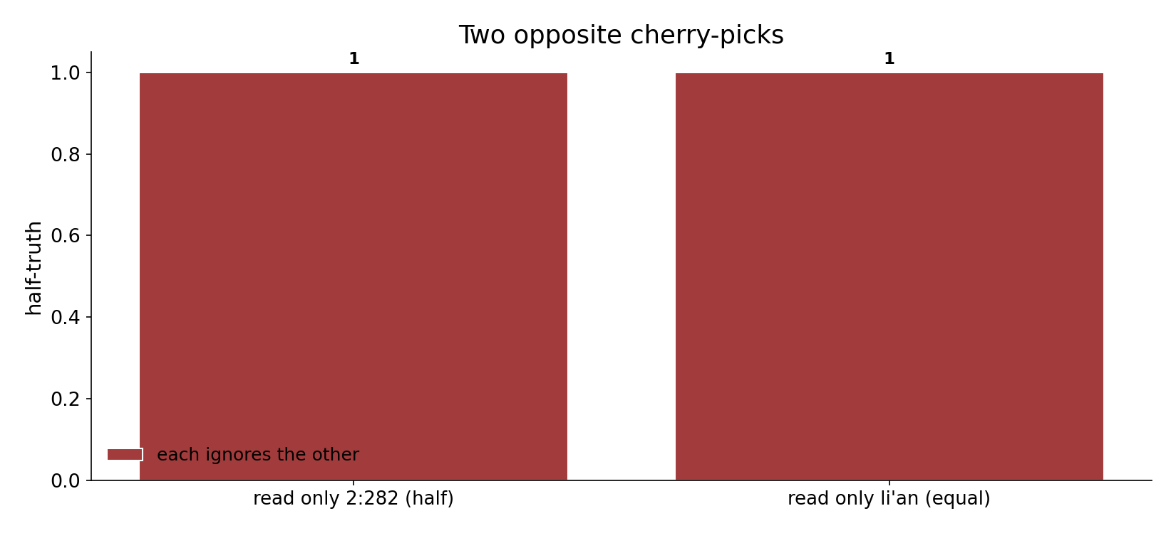
Two opposite cherry-picks
In the data - reading only 2:282 as a universal law ignores 24:6-9; reading only li'an ignores the debt asymmetry. Both are half-truths.

Slide 13
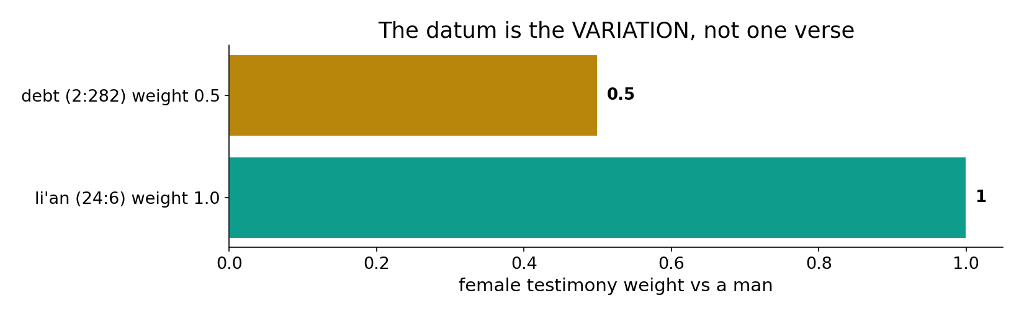
The datum is the variation
In the data - the honest finding is the VARIATION (0.5 in debt, 1.0 in li'an); the REASON for it is interpretation, not count.

Slide 14
Context, not a constant
Debt (2:282)
two women for one man
Li'an (24:6-9)
her oath equals his
Datum
the VARIATION itself
'Half' is not general
the corpus assigns weight by context; reading one verse as universal is the cherry-pick.

Slide 15
Honest limits and critique
Both readings cherry-pick
reading only 2:282 ignores li'an; reading only li'an ignores the debt asymmetry - the honest datum is the variation.
2:282 is about record-keeping
the debt verse concerns documenting an unfamiliar commercial transaction, not a general courtroom scale of female worth.

Slide 16
Reading this honestly - the audit
✓ Contexts compared
debt 2:282 vs li'an 24:6-9.
✓ Li'an symmetric
four oaths each - 1:1.
✓ Variation is the datum
0.5 in debt, 1.0 in li'an.
~ Reason is interpretive
why the weights differ is a reading.
✗ Not a proof
the text's data is computed; verdicts/analogies are labelled.
✗ No raw mixing
forms/senses separated; contexts kept apart (course rule).

Slide 17
How this was computed (reproducible)
Book6
testimony verses by context; witness-root
measure
weight by context; symmetric oaths
figures
weight bars, oath bars, witness field, sura map
count
chart
Fully reproducible
Every figure recomputes from Book6.xlsx via the shared wk.py kernel (fixed seed). Roots are normalized (Persian/Arabic letter variants folded) so counts are stable; surface forms are used wherever a concept must be kept apart from its root family (per the course's sense-verification rule).

Slide 18
Appendix - input snippets (Book6, vocalized)
verbatim snippets with addresses:
2:282 يَا أَيُّهَا الَّذِينَ آمَنُواْ إِذَا تَدَايَنتُم بِدَيْنٍ إِلَى أَجَلٍ - debt contract: two women, one man

Slide 19
Takeaway
'Half' is not a general rule
Testimony weight is context-dependent: 2-for-1 in debt-documentation (2:282), 1-for-1 in li'an (24:6-9).
In li'an a woman's sworn word overturns a man's - one-to-one. 2:282 concerns record-keeping, not a scale of worth.
The datum is the VARIATION; the reason is interpretation. Presented from the text.

Slide 20
Quick reference
The verses
debt 2:282 (2-for-1) - li'an 24:6-9 (1-for-1, four oaths each); witness-root 123 ayat.
The shape
testimony weight varies by context; 'half' is not a general rule; the datum is the variation, the reason interpretive.

