Slide 1
SPECIAL TOPIC - women & men: social/spiritual, Week 9
Women & men - social & spiritual standing
Parity stated in origin, reward and relation - kept apart from role
Are women and men equal in moral and spiritual standing - in origin, reward, and mutual relation? We read the verses on creation, reward, and mutual standing at face value, marking where parity is STATED vs interpreted, and keeping moral standing apart from role/legal differentiation.
Verse content is quoted from Book6; the 'ten matched virtues' and 'male or female' formulas are what the cited verses state.

Slide 2
The question, and the method
The claim to test
Are women and men equal in moral/spiritual standing - in origin, reward, and relation?
The method
- read the verses on creation, reward, mutual standing at face value
- mark where parity is STATED vs interpreted
- keep moral standing apart from role/legal differentiation (separate question)

Slide 3
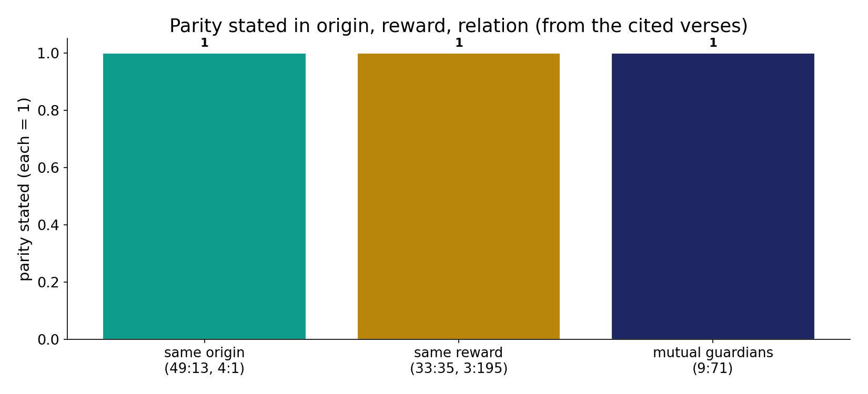
Parity stated in three registers
In the data (from the cited verses) - parity is stated in origin (49:13, 4:1), reward (33:35, 3:195) and mutual relation (9:71). Three explicit statements.

Slide 4
Same origin; same reward
the text's own words (address - snippet - gloss):
49:13 يَا أَيُّهَا النَّاسُ إِنَّا خَلَقْنَاكُم مِّن ذَكرٍ وَأُنثَى وَجَعَلْنَاكُمْ - created from male and female
4:1 يَا أَيُّهَا النَّاسُ اتَّقُواْ رَبَّكُمُ الَّذِي خَلَقَكُم - created you from one soul

Slide 5
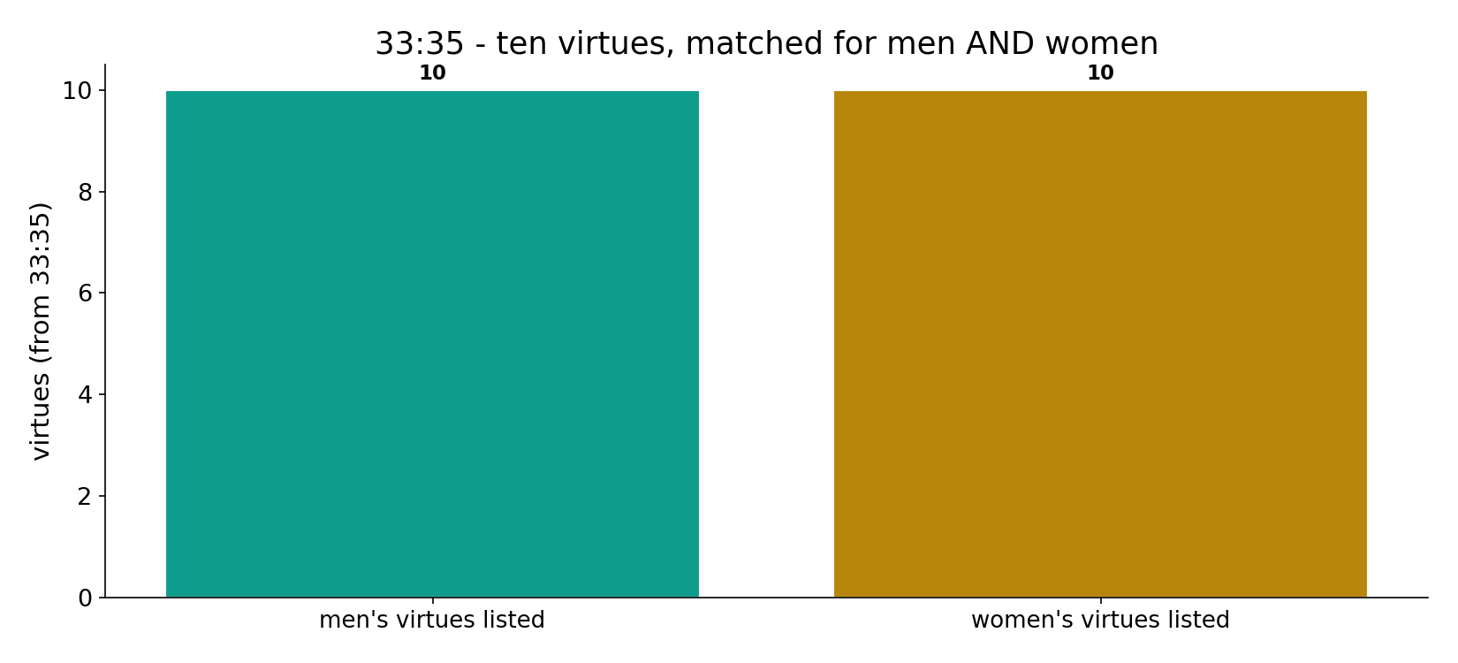
33:35 - ten virtues, matched
In the data (33:35) - the verse pairs TEN virtues for men and women identically, promising the same forgiveness and reward - parity made explicit.

Slide 6
What the data shows
Same origin
'created you from a male and a female' (49:13) and 'from one soul' (4:1); rank is by taqwa, not sex.
Same reward
33:35 pairs ten virtues identically; 'I will not waste the work of any worker, male or female' (3:195).
Mutual guardianship
'the believing men and women are guardians (awliya) of one another' (9:71) - a reciprocal relation, not one-way.

Slide 7
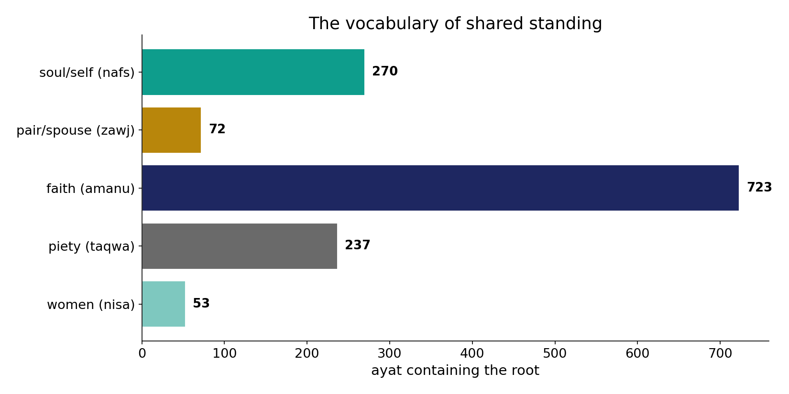
The vocabulary of shared standing
In the data - soul/self (270), pair/spouse (72), faith (723) and piety (237) frame a standing ranked by taqwa, not sex (49:13).

Slide 8
Same reward; mutual guardianship
the text's own words (address - snippet - gloss):
33:35 إِنَّ الْمُسْلِمِينَ وَالْمُسْلِمَاتِ وَالْمُؤْمِنِينَ وَالْمُؤْمِنَاتِ وَالْقَانِتِينَ وَالْقَانِتَاتِ وَالصَّادِقِينَ - ten paired virtues — same reward
3:195 فَاسْتَجَابَ لَهُمْ رَبُّهُمْ أَنِّي لاَ أُضِيعُ عَمَلَ عَامِلٍ مِّنكُم مِّن - “…male or female, of one another”
9:71 وَالْمُؤْمِنُونَ وَالْمُؤْمِنَاتُ بَعْضُهُمْ أَوْلِيَاء بَعْضٍ يَأْمُرُونَ بِالْمَعْرُوفِ وَيَنْهَوْنَ - believing men & women: mutual guardians

Slide 9
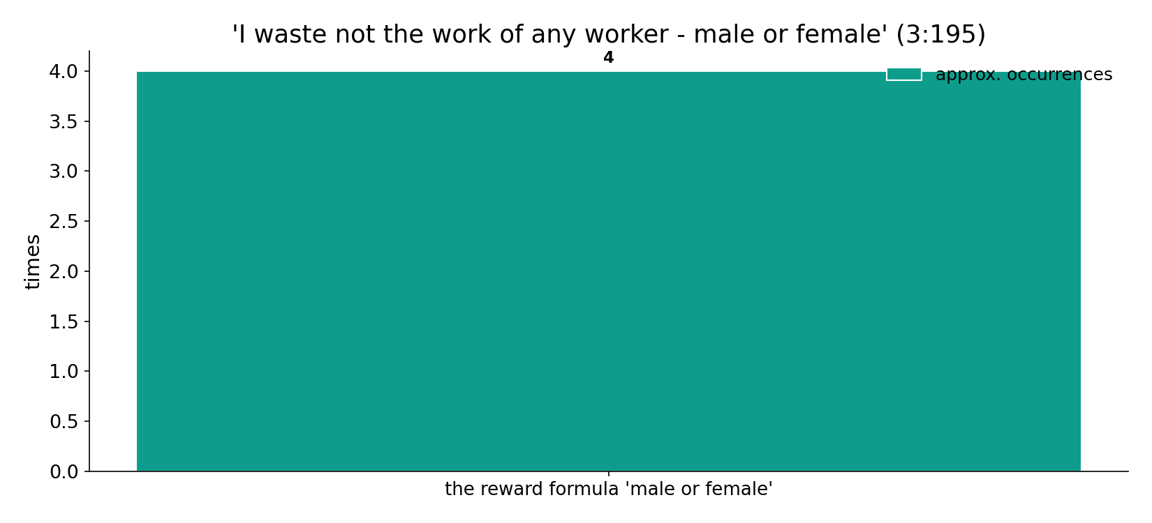
'Male or female' - the reward formula
In the data - 'I will not waste the work of any worker among you, male or female' (3:195) - the reward formula recurs, tying outcome to deeds, not sex.

Slide 10
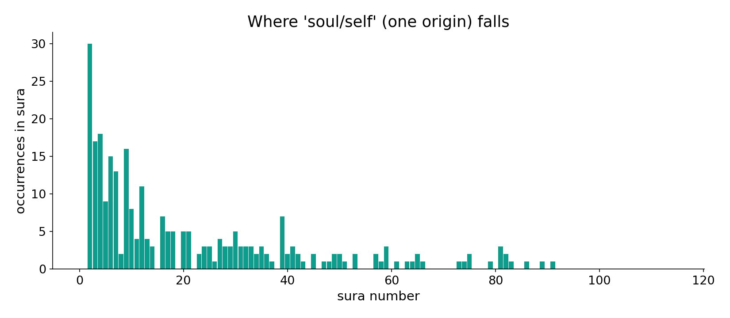
'Soul/self' across the corpus
In the data - the 'one soul' origin (4:1) sits in a root spread across the corpus - shared human origin.

Slide 11
Symmetric in standing
Computed datum: in origin, moral agency and reward the text states parity explicitly and repeatedly - 33:35's ten matched pairs, the 'male or female' reward formula, reciprocal guardianship (9:71). On the face of the text, spiritual and moral standing is symmetric. Role and legal differentiations (other verses) are a distinct question, not this one.
Face-value parity in origin and reward is a strong textual datum; whether social ROLES are 'equal' is contested and separate.

Slide 12
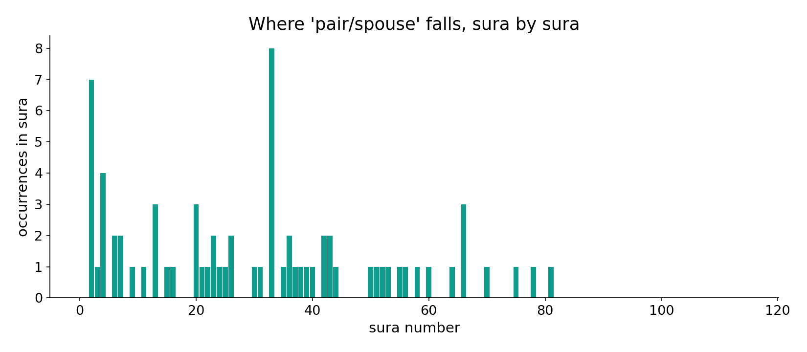
'Pair/spouse' across the corpus
In the data - the pair/spouse root names the reciprocal relation - 'created for you mates' - throughout the corpus.

Slide 13
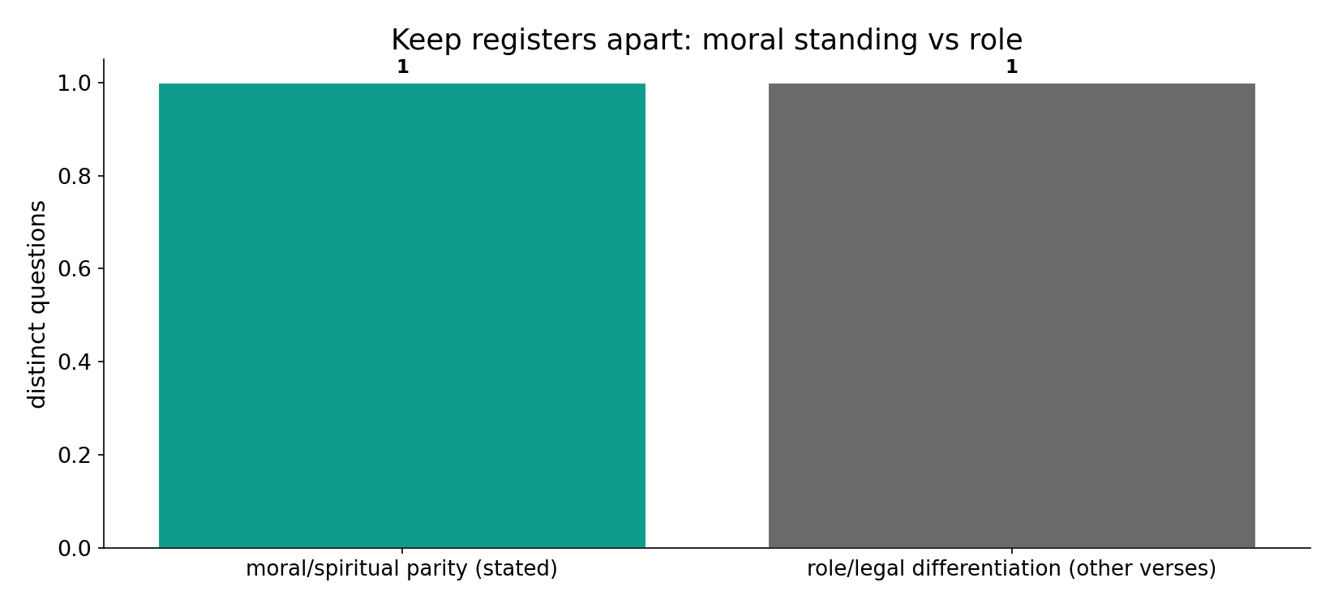
Two distinct questions
In the data - moral/spiritual parity (stated) and role/legal differentiation (other verses) are SEPARATE questions; we do not collapse one into the other.

Slide 14
Three registers of parity
Origin
one soul / male and female
Reward
'male or female', ten virtues
Relation
mutual guardianship
Symmetric in standing
ranked by taqwa not sex; role is a separate question kept apart.

Slide 15
Honest limits and critique
Roles are a separate question
face-value parity in origin and reward is strong; whether social ROLES are 'equal' is contested and not decided by these verses.
Keep registers apart
we keep moral standing and role distinct rather than collapse one into the other - they are answered by different verses.

Slide 16
Reading this honestly - the audit
✓ Parity verses cited
origin 49:13/4:1, reward 33:35/3:195, relation 9:71.
✓ 33:35 matched
ten virtues paired identically.
~ Roles separate
moral standing != role/legal question.
✗ Not a proof
the text's data is computed; the equity verdict is interpretive.
✗ No raw mixing
forms/senses separated; registers kept apart (course rule).

Slide 17
How this was computed (reproducible)
Book6
parity verses; shared-standing vocabulary
measure
what each verse states; root fields
figures
parity bars, 33:35 bars, vocabulary bars, sura maps
count
chart
Fully reproducible
Every figure recomputes from Book6.xlsx via the shared wk.py kernel (fixed seed). Roots are normalized (Persian/Arabic letter variants folded) so counts are stable; surface forms are used wherever a concept must be kept apart from its root family (per the course's sense-verification rule).

Slide 18
Appendix - input snippets (Book6, vocalized)
verbatim snippets with addresses:
49:13 يَا أَيُّهَا النَّاسُ إِنَّا خَلَقْنَاكُم مِّن ذَكرٍ وَأُنثَى وَجَعَلْنَاكُمْ - created from male and female
4:1 يَا أَيُّهَا النَّاسُ اتَّقُواْ رَبَّكُمُ الَّذِي خَلَقَكُم - created you from one soul

Slide 19
Takeaway
Symmetric in standing
In origin (49:13, 4:1), reward (33:35, 3:195) and relation (9:71) the text states parity explicitly and repeatedly.
On the face of the text, spiritual and moral standing is symmetric - ranked by taqwa, not sex.
Role/legal differentiation is a separate question; we keep the registers apart. Presented from the text.

Slide 20
Quick reference
The verses
origin 49:13, 4:1 - reward 33:35 (10 virtues), 3:195 - relation 9:71; vocabulary: soul 270, pair 72.
The shape
moral/spiritual standing is symmetric (origin, reward, relation); role/legal differentiation is a distinct, interpretive question.

