Slide 1
SPECIAL TOPIC - a labelled analogy, Week 9
'We were transcribing what you did' - nasakh and genomic transcription
A teaching analogy - explicitly NOT a scientific-miracle claim
45:29: 'This is Our record that speaks against you in truth; We were TRANSCRIBING (nastansikh) what you used to do' - the same root as the abrogation topic, here meaning to record/copy. As an ANALOGY ONLY (a teaching bridge, not a claim about the text), we map the recorded-deeds structure onto genomic transcription: information copied first, expressed later.
The deed-record verses are quoted from Book6 (the computed anchor); every biology parallel is a labelled teaching device, NOT a claim that the Qur'an encodes molecular biology.

Slide 2
The question, and the method
The text (computed anchor)
45:29 'We were transcribing what you did'; the recording field: a watcher by every word (50:18), all enumerated (78:29), nothing omitted (18:49), to an atom's weight (99:7).
The analogy (labelled)
- map the STRUCTURE (copy -> store -> express), not the mechanism
- keep the mapping where it illuminates and DROP it where it breaks
- state clearly: a mental model, NOT evidence or a 'scientific miracle'

Slide 3
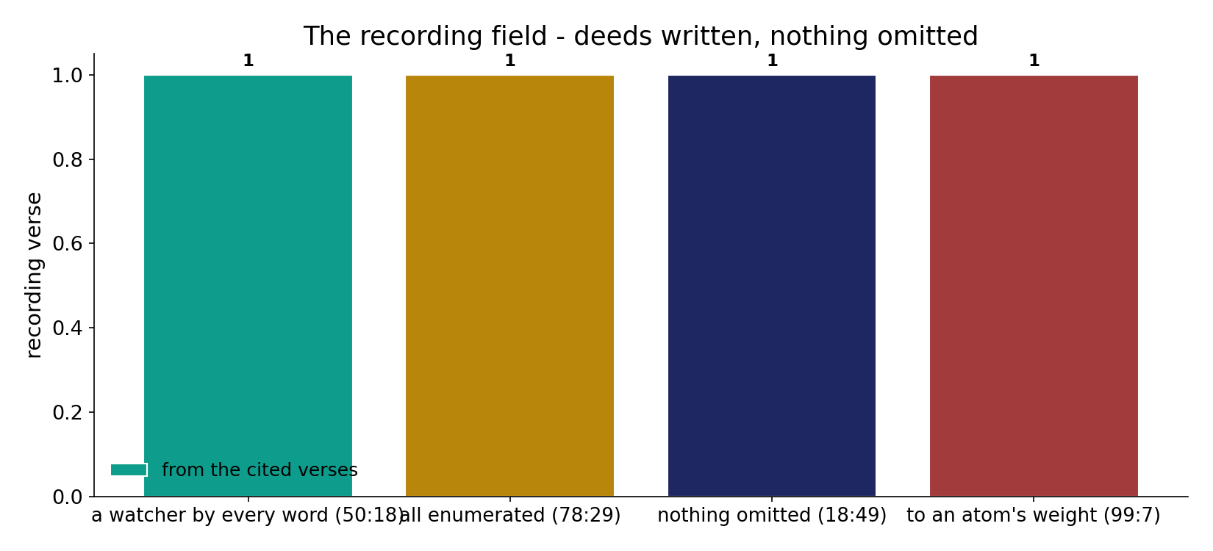
The recording field
In the data (from the cited verses) - a watcher by every word (50:18), all things enumerated (78:29), nothing small or great omitted (18:49), to an atom's weight (99:7): deeds are recorded completely and truthfully.

Slide 4
Transcription - 'We were transcribing'
the text's own words (address - snippet - gloss):
45:29 هَذَا كِتَابُنَا يَنطِقُ عَلَيْكُم بِالْحَقِّ إِنَّا كُنَّا نَسْتَنسِخُ مَا - “We were TRANSCRIBING what you did” (نستنسخ)
78:29 وَكُلَّ شَيْءٍ أَحْصَيْنَاهُ كِتَابًا - “everything We have enumerated in a record”

Slide 5
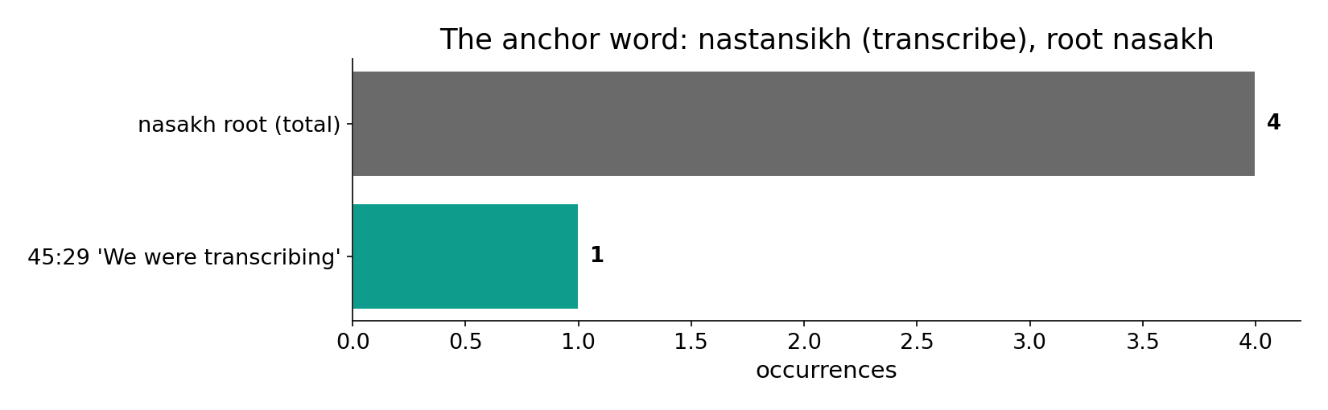
The anchor word: transcribe
In the data - the root appears 4 times; 45:29 ('We were transcribing what you did') uses it in the COPY/RECORD sense (sense-checked vs the abrogation topic).

Slide 6
What the data shows
Transcription - deeds to record
45:29: deeds copied into the record 'in truth'; nothing small or great omitted (18:49). The parallel is faithful copying.
Translation - record to verdict
on the Day the record is READ out - 'Read your record' (17:14) - and deeds are weighed on just scales (21:47; an atom's weight, 99:7).
Phenotype - expressed later
the consequence is manifested in the hereafter - garden or fire - its 'phenotype,' deferred and context-specific.

Slide 7
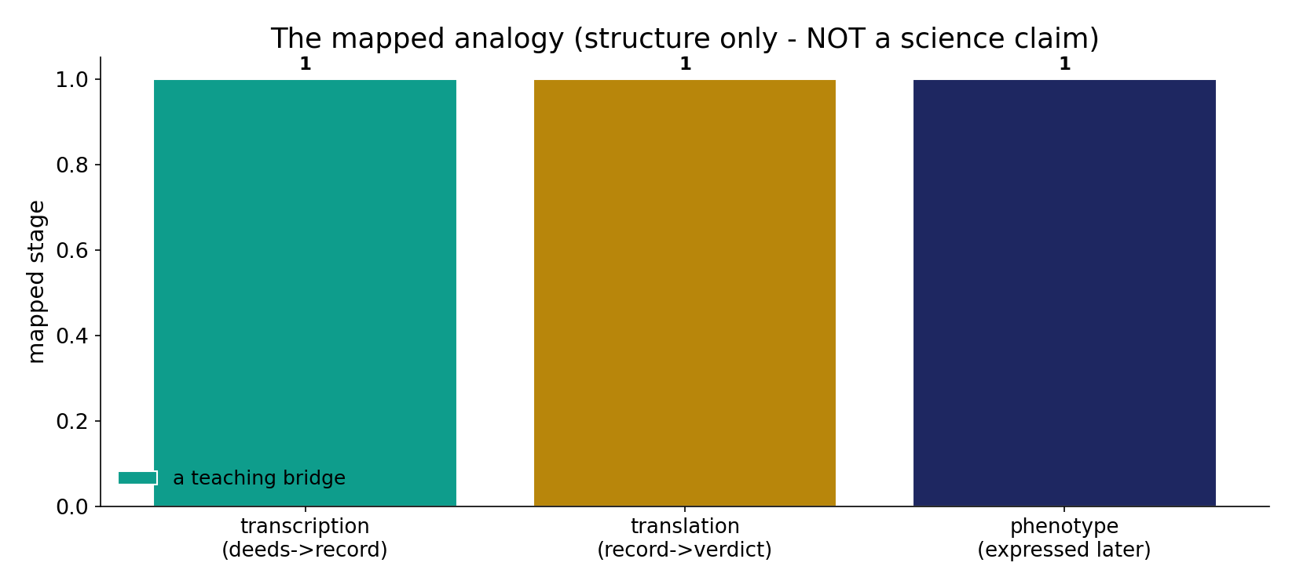
The mapped analogy (structure only)
A labelled teaching bridge - NOT a science claim: transcription (deeds -> record), translation (record -> verdict), phenotype (consequence expressed later, in its own context).

Slide 8
Read your record; weighed to an atom's weight
the text's own words (address - snippet - gloss):
17:14 اقْرَأْ كتَابَك كفَى بِنَفْسِك الْيَوْمَ عَلَيْك حَسِيبًا - TRANSLATION — “Read your record!”
21:47 وَنَضَعُ الْمَوَازِينَ الْقِسْطَ لِيَوْمِ الْقِيَامَةِ فَلَا تُظْلَمُ نَفْسٌ شَيْئًا - the just scales — deeds weighed
99:7 فَمَن يَعْمَلْ مِثْقَالَ ذَرَّةٍ خَيْرًا يَرَهُ - “an atom’s weight of good — he will see it”

Slide 9
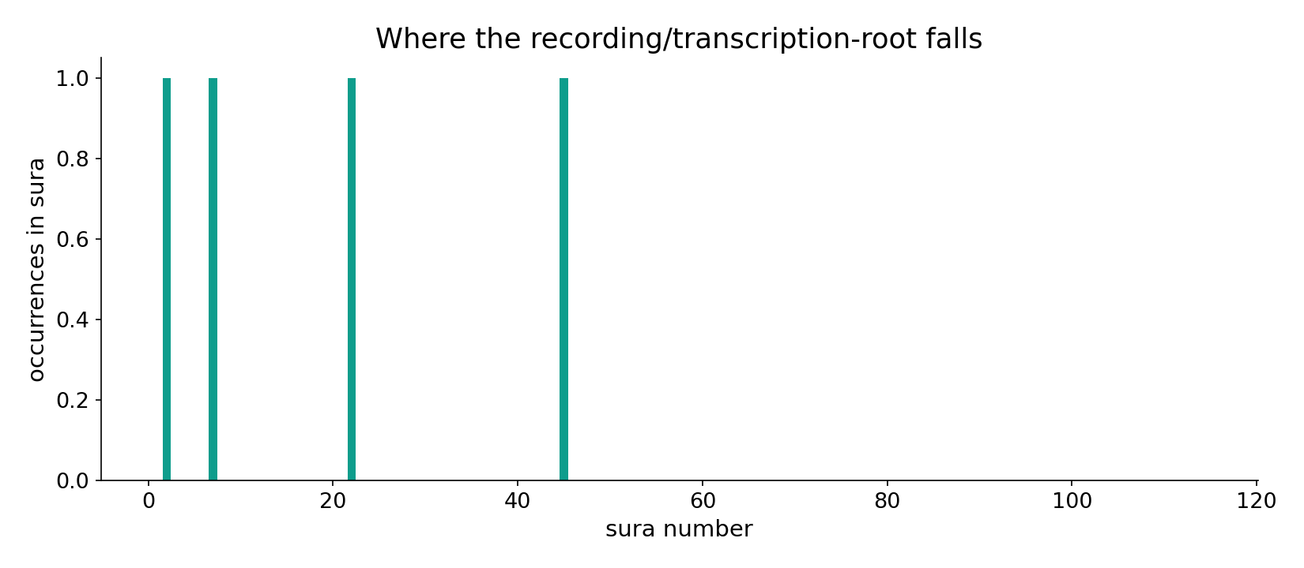
The recording-root across the corpus
In the data - the recording/transcription-root sits among the eschatology and record passages.

Slide 10
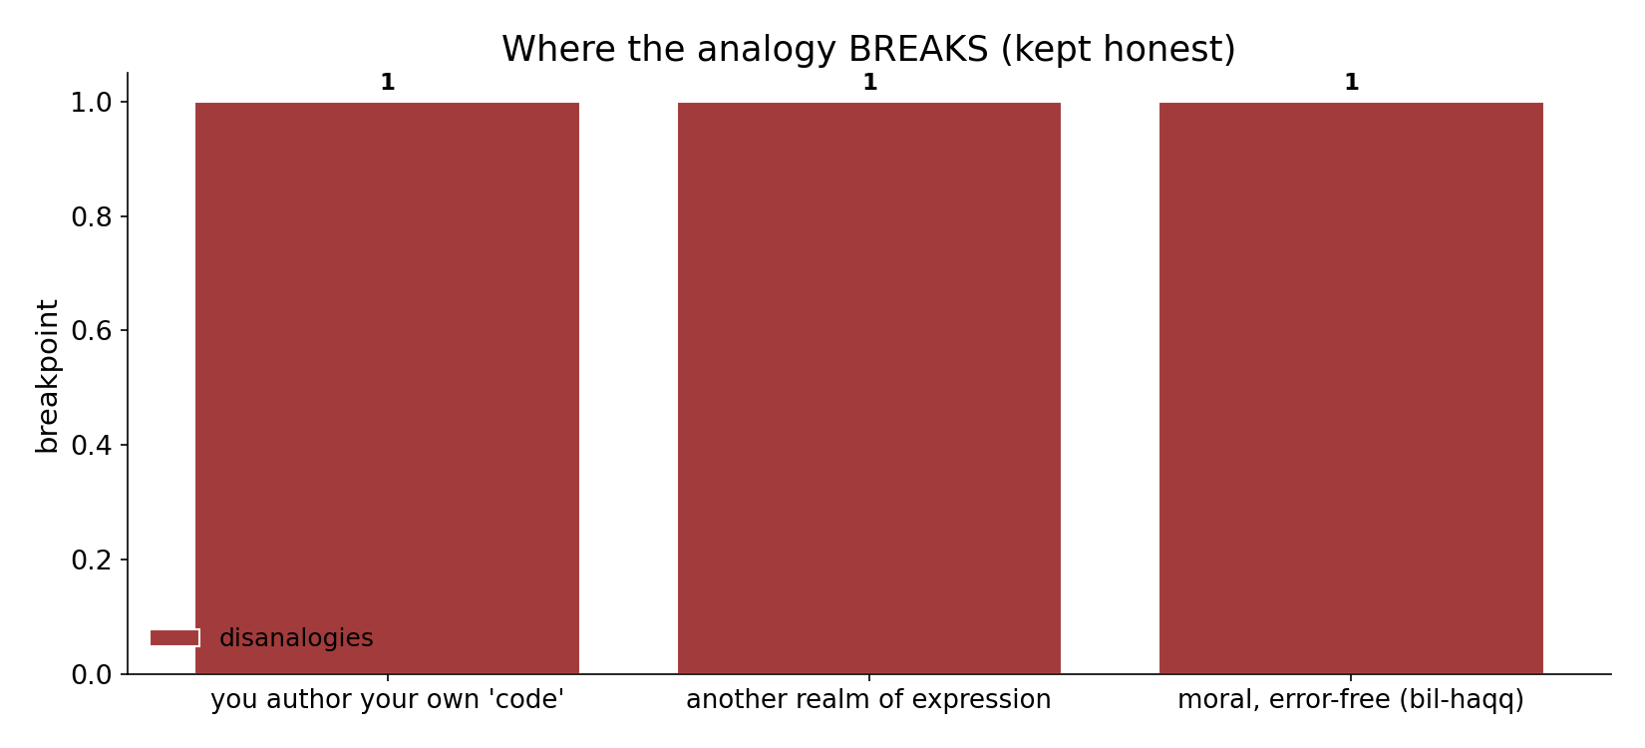
Where the analogy breaks
Kept honest - the disanalogies: you author your own 'code' (free deeds); expression is in ANOTHER realm; the recording is moral and error-free (bil-haqq), unlike mutation-prone copying.

Slide 11
Where it breaks, and the verdict
Computed datum: deeds are transcribed into a complete, truthful record whose consequence unfolds later (45:29; 78:29; 18:49; 50:18; 17:13). The genomics parallel - transcription -> deferred phenotype -> context-specific expression - is an illuminating teaching bridge. But it BREAKS in three ways: you author your own 'code' (free deeds, not an inherited genome); the deed-phenotype expresses in ANOTHER realm; and the recording is moral and error-free (bil-haqq), unlike mutation-prone copying. Honest limit: it is NOT a 'scientific miracle' - its worth is a vivid mental model, not evidence.
Every biology parallel is a teaching device - NOT a claim that the Qur'an describes molecular biology.

Slide 12
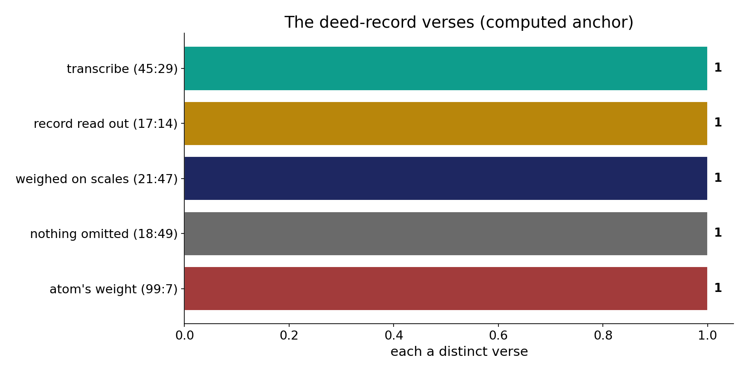
The deed-record verses
In the data - transcribe (45:29), record read out (17:14), weighed on just scales (21:47), nothing omitted (18:49), an atom's weight (99:7): the computed textual anchor.

Slide 13
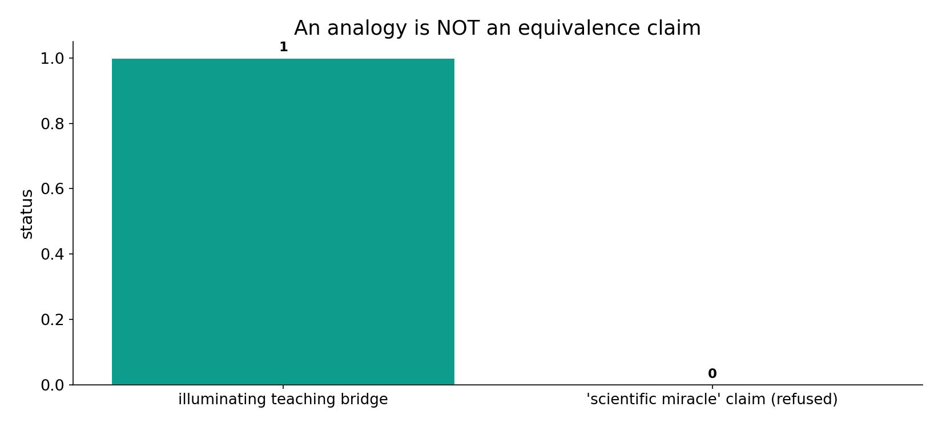
An analogy is not an equivalence
The status, stated plainly - an illuminating teaching bridge, NOT a 'scientific miracle': its worth is a vivid mental model, not evidence.

Slide 14
Copy, store, express
Transcription
deeds -> truthful record
Translation
record read & weighed
Phenotype
expressed in the hereafter
A teaching bridge, not evidence
the structure maps; the mechanism does not - and we refuse the 'miracle' framing.

Slide 15
Honest limits and critique
It is NOT a scientific miracle
the analogy's worth is a mental model, not evidence; we explicitly refuse the 'scientific miracle' framing.
Keep it where it illuminates
an analogy maps structure (copy->store->express), not identity; we drop it where it breaks (free authorship, another realm, error-free recording).

Slide 16
Reading this honestly - the audit
✓ Anchor verses cited
45:29, 17:14, 21:47, 18:49, 99:7 - from Book6.
✓ Sense-checked
nasakh here = transcribe, not abrogate.
~ Analogy, not claim
structure mapped; mechanism unrelated.
✗ Not a miracle-claim
a teaching bridge, not evidence.
✗ No raw mixing
forms/senses separated; contexts kept apart (course rule).

Slide 17
How this was computed (reproducible)
Book6
the transcription verse; the recording field
measure
quote the anchor; map structure (labelled)
figures
record bars, anchor verses, pipeline (labelled)
count
chart
Fully reproducible
Every figure recomputes from Book6.xlsx via the shared wk.py kernel (fixed seed). Roots are normalized (Persian/Arabic letter variants folded) so counts are stable; surface forms are used wherever a concept must be kept apart from its root family (per the course's sense-verification rule).

Slide 18
Appendix - input snippets (Book6, vocalized)
verbatim snippets with addresses:
45:29 هَذَا كِتَابُنَا يَنطِقُ عَلَيْكُم بِالْحَقِّ إِنَّا كُنَّا نَسْتَنسِخُ مَا - “We were TRANSCRIBING what you did” (نستنسخ)
78:29 وَكُلَّ شَيْءٍ أَحْصَيْنَاهُ كِتَابًا - “everything We have enumerated in a record”

Slide 19
Takeaway
A vivid teaching bridge - and nothing more
The computed anchor: deeds are transcribed into a complete, truthful record whose consequence unfolds later (45:29, 18:49, 99:7).
The genomics parallel (copy -> store -> express) is an illuminating mental model - but it breaks where authorship, realm and fidelity differ.
Stated plainly: NOT a scientific miracle - a teaching device, not evidence. Presented from the text.

Slide 20
Quick reference
The anchor
45:29 'We were transcribing'; record read out (17:14), weighed (21:47), nothing omitted (18:49), atom's weight (99:7); nasakh root 4.
The status
a labelled structural analogy (copy->store->express); breaks at authorship/realm/fidelity; NOT a scientific-miracle claim.

