Slide 1
SPECIAL TOPIC - abrogation, Week 9
Does the Qur'an abrogate itself? (naskh)
A whole doctrine - resting on about two verses
A whole doctrine (naskh) holds that later verses cancel earlier ones. How much textual ground does the word itself actually cover? We find every occurrence of the root, read each in context, and separate the 'abrogate' sense from the 'copy/transcribe' sense.
The root-count recomputes from Book6 and reproduces exactly (4 occurrences); the sense split is read from context.

Slide 2
The question, and the method
The claim to test
How much textual base does the abrogation doctrine actually have - and does the text ever name which verse cancels which?
The method
- find every occurrence of the abrogation-root
- separate 'abrogate' from 'copy/transcribe' in context
- ask whether the text ever NAMES a specific verse-cancels-verse case

Slide 3
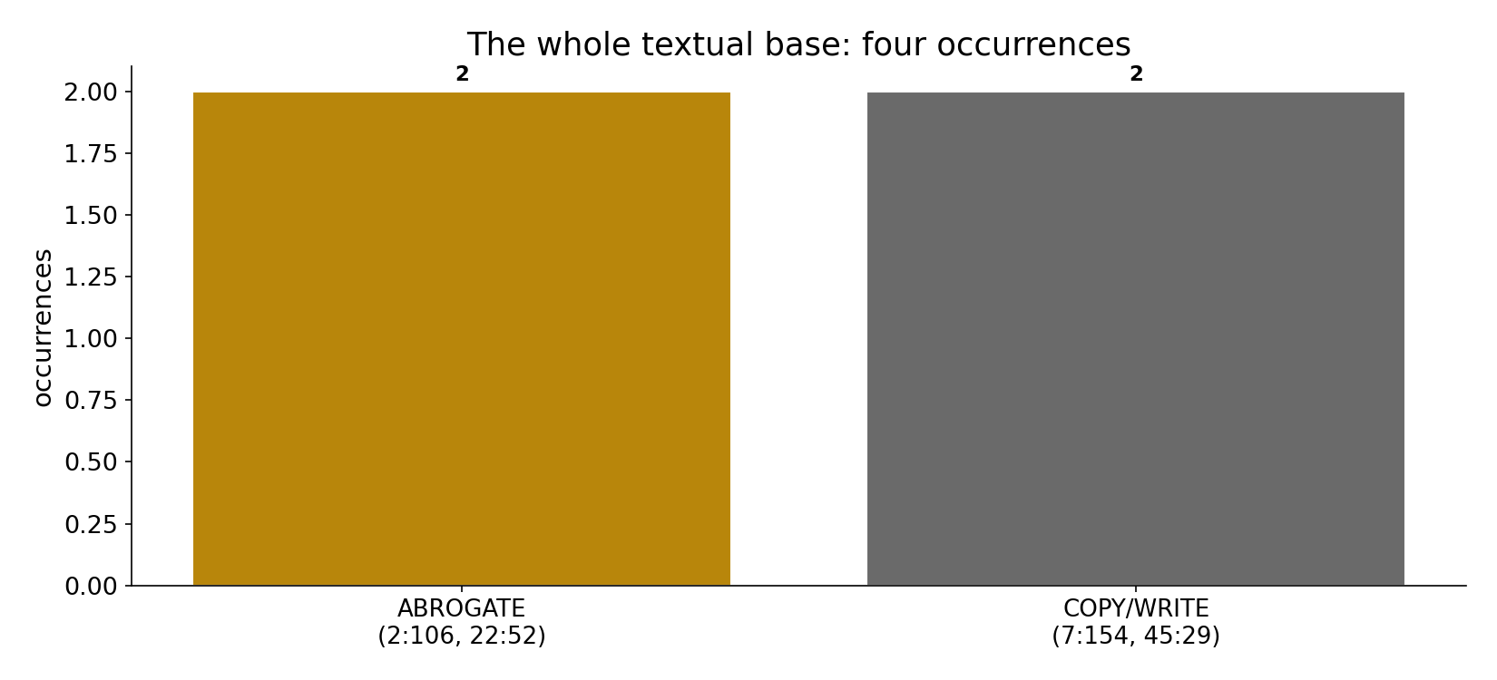
The whole textual base: four occurrences
In the data - the root appears just 4 times in the entire Qur'an: two mean 'abrogate' (2:106, 22:52), two mean 'copy/transcribe' (7:154, 45:29). A slender base for so large a doctrine.

Slide 4
The 'abrogate' sense (2 of 4)
the text's own words (address - snippet - gloss):
2:106 مَا نَنسَخْ مِنْ آيَةٍ أَوْ نُنسِهَا نَأْتِ بِخَيْرٍ - “whatever sign We abrogate…”
22:52 وَمَا أَرْسَلْنَا مِن قَبْلِك مِن رَّسُولٍ وَلَا نَبِيٍّ إِلَّا إِذَا تَمَنَّى أَلْقَى - God abrogates what Satan casts

Slide 5
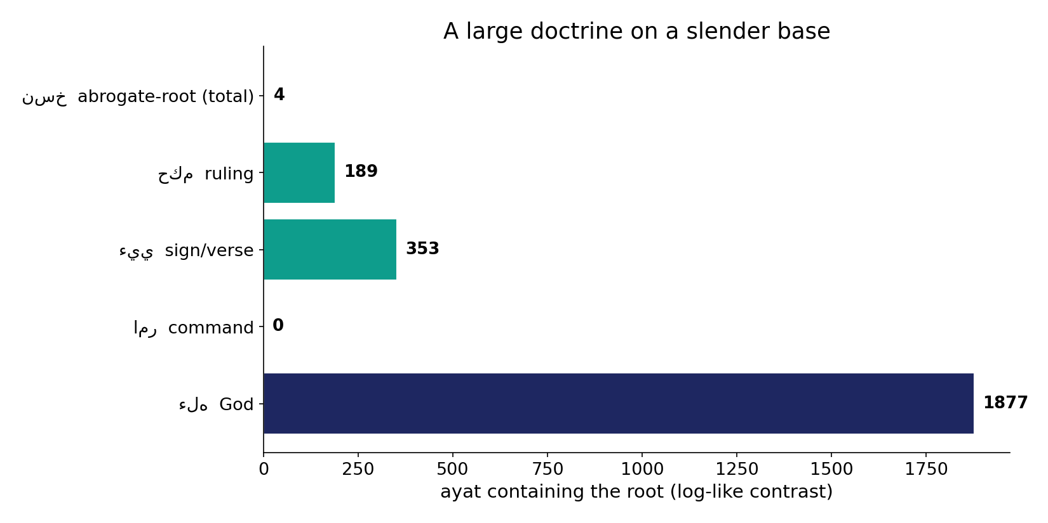
A large doctrine on a slender base
In the data - against ruling (189), sign/verse (353) and command (0), the abrogation-root's 4 occurrences are tiny. The doctrine vastly outweighs its lexical footprint.

Slide 6
What the data shows
Only four occurrences
the root appears just 4 times in the whole Qur'an - a slender base for so large a doctrine.
Half are not 'abrogation'
two mean abrogate (2:106, 22:52); two mean copy/transcribe (7:154, 45:29) - the same root, a different sense.
No named case
the text never names a specific verse-cancels-verse case; which verses (if any) abrogate which is entirely interpretive.

Slide 7
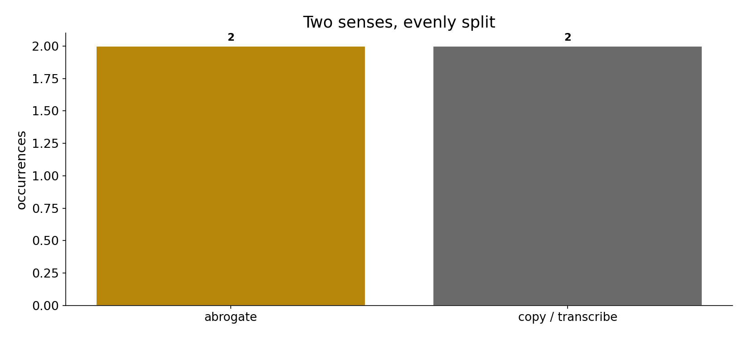
Two senses, evenly split
In the data - half the occurrences are not 'abrogation' at all: the tablets' text (7:154) and 'We were having it copied' (45:29) are about transcription. Same root, different sense.

Slide 8
The 'copy / transcribe' sense (2 of 4)
the text's own words (address - snippet - gloss):
7:154 وَلَمَّا سَكتَ عَن مُّوسَى الْغَضَبُ أَخَذَ الأَلْوَاحَ وَفِي نُسْخَتِهَا - COPY — “in its text (nuskha) is guidance”
45:29 هَذَا كِتَابُنَا يَنطِقُ عَلَيْكُم بِالْحَقِّ إِنَّا كُنَّا نَسْتَنسِخُ - same root = “We were COPYING”

Slide 9
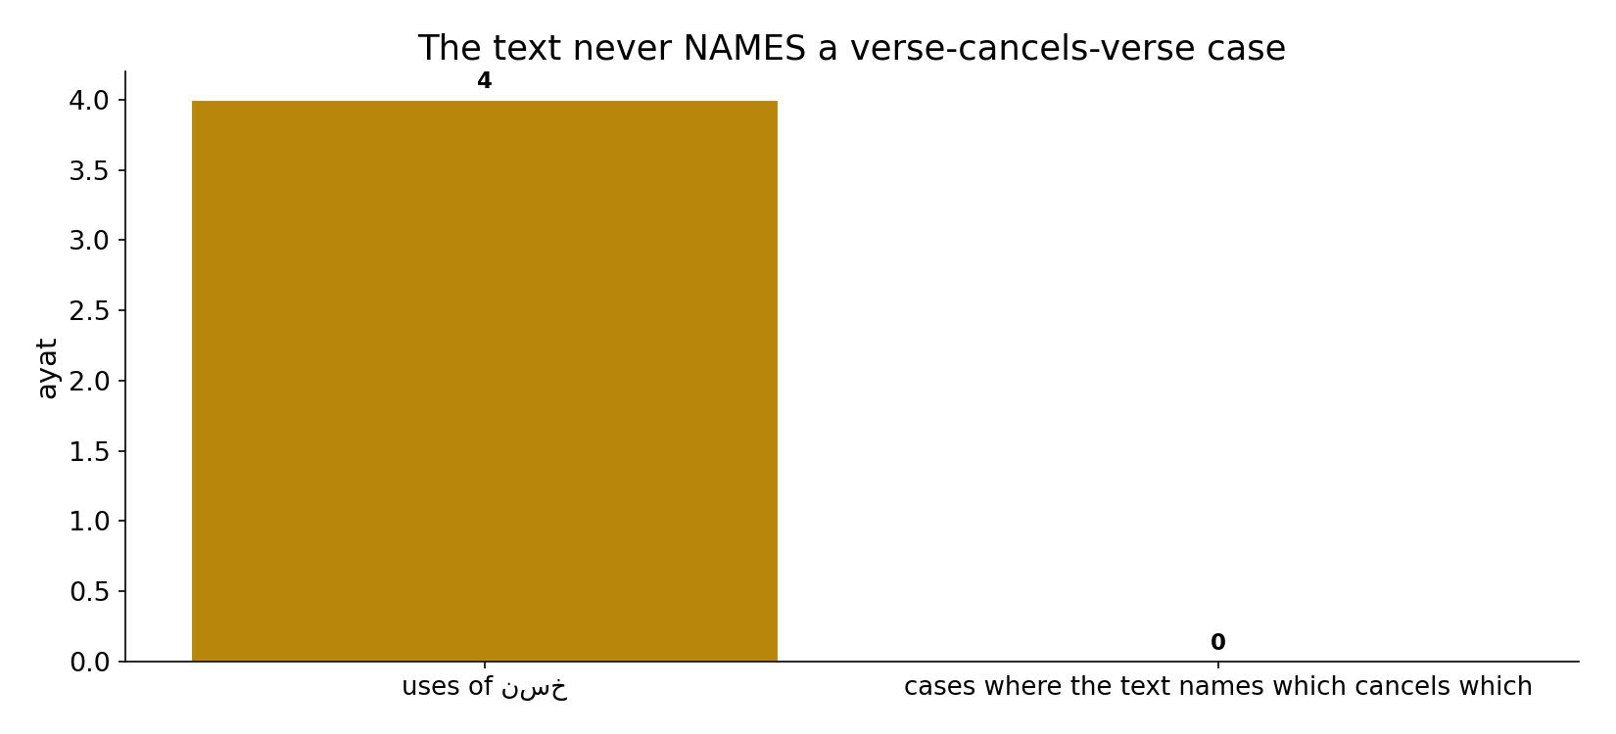
The text never names a case
In the data - across all 4 uses, the Qur'an never names a specific verse that cancels another: which verses (if any) abrogate which is entirely interpretive.

Slide 10
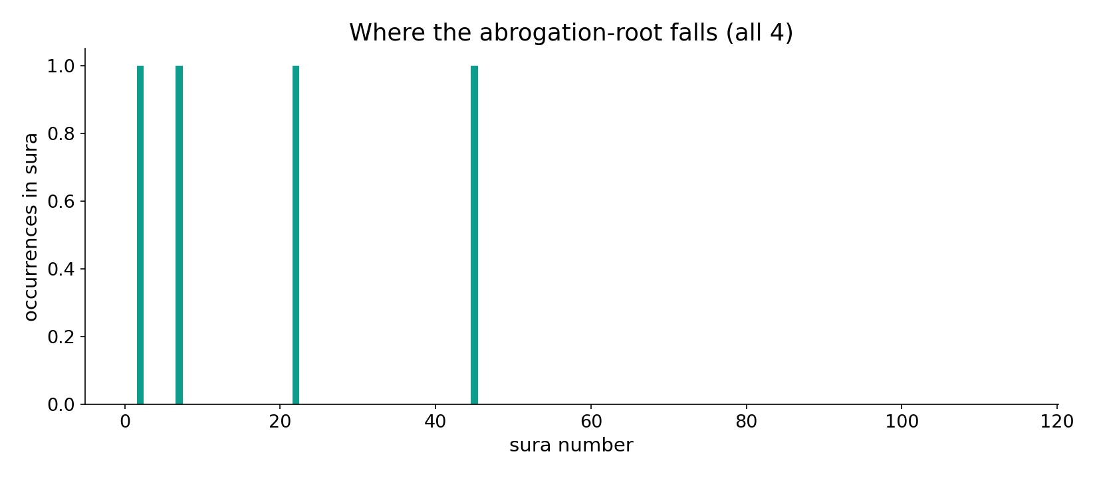
Where the root falls
In the data - the four occurrences sit in al-Baqara, al-Hajj, al-A'raf and al-Jathiya - scattered, not a doctrinal cluster.

Slide 11
A large doctrine on a slender textual base
Computed: the abrogation idea rests on ~2 verses (2:106, 22:52); the word also means 'copy,' and the text NEVER names a specific verse-cancels-verse case. So intra-Qur'anic abrogation is a juristic CONSTRUCT built atop a thin lexical base - not a self-declared feature of the text. This does not settle whether abrogation is true - only that the corpus barely uses the word and never lists cases.
2:106's 'sign' (aya) may mean a miracle or a prior scripture, not necessarily a Qur'anic verse - itself a reading.

Slide 12
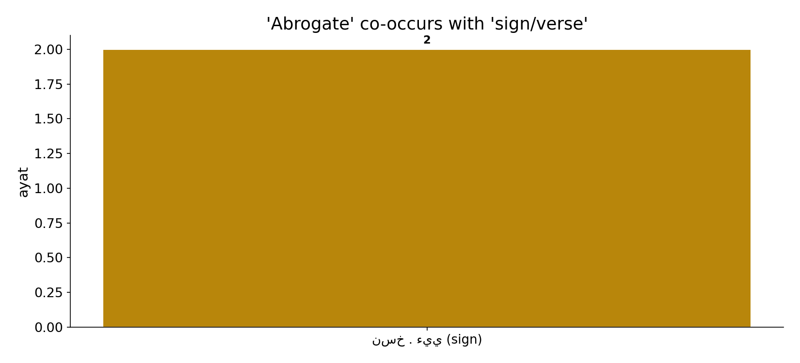
'Abrogate' and 'sign/verse'
In the data - 2:106 pairs the abrogate-sense with 'sign' (aya, 2 co-occurrence) - but 'sign' may mean a miracle or a prior scripture, not necessarily a Qur'anic verse.

Slide 13
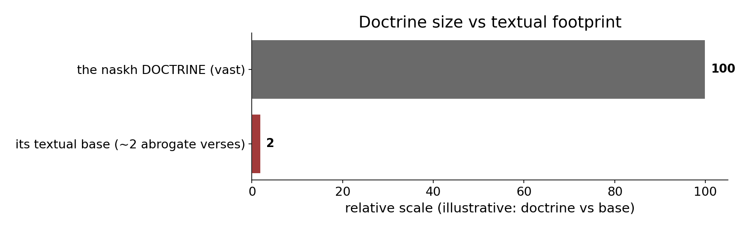
Doctrine vs footprint
In the data - the intra-Qur'anic abrogation doctrine is a juristic construct built atop ~2 abrogate-verses - the imbalance is the point (illustrative scale).

Slide 14
Doctrine vs base
The doctrine
vast juristic construct
The root
only 4 uses
Named cases
zero
A construct on a thin base
the corpus barely uses the word and never names a case - which verses abrogate which is interpretive.

Slide 15
Honest limits and critique
It does not disprove the doctrine
the slender base shows only that the corpus barely uses the word and never lists cases - not that abrogation is false.
'Sign' is ambiguous
2:106's 'aya' may mean a miracle or a prior scripture, not necessarily a Qur'anic verse - the reading is interpretive.

Slide 16
Reading this honestly - the audit
✓ Root counted
4 occurrences (reproduces exactly).
✓ Senses split
2 abrogate, 2 copy/transcribe.
✓ No named case
the text never names which verse cancels which.
~ Doesn't settle truth
only the lexical base is shown.
✗ Not a proof
counts/co-occurrence locate structure; theology is not settled by counts.
✗ No raw mixing
forms/senses separated before counting (course rule).

Slide 17
How this was computed (reproducible)
Book6
the abrogation-root; context senses
measure
count, sense split, named-case check
figures
use bars, slender-base contrast, sura map
count
chart
Fully reproducible
Every figure recomputes from Book6.xlsx via the shared wk.py kernel (fixed seed). Roots are normalized (Persian/Arabic letter variants folded) so counts are stable; surface forms are used wherever a concept must be kept apart from its root family (per the course's sense-verification rule).

Slide 18
Appendix - input snippets (Book6, vocalized)
verbatim snippets with addresses:
2:106 مَا نَنسَخْ مِنْ آيَةٍ أَوْ نُنسِهَا نَأْتِ بِخَيْرٍ - “whatever sign We abrogate…”
22:52 وَمَا أَرْسَلْنَا مِن قَبْلِك مِن رَّسُولٍ وَلَا نَبِيٍّ إِلَّا إِذَا تَمَنَّى أَلْقَى - God abrogates what Satan casts

Slide 19
Takeaway
A vast doctrine on about two verses
The abrogation-root appears only 4 times - two meaning 'abrogate,' two meaning 'copy.'
The text never names which verse cancels which: intra-Qur'anic abrogation is a juristic construct on a thin base.
This shows the lexical footprint, not whether the doctrine is true. Presented from the text.

Slide 20
Quick reference
The numbers
abrogation-root 4 total - 2 abrogate (2:106, 22:52), 2 copy (7:154, 45:29); zero named verse-cancels-verse cases.
The shape
a large doctrine on ~2 verses; half the root's uses mean 'copy'; the text never lists cases.

