Slide 1
SPECIAL TOPIC - intercession, Week 9
Is intercession denied or affirmed? (shafaa)
An apparent contradiction that dissolves on one qualifier
Some verses say no intercession will help; others speak of intercession 'by His leave.' A contradiction - or two halves of one rule? We read the intercession-root (26 occurrences) by type: independent intercession (denied) vs God-permitted intercession (affirmed).
The root-count recomputes from Book6 and reproduces exactly (26); the qualifier co-occurrence is computed.

Slide 2
The question, and the method
The claim to test
Do the 'no intercession' and 'intercession by His leave' verses contradict, or form one conditioned rule?
The method
- read the intercession-root by type: independent (denied) vs God-permitted (affirmed)
- count where the qualifier 'by His leave' (idhn) appears with it
- let the conditional clause work with the negation, not against it

Slide 3
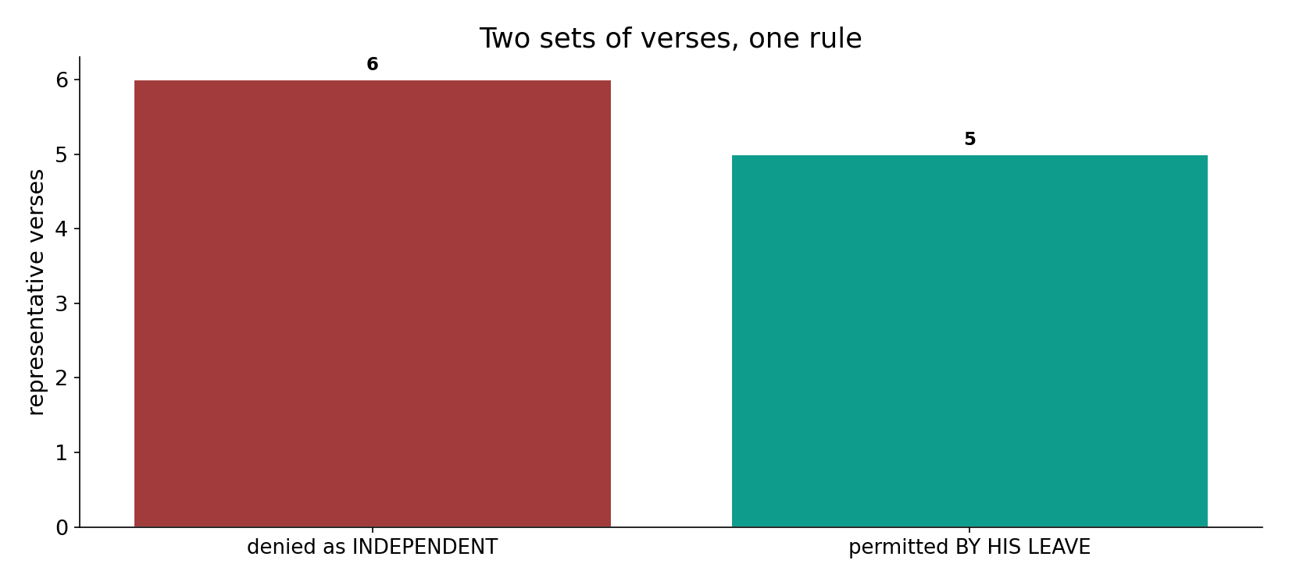
Two sets of verses, one rule
In the data - the 'denied' verses reject autonomous intercession; the 'permitted' ones add the qualifier 'by His leave' (5 co-occurrences with idhn). Two halves, not a contradiction.

Slide 4
Denied as an independent power
the text's own words (address - snippet - gloss):
2:48 وَاتَّقُواْ يَوْماً لاَّ تَجْزِي نَفْسٌ عَن نَّفْسٍ شَيْئاً وَلاَ - no intercession will avail
2:254 يَا أَيُّهَا الَّذِينَ آمَنُواْ أَنفِقُواْ مِمَّا رَزَقْنَاكُم مِّن قَبْلِ أَن - a Day with no intercession

Slide 5
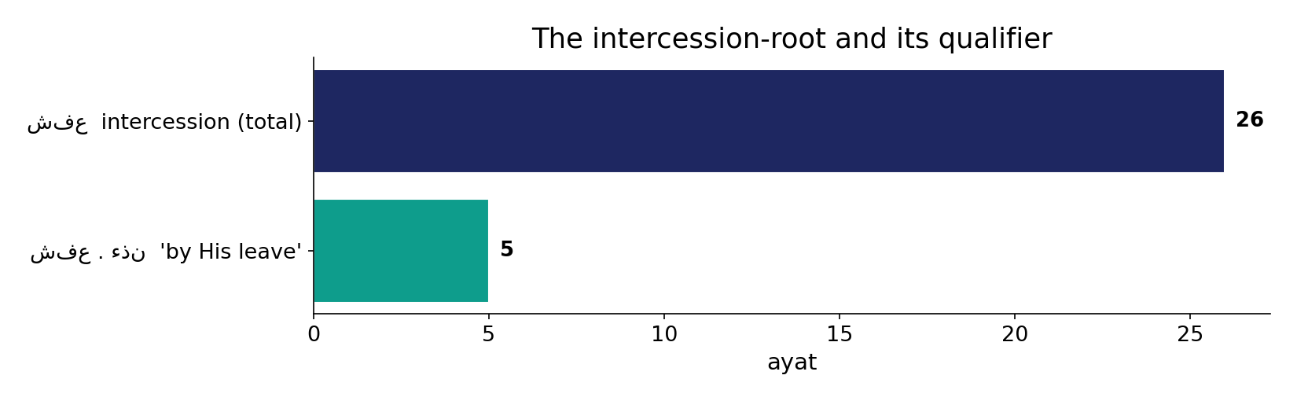
The root and its qualifier
In the data - intercession appears in 26 ayat; in 5 of them it is explicitly conditioned by 'His leave' (idhn) - the clause that reconciles the sets.

Slide 6
What the data shows
Denied as INDEPENDENT
no autonomous broker can override the verdict - 'no intercession is accepted' (2:48).
Permitted BY HIS LEAVE
intercession exists, but only as God permits - 'except by His leave' (2:255); 5 ayat carry the qualifier.
Belongs WHOLLY to God
'Say: intercession belongs altogether to God' (39:44) - the power is His to grant, never a rival authority.

Slide 7
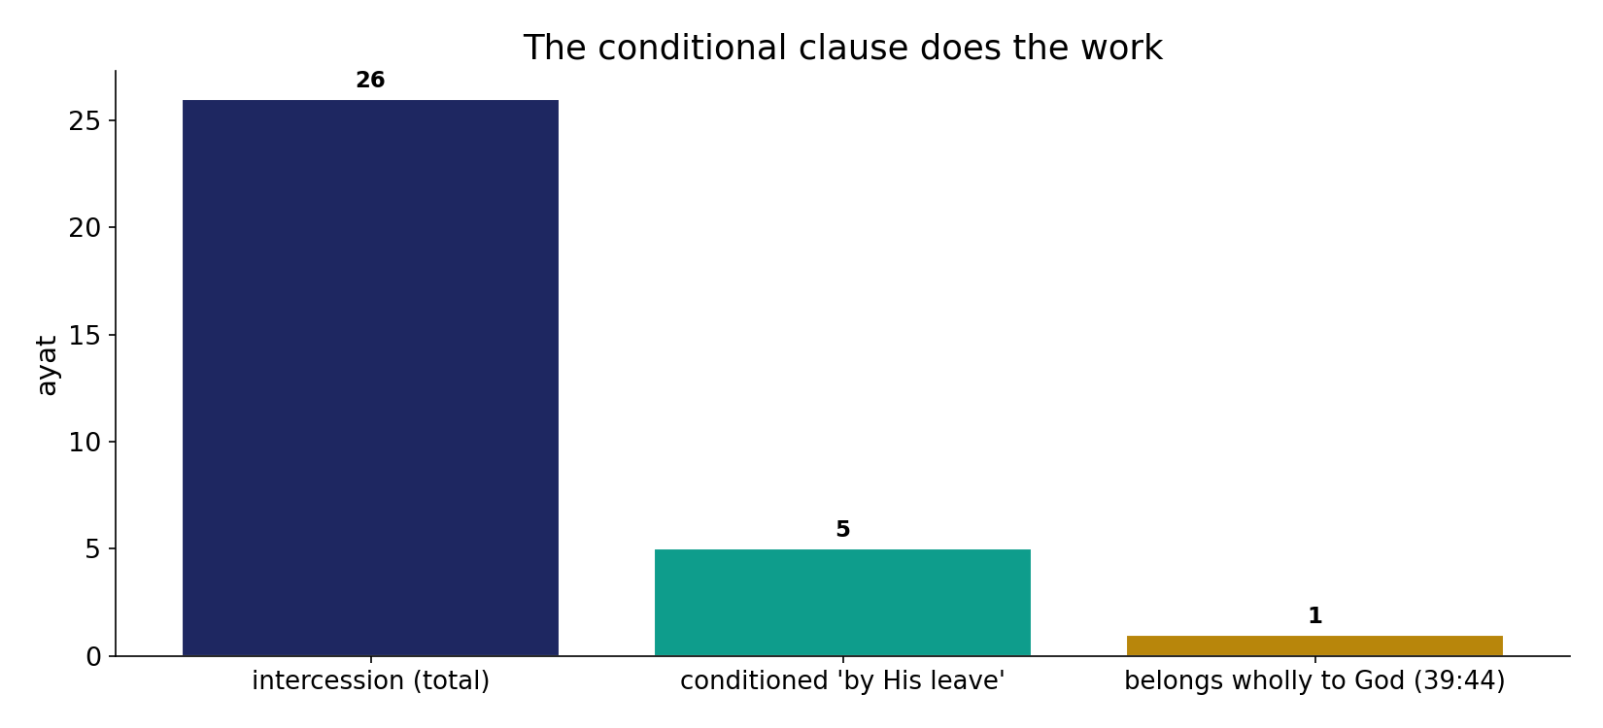
The conditional clause does the work
In the data - intercession (26) is denied as a power, permitted by leave (5), and declared to 'belong wholly to God' (39:44) - never a rival authority.

Slide 8
Only by His leave; wholly God's
the text's own words (address - snippet - gloss):
2:255 اللّهُ لاَ إِلَهَ إِلاَّ هُوَ الْحَيُّ الْقَيُّومُ لاَ تَأْخُذُهُ سِنَةٌ وَلاَ نَوْمٌ - “who intercedes except by His leave?”
10:3 إِنَّ رَبَّكُمُ اللّهُ الَّذِي خَلَقَ السَّمَاوَاتِ وَالأَرْضَ فِي سِتَّةِ أَيَّامٍ - “no intercessor except after His leave”
39:44 قُل لِّلَّهِ الشَّفَاعَةُ جَمِيعًا لَّهُ مُلْكُ - “intercession belongs wholly to God”
21:28 يَعْلَمُ مَا بَيْنَ أَيْدِيهِمْ وَمَا خَلْفَهُمْ وَلَا يَشْفَعُونَ إِلَّا - “they intercede only for whom He approves”

Slide 9
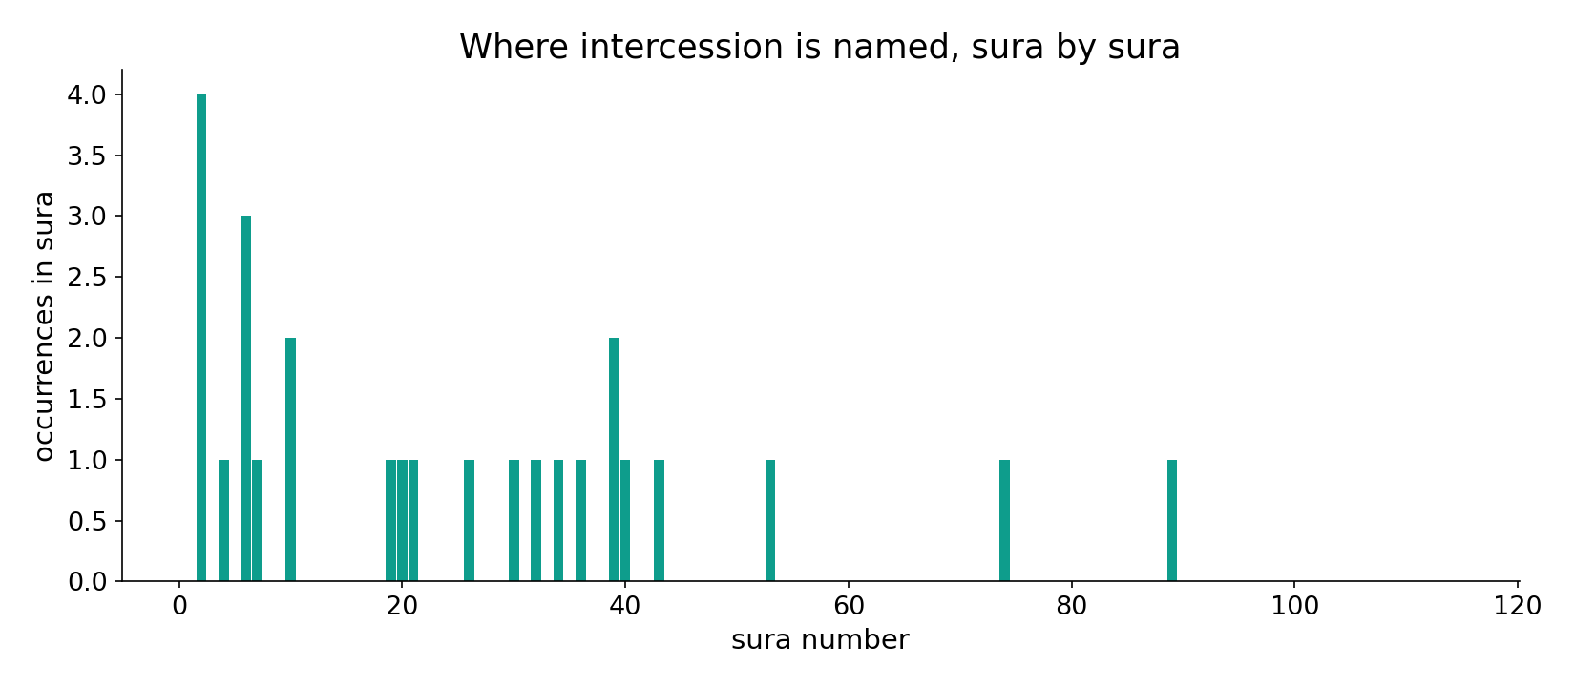
Intercession across the corpus
In the data - the intercession verses cluster in the eschatology passages (the Day, the reckoning).

Slide 10
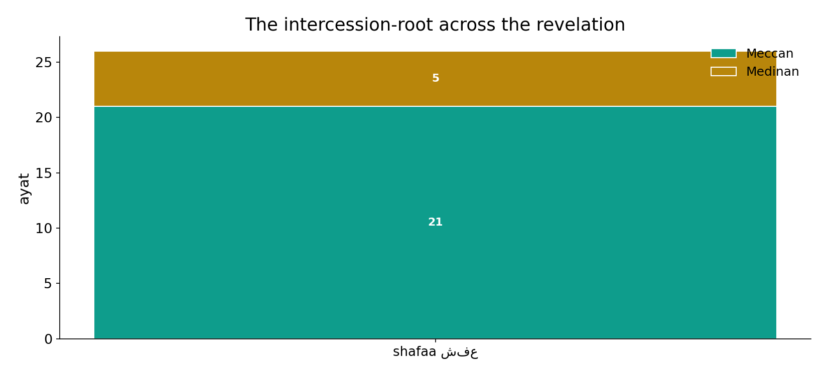
Across the revelation
In the data - the intercession-root runs across periods; the conditioned rule is consistent throughout.

Slide 11
Not a contradiction - a single conditioned rule
The two sets are reconciled by one qualifier. Intercession is denied as an INDEPENDENT power and affirmed only as GOD-PERMITTED - 'by His leave' (5 ayat), 'belongs wholly to God' (39:44). The apparent contradiction dissolves once the conditional clause is read WITH the negation, not against it. Whether anyone in fact receives that leave - and who - is the interpretive question the count does not settle.
Reading the 'no intercession' verses absolutely (ignoring 'except by His leave') is the classic audit failure.

Slide 12
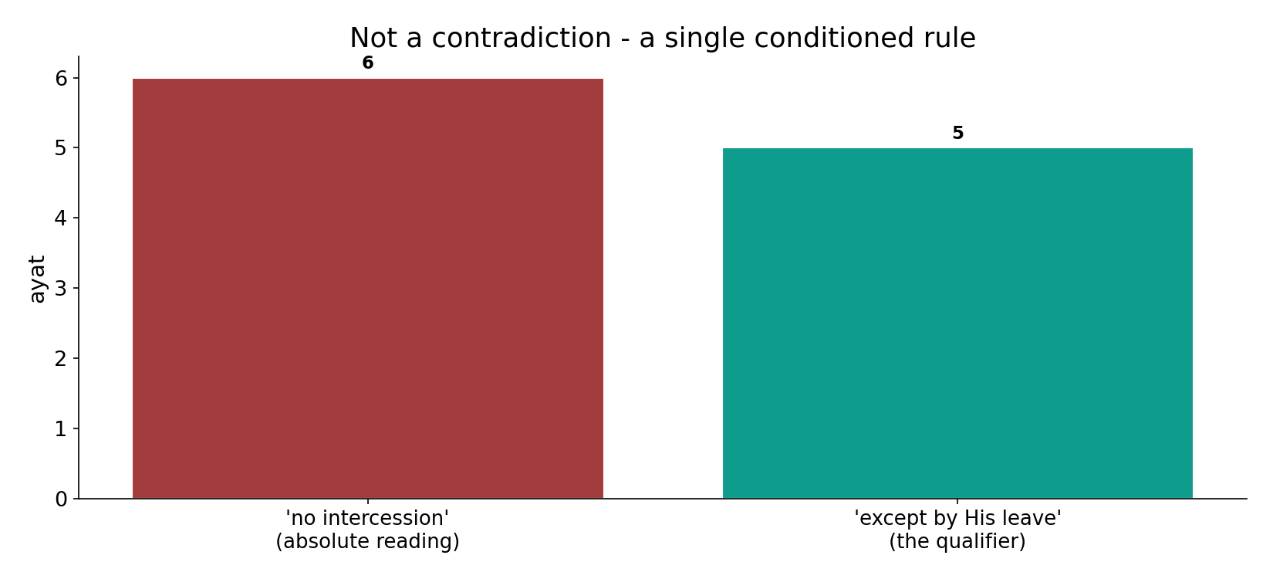
Not a contradiction
In the data - reading the 'no intercession' verses absolutely IGNORES 'except by His leave' (5); the apparent contradiction dissolves once the qualifier is read WITH the negation.

Slide 13
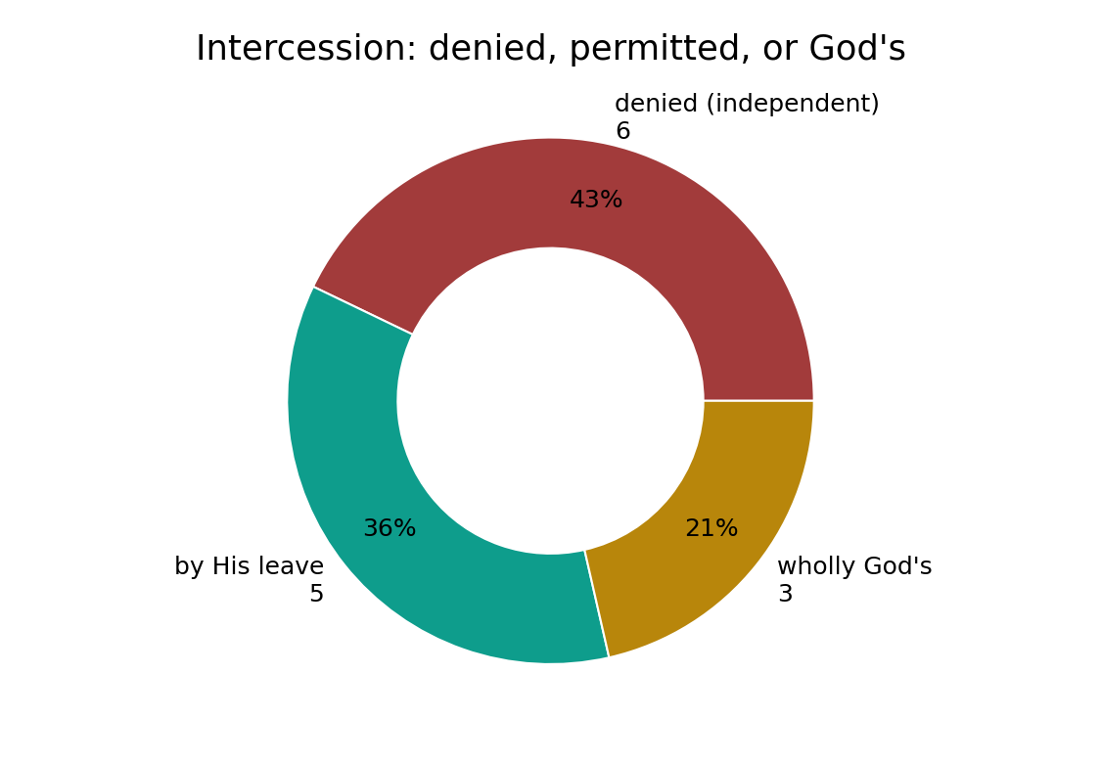
Denied, permitted, or God's
In the data - the verses sort into: denied as an independent power, permitted by His leave, and belonging wholly to God - one conditioned rule with three faces.

Slide 14
One rule, two halves
Denied
no independent broker
+ Qualifier
'except by His leave'
= One rule
intercession belongs wholly to God
The qualifier reconciles
read 'except by His leave' WITH the negation and the contradiction dissolves.

Slide 15
Honest limits and critique
The count does not settle 'who'
whether anyone in fact receives that leave - and who - is the interpretive question the data leaves open.
Absolute reading is the audit failure
treating 'no intercession' as unconditional ignores the explicit qualifier in the same corpus - the classic cherry-pick.

Slide 16
Reading this honestly - the audit
✓ Root counted
26 occurrences (reproduces exactly).
✓ Qualifier computed
'by His leave' co-occurs 5 times.
✓ Reconciled by one clause
denied independent + permitted by leave = one rule.
~ 'Who receives leave' open
the count does not settle that.
✗ Not a proof
counts/co-occurrence locate structure; theology is not settled by counts.
✗ No raw mixing
forms/senses separated before counting (course rule).

Slide 17
How this was computed (reproducible)
Book6
the intercession-root; the qualifier idhn
measure
type split, qualifier co-occurrence
figures
split bars, qualifier bar, sura map, donut
count
chart
Fully reproducible
Every figure recomputes from Book6.xlsx via the shared wk.py kernel (fixed seed). Roots are normalized (Persian/Arabic letter variants folded) so counts are stable; surface forms are used wherever a concept must be kept apart from its root family (per the course's sense-verification rule).

Slide 18
Appendix - input snippets (Book6, vocalized)
verbatim snippets with addresses:
2:48 وَاتَّقُواْ يَوْماً لاَّ تَجْزِي نَفْسٌ عَن نَّفْسٍ شَيْئاً وَلاَ - no intercession will avail
2:254 يَا أَيُّهَا الَّذِينَ آمَنُواْ أَنفِقُواْ مِمَّا رَزَقْنَاكُم مِّن قَبْلِ أَن - a Day with no intercession

Slide 19
Takeaway
One conditioned rule, not a contradiction
Intercession (26 ayat) is denied as an independent power and affirmed only 'by His leave' (5).
'Belongs wholly to God' (39:44) - the power is His to grant, never a rival authority.
The contradiction dissolves on the qualifier; whether anyone receives leave is interpretive. Presented from the text.

Slide 20
Quick reference
The numbers
intercession-root 26; 'by His leave' co-occurs 5; 'wholly God's' (39:44).
The shape
denied as independent, permitted by His leave, wholly God's - one conditioned rule; reading absolutely is the audit failure.

