Slide 1
SPECIAL TOPIC - conditioned combat, Week 9
Does Islam rule by the sword or by peace?
The literal 'sword' never occurs - combat is a conditioned minority
A loaded either/or: 'Islam spread by the sword' vs 'Islam is a religion of pure peace.' The corpus is the referee. First datum: the literal word for 'sword' never occurs. We sense-filter the war vocabulary (killing is mostly murder, not war; striving is not all combat) and read the conditions placed on combat.
Counts recompute from Book6; only sense-filtered forms are counted (the killing-root is mostly 'kill/murder', not war).

Slide 2
The question, and the method
The claim to test
'Rules by the sword' vs 'pure pacifism' - which, if either, does the corpus support?
The method
- count the war-words, sense-filtered (sword, war, combat, striving)
- separate combat (qital) from killing/murder
- read the conditions placed on combat - defensive, bounded, suspended on peace

Slide 3
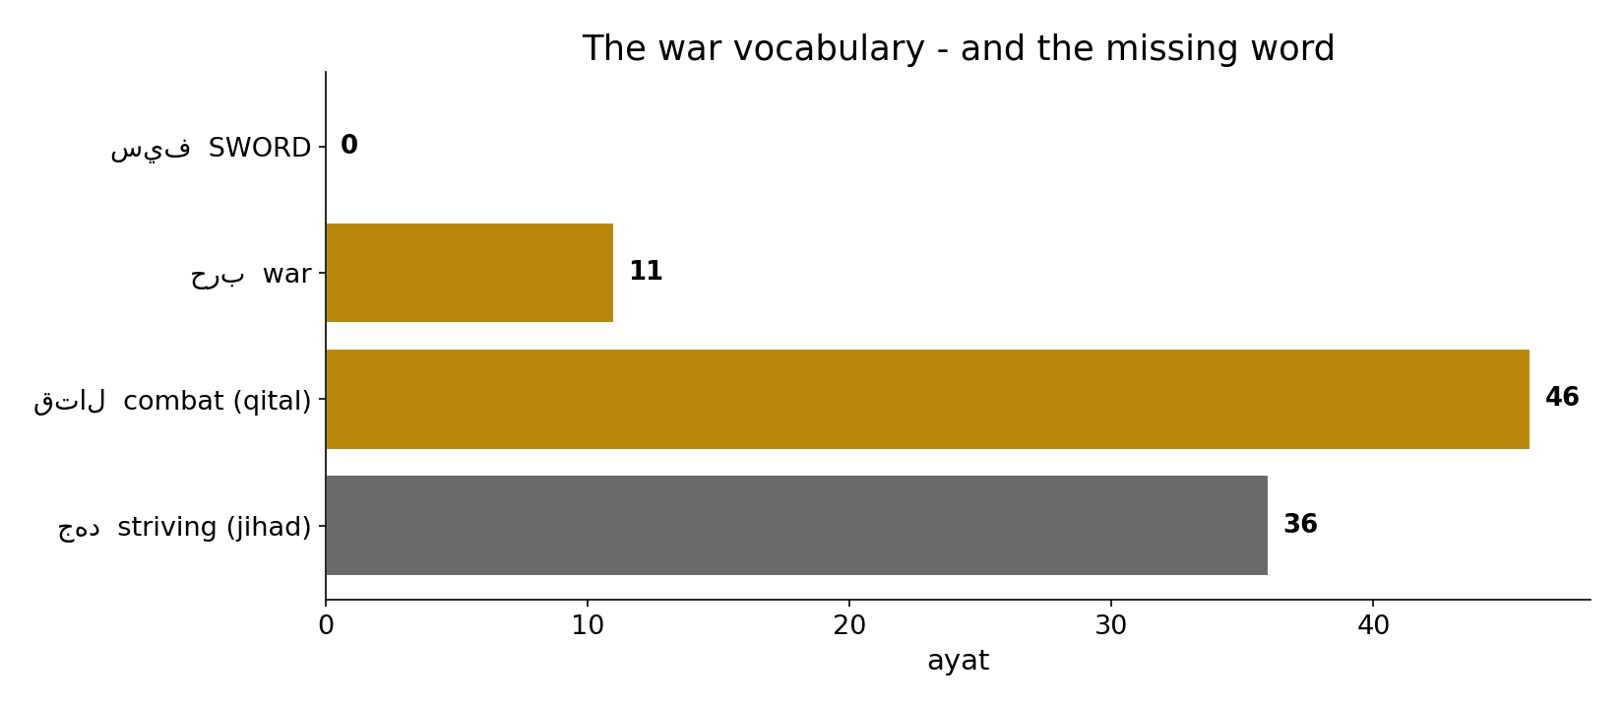
The war vocabulary - and the missing word
In the data - the literal 'sword' appears 0 times; war-words exist (combat 46, war 11) but are a minority. There is no lexical basis for 'the sword.'

Slide 4
Fighting is conditioned
the text's own words (address - snippet - gloss):
2:190 وَقَاتِلُواْ فِي سَبِيلِ اللّهِ الَّذِينَ يُقَاتِلُونَكُمْ - fight only those who fight you
60:8 عَنِ الَّذِينَ لَمْ يُقَاتِلُوكُمْ فِي الدِّينِ وَلَمْ يُخْرِجُوكُم مِّن - be kind to those who don’t fight you

Slide 5
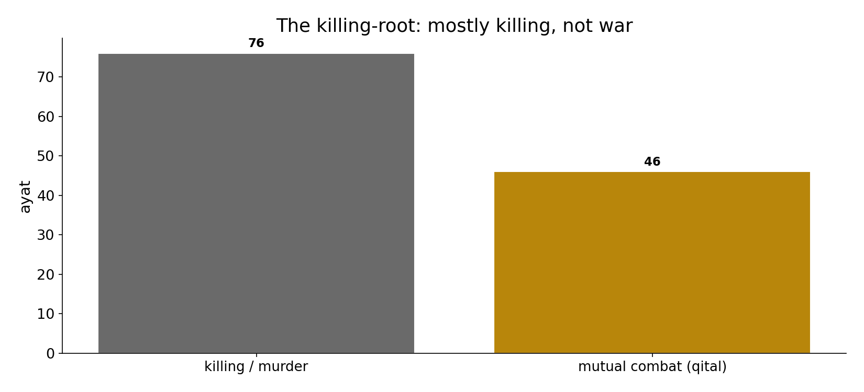
Killing is mostly NOT war
In the data - the killing-root (122) is mostly killing/murder - much of it CONDEMNED ('who kills one soul kills all', 5:32); only 46 are mutual combat (qital).

Slide 6
What the data shows
The sword is absent
the literal word for 'sword' = 0. War-words exist but are a minority - no lexical basis for 'the sword.'
Killing is mostly not war
76 of the killing-root are killing/murder (much condemned); only 46 are mutual combat.
Combat is conditioned
defensive ('fight those who fight you', 2:190), bounded ('do not transgress', 12), suspended on peace ('incline to it', 4).

Slide 7
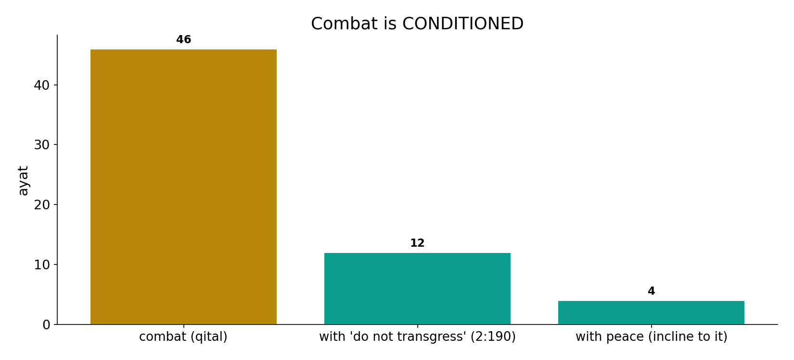
Combat is conditioned
In the data - combat (46) sits with 'do not transgress' (12) and with peace (4): defensive, bounded, and suspended on the enemy's peace.

Slide 8
Peace, and no compulsion
the text's own words (address - snippet - gloss):
8:61 وَإِن جَنَحُواْ لِلسَّلْمِ فَاجْنَحْ لَهَا وَتَوَكَّلْ عَلَى اللّهِ - if they incline to peace, incline
2:256 لاَ إِكْرَاهَ فِي الدِّينِ قَد تَّبَيَّنَ الرُّشْدُ مِنَ الْغَيِّ - no compulsion in religion
49:9 مِنَ الْمُؤْمِنِينَ اقْتَتَلُوا فَأَصْلِحُوا بَيْنَهُمَا فَإِن بَغَتْ إِحْدَاهُمَا عَلَى - make peace between believers
5:32 إِسْرَائِيلَ أَنَّهُ مَن قَتَلَ نَفْسًا بِغَيْرِ نَفْسٍ أَوْ فَسَادٍ - to kill one soul = to kill all

Slide 9
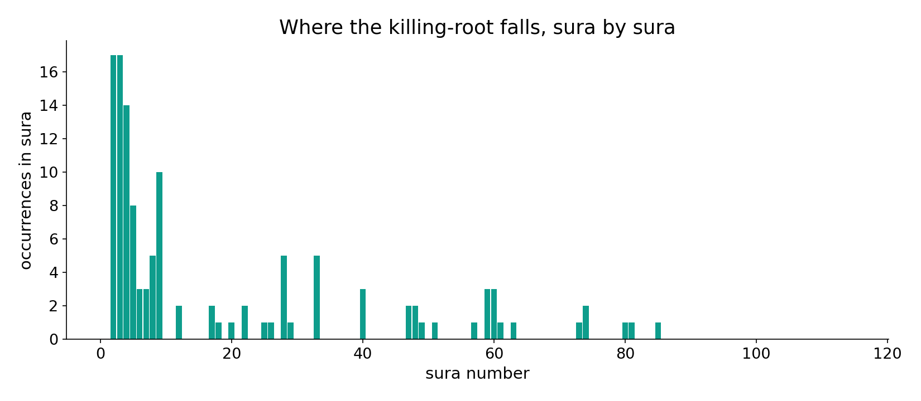
The killing-root across the corpus
In the data - the killing-root spans the corpus, much of it in narrative and prohibition (murder condemned), not battle command.

Slide 10
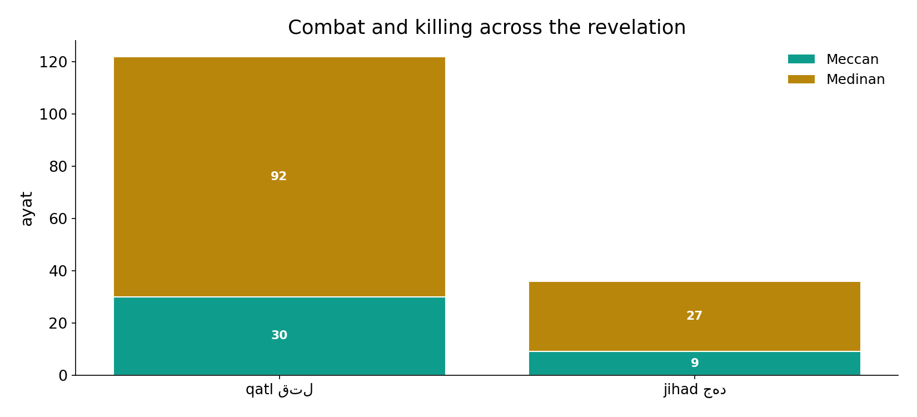
Combat and striving across the revelation
In the data - combat concentrates in the Medinan period (self-defence of the community); striving (jihad) is broader than fighting.

Slide 11
Conditioned combat inside a default of peace
Neither slogan holds. Combat is permitted but CONDITIONED: defensive ('fight those who fight you', 2:190), bounded ('do not transgress', 12 co-occurrences), suspended on the enemy's peace ('if they incline to peace, incline to it', 8:61). And belief is left free: 'no compulsion in religion' (2:256; ikrah 35); be just to those who do not fight you (60:8).
'Rules by the sword' has no lexical basis (sword=0) and ignores the conditions; 'pure pacifism' ignores the real combat commands.

Slide 12
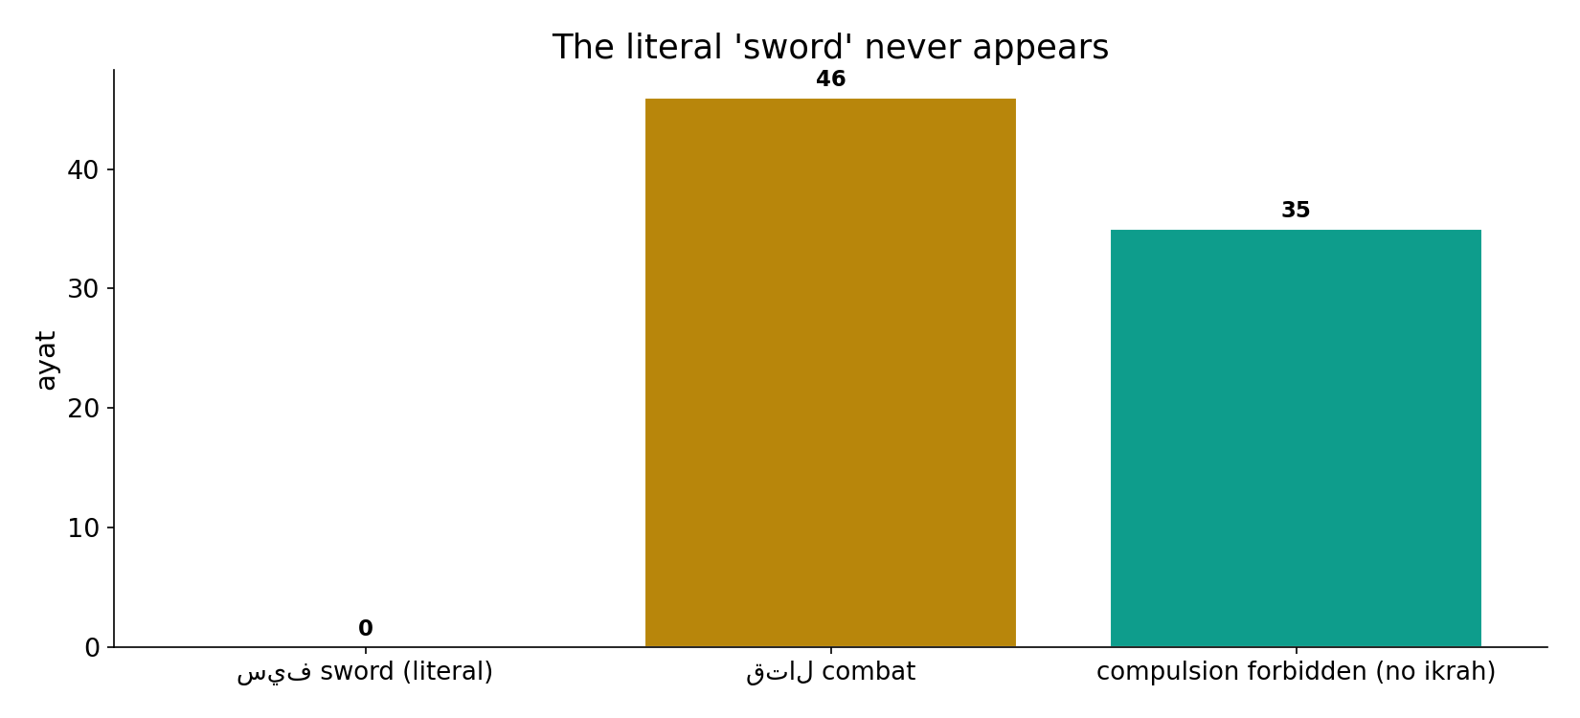
The literal 'sword' never appears
In the data - sword = 0, while 'no compulsion' vocabulary (ikrah, 35) and conditioned combat frame the picture: a default of peace around hedged combat.

Slide 13
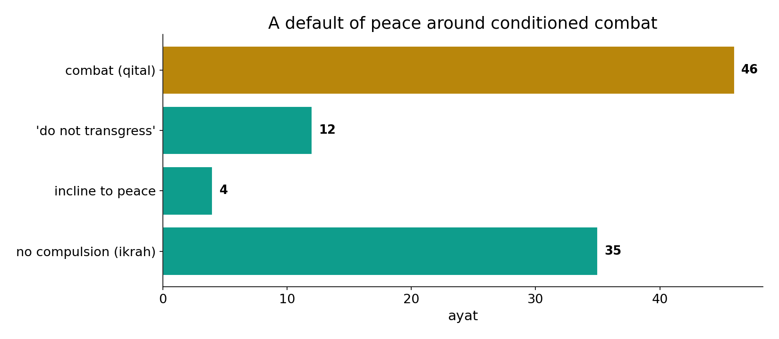
A default of peace
In the data - combat (46) is wrapped in 'do not transgress' (12), 'incline to peace' (4) and 'no compulsion' (35). Belief is left free (2:256).

Slide 14
Neither slogan
'By the sword'
no lexical basis (sword=0)
Conditioned combat
defensive, bounded
'Pure pacifism'
ignores real qital commands
A default of peace around hedged combat
combat is permitted but conditioned; belief is left free - both slogans cherry-pick.

Slide 15
Honest limits and critique
Both slogans cherry-pick
'rules by the sword' has no lexical basis and ignores the conditions; 'pure pacifism' ignores the real combat commands - each picks half.
Raw counts would mislead
the killing-root is mostly 'killing', the striving-root is broader than war; only sense-filtered forms were counted.

Slide 16
Reading this honestly - the audit
✓ Sword absent
literal sword = 0.
✓ Combat sized
combat 46 of killing-root 122.
✓ Conditions computed
'do not transgress' 12, peace 4, no-compulsion 35.
~ Sense-filtered
killing != war; striving != combat.
✗ Not a proof
counts/co-occurrence locate structure; theology is not settled by counts.
✗ No raw mixing
forms/senses separated before counting (course rule).

Slide 17
How this was computed (reproducible)
Book6
war vocabulary (sense-filtered); conditions
measure
sword/war/combat counts, combat conditions
figures
war bars, killing-vs-combat, condition bars, sura map
count
chart
Fully reproducible
Every figure recomputes from Book6.xlsx via the shared wk.py kernel (fixed seed). Roots are normalized (Persian/Arabic letter variants folded) so counts are stable; surface forms are used wherever a concept must be kept apart from its root family (per the course's sense-verification rule).

Slide 18
Appendix - input snippets (Book6, vocalized)
verbatim snippets with addresses:
2:190 وَقَاتِلُواْ فِي سَبِيلِ اللّهِ الَّذِينَ يُقَاتِلُونَكُمْ - fight only those who fight you
60:8 عَنِ الَّذِينَ لَمْ يُقَاتِلُوكُمْ فِي الدِّينِ وَلَمْ يُخْرِجُوكُم مِّن - be kind to those who don’t fight you

Slide 19
Takeaway
Conditioned combat inside a default of peace
The literal 'sword' never appears (0); combat (46) is a sense-filtered minority of the killing-root.
Combat is defensive, bounded ('do not transgress', 12), and suspended on peace (4); belief is free ('no compulsion', 35).
Both slogans cherry-pick; raw counts would mislead. Presented from the text.

Slide 20
Quick reference
The numbers
sword 0 - war 11 - combat 46 - jihad 36; killing-root 122; 'do not transgress' 12, peace 4, no-compulsion 35.
The shape
no literal sword; combat conditioned (defensive, bounded, suspended on peace); belief free; both slogans cherry-pick.

