Slide 1
SPECIAL TOPIC - divine names, Week 10
Allah, Rabb, al-Rahman, ilah - which Name does which work?
Not interchangeable - each word carries a distinct role
The Qur'an names God many ways. Are they interchangeable, or does each carry a distinct role - proper name, relation, attribute, or negated generic? We count the principal divine words and read how each is used grammatically.
Counts recompute from Book6; 'Allah' is the most frequent word in the corpus, al-Rahman the rare signature attribute.

Slide 2
The question, and the method
The question
Are the divine names interchangeable, or do they divide the labour of naming God?
The method
- count the principal divine words
- read how each is used: proper name? possessed? negated?
- separate computed frequency from the labelled role

Slide 3
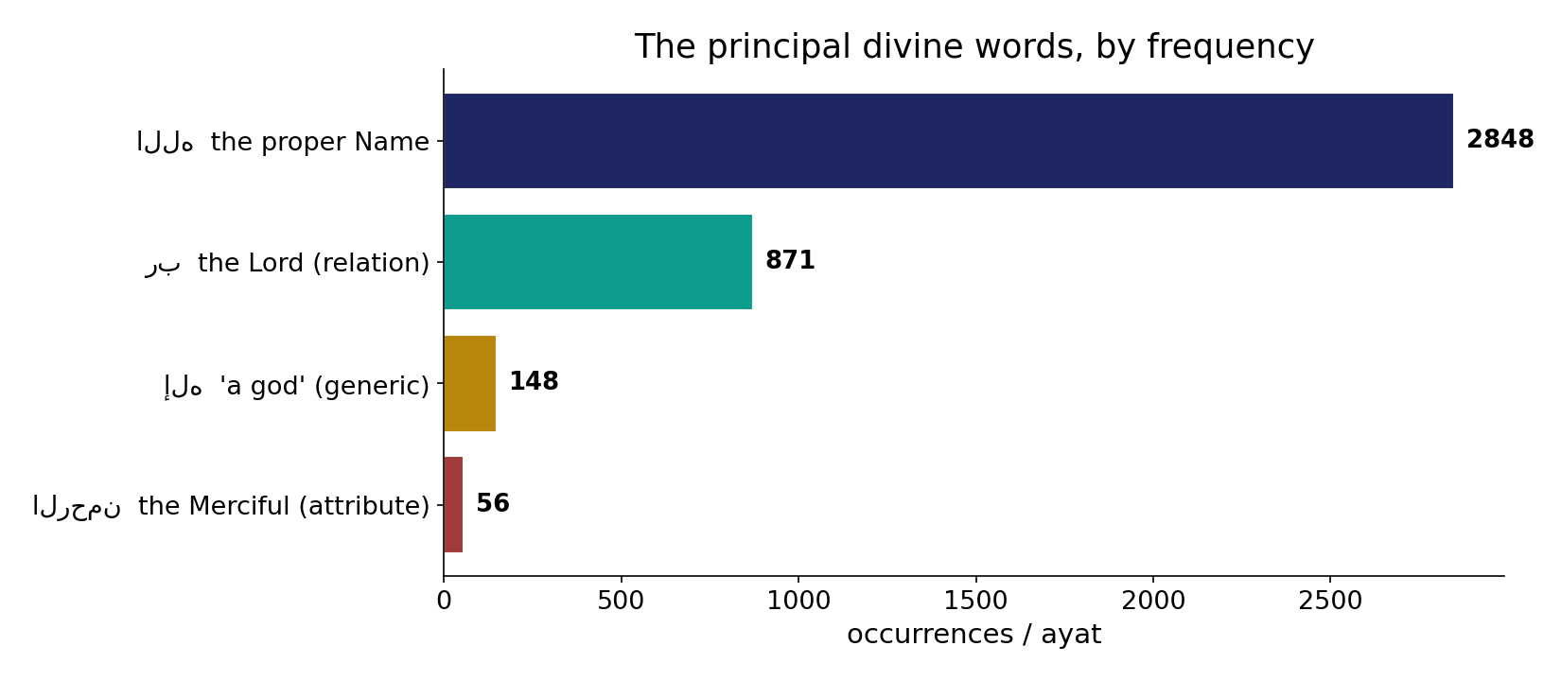
The principal divine words
In the data - 'Allah' dominates (2848); 'Lord' (Rabb) is next (871); 'a god' (ilah, 148) and al-Rahman (56) are far smaller. Frequency alone hints at different roles.

Slide 4
The relational Lord; the proper Name
the text's own words (address - snippet - gloss):
1:2 الْحَمْدُ للّهِ رَبِّ الْعَالَمِينَ - رَبّ — Lord of the worlds
113:1 قُلْ أَعُوذُ بِرَبِّ الْفَلَقِ - رَبّ — “Lord of the daybreak”
112:1 قُلْ هُوَ اللَّهُ أَحَدٌ - الله — “Say: He is God, One”
2:255 اللّهُ لاَ إِلَهَ إِلاَّ هُوَ الْحَيُّ الْقَيُّومُ - الله — “God: no god but He…”

Slide 5
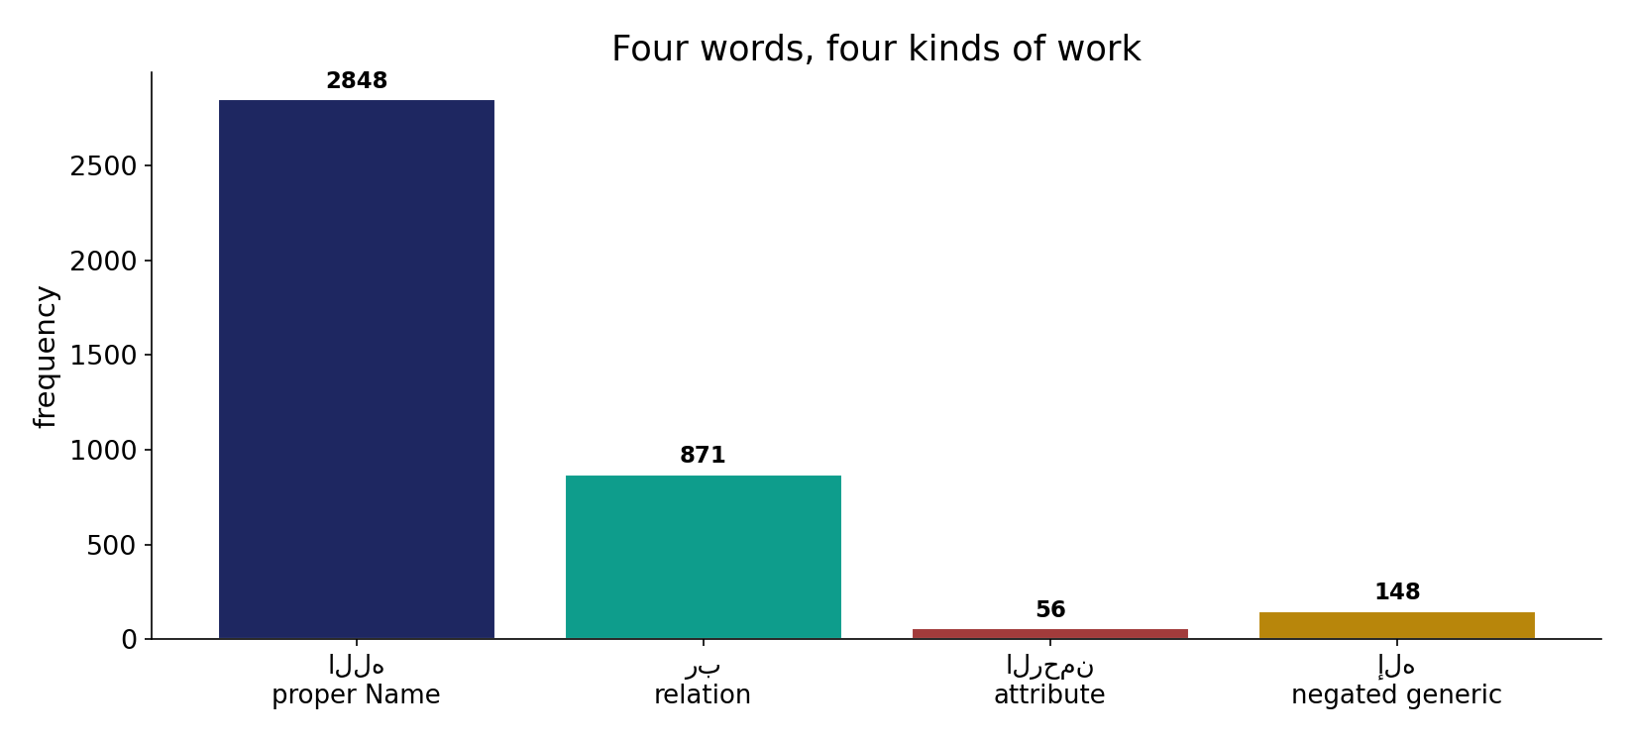
Four kinds of work
In the data - the proper Name (Allah, 2848), the relation (Rabb, 871), the attribute (al-Rahman, 56) and the negated generic (ilah, 148) divide the labour of naming God.

Slide 6
What the data shows
Allah - the proper Name
by far the most frequent (2848); a proper name, not a description - never pluralised, never feminised.
Rabb - the relational Lord
Lord/sustainer (871), overwhelmingly possessed (your/our/my Lord) - the Name prayers most often call.
al-Rahman & ilah - attribute & negation
al-Rahman (56) is the signature attribute; ilah (148) is the generic the creed negates ('no god but Allah').

Slide 7
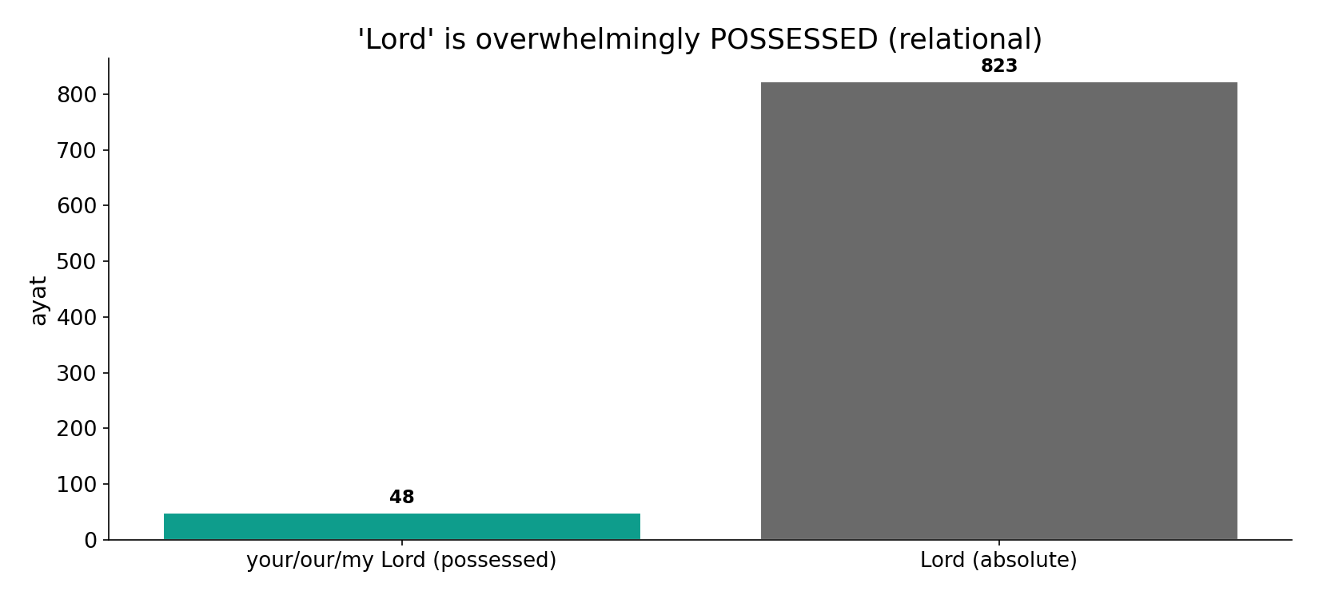
'Lord' is overwhelmingly possessed
In the data - 'Rabb' appears mostly POSSESSED (your/our/my Lord) - a name of RELATION, the one prayers most often call.

Slide 8
The negated generic - 'no god but...'
the text's own words (address - snippet - gloss):
21:25 وَمَا أَرْسَلْنَا مِن قَبْلِك مِن رَّسُولٍ إِلَّا نُوحِي إِلَيْهِ أَنَّهُ - إله — no god but Me (worship)
47:19 فَاعْلَمْ أَنَّهُ لَا إِلَهَ إِلَّا اللَّهُ وَاسْتَغْفِرْ - إله — “know there is no god but Allah”

Slide 9
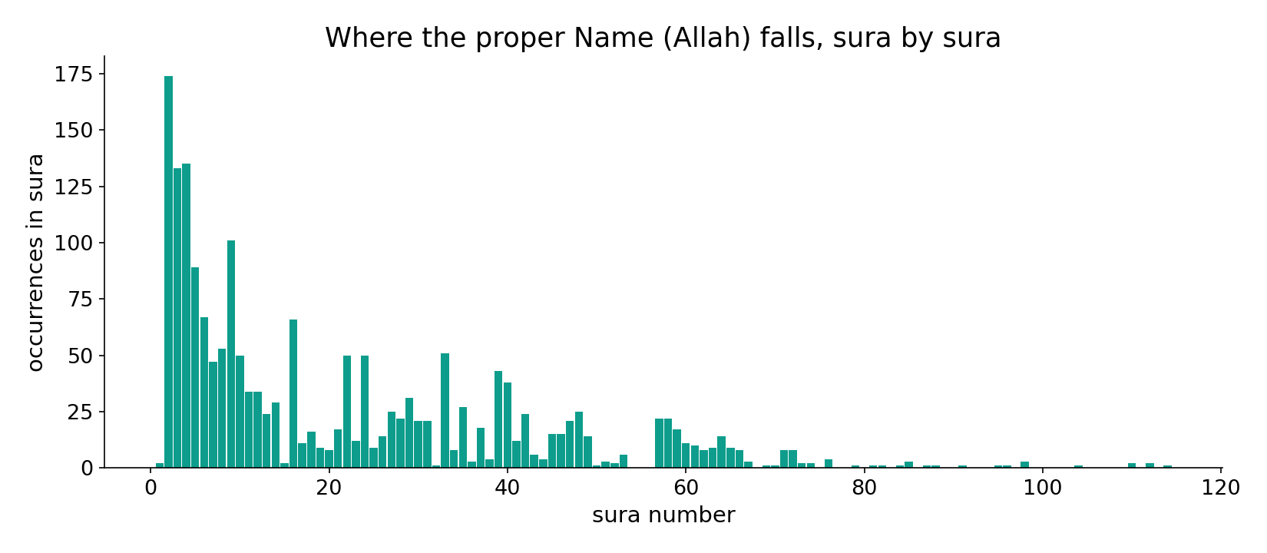
The proper Name across the corpus
In the data - 'Allah' is named throughout - the unique referent, never pluralised, never feminised.

Slide 10
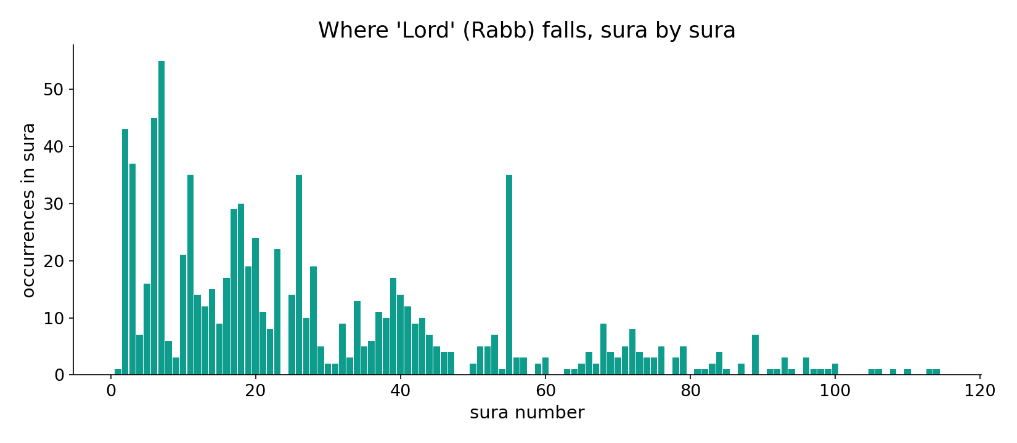
'Lord' across the corpus
In the data - 'Rabb' clusters in the supplication and creation passages - the relational, called-upon Name.

Slide 11
One Referent, four kinds of word
Computed: 'Allah' dominates (2848) as the proper name; 'Rabb' (871) is the relational term, almost always possessed; al-Rahman (56) is the signature attribute; 'ilah' (148) is the category-word, mostly appearing to be DENIED. So the names are not interchangeable - they divide the labour: identity (Allah), relationship (Rabb), mercy-attribute (al-Rahman), and the negated generic (ilah).
Lemma-level counting flattens Rabb's possessive forms into one figure; the relational point is read from usage, not the bare count.

Slide 12
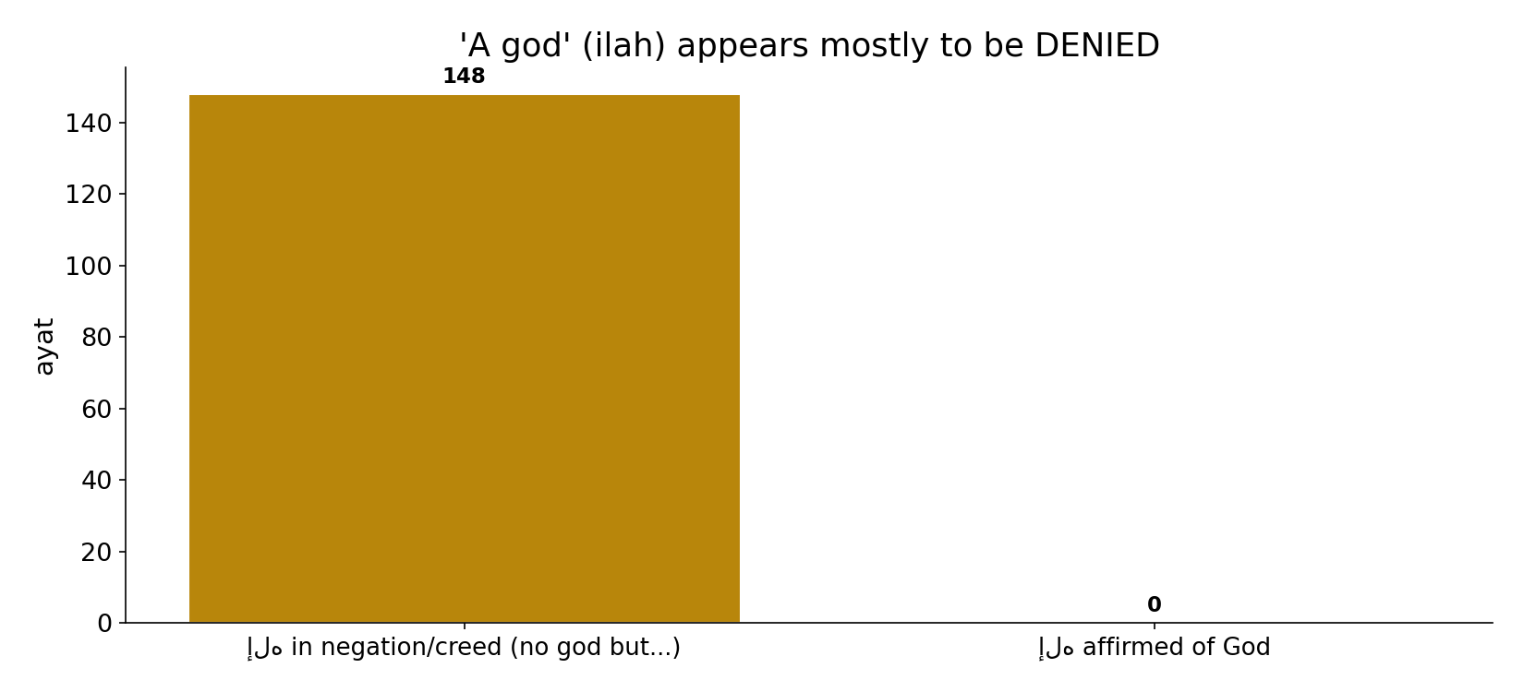
'A god' appears mostly to be denied
In the data - 'ilah' (148) is the GENERIC the creed negates - 'no ilah but Allah' - a category-word that mostly appears inside a negation.

Slide 13
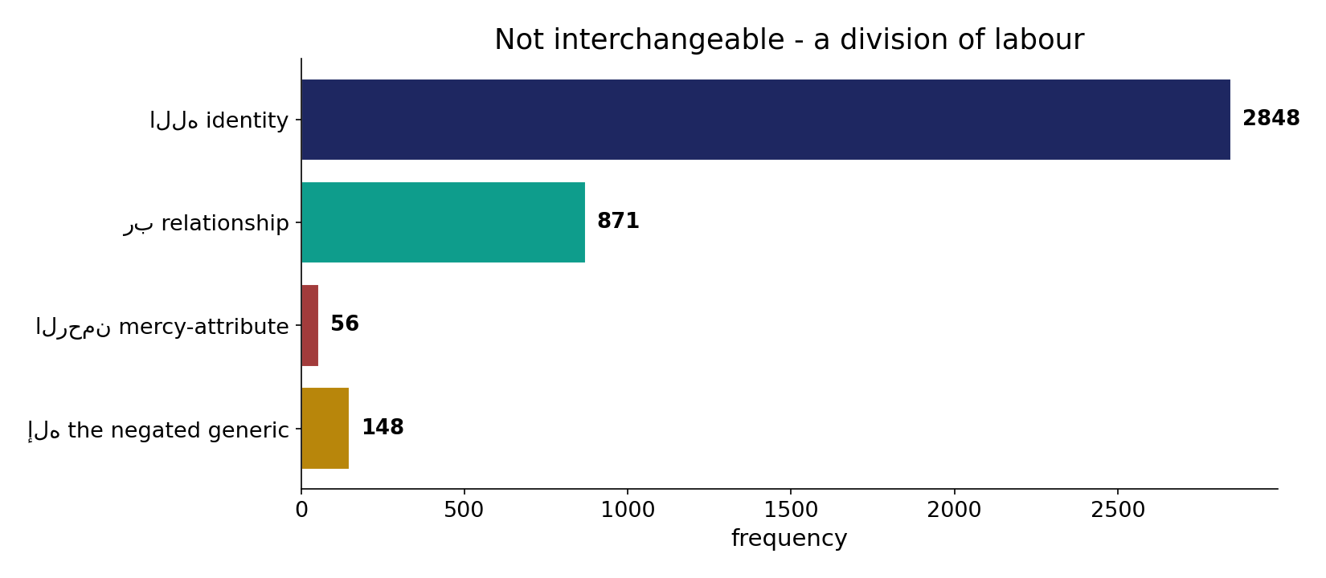
A division of labour
In the data - the names are not interchangeable: identity (Allah), relationship (Rabb), mercy-attribute (al-Rahman), and the negated generic (ilah).

Slide 14
A division of labour
Allah
identity - the proper Name
Rabb
relationship - possessed
al-Rahman / ilah
attribute / negated generic
Not interchangeable
the names divide the work of naming God - identity, relation, attribute, negation.

Slide 15
Honest limits and critique
Counting flattens grammar
lemma-level counting collapses Rabb's possessive forms (your/our/my Lord) into one figure; the relational role is read from usage, not the count.
'Roles' are a gloss
the role labels (name/relation/attribute/negation) are a descriptive gloss on grammar, not a Qur'anic taxonomy.

Slide 16
Reading this honestly - the audit
✓ Frequencies counted
Allah 2848, Rabb 871, al-Rahman 56, ilah 148.
✓ Rabb is possessed
mostly 'your/our/my Lord' - relational.
✓ ilah is negated
mostly inside 'no god but Allah'.
~ Roles are a gloss
descriptive labels on grammar.
✗ Not a proof
counts/co-occurrence locate roles; theology is not settled by counts.
✗ No raw mixing
forms/senses separated before counting (course rule).

Slide 17
How this was computed (reproducible)
Book6
principal divine words; grammatical use
measure
frequency, possession, negation
figures
frequency bars, role bars, sura maps
count
chart
Fully reproducible
Every figure recomputes from Book6.xlsx via the shared wk.py kernel (fixed seed). Roots are normalized (Persian/Arabic letter variants folded) so counts are stable; surface forms are used wherever a concept must be kept apart from its root family (per the course's sense-verification rule).

Slide 18
Appendix - input snippets (Book6, vocalized)
verbatim snippets with addresses:
1:2 الْحَمْدُ للّهِ رَبِّ الْعَالَمِينَ - رَبّ — Lord of the worlds
113:1 قُلْ أَعُوذُ بِرَبِّ الْفَلَقِ - رَبّ — “Lord of the daybreak”
112:1 قُلْ هُوَ اللَّهُ أَحَدٌ - الله — “Say: He is God, One”
2:255 اللّهُ لاَ إِلَهَ إِلاَّ هُوَ الْحَيُّ الْقَيُّومُ - الله — “God: no god but He…”

Slide 19
Takeaway
One God, named four ways - each a distinct word
'Allah' (2848) is the proper name; 'Rabb' (871) the relational Lord; al-Rahman (56) the attribute; 'ilah' (148) the negated generic.
The names are not interchangeable - they divide the labour of naming God.
Counts are computed; the role-labels are a descriptive gloss. Presented from the text.

Slide 20
Quick reference
The numbers
Allah 2848 - Rabb 871 (mostly possessed) - al-Rahman 56 - ilah 148 (mostly negated).
The shape
identity (Allah), relationship (Rabb), mercy-attribute (al-Rahman), negated generic (ilah) - a division of labour, not synonyms.

